Slide 1

Math.js
Founder: Jos de Jong, Netherlands
GitHub: https://github.com/josdejong/mathjs

Slide 2
What is Math.js?
Math.js is a JavaScript library that provides a wide range of mathematical functions and operations.
It can be used to perform complex mathematical calculations, such as solving equations, finding the roots of a function, and calculating statistical measures.
Math.js can be used in web applications, scientific and engineering applications, and financial applications.
It is designed to be easy to use and flexible, allowing developers to perform complex calculations with just a few lines of code.
Some potential risks of using Math.js include dependency risk, performance risk, and accuracy risk. These risks can be mitigated by ensuring that you are using a stable version of the library, optimizing your code, and thoroughly testing your code.
Math.js is generally well-regarded by developers, due to its wide range of functions and operations, ease of use, and flexibility. It is a valuable resource for anyone looking to perform complex mathematical calculations in their projects.

Slide 3
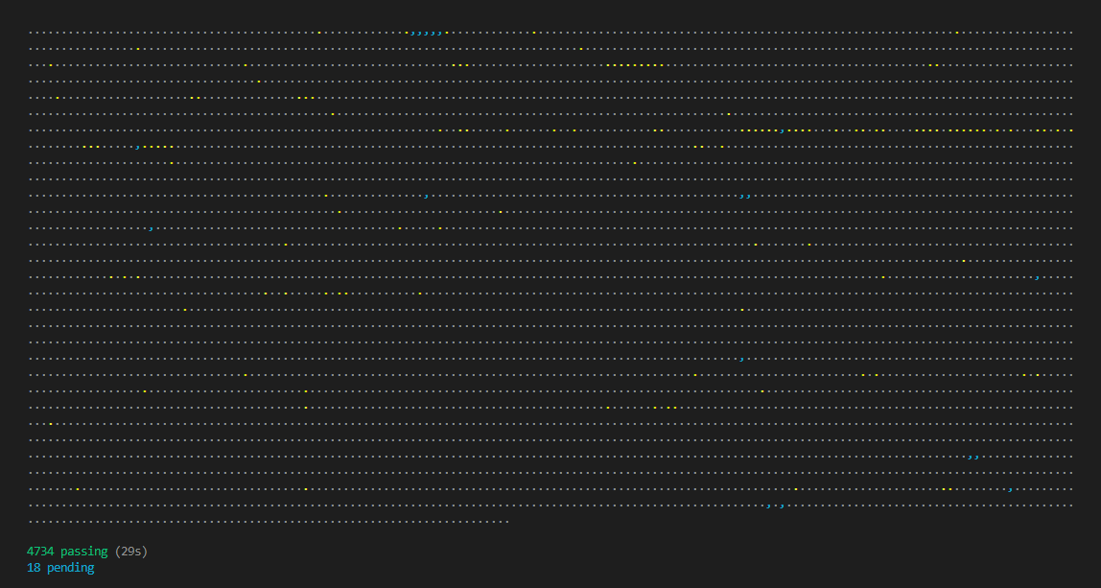
Unit tests of Math.js
Dot Matrix
Grey dots equals passing test.
Yellow dots equals slow test.
Blue dots equals pending test.

Slide 4
Coverage of Math.js
Problem : Istanbul (nyc) != ESM (ECMAScript Modules)
“Yeah, code coverage is broken, the nyc library doesn't work with ESM modules out of the box, so after refactoring mathjs from CommonJS to ESM, coverage didn't work anymore (except for two files that are still CommonJS). I don't really use coverage that much, so it hasn't been a prio to fix this yet. Help getting the coverage working again would be welcome (either implementing a workaround for nyc or replacing that with a different coverage library).
Have a nice day, Jos”
Solution: c8 = ESM

Slide 5
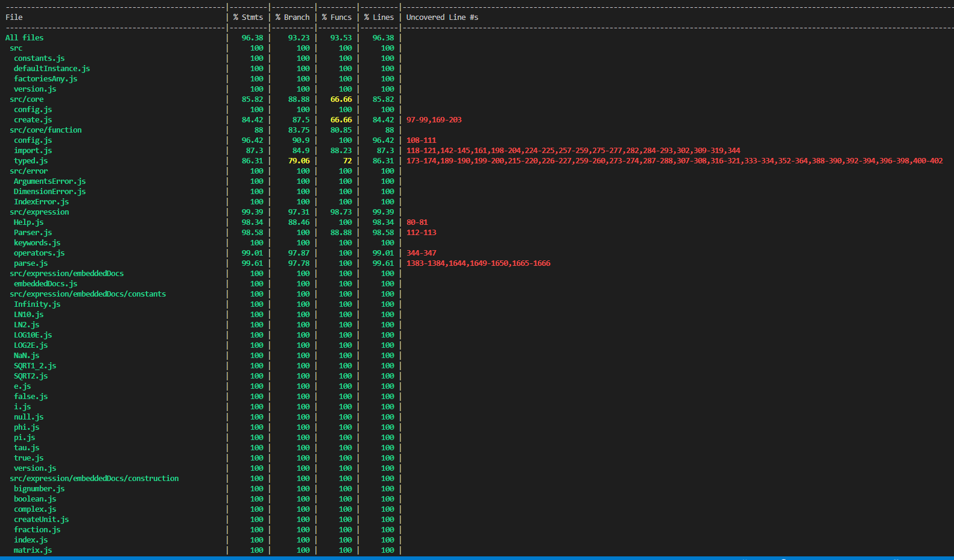
Coverage of Math.js
Coverage testing measures the percentage of different parts of the code (e.g., statements, branches, functions, lines) that are executed during testing.
This helps you determine how thoroughly your tests exercise the code and can help you identify areas of the code that may not be adequately tested.
By ensuring that a high percentage of code is executed during testing, you can have greater confidence in the correctness and quality of your code

Slide 6

Thank You For Listening.

