Slide 1
Analysis of Chinese Mobile Phone User Population vs Phone Specifications
Using limited information can we create a model to determine the user’s current phone brand?

Slide 2
What is the problem you want to solve?
The project conducted was focused on using a user’s personal information to determine the type of phone that user has using a classification model.
The hopes of this model is to allow for a marketer to give better and more reliable suggestions to potential consumers.
This idea was sparked through a public dataset found on Kaggle documenting thousands of phone users over the last recent years.

Slide 3
Data
The User Data is found on Kaggle’s TalkingSDK Dataset
The GSMArena Data is pulled directly from the web
Updated some open sourced program that parsed the webpages

Slide 4
Features – what do we plan on using to model?
The goal of the model is to use the least amount of features to recommend a phone brand to new consumers that match a similar profile.
To accomplish this goal, I choose to use four features: label id, gender, age, and year
The label id represents how the phone is used
The year is when the phone was released
The year can be assumed as when the user purchased their last phone because android users typically don’t purchase older generations

Slide 5
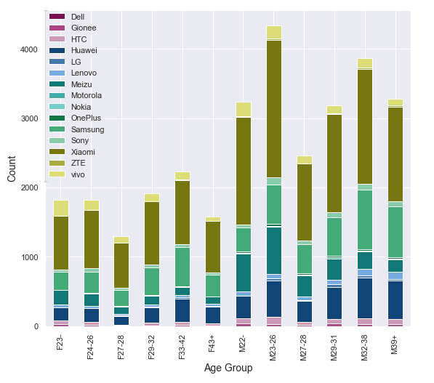
Data Visualization
This graph best visualizes the data we’re working with, by showing the gender split age groups’ user phone brands.

Slide 6
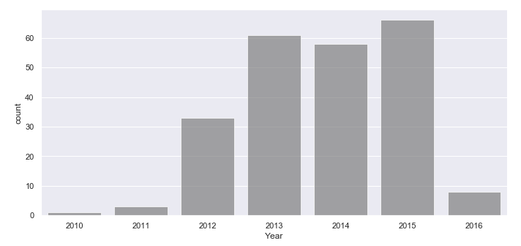
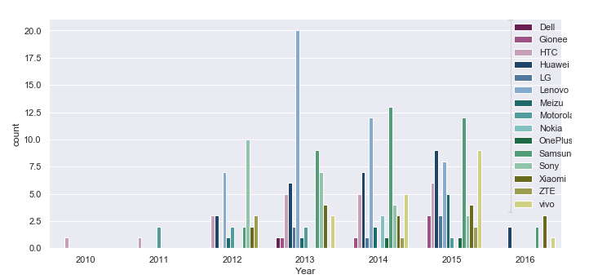
Timeframe of data

Slide 7
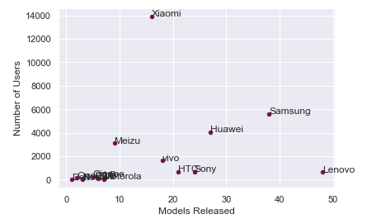
Basic statistical analysis
There is a small positive correlation (~.25) between the number of models released and the number of users, but the p-value (~.35) is too high to be considered a valid conclusion

Slide 8
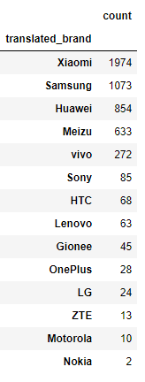
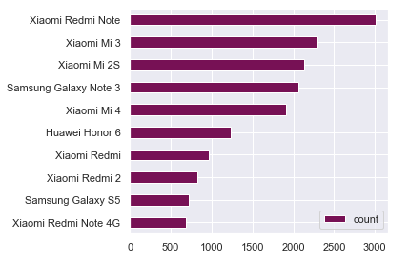
Most popular model/brands
The brand chart shows the remainder of the data after I filtered out entries that did not satisfy the minimum feature requirements
From the chart and the graph, you can easily see the class imbalance problem.
If our model does not account for it, we can get extremely high accuracy by blindly guessing Xiaomi, Samsung or Huawei

Slide 9
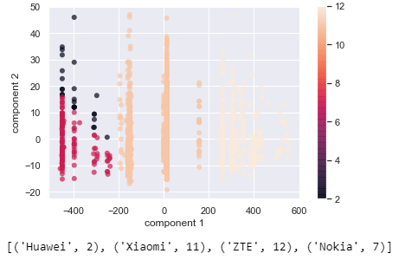
First Attempt – Logistic regression
Log-loss: 2.44
Logistic regression even with class balancing, returns a very poor score
Logistic regression could not account for other classes and resulted in a model that predicted only four of the classes
Huawei, Xiaomi, ZTE, and Nokia
The graph shows the data in PCA form with the predictions color coated

Slide 10
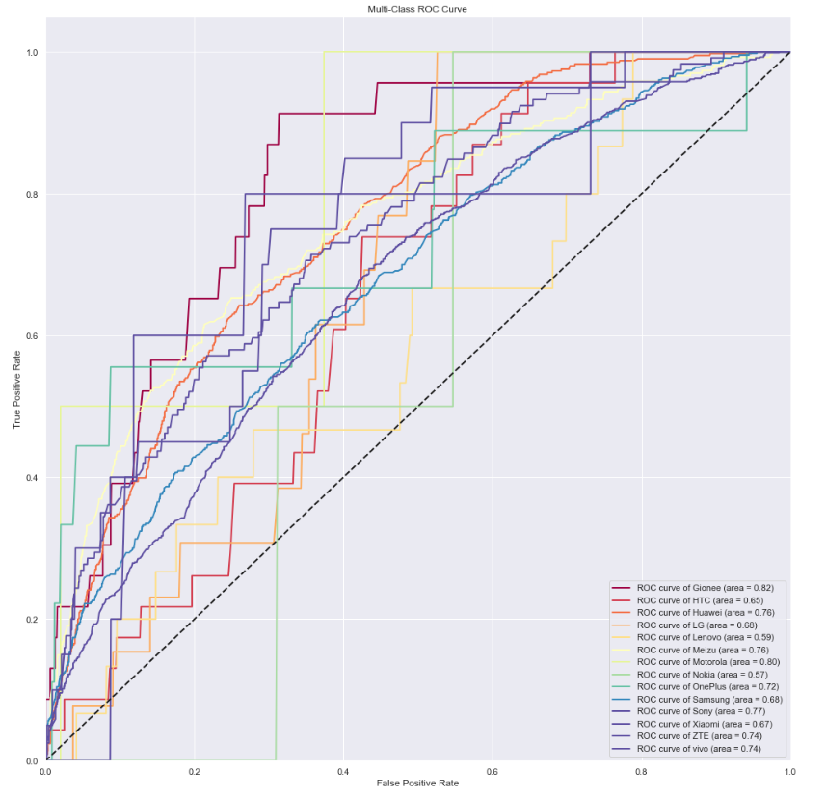
Model results
Log-loss score: 1.48
Total accuracy: 0.44
XGBoost is an ensemble model that “boosts” a bunch of decision trees to get better result
Hyper parameter tuning was done but resulting in very little improvement to the base model, so it was retracted from the code (on a scale of ~0.01 to ~0.001 in terms of log-loss)

Slide 11
Conclusion
The current model returns a reasonable result shown by the ROC AUC values for each brand
Future improvements: Add more features? (Data did contain location by coordinates, but this was out of the current work scope)

