Slide 1
Starcraft 2 Unit Recognition

Slide 2
Starcraft 2?
Using deep learning, we can create a model that recognizes Starcraft 2 units and structures as a way to create an interactive stream.
If the viewer decides to hover over one of the units that has been recognized by the model, we can display the unit’s details and background information giving unfamiliar viewers a deeper understanding of the game.
This model can be used to handle in-game replays, live streams, and other video content.

Slide 3
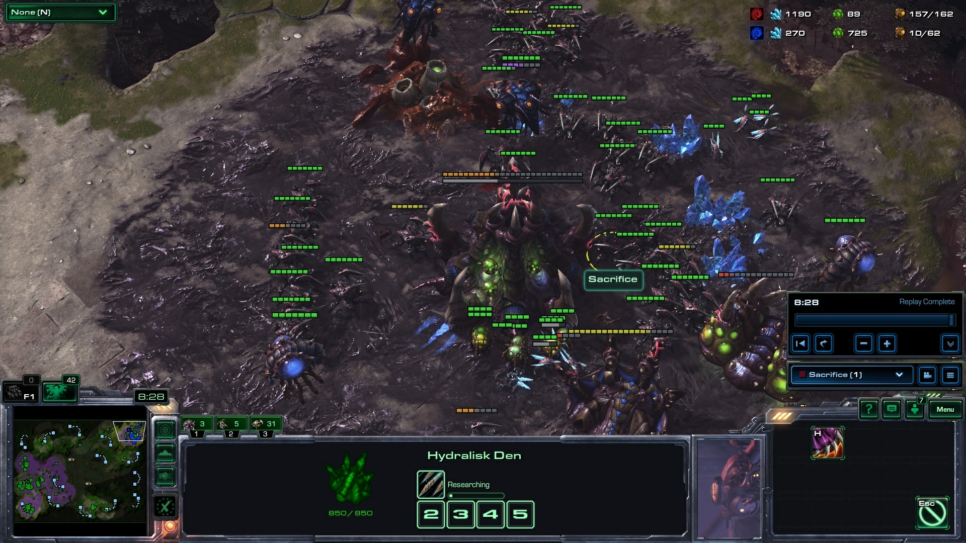
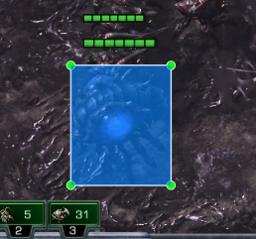


Collecting Data
filename | width | height | class | xmin | ymin | xmax | ymax
Screenshot.jpg | 1920 | 1080 | overlord | 525 | 655 | 651 | 806

Slide 4
Model: MobileNet
“MobileNets are small, low-latency, low-power models parameterized to meet the resource constraints of a variety of use cases. They can be built upon for classification, detection, embeddings and segmentation similar to how other popular large scale models, such as Inception, are used.” – TensorFlow GitHub
MobileNet is also integrated with Keras allowing us to have even greater interactivity with it.

