Slide 1
Starcraft 2 Unit Recognition

Slide 2
Starcraft 2?
Using deep learning, we can create a model that recognizes Starcraft 2 units and structures as a way to create an interactive stream.
If the viewer decides to hover over one of the units that has been recognized by the model, we can display the unit’s details and background information giving unfamiliar viewers a deeper understanding of the game.
This model can be used to handle in-game replays, live streams, and other video content.

Slide 3
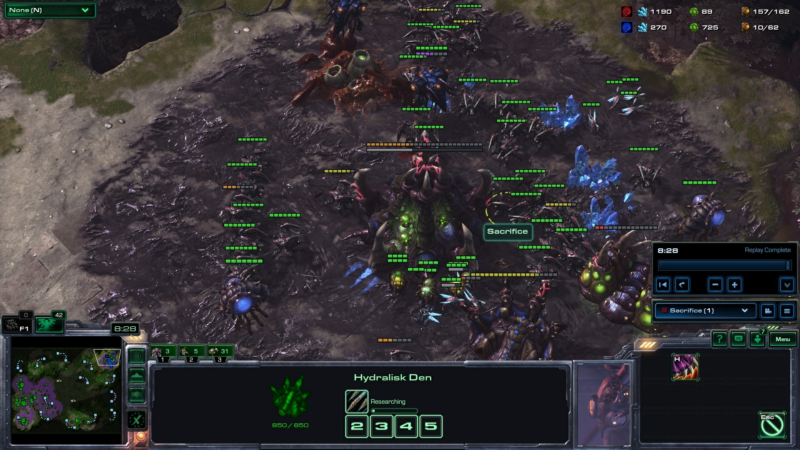
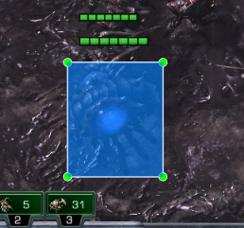

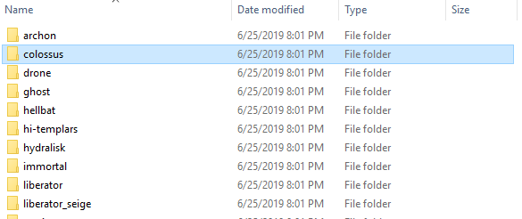
Collecting Data
filename | width | height | class | xmin | ymin | xmax | ymax
Screenshot.jpg | 1920 | 1080 | overlord | 525 | 655 | 651 | 806

Slide 4
Model: MobileNet
“MobileNets are small, low-latency, low-power models parameterized to meet the resource constraints of a variety of use cases. They can be built upon for classification, detection, embeddings and segmentation similar to how other popular large scale models, such as Inception, are used.” – TensorFlow GitHub
MobileNet is also integrated with Keras allowing us to have even greater interactivity with it.

Slide 5

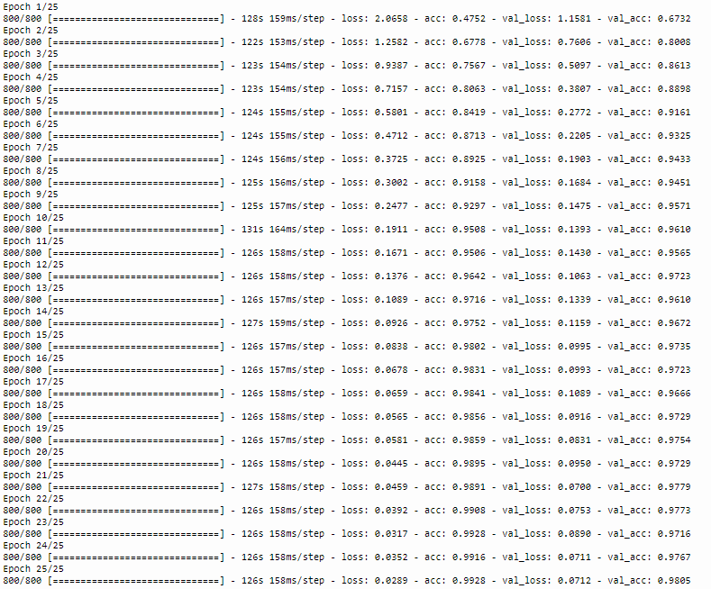
Training
Total Time = ~1 hour
Final Score: Log loss = 0.0289
Accuracy on validation set: 98%

Slide 6
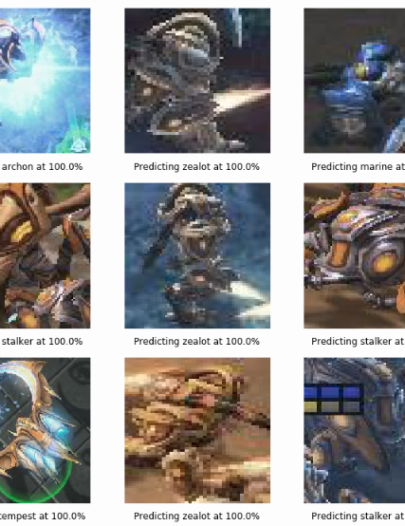
Showing off the model
With only a couple of images per class, we achieved nearly 100% accuracy for all classes.
ImageDataGenerator was a big help to the model as it added effects per epoch simulated new data.
Starcraft 2 Unit Recognition is 100% doable

Slide 7
Future Work
I did attempt to train a Yolo Model but without much more data, the model will not perform as well in object detection as our unit recognition model is doing
OpenCV can be used to apply this unit recognition model
Data!!! We can still expand this model to include all of the units and structures that Starcraft 2 has to offer (> 100)

