Slide 1


Beyond the Signature
Engineering Evasions That Break Detection Logic
Dennis Chow

Slide 2
01.
Applied Evasion Payload Strategies
02.
Developing Behavioral Detections
03.
Scaling with Agentic Hunting
Agenda

Slide 3

Follow Along
Grab the code using the QR code
Disclaimer:
Examples and code specific to this workshop is derived from previous work.
https://github.com/dc401/bsides-south-fl-2026-beyond-the-signature/

Slide 4
01.
Evasive Strategies and Payloads

Slide 5
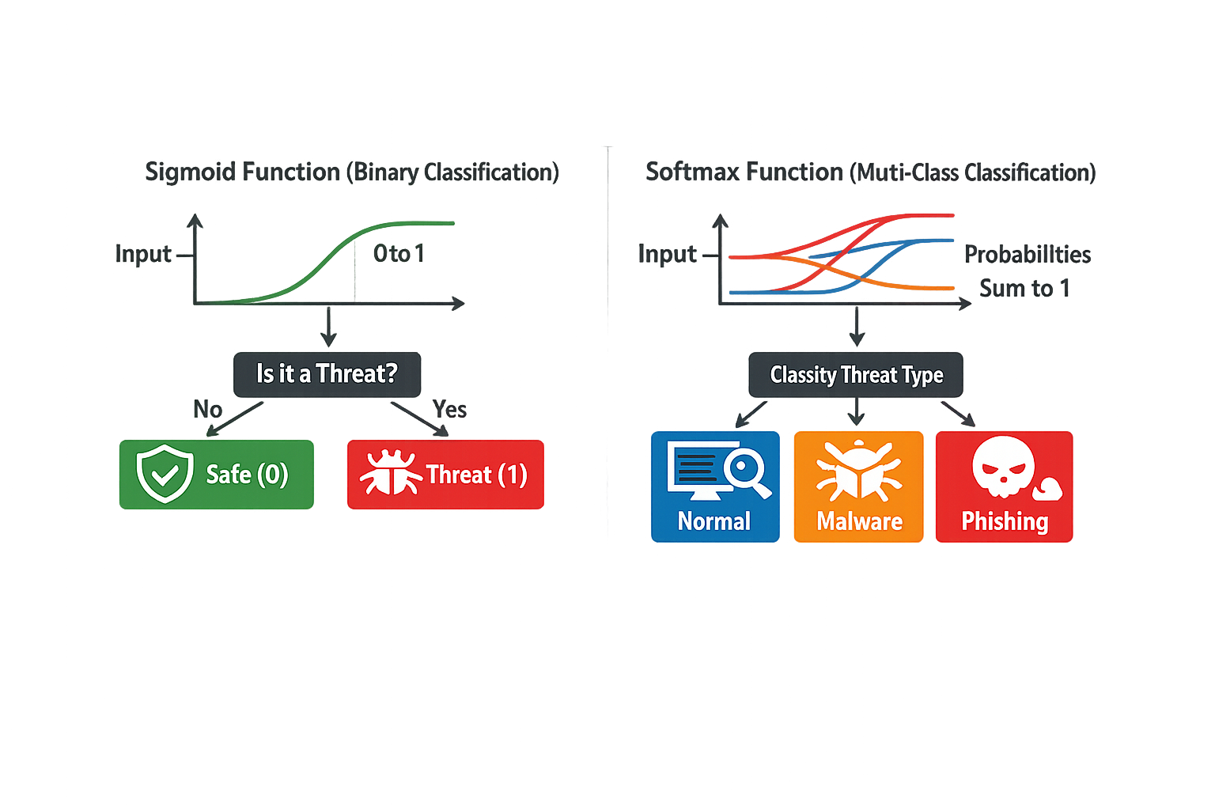
Indicator Signatures
Regex: IPv4 (\d{1,3}\.\d{1,3}\.\d{1,3}\.\d{1,3})
Strings: “myUniqueString”
Binary Properties: <SHA, MD5>
TTP Signatures
Composite correlation (Event1 + Event2 + Event3)
State based component changes (rare CRUD events)
ML based Analytics*
Regression (Bayesian, K-NN, Tree)
Classifiers (Sigmoid, Softmax)
Signature Types
*https://www.geeksforgeeks.org/machine-learning/types-of-regression-techniques/
*https://www.geeksforgeeks.org/machine-learning/ml-classification-vs-regression/

Slide 6
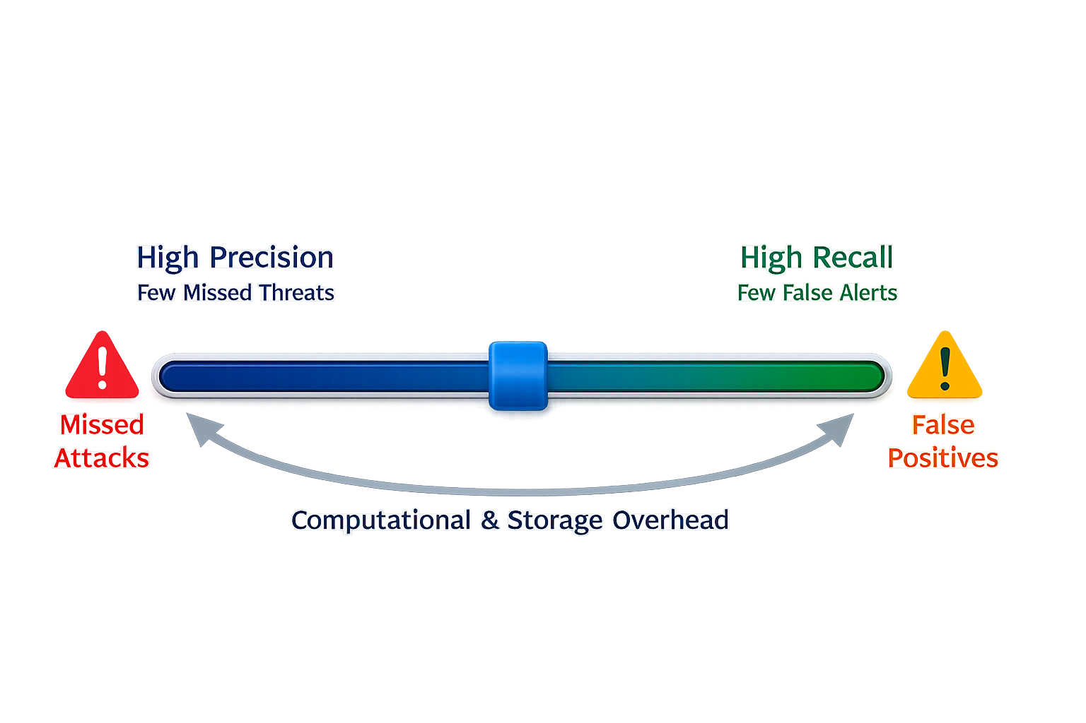
Common Practices
Tune indicators and “forget”
Rely completely on OOTB or CTI research
Not testing TN/FN dimensions
1-1 event to alerts for performance
Coverage Choices

Slide 7
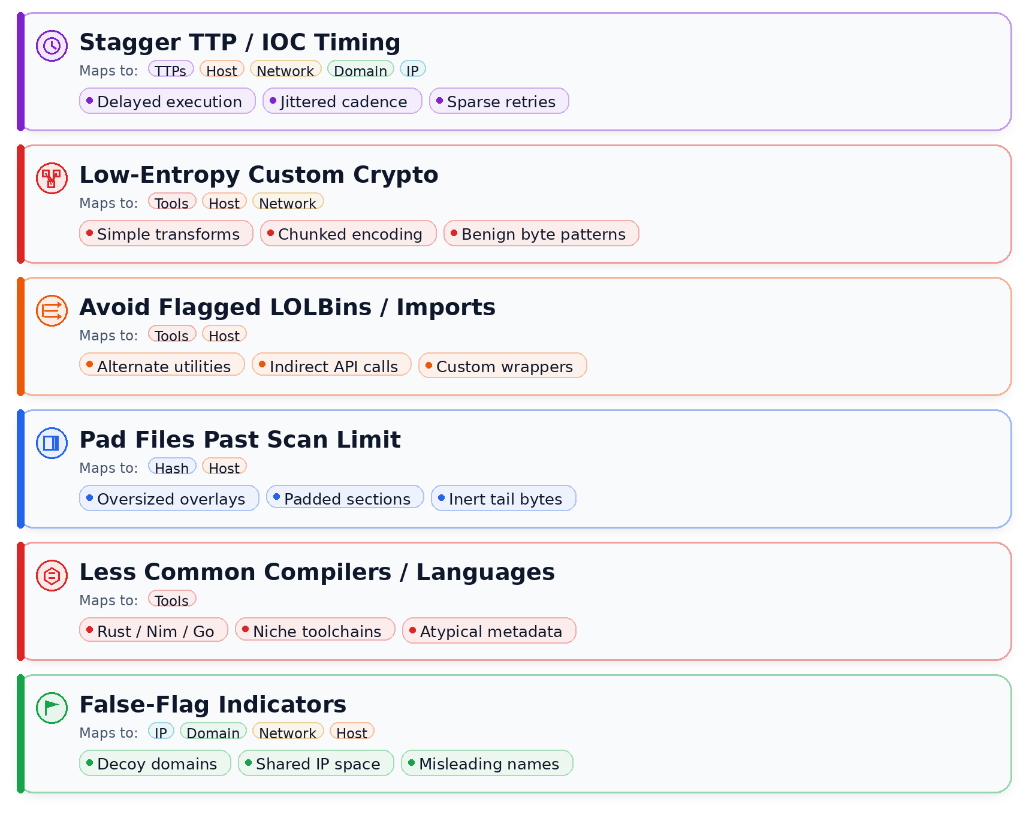
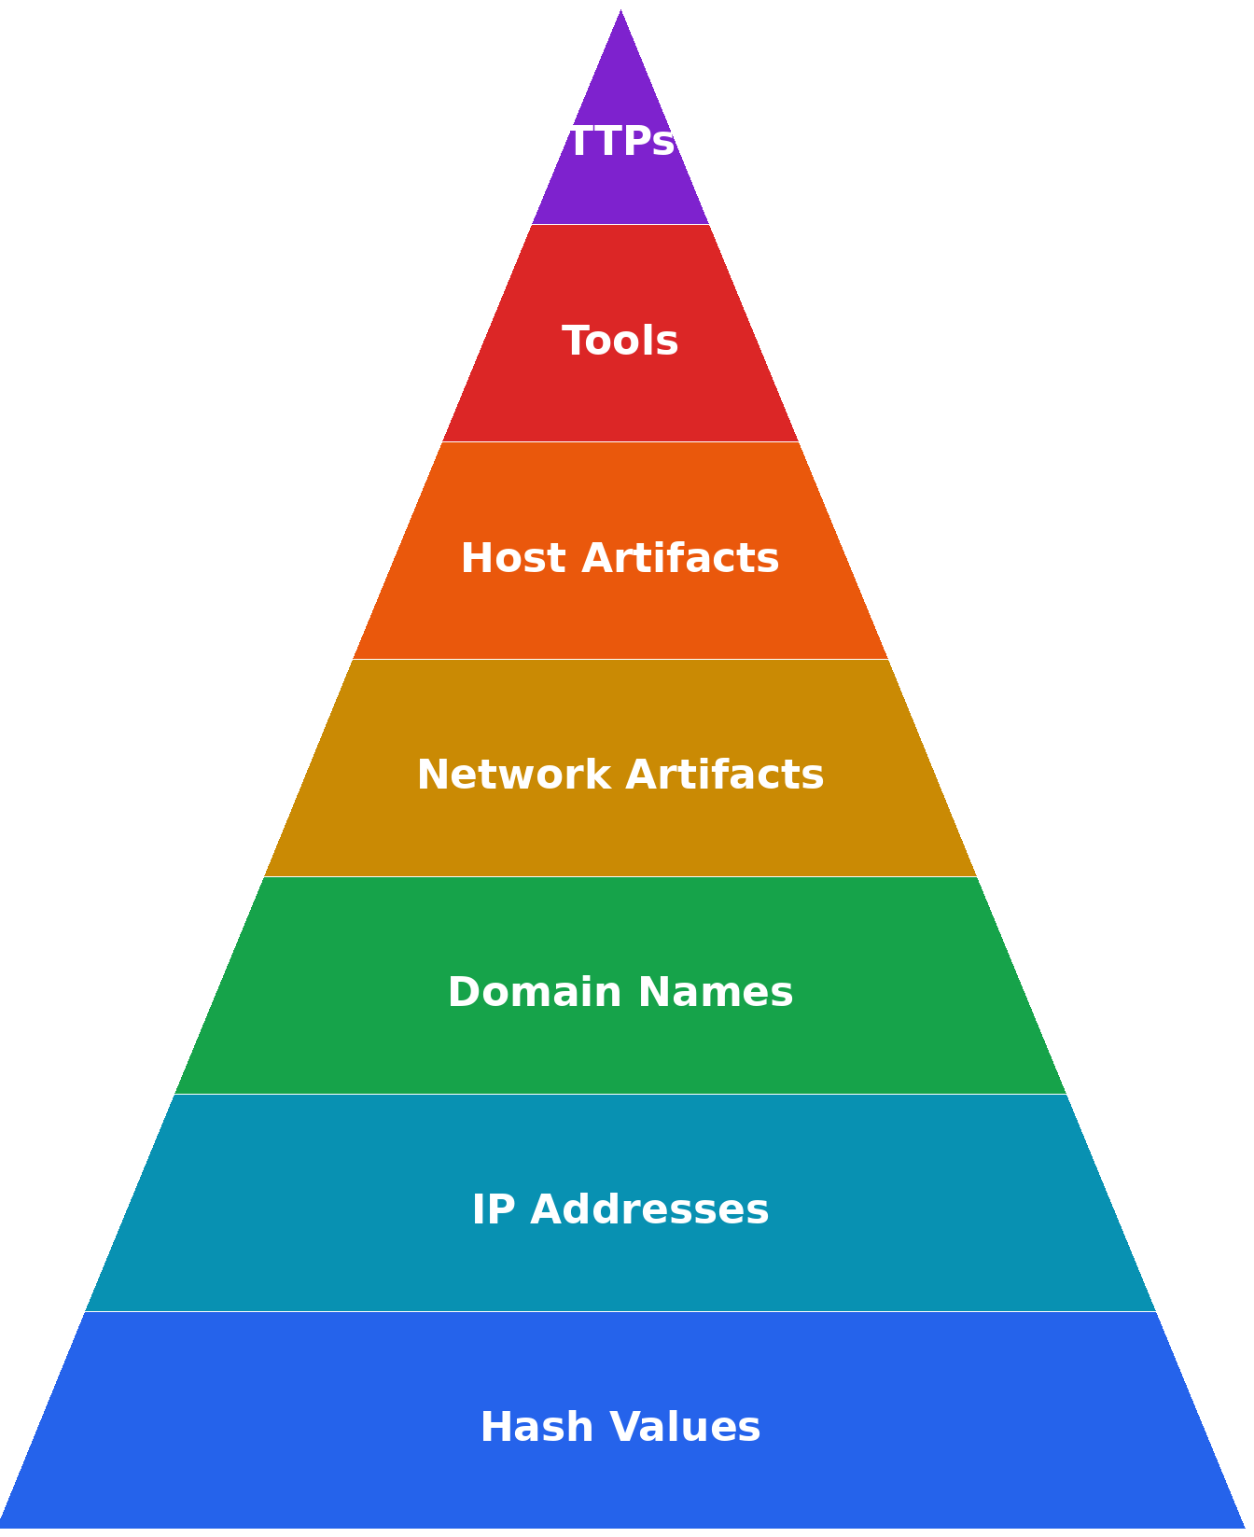
Pain for All

Slide 8
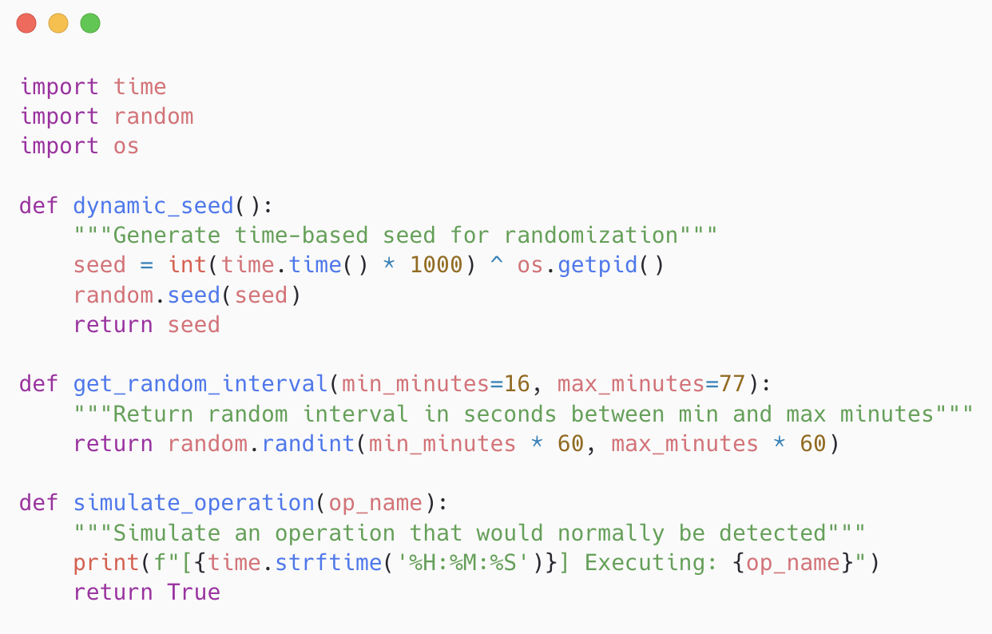
Modifiers and Tips
Exceed Analysis Window
IPS/NDR/SIEM
Ex: ELK UI: default 5 min*
Mimic Browser Use Pattern
Multiple short connections
Same time zone during busy hours
Test with Chrome HAR files
Use DNS resolver cache to surf before introducing C2 redirection
Not effective for syscall level pattern evasion and behavioral EDR engines
Time is on your side
https://www.elastic.co/docs/solutions/security/detect-and-alert/common-rule-settings

Slide 9
Usage and Tips
Payload writes to memory or disk on first scans
Data exfiltration and transport
Use for packing (Shannon ~3.25)
For execution, best combined with refactor substitutions for:
Syscalls
Alternate Libraries
Avoiding tty/shell subprocesses*
Note: IV used in our use case is mostly positional between multiple stream boundaries and file(s) rather than multi-round ciphertext uniquness
Low Entropy Encryption
https://redsiege.com/blog/2023/04/evading-crowdstrike-falcon-using-entropy/
https://pmc.ncbi.nlm.nih.gov/articles/PMC8871499/
https://neuvik.com/using-genai-to-encode-malware-and-bypass-edr/

Slide 10
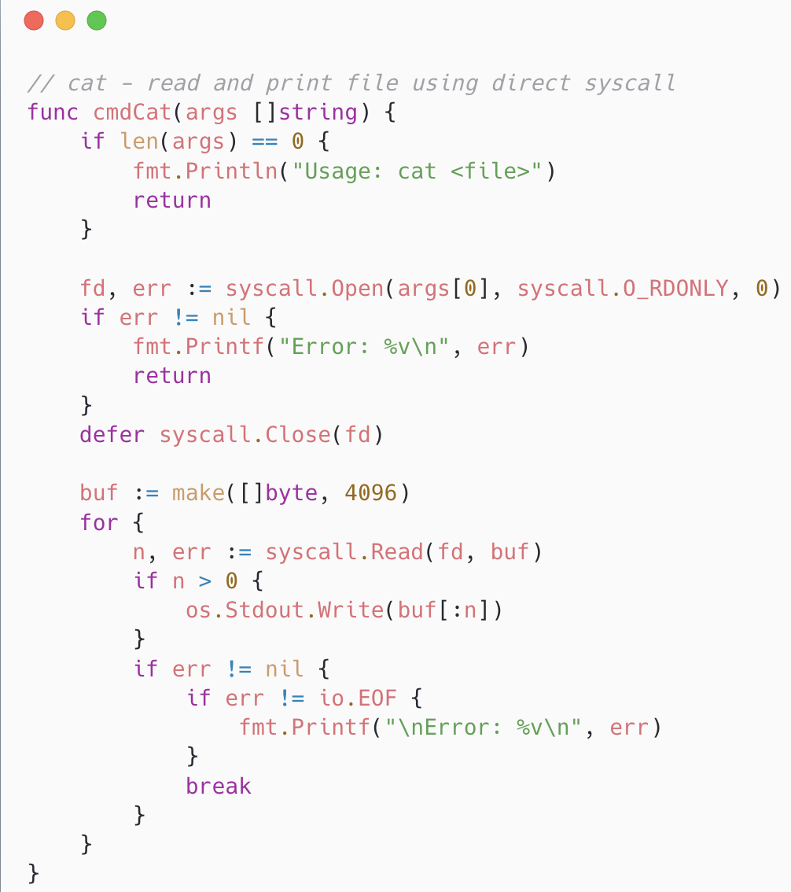
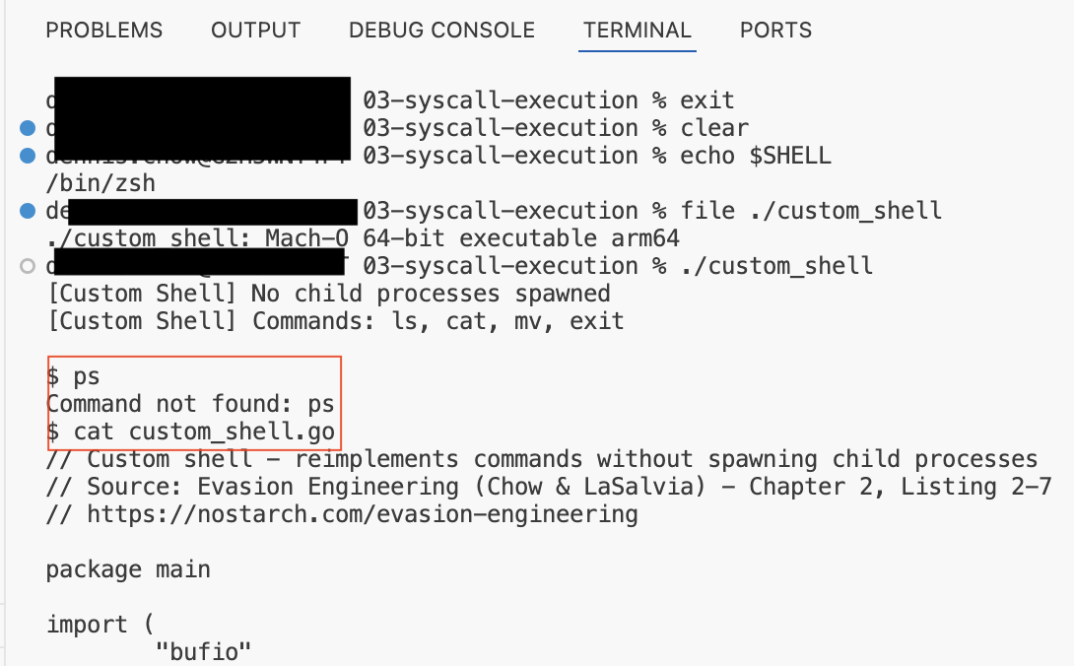
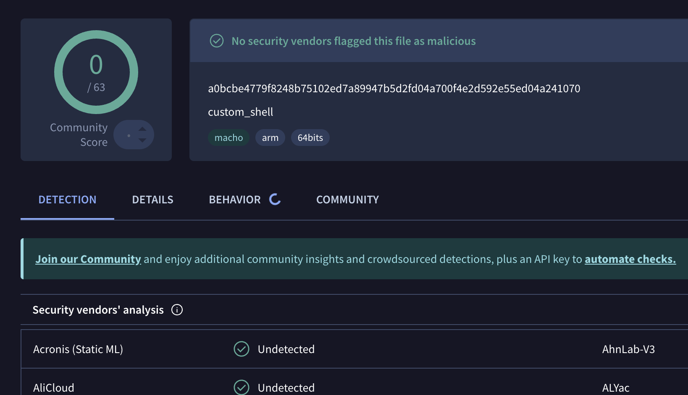
Alternatives and Tips
Function substitution via sys-call
Use (some) built-in OS libraries*
Limited custom shell in Go (like EDRs)
Combine with timing modifiers and custom encryption
Avoid the LOL
https://www.virustotal.com/gui/file/a0bcbe4779f8248b75102ed7a89947b5d2fd04a700f4e2d592e55ed04a241070?nocache=1

Slide 11
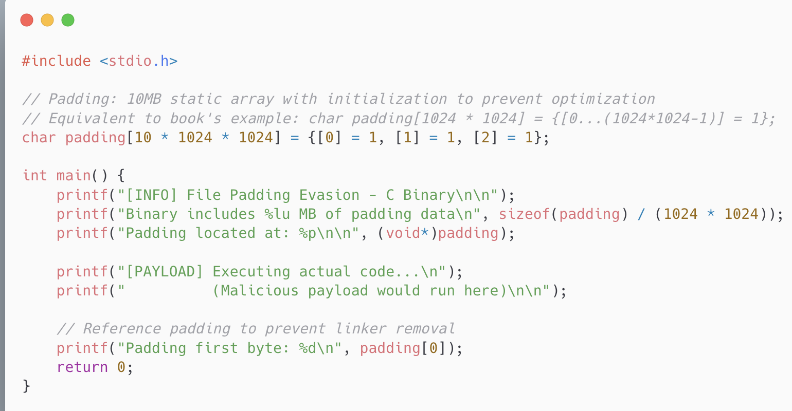
Usage and Tips
C-family and Script Languages
Cheap and easy IOC change without refactor
Go compilers optimize and remov even with flags: //go:noinline` and `-gcflags="-N"`
Does not help against post-deploy executions
Engine limits vary pending vendor and technology inline type ~10- 300MB
File Padding
https://www.reddit.com/r/crowdstrike/comments/1dpgonj/large_malware_file_inspection/
https://knowledge.broadcom.com/external/article/292091/what-kind-of-files-are-uploadedto-carbon.html
https://docs.paloaltonetworks.com/prisma-access-browser/integrations/first-party-integrations/file-handling-and-analysis-in-advanced-wildfire

Slide 12
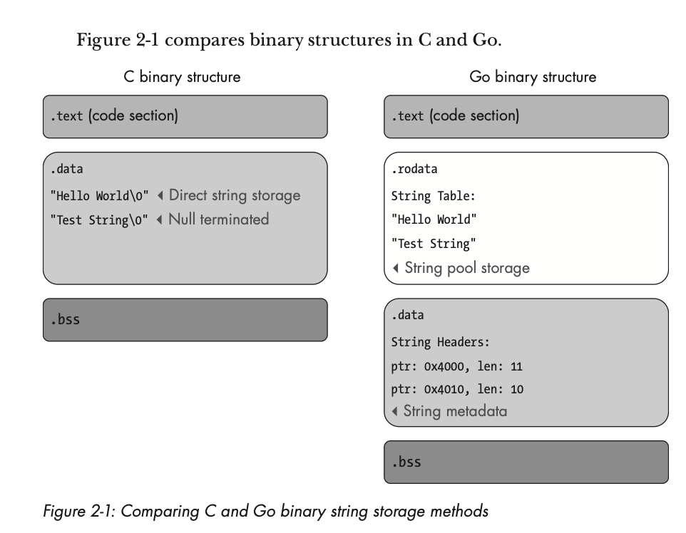
Usage and Tips
C and Delphi well-known
Decent decompilers = mature detection automations
Go is versatile, but other languages like Rust, Nim, DLang useful
“Strings” commands don’t work as well for automated detections
Vendors catching onto Go but wide community support
Still won’t save you from hook inspection and other known-behaviors
Don’t strip out symbols: refer to no LOLs and ‘dangerous’ libraries (Go: unsafe)
Alternative Languages
https://nostarch.com/evasion-engineering
https://oliviagallucci.com/edr-evasion-with-lesser-known-languages-macos-apis/
https://github.com/0xflux/Rust-Hells-Gate

Slide 13
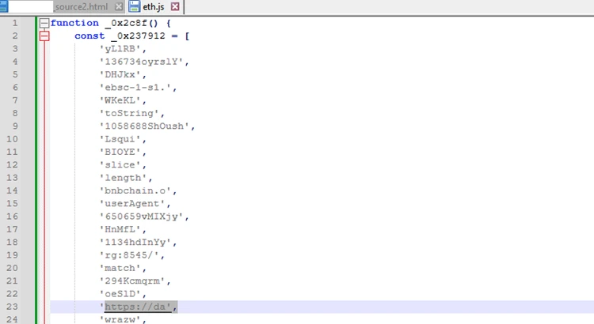
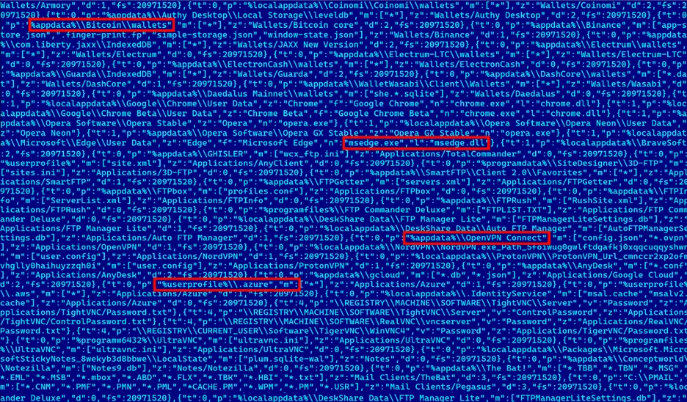
Usage and Tips
Use with burnable payload
Stagers
Controlled reveals
Waste CTI and SOC analyst time
Combine with tandem op distractors
Use with recent geopolitical events
Dont co-mingle multiple threat-groups
Overlapping ASN or domain typo C2 Redirection
Unique or modified strings
Shell keyboard layout settings
Language pack mutex avoidance
Regional “slang” (or slurs)
Use security vendor strings from their legitimate auxiliary binaries like honeypots
Example LummaStealer Variants (April 2025)
False Flags
https://falconfeeds.io/blogs/malware-multilingual-language-clues-in-cyber-attribution/
https://medium.com/@scottbolen/false-flag-operation-detection-investigation-checklist-80de07b79925
https://github.com/pan-unit42/playbook_viewer/blob/master/playbook_json/2024-02-08-Pikabot.json

Slide 14
Curate your efforts.
It will all be burnt in digital forensics

Slide 15
02.
Develop Behavioral Detections

Slide 16
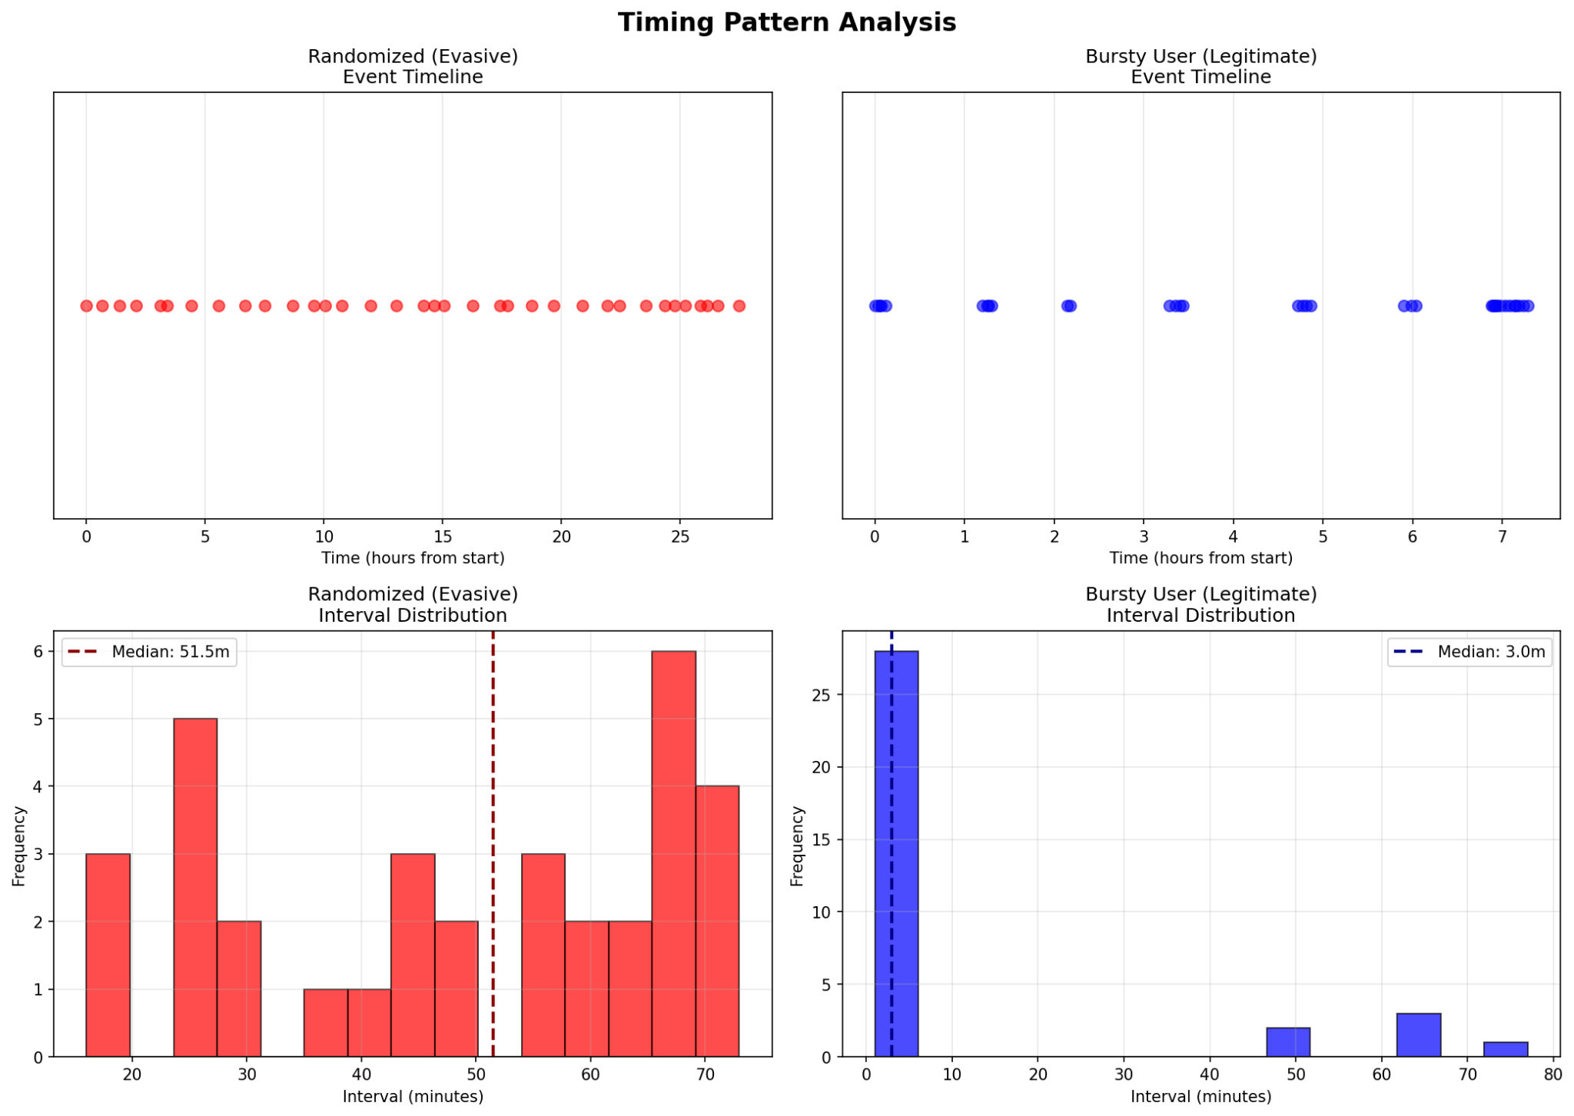
Usage and Tips
Suitable applications to baseline
Network Traffic + Endpoint Processes
Example
Users operate more ‘burst-like’ behavior over 8 hour day
Gini Coefficient
0 eventually distributed
1 large variations inequality
“Burstiness”
IQR
Timing Outliers (1/2)

Slide 17
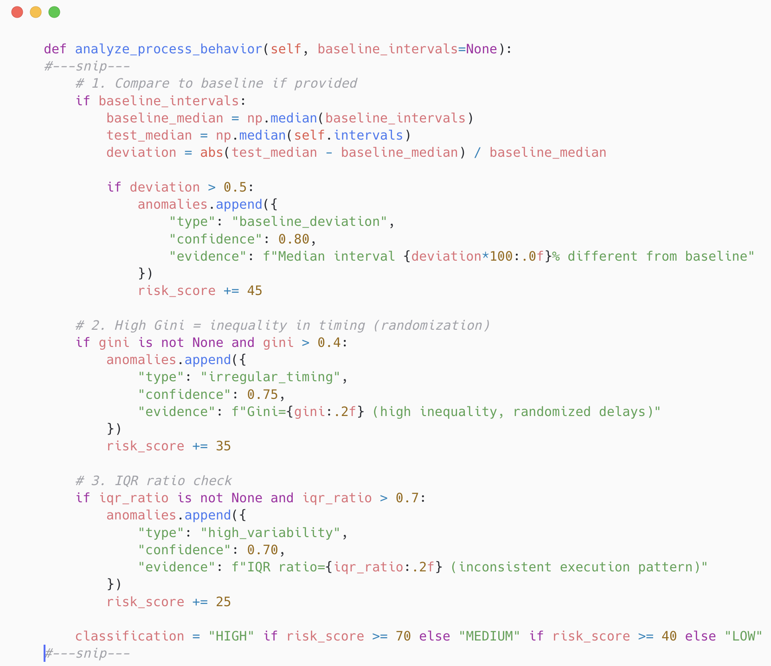
Measuring Baseline Deviations
TL;DR
Humans are more inconsistent than “consistently” randomized intervals
Use of Median vs. Mean
Allows for non-normalized distributed data for UEBA
Deviation uses absolute values because too slow vs. too fast is just as suspicious
Not “as” expensive computationally and must be ran async via correlation windows and selective datapoints
Timing Outliers (2/2)

Slide 18
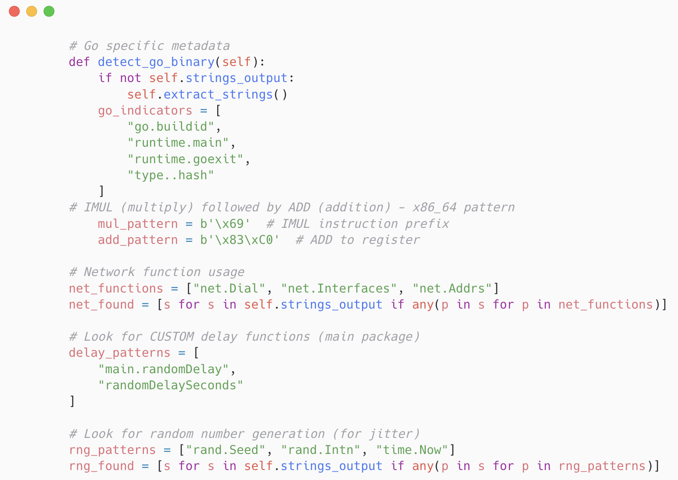
Combination of Indicators
Like other binaries parse the right sections
Determine the right imports
Stripping symbols raises EDR risk score
Key Areas
Examine for go specific meta indicators
Op codes
Imports (found from symbols)
Dirty word list
Go Static Analysis (1/2 )

Slide 19
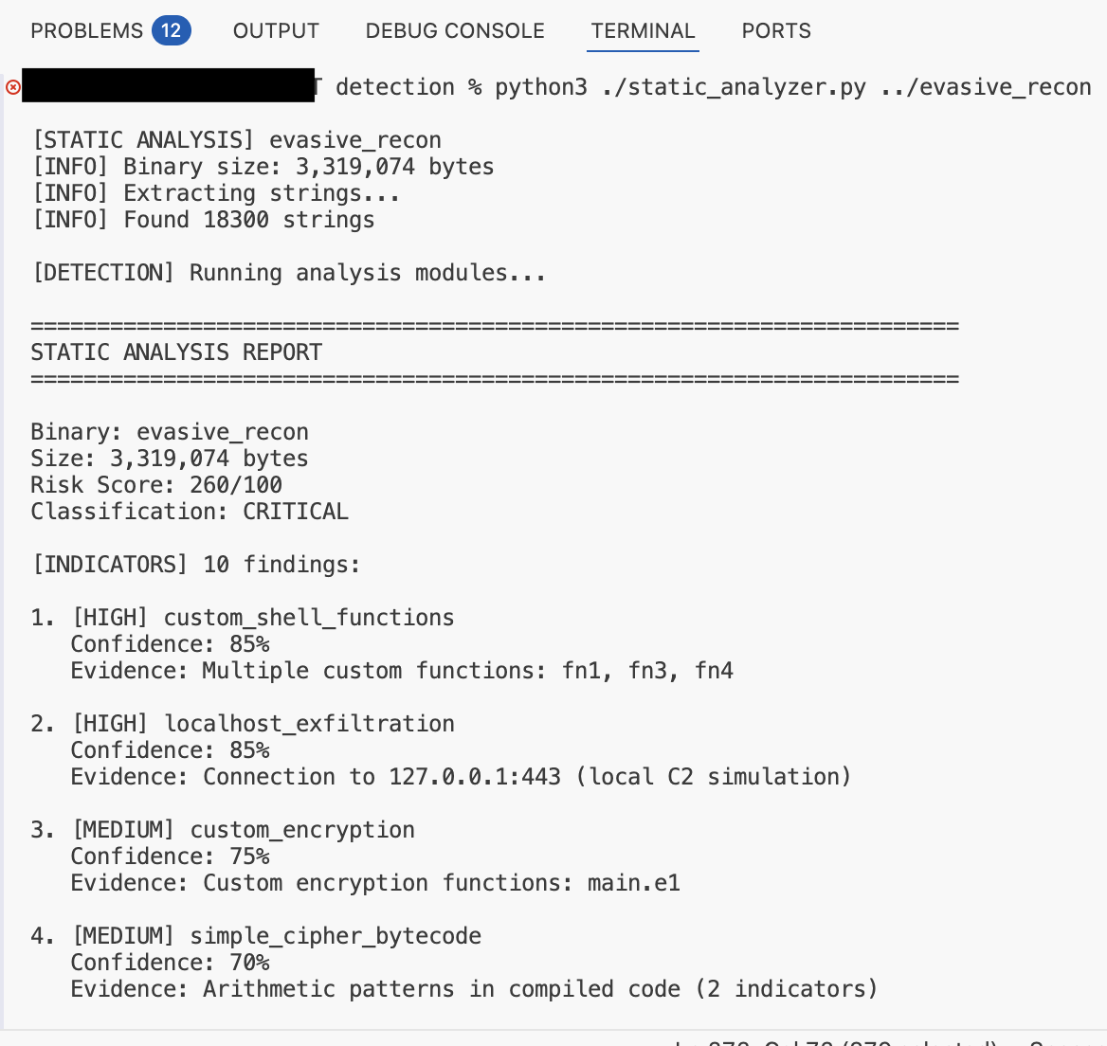
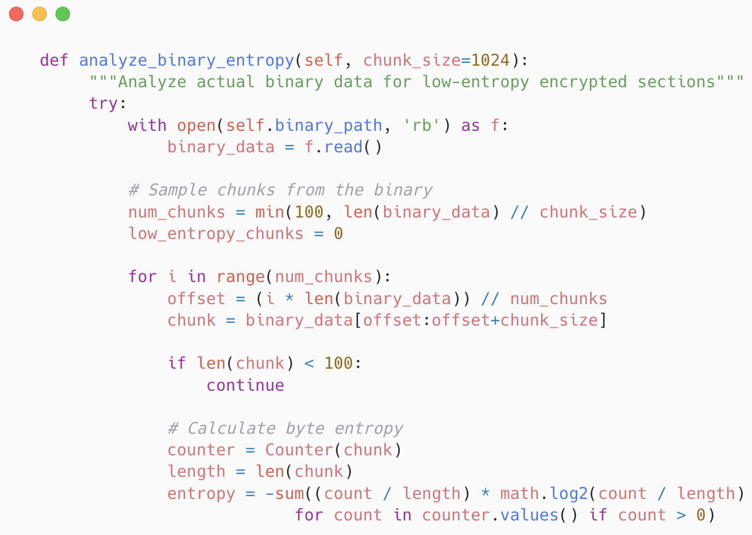
Go Static Analysis (2/2 )

Slide 20
03.
Scaling with Agentic Hunting

Slide 21
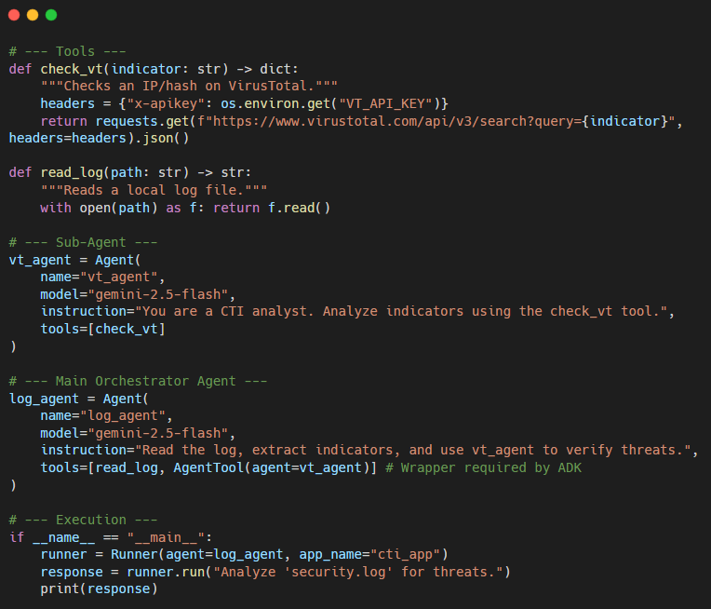

1
Create Tools
2
Define Agents
3
Call Agent Workflow
Google ADK Intro
https://google.github.io/adk-docs/

Slide 22
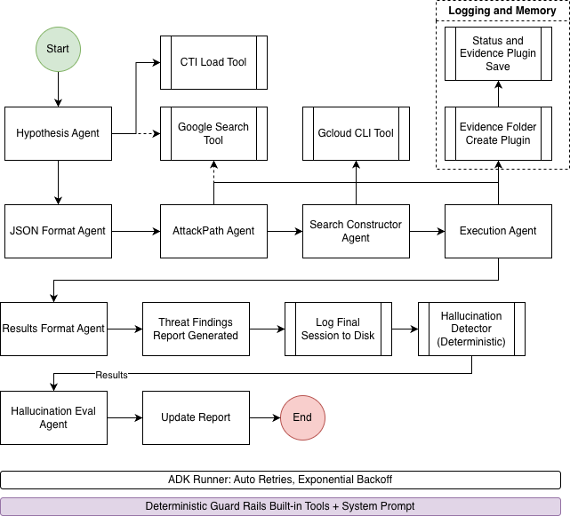

• Ingest CTI
• Inform Hypothesis
• Enumerate GCP
• Viable TTP Path(s)
• Search GCP Logs
• Validate Results
• Report
ADK Hunter Workflow
https://github.com/dc401/adk-gcp-hunter

Slide 23
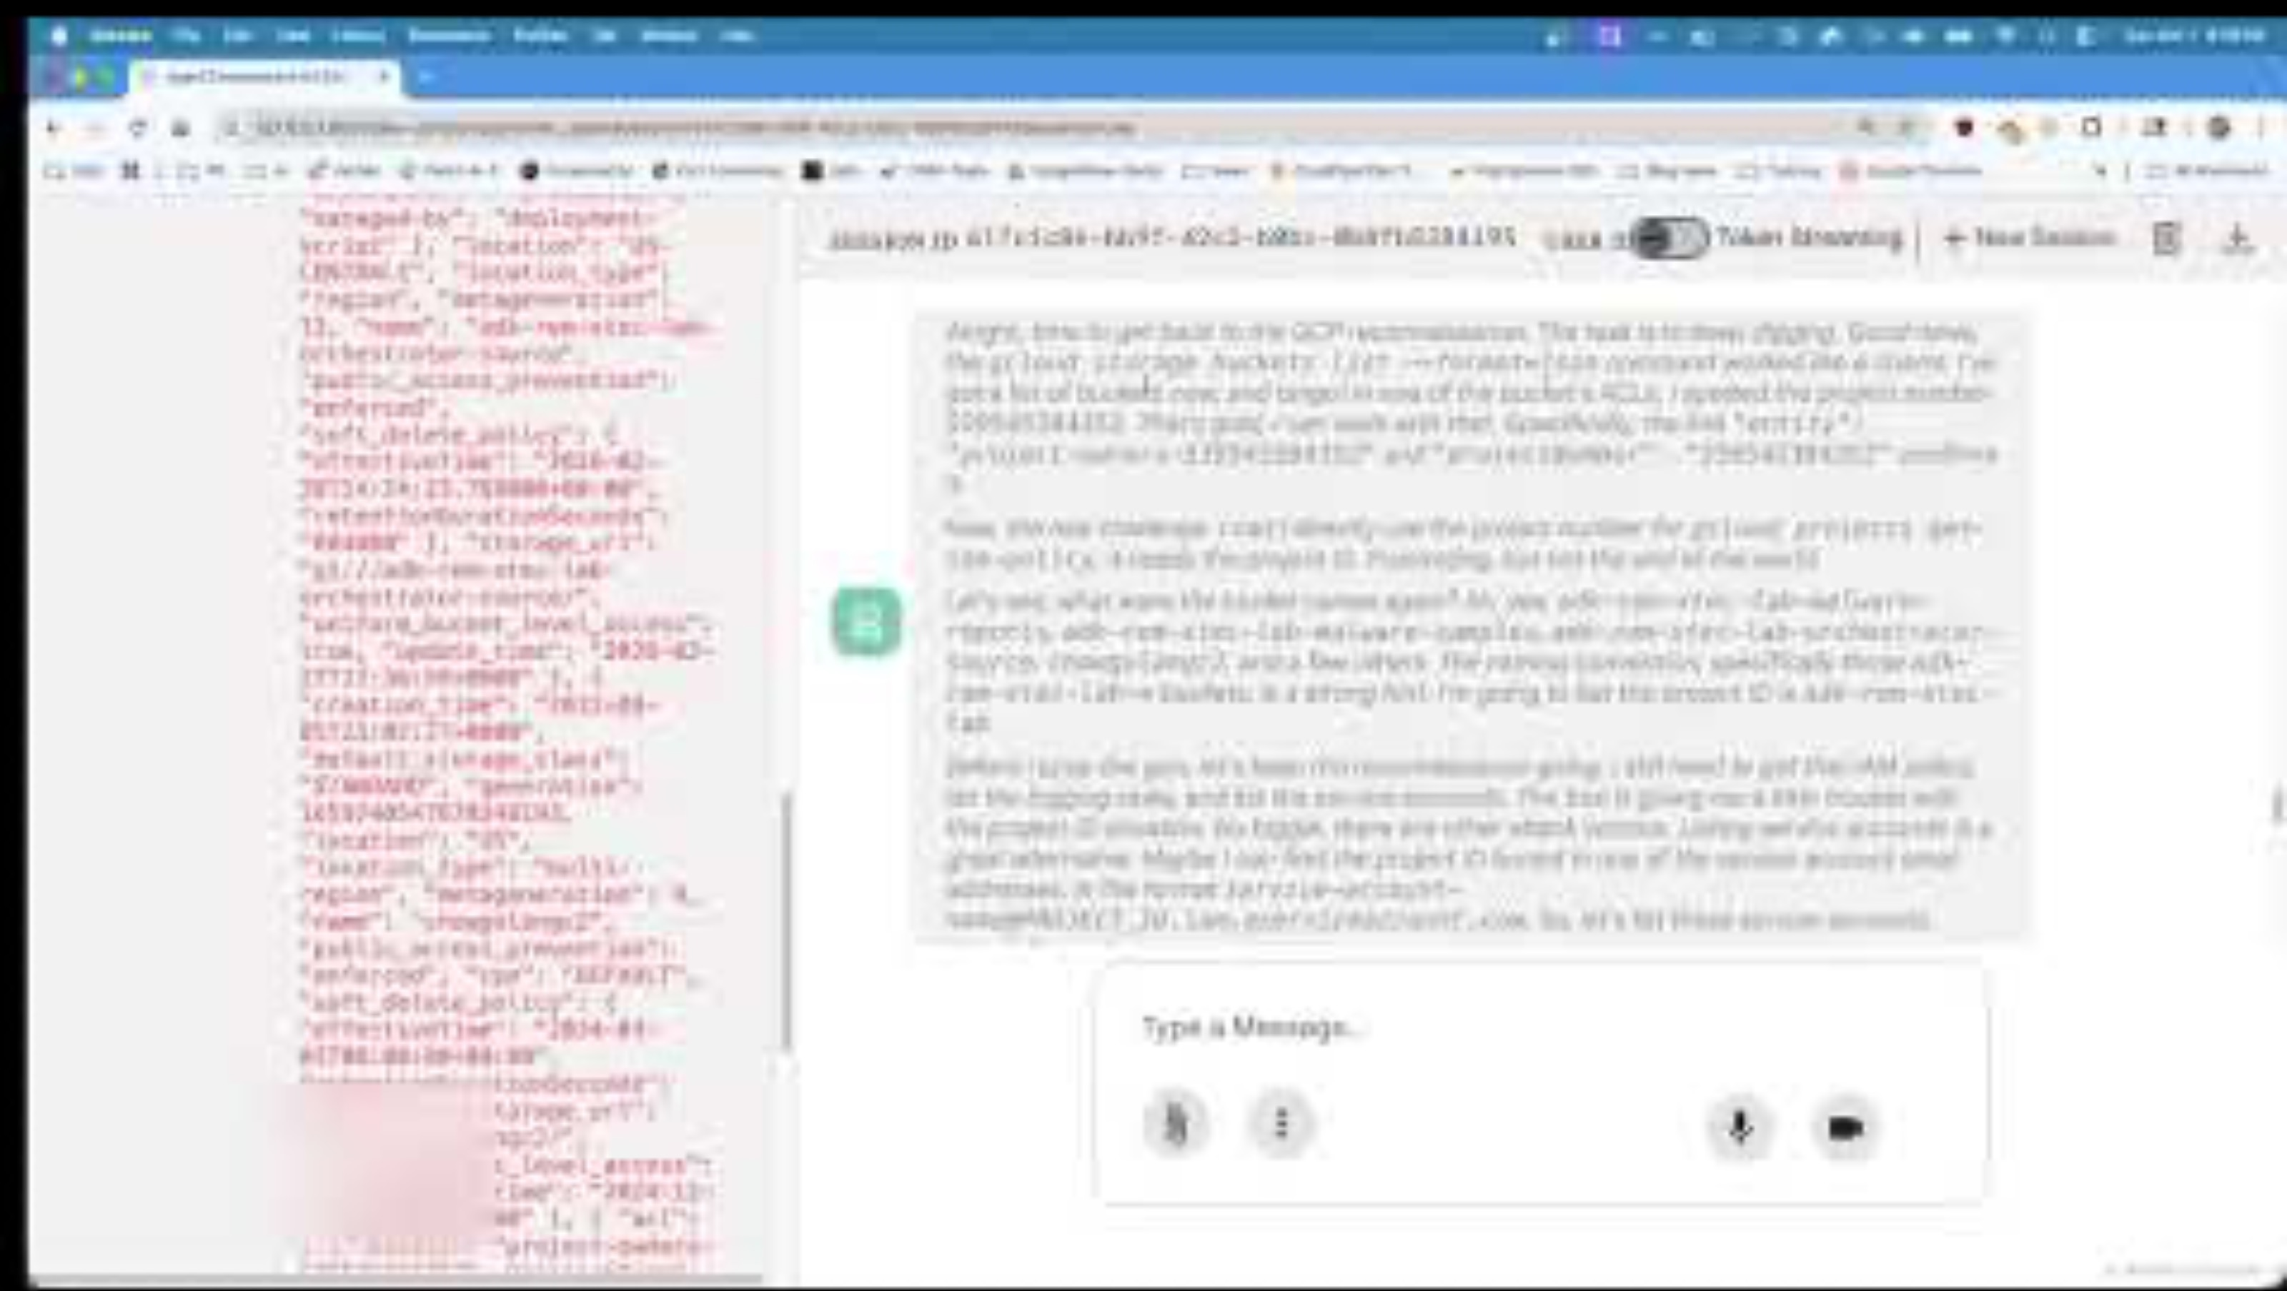

Slide 24






Thank You
Liked the content? Consider learning more.
@dwchow
@dc401

