Slide 1
Beacon Harvest: Conquering Cobalt Strike at Scale
@polygonben

Slide 2
Agenda
whoami
01
Threat Intelligence
02
Cobalt Strike?
03
Stealing those configs
04
Analysis of data
05
Case Studies
06

Slide 3
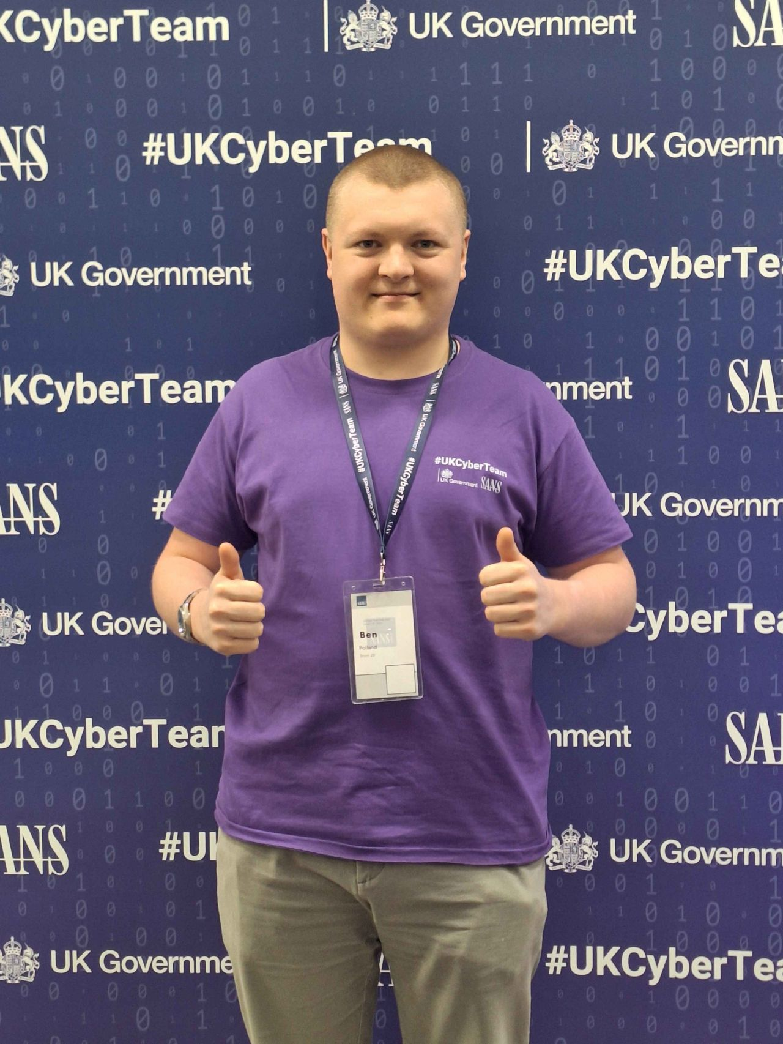
$ whoami
@polygonben
Analyst @ Huntress
https://polygonben.github.io/
Loves threat hunting, malware analysis & DFIR

Slide 4
What is TI?
UK NCSC – “evidence-based knowledge, including context, mechanisms, indicators, implications and actionable advice, about an existing or emerging menace or hazard to assets that can be used to inform decisions regarding the subject's response to that menace or hazard”

Slide 5
What is TI?
intelligence pertaining to a threat
UK NCSC – “evidence-based knowledge, including context, mechanisms, indicators, implications and actionable advice, about an existing or emerging menace or hazard to assets that can be used to inform decisions regarding the subject's response to that menace or hazard”

Slide 6
What is TI?
intelligence pertaining to a threat
UK NCSC – “evidence-based knowledge, including context, mechanisms, indicators, implications and actionable advice, about an existing or emerging menace or hazard to assets that can be used to inform decisions regarding the subject's response to that menace or hazard”
the threat

Slide 7
What is TI?
intelligence pertaining to a threat
UK NCSC – “evidence-based knowledge, including context, mechanisms, indicators, implications and actionable advice, about an existing or emerging menace or hazard to assets that can be used to inform decisions regarding the subject's response to that menace or hazard”
threat informed defence
the threat

Slide 8
Why is CTI important?
Military Intelligence | Cyber Threat Intelligence
Identifies enemy movements, capabilities, and plans | Identifies threat actors, malware, and attack tactics before they strike

Slide 9
Why is CTI important?
Military Intelligence | Cyber Threat Intelligence
Identifies enemy movements, capabilities, and plans | Identifies threat actors, malware, and attack tactics before they strike
Supports battlefield decisions with real-time intel | Informs security teams and execs with up-to-date threat insights assisting with strategic planning

Slide 10
Why is CTI important?
Military Intelligence | Cyber Threat Intelligence
Identifies enemy movements, capabilities, and plans | Identifies threat actors, malware, and attack tactics before they strike
Supports battlefield decisions with real-time intel | Informs security teams and execs with up-to-date threat insights assisting with strategic planning
Coordinates allied responses in multi-force ops | Shares threat intel across organizations for collective defense

Slide 11
Why is CTI important?
Military Intelligence | Cyber Threat Intelligence
Identifies enemy movements, capabilities, and plans | Identifies threat actors, malware, and attack tactics before they strike
Supports battlefield decisions with real-time intel | Informs security teams and execs with up-to-date threat insights assisting with strategic planning
Coordinates allied responses in multi-force ops | Shares threat intel across organizations for collective defense
Protects troops from ambushes or surprise attacks | Proactive threat hunting based on CTI to identify undiscovered threats

Slide 12
Why is CTI important?
Military Intelligence | Cyber Threat Intelligence
Identifies enemy movements, capabilities, and plans | Identifies threat actors, malware, and attack tactics before they strike
Supports battlefield decisions with real-time intel | Informs security teams and execs with up-to-date threat insights assisting with strategic planning
Coordinates allied responses in multi-force ops | Shares threat intel across organizations for collective defense
Protects troops from ambushes or surprise attacks | Proactive threat hunting based on CTI to identify undiscovered threats
Reduces fog of war by increasing clarity | Cuts through alert noise, helping focus on real threats

Slide 13
What does CTI look like?
Strategic – Informs high-level decision-making, focuses on long-term threats, trends, motivation
Intelligence in the format of reports & risk heat maps pertaining to threat actors, industry targeting & geopolitical motivations

Slide 14
What does CTI look like?
Strategic – Informs high-level decision-making, focuses on long-term threats, trends, motivation
Intelligence in the format of reports & risk heat maps pertaining to threat actors, industry targeting & geopolitical motivations
Operational – Supports incident response, threat hunting, and SOC operations, focuses on Tactics, Techniques and Procedures (TTPs) of adversaries
Intelligence in the format of incident reports, campaign briefs, threat hunting queries, malware analyses that provide context-rich insights into how attacks were carried out

Slide 15
What does CTI look like?
Strategic – Informs high-level decision-making, focuses on long-term threats, trends, motivation
Intelligence in the format of reports & risk heat maps pertaining to threat actors, industry targeting & geopolitical motivations
Operational – Supports incident response, threat hunting, and SOC operations, focuses on Tactics, Techniques and Procedures (TTPs) of adversaries
Intelligence in the format of incident reports, campaign briefs, threat hunting queries, malware analyses that provide context-rich insights into how attacks were carried out
Technical – Feeds automated defences enabling rapid detection and blocking, focusing on IOCs
Intelligence in the format of volatile, machine-readable, IOCs (hashes, IP addresses, domains, YARA rules, …)

Slide 16
Cobalt Strike
Cobalt Strike is an Adversary Simulation & Red Team C2 framework tool
Used legitimately by red teamers & penetration testers
Threat actors cracked Cobalt Strike, and it is now abused by every flavour of threat actor
APTs, cybercriminals, script kiddies, hacktivists

Slide 17
What is C2 & post-exploitation?
Cobalt Strike is a post-exploitation & C2 framework
Command & Control (C2) – “The adversary is trying to communicate with compromised systems to control them”
Cobalt Strike facilitates C2 via common network protocols (HTTP/S, DNS, SMB)
Post-Exploitation – refers to the stage of an attack that occurs after a system has been successfully compromised
Cobalt Strike can perform Credential Theft, Persistence, Privilege Escalation, Lateral Movement & Discovery for Post-Exploitation

Slide 18
Cobalt Strike Key Terms
Team Server – The threat actor owned C2 server, accepting client connections from the Beacon
Beacon – the name for Cobalt Strike’s payload that establishes C2 to with the Team Server
Loaders – Additional pieces of code that run the Beacon. They “load” the Beacon and run it
Malleable configuration – Every component of the Beacon is configurable

Slide 19
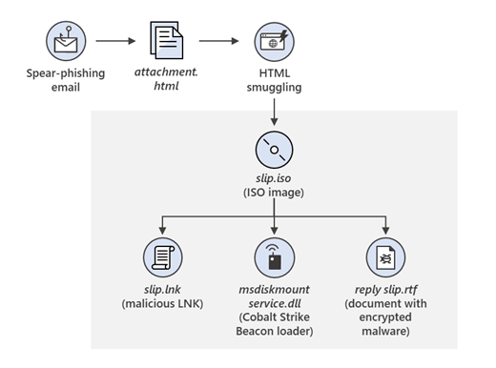
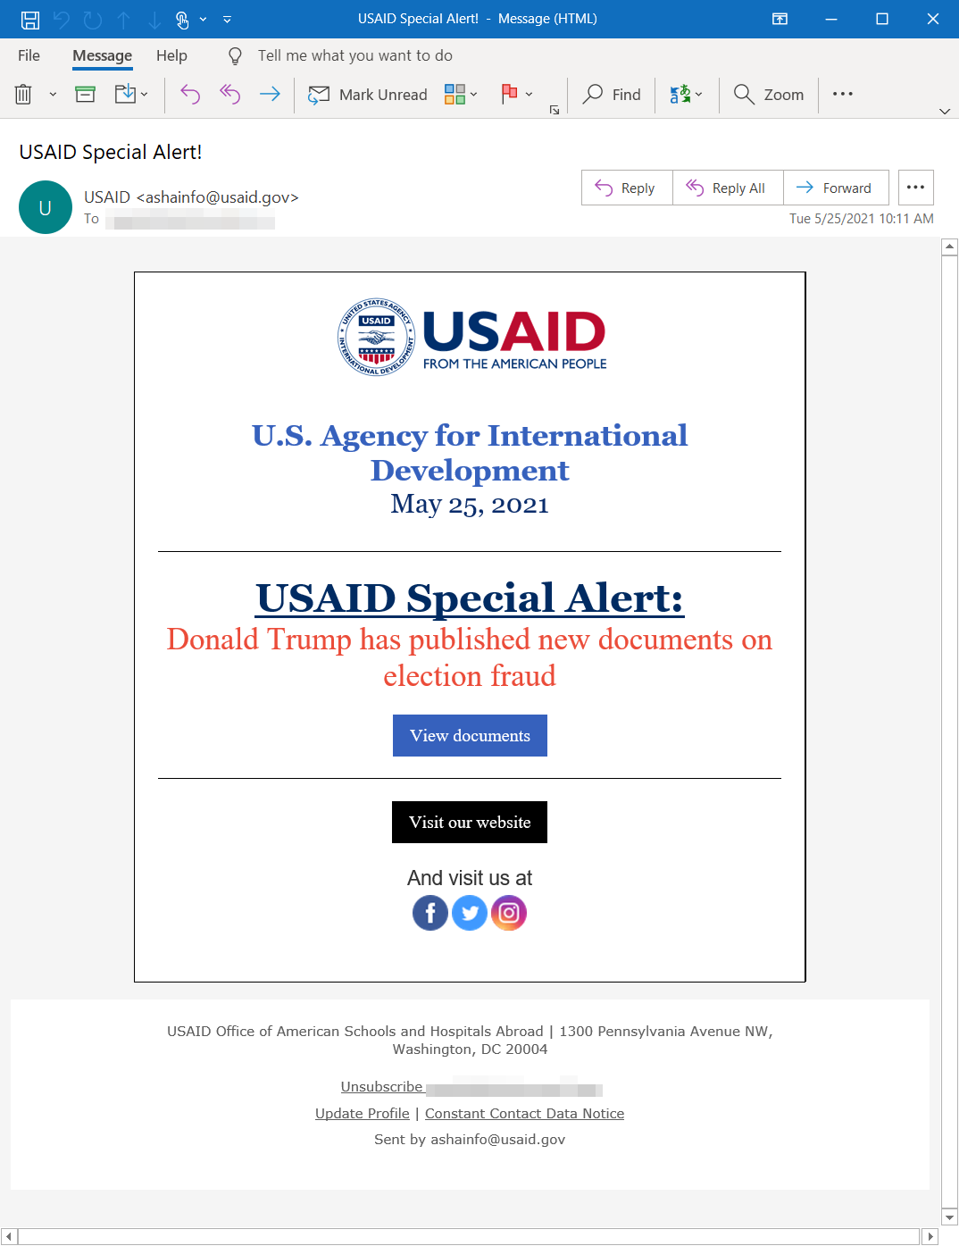
APT29
APT29, also known as Cozy Bear or Midnight Blizzard, attributed to Russia’s Foreign Intelligence Service (SVR) are known to abuse Cobalt Strike for C2
Spear phishing email impersonating USAID led to the installation of a Cobalt Strike

Slide 20
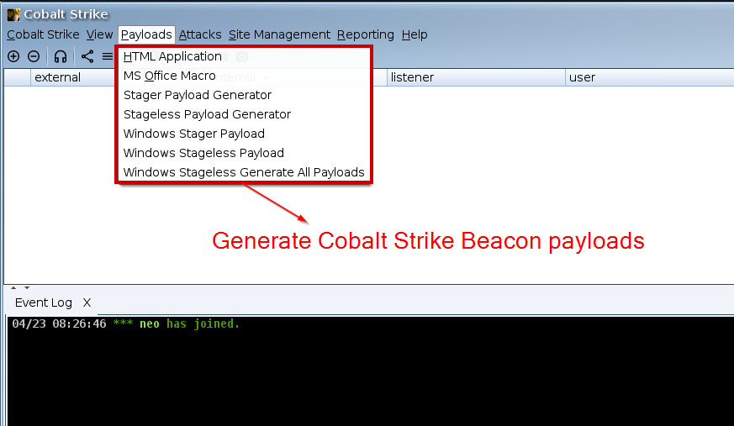
Cobalt Strike Team Server

Slide 21
Cobalt Strike Payload Generation

Slide 22
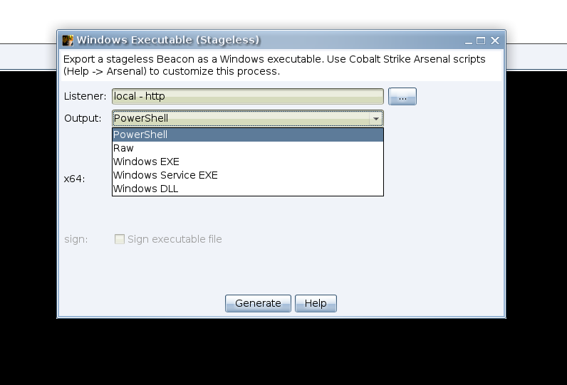
Cobalt Strike Payload Generation

Slide 23
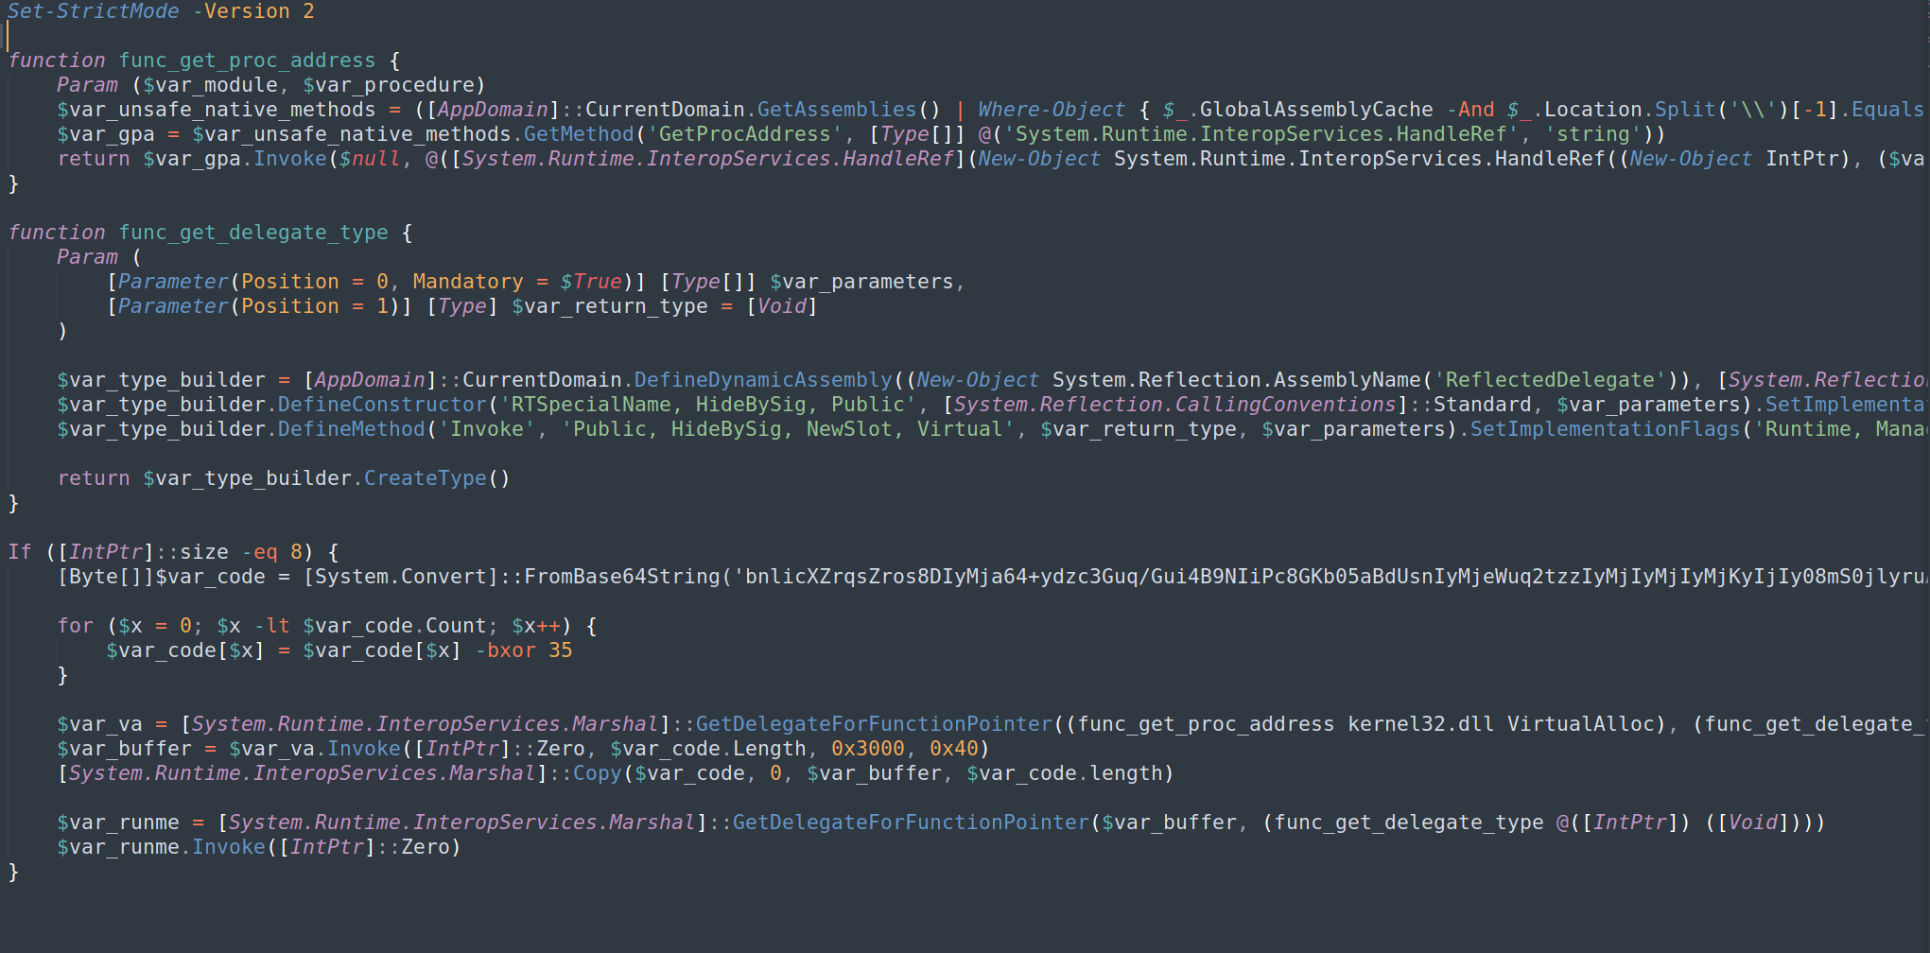
Cobalt Strike PowerShell Payload

Slide 24
YARA
YARA can help us classify the variations of Cobalt Strike Beacon Loaders
YARA is tool used to identify malware by matching patterns in files — like a digital fingerprints.

Slide 25
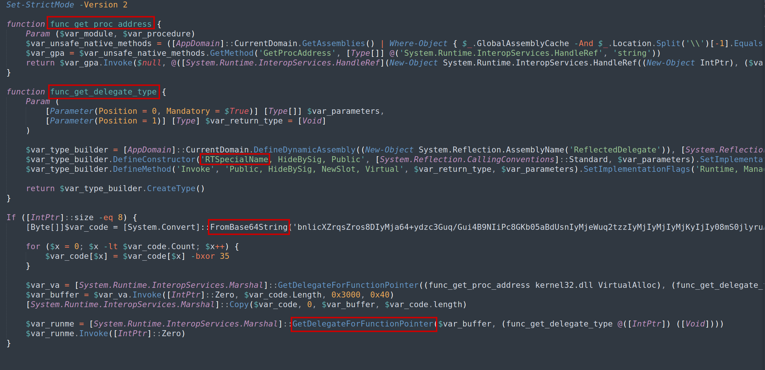
PowerShell Payload - YARA

Slide 26
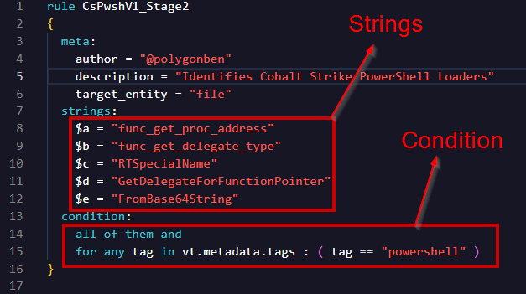
PowerShell Payload - YARA

Slide 27
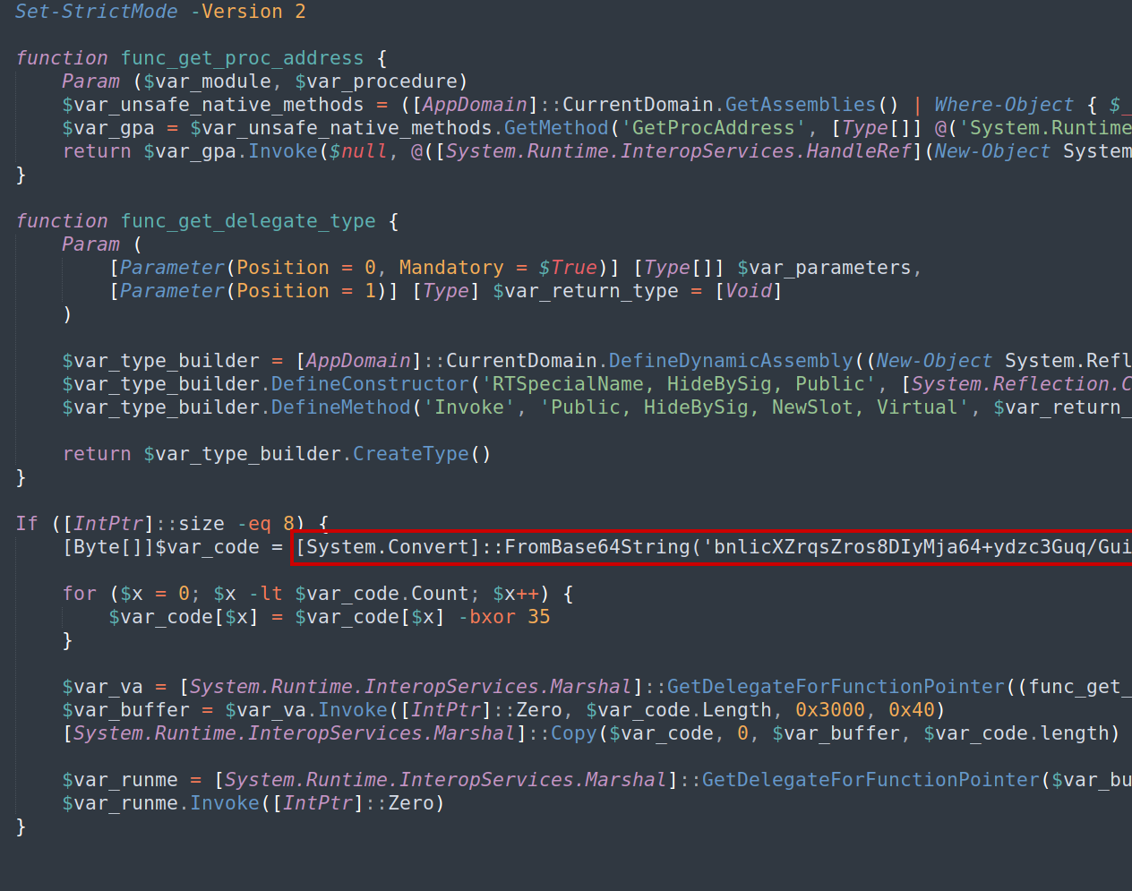
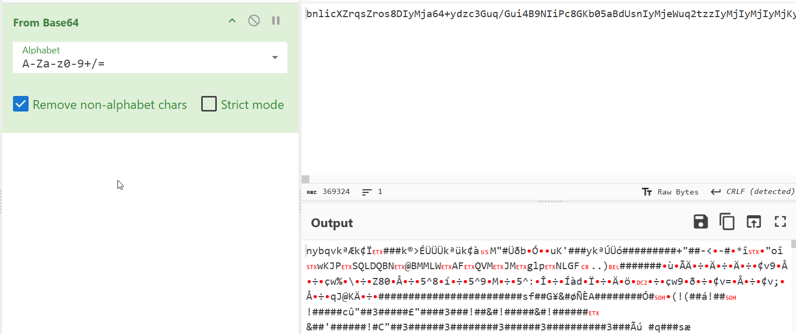
PowerShell Payload - YARA

Slide 28
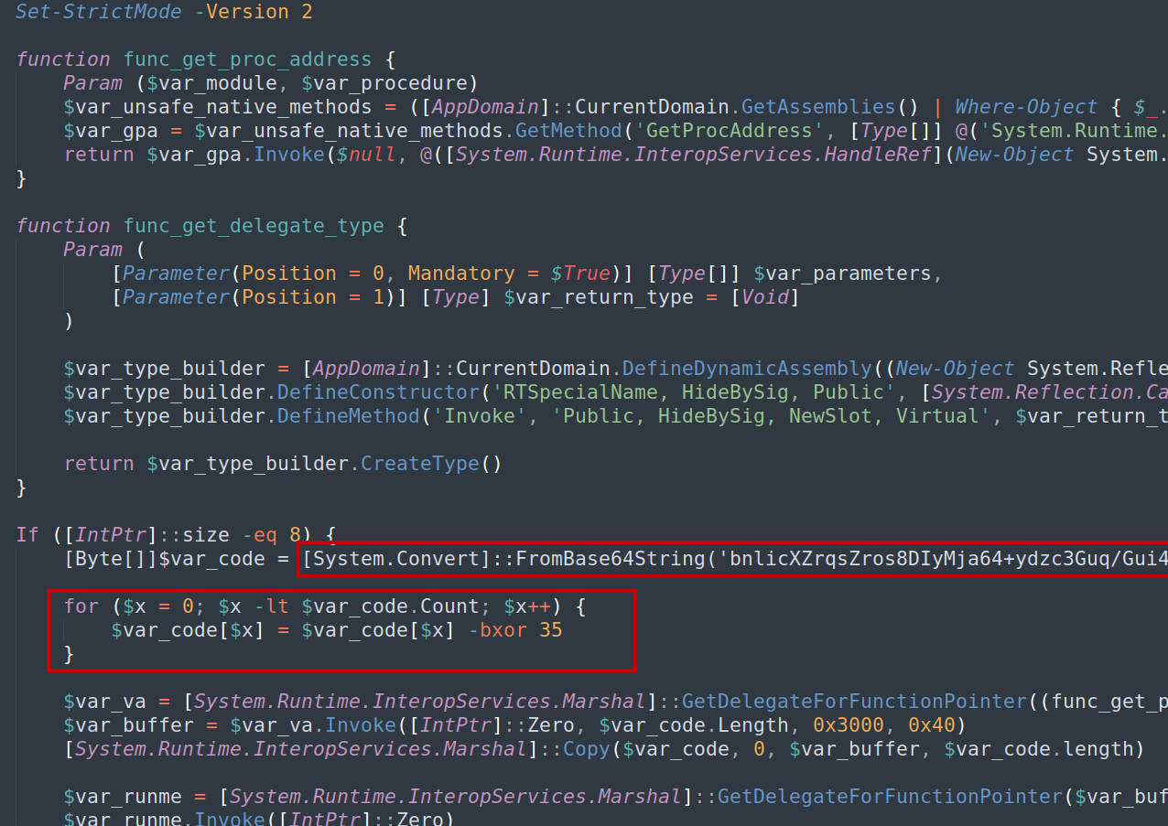
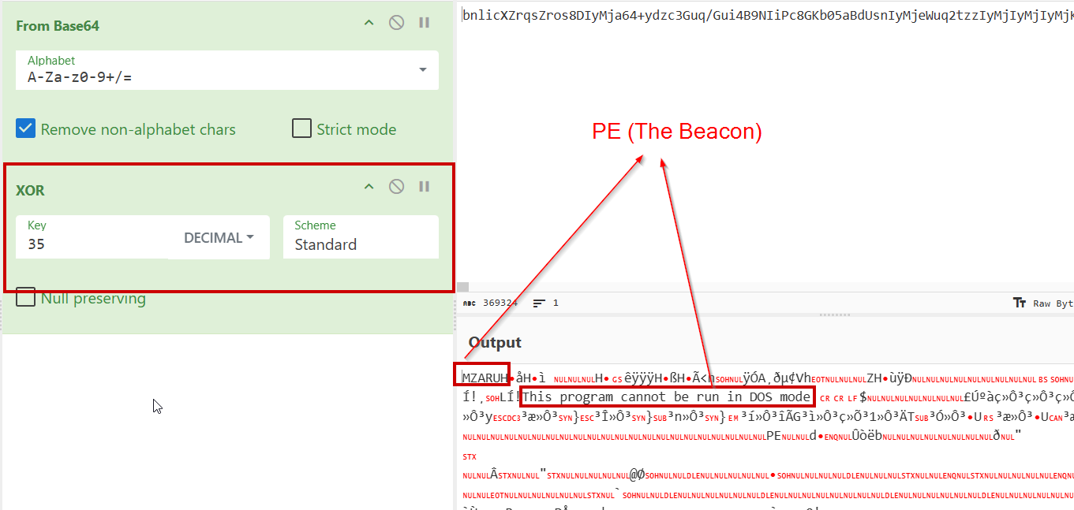
PowerShell Payload - YARA

Slide 29
Didier Stevens – 1768.py
1768.py is a malleable C2 beacon configuration extraction tool
https://github.com/DidierStevens/DidierStevensSuite/blob/master/1768.py
https://blog.nviso.eu/series/cobalt-strike-decrypting-traffic/page/2/

Slide 30
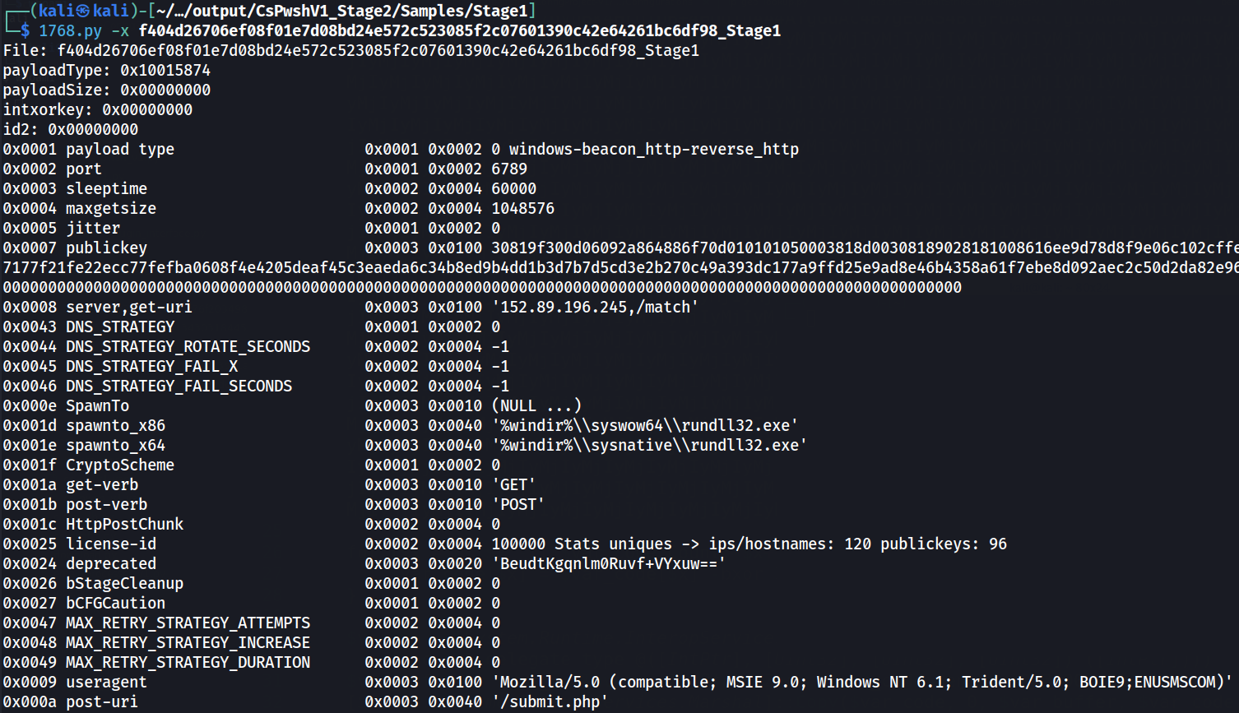
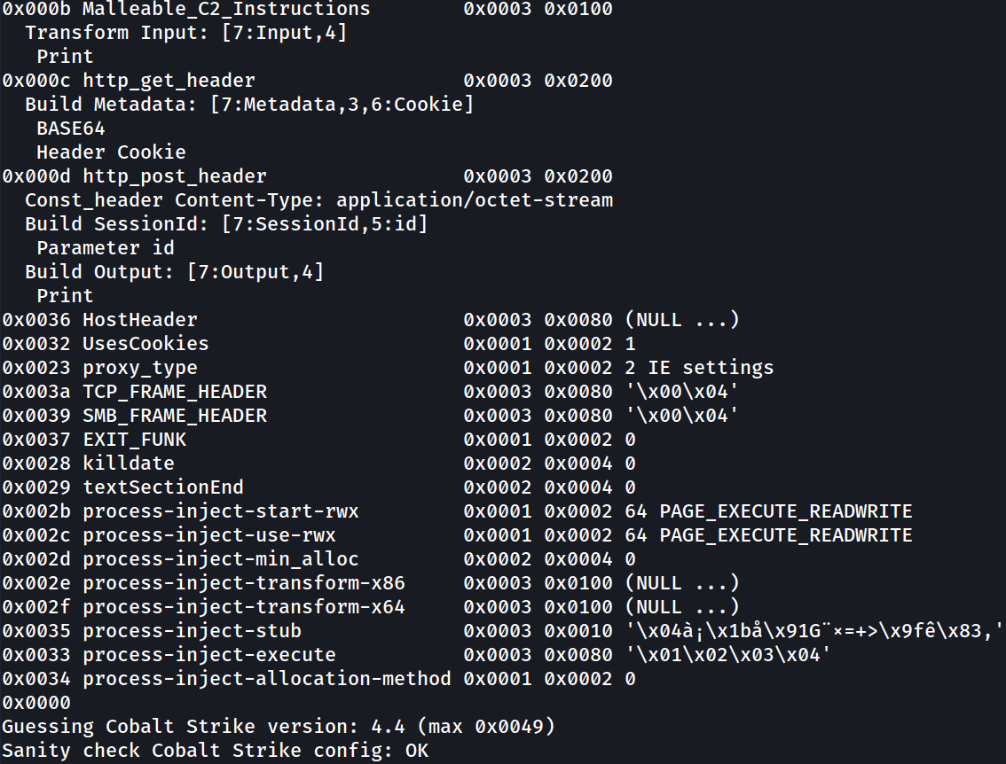
Didier Stevens – 1768.py

Slide 31
Didier Stevens – 1768.py

Slide 32
Didier Stevens – 1768.py

Slide 33
Didier Stevens – 1768.py

Slide 34
Didier Stevens – 1768.py

Slide 35
Didier Stevens – 1768.py

Slide 36
Didier Stevens – 1768.py

Slide 37
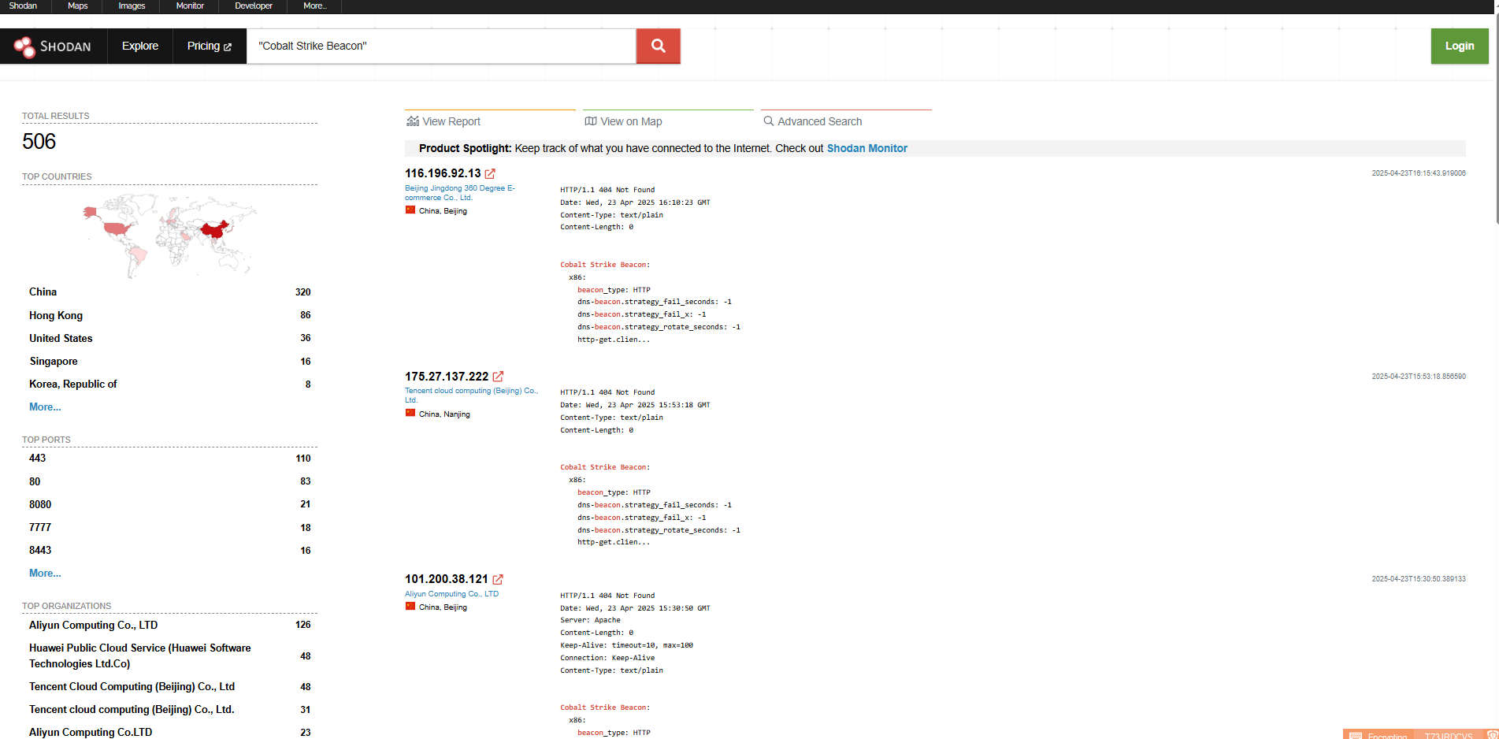
Hunting for Team Servers
OSINT! Shodan, Censys

Slide 38
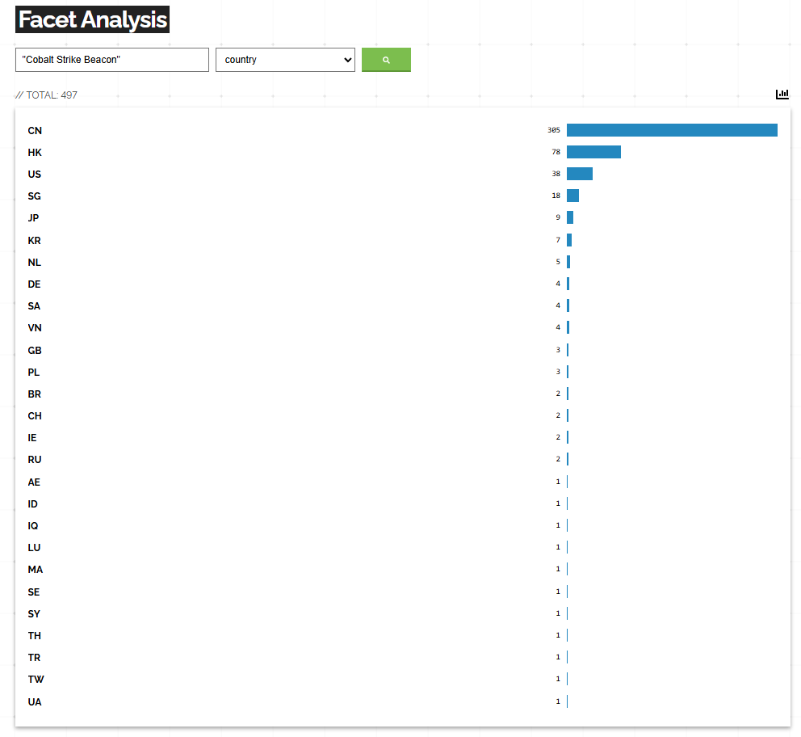
Hunting for Team Servers
OSINT! Shodan, Censys

Slide 39
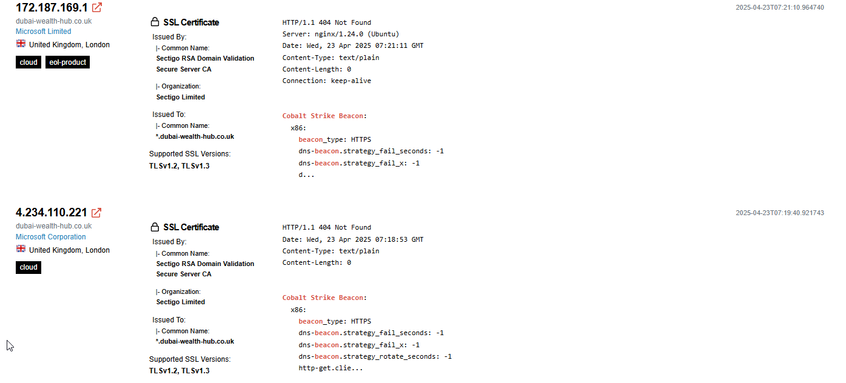
Hunting for Team Servers

Slide 40
Beacon Harvest
Automated malware analysis and configuration extraction tool
Modular & plugin-based for different samples of malware or strains of Cobalt Strike Beacon
Uses VirusTotal APIs, YARA-X and multiple scripts for automated deobfuscation and configuration extraction

Slide 41
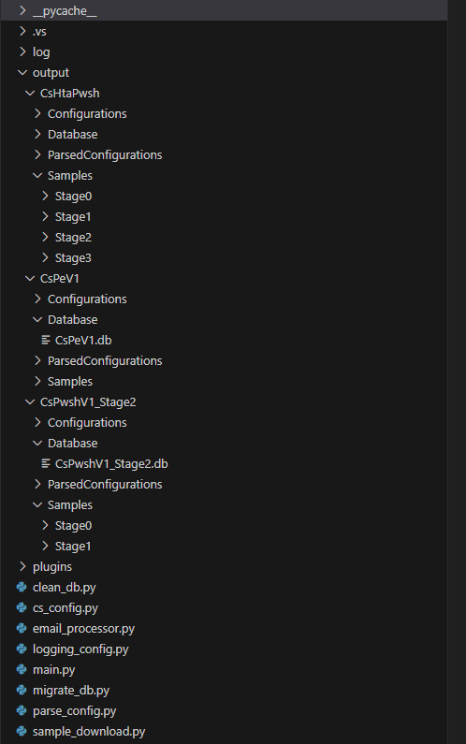
Beacon Harvest
CsHtaPwsh/
├── Configurations/
├── Database/
│ ├── CsHtaPwsh.db
├── ParsedConfigurations/
├── Samples/
│ ├── Stage0/
│ ├── Stage1/
│ ├── Stage2/
│ └── Stage3/

Slide 42
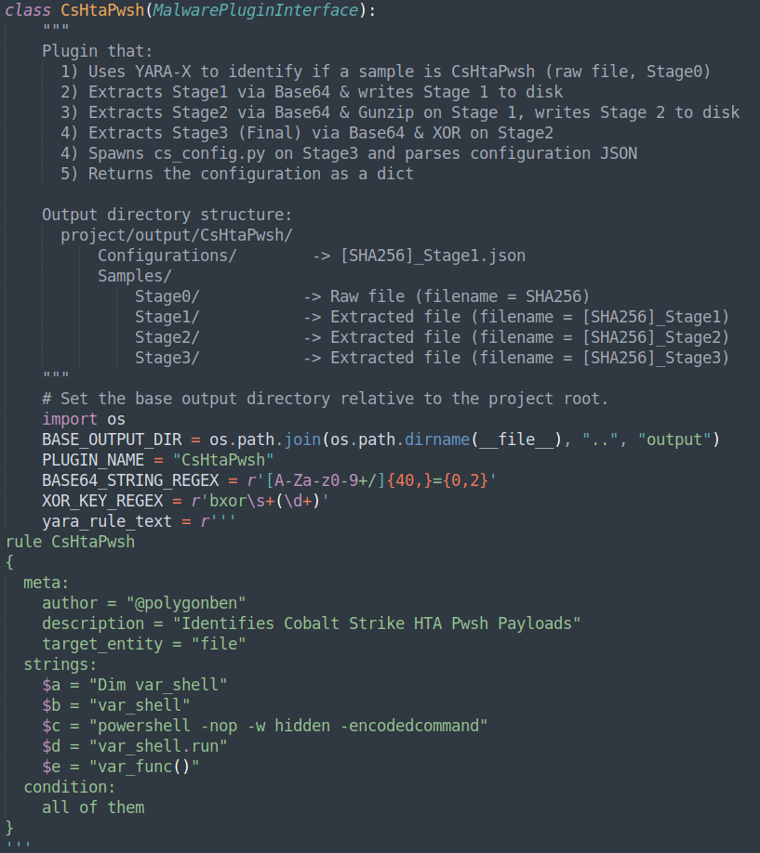
Beacon Harvest - CsHtaPwsh
CsHtaPwsh/
├── Configurations/
├── Database/
│ ├── CsHtaPwsh.db
├── ParsedConfigurations/
├── Samples/
│ ├── Stage0/
│ ├── Stage1/
│ ├── Stage2/
│ └── Stage3/

Slide 43
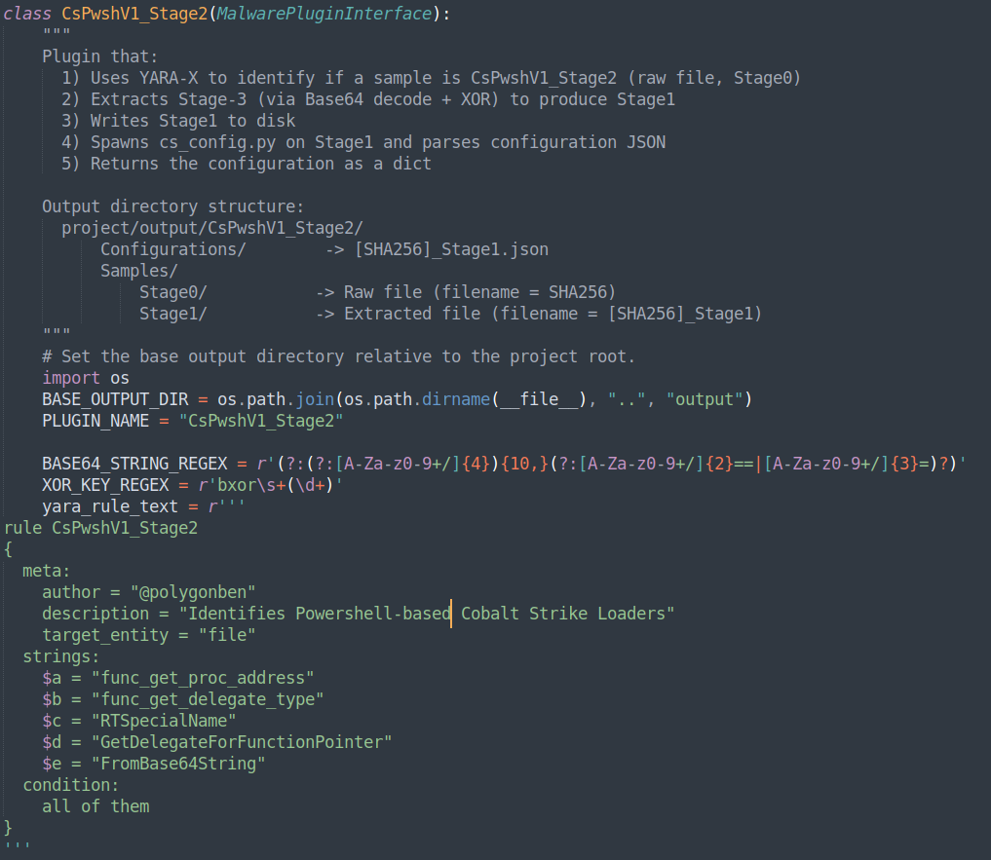
Beacon Harvest – CsPwshV1_Stage2
CsPwshV1_Stage2/
├── Configurations/
├── Database/
│ └── CsPwshV1_Stage2.db
├── ParsedConfigurations/
└── Samples/
├── Stage0/
└── Stage1/

Slide 44
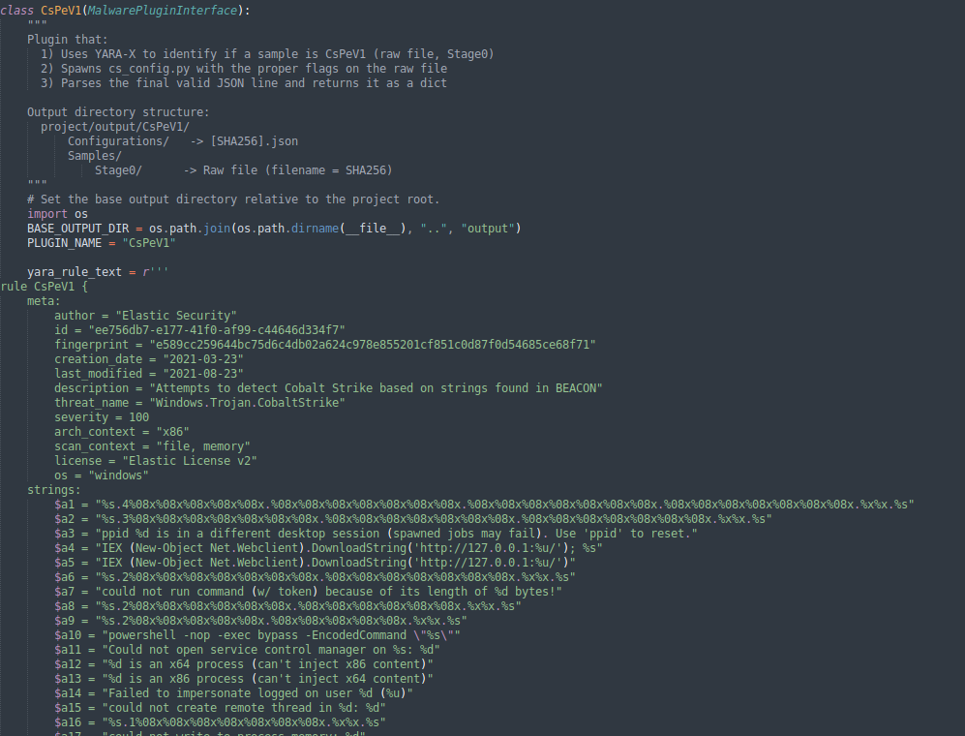
Beacon Harvest – CsPeV1
CsPeV1/
├── Configurations/
├── Database/
│ └── CsPeV1.db
├── ParsedConfigurations/
└── Samples/

Slide 45
Beacon Harvest – CsPeV1
Payload Type | Count | Percentage
windows-beacon_dns-reverse_http | 16380 | 96.95
windows-beacon_http-reverse_http | 346 | 2.05
windows-beacon_https-reverse_https | 153 | 0.91
windows-beacon_smb-bind_pipz | 8 | 0.05
windows-beacon_tcp-bind_tcp | 6 | 0.04
windows-beacon_tcp-reverse_tcp | 3 | 0.02
Samples analysed: 16,896

Slide 46
Beacon Harvest – CsPeV1
server – Team Server C2 domain/IP
Threat Hunting Strategy:
Use network telemetry to identify network connections to IOCs
Use EDR telemetry to identify processes making network connections with IOCs
Detection:
Build analytics looking for network connections to Cobalt Strike Team Server C2 IOCs
server | Count of server
ns7.softline.top | 16365
37.252.15.241 | 16
direct8.ddns.net | 6
95.141.41.29 | 5
43.138.77.252 | 5
192.168.138.137 | 5
139.196.6.154 | 5
blockbitcoin.com | 4
192.168.133.154 | 4
192.168.159.132 | 3
8.142.171.59 | 3
cdn.microsoftdocs.workers.dev | 3
43.142.44.35 | 3
192.168.1.10 | 3
173.242.124.42 | 3
services.pravdarubl.com | 3
3.78.244.11 | 3

Slide 47
Beacon Harvest – CsPeV1
spawnto_x64 | Count of payload type
%windir%\\sysnative\\rundll32.exe | 16843
%windir%\\sysnative\\gpupdate.exe | 7
c:\\windows\\system32\\rundll32.exe | 7
%windir%\\sysnative\\dllhost.exe | 5
%windir%\\sysnative\\svchost.exe | 2
%windir%\\sysnative\\Locator.exe | 2
%windir%\\sysnative\\WerFault.exe | 1
%windir%\\sysnative\\dfrgui.exe | 1
%windir%\\sysnative\\backgroundtaskhost.exe | 1
%windir%\\sysnative\\taskeng.exe | 1
%windir%\\sysnative\\grpconv.exe | 1
%windir%\\sysnative\\ucsvc.exe | 1
%windir%\\sysnative\\wbem\\wmiprvse.exe –Embedding | 1
c:\\Program Files\\internet explorer\\iexplore.exe | 1
%windir%\\sysnative\\eventvwr.exe | 1
%windir%\\system32\\svchost.exe | 1
%windir%\\sysnative\\cmd.exe | 1
%windir%\\sysnative\\logman.exe | 1
%windir%\\sysnative\\mstsc.exe | 1
spawnto_x64 – Sacrificial Process
Threat Hunting Strategy:
Use process spawn telemetry to look for large number of process spawn events for the sacrificial processes
Use process spawn telemetry to look for unusual parent processes
Use Sysmon telemetry to look for remote thread & process access events
Detection:
Rare process injection or remote thread access events

Slide 48
Beacon Harvest – CsPeV1
pipename – Cobalt Strike Named Pipe for IPC
Threat Hunting Strategy:
Use EDR/Sysmon telemetry to hunt for these named pipes being used
Detect
Detect on these named pipes being used via EDR Telemetry or Sysmon
pipename | Count of pipename
'\\\\%s\\pipe\\msagent_%x' | 16436
'\\\\%s\\pipe\\interprocess_%x' | 6
'\\\\.\\pipe\\msagent_78' | 1
'\\\\%s\\pipe\\mojo.5688.8052.183894939787088877%x' | 1
'\\\\.\\pipe\\kaspersky_server' | 1
'\\\\%s\\pipe\\fhsvc-%x' | 1
'\\\\%s\\pipe\\budtv_%x' | 1
'\\\\.\\pipe\\give_your_some_color_see_see' | 1
'\\\\.\\pipe\\flag14878b0d3347008ebb8547c6317c5ce5' | 1

Slide 49
Beacon Harvest – CsPeV1
useragent | Count of useragent
'Mozilla/5.0 (Windows NT 6.1; WOW64; Trident/7.0; rv:11.0) like Gecko' | 16382
'Mozilla/5.0 (compatible, MSIE 11, Windows NT 6.3; Trident/7.0; rv:11.0) like Gecko' | 23
'Mozilla/5.0 (compatible; MSIE 8.0; Windows NT 6.1; Trident/5.0)' | 22
'Mozilla/5.0 (compatible; MSIE 9.0; Windows NT 6.1; WOW64; Trident/5.0)' | 13
'Mozilla/4.0 (compatible; MSIE 7.0; Windows NT 5.1; .NET CLR 2.0.50727; .NET CLR 3.0.04506.30)' | 12
'Mozilla/4.0 (compatible; MSIE 7.0; Windows NT 5.1)' | 12
'Mozilla/5.0 (compatible; MSIE 9.0; Windows NT 6.1; WOW64; Trident/5.0; MANM)' | 9
'Windows-Update-Agent/10.0.10011.16384 Client-Protocol/1.40' | 9
'Mozilla/5.0 (compatible; MSIE 9.0; Windows NT 6.0; Trident/5.0)' | 8
'Mozilla/5.0 (compatible; MSIE 9.0; Windows NT 6.1; WOW64; Trident/5.0; BOIE9;ENUS)' | 8
'Mozilla/5.0 (compatible; MSIE 10.0; Windows NT 6.2; Win64; x64; Trident/6.0)' | 8
'Mozilla/5.0 (compatible, MSIE 11, Windows NT 6.3; Trident/7.0; rv:11.0) like Gecko' | 7
'Mozilla/4.0 (compatible; MSIE 7.0; Windows NT 6.0)' | 7
'Mozilla/5.0 (compatible; MSIE 9.0; Windows NT 6.1; Win64; x64; Trident/5.0; BOIE9;ENUS)' | 7
'Mozilla/5.0 (Windows NT 10.0; Win64; x64) AppleWebKit/537.36 (KHTML, like Gecko) Chrome/96.0.4664.110 Safari/537.36' | 6
useragent – User Agent used within C2 HTTP/S requests
Threat Hunting Strategy:
Use HTTP proxy to hunt for User-Agents used by Beacon’s for C2
Detect
Detect unique User-Agents used by Beacon’s for C2

Slide 50
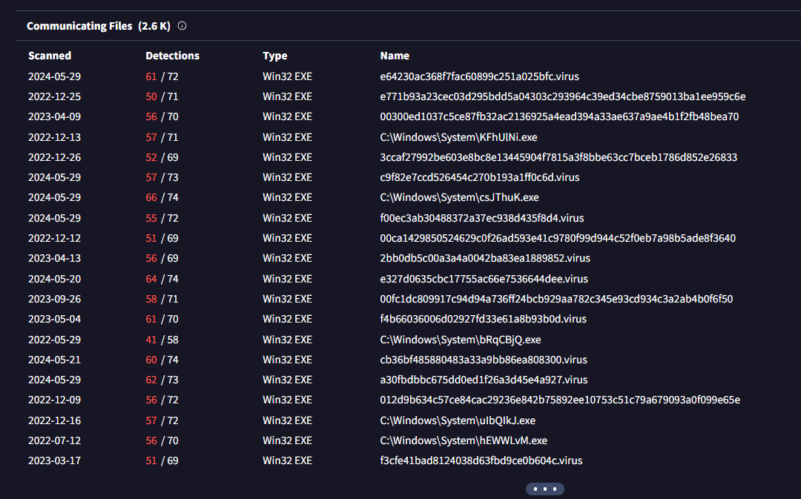
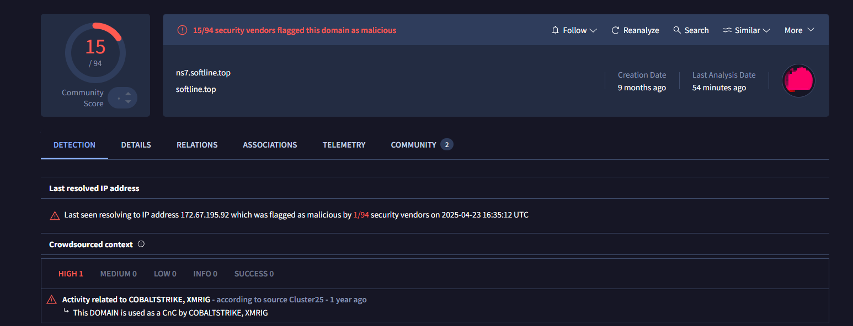
ns*.softline[.]top
16,366 Cobalt Strike Beacon’s were using DNS reverse HTTP for C2 with the domain ns*.softline[.]top

Slide 51
ns*.softline[.]top
server,get-uri: ns7.softline.top,/s/ref=nb_sb_noss_1/167-3294888-0262949/field-keywords=books,ns8.softline.top,/s/ref=nb_sb_noss_1/167-3294888-0262949/field-keywords=books,ns9.softline.top,/s/ref=nb_sb_noss_1/167-3294888-0262949/field-keywords=books
useragent: Mozilla/5.0 (Windows NT 6.1; WOW64; Trident/7.0; rv:11.0) like Gecko
spawnto_x64: %windir%\sysnative\rundll32.exe
spawnto_x86 %windir%\syswow64\rundll32.exe
pipename: \\%s\pipe\msagent_%x
'Mozilla/5.0 (Windows NT 6.1; WOW64; Trident/7.0; rv:11.0) like Gecko'

