Slide 1

Knock, Knock, Knocking on Your DC's Door
From Outside to Domain Admin

Slide 2

disclaimer

Slide 3

target audience

Slide 4

doxxed

Slide 5

lab setup
Lab Setup
VirtualBox
Turnkey LAMP Stack
Win 2k8 Server Trial
Attacker Machine

Slide 6
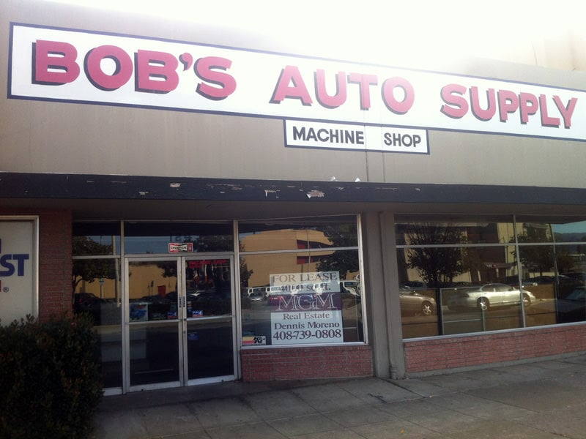
scope
Client Info
30 employees
1 IT person
Worried about this "PCI stuff" the bank is talking about
One external IP
10 computers and a "server"
Website hasn't been completed

Slide 7

recon & enum
Enumerate Everything Thoroughly
nmap All The Things
Look for any ports of interest
Check service banners
Look for any web services
dirb any websites
Use cewl to generate any word lists

Slide 8

dig deeper
Pick a door, any door!
Keep track of what you have tried
Check versions and auth types
Look for known vulns and exploits
Check support user forums for manuals etc

Slide 9
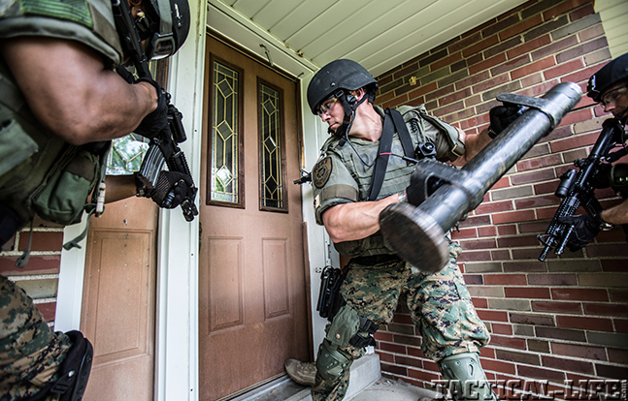
knock knock
Lets make a proper entrance
Choose the wordlist for your current needs
Benchmark your tools for speed
Don't stop exploring
Enter any creds into your exploitation tool of choice

Slide 10
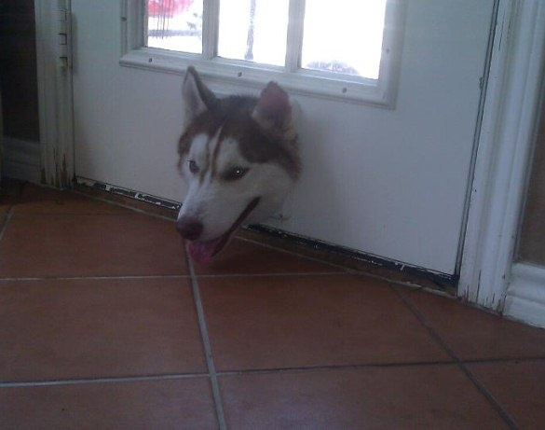
anyone home
Enumerate all the (internal) things
Use nmap or script of choice to find internal targets
Check open connections
Check configs for any network passwords
Check history and logs

Slide 11

pivot
Dig yourself a tunnel quick n easy!
Use proxychains or SSH to create a tunnel quickly
Check SSH config and enable AllowTcpForwarding
Restart SSH and reconnect if needed
Always try found creds before bruteforcing
Begin tunneled bruteforce

Slide 12
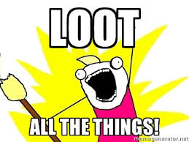
loot all the things
Leave no stone unturned
Screenshot everything
Use scripts and references
Look for high value loot
Copy locally for cracking
Check a 2nd and 3rd time
Make sure evidence transferred properly

Slide 13

clean house
Leave it how you found it
Begin at the end
Remove files & exploits
Clear logs before signoff
Repeat on each host
Don't over clean
Check evidence integrity again before ending

Slide 14
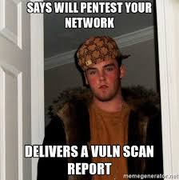
report
Prompt and Professional Every Time
Start right away
Create high level and detailed reports
Create a template from your first test
Be very clear and detailed to prevent questions
Always keep template updated and fresh

Slide 15
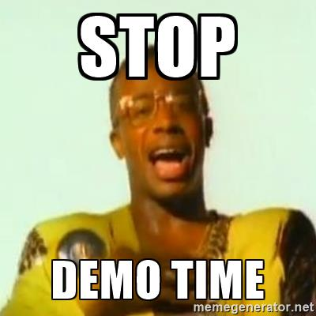
enough talk already

Slide 16

retesting

Slide 17
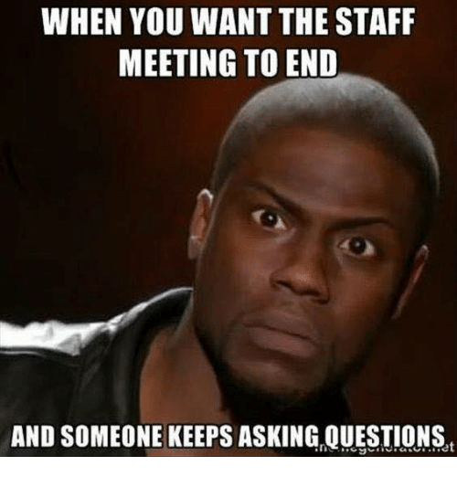
questions
Reach Me
daniel@n0logic.com
Twitter - @realn0logic
Freenode - n0logic
https://keybase.io/dhampton
https://github.com/n0logic

Slide 18

thank you

