Slide 1

Knock, Knock, Knocking on Your DC's Door
From Outside to Domain Admin

Slide 2

disclaimer

Slide 3

targets

Slide 4

doxxed

Slide 5
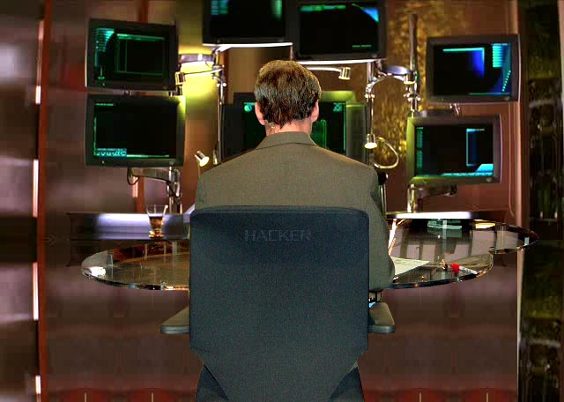
lab setup
Lab Setup
VirtualBox
Turnkey LAMP Stack
Win 2k8 Server Trial
Attacker Machine

Slide 6
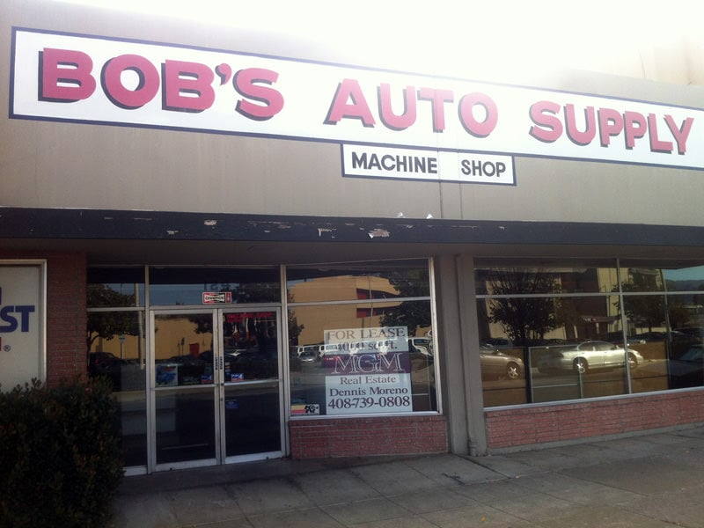
scope
Client Info
30 employees
1 IT person
Worried about this "PCI stuff" the bank is talking about
One external IP
10 computers and a "server"
Website hasn't been completed

Slide 7

recon & enum
Enumerate Everything Thoroughly
nmap All The Things
Look for any ports of interest
Check service banners
Look for any web services
dirb any websites
Use cewl to generate any word lists

Slide 8
dig deeper

Slide 9
knock knock

Slide 10
anyone home

Slide 11
pivot

Slide 12
loot all the things

Slide 13
clean house

Slide 14
report

Slide 15
enough talk already

Slide 16
retesting

Slide 17
references

Slide 18
questions

Slide 19
thank you

