Slide 1

Connecticut Sales Territory Analysis
Eastern Region Performance Review
David Clark

Slide 2
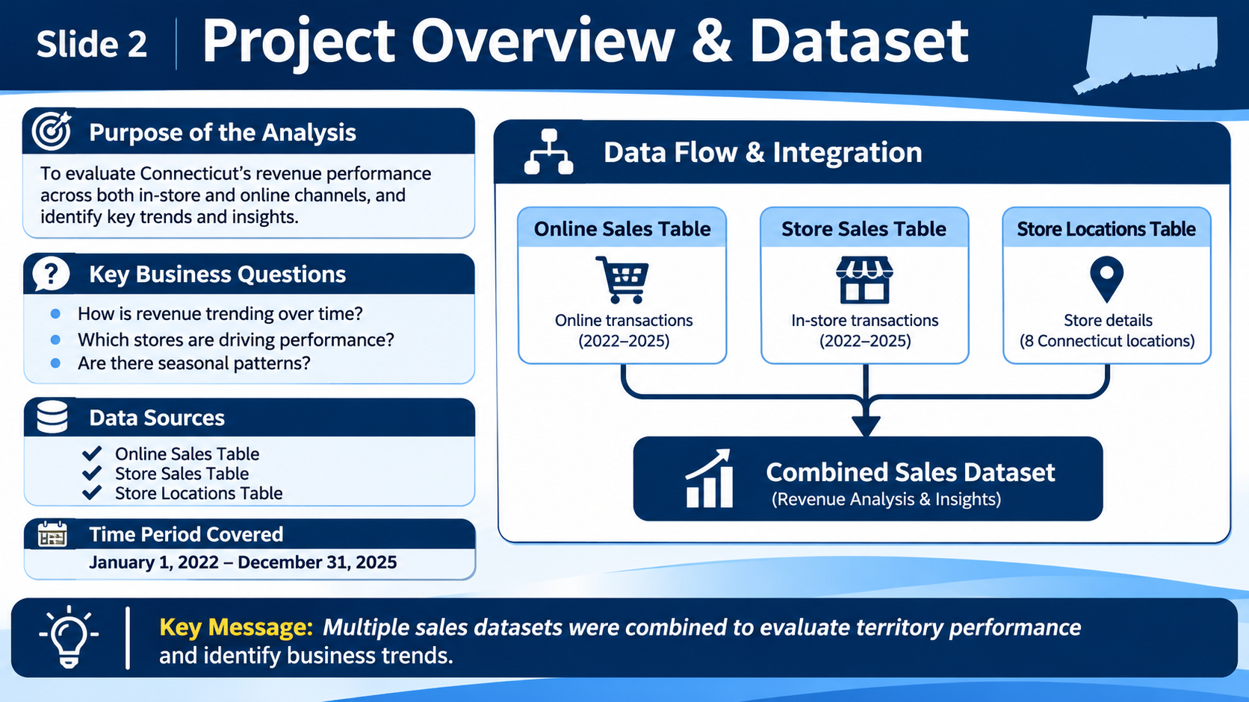
2. Project Overview & Dataset
SQL sources and reporting period

Slide 3
3. Overall Revenue Performance
Connecticut revenue KPI summary
KPI | Value
Total Revenue | $362,960,390.80
Start Date | Jan 1, 2022
End Date | Dec 31, 2025
$362.96 Million
Connecticut Total In-Store Revenue

Slide 4
4. Connecticut In-Store Revenue Trend (2022-2025)
Monthly in-store revenue generated within Connecticut
📈 Overall trend indicates significant revenue growth during 2025.
🏆 Highest Revenue Month
August 2025
$263,650.12
🥈 Second Highest Revenue Month
January 2025
$213,649.95
💰 Strong Year-End Performance
December 2025
$99,201.57

Slide 5
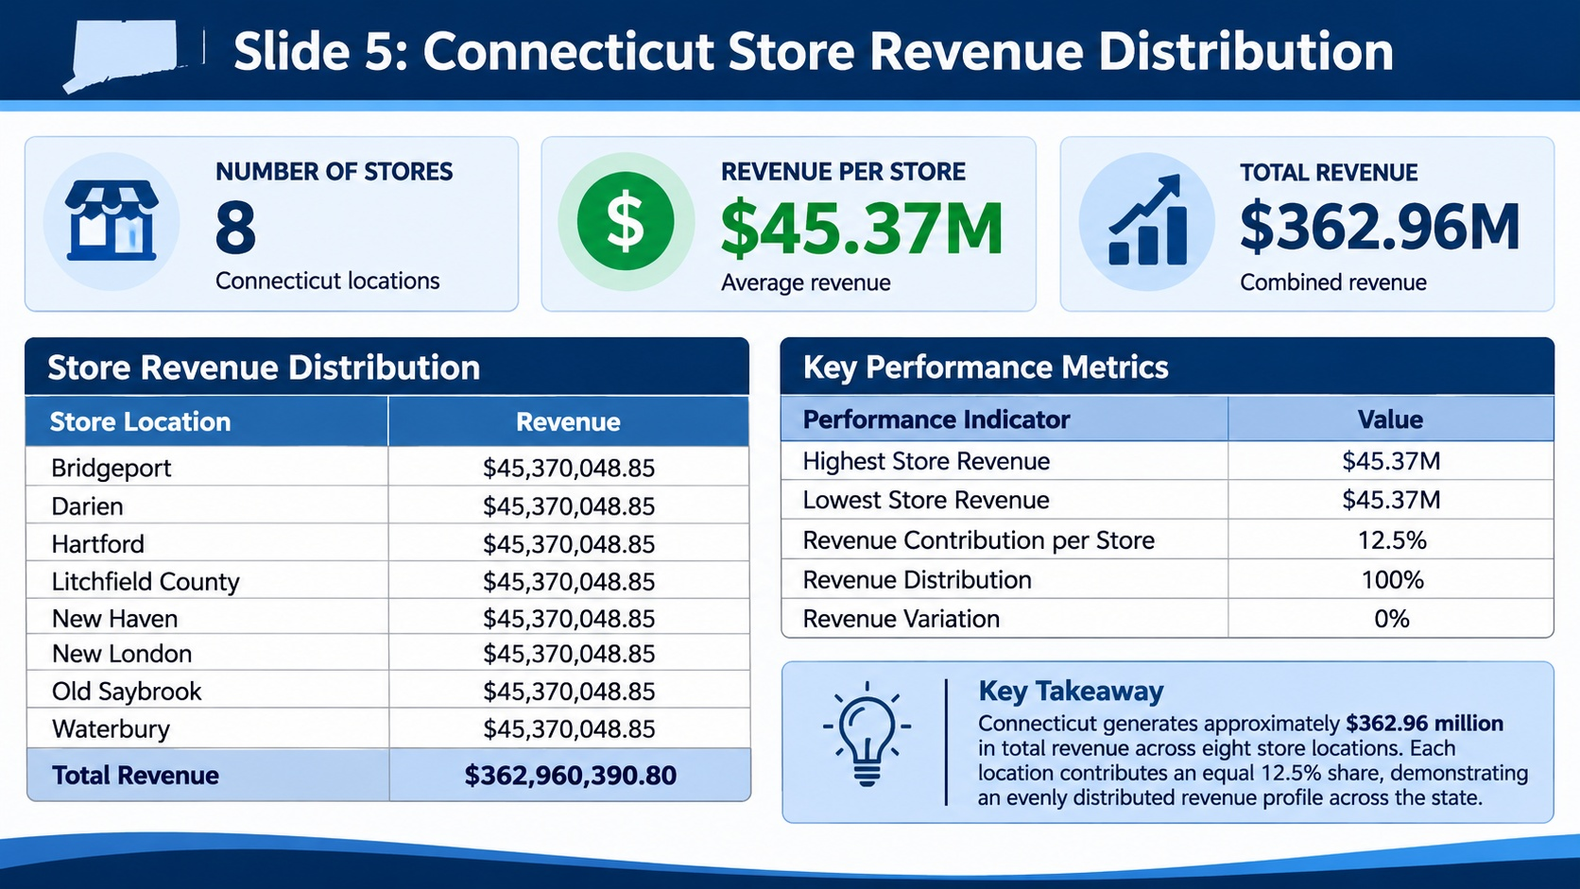
5. Connecticut vs Eastern Region
Regional comparison placeholder

Slide 6
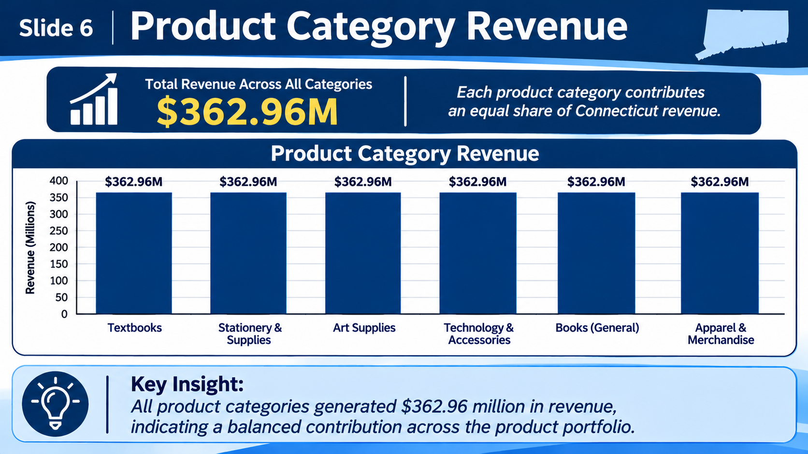
6. Product Category Performance
Category analysis placeholder

Slide 7
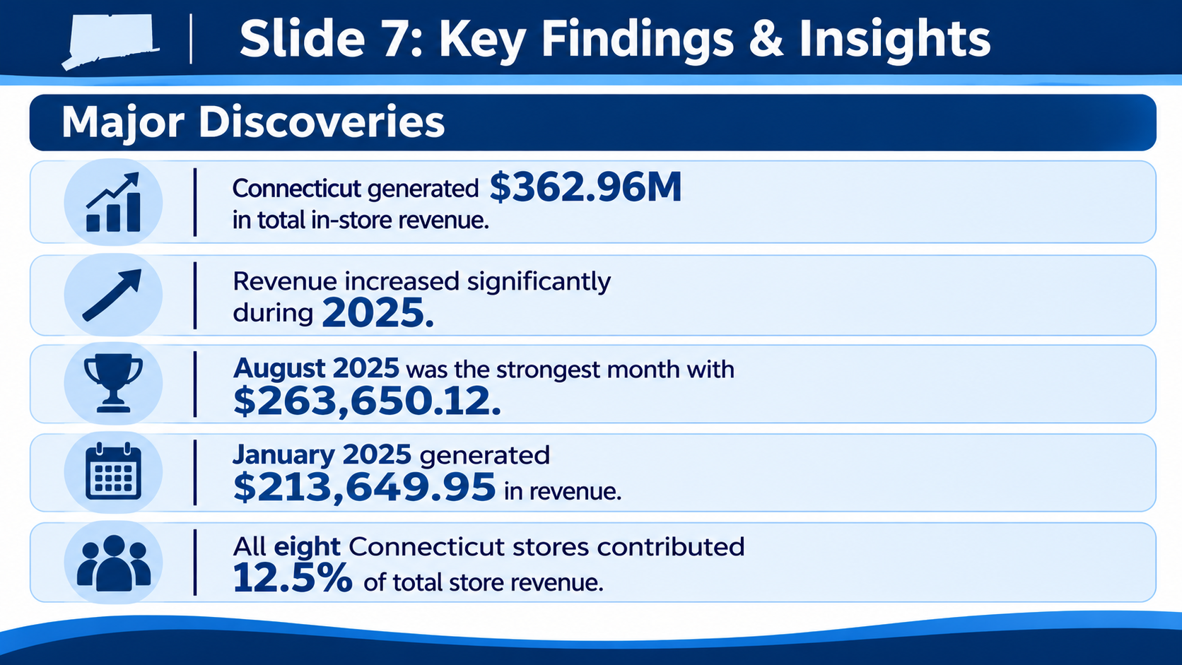
7. Key Findings & Insights
Major discoveries

Slide 8
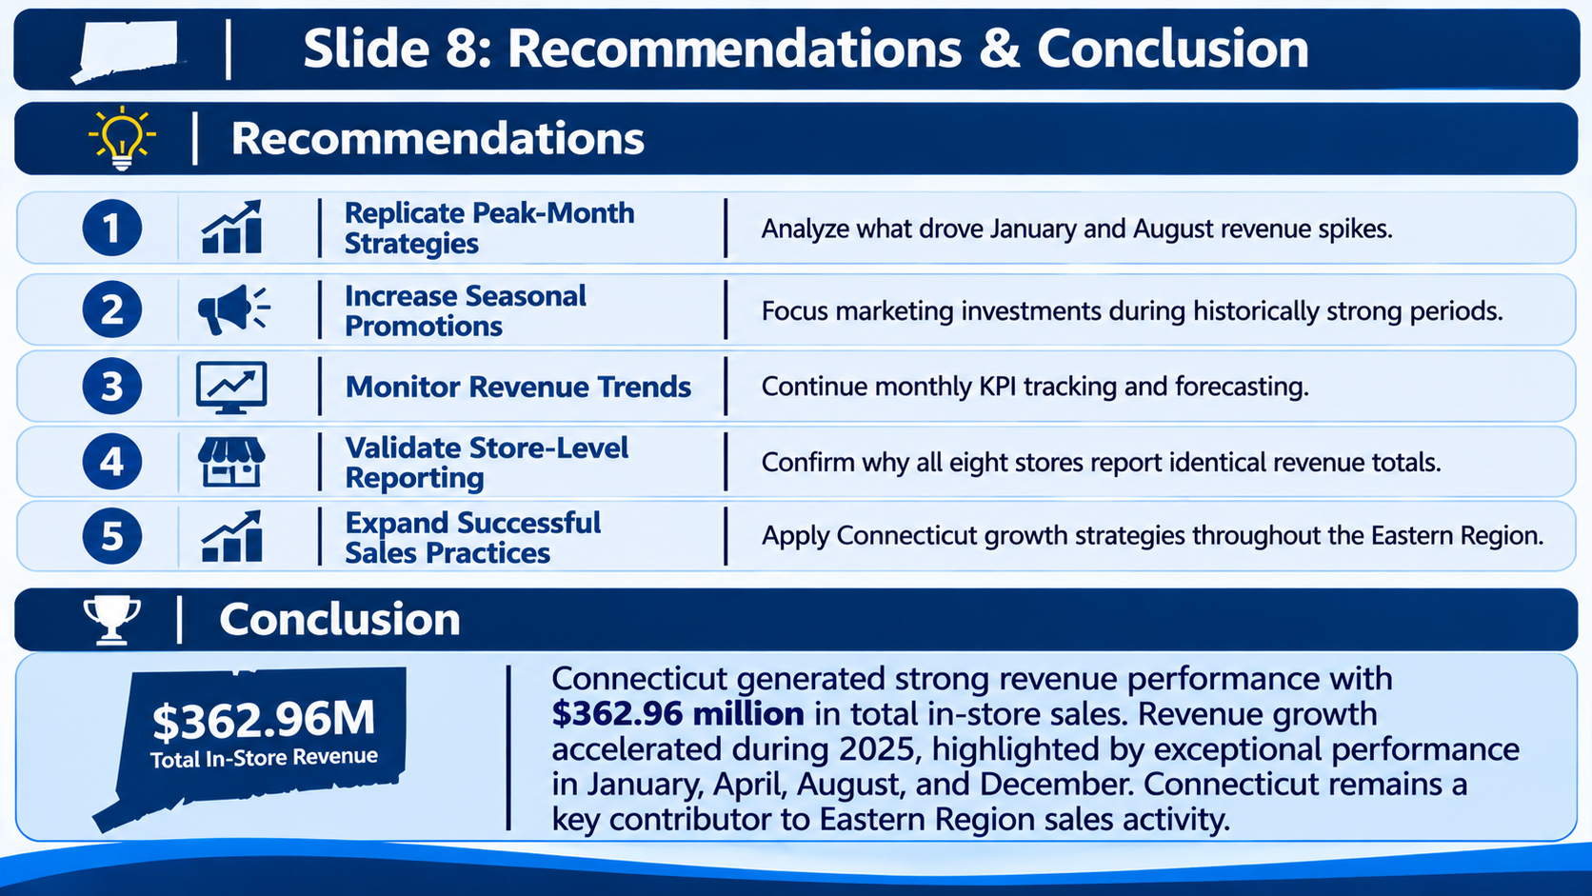
8. Recommendations & Conclusion
Strategic next steps

Slide 9
What is the number of transactions per month and average transaction amount by product category for the sales territory?

