Slide 1


Error-Bounded Online Trajectory Simplification with Multi-Agent Reinforcement Learning
Zheng Wang*, Cheng Long*, Gao Cong*, Qianru Zhang^
*Nanyang Technological University
^The University of Hong Kong

Slide 2
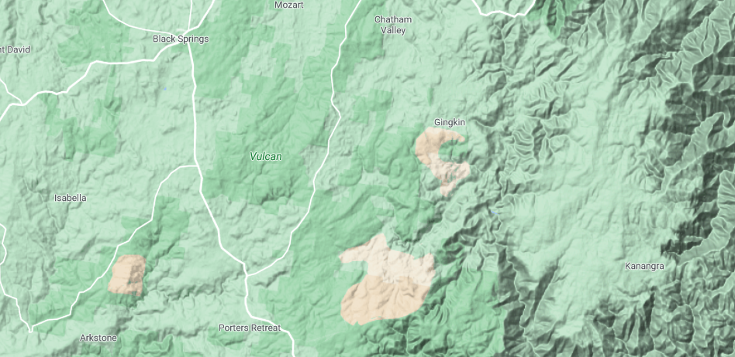









Trajectory Simplification: Introduction
8 sampled positions and 7 segments
$$p_{2}$$
$$p_{1}$$
$$p_{3}$$
$$p_{4}$$
Segment
$$p_{5}$$
$$p_{8}$$
$$p_{6}$$
$$p_{7}$$
Trajectory

Slide 3
Trajectory Simplification: Motivation
Raw trajectory data is usually very large
$$p_{2}$$
$$p_{1}$$
$$p_{3}$$
$$p_{4}$$
$$p_{5}$$
$$p_{8}$$
Trajectory Simplification
$$p_{6}$$
$$p_{7}$$
Drop some positions
As a result, only a portion of the positions is kept
Consider a scenario:
- 10,000 pedestrians
- Sampling rate: 5s
- Hundreds of millions of positions per day!!
Issue 1: high space cost for trajectory storage
Issue 2: high time cost for query processing

Slide 4
Trajectory Simplification: Motivation
Raw trajectory data is usually very large
$$p_{1}$$
simplified trajectory
$$p_{8}$$
Trajectory Simplification
$$p_{7}$$
Drop some positions
As a result, only a portion of the positions is kept
Consider a scenario:
- 10,000 pedestrians
- Sampling rate: 5s
- Hundred of millions of positions per day!!
Issue 1: high space cost for trajectory storage
Issue 2: high time cost for query processing

Slide 5
Trajectory Simplification: Motivation
Raw trajectory data is usually very large
$$p_{2}$$
$$p_{1}$$
$$p_{3}$$
$$p_{4}$$
$$p_{5}$$
$$p_{8}$$
Trajectory Simplification
$$p_{6}$$
$$p_{7}$$
Drop some positions
As a result, only a portion of the positions is kept
Consider a scenario:
- 10,000 pedestrians
- Sampling rate: 5s
- Hundred of millions of positions per day!!
Issue 1: high space cost for trajectory storage
Issue 2: high time cost for query processing

Slide 6
Trajectory Simplification: Motivation
Which positions should be dropped?
Raw trajectory data is usually very large
$$p_{2}$$
another simplified trajectory
$$p_{1}$$
$$p_{8}$$
Trajectory Simplification
Drop some positions
As a result, only a portion of the positions is kept
Consider a scenario:
- 10,000 pedestrians
- Sampling rate: 5s
- Hundred of millions of positions per day!!
Issue 1: high space cost for trajectory storage
Issue 2: high time cost for query processing

Slide 7
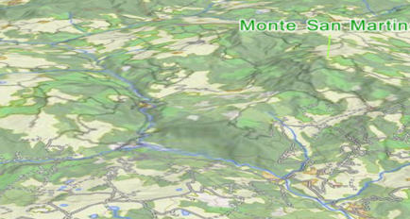
Trajectory Simplification: Error measurements
Perpendicular Euclidean Distance (PED)
p₃
p₁₀
p₈
p₇
p₉
p₄
p₁
p₂
p₅
p₆
Original trajectory: T
Simplified trajectory: T’

Slide 8
Trajectory Simplification: Error measurements
Perpendicular Euclidean Distance (PED)
Error of T’ = the maximum distance
p₃
p₁₀
The worst (maximal) distance of the perpendicular positions
p₈
P’₉
distance
P’₄
p₇
P’₂
P’₅
P’₈
p₉
p₄
P’₇
p₁
p₂
p₅
p₆
perpendicular positions on T’
Synchronized Euclidean Distance (SED)
Direction-Aware Distance (DAD)
Speed-Aware Distance (SAD)

Slide 9
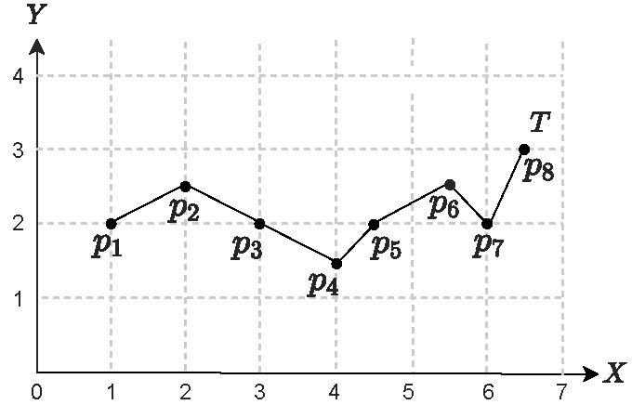

Error-Bounded Online Trajectory Simplification (EB-OTS)
Problem (EB-OTS):
Input: T = <P1, P2,…, Pn> in streaming
Objective: minimize |T’|
Constraint: ε(T’) ≤ εt (error tolerance)
Input: T = <P1, P2, P3, P4, P5, P6, P7, P8> in streaming
Objective: |T’| as small as possible
Constraint: an error tolerance 0.5 for PED
Output: T’=<P1, P7, P8> with |T’|=3

Slide 10















Existing Solutions: three-step process
Existing solutions: adopt the three-step process for EB-OTS problem
Step 1
Open window
Step 2
Expand window
Step 3
Re-open window
$$p_{4}$$
$$p_{4}$$
tolerance
violation
$$p_{3}$$
$$p_{5}$$
$$p_{3}$$
$$p_{5}$$
$$p_{2}$$
$$p_{2}$$
$$p_{6}$$
$$p_{2}$$
$$p_{6}$$
$$p_{1}$$
$$p_{7}$$
$$p_{1}$$
$$p_{1}$$
safe point

Slide 11
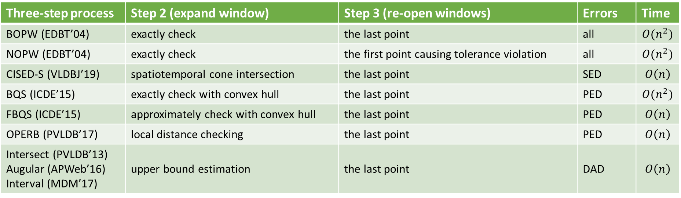
Existing Solutions: three-step process
Effectiveness Issue:
human-crafted rules for re-opening a window
Efficiency Issue:
Expand one point each time.
Three-step process | Step 2 (expand window) | Step 3 (re-open windows) | Errors | Time
BOPW (EDBT’04) | exactly check | the last point | all | $${O(n}^{2})$$
NOPW (EDBT’04) | exactly check | the first point causing tolerance violation | all | $${O(n}^{2})$$
CISED-S (VLDBJ’19) | spatiotemporal cone intersection | the last point | SED | $$O\left(n\right)$$
BQS (ICDE’15) | exactly check with convex hull | the last point | PED | $${O(n}^{2})$$
FBQS (ICDE’15) | approximately check with convex hull | the last point | PED | $$O\left(n\right)$$
OPERB (PVLDB’17) | local distance checking | the last point | PED | $$O\left(n\right)$$
Intersect (PVLDB’13) Augular (APWeb’16) Interval (MDM’17) | upper bound estimation | the last point | DAD | $$O\left(n\right)$$
MARL4TS (ours) | by Agent-E via RL | by Agent-R via RL | all | $$O\left(n\right)$$
effective, efficient and general solution

Slide 12
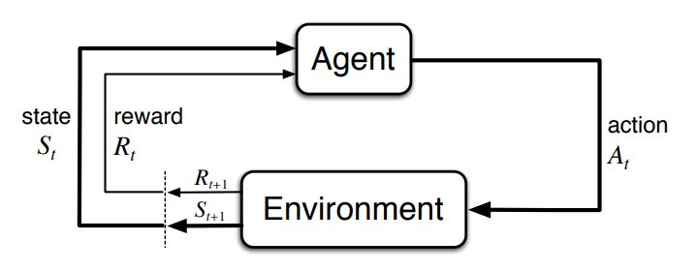
Background of Reinforcement Learning
Reinforcement Learning (RL):
RL is to guide agents on how to take actions to maximize a cumulative reward in an environment
Markov Decision Process (MDP):
The environment is modelled as an MDP, involving state, action, transition and reward

Slide 13

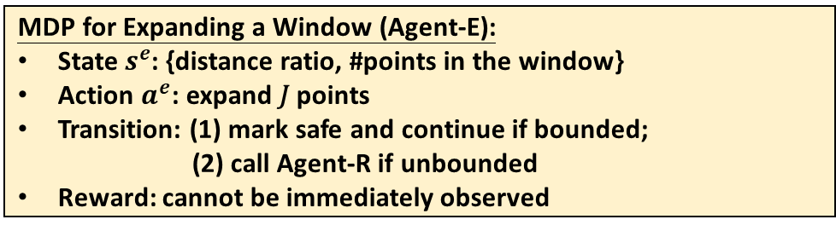



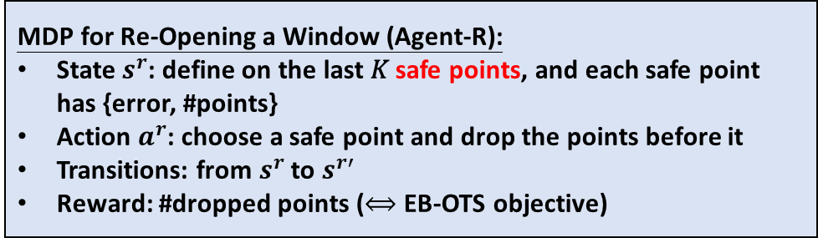
MDP for Agent-E and Agent-R
error tolerance is 1.0
MDP for Expanding a Window (Agent-E):
State $s^{e}$: {distance ratio, #points in the window}
Action $a^{e}$: expand 𝐽 points
Transition: (1) mark safe and continue if bounded;
(2) call Agent-R if unbounded
Reward: cannot be immediately observed
Agent-E and Agent-R cooperate for the same objective
MDP for Re-Opening a Window (Agent-R):
State $s^{r}$: define on the last 𝐾 safe points, and each safe point has {error, #points}
Action $a^{r}$: choose a safe point and drop the points before it
Transitions: from $s^{r}$ to $s^{r′}$
Reward: #dropped points ($⟺$EB-OTS objective)
distance ratio $=\frac{5.886}{5}=1.177$
#points in the window $=7$
error at $P_{8}$ $=\text{1.029}$ (unbounded)
$$K=2, P_{5}=\left(0.5, 5\right), P_{7}=\left(0.5,7\right)$$
Reward $=$ 5

Slide 14
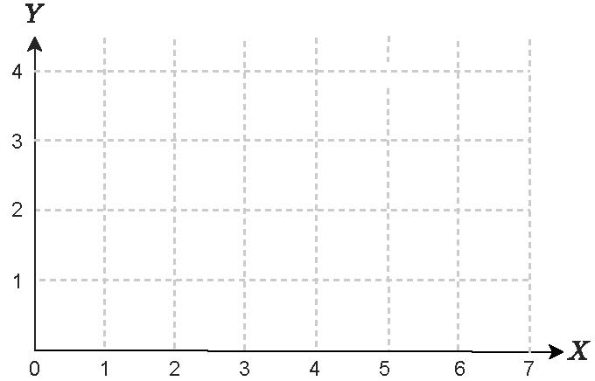













Multi-Agent Reinforcement Learning Solution (MARL4TS)
DQN
Network
Initial: L=1, R=2, J=2, K=2, εt=1.0
W[L, R]
Error
Safe points
Agent
State
Action
W[1, 2]
0.0 < εt
<P2>
E
$s_{1}^{e}$ = {1.0, 2}
Expand to P3
W[1, 3]
0.5 < εt
<P2, P3>
E
$s_{2}^{e}$ = {1.118, 3}
Expand to P5
$$p_{8}$$
W[1, 5]
0.5 < εt
<P2, P3, P5>
E
$$p_{2}$$
$$p_{6}$$
$s_{3}^{e}$ = {1.160, 5}
Expand to P7
$$p_{1}$$
$$p_{3}$$
$$p_{5}$$
$$p_{7}$$
W[1, 7]
0.5 < εt
<P2, P3, P5, P7>
E
$s_{4}^{e}$ = {1.177, 7}
Expand to P8
$$p_{4}$$
W[1, 8]
1.029 > εt
<P2, P3, P5, P7>
R
$s_{1}^{r}$ = {(0.5, 5), (0.5, 7)}
Re-open at P7
W[7, 8]
0.0 < εt
<P8>
-
-
-
Output: T’=<P1, P7, P8>

Slide 15
Optimization Techniques
more safe points to be more effective
Technique-1 for boosting effectiveness:
In Step 3, consider more 𝐷 points that follow the last point in the window
the cost of checking the error in a window depends on its size
Technique-2 for boosting efficiency:
In Step 2, constraint the window size to be expanded

Slide 16
Experimental Setup
Datasets
Geolife (Ave. 1412 pts per traj)
T-drive (Ave. 1713 pts per traj)
Indoor (Ave. 624 pts per traj)
Algorithms
OPW [1]
CISED-S [2]
BQS [3]
FBQS [3]
OPERB [4]
Intersect [5]
Angular [6]
Interval [7]
Experiments | Performance metrics
Effectiveness | Compression ratio
Efficiency | Running time
[1] Spatiotemporal compression techniques for moving point objects, EDBT’04
[2] One-pass trajectory simplification using the synchronous Euclidean distance, VLDBJ’19
[3] Bounded quadrant system: Error-bounded trajectory compression on the go, ICDE’15
[4] One-pass error bounded trajectory simplification, PVLDB’17
[5] Direction-preserving trajectory simplification, PVLDB’13
[6] An online approach for direction-based trajectory compression with error bound guarantee, APWeb’16
[7] An efficient online approach for direction-preserving trajectory simplification with interval bounds, MDM’17

Slide 17
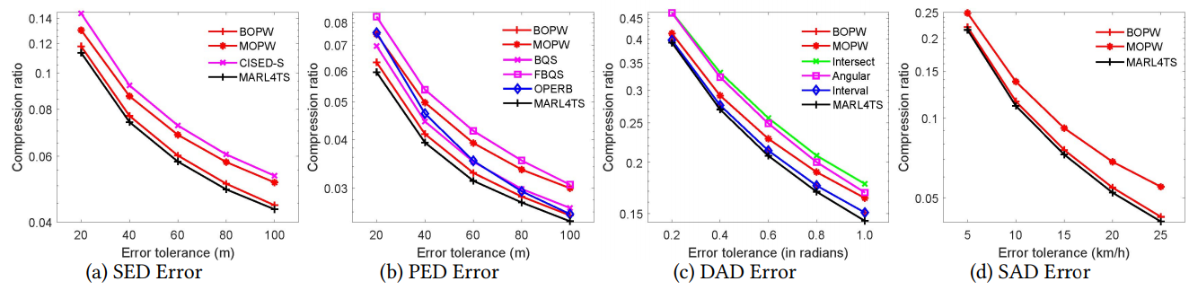
Effectiveness Results
MARL4TS achieves the best effectiveness.

Slide 18
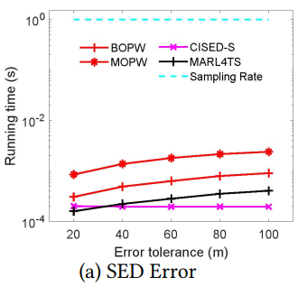
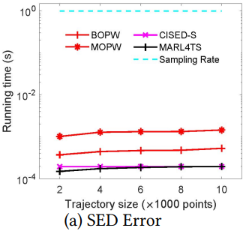
Efficiency Results
MARL4TS is fast enough to meet the practical needs (i.e., 1s sampling rate )

Slide 19
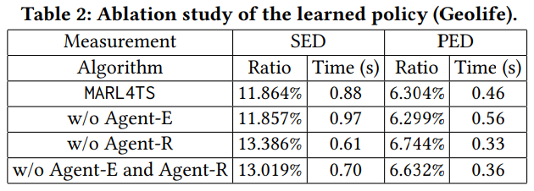
Ablation study of the learned policy
As expected, Agent-E improves the efficiency and Agent-R improves the effectiveness

Slide 20
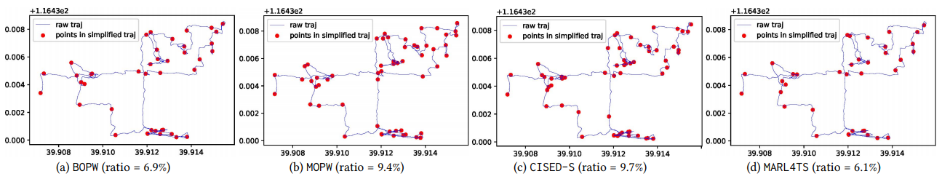
Case Study
MARL4TS returns better results under SED error (i.e., ratio=6.1%)

Slide 21
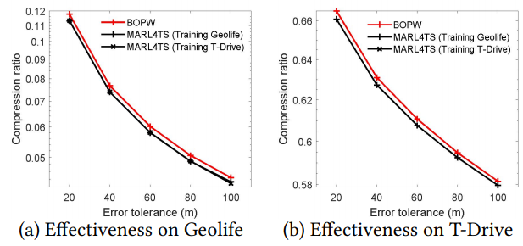
Transferability Test
MARL4TS has a good transferability

Slide 22
Conclusion
Problem:
Error-Bounded Online Trajectory Simplification (EB-OTS) problem
Algorithm:
the first Multi-Agent Reinforcement Learning method (MARL4TS)
Experiment:
the effectiveness and efficiency (across error measurements, datasets, and settings)

Slide 23

Q & A
THANKS FOR WATCHING

