Slide 1


Trajectory Simplification with Reinforcement Learning
Zheng Wang, Cheng Long, Gao Cong
Nanyang Technological University

Slide 2
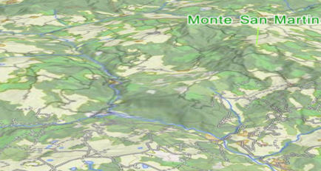

Trajectory Simplification: Introduction
p₃
p₁₀
Trajectory
p₈
p₇
p₉
p₄
p₁
p₂
p₅
p₆
A segment

Slide 3
Trajectory Simplification: Introduction
p₃
p₁₀
10 sampled positions
Trajectory
p₈
p₇
p₉
p₄
p₁
p₂
p₅
p₆
9 segments

Slide 4
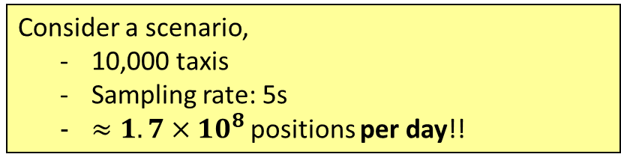
Trajectory Simplification: Motivation
Raw trajectory data is usually very large
Consider a scenario,
10,000 taxis
Sampling rate: 5s
$≈1.7×{10}^{8}$ positions per day!!
Trajectory Simplification
Drop some positions
Issue 1: Storing all sampled positions incurs a very high space cost
As a result, only a portion of the positions is kept
Issue 2: Query processing big trajectory data incurs high time cost

Slide 5
Trajectory Simplification: Motivation
Trajectory Simplification:
Drop some positions
p₃
p₁₀
p₈
p₇
Suppose p₂, p₄, p₅, p₇, p₈, p₉ are dropped
p₉
p₄
p₁
p₂
p₅
p₆

Slide 6
Trajectory Simplification: Motivation
Trajectory Simplification:
Drop some positions
p₃
p₁₀
p₁
p₆
Simplified trajectory

Slide 7
Trajectory Simplification: Motivation
Trajectory Simplification:
Drop some positions
p₃
p₁₀
p₈
p₇
Suppose p₂, p₃, p₅, p₆, p₇, p₉ are dropped
p₉
p₄
p₁
p₂
p₅
p₆

Slide 8
Trajectory Simplification: Motivation
Trajectory Simplification:
Drop some positions
p₁₀
p₈
p₄
p₁
Another Simplified trajectory

Slide 9
Trajectory Simplification: Problems
Trajectory Simplification:
Drop some positions
Which positions should be dropped?
Depending on which positions to be dropped, it returns different simplified trajectories

Slide 10
Trajectory Simplification: Error measurements
Synchronized distance preserving trajectory simplification (SED)
p₃
p₁₀
p₈
p₇
p₉
p₄
p₁
p₂
p₅
p₆
Original trajectory: T
Simplified trajectory: T’

Slide 11
Trajectory Simplification: Error measurements
Synchronized distance preserving trajectory simplification (SED)
Error of T’ = the maximum distance
p₃
p₁₀
p₈
P’₉
distance
The worst (maximal) distance of the synchronized positions
P’₂
P’₄
p₇
P’₅
P’₈
p₉
p₄
P’₇
p₁
p₂
p₅
p₆
Synchronized positions on T’ (i.e., assuming the movement is with a constant speed on the segment)
Perpendicular distance preserving trajectory simplification (PED)
Direction preserving trajectory simplification (DAD)
Speed preserving trajectory simplification (SAD)

Slide 12
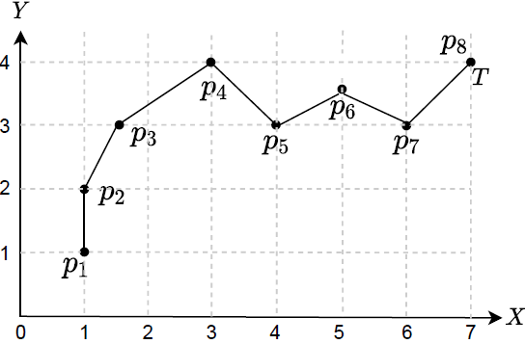

Trajectory Simplification: Problem
Problem (Min-Error):
Objective: errors (e.g., SED, PED, DAD or SAD) as small as possible
Constraint: the storage budget (|T’|) at most a given W
Input: T = <P1, P2, P3, P4, P5, P6, P7, P8>
Objective: the PED error as small as possible
Constraint: the storage budget 4
Output: T’=<P1, P4, P5, P8> with the PED error 0.693
Online Mode: a trajectory is fed point by point in an online fashion, the dropped points will no longer be accessible
Batch Mode: all the points in a trajectory are fed together, and remain accessible during the simplification process

Slide 13
Trajectory Simplification: Solutions
Existing solutions:
Defining a heuristic value on each point
Greedily drop points based on the heuristic values, and update the heuristic values of the remaining points, in which the existing algorithms differ from one another
Human-crafted rules, cannot optimize the trajectory simplification objective explicitly
Data-driven (Reinforcement Learning) solutions for trajectory simplification, and the objective is perfectly captured by the proposed RL methods
General framework using any error measurement for the online/batch mode

Slide 14
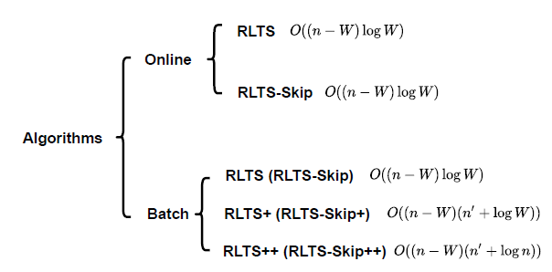
Algorithms
Background: RL is to guide agents on how to take actions to maximize a cumulative reward in an environment, and the environment is generally modelled as a Markov decision process (MDP)
Difference: increased data access

Slide 15
RL-based Trajectory Simplification with Skipping (RLTS-Skip)
Simplification as an MDP:
State: S = K lowest error values in the buffer
Action: Drop one of Top-K points in the buffer (the space is K) or Skip some points outside the buffer (the space is J), K+J in total
Transition: from S to S’
Reward: error of T’ – error of T’’
sequential process with a buffer
Policy
Network
Calculate PED error on each point
Point
State
Action
Buffer
Reward
Accum Reward
P5
{v(p2) = 0.243, v(p3) = 0.354, v(p4) = 1.0}
Drop P3
< P1, P2, P4, P5 >
-0.354
-0.354
P6
{v(p2) = 0.693, v(p5) = 0.728, v(p4) =1.265}
Skip p6 and p7
< P1, P2, P4, P5 >
-0.278
-0.632
P7
-
-
-
-
-
Efforts for constructing states and taking actions are saved by the ‘Skip’
P8
{v(p2) = 0.693, v(p5) = 1.0, v(p4) = 1.265}
Drop p2
< P1, P4, P5, P8 >
-0.061
-0.693
Output: T’=<P1, P4, P5, P8> with PED error 0.693

Slide 16
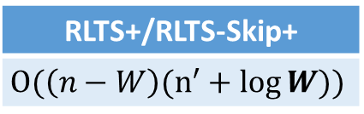
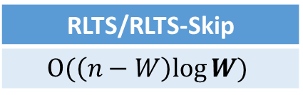
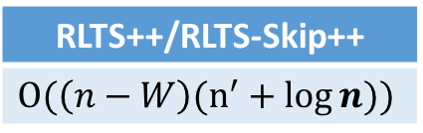
RL-based Algorithms for Batch Mode
Defining the states with the increased data access in batch mode
RLTS/RLTS-Skip
$$O(\left(n−W\right)log{W)}$$
RLTS+/RLTS-Skip+
$$O(\left(n−W\right)(n^{′}+log{W))}$$
RLTS++/RLTS-Skip++
$$O(\left(n−W\right)(n^{′}+log{n)})$$

Slide 17
Experimental Setup
Datasets
Geolife (Ave. 1412 pts per traj)
T-drive (Ave. 1713 pts per traj)
Truck (Ave. 995 pts per traj)
Experiments | Performance metrics
Effectiveness | Simplification error
Efficiency | Running time
Compared Methods
Online mode | STTrace [1], SQUISH [2], SQUISH-E [3]
Batch mode | Bellman [4], Top-Down [5], Bottom-Up [6], Span-Search [7]
[1] Sampling trajectory streams with spatiotemporal criteria, SSDBM’06
[2] Squish: an online approach for gps trajectory compression, COM-GEO’11
[3] Compression of trajectory data: a comprehensive evaluation and new approach, GeoInformatica’14.
[4] On the approximation of curves by line segments using dynamic programming, CACM’61
[5] Speeding up the Douglas-Peucker line-simplification algorithm, UBC Tech Report’92
[6] An online algorithm for segmenting time series, ICDM’01
[7] Trajectory simplification: on minimizing the direction-based error, PVLDB’14

Slide 18
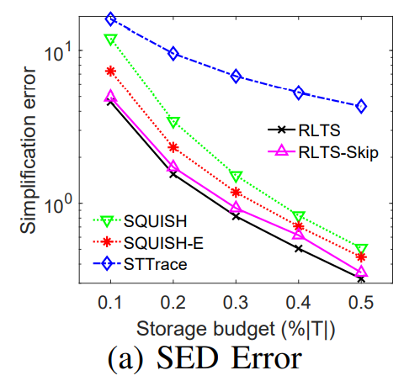
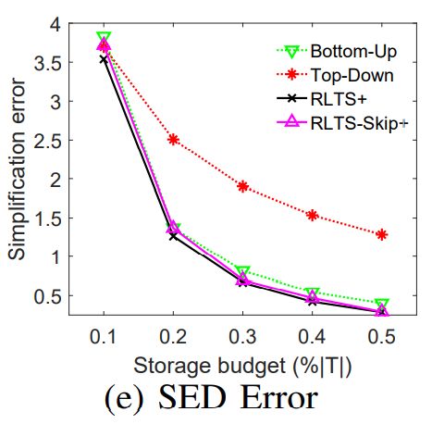
Effectiveness Results
RLTS (RLTS+) achieves the best effectiveness.

Slide 19
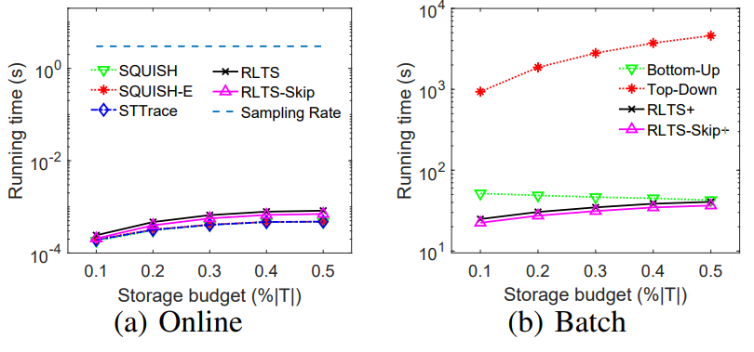
Efficiency Results
RLTS-Skip+ achieves the best efficiency on batch mode.
For online mode, RLTS and RLTS-Skip are fast enough to meet the practical needs.

Slide 20
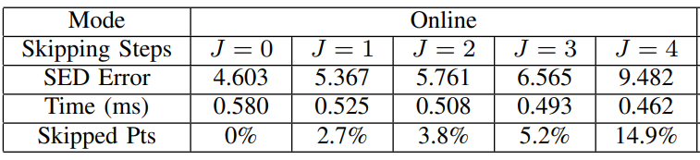
Parameter Study – Skipping Steps J for RLTS-Skip
The trade-off between effectiveness and efficiency

Slide 21
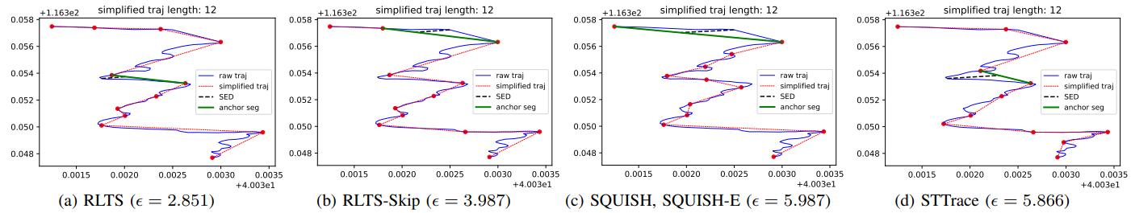
Case Study
RL-based methods return better results than baselines.

Slide 22
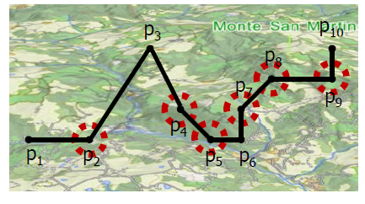
Conclusion
+
+
Min-Error
Algorithms
Experiments
Experiments | Performance metrics
Effectiveness | Simplification error
Efficiency | Running time

Slide 23

Q & A
THANKS FOR WATCHING

