Slide 1

Efficient and Effective Similar Subtrajectory Search with Deep Reinforcement Learning
Zheng Wang, Cheng Long, Gao Cong, Yiding Liu
Nanyang Technological University

Slide 2




Trajectory Data
Player trajectory
Vehicle
trajectory
Pedestrian
trajectory
Animal
trajectory
…

Slide 3
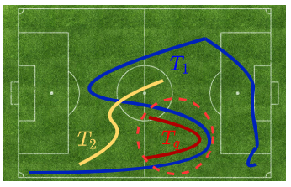
Similar Trajectory Search
T₁ and T₂ are dissimilar to T_{q}
T₁ has a portion that is similar to T_{q}

Slide 4
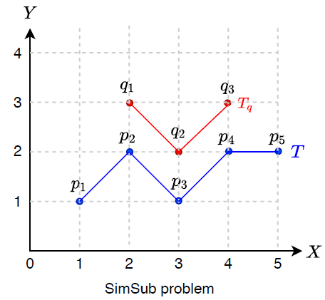
SimSub Problem
SimSub problem:
return a portion of a data trajectory (i.e., a subtrajectory), which is the most similar to a query trajectory
Tq is a query trajectory and T is a data trajectory:
Return T[2:4] = <p2, p3, p4>
General framework using any similarity measurement

Slide 5
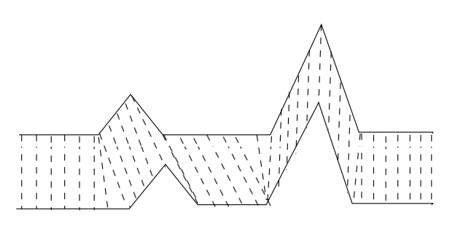
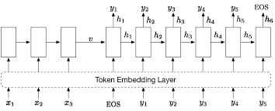
Trajectory Similarity Measurement
DTW and Frechet:
Pairwise matching
Quadratic time complexity
t2vec:
Data-driven (representation learning)
Linear time complexity

Slide 6
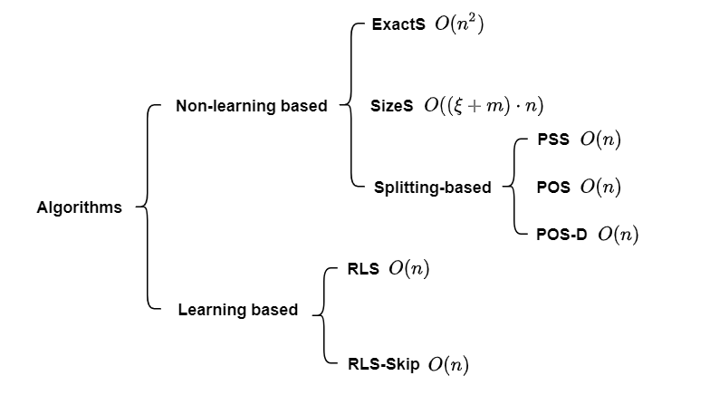
Algorithms
Linear time (t2vec)

Slide 7
Prefix-Suffix Search (PSS)
max(sim_prefix, sim_suffix) > sim_best
Split at current point P_i, it updates the splitting index to i+1
Point
Prefix
Suffix
Split
Splitting
index
BEST
P1
T[1,1]
T[1,5]
Yes
2
T[1,5]
P2
T[2,2]
T[2,5]
Yes
3
T[2,2]
P3
T[3,3]
T[3,5]
No
3
T[2,2]
P4
T[3,4]
T[4,5]
No
3
T[2,2]
P5
T[3,5]
T[5,5]
No
3
T[2,2]
Output: BEST=T[2,2]
max(sim_prefix, sim_suffix) <= sim_best

Slide 8
Algorithms
Linear time (t2vec)

Slide 9
Reinforcement Learning based Search with Skipping (RLS-Skip)
Splitting as an MDP:
State: S = (sim_best, sim_prefix, sim_suffix)
Action: Split, No-split, Skip
Transition: from S to S’
Reward: S’.sim_best - S.sim_best
Split at current point P_i, it updates the splitting index to i+1
Skip next point
Point
State
(best, prefix, suffix)
Action
Splitting
index
BEST
P1
(Ø,T[1,1],T[1,5])
Split
2
T[1,5]
Deep-Q-Network
P2
(T[1,5],T[2,2],T[2,5])
Skip
2
T[2,2]
P3
-
-
-
-
P4
(T[2,2],T[2,4],T[4,5])
Split
5
T[2,4]
P5
(T[2,2],T[5,5],T[5,5])
No-split
5
T[2,4]
Output: BEST=T[2,4]

Slide 10
Experimental Setup
Datasets
Porto (1.7M)
Harbin (1.2M)
Sports (0.2M)
Compared Methods
Proposed algorithms
UCR [1]
Spring [2]
Random-S
Experiments | Performance metrics
Effectiveness | Approximate ratio
 | Mean rank
 | Relative rank
Efficiency | Running time
[1] T. Rakthanmanon, B. Campana, A. Mueen, G. Batista, B. Westover, Q. Zhu, J. Zakaria, and E. Keogh.
Searching and mining trillions of time series subsequences under dynamic time warping. SIGKDD 2012.
[2] Y. Sakurai, C. Faloutsos, and M. Yamamuro. Stream monitoring under the time warping distance. ICDE 2007.

Slide 11
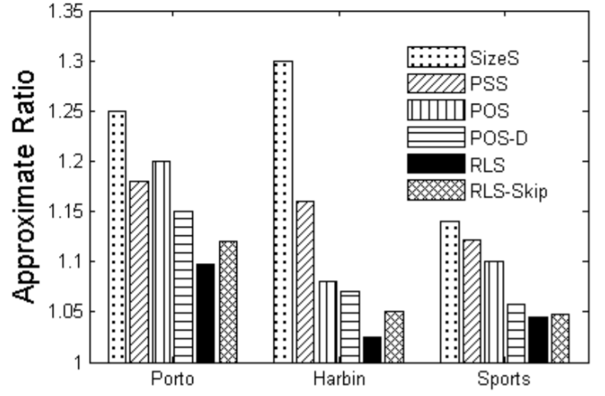
Effectiveness Results
RLS achieves the best effectiveness

Slide 12
Efficiency Results
RLS-Skip achieves the best efficiency

Slide 13
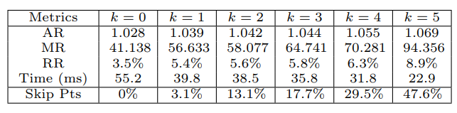
Parameter Study – Skipping Steps k for RLS-Skip

Slide 14
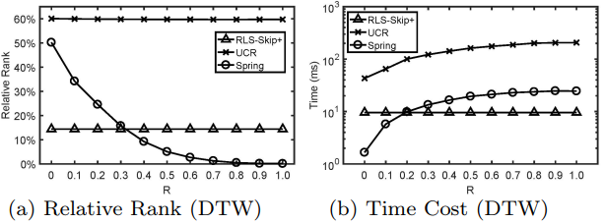
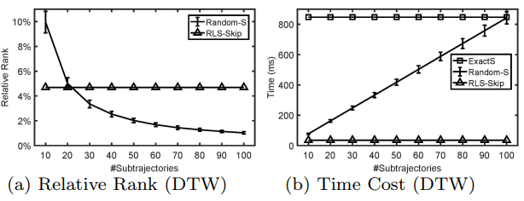
Comparison with UCR, Spring and Random-S
UCR and Spring
Random-S

Slide 15
Conclusion
+
+
Problem
Algorithms
Experiments
Experiments | Performance metrics
Effectiveness | Approximate ratio
 | Mean rank
 | Relative rank
Efficiency | Running time

Slide 16

Q & A
THANKS FOR WATCHING

