Slide 1

On Inferring User Socioeconomic Status with Mobility Records
Zheng Wang*, Mingrui Liu*, Cheng Long*, Qianru Zhang^, Jiangneng Li*, Chunyan Miao*
*Nanyang Technological University, ^The University of Hong Kong
IEEE International Conference on Big Data (IEEE BigData 2022)
Notes:
Hello everyone, I am wang zheng from Nanyang Technological University. I present our paper titled “On Inferring User Socioeconomic Status with Mobility Records”

Slide 2
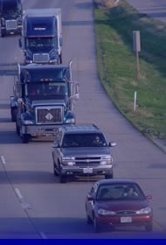

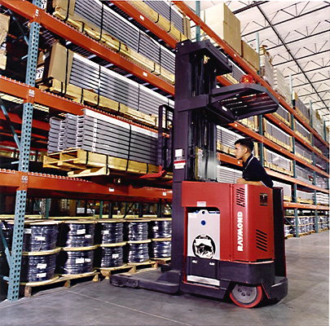
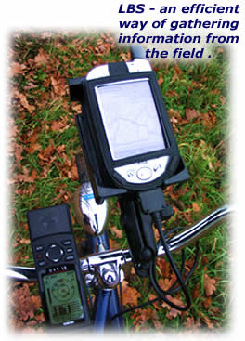
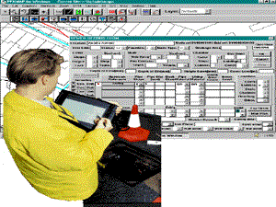
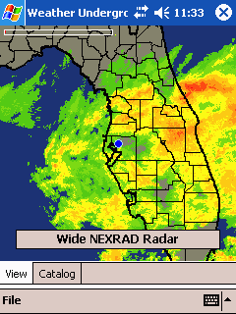


Location-Based Services
Can we acquire knowledge from human
mobility behaviors?
Traffic info
Logistics
Mobile Commerce
Navigation
Local weather
Geographical Information
System (GIS)
Tracking
Emergency service
Notes:
With the rapid development of GPS devices and mobile technologies, recent years we have witnessed an unprecedented growth in mobility data, and it supports many important applications in the computing era.
This big amount of data has attracted many research efforts, an immediate question is can we acquire knowledge of human mobility behaviors?

Slide 3
Problem definition
Problem:
Inferring users’ socioeconomic statuses (SES) from their mobility records
Consideration 1:
Inferring users’ SES are closely linked to where they live or work
Consideration 2:
Users’ SES can sometimes be inferred by the places they visit
The Indicator of SES:
House price data
Clarification: as a proxy, and no privacy concern
Notes:
Motivated by this, in this paper, we study a novel problem of inferring users’ socioeconomic statuses (namely SES) from their mobility records.
We study the problem by two considerations. The first is users’ SES are closely linked to where they live or work, both of which could be potentially reflected by their mobility records.
The second is users’ SES can sometimes be disclosed by the places they visit, especially those they visit during weekends, and the patterns of their visits at these places, which again could be tracked by their mobility records.
We note that a user’s SES can refer to many different indicators, such as the price range of the user’s living house, the likelihood that the user will pay a car loan on time, or the user’s income, and so on.
Here, we choose house price data from the web as the proxy of a user’s SES based on the home location detection. The data is publicly available, and therefore no privacy will be broken in this study.

Slide 4
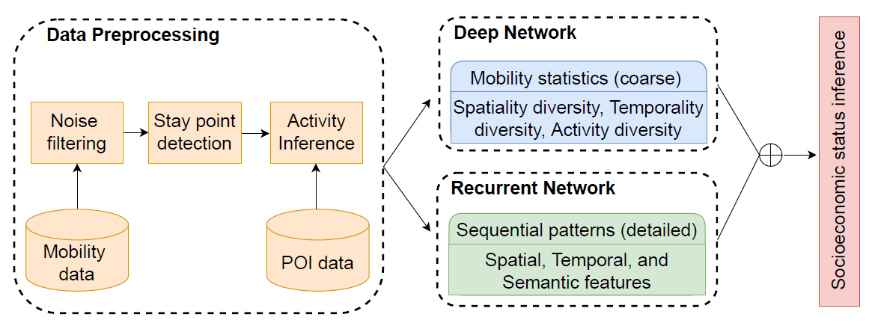
Framework
(1) Pre-train DN
(3) Joint train
(2) Pre-train RN
Notes:
The proposed framework in this paper is called DeepSEI. DeepSEI model consists of three components, including data preprocessing, deep network and recurrent network.
To train the framework, we first pre-train the deep and recurrent networks separately and then jointly train them together.
During the pre-training, it provides a warm-start for the two networks and boosts the convergence in the joint training.
During the joint training, we concatenate the outputs by the two networks as a long vector, which is further fed into a fully connected layer with the softmax function with the cross entropy loss.
I will introduce more details of those components one by one.

Slide 5
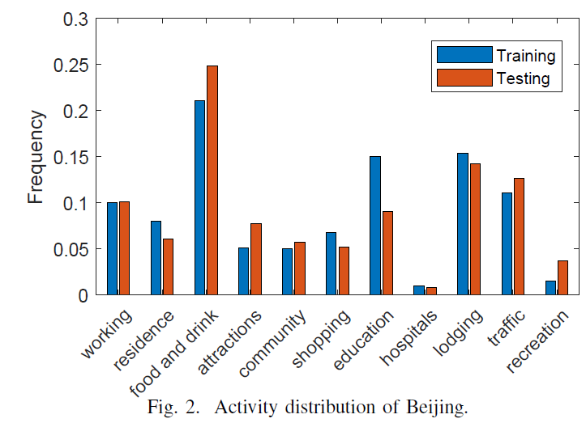
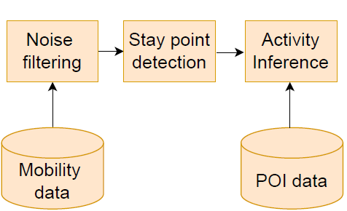
Data preprocessing
(2) Speed threshold
(3) Distance and duration
(5) Nearest Neighbor
(1) GPS trajs
(4) Baidu Map
Notes:
For preprocessing, based on some mobility records data (such as GPS trajs), the component is to filter the noises (with something like speed threshold method) to extract the stay points from the mobility records, here we denote some points are stay points if they satisfy some distance and duration constraints,
and then we infer the activities behind the extracted stay points by some ideas like nearest neighbor. Here, to infer the activities, it also requires the POI data with the semantics from Baidu Map. In this figure, we provide the statistics illustrated the inferred activity distribution for Beijing in terms of training and testing.

Slide 6
Framework

Slide 7
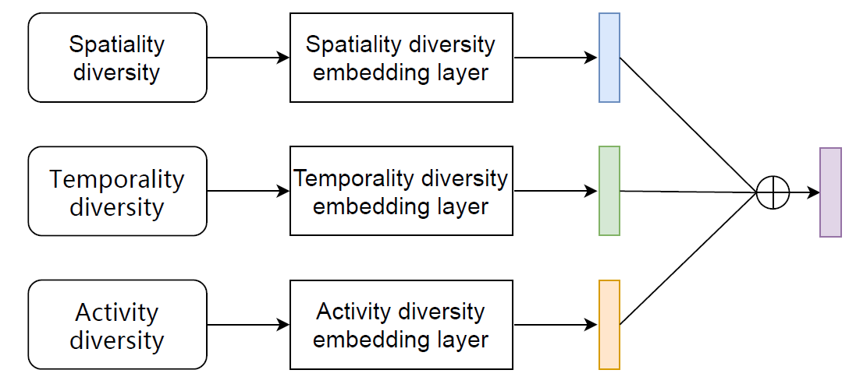
Deep Network
Notes:
For the deep network, it aims to capture some indicators based on users’ mobility records (i.e., at a coarse level). These indicators capture the spatiality, temporality and activity aspects of users’ mobility patterns. We embed them via a deep network and
concatenate the embeddings for our task.

Slide 8
Framework

Slide 9
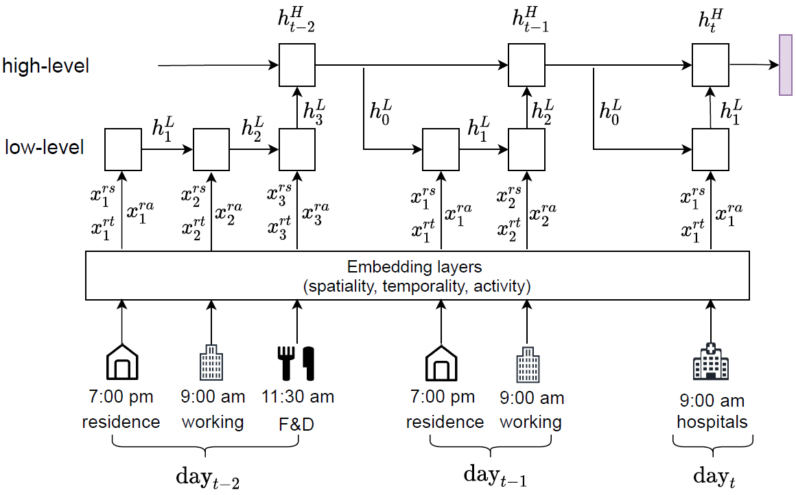
Recurrent Network
Notes:
For the recurrent network, it aims to capture sequential patterns of users’ activities, each of which involves spatial, temporal and semantic features. We first embed these features of each
activity and then feed the embeddings to a hierarchical LSTM network, where the hierarchical LSTM is more capable of capturing the sequential and periodic information from users’ trajectory data.
Therefore, the two networks can cooperate to capture rich information from users’ mobility records data.

Slide 10
Experimental setup
Datasets
Mobility data (Geolife)
POI data (Baidu Map API)
House price (Lianjia)
Tasks | Performance metrics
Classification | F1-socre Accuracy
Clustering | ARI and AMI
Notes:
We conduct the experiments based on three types of data, mobility data records the trajectories on Geolife, POI data provides the semantic by Baidu Map API, and house price data from Lianjia denotes a proxy of users’ economic status.
We consider two tasks to verify the effectiveness of our framework: classification and clustering. For classification, we evaluate it in terms of F1-score and accuracy. For clustering, we evaluate it in terms of ARI and AMI.

Slide 11
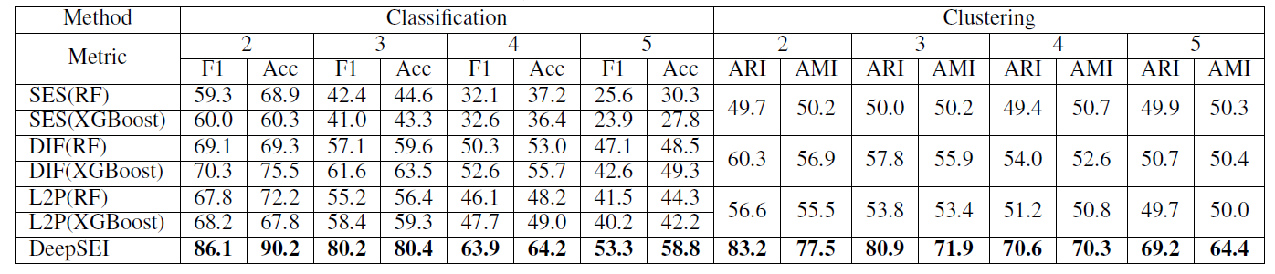
Effectiveness
Notes:
For the effectiveness, we notice our DeepSEI model consistently outperforms the baselines, e.g., in binary classification and clustering, it outperforms the best baseline by around 22% and 40%, respectively.

Slide 12
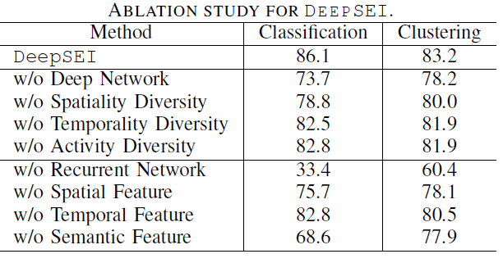
Ablation study
Notes:
We also conduct an ablation study, Overall, we can see all these networks and features contribute to the final result.

Slide 13
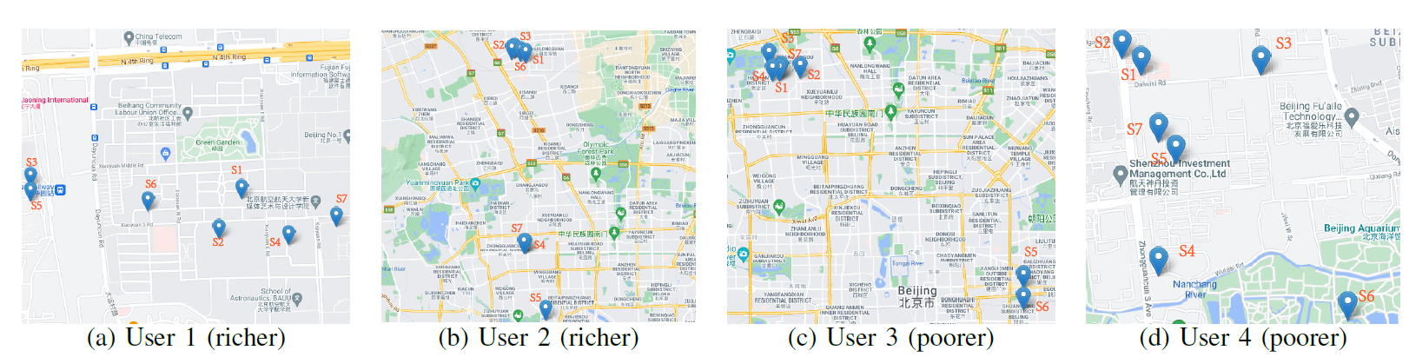
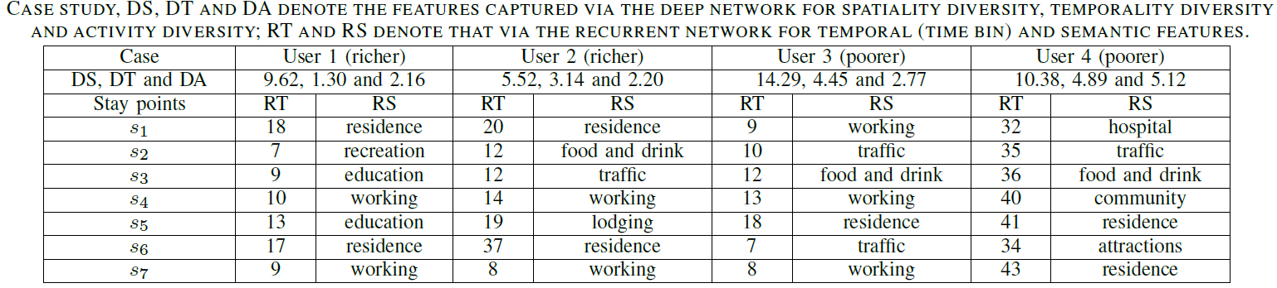
Case study
(2) Rich with lower activity
(1) Rich travel shorter
(3) Rich with steady job
Notes:
We also conduct a case study to illustrate some insights from the dataset.
Insight 1: rich users (like user 1 and user 2 in the figures) tend to travel shorter, e.g., the user 2 has smaller spatial diversities (5.52) than other users.
Insight 2: rich users are generally with daily activities, e.g., user 1 mainly commutes between the home and office in the figure.
Insight 3: rich users are with steady jobs, e.g., based on the RT features of user 1, we notice that user is with a steady job because he/she works and stay homes regularly.

Slide 14
Contributions
A novel problem
Inferring SES by GPS trajectories
A novel framework
DeepSEI (DN & RN) spatiality, temporality, and activity
Experiments
Effectiveness (prediction accuracy)
Notes:
I conclude the contributions in this paper. (1) we study a novel problem of inferring user socioeconomic status by their GPS trajectories. (2) we propose a novel socioeconomic-aware deep model called
DeepSEI for the task. DeepSEI incorporates two neural networks, i.e., deep network and recurrent network, and extract features from three aspects of users’ mobility records, namely spatiality, temporality and activity.
We conduct the experiments on Geolife dataset, POI dataset and house price dataset, and the results show that the DeepSEI model achieves a noticeable improvement.

Slide 15

Q & A
Thank You!
Notes:
That is all. Thank you!

