Slide 1


On Predicting and Generating a Good Break Shot in Billiards
Qianru Zhang^, Zheng Wang*, Cheng Long*, Siuming Yiu^
^The University of Hong Kong
*Nanyang Technological University

Slide 2
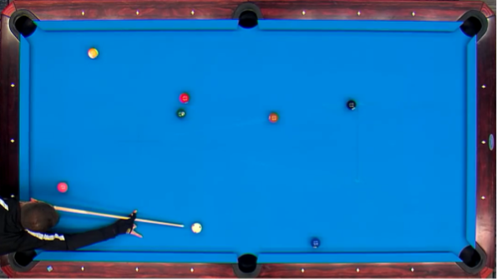
Ball 1-9: Cue ball (white), ball 1 (yellow), ball 2(blue), ball 3 (red), ball 4 (purple), ball 5 (pink), ball 6 (green), ball 7(brown) ball 8 (black), ball 9 (yellow-strip).
Background:
Rule of 9-ball:
Hit the smallest
Win if the ball 9 potted

Slide 3
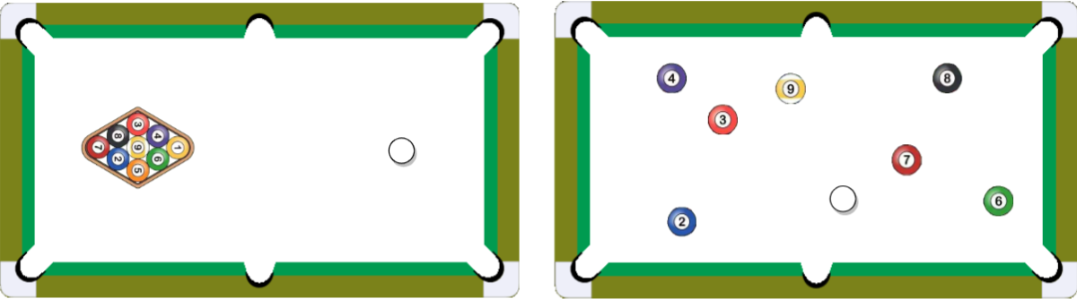
Background:
Break shot
Ball 1 and ball 5 are potted into pockets.

Slide 4


Challenges:
How to capture the positions of balls?
How to capture the orders of potted balls?
Lacking the billiards layouts?

Slide 5
Contribution:
Dataset:
Break shots
Strike statistics
Trajectory data
Three tasks:
Prediction
Generation
Trajectory similarity search
Experiments:
High accuracy
Good generation quality

Slide 6
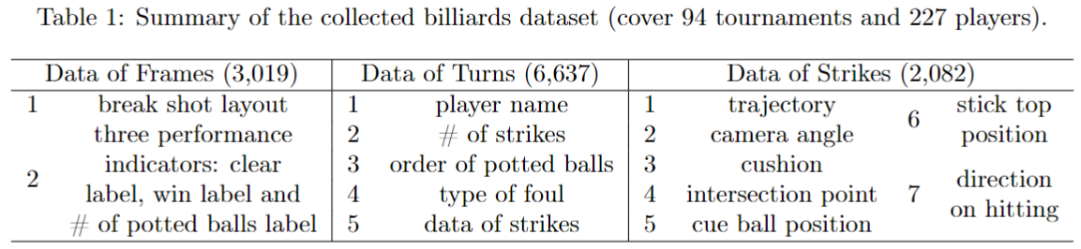
Contribution 1:
Prepare data

Slide 7
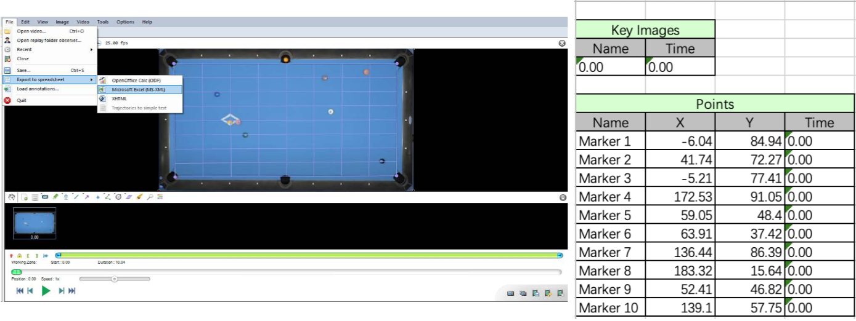
Contribution 1:
Prepare data
Kinovea: https://www.kinovea.org/download.html

Slide 8
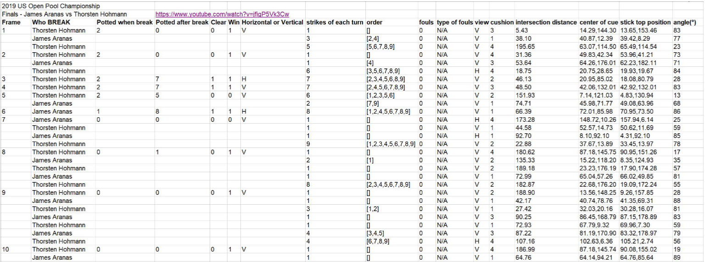
Contribution 1:
Prepare data
(1) clear or not; (2) win or not; (3) # of potted balls

Slide 9
Contribution 2:
Feature extraction
BS: position
BP: pocket-1(min(deg_left_cushion, deg_right_cushion), distance, 0/1 to denote whether the pocket can be potted or not, pocket_index), … , pocket-6
BB: (min_deg(cue, ball1, pocket_i), pocket_index)
Ordering: cue ball, ball1, …, ball9
27 features represent a ball, and 10 balls in total, one break shot is with 270 features

Slide 10
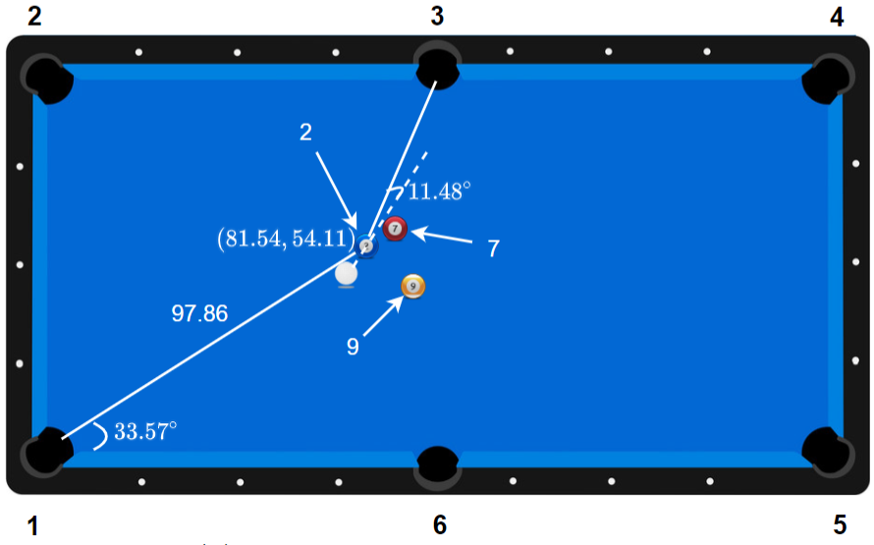
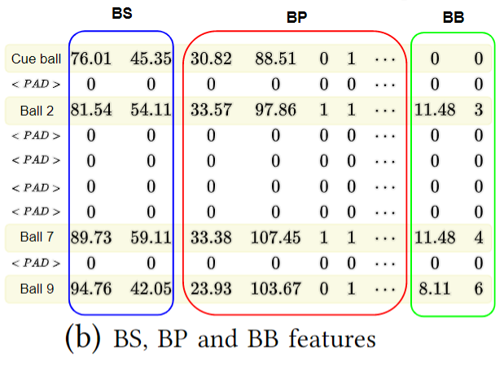
Feature extraction
Contribution 2:

Slide 11
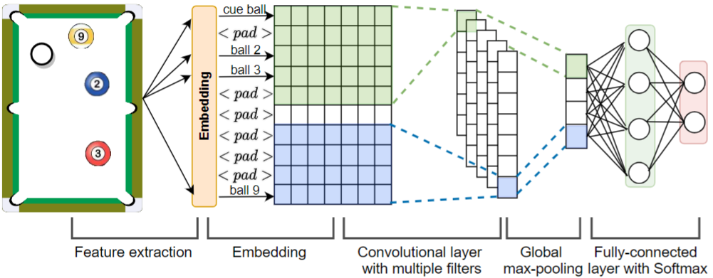
Contribution 2:
Prediction framework
Clear: 0, 1(clear)
Win: 0, 1(win)
Potted balls: 0, 1,2,3,4,5,6,7,8

Slide 12
Contribution 2:
GAN: cannot evaluate intermediate results for generates layouts
GAN: cannot generate discrete tokens
How to choose good clear break shots?
Generating good break shots, which helps coaches to provide good guidance for players.

Slide 13
Contribution 2:
What is GAN? (Generative Adversarial Network)
Generator:
Proposed for image generations
Provides good images that discriminators cannot discriminate
Generated images
Feedback
Discriminators:
Provide the evaluation for the generated images

Slide 14
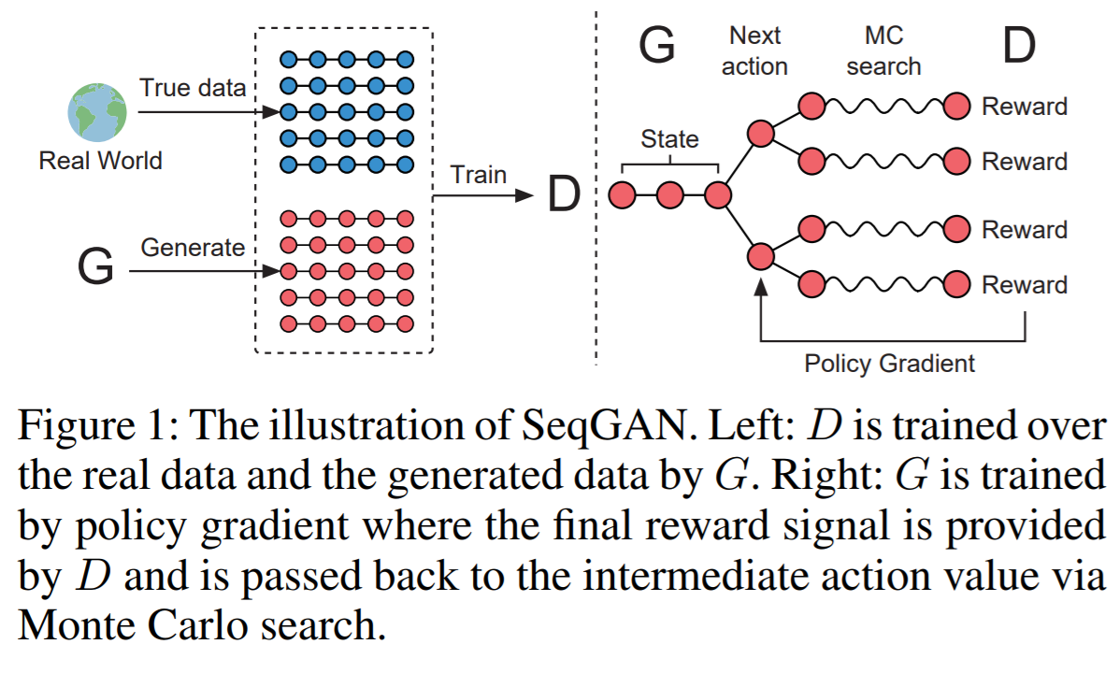
Literature: SeqGAN [1]
Contribution 2:
Ref 1
1. Yu L, Zhang W, Wang J, et al. Seqgan: Sequence generative adversarial nets with policy gradient, AAAI 2017

Slide 15
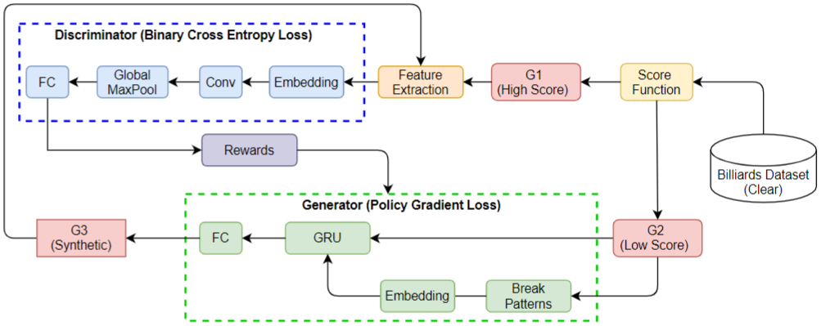
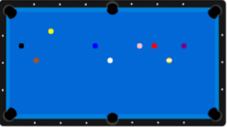
BLGAN
Contribution 2:
BLCNN
Defined as (6) since the
ball 6 is potted

Slide 16
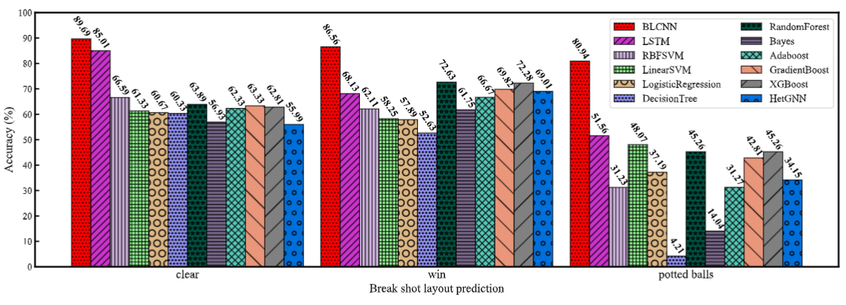
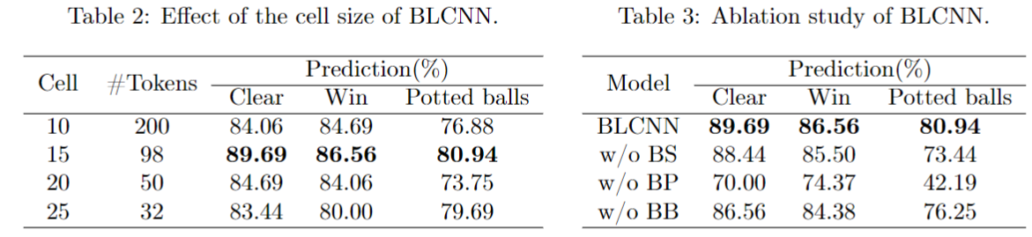
Contribution 3:

Slide 17
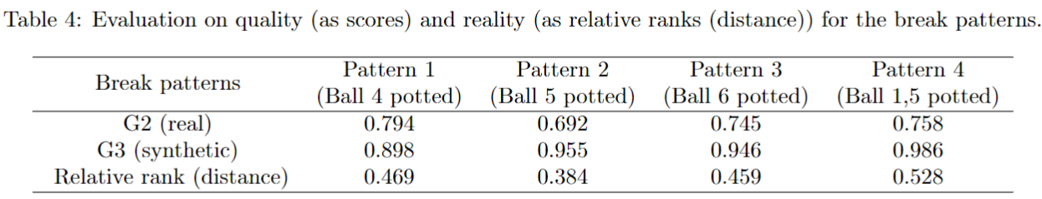
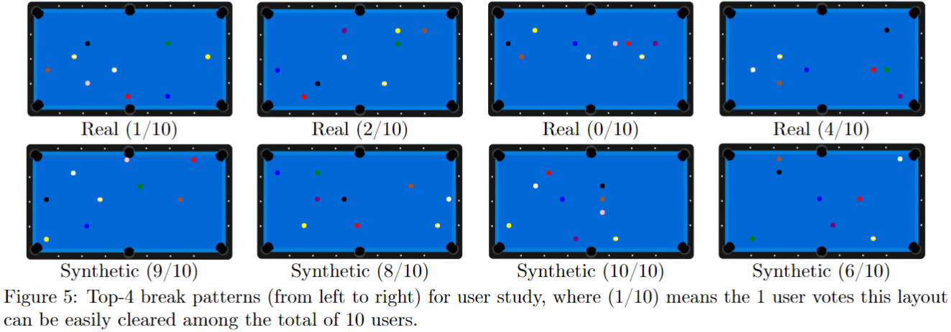
Contribution 3:

Slide 18
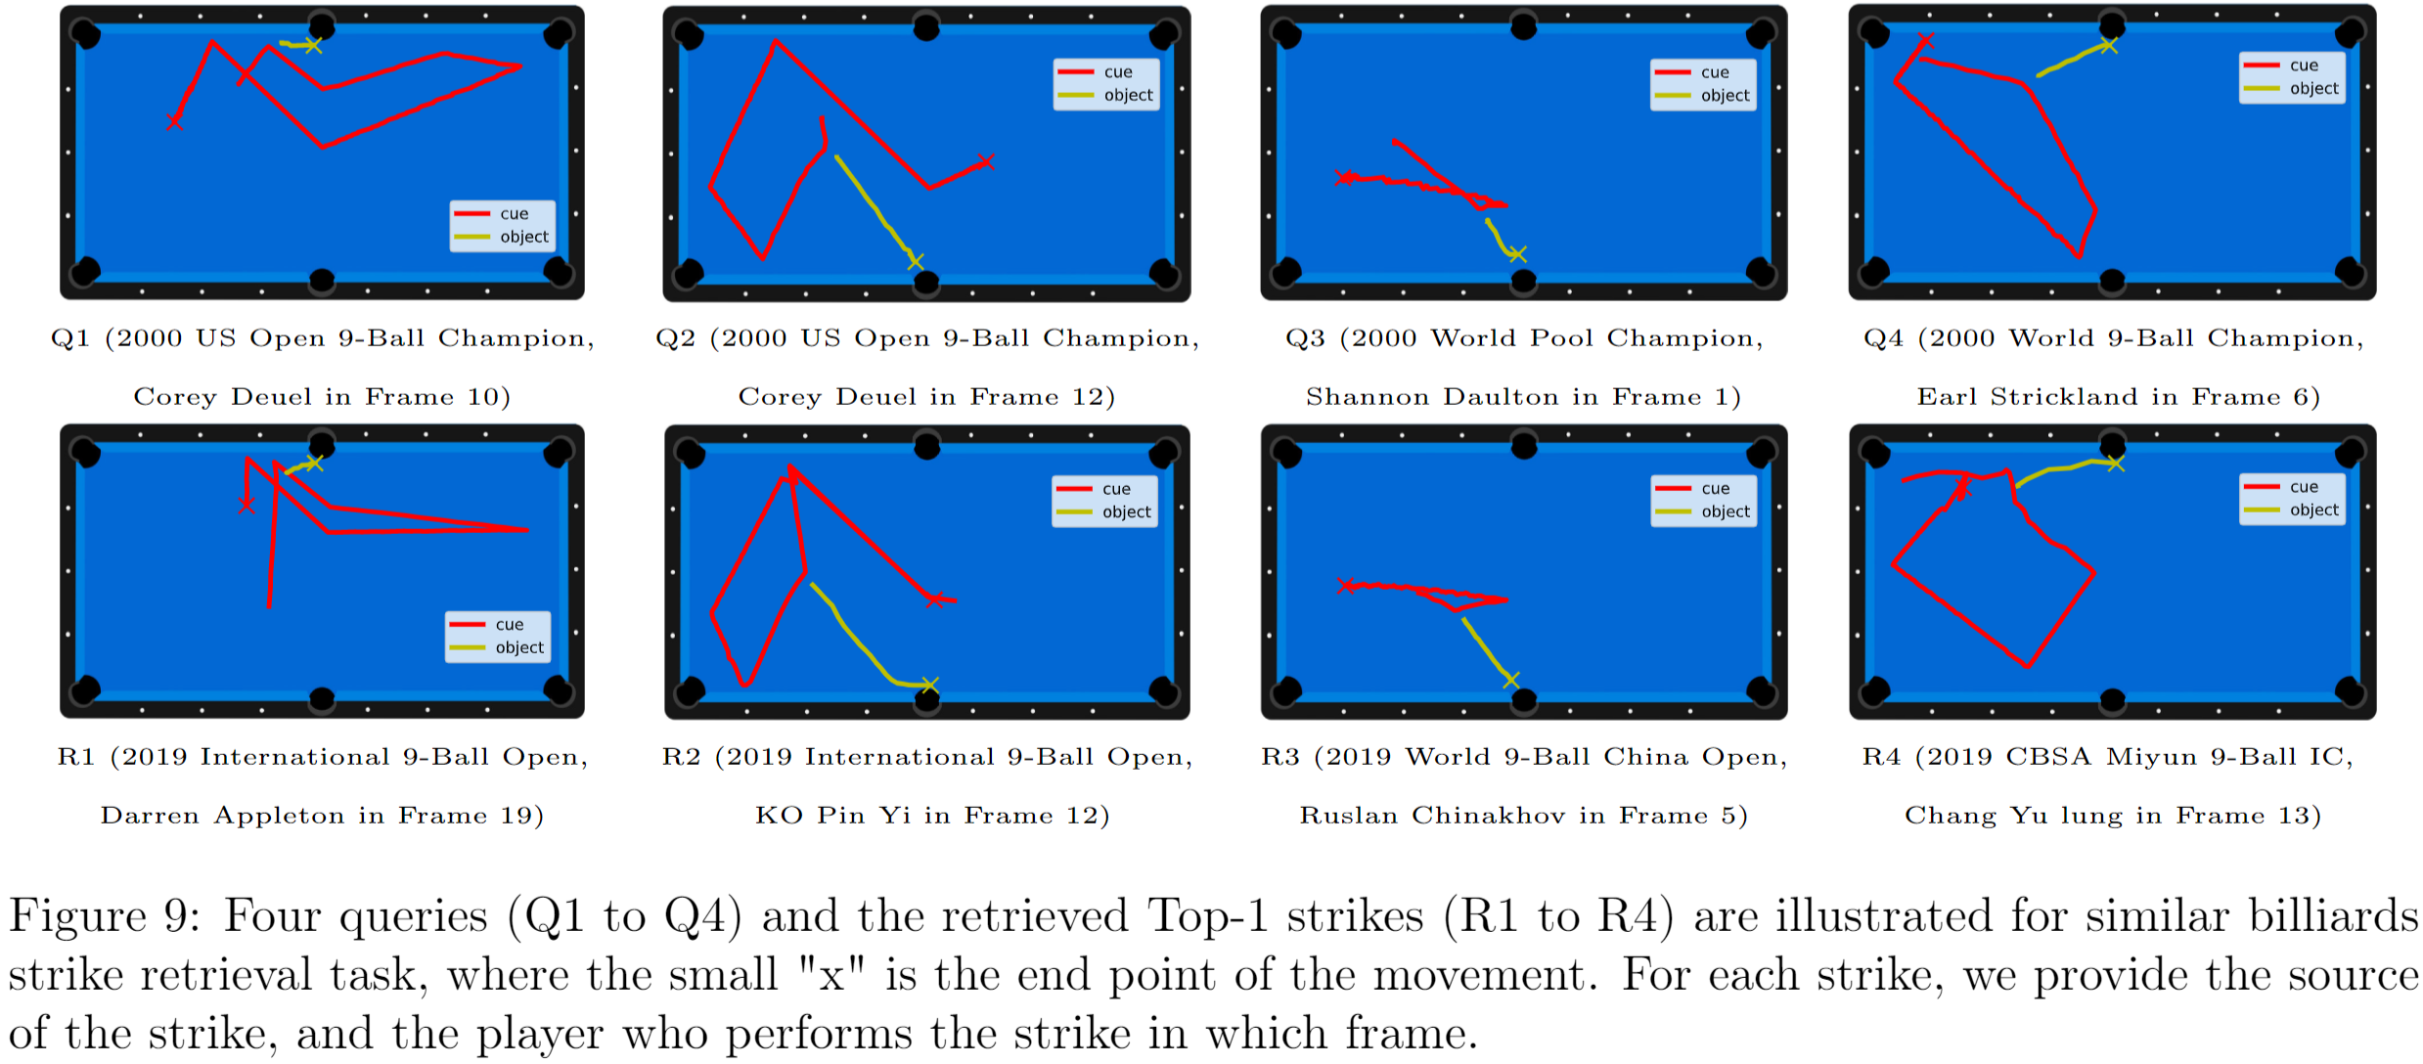
Trajectory similarity search

Slide 19

Q&A
THANKS FOR WATCHING

