Slide 1
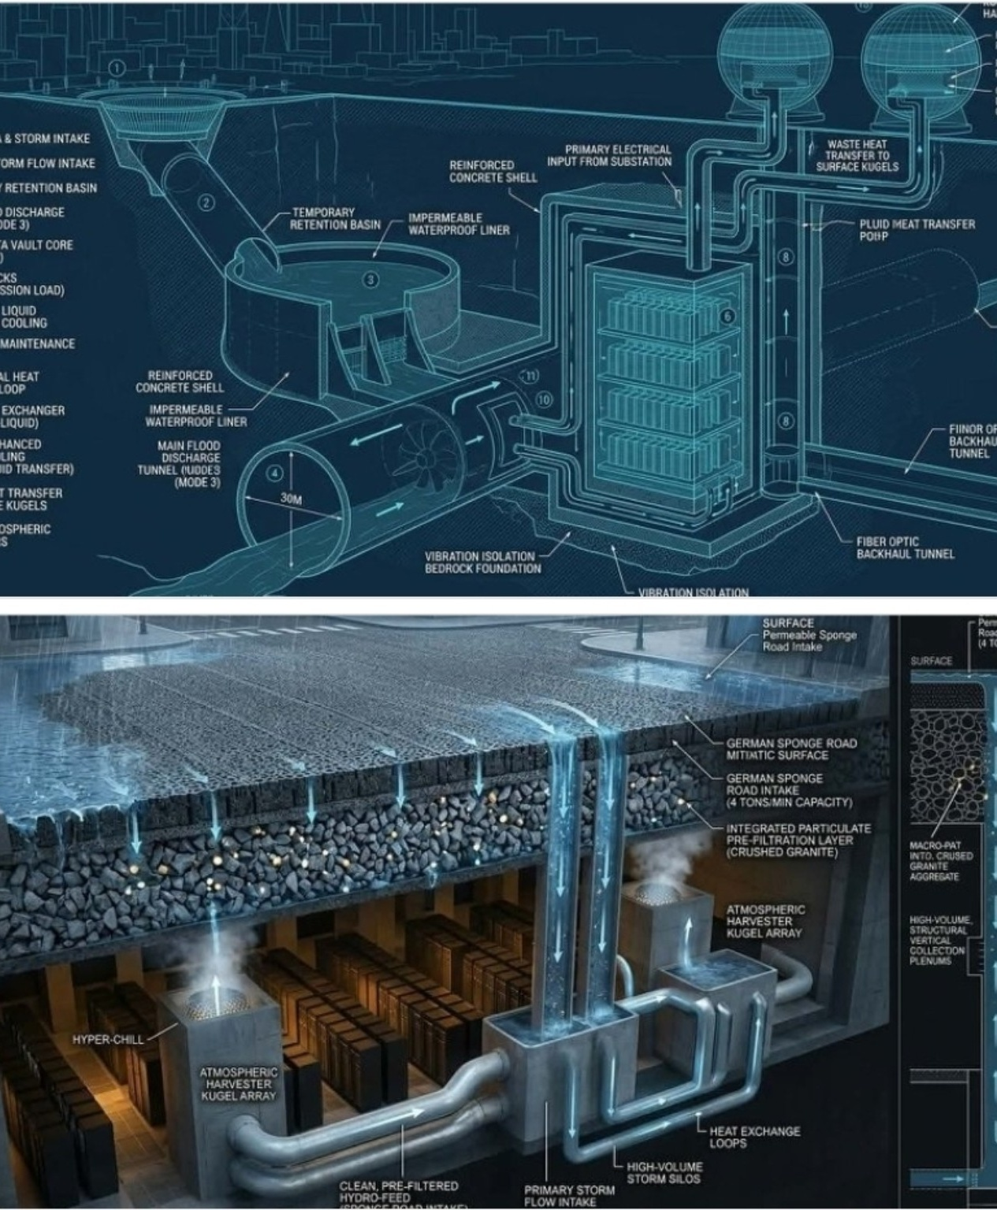
PROJECT KORIDOR
KWai
AI-Native Climate & Water Infrastructure
Turning stormwater, heat, cooling, underground space and data infrastructure into one adaptive urban system.
NVIDIA Inception Pitch Deck | Concept → Digital Twin → Pilot
ODYNEX AXIS LOGISTICS LLC
Project Koridor / Adaptive Futures
PROJECT KORIDOR KWai • ODYNEX AXIS LOGISTICS
01

Slide 2
THE THESIS
Infrastructure should behave like a living system.
KWai connects water, energy, thermal management, mobility corridors and AI into one feedback loop.
WATER
THERMAL
COMPUTE
CORRIDOR
Capture stormwater before it becomes a flood event. Temporarily store, filter, route and reuse water.
Move waste heat where it creates value: district thermal loops, surface systems and atmospheric harvesting.
Use AI simulation and digital twins to predict loads, optimize flows and test infrastructure before construction.
Make roads and underground corridors active infrastructure rather than passive surfaces.
Core proposition
A city can become its own adaptive infrastructure platform.
PROJECT KORIDOR KWai • ODYNEX AXIS LOGISTICS
02

Slide 3
THE PROBLEM
Today’s infrastructure is fragmented.
Flood control, data centers, roads, cooling, water management and emergency response are usually designed as separate systems.
EXTREME RAIN
HEAT LOAD
Stormwater arrives faster than conventional drainage can absorb or safely convey.
Dense computing creates concentrated thermal loads while cities face hotter conditions.
INFRASTRUCTURE COST
SLOW DECISIONS
Major upgrades are expensive when every system requires its own trench, plant and control layer.
Cities often lack a shared digital model for testing interventions before capital is committed.
KWai reframes the problem: not “How do we add another system?” → “How do we make existing infrastructure do more?”
PROJECT KORIDOR KWai • ODYNEX AXIS LOGISTICS
03

Slide 4
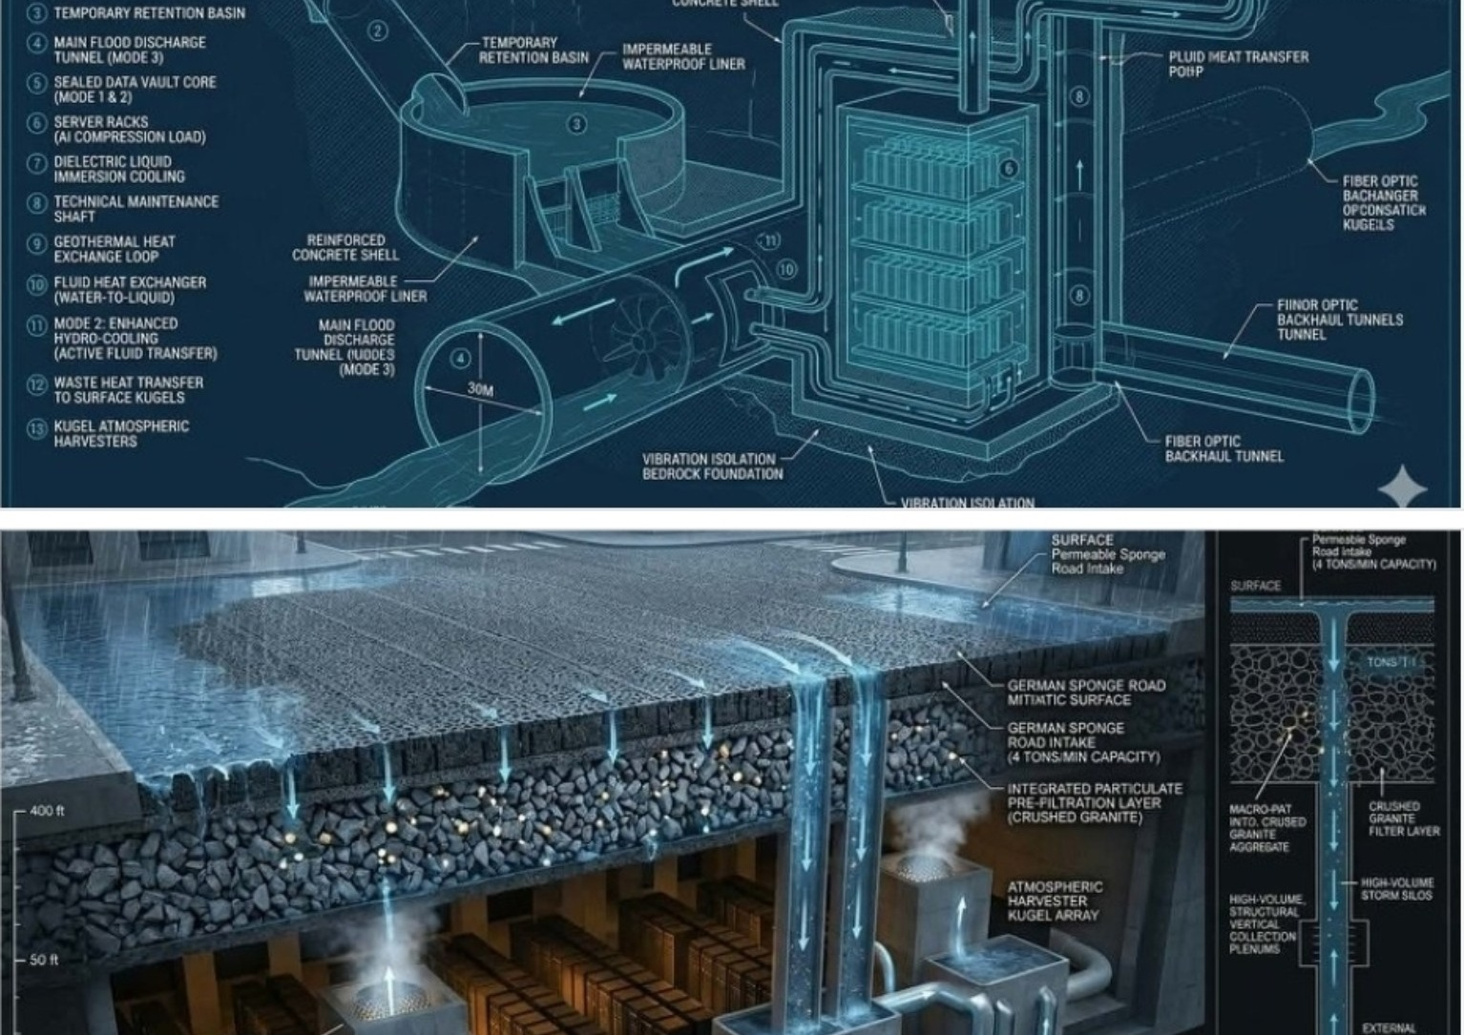
THE ARCHITECTURE
One corridor. Multiple functions. One intelligence layer.
The supplied concept image becomes the visual reference architecture for the KWai MVP.
01 SURFACE
02 STORAGE
Permeable / sponge-road layers route water downward.
Temporary retention and controlled discharge.
03 HEAT
04 COMPUTE
Exchange loops couple cooling and thermal reuse.
AI infrastructure provides the intelligence layer.
05 FIBER
06 DIGITAL TWIN
Backhaul enables telemetry and distributed control.
Simulate scenarios before physical deployment.
PROJECT KORIDOR KWai • ODYNEX AXIS LOGISTICS
04

Slide 5
KWAI INTELLIGENCE LAYER
From physical infrastructure to an AI control plane.
The long-term product is not only the hardware—it is the continuously learning model of the corridor.
CITY / SITE DATA
Rainfall • sensors • terrain • traffic • power • thermal loads • asset condition
DIGITAL TWIN
3D/physics model • scenario engine • risk map • capacity model
AI / OPTIMIZATION
Forecasting • anomaly detection • routing • load balancing • maintenance prioritization
CONTROL + REPORTING
Operator dashboard • alerts • emergency modes • capital-planning outputs
Design principle: AI recommends and predicts; engineered safety systems remain deterministic, auditable and fail-safe.
PROJECT KORIDOR KWai • ODYNEX AXIS LOGISTICS
05

Slide 6
WHY NVIDIA
KWai is a natural accelerated-computing and digital-twin use case.
NVIDIA’s current ecosystem supports the exact development path KWai needs: prototype → simulation → optimization → deployment.
ACCELERATED AI
DIGITAL TWINS
STARTUP SCALE
Use GPU-accelerated workflows for forecasting, computer vision, sensor fusion, optimization and anomaly detection.
Explore climate / infrastructure simulation, interactive visualization and physics-informed modeling.
Inception can provide developer tools, training, preferred pricing, cloud credits, ecosystem exposure and potential technical pathways.
NVIDIA alignment is a development hypothesis to validate—not a claim of endorsement or partnership.
PROJECT KORIDOR KWai • ODYNEX AXIS LOGISTICS
06
Notes:
Reference sources: NVIDIA Inception Program (official NVIDIA startup page); NVIDIA Innovation Lab; NVIDIA High-Performance Computing / Simulation and Modeling; NVIDIA Earth-2 climate digital twin materials. Accessed August 18, 2026.

Slide 7
THE MVP
Build the smallest corridor that proves the system.
Start with a bounded pilot, instrument it, build the digital twin, then scale by corridor.
A
B
C
D
Instrumented corridor
Digital twin
AI models
Decision dashboard
Rainfall, water level, flow, temperature, power and asset sensors.
A live model of terrain, drainage, thermal and infrastructure capacity.
Forecast stormwater demand, thermal loads and asset anomalies.
Operator view with safe operating modes and scenario testing.
MEASURE
COMPARE
LEARN
Peak flow • retention • thermal load • energy • uptime
Baseline corridor vs. KWai scenario
Use observed data to recalibrate the twin
PROJECT KORIDOR KWai • ODYNEX AXIS LOGISTICS
07

Slide 8
PILOT GEOGRAPHY
Albany, Georgia as a living laboratory.
A Southwest Georgia demonstration can connect climate resilience, workforce development, public infrastructure and applied AI.
WHY ALBANY
WHO BUILDS IT
WHAT SCALES
• Flood and stormwater resilience
• Underutilized corridors / parcels
• Regional logistics significance
• Access to technical education
• Opportunity to demonstrate a replicable model
• Odynex Axis Logistics
• Odynex Institute
• SOWEGA Asian Pacific Chamber & Foundation
• Local colleges / students
• Engineering + technology partners
The pilot becomes a repeatable corridor package for municipalities, industrial sites, data-center districts and climate-vulnerable communities.
The objective is not to build one showcase. It is to prove a deployment pattern.
PROJECT KORIDOR KWai • ODYNEX AXIS LOGISTICS
08

Slide 9
BUSINESS MODEL
A platform that can be deployed as infrastructure intelligence.
Revenue can layer software, engineering integration, monitoring and recurring optimization services.
1 Digital Twin Setup
Site model + data architecture + baseline simulation
2 KWai Platform
Recurring software / monitoring / analytics
3 Integration
Sensors, controls, fiber, thermal and stormwater systems
4 Optimization
Ongoing AI-assisted operations and capital planning
Long-term opportunity: a “Corridor-as-a-Service” model for municipalities, campuses, industrial parks and data-center ecosystems.
PROJECT KORIDOR KWai • ODYNEX AXIS LOGISTICS
09

Slide 10
DEVELOPMENT ROADMAP
12 months from concept to measurable pilot.
The sequence is deliberately staged to reduce engineering and capital risk.
0–60 DAYS
2–4 MONTHS
4–8 MONTHS
8–12 MONTHS
System definition
→
Digital twin
→
AI prototype
→
Field pilot
Requirements • data inventory • site selection • safety architecture
Terrain • hydrology • thermal model • sensor architecture • baseline
Forecasting • optimization • anomaly detection • dashboard
Instrumentation • validation • operator workflow • performance report
Gate every phase with engineering review, field data and measurable go/no-go criteria.
PROJECT KORIDOR KWai • ODYNEX AXIS LOGISTICS
10

Slide 11
THE ASK
Help us turn KWai from an architectural concept into a validated AI platform.
The immediate need is technical acceleration, simulation capacity and ecosystem guidance—not simply capital.
COMPUTE
EXPERTISE
GPU/cloud access for model development, simulation and inference.
Architecture review across AI, accelerated computing, simulation and deployment.
SOFTWARE
ECOSYSTEM
Identify the NVIDIA stack best suited for digital twins, AI and physics-informed workflows.
Technical introductions, pilot partners and pathways to scale.
Desired outcome
A reproducible NVIDIA-powered reference architecture for AI-native climate infrastructure.
PROJECT KORIDOR KWai • ODYNEX AXIS LOGISTICS
11

Slide 12
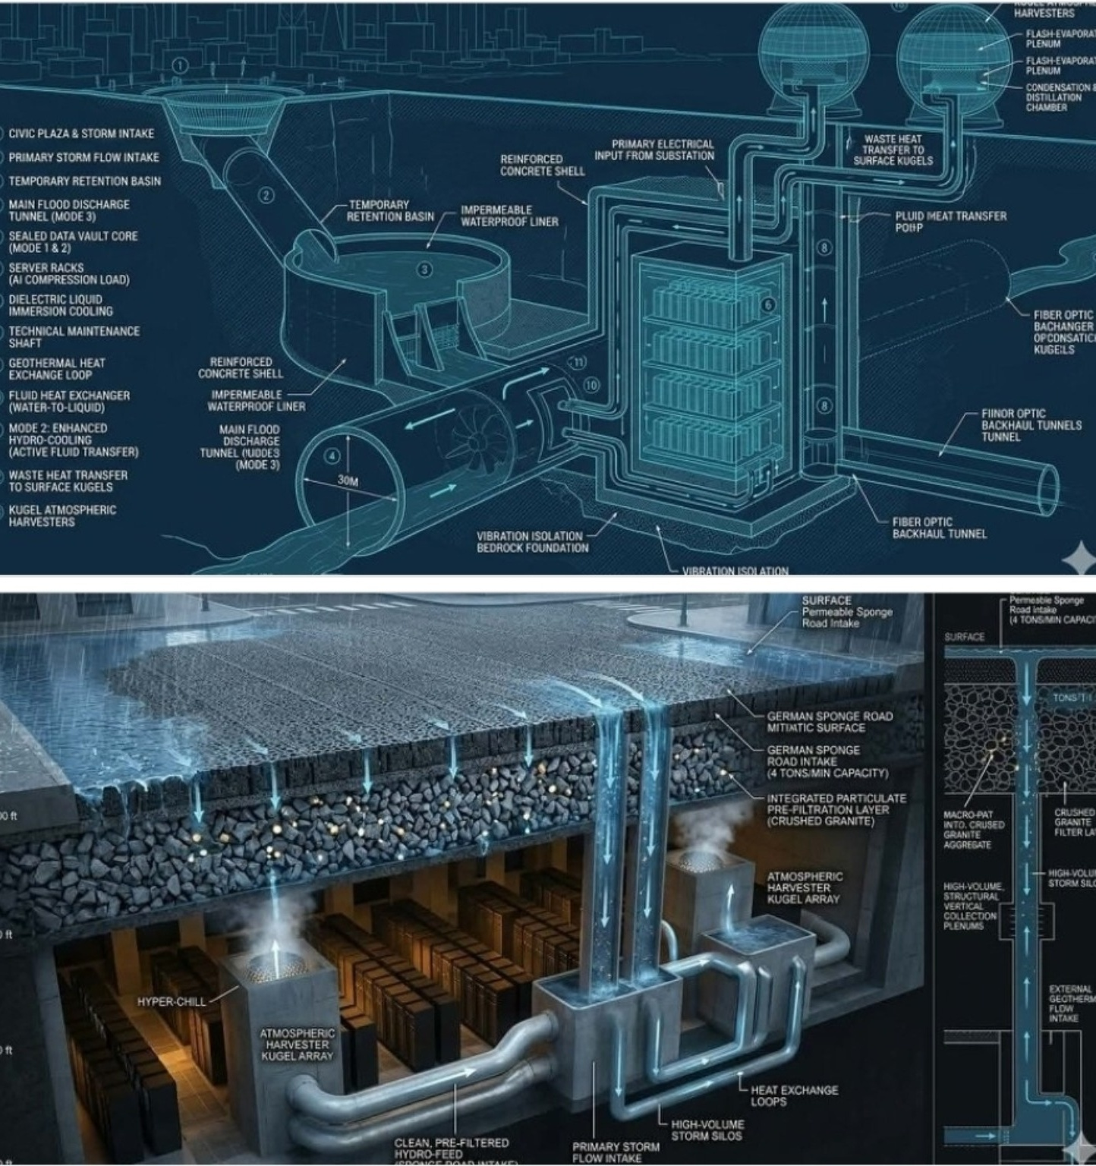
PROJECT KORIDOR
KWai
Infrastructure that can sense.
Intelligence that can adapt.
Corridors that can regenerate.
ODYNEX AXIS LOGISTICS LLC
Odynex Institute
SOWEGA Asian Pacific Chamber & Foundation
Concept-stage system architecture • Engineering validation required before physical deployment
NVIDIA alignment references: Inception • accelerated AI • digital twins / climate simulation
PROJECT KORIDOR KWai • ODYNEX AXIS LOGISTICS
12

