Slide 1

Introduction to HPCC Systems ECL
Dan S. Camper – Thaumaturge, HPCC Systems Solutions Lab
Bahar Fardanian – Software Engineer, Data & Scoring Engineering
January 13, 2020

Slide 2
Agenda
Setting Up Your Workstation
Source Code and IDE Installation Instructions
Browser Bookmark
Enterprise Control Language
What is it?
Basic, But Important, Stuff
Common Data Types
Important Minutia
Code Examples
Getting to Know the Data
Via ECL Watch
Via code
Working with the Data
Data Validation
Data Enrichment From Within
Data Enrichment From Without
Analyzing Data
The TABLE() Function
GROUP() Can Be Fun, Too

Slide 3

Setting Up Your Workstation

Slide 4
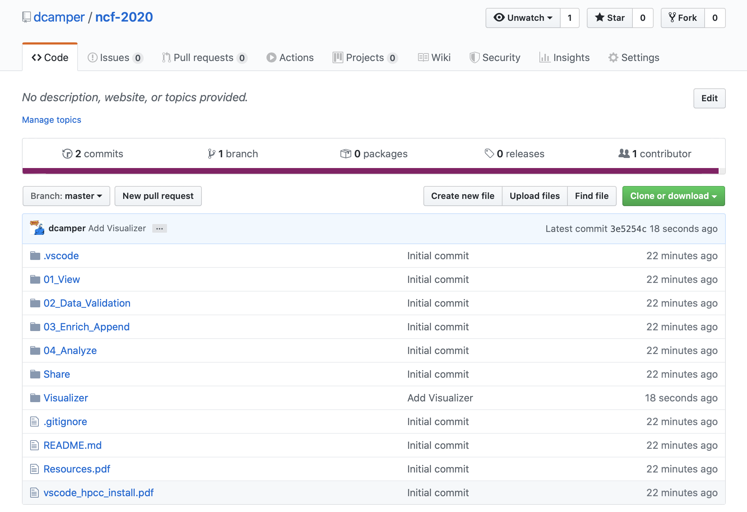
Source Code and IDE Installation Instructions
https://github.com/dcamper/ncf-2020

Slide 5
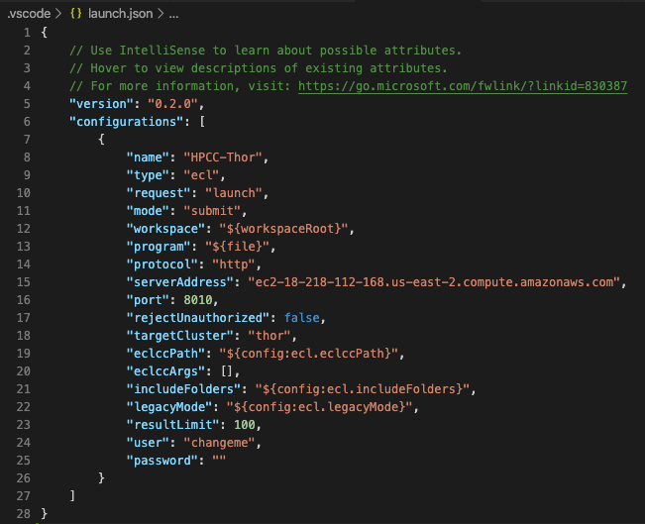

Personalize Your Local Copy
Supply a username for the VS Code launch.json profile
Supply a username within the cloned code

Slide 6
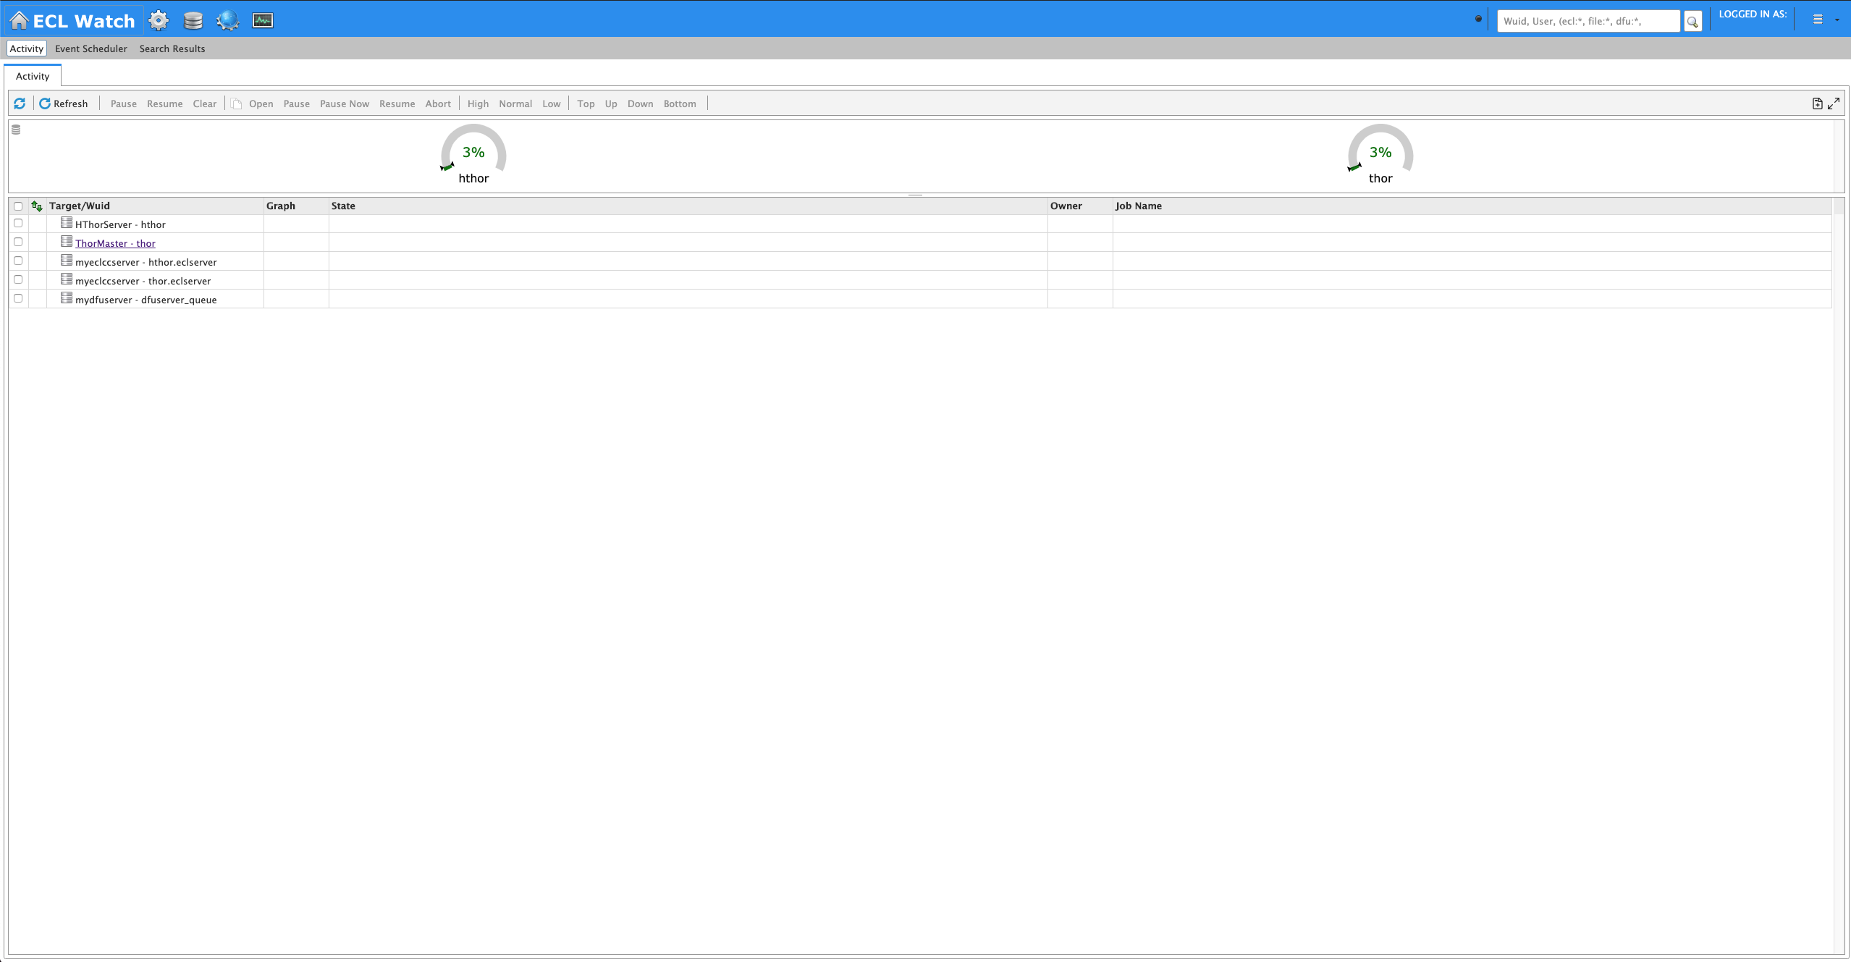
Setting Up Your Workstation – Browser Bookmark
http://ec2-18-218-112-168.us-east-2.compute.amazonaws.com:8010/

Slide 7

Enterprise Control Language (ECL)

Slide 8
ECL: What is it?
Declarative Programming Language
“… a programming paradigm … that expresses the logic of a computation without describing its control flow.” – Wikipedia
Designed For Big Data Scenarios
Any Cluster Size
Source-to-source compiler
ECL code translated to C++ that is compiled to shared libraries and executed within a custom framwork
Useful Documentation (these links are in the Resources.pdf document)
Language Reference
https://hpccsystems.com/training/documentation/ecl-language-reference/html
Standard Library
https://hpccsystems.com/training/documentation/standard-library-reference/html

Slide 9
ECL: Basic, But Important, Stuff
Two Statement Types
Definition
Assign an expression to an attribute
Action
Actually do something that affects the outside world
Plot Twist
You can define an attribute as an action

Slide 10
ECL: Common Data Types
Character
STRING[n]
UTF8
UNICODE[_locale][n]
Numeric
INTEGER[n]
UNSIGNED[n]
REAL[n]
DECIMAL<n>[_y]
UDECIMAL<n>[_y]
Other
BOOLEAN
SET OF <type>
RECORD
DATASET

Slide 11
ECL: Important Minutia
Case-insensitive
Whitespace insensitive (within reason)
String literals are quoted with apostrophes
Semicolon terminator
C++/Java style commenting
Definition (assignment) operator is :=
Equality test operator is =
Attributes can be defined only once
Single-pass code parser
Only previously-defined attributes can be referenced
Only those definitions that contribute to a result are actually compiled and used
There are no loops

Slide 12
Randomly-Chosen ECL Examples

Slide 13
ECL: Hello World
// Define an attribute with a string literal
MY_STRING := 'Hello World!';
// Action that displays the string in the workunit
OUTPUT(MY_STRING);

Slide 14
ECL: Defining a FUNCTION
[return_data_type] function_name(data_type arg [, data_type arg]+) := FUNCTION ecl_code RETURN return_value; END;
return_data_type
Optional (compiler can infer it from return_value)
If returning a dataset, the data type is DATASET(record_definition)
function_name
The name by which the function will be invoked
data_type
The argument’s data type
If passing a dataset, the data type is DATASET(record_definition)
ecl_code
Whatever code is needed to build return_value
Conversely, if the code does not contribute to return_value then it is ignored
Attributes defined here are scoped to the function
return_value
The result of the function
If you don’t have any ecl_code for the function – it is a one-liner – then you can omit FUNCTION, RETURN and END
UNSIGNED2 Squared(UNSIGNED1 n) := n * n;

Slide 15
ECL: Overly-Complicated Hello World
// Define an attribute with a string literal
SUFFIX := 'World!';
// Define a function
STRING AddSuffix(STRING prefix) := FUNCTION
RETURN prefix + ' ' + SUFFIX;
END;
// Define an attribute as the result of a function all
myValue := AddSuffix('Hello');
// Action that displays the result (“Hello World!”) in the workunit
OUTPUT(myValue);

Slide 16
ECL: RECORD and DATASET
List of data types and their attribute names
Defining a record structure
attr := RECORD data_type field1; … data_type field100; END;
attr := {data_type field1, ..., data_type field100};
Defining a reference to saved data
attr := DATASET(path, record_structure, file_type);
file_type
FLAT: Native file type for Thor; also used for fixed-length raw records
CSV: Any kind of delimited data, including CSV-encoded data
JSON: Data stored as a series of JSON objects
XML: Data stored as a series of XML documents
PIPE: Data obtained dynamically via process calls

Slide 17
ECL: Output Existing File – RECORD and DATASET
// Record definition of the file
PersonRec := RECORD
UNSIGNED4 id;
STRING name;
STRING5 zip_code;
END;
// Reference to the data within the file
personData := DATASET
(
'~person_file', // Path to file
PersonRec, // Record structure of file
FLAT // File type
);
// Output first 100 records
OUTPUT(personData, NAMED('PersonSample'));

Slide 18
ECL: Filtering Data
Filters can be specified using a simple syntax
attr := dataset(boolean_expression);
Basically, put your filter within parenthesis after the attribute representing the data
All records within dataset will be evaluated
If boolean_expression evaluates to TRUE for a particular record, it will be included in the result
Logical operators
AND
OR
NOT or ~
Comparison operators
=
<> or !=
<
>
<=
>=
<=>
Equivalency comparison, returns -1, 0 or 1
Can use parenthesis to group subconditions

Slide 19
ECL: Simple Filter Data Example
// Record definition of the file
PersonRec := RECORD
UNSIGNED4 id;
STRING name;
STRING5 zip_code;
END;
// Reference to the data within the file
personData := DATASET
(
'~person_file', // Path to file
PersonRec, // Record structure of file
FLAT // File type
);
// Get only those records with a certain zip code
oneZip := personData(zip_code = '78613');
// Output first 100 records
OUTPUT(oneZip, NAMED('Zip78613'));

Slide 20
ECL: TRANSFORM and PROJECT
Convert one record format into another
out_record_def transform_name(in_record_def rec) := TRANSFORM SELF.field1 := SomeFunction(rec.field1); … SELF.field50 := rec.field50 * 3.141592; SELF := rec; // Member-wise copy of all other attributes END;
Defined like a function with an explicit return data type (a record definition)
Will be iteratively called with a single record from the source dataset
Conceptually similar to an object constructor in C++ or Java
Can accept any number of arguments
Transform every record in a dataset
attr := PROJECT(dataset, transform_name(LEFT));
Basically walks an entire dataset, converting each record to something else or modifying what is already there
LEFT refers to the first (and only) dataset input to the PROJECT function

Slide 21
ECL: Process Every Record – TRANSFORM and PROJECT
IMPORT Std;
// Record definition of the file
PersonRec := RECORD
UNSIGNED4 id;
STRING name;
STRING5 zip_code;
END;
// Reference to the data within the file
personData := DATASET
(
'~person_file', // Path to file
PersonRec, // Record structure of file
FLAT // File type
);
// Output first 100 records from original file
OUTPUT(personData, NAMED('PersonSample'));
// Define a transform that uppercases the name and simply
// copies all other attributes
PersonRec UppercaseName(PersonRec rec) := TRANSFORM
SELF.name := Std.Str.ToUpperCase(rec.name);
SELF := rec;
END;
// Define an attribute to hold the transformed data
upperCasedPersonData := PROJECT(personData, UppercaseName(LEFT));
// Output first 100 records of the uppercased data
OUTPUT(upperCasedPersonData, NAMED('UppercasePersonSample'));

Slide 22
ECL: Process Every Record – Inline TRANSFORM
IMPORT Std;
// Record definition of the file
PersonRec := RECORD
UNSIGNED4 id;
STRING name;
STRING5 zip_code;
END;
// Reference to the data within the file
personData := DATASET
(
'~person_file', // Path to file
PersonRec, // Record structure of file
FLAT // File type
);
// Output first 100 records from original file
OUTPUT(personData, NAMED('PersonSample'));
// Define an attribute to hold the transformed data
upperCasedPersonData := PROJECT
(
personData,
TRANSFORM
(
PersonRec,
SELF.name := Std.Str.ToUpperCase(LEFT.name),
SELF := LEFT
)
);
// Output first 100 records of the uppercased data
OUTPUT(upperCasedPersonData, NAMED('UppercasePersonSample'));

Slide 23
ECL: JOIN
Find matching records between two datasets and create a new record based on each match
attr := JOIN(ds1, ds2, condition, transform [, flags]);
condition
Boolean test of arbitrary complexity
Normally contains at least one equality test
Reference attributes within the input datasets via LEFT and RIGHT
ds1 = LEFT
ds2 = RIGHT
Example: LEFT.id = RIGHT.id AND LEFT.name = RIGHT.name
transform
If using an explicit TRANSFORM, it should accept at least two arguments
One representing a LEFT record and the other representing a RIGHT record
Ex: BazRec MakeBaz(FooRec rec1, BarRec rec2) := TRANSFORM … END;
If using an inline TRANSFORM, use LEFT and RIGHT to reference input data
flags
Optional flags that can alter the behavior of the JOIN
Commonly used flags
LEFT OUTER: Keep all records from LEFT, even if there are no matches
LOOKUP: The RIGHT dataset is relatively small and there should be only one match for any LEFT record
ALL: The RIGHT dataset is relatively small and can be copied to every node in its entirety
Can have multiple matches (unlike LOOKUP)
Supports join conditions that contain no equalities
Required if there are no equality tests in the condition

Slide 24
ECL: JOIN Example
PersonRec := RECORD
UNSIGNED4 id;
STRING name;
STRING5 zip_code;
END;
personData := DATASET('~person_file', PersonRec, FLAT);
ZipLookupRec := RECORD
STRING5 zip5;
STRING city;
STRING2 state;
END;
zipData := DATASET('~zip_lookup', ZipLookupRec, FLAT);
MergedRec := RECORD
UNSIGNED4 id;
STRING name;
STRING city;
STRING2 state;
STRING5 zip_code;
END;
MergedRec MergePersonAndZip(PersonRec personInfo, ZipLookupRec zipInfo) := TRANSFORM
SELF := personInfo; // Copy all values from personInfo
SELF := zipInfo; // Copy all values from zipInfo
END;
personAndZipInfo := JOIN
(
personData, // LEFT
zipData, // RIGHT
LEFT.zip_code = RIGHT.zip5, // Join condition
MergePersonAndZip(LEFT, RIGHT), // Transform
LEFT OUTER // Join flag
);
OUTPUT(personAndZipInfo, NAMED(MergedPersonInfo'));

Slide 25
ECL: Aggregation via TABLE
TABLE is the most commonly-used data aggregation functions in ECL
attr := TABLE(dataset, out_record_def, grouping_conditions [, flags]);
out_record_def
Record definition that will contain both the grouping condition results and any new attributes computed as part of the aggregation
Functions that operate on TABLE groups
SUM, MAX, MIN, COUNT, AVE, VARIANCE, COVARIANCE, CORRELATION
When used within TABLE, these functions accept the keyword GROUP to denote currently-grouped table data
grouping_conditions
One or more comma-delimited expressions
An expression could simply be an attribute name within the dataset; this is the most common usage
An expression could be a computed value, such as (myValue % 2) to group on even/odd values
All records within dataset that evaluate to the same set of condition values will be grouped together
Each group will result in one output record
Functions evaluated within out_record_def will operate on the group
flags
Optional flags that can alter the behavior of TABLE
Commonly used flags
MERGE: Evaluate the data on stored on each Thor node independently, then merge those results into a final result
LOCAL: Evaluate the data stored on each Thor node independently and do not merge the results
Useful only when the data has been explicitly distributed

Slide 26
ECL: Simple TABLE example
PersonRec := RECORD
UNSIGNED4 id;
STRING name;
STRING5 zip_code;
END;
personData := DATASET('~person_file', PersonRec, FLAT);
// Count the number of people for each zip code
zipPeopleCount := TABLE
(
personData,
{
zip_code, // Field used in grouping condition
UNSIGNED4 num_people := COUNT(GROUP) // Computed field
},
zip_code, // Grouping condition
MERGE // Flag
);
OUTPUT(zipPeopleCount, NAMED('NumPeopleInEachZipCode'));

Slide 27
ECL: Code Organization via File System Directories
MyProject/
Util/
Uppercase.ecl
IMPORT Std; EXPORT Uppercase(STRING s) := FUNCTION RETURN Std.Str.ToUpperCase(s); END;
DoubleNum.ecl
EXPORT DoubleNumPlusConst(INTEGER2 n) := n * 2;
DoubleNumPlusConst.ecl
IMPORT $; SHARED MY_CONST := 42; EXPORT DoubleNumPlusConst(INTEGER2 n) := FUNCTION RETURN $.DoubleNum(n) + MY_CONST; END;
myUppercasedValue := MyProject.Util.Uppercase('foo');
myDoubledNumber := MyProject.Util.DoubleNum(10);
myDoubledPlusConst := MyProject.Util.DoubleNumPlusConst(20);

Slide 28
ECL: Code Organization via MODULE
MyProject/
Util.ecl
IMPORT Std;
EXPORT Util := MODULE EXPORT Uppercase(STRING s) := FUNCTION RETURN Std.Str.ToUpperCase(s); END; EXPORT DoubleNumPlusConst(INTEGER2 n) := n * 2; SHARED MY_CONST := 42; EXPORT DoubleNumPlusConst(INTEGER2 n) := FUNCTION RETURN DoubleNum(n) + MY_CONST; END; END; // Module
myUppercasedValue := MyProject.Util.Uppercase('foo');
myDoubledNumber := MyProject.Util.DoubleNum(10);
myDoubledPlusConst := MyProject.Util.DoubleNumPlusConst(20);

Slide 29

HPCC Systems’ Admin Console (ECL Watch)

Slide 30
ECL Watch: What is it?
Browser-based interface that provides admin control over a cluster
Monitor cluster status
Job information
Schedule and deschedule periodic tasks
Manage data
Maintain Roxie queries
Security management
Default URL
http://hostname:8010

Slide 31
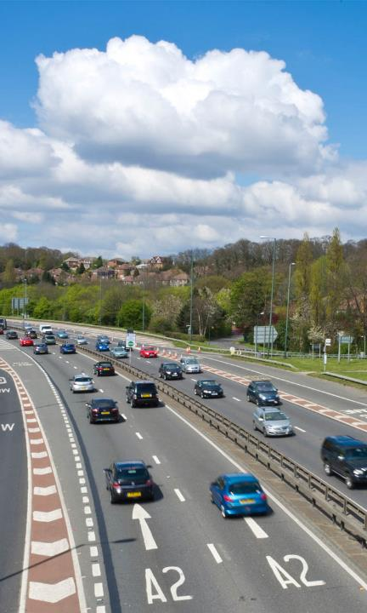
Getting to Know the Data

Slide 32
The Data – Scheduled Flight Information
GSEC
Meaning: “Global Sectorized”
Each record represents one, possibly repeating, scheduled flight
4.88M rows of data
~4.5GB in size
Originally in CSV format
General contents
Plane
Carrier
Seating
Meal options
Flight
Flight number
Source and destination
Departure/arrival times
Connection info
Dates
Valid date range for schedule
Operating days of week
Notes:
Click links to see raw data

Slide 33
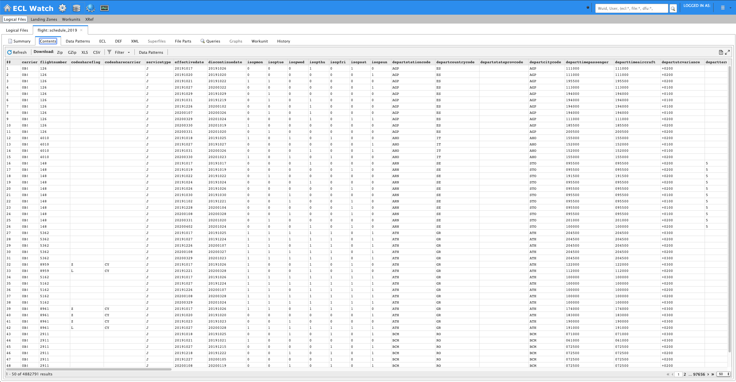
Data Inspection via ECL Watch
Notes:
Click links to see raw data

Slide 34

Data Inspection via Code – 01_View
Submit each of the BWR files
View results of each run in your browser
Note the workunit ID in the VS Code debug console area
Example: W20200110-195905
Show ‘ECL’ tab in ECL Watch
Gear icon in the blue ribbon
Find your workunit and click on its ID
Open the Outputs tab to see results
The Graphs tab is also interesting

Slide 35

Working with the Data

Slide 36
Data Validation
It is often a good idea to test specific values within records for validity
What you do with the results is a different matter
Recommendation: Mark the record as having problems, but don’t delete it
Validation is usually fast and easy
Define a new record structure with new fields containing test results
BOOLEAN values with descriptive names
Include a final “is this valid” BOOLEAN field that summarizes all tests
This makes it easy to filter the records
All of the above can be done in one pass, using the PROJECT() function

Slide 37
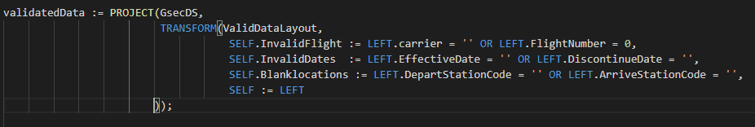
Data Validation – Testing and Assigning Results

Slide 38
Data Validation Exercise – 02_Data_Validation
Sample: A_Validation_Intro.ecl
Beginnings of a validation step
B_GSEC_Validation.ecl
Tests for three fields are included
Assignment
Examine record within Share.GSEC.ecl
Make logical guesses for tests that could be applied for other fields
Modify the ValidatedRec record definition to hold your test results
Modify the TRANSFORM() within the PROJECT() to assign test results
Look for the ‘TODO’ lines

Slide 39
Data Enrichment From Within – Complex Single Values
Some values in a dataset contain “complex” information
Not “complicated”
Packing a lot of information into a single field
Complex information can be picked apart and the useful bits separately appended to the dataset
Ex: Booking classes could be broken out into a series of boolean fields
Making the useful bits separately available greatly eases filtering, grouping, computing aggregations and finding correlations

Slide 40
Data Enrichment From Within – Inter-Record Computations
In some datasets, field values are paired – two fields are related – and a trivial computation can yield a new useful value that can be appended
Example: Start/stop times can yield a duration
Can also be used for validation: Is the start time actual prior to the end time?
Other fields are naturally grouped
Example: Several fields that reflect a portion of a bill of sale can yield a total amount

Slide 41
Data Enrichment From Within – Other Miscellaneous Thoughts
Standardizing on value scales is sometimes a good idea
Example: Convert all speeds to km/h or mph or m/s
Example: Convert times to UTC or to a uniform time zone
Bucketizing is useful for time series data
Put time-oriented data into indexed buckets
The buckets can then be used for filtering, correlation, etc.
Appending a “conventional representation” of a value
Ex: is_redeye boolean field, populated by examining arrival times

Slide 42
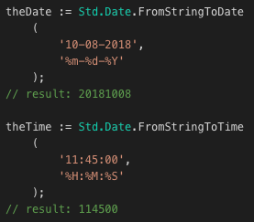
Useful Date-Oriented ECL Types And Functions – Std Library
Std.Date.Date_t
Datatype reflecting a numeric date in YYYYMMDD format
Std.Date.Time_t
Datatype reflecting a numeric time in HHMMSS format
Std.Date.FromStringToDate()
Function parses a string according to a format and returns a Date_t
Std.Date.FromStringToTime()
Function parses a string according to a format and returns a Time_t

Slide 43
Useful Date-Oriented ECL Types And Functions – Std Library
Std.Date.Year(Date_t)
Std.Date.Month(Date_t)
Std.Date.Day(Date_t)
Std.Date.Hour(Time_t)
Std.Date.Minute(Time_t)
Std.Date.Second(Time_t)
Std.Date.DayOfWeek(Date_t)
Returns 1-7, where 1=Sunday
Std.Date.DaysBetween(Date_t, Date_t)
Returns the number of whole days between the two given dates

Slide 44
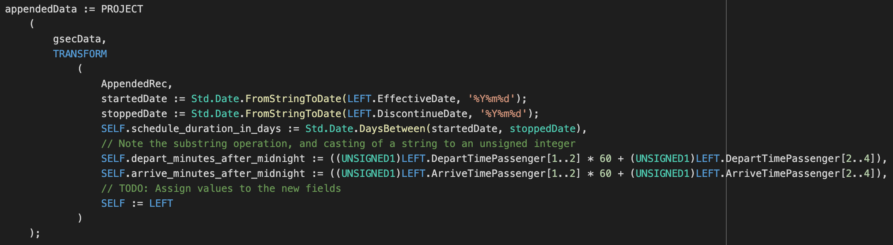
Useful Date-Oriented ECL Types And Functions – Example

Slide 45
Data Enrichment Exercise #1 – 03_Enrich_Append
Use A_Enrich_Data.ecl in code directory
Beginnings of an enrichment step
Three additional fields appended
Assignment
Examine record definition within the file
Try to extract additional information from individual fields, or pairs of fields
Modify the AppendedRec record definition to hold your results
Modify the TRANSFORM() within the PROJECT() to assign the new values

Slide 46
Data Enrichment From Without – Append From Other Data Sources
Three major purposes
Provide a greater or more precise context for the data
Example: Append cell carrier name by matching the phone number
Add new information relating to an entity within a record
Example: Given a record with only a customer ID, append the customer’s name, address, phone, etc.
Join coinciding information
Used most often in time-oriented data to find possible correlations between disparate data
Example: Given data on fast-food sales in a city, append city traffic conditions to see if traffic jams affect the sale of hamburgers
Joining datasets is not always straightforward
Easy: Finding customer information given a customer ID
Harder: Finding customer information given a customer’s first and last name, and the match can include typos or misspellings

Slide 47
Data Enrichment From Without – JOIN() Function
The JOIN() function in ECL is really powerful
Types
INNER
LEFT OUTER
RIGHT OUTER
FULL OUTER
LEFT ONLY
RIGHT ONLY
FULL ONLY
JOIN() is most efficient if there is at least one equality condition in the matching statement
Example: LEFT.customer_id = RIGHT.customer_id
You can still use JOIN() if you don’t have an equality condition, but then you must use the ALL option and the right-hand-side dataset must be relatively small
Options (only some of them)
SMART
LOOKUP
ALL
LOCAL
GROUPED
KEEP
ATMOST
LIMIT

Slide 48
Data Enrichment From Without – Carrier (Airline) Name
GSEC data includes carrier codes, but no names
Additional dataset defined in Share/ directory contains airline information
Share/Airlines.ecl
Contains codes, names, call signs, country of origin
A simple JOIN between GSEC and airline data, with a single exact match criteria should allow us to append the carrier name into the GSEC data

Slide 49
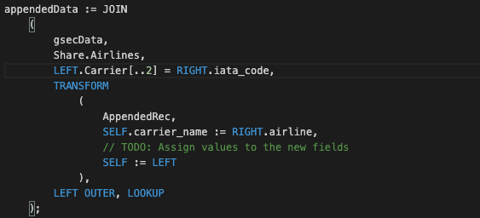
Data Enrichment From Without – Airline Name

Slide 50
Data Enrichment Exercise #2 – 03_Enrich_Append
Use B_Append_Data.ecl in code directory
Beginnings of an append step
Assignment
Append country names to the dataset, for both departure and arrival points
Hint: Replicate AppendedRec and appendedData attributes (but with different names!)
Hint: Don’t forget to modify the OUTPUT() command so that your new dataset is written to a new logical path

Slide 51

Analyzing Data

Slide 52
The TABLE() Function
Basic concept is similar to SQL’s GROUP BY
Group records that evaluate to identical expressions, then perform aggregations across each group
Examples
MIN/MAX/AVE flight distance
Record counts
Variances

Slide 53
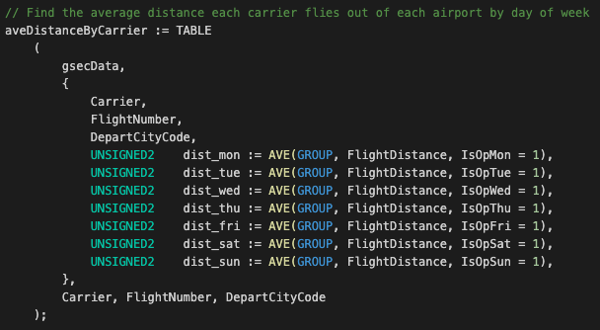
The TABLE() Function

Slide 54
Analyzing Data Exercise #1 – 04_Analyze
A_Distinct_TABLE.ecl
TABLE() is useful for the simple action of finding the distinct values in a field
The given code finds the unique airline codes in the GSEC dataset and then looks up the airline names and outputs the result to the workunit
Assignment is to do the same thing, but with different codes found in GSEC
See code comments for details

Slide 55
Analyzing Data Exercise #2 – 04_Analyze
B_TABLE_Fun.ecl in code directory
Example computes average distance flown by each carrier from an airport for every day of the week
Assignment is to use TABLE() to compute new aggregations
May either add fields to existing TABLE (if you are using the same grouping fields) or create new TABLE() definitions

Slide 56
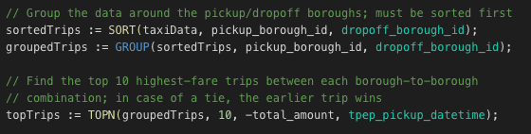
GROUP() Can Be Fun, Too
GROUP() is a function that creates “virtual subsets” within your data
Groups are created for identical values within one or more fields
When you apply aggregations or other functions to the grouped data, the functions are applied to each group individually

Slide 57
Analyzing Data Exercise #3 – 04_Analyze
C_More_Advanced.ecl in code directory
Goal of code is to find the airline scheduled to fly the most routes between any two cities
Show the results in a human-readable way
Several concepts covered in this code
TABLE() used to slim the dataset and group between any two cities (taking into account flights that go from A to B as well as B to A)
Appending several descriptions (names) of codes
An example of using the GROUP() function
Assignment
Read, comprehend, question
Hey, and maybe write some more code

Slide 58
Analyzing Data Exercise #4 – Final
I want to fly from Austin to Chicago sometime during the month of March, 2020. Exactly when is not important. During that trip, I want to visit some relatives during a brief overnight stay in Bloomington, IL.
Output a dataset to the workunit where every record contains a flight that satisfies the following criteria
Depart from Austin, TX airport (AUS)
Arrive at the Bloomington/Normal airport in Illinois (BMI)
Hint: There will be one layover
For the connecting flight, I want to stay on the same airline because I want my bags to be transferred automatically
The layover time should be no less than 1 hour and no more than 2 hours
The very next day, before 10am, depart from the Bloomington/Normal airport and fly to O’Hare International Airport in Chicago (ORD)
Only the record(s) matching the minimum sum total flight time + layover should be shown
Bonus
For each flight in the result, show the effective schedule date range taking into account that I want to fly only in March 2020

