Slide 1
NETWORK AS CODE · DMVPN PHASE 3
C8000v DMVPN Portal
One place to see, change, prove and share a multi-hub DMVPN service: for the operators who run it and the customers who use it.
Three Catalyst 8000v hubs · C8000v and VyOS customers · two providers · Nautobot · Terraform (NAC) · VictoriaMetrics
Version 0.21.0 · September 2026
Notes:
Title. The portal runs on the lab host at :8094 and fronts the whole lab: lab.conf is the source of truth, Network-as-Code pushes the Catalyst 8000v routers, SSH pushes the VyOS routers, Nautobot mirrors the model.

Slide 2
THE PROBLEM
Running a DMVPN service by hand does not scale
A single customer touches three hubs, one or two providers, two router operating systems and a source of truth. Every question and every change means logging in to several boxes.
Scattered state
Slow, risky changes
Drift
No change control
Is every spoke registered with every hub? Are shortcuts forming? Health lives in a dozen CLI sessions on IOS XE and VyOS.
Adding, changing or removing a customer means consistent edits on hubs, spoke, provider and Nautobot. It is easy to miss one.
Hand edits leave routers differing from the intended design, and nobody notices until something breaks.
Who changed what, who approved it, and what exactly changed on each router? Usually nobody can say.
Unproven resilience
Blind customers
Static secrets
The result
Slow onboarding, outages from avoidable mistakes, and no evidence for customers or auditors.
Dual hubs and dual providers look good on paper, but how long does failover really take?
Customers cannot see their own service, test it, or ask for changes. SLA reports are assembled by hand.
The DMVPN pre-shared key is set once and rarely rotated, because rotating it by hand risks an outage.
C8000v DMVPN Portal · v0.21.0
2
Notes:
The problem statement: the service is simple to draw but has many moving parts, and without tooling every question costs a round of logins.

Slide 3
THE SOLUTION
What the portal does
One web portal on top of a single source of truth (lab.conf). It reads every router live, turns every change into a controlled, verified job, and gives each customer a view of its own service.
Catalyst 8000v
lab.conf
Terraform (NAC) → RESTCONF
Operators
the intended design
viewer · operator · approver · admin
Portal :8094
FastAPI · jobs · change control · SLA probes · failover lab · config history · roles
VyOS
Render
SSH push, declarative
hub, spoke and provider config
Customers
Providers
their own site, SLA, requests, tests
Nautobot
mpls and mpls2 (VyOS)
mirrors the model
Read path: the portal polls every router (RESTCONF, CLI, VyOS op mode) and draws what is really there, not what should be.
VictoriaMetrics
every minute: pings, app checks
SLA and application probes
C8000v DMVPN Portal · v0.21.0
3
Notes:
Architecture: the portal never edits routers ad hoc. Changes go through lab.conf, the renderer and the same push pipeline, then a verification step.

Slide 4
WHAT YOU CAN DO
Capabilities at a glance
1
See
2
Change
3
Control
4
Audit
Live cloud table and KPIs, a topology map drawn from live state, per-customer details, path trace and 'watch the shortcut form'.
Add, modify and remove customers, deploy the model, fix drift, back up and restore, choose the preferred hub or add a second provider.
Change requests with four-eyes approval, change windows, emergency changes, and maintenance mode that mutes alerts.
Every job snapshots every router before and after it runs, records who asked and who approved, and shows a diff per router.
5
Prove
6
Secure
7
Customers
8
Automate
SLA per customer (availability, latency, loss), application checks, simulated failures and measured failover times.
Sign-in with roles, admin-only pre-shared key rotation with a random key, and secrets masked in every view and log.
A read-only customer portal: its own site and applications, SLA and PDF report, change requests and self-service tests.
A REST API for everything (Swagger), Prometheus metrics, progress and ETA for each job, and a 73-test Robot suite after each change.
C8000v DMVPN Portal · v0.21.0
4
Notes:
Eight capability areas. The tour that follows shows each one in the portal, with numbered callouts matching the explanation beside each screenshot.

Slide 5
A tour of the portal
Numbered callouts on each screenshot match the explanations beside it.
5

Slide 6
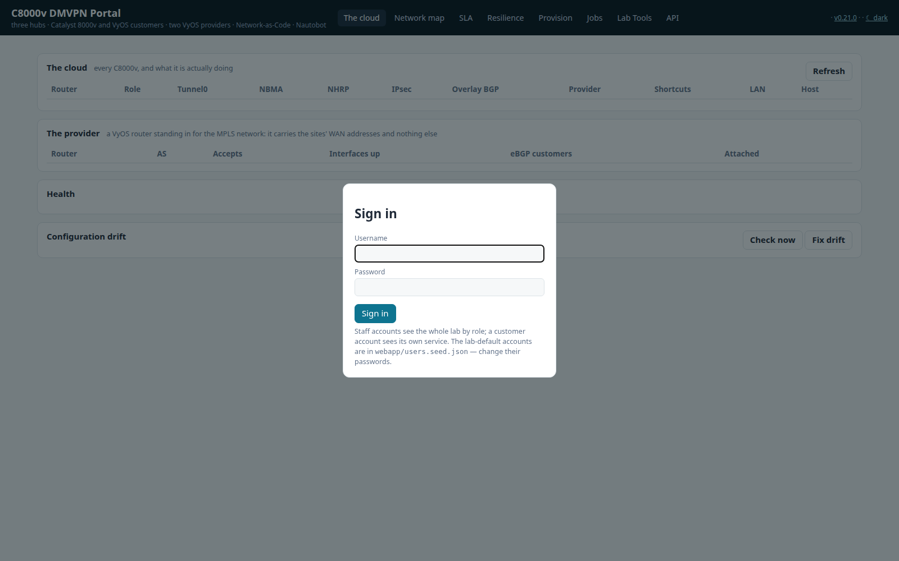
ACCESS
Everyone signs in, and the role decides what they see
1
Sign in
Staff roles are viewer, operator, approver and admin. A customer account sees only its own service. Sessions are signed cookies, passwords are PBKDF2 hashes.
1
Why it matters
Read-only users cannot start jobs, nobody approves their own change, and customers never see another customer.
C8000v DMVPN Portal · v0.21.0
6
Notes:
Everyone signs in, and the role decides what they see
1. Sign in: Staff roles are viewer, operator, approver and admin. A customer account sees only its own service. Sessions are signed cookies, passwords are PBKDF2 hashes.
Read-only users cannot start jobs, nobody approves their own change, and customers never see another customer.

Slide 7
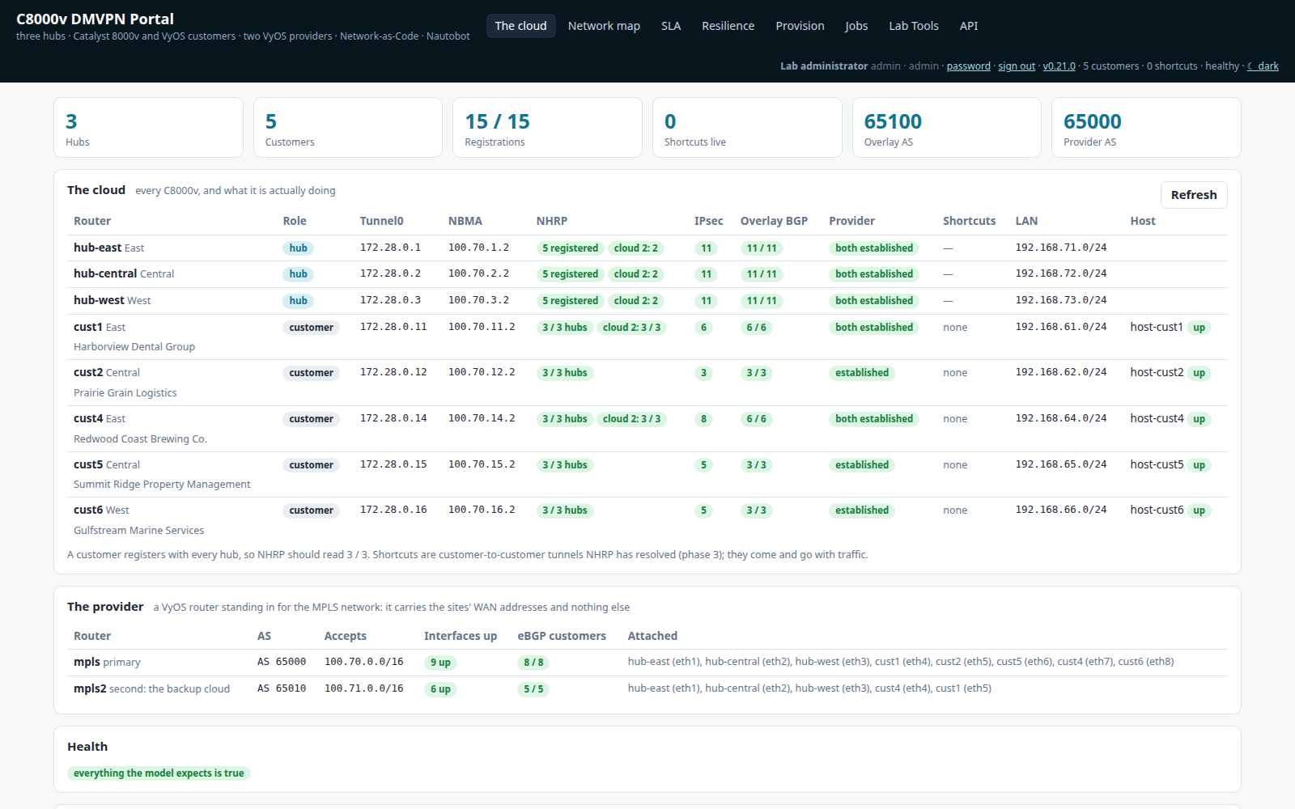
SEE
The cloud: every router, read live
1
KPIs
Hubs, customers, registrations, shortcuts and BGP at a glance.
4
1
2
Every router
NHRP registrations, IPsec, overlay BGP, the provider and the preferred hub, read from the routers themselves.
2
3
Both providers
Access links and eBGP on mpls and mpls2.
4
Who you are
The account, its role and the portal version, always visible.
3
Why it matters
One screen answers 'is every spoke registered with every hub?' with no CLI logins.
C8000v DMVPN Portal · v0.21.0
7
Notes:
The cloud: every router, read live
1. KPIs: Hubs, customers, registrations, shortcuts and BGP at a glance.
2. Every router: NHRP registrations, IPsec, overlay BGP, the provider and the preferred hub, read from the routers themselves.
3. Both providers: Access links and eBGP on mpls and mpls2.
4. Who you are: The account, its role and the portal version, always visible.
One screen answers 'is every spoke registered with every hub?' with no CLI logins.

Slide 8
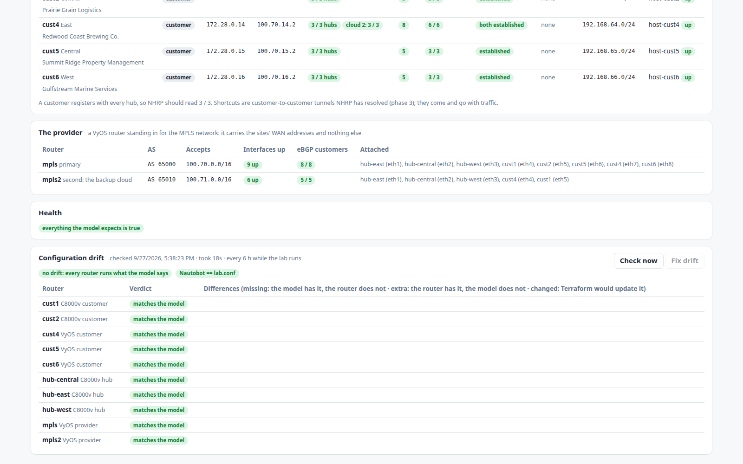
SEE
Health and configuration drift
1
Health
Everything the model expects to be up is checked, and anything missing is named.
2
Drift
Each router is compared with what lab.conf renders. 'Fix drift' puts it back as a controlled job.
1
2
Why it matters
Hand edits no longer go unnoticed: drift is visible per router, and fixing it is one approved job.
C8000v DMVPN Portal · v0.21.0
8
Notes:
Health and configuration drift
1. Health: Everything the model expects to be up is checked, and anything missing is named.
2. Drift: Each router is compared with what lab.conf renders. 'Fix drift' puts it back as a controlled job.
Hand edits no longer go unnoticed: drift is visible per router, and fixing it is one approved job.

Slide 9
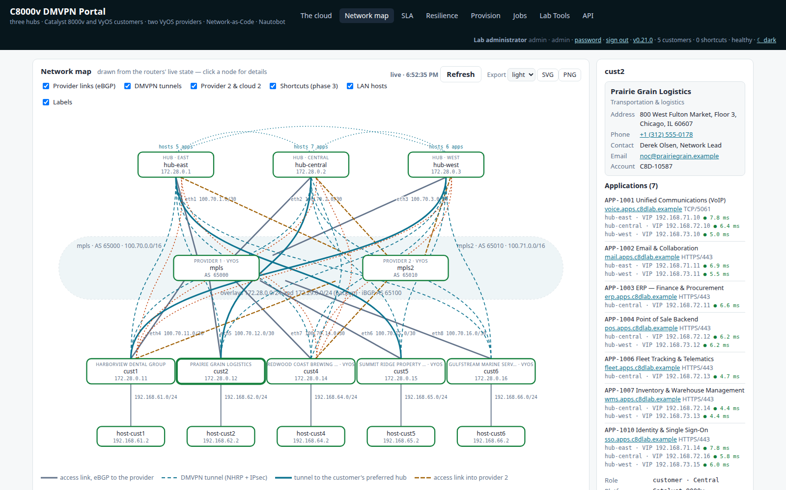
SEE
A topology map drawn from live state
1
The map
Hubs, providers, customers and LAN hosts. Tunnel colour shows health, and the preferred hub is drawn bold.
3
4
2
1
Layers
Turn provider 2 and cloud 2, shortcuts, hosts and labels on or off.
2
3
Export
SVG or PNG, light or dark, exactly as drawn.
4
Details
Click a node to see the customer company, its applications (checked every minute) and the router's live state.
Why it matters
Everyone gets the same live picture, from operations to account managers and customers.
C8000v DMVPN Portal · v0.21.0
9
Notes:
A topology map drawn from live state
1. The map: Hubs, providers, customers and LAN hosts. Tunnel colour shows health, and the preferred hub is drawn bold.
2. Layers: Turn provider 2 and cloud 2, shortcuts, hosts and labels on or off.
3. Export: SVG or PNG, light or dark, exactly as drawn.
4. Details: Click a node to see the customer company, its applications (checked every minute) and the router's live state.
Everyone gets the same live picture, from operations to account managers and customers.

Slide 10
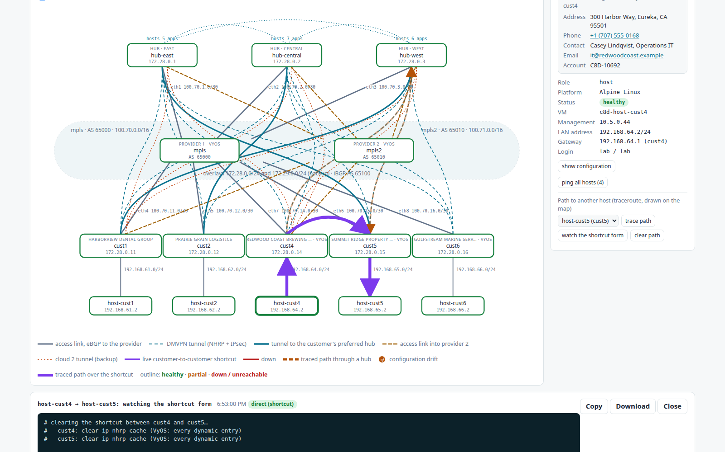
SEE
Path trace: watch the phase 3 shortcut form
1
1
First via a hub, then direct
The first packets go through a hub. NHRP then builds a spoke-to-spoke shortcut, drawn in purple.
2
Details and actions
Trace, watch the shortcut form, ping every host, and view the config history per router.
2
3
Every trace, hop by hop
The raw output is kept so you can copy or download it.
3
Why it matters
It shows that DMVPN phase 3 works end to end, and makes it easy to explain.
C8000v DMVPN Portal · v0.21.0
10
Notes:
Path trace: watch the phase 3 shortcut form
1. First via a hub, then direct: The first packets go through a hub. NHRP then builds a spoke-to-spoke shortcut, drawn in purple.
2. Details and actions: Trace, watch the shortcut form, ping every host, and view the config history per router.
3. Every trace, hop by hop: The raw output is kept so you can copy or download it.
It shows that DMVPN phase 3 works end to end, and makes it easy to explain.

Slide 11
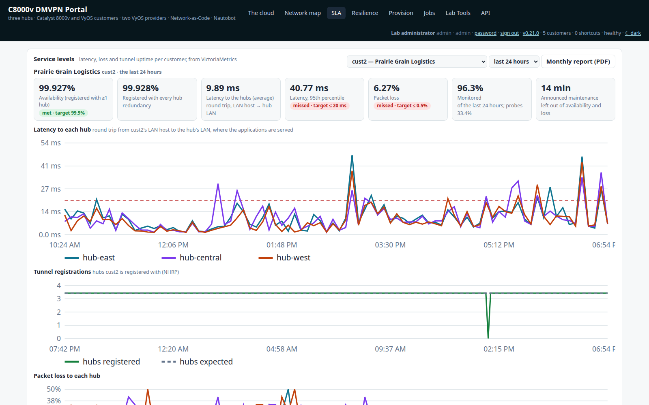
PROVE
SLA per customer, from VictoriaMetrics
1
Against targets
Availability, latency, loss and tunnel uptime, each compared with its SLA target.
3
1
2
Latency to each hub
Probed every minute from the customer's own LAN host.
2
3
Window and report
24 hours, 30 days or this month, with a monthly PDF report for the customer.
Why it matters
SLA reporting is automatic and based on measurements the customer can check.
C8000v DMVPN Portal · v0.21.0
11
Notes:
SLA per customer, from VictoriaMetrics
1. Against targets: Availability, latency, loss and tunnel uptime, each compared with its SLA target.
2. Latency to each hub: Probed every minute from the customer's own LAN host.
3. Window and report: 24 hours, 30 days or this month, with a monthly PDF report for the customer.
SLA reporting is automatic and based on measurements the customer can check.

Slide 12
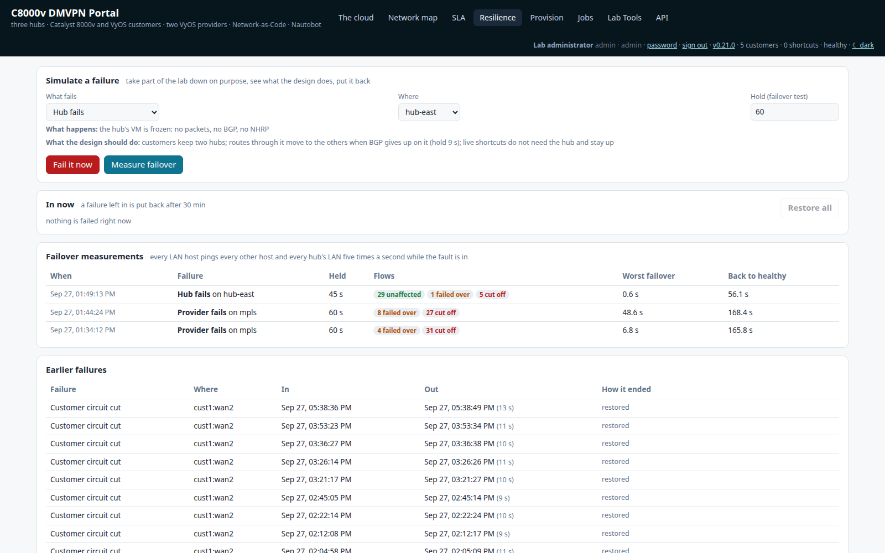
PROVE
Simulate failures on purpose
1
Choose a failure
A hub, a provider, or a customer circuit. The page says what should happen before you press anything.
1
2
Measure failover
Every LAN host pings every other host five times a second while the fault is in.
2
3
Every measurement
Flows unaffected, failed over or cut off, the worst failover and the time back to healthy.
3
Why it matters
Resilience becomes a number rather than a claim, for example 0.6 s worst case for a hub failure.
C8000v DMVPN Portal · v0.21.0
12
Notes:
Simulate failures on purpose
1. Choose a failure: A hub, a provider, or a customer circuit. The page says what should happen before you press anything.
2. Measure failover: Every LAN host pings every other host five times a second while the fault is in.
3. Every measurement: Flows unaffected, failed over or cut off, the worst failover and the time back to healthy.
Resilience becomes a number rather than a claim, for example 0.6 s worst case for a hub failure.

Slide 13
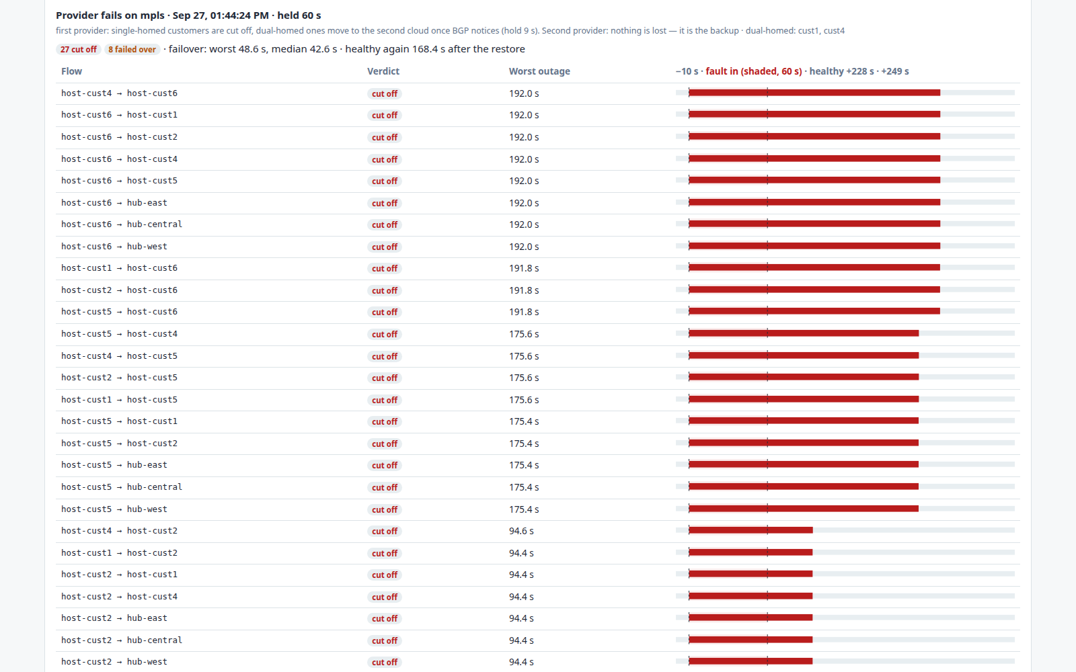
PROVE
One failover experiment, flow by flow
1
1
The experiment
What failed, for how long, and the headline figures.
2
2
Each flow
The verdict and an outage timeline for every host pair, so you can see which paths moved and which were cut.
Why it matters
You can see exactly which customers a failure affects, and for how long.
C8000v DMVPN Portal · v0.21.0
13
Notes:
One failover experiment, flow by flow
1. The experiment: What failed, for how long, and the headline figures.
2. Each flow: The verdict and an outage timeline for every host pair, so you can see which paths moved and which were cut.
You can see exactly which customers a failure affects, and for how long.

Slide 14
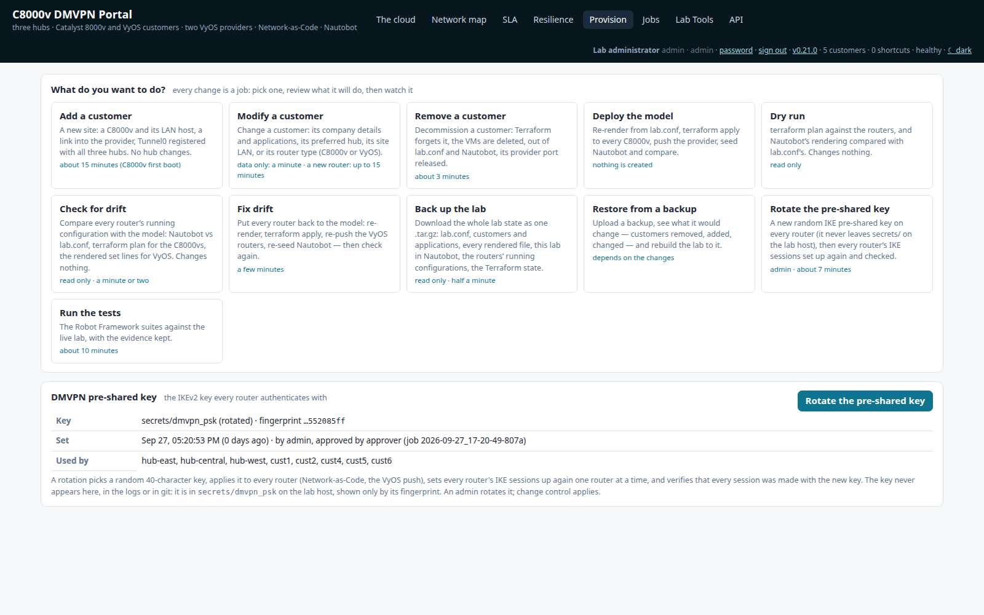
CHANGE
Provision: every change is a job
1
Tasks
Add, modify and remove customers, deploy, check for and fix drift, back up, restore, dry run and tests.
1
2
Pre-shared key
Admins rotate the DMVPN key. The system picks a random 40-character key, and only its fingerprint is ever shown.
2
Why it matters
Operators pick what they want done, and the portal carries it out consistently on every router.
C8000v DMVPN Portal · v0.21.0
14
Notes:
Provision: every change is a job
1. Tasks: Add, modify and remove customers, deploy, check for and fix drift, back up, restore, dry run and tests.
2. Pre-shared key: Admins rotate the DMVPN key. The system picks a random 40-character key, and only its fingerprint is ever shown.
Operators pick what they want done, and the portal carries it out consistently on every router.

Slide 15
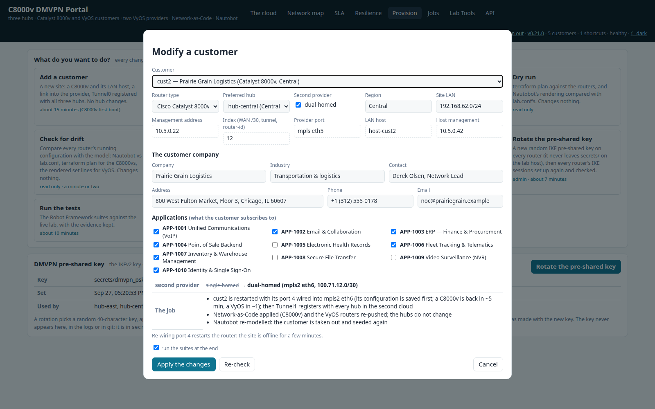
CHANGE
Modify a customer, with the plan shown first
1
Router type
Move a customer between C8000v and VyOS.
2
Preferred hub
Pick the hub its traffic should prefer (local-preference 200).
1
2
3
3
Second provider
Dual-home the customer onto mpls2 and cloud 2.
4
The plan
Exactly what will change on which routers, before anything runs.
4
Why it matters
No surprises: the impact is visible and reviewed before a change request is filed.
C8000v DMVPN Portal · v0.21.0
15
Notes:
Modify a customer, with the plan shown first
1. Router type: Move a customer between C8000v and VyOS.
2. Preferred hub: Pick the hub its traffic should prefer (local-preference 200).
3. Second provider: Dual-home the customer onto mpls2 and cloud 2.
4. The plan: Exactly what will change on which routers, before anything runs.
No surprises: the impact is visible and reviewed before a change request is filed.

Slide 16
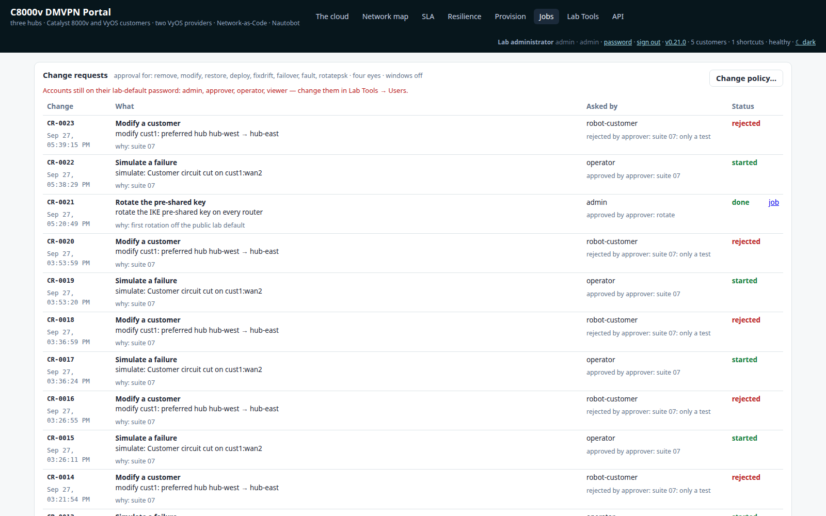
CONTROL
Change requests: four eyes and change windows
1
Change requests
Each request shows who asked, what for, who approved or rejected it, and its status, including requests from customers.
1
Why it matters
Disruptive work cannot start without a second person, and it runs only inside the agreed windows.
C8000v DMVPN Portal · v0.21.0
16
Notes:
Change requests: four eyes and change windows
1. Change requests: Each request shows who asked, what for, who approved or rejected it, and its status, including requests from customers.
Disruptive work cannot start without a second person, and it runs only inside the agreed windows.

Slide 17
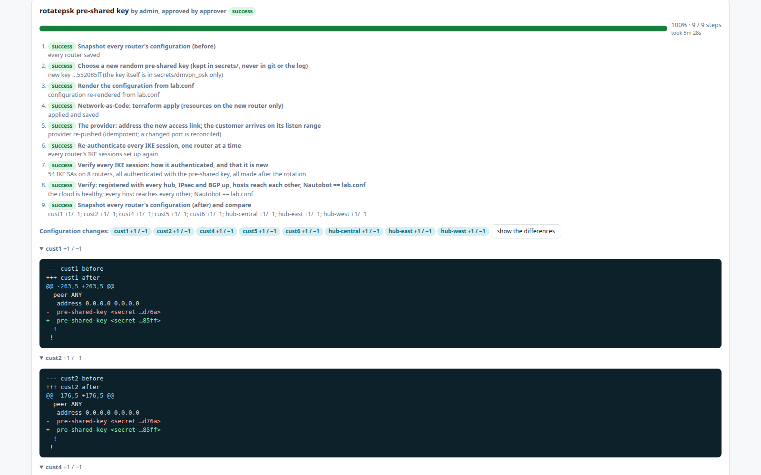
AUDIT
A job: who, what, and the proof
1
1
Who
Who started the job and who approved it.
2
4
2
Progress
Live progress and the time it took.
3
What changed
The before-and-after diff per router. Secrets are masked but their change is still visible.
3
4
Every step
Each step's result, for example '54 IKE SAs on 8 routers, all made after the rotation'.
Why it matters
Every change leaves evidence: the steps, the approvals and the exact configuration difference.
C8000v DMVPN Portal · v0.21.0
17
Notes:
A job: who, what, and the proof
1. Who: Who started the job and who approved it.
2. Progress: Live progress and the time it took.
3. What changed: The before-and-after diff per router. Secrets are masked but their change is still visible.
4. Every step: Each step's result, for example '54 IKE SAs on 8 routers, all made after the rotation'.
Every change leaves evidence: the steps, the approvals and the exact configuration difference.

Slide 18
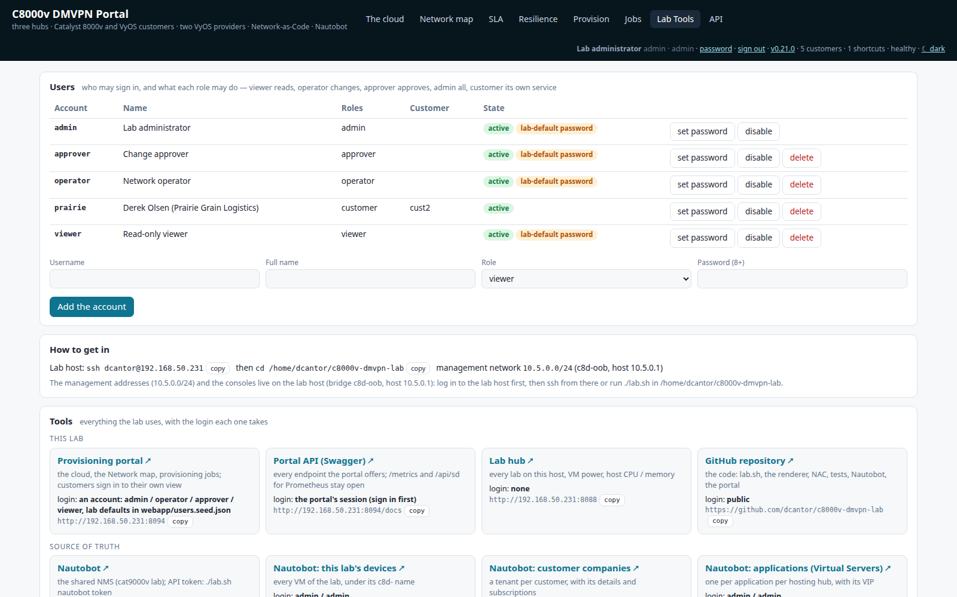
SECURE
Lab tools and accounts
1
Accounts and roles
Admins add, disable and delete accounts and set passwords. Accounts still on their lab-default password are flagged.
1
2
Every tool
Nautobot, the API, the lab hub and the repository, each with how to sign in.
2
Why it matters
Access is managed in one place, with visible warnings when the defaults have not been changed.
C8000v DMVPN Portal · v0.21.0
18
Notes:
Lab tools and accounts
1. Accounts and roles: Admins add, disable and delete accounts and set passwords. Accounts still on their lab-default password are flagged.
2. Every tool: Nautobot, the API, the lab hub and the repository, each with how to sign in.
Access is managed in one place, with visible warnings when the defaults have not been changed.

Slide 19
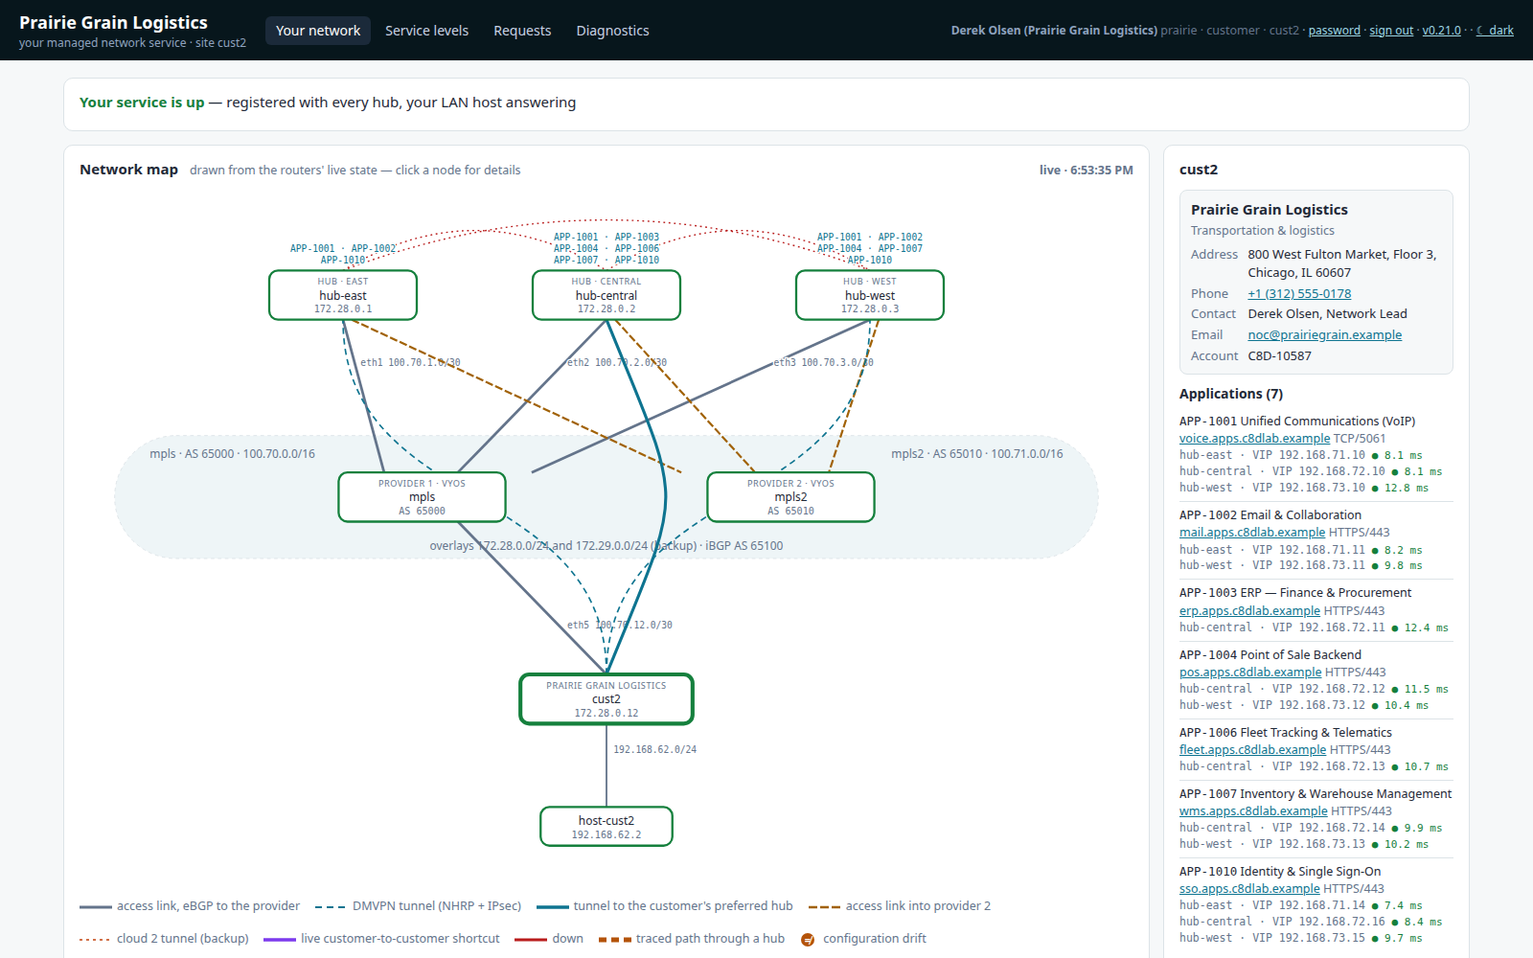
CUSTOMERS
The customer's own view
4
1
Status
Service status, incidents and planned maintenance for this customer.
1
3
2
2
Its own site
The map, cut down to the customer's own site and the hubs it uses.
3
Its applications
Its company details and live application status.
4
Its own pages
Network, service levels, requests and diagnostics. Nothing else is reachable.
Why it matters
Customers can answer their own questions, which means fewer tickets and more trust.
C8000v DMVPN Portal · v0.21.0
19
Notes:
The customer's own view
1. Status: Service status, incidents and planned maintenance for this customer.
2. Its own site: The map, cut down to the customer's own site and the hubs it uses.
3. Its applications: Its company details and live application status.
4. Its own pages: Network, service levels, requests and diagnostics. Nothing else is reachable.
Customers can answer their own questions, which means fewer tickets and more trust.

Slide 20
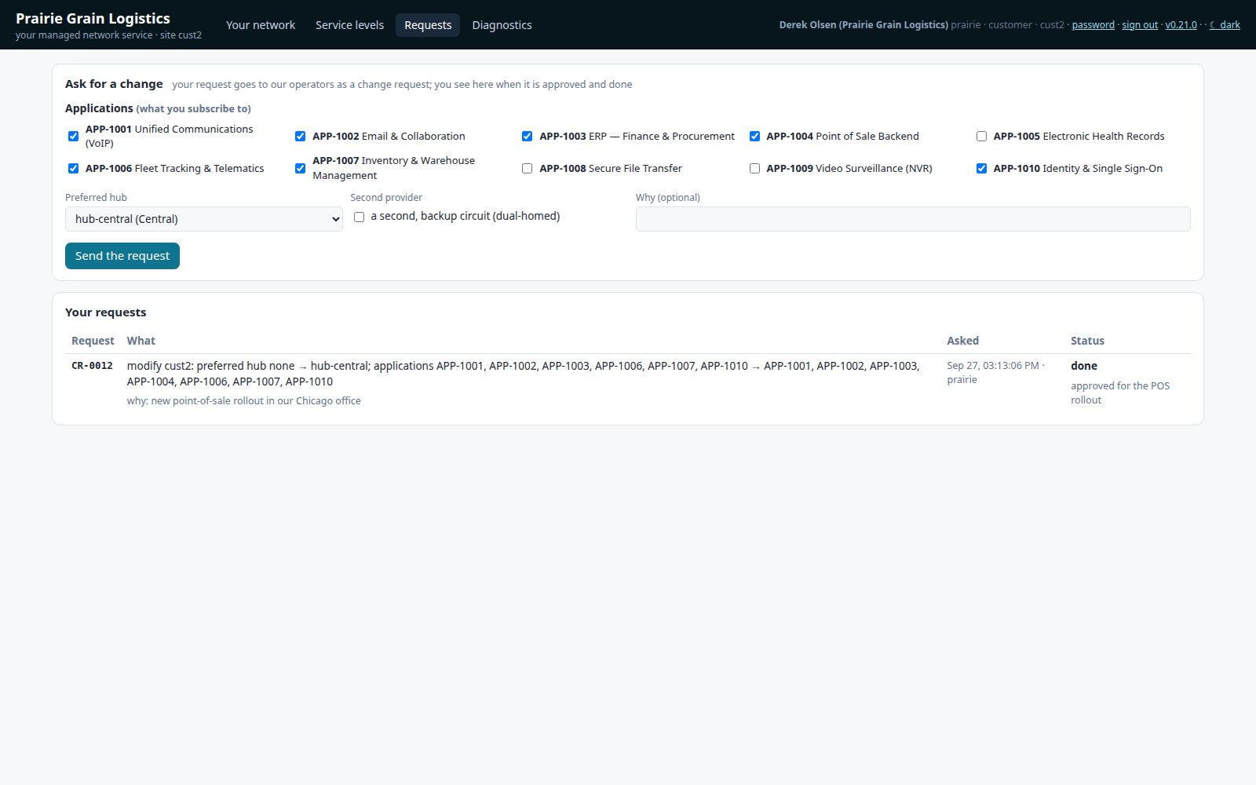
CUSTOMERS
Customer self-service requests
1
Ask for a change
Applications, the preferred hub or a second provider, with a reason.
1
2
Track it
Each request becomes a change request for the operators, and its progress is shown here.
2
Why it matters
Customers can request changes without email, and the request still goes through staff approval.
C8000v DMVPN Portal · v0.21.0
20
Notes:
Customer self-service requests
1. Ask for a change: Applications, the preferred hub or a second provider, with a reason.
2. Track it: Each request becomes a change request for the operators, and its progress is shown here.
Customers can request changes without email, and the request still goes through staff approval.

Slide 21
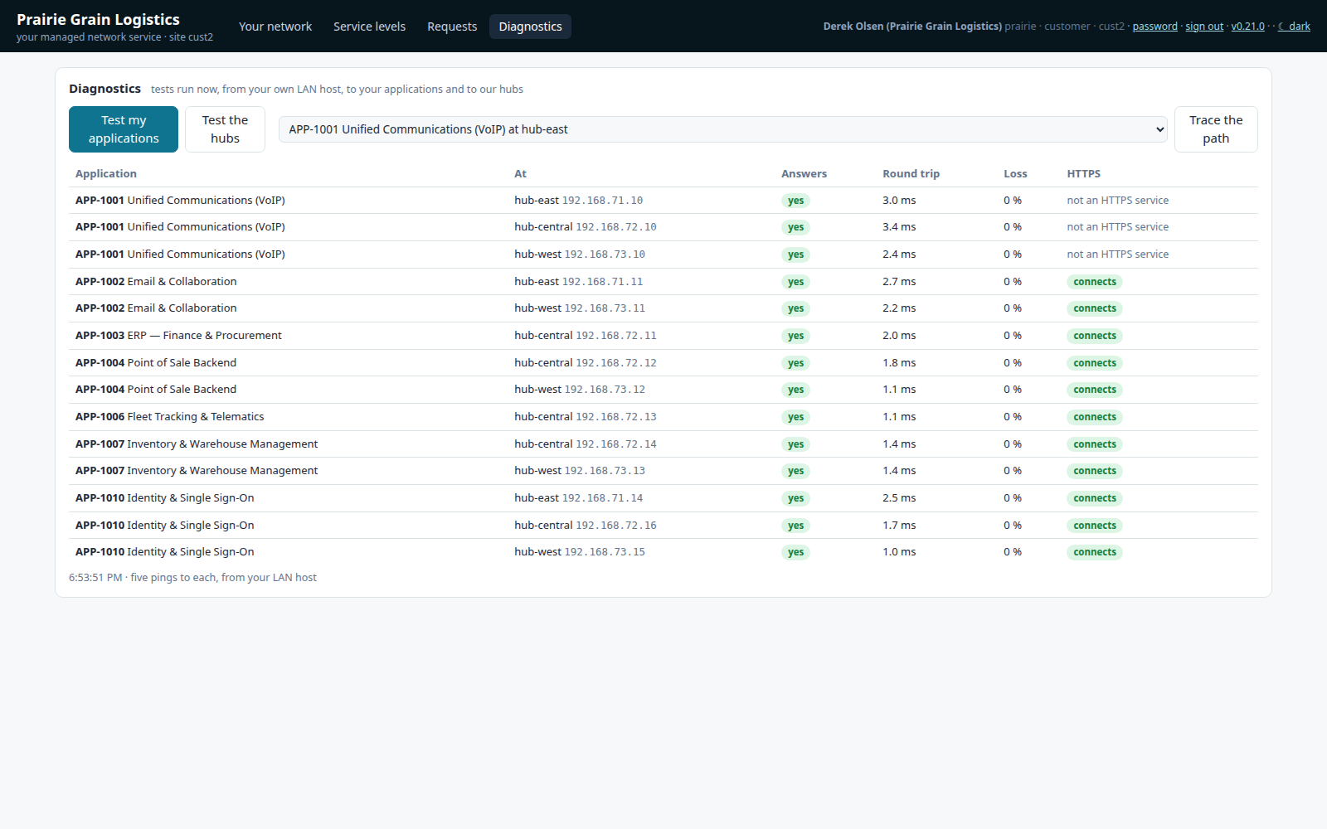
CUSTOMERS
Self-service diagnostics
1
Tests from its LAN host
The customer tests its applications, the hubs, or traces a path.
1
2
Every application, every hub
Round-trip time, loss and HTTP status, run on demand.
2
Why it matters
The first-line diagnosis is done by the customer in seconds, with no ticket needed.
C8000v DMVPN Portal · v0.21.0
21
Notes:
Self-service diagnostics
1. Tests from its LAN host: The customer tests its applications, the hubs, or traces a path.
2. Every application, every hub: Round-trip time, loss and HTTP status, run on demand.
The first-line diagnosis is done by the customer in seconds, with no ticket needed.

Slide 22
CHANGE LIFECYCLE
How a change moves through the portal
Request
Approve
Window
Run the job
Prove
Record
An operator (or a customer) asks: add, modify, remove, deploy, rotate the key…
Someone else approves it (four eyes). An emergency change needs a reason.
It runs now if a change window is open. Otherwise it is scheduled for the next window.
Snapshot, render, NAC and VyOS push, then verify. Progress and ETA are shown live.
Every router registered, every host reachable, 73 tests, Nautobot == lab.conf.
The config diff per router, who asked, who approved and the outcome, kept per job.
What is never allowed
What never needs approval
• Approving your own request (four eyes)
• A viewer or customer starting a job
• Rotating the pre-shared key unless you are an admin
• A secret reaching git, a job log or the screen
• Adding a customer: it takes nothing away
• Dry runs, tests and drift checks
• Customer diagnostics from its own LAN host
• Reading anything the role allows
C8000v DMVPN Portal · v0.21.0
22
Notes:
The policy is editable in the portal: which job types need approval, change windows, emergency changes and expiry of stale requests.

Slide 23
RESULTS IN THE LAB
Measured, not assumed
3 / 3
20 / 20
33 / 33
73 / 73
hubs every spoke is registered with
LAN hosts reach every other host
application checks passing
Robot tests pass after each change
0.6 s
6.8 s
54
5 m 28 s
worst failover when a hub fails; 29 of 35 flows never noticed
worst failover for dual-homed flows when a provider fails
IKE SAs re-authenticated with the new pre-shared key
key rotation end to end, one router at a time, then verified
Provider failure: dual-homed customers (cust1, cust4) move to cloud 2 over the second provider. Single-homed customers lose that provider by design, and the portal shows it as 'cut off' rather than hiding it.
Hub failure: customers keep two other hubs, live shortcuts need no hub, and routing converges when BGP gives up on the failed hub (hold 9 s).
C8000v DMVPN Portal · v0.21.0
23
Notes:
Figures from the lab on 27 September 2026: the health check, the failover measurements on the Resilience page, and the pre-shared key rotation job (CR-0021).

Slide 24
In short
One source of truth
lab.conf drives the configuration, Nautobot and the portal, and drift is detected against it.
Every change is a job
It is planned, approved, run, verified and recorded with a before-and-after diff per router.
Resilience you can measure
Simulate a failure and get the outage timeline for every flow.
Customers see their own service
SLA, applications, requests and self-service diagnostics, and nothing else.
Secure by default
Roles, four eyes, key rotation on demand, and secrets never shown.
github.com/dcantor/c8000v-dmvpn-lab · portal on the lab host at :8094 · API at /docs
24

