Slide 1
The VPN Provisioning Portal
12
An executive overview of the workflows — every screen an operator touches, in order
workflows, one screen
Managed IPsec VPN service · Catalyst 8000v VTI + eBGP · Nautobot source of truth · Network-as-Code (Terraform) · Robot Framework validation

Slide 2
What the portal runs
The live service, as the portal itself reports it — every number below is read from the routers and from Nautobot, never typed in.
20
10 / 10
74
~15 min
routers onboarded
tunnels up
tests per change
to add a branch
3 headends · 4 branches · firewalls, hosts and the interconnect
one static IPsec VTI per branch per headend, each with eBGP
the Robot Framework suites run at the end of a job
VM, onboarding, model, Terraform apply and tests
The portal is the only place the service is changed.
An operator states intent on a form; the portal writes it to the intent document, seeds Nautobot, renders the Network-as-Code data from Nautobot, plans and applies Terraform against the routers, then runs the test suites and keeps the evidence. Nobody logs into a router to make a change.

Slide 3
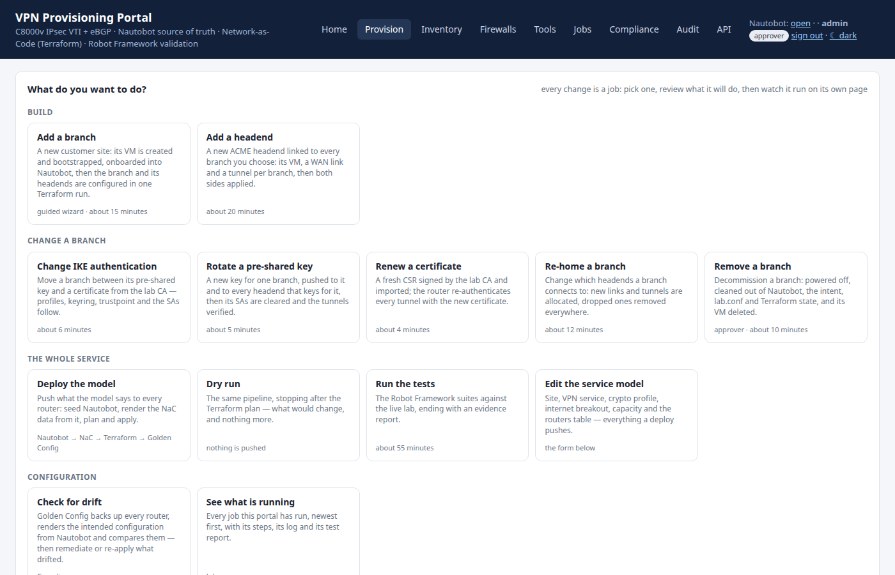
One screen: “what do you want to do?”
The Provision tab opens on the task, not on a form. Each card says what the job does, how long it takes and who may start it.
BUILD
Add a branch · Add a headend
CHANGE A BRANCH
Change IKE authentication · Rotate a pre-shared key · Renew a certificate · Re-home · Remove
THE WHOLE SERVICE
Deploy the model · Dry run · Run the tests · Edit the service model
CONFIGURATION
Check for drift · See what is running
Each card carries its own duration and the role it needs — five minutes to rotate a key, about fifteen to build a branch, and an approver before anything is removed.
Provision — the task launcher; every card is one job

Slide 4
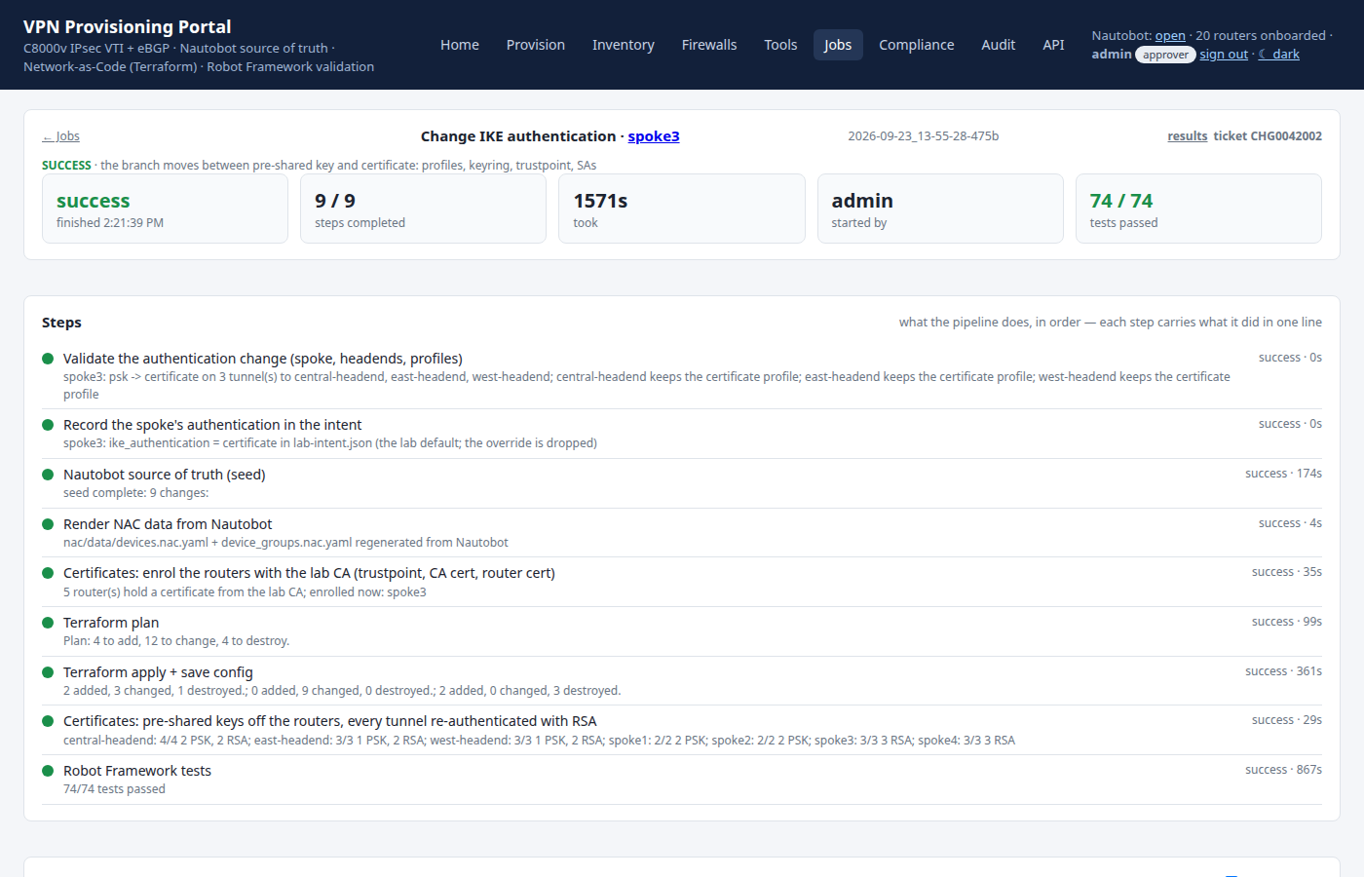
Every job looks the same
Pick a task, review what it will do, then watch it run on its own page — steps, live log, tests, ticket.
What that gives you
One job at a time — two changes can never race each other on the same router.
Every step names what it did: how many objects Nautobot changed, what Terraform added and destroyed.
A failed job resumes from the failed step; the successful steps are not repeated.
The tests are part of the job, not an afterthought — the evidence is attached to it.
A finished job: nine steps, 74/74 tests, who started it and against which change ticket

Slide 5
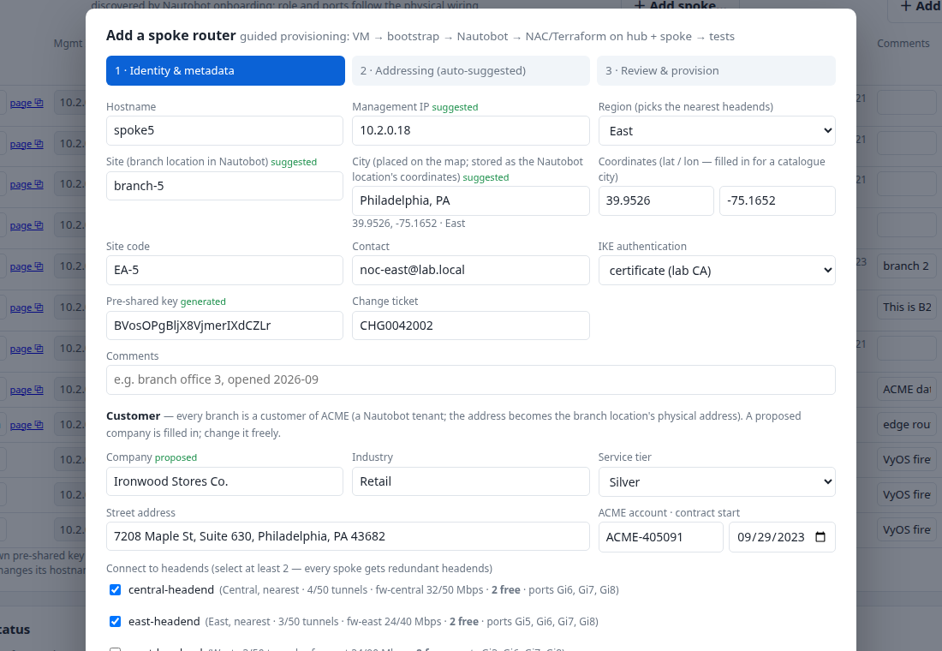
1
Add a branch — who it is
The wizard opens with the identity of the new site; the fields it can work out, it fills in.
What happens here
The branch name and its customer come from the service model; the portal checks the name is free in Nautobot and in the lab.
Choosing two headends is what makes the branch dual-homed — the wizard will allocate a tunnel to each.
Nothing is created yet. Cancel costs nothing.
Step 1 of 3 — name, site, customer, and the headends this branch will reach

Slide 6
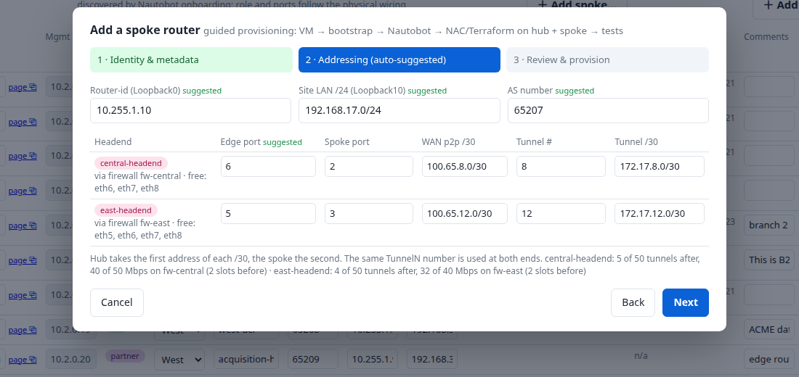
2
Add a branch — where it lives
Addressing is allocated for you: router-id, LAN, AS number, ports, WAN /30s and tunnel numbers.
Allocation, not arithmetic
Each headend line shows the free ports on its firewall and how many tunnel slots remain — capacity is part of the form.
The convention is stated where it is applied: the hub takes the first address of each /30, the spoke the second.
Change any value and the portal re-validates it against the live lab, not against a stale copy.
Step 2 of 3 — every field suggested from the next free value, and editable

Slide 7
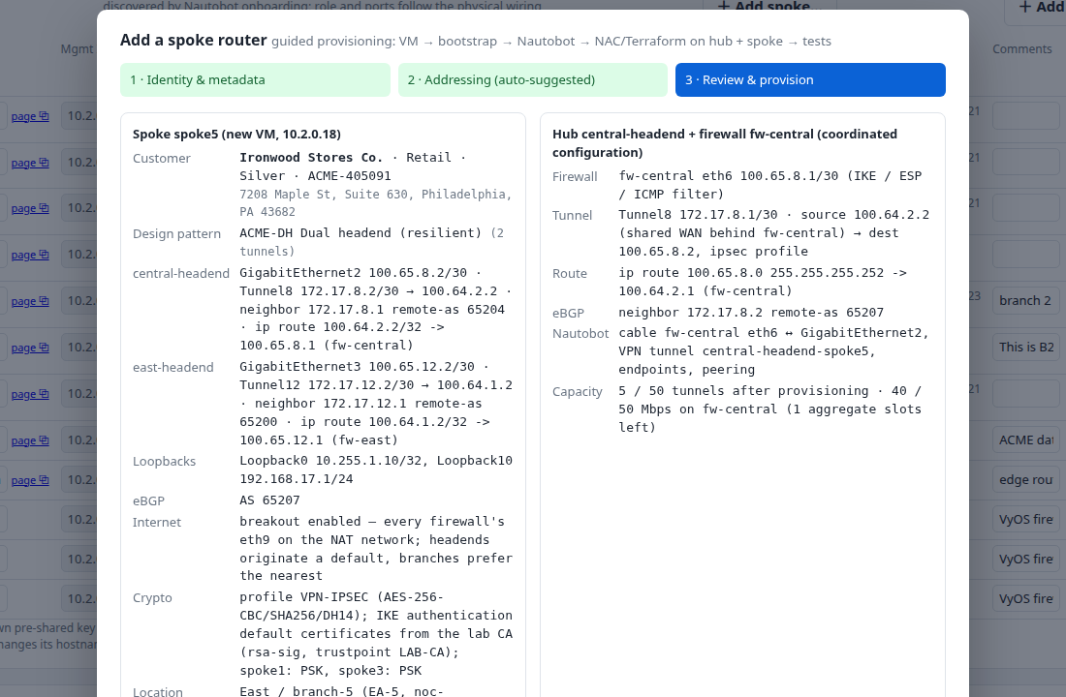
3
Add a branch — confirm, then provision
The last step is the whole change in one place: what will be created, on which devices, under which ticket.
One button, one job
The change ticket is required: it travels with the job and appears in the audit trail.
Provisioning is one job — VM, onboarding, Nautobot, Terraform on both ends, then the tests.
About fifteen minutes later the branch is carrying traffic and the tests say so.
Step 3 of 3 — review and provision

Slide 8
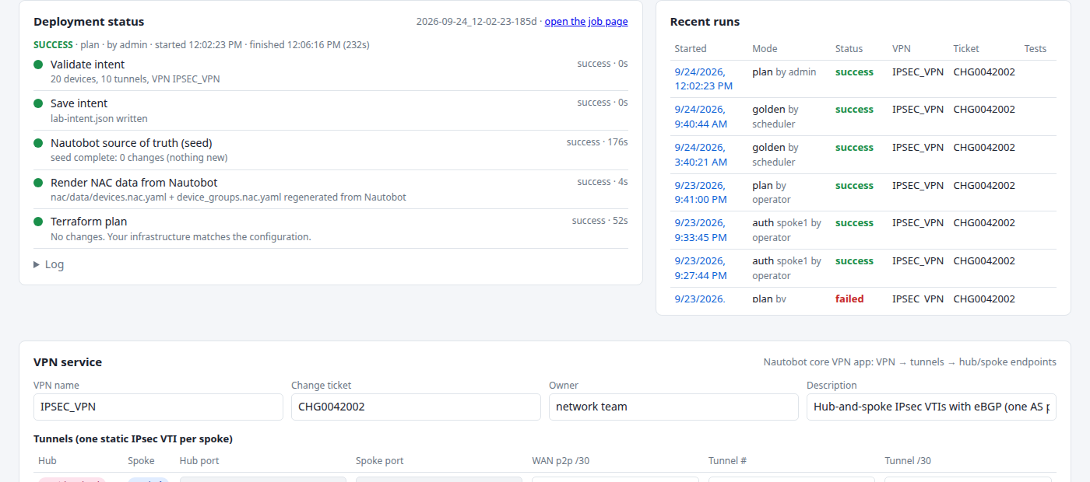
4
Add a branch — watch it run
The job page streams each step as it completes, with what that step actually changed.
The pipeline: validate intent → save intent → seed Nautobot → render NaC → Terraform plan → apply → tests
Recent runs sit beside it: mode, who started it, the ticket and the outcome.

Slide 9
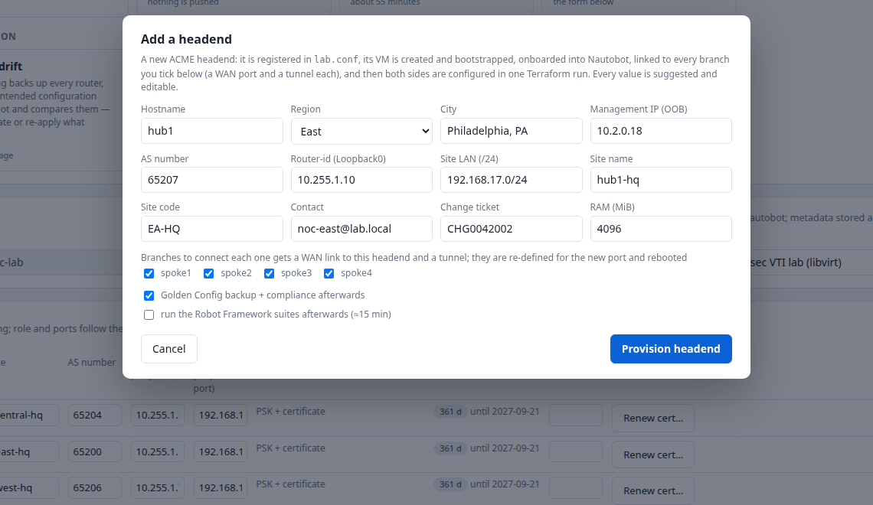
Add a headend
The same shape of form for the other direction: a new ACME headend, linked to every branch you choose.
The other direction
A headend is the heavier job (about twenty minutes): a new router, a new firewall link, and a tunnel added at both ends of every branch it serves.
The wizard allocates the tunnel numbers and /30s for each branch at once, so the mesh stays consistent.
The same pipeline runs it, and the same tests prove it.
Every value suggested — identity, WAN link, firewall ports and a tunnel per branch

Slide 10
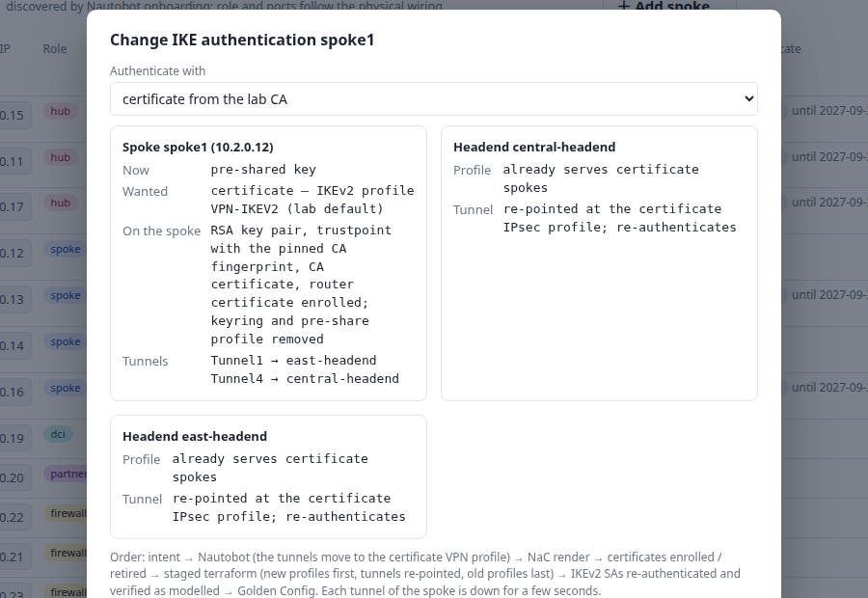
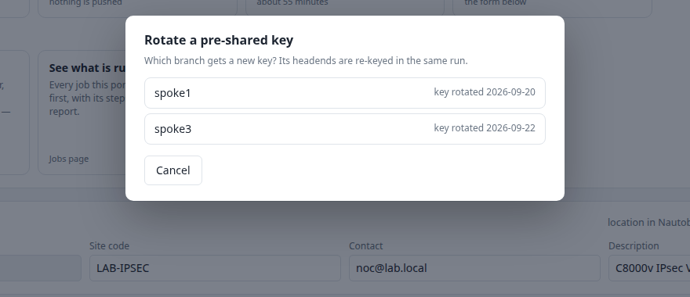
Change a branch, safely
Day-two work is a short job with a narrow blast radius — one branch, one property, one ticket.
Change IKE authentication — pre-shared key ↔ certificate from the lab CA
Every per-branch task starts by asking which router
Moving a branch to certificates re-enrols it with the CA, swaps the IKEv2 profile, keyring and trustpoint, clears the security associations and waits for every tunnel to re-authenticate — nine steps, and the tests at the end.
Rotating a pre-shared key is the same idea in five minutes: a new key on the branch and on every headend that serves it, then the SAs are cleared and the tunnels verified.

Slide 11
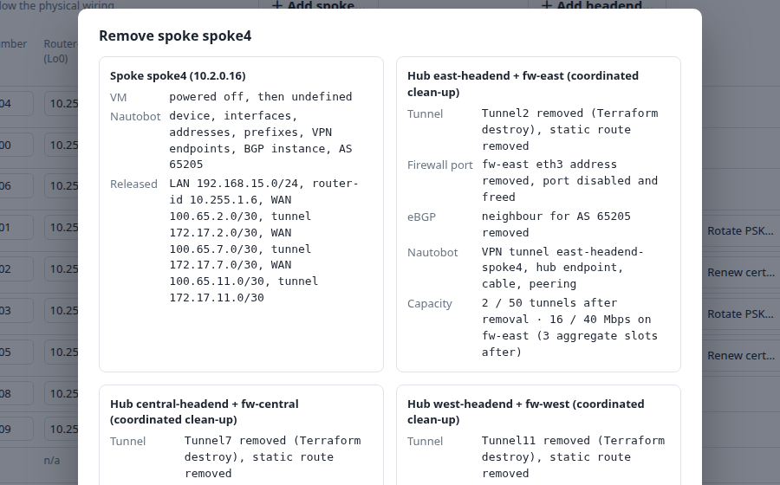
Remove a branch
Decommissioning says what it is about to delete before it deletes anything — and needs an approver.
Guarded by design
Only a user with the approver role may start it; an operator sees the card but cannot run it.
The reverse of provisioning, in the same order: tunnels dropped at both ends, objects removed from Nautobot, lab.conf and Terraform state cleaned, the VM deleted.
The job and its log stay in the ledger afterwards.
The confirmation lists the router, the tunnels, the Nautobot objects and the Terraform state that will go

Slide 12
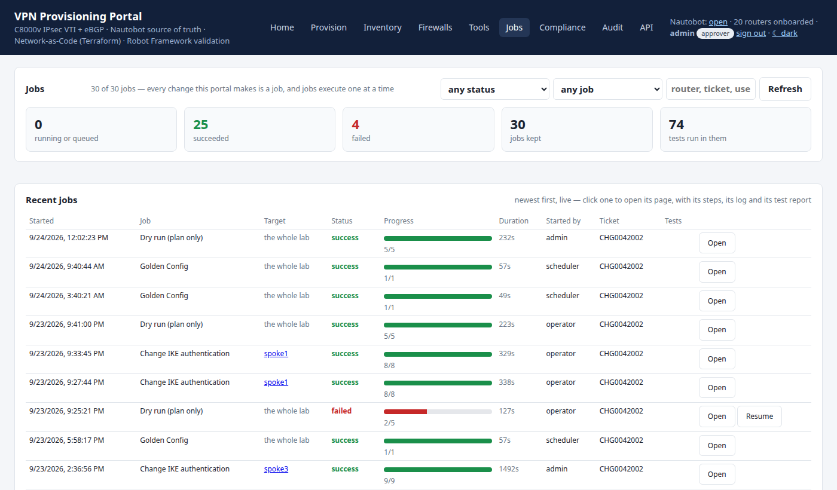
The ledger: every job the portal has run
Jobs is the operational record — what ran, against what, by whom, for how long, and whether the tests passed.
The record
Thirty jobs kept · twenty-five succeeded · seventy-four tests run in them — the portal's own counters.
Every row carries its change ticket, so the record matches the change-management system.
A failed job keeps its successful steps and offers Resume rather than a fresh start.
Filterable by status, job type and target; a failed job offers Resume

Slide 13
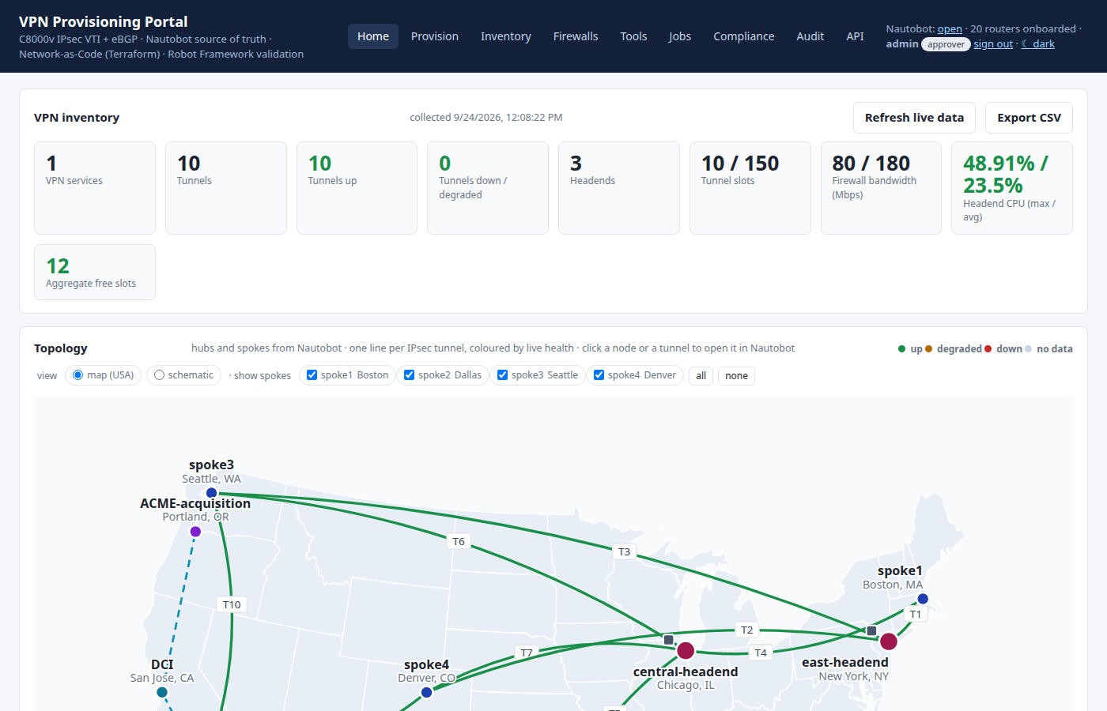
The service as it stands
Home is the daily view: capacity and health first, the live topology below it.
Capacity, not guesswork
Every tile is collected from the routers and the firewalls, with the time of collection shown; nothing is cached silently.
The topology is drawn from Nautobot and coloured live: a degraded tunnel is visible before anyone reports it.
Free tunnel slots and spare firewall bandwidth are the numbers that decide whether the next branch fits.
Tunnels up, headend CPU, firewall bandwidth and free tunnel slots — then the map, coloured by live state

Slide 14
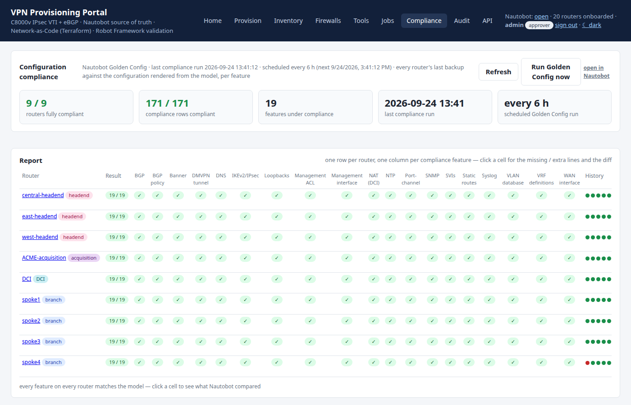
Drift, and what to do about it
Golden Config renders the intended configuration from Nautobot and compares it with what each router is actually running.
Two ways back
A scheduled run keeps the comparison current; the page shows when it last ran and what it found.
Remediate pushes only the difference; Re-apply pushes the whole intended configuration — both are ordinary jobs with logs and tests.
Drift history is kept, so 'when did this device start differing?' has an answer.
Per-device compliance with the differences, remediation and re-apply as jobs of their own

Slide 15
What the UI is for
Anyone can run it
Nothing happens off the record
The model stays true
The knowledge is in the forms, not in an engineer's head: every value is suggested from the model and validated against the live lab before anything is applied.
Sign-in, role, change ticket, the steps, the log and the test report are kept with the job. The audit page lists every action the portal took.
Golden Config compares the routers against what Nautobot says they should be; drift is visible on one page and remediated as a job of its own.
The portal is at http://192.168.50.231:8090 — Provision to start a job, Jobs to see every one that has run, Home for the service as it stands. The full specification (115 requirements) is docs/requirements.pdf.

