Slide 1

FABRIC FACTORY
From a web form to a verified change on a 20-VM EVPN/VXLAN data centre
Architecture, tech stack, and the automation and orchestration behind the evpn-3tier lab
evpn-3tier 0.18.0 · 9 November 2026 · Technical overview
Notes:
Fabric Factory is the self-service front end of the evpn-3tier lab. This deck covers the network, the platform, the sources of truth, the pipelines and the orchestration, resilience, and the tech stack. The companion white paper (PDF) has the full detail.

Slide 2



The lab at a glance
A complete data centre in software, changed only through self-service requests that are checked end to end
20
4
4
65
VMs: 11 VyOS, 9 Alpine Linux
VRFs, joined only through the firewalls
Gitea pipelines, one per device group
end-to-end checks in verify, plus 9 test suites
Intent, not commands
phpIPAM holds the addressing, Nautobot holds the plan, and pipelines render every configuration. Deleting intent deletes configuration.
Isolation by routing
Each tier lives in its own VRF and learns only a default route to the firewalls, so all traffic between tiers or to the WAN crosses the zone firewall.
Visible, reversible automation
Every step is idempotent and shown live. A failed request is fixed and retried, and nothing is called done until it is checked on the devices and from the WAN.
Notes:
Three ideas shape the lab. Intent, not commands: nobody configures a device by hand. Isolation by routing: tiers only ever see a default route that points at the firewalls. Visible, reversible automation: every workflow stage is idempotent and the request page shows the pipelines live.

Slide 3
Architecture
01
The platform, the EVPN/VXLAN fabric, the routing and security policy, the application, and the sources of truth

Slide 4
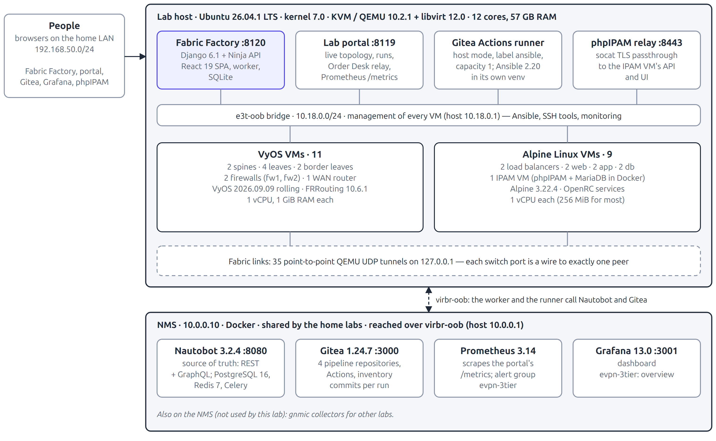
Platform and deployment
One Ubuntu host runs the 20 VMs and the lab services; a shared NMS runs the source of truth and CI
Service | Port
Fabric Factory | 8120
Lab portal | 8119
phpIPAM relay | 8443
Nautobot (NMS) | 8080
Gitea (NMS) | 3000
Grafana / Prom. | 3001 / 9090
Lab Hub | 8088
Point-to-point cabling
Every switch port is a QEMU UDP tunnel to exactly one peer port, proved by lab.sh check-wiring. Management stays on the e3t-oob bridge.
Notes:
KVM guests managed by libvirt. Fabric links are QEMU UDP tunnels, so wiring is point-to-point like real cabling. Every VM has an out-of-band management interface used by automation, device tools and monitoring. The NMS at 10.0.0.10 hosts Nautobot, Gitea, Prometheus and Grafana.

Slide 5
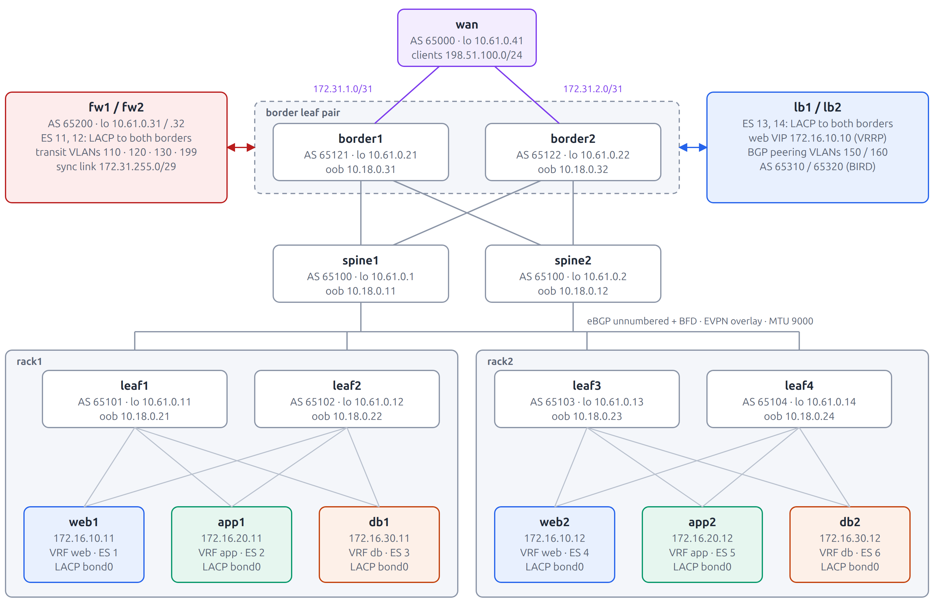
Fabric topology
A two-tier Clos of VyOS routers: 2 spines, 4 leaves, 2 border leaves; eBGP unnumbered + BFD underlay, EVPN/VXLAN overlay
Underlay
BGP over IPv6 link-local; BFD 300 ms × 5; ECMP 4; MTU 9000; one AS per leaf, spines share 65100
Overlay
EVPN on the same sessions; explicit RTs 65500:VNI; L2VNI = 10000 + VLAN; one L3VNI per VRF
Multihoming
Every server and border appliance is dual-homed with LACP as one Ethernet segment (ESI)
Notes:
Every leaf and border has one link to each spine. BGP runs unnumbered, so no point-to-point subnets. Each switch's loopback in 10.61.0.0/24 is router ID and VTEP.

Slide 6
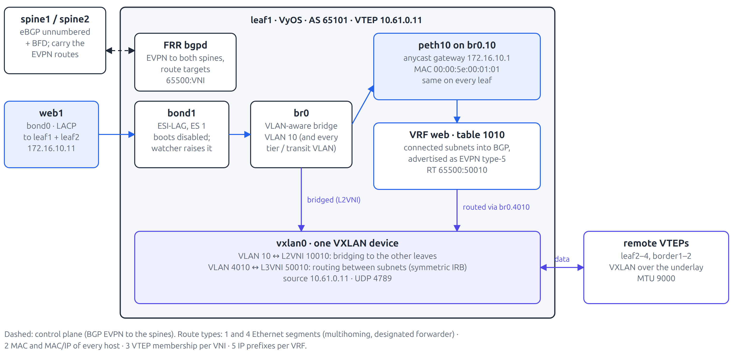



EVPN/VXLAN inside a leaf
Symmetric IRB with an anycast gateway: every leaf routes locally and bridges over a single VXLAN device
Symmetric IRB
The ingress leaf routes in the VRF and sends over the L3VNI; the egress leaf routes again into the subnet
Anycast gateway
Every leaf answers for the same gateway IP and virtual MAC 00:00:5e:00:01:01
ESI multihoming
A designated forwarder per segment; a failed leg is withdrawn within a second
Notes:
Segment bonds boot disabled and a watcher raises them only once EVPN has converged, so a rebooting leaf does not attract traffic it cannot forward yet.

Slide 7
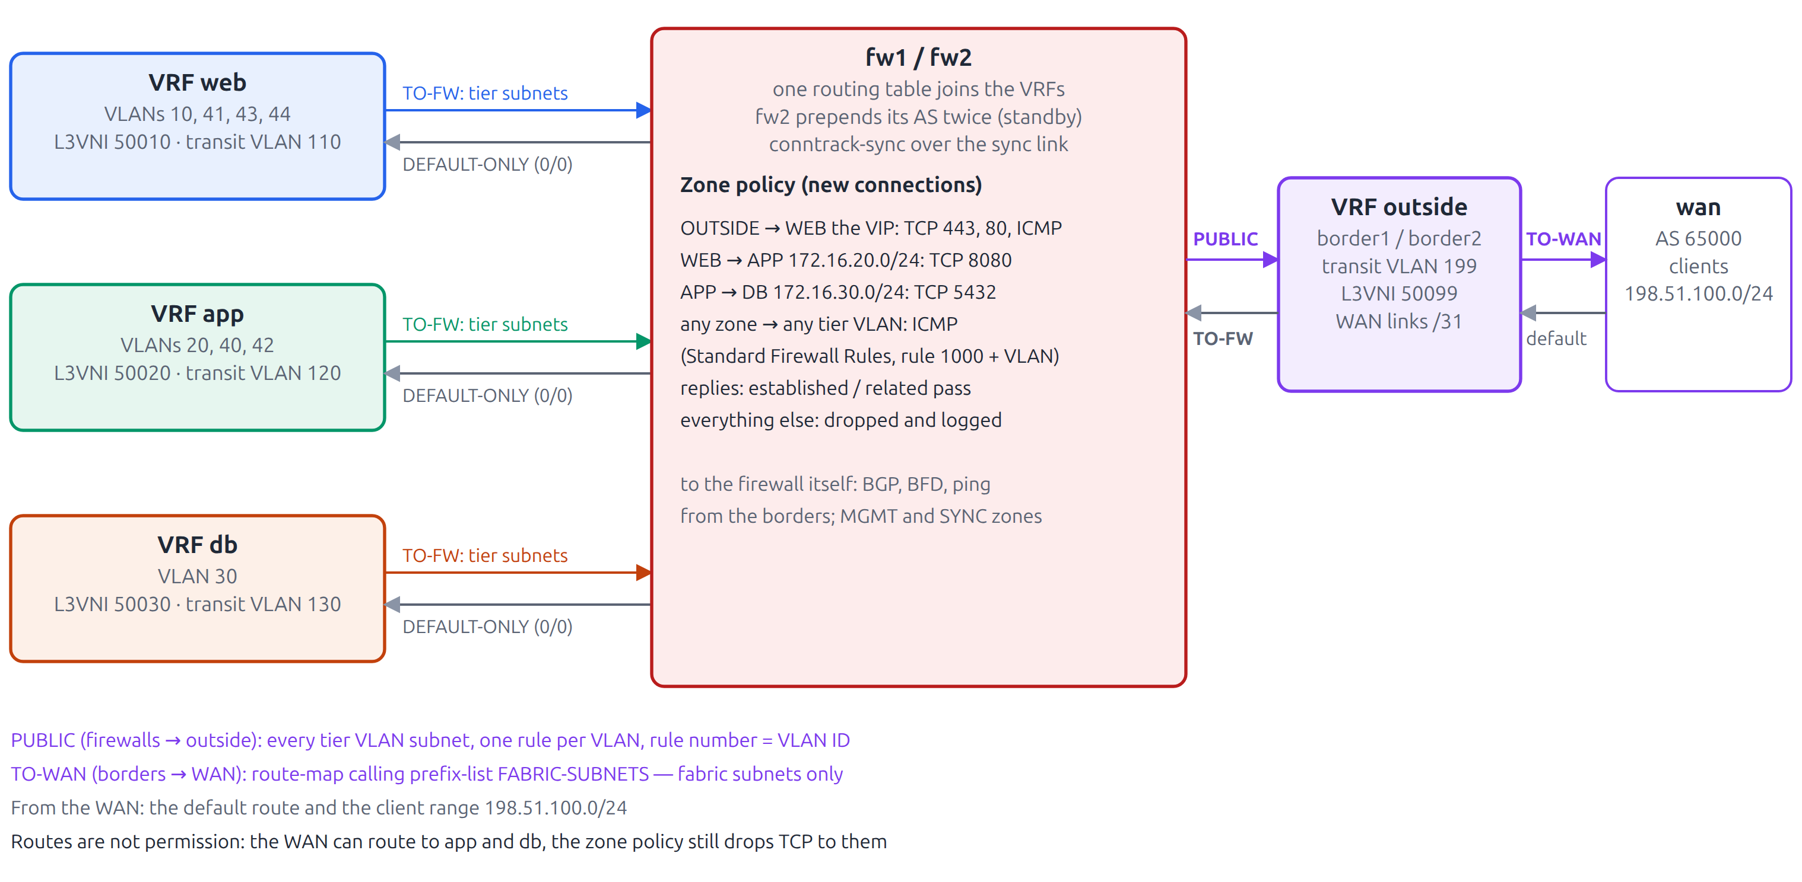
Routing and security policy
Routing makes the firewalls the only way out of a tier; the zone firewall decides which connections may start
TO-FW borders → firewalls
Tier subnets only, no /32s or transit
DEFAULT-ONLY firewalls → tier VRFs
0.0.0.0/0, so a tier can only leave via the firewall
PUBLIC firewalls → outside
Every tier subnet; rule = VLAN ID
TO-WAN borders → WAN
Prefix-list FABRIC-SUBNETS: VLAN subnets only
Notes:
The borders carry one transit VLAN per VRF to each firewall. Each firewall keeps all VRFs in one routing table, so inter-tier routing happens inside the firewall where the zone policy applies.

Slide 8


Zone firewall and high availability
Replies always pass; new connections pass only as listed in Nautobot's fw_policy; everything else is dropped and logged
Standard Firewall Rules
ICMP to every tier VLAN from every other zone.
Rule number = 1000 + VLAN ID, so adding or removing a VLAN never renumbers anything.
Active / standby pair
fw2 prepends its AS twice, so fw1 is preferred; conntrackd syncs connection state to fw2.
1.8 s pause when fw1 powers off
VRF | L3VNI / VLAN | Tier VLANs (L2VNI = 10000 + VLAN) | Firewall transit
web | 50010 / 4010 | 10 (lab design); 41, 43, 44 via Fabric Factory | VLAN 110 · 172.16.110.0/28
app | 50020 / 4020 | 20 (lab design); 40, 42 via Fabric Factory | VLAN 120 · 172.16.120.0/28
db | 50030 / 4030 | 30 (lab design) | VLAN 130 · 172.16.130.0/28
outside | 50099 / 4090 | none; WAN links 172.31.1.0/31, 172.31.2.0/31 | VLAN 199 · 172.16.199.0/28
Notes:
Powering off fw1 pauses a live connection for 1.8 seconds (BFD plus BGP) before it continues through fw2.

Slide 9
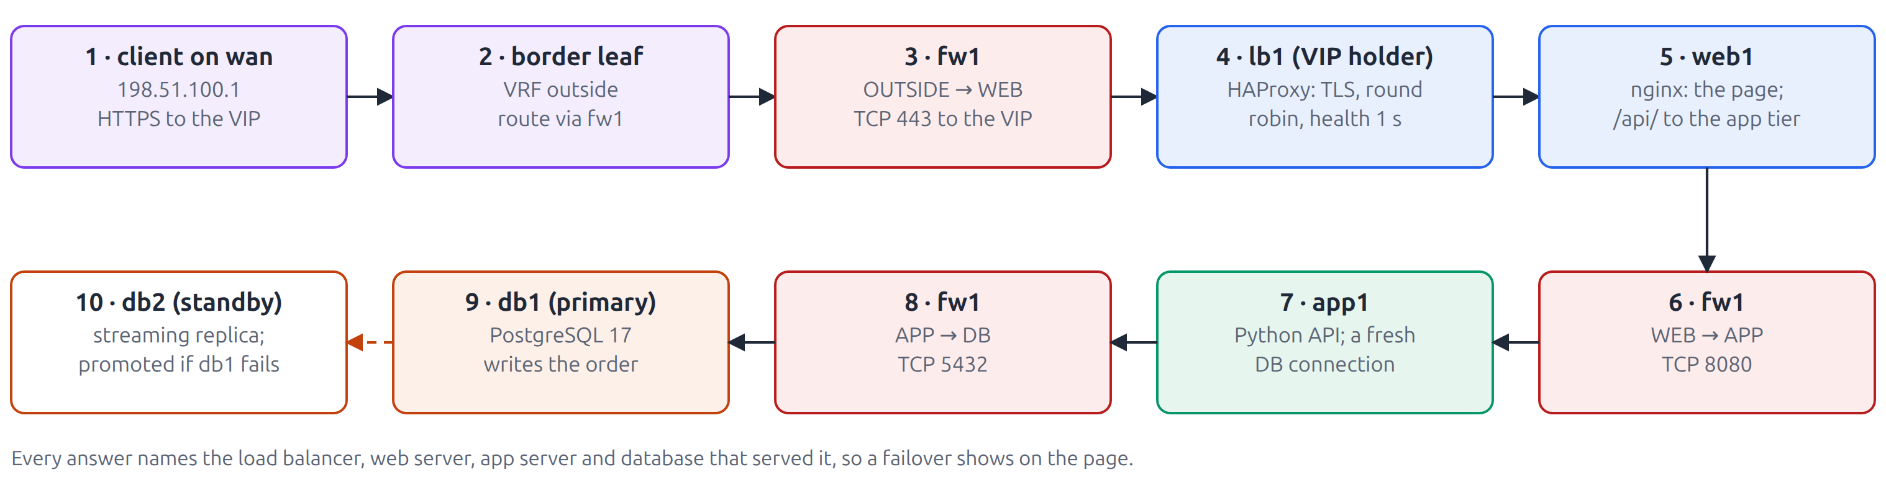




The application: Order Desk
Every answer names the load balancer, web, app and database server that served it, so failovers show on the page
HAProxy 3.2 + keepalived
TLS on VIP 172.16.10.10; VRRP with a virtual MAC
nginx 1.28
Page, /health, /api/ proxy with retry
Python 3.12 API
psycopg 3; asks for the read-write database
PostgreSQL 17
Streaming replication to a hot standby
Notes:
The load balancers can also announce their own VIP prefixes over BGP: lb1 (AS 65310) and lb2 (AS 65320) run BIRD 2.17 to both borders on peering VLANs 150 and 160 with BFD. Both peerings were requested and built through Fabric Factory.

Slide 10



Two sources of truth, one direction of flow
Each system owns one kind of fact; everything on the devices is derived from them
phpIPAM 1.8.3
Addressing
Nautobot 3.2.4
The plan
Gitea 1.24.7
Code and history
Holds
Subnets under 172.16.0.0/16, gateway and host reservations, VLAN numbers, VRFs
Holds
Devices, cabling, VLAN and prefix objects, and the evpn-3tier config context
Holds
Four repositories: templates, playbooks, each run's rendered inventory
Read by
Allocator reads free /24s and used VLANs
Read by
Every pipeline reads it over GraphQL
Read by
The runner executes them
phpIPAM first when adding, last when removing. Addresses are reserved before anything uses them and released only after nothing does. The pipelines read only Nautobot.
Notes:
Fabric Factory writes phpIPAM before Nautobot when adding and releases phpIPAM after the devices are clean when removing, so an address is never handed out while still in use.

Slide 11
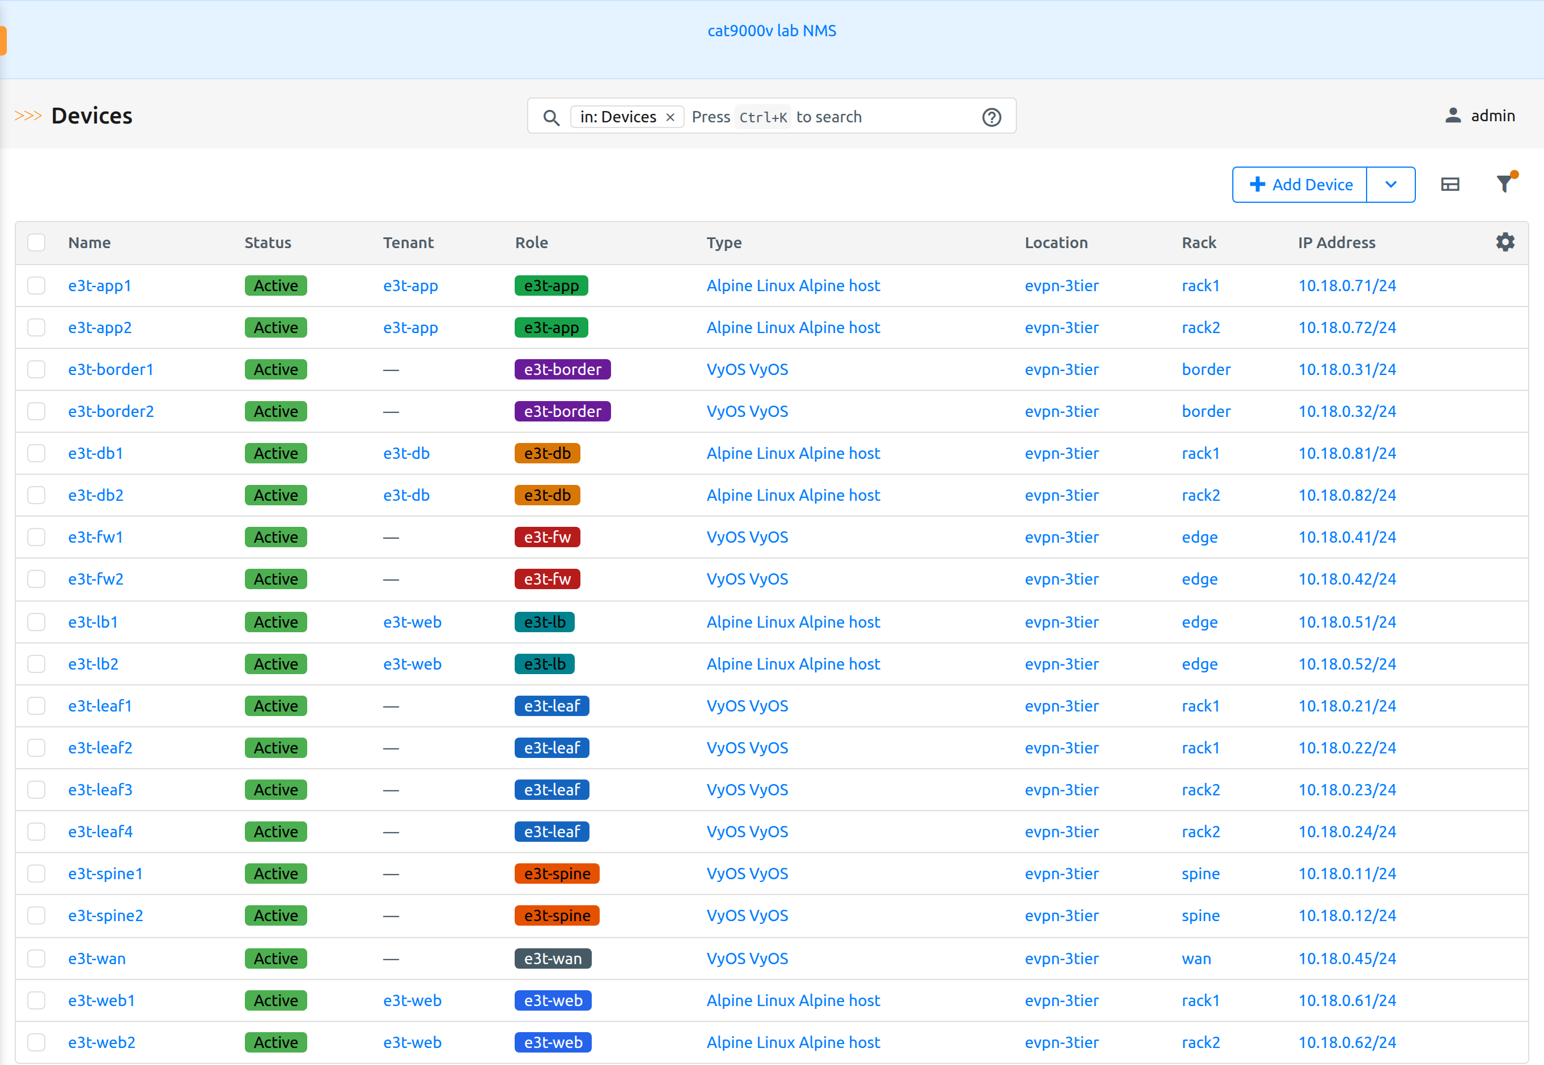
Where the lab lives in Nautobot
Everything of this lab sits under one name, evpn-3tier, on a Nautobot shared with other labs; devices are named e3t-<node>
Object | Where in Nautobot | Count
Location, racks | Organization → Locations → evpn-3tier (Site); racks spine, rack1, rack2, border, edge, wan | 1, 6
Devices | Devices, location evpn-3tier: role e3t-<role>, type VyOS / Alpine host, primary IPv4 = OOB (ansible_host) | 19
Interfaces, cables | eth0–7, loopback dum0, server bonds; cables labelled fabric / access / wan / sync | 117, 35
VRFs, tenants | IPAM → VRFs, namespace evpn-3tier: web, app, db, outside; route target 65500:<L3VNI>; tenant e3t-<VRF> | 4, 4
VLANs | IPAM → VLANs, group evpn-3tier: tier, transit, peering, L3VNI | 21
Prefixes, IPs | IPAM, namespace evpn-3tier: each prefix with its VRF, VLAN, tenant, location | 25, 38
Config context | Extensibility → Config Contexts → evpn-3tier: evpn plan (VRFs, VLANs, VNIs, gateways), fw_policy, lb_peerings, WAN, MTU | 1
Devices → Devices, filtered to location evpn-3tier
Seeded once from lab.conf by tools/nautobot_seed.py (idempotent); changed afterwards only by Fabric Factory's workflows.
Notes:
Five names keep the lab apart on the shared NMS: location, namespace, VLAN group, tenant group and config context are all evpn-3tier, and every device is e3t-<node> because Nautobot names are global. The config context holds what Nautobot has no model for: VNIs, the anycast MAC, the route-target AS, transit and WAN plans, the firewall policy and load balancer peerings. Each device's local config context carries its index, ASN and console port.

Slide 12
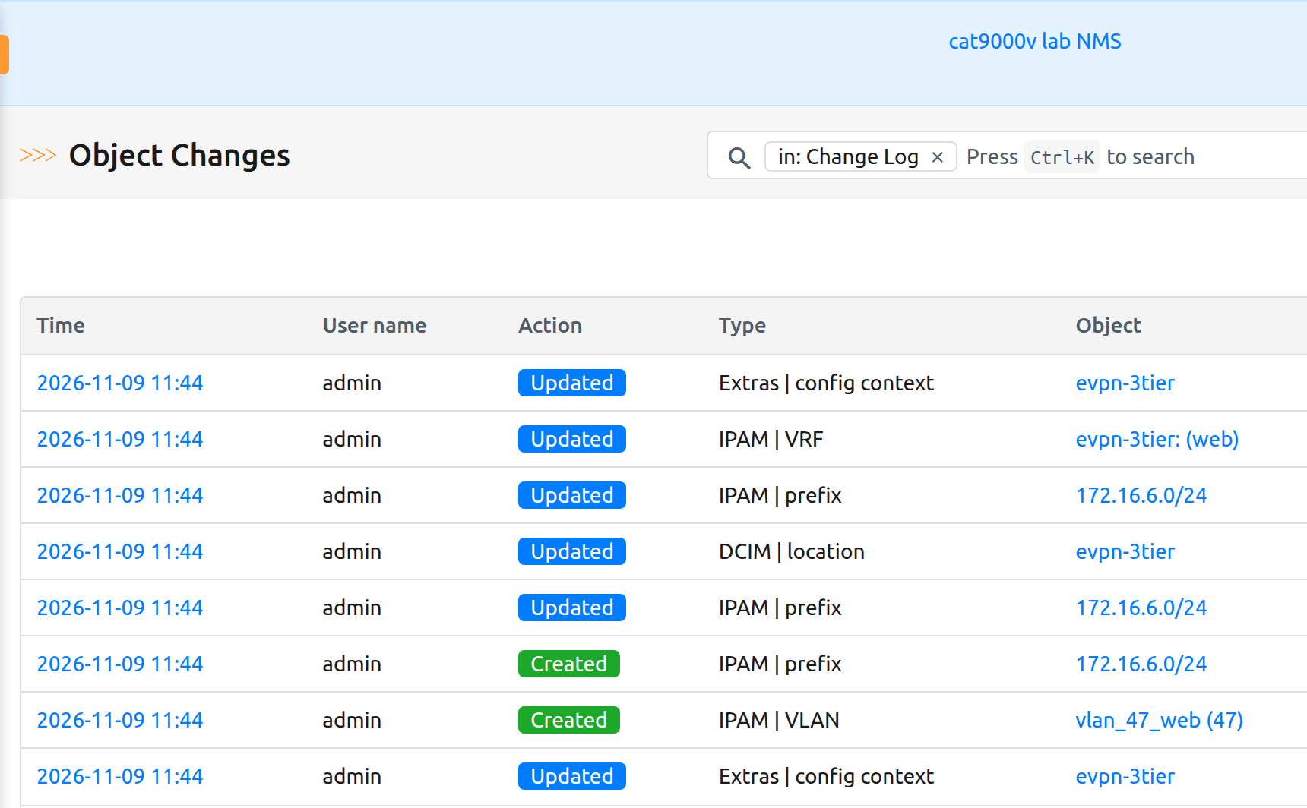

How each request writes to Nautobot
REST calls, each after a read of the same object, so a retry skips what already exists
Workflow | REST calls, in order
Add a VLAN | PATCH config-contexts/{id}: append the VLAN to evpn.vlans POST ipam/vlans: vlan_<ID>_<VRF>, group evpn-3tier, tenant POST ipam/prefixes, PATCH its location, POST vrf-prefix-assignments PATCH config-contexts/{id}: three standard ICMP rules in fw_policy
Remove a VLAN | PATCH config context: out of evpn.vlans, its rules out of fw_policy DELETE ipam/prefixes/{id}, DELETE ipam/vlans/{id}
LB peering | PATCH config context: append to lb_peerings POST ipam/vlans peering-<LB>; POST prefixes (peering /29, VIPs) + location + VRF
Nautobot's change log: request #18 (Add VLAN 47), newest first
Every write is traceable
Nautobot's change log records each call; every VLAN and prefix a request creates names the request in its description (“self-service request #18”).
Notes:
The worker uses Nautobot's REST API with a token read from the NMS at run time. Before each POST it GETs the object by name, VID or prefix; a retry therefore finds what an earlier attempt created. Nautobot's change log records every write: for request #18 the plan entry, the VLAN object, the prefix and its location and VRF assignment, and finally the Standard Firewall Rules.

Slide 13
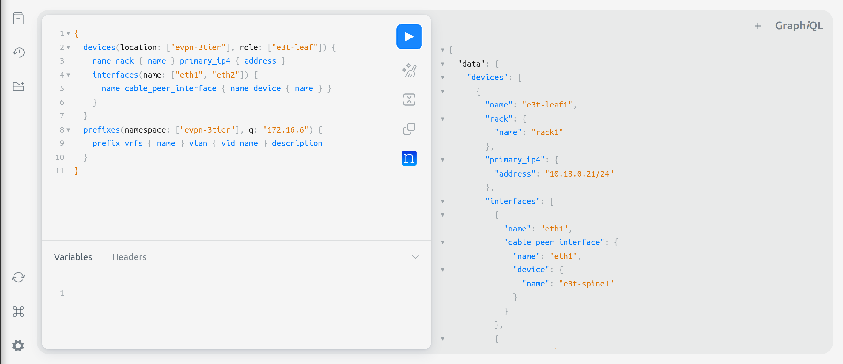
How it is read back: one GraphQL query per reader
Each reader asks /api/graphql/ once and gets devices, cabling and the config context in a single answer
The pipelines' inventory query
Pipelines nautobot_inventory.py, every run → hosts.yml, group_vars, host_vars, committed to Gitea
query {
config_contexts(name: ["evpn-3tier"]) { data }
devices(location: ["evpn-3tier"]) {
name local_config_context_data
role { name } rack { name }
platform { name } primary_ip4 { address }
interfaces {
name description mac_address mtu
vrf { name }
ip_addresses { address }
cable { label }
cable_peer_interface {
name device { name }
}
}
}
}
Fabric Factory forms labmodel.py, cached 30 s → used VLANs, VNIs, subnets, ASNs; switch pairs; removable VLANs
Fabric Dashboard fabric.py, cached 30 s → counts, design KPIs, topology
The same kind of query in Nautobot's GraphiQL
Notes:
Nothing walks the REST API object by object to rebuild the plan. The pipelines' query returns the config context and every device with its role, rack, platform, primary IPv4, local context and every interface's description, MAC, MTU, VRF, addresses, cable label and cable peer; the inventory script turns that into the same lab model lab.conf produces. Fabric Factory's lab model and the Fabric Dashboard send similar queries; the executors' guards use plain REST GETs before each write.

Slide 14
Automation and orchestration
02
How Fabric Factory sequences phpIPAM, Nautobot and four Gitea pipelines, and how Ansible renders, applies and verifies

Slide 15
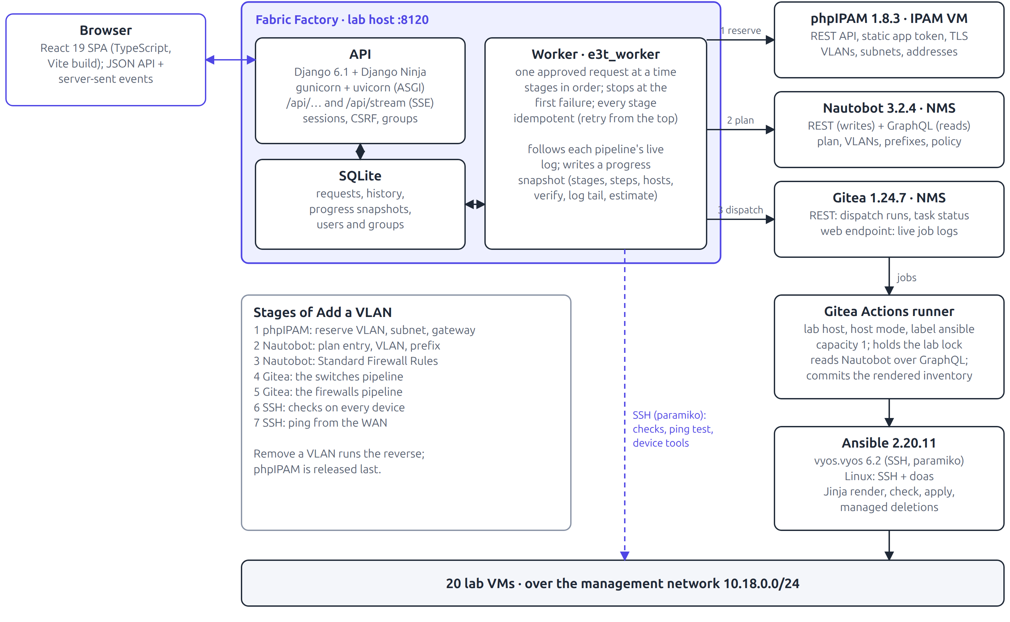
Orchestration architecture
Fabric Factory orchestrates in order; the pipelines are the only thing that configures a device
Solid arrows
requests and writes
Dashed arrows
reads and observation
One worker
carries out one approved request at a time; restarts mark it failed and retryable
Device tools
a fixed command list over SSH, with redaction and an audit log
Notes:
The worker talks to phpIPAM over REST with a static app token, to Nautobot over REST and GraphQL, to Gitea to dispatch workflows and follow job logs, and to devices over SSH for checks and the ping test.

Slide 16
Interfaces between the components
Every hop, how it authenticates, and what it carries
From → to | Protocol and authentication | Carries
Browser → Fabric Factory | HTTP; Django session cookie, CSRF token on every change | JSON API calls; server-sent events (1 s)
Worker → phpIPAM | REST over TLS, static application token | Free subnets and VLANs; reserve and release
Worker → Nautobot | REST (writes) and GraphQL (reads), API token | Config context edits; VLAN and prefix objects
Worker → Gitea | REST dispatch + the web job endpoint with log cursors | Run start, status, and the live log
Pipeline → Nautobot | GraphQL, token from a Gitea Actions secret | Devices, cables, config context → inventory
Pipeline → Gitea | git over HTTP, the job's own token | The rendered inventory, committed [skip ci]
Ansible → devices | SSH on management; vyos.vyos (paramiko), doas on Linux | Configuration lines, files, services
Worker / tools → devices | SSH (paramiko) on management | Post-change checks, ping test, configs, state
Notes:
Secrets: the Nautobot token is a Gitea Actions secret; the worker reads Gitea and Nautobot credentials from the NMS at run time and phpIPAM's from a mode-600 file. None is stored in a repository.

Slide 17
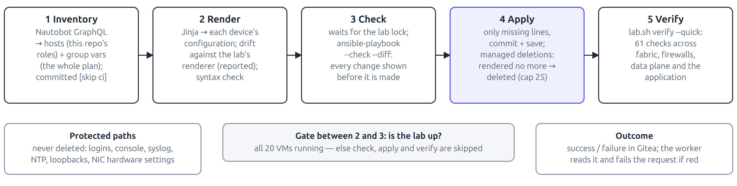




Anatomy of a pipeline run
The same five steps in all four repositories: switches, firewalls, load balancers, servers
Inventory from Nautobot
Committed back every run, so each run's input is versioned
Check before apply
--check --diff records exactly what will change
Managed deletions
Lines the templates no longer produce are deleted; more than 25 on one device stops for a human
One at a time
Runner capacity 1 and a shared file lock with the lab's tests
Protected paths
Logins, console, syslog, NTP, loopbacks, NIC settings are never deleted
Verify gates the run
61 quick checks after every apply; a red verify fails it
Notes:
On VyOS only lines missing from the running configuration are committed, so runs are idempotent and a run with nothing to do reports changed=0. Managed deletions are what make removal by intent safe.

Slide 18




How Fabric Factory orchestrates
Ordered, idempotent stages; guards before writes; the pipelines followed live; proof before done
Ordered, idempotent stages
Each stage checks what already exists, so a retry skips completed work. A reservation tagged with the request number is recognised as its own.
Progress snapshot on a running request (abridged)
{
"stage": "switches",
"pipeline": {
"repo": "evpn-3tier-switches",
"run": 23,
"status": "running",
"steps": [
{"name": "inventory", "status": "success"},
{"name": "render", "status": "success"},
{"name": "check", "status": "success"},
{"name": "apply", "status": "running",
"play": "Configure VyOS",
"task": "Commit missing lines",
"hosts": {"leaf1": "changed",
"leaf2": "ok"}}
]
},
"updated": "2026-11-09T04:33:41Z"
}
Guards before writes
Every check runs before the first write to a system, so a refusal changes nothing.
Following the pipelines live
Gitea 1.24 has no API for a running job's log, so the worker polls the web UI's job endpoint with log cursors every 3 s and parses PLAY, TASK and verify lines.
Proof, not assumption
Each workflow ends with checks on the devices and, for VLANs, a ping test from the WAN.
Notes:
The browser receives the snapshot through server-sent events; each request page shows the stage list, the pipeline's steps, the current Ansible play and task and per-host results, with the full step log one click away.

Slide 19
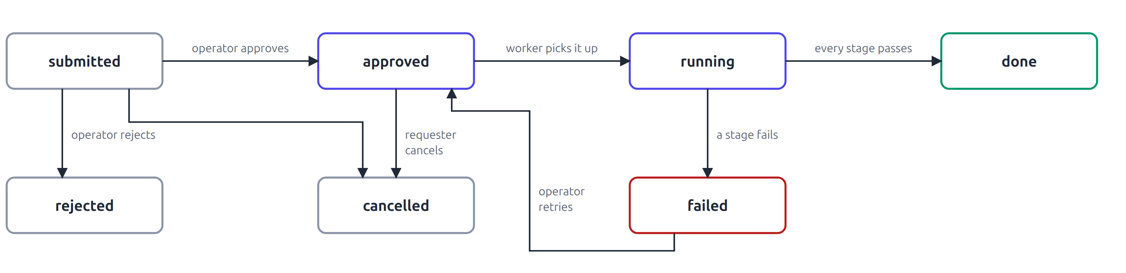
Fabric Factory workflows
Users choose little; the app works out the rest from phpIPAM and Nautobot, and an operator approves
Add a VLAN
Remove a VLAN
Load balancer peering
You choose: Choose the VRF and span
App works out: Next unused VLAN and VNI, a free /24, gateway = first host, name vlan_ID_VRF
You choose: Choose the VLAN and confirm
App works out: Removable? Not the lab's design, no hosts, not the VRF's last VLAN
You choose: ASN, peering VLAN, VIPs, BFD
App works out: The border pair and VRF, from the load balancer's cabling in Nautobot
phpIPAM
Nautobot
FW rules
pre-flight
Nautobot
switches
Nautobot
switches
LBs
phpIPAM
switches
firewalls
checks
ping
firewalls
checks
phpIPAM
checks
Notes:
Forms are validated against a live model of the lab built from Nautobot: VLAN IDs, VNIs, ASNs and overlapping subnets already in use are refused, including those held by other open requests. Values are re-checked at submission and at execution.

Slide 20
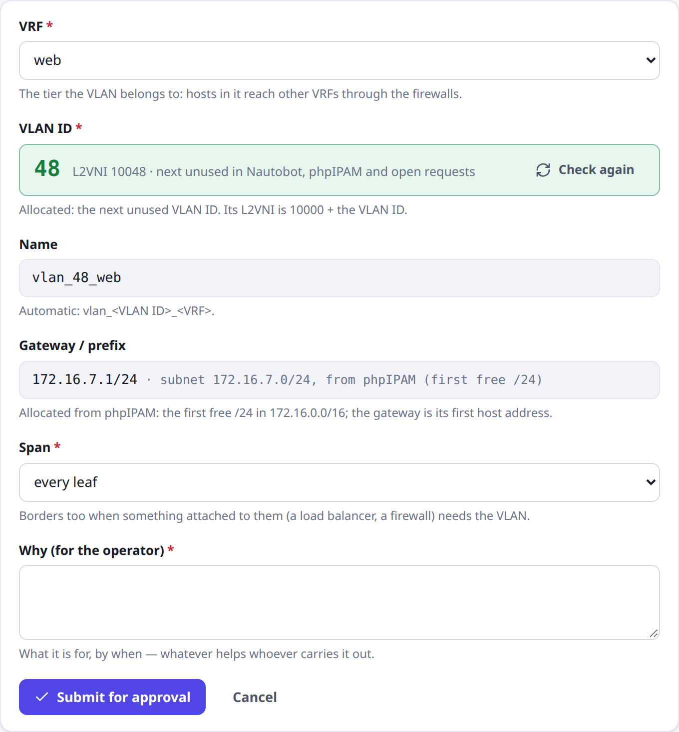
Most fields fill themselves, by design
When a user requests a VLAN, the system picks the next available VLAN ID and subnet, without being asked
THE USER CHOOSES
VRF
Span
Reason
FILLED IN AUTOMATICALLY
VLAN ID the next unused ID: Nautobot, phpIPAM and open requests
L2VNI 10000 + VLAN ID
Name vlan_<ID>_<VRF>
Subnet phpIPAM's first free /24 that overlaps nothing
Gateway always the subnet's first host
Why: fewer fields, fewer mistakes
No typos, duplicate IDs or overlapping subnets; re-checked at submission and at execution.
Notes:
This is by design. Hand-typed VLAN IDs, VNIs and subnets are where network changes most often go wrong. The requester presses one button, Select the next unused VLAN ID; the allocator takes the lowest unused ID above the highest tier VLAN, skipping anything in Nautobot, phpIPAM or an open request, and asks phpIPAM for its first free /24 under 172.16.0.0/16. The gateway is always the first host. Values are checked again when the request is submitted and when the worker carries it out.

Slide 21




Inside Fabric Factory
A React front end, a Django Ninja API, one worker and a live event stream, on one origin with one session cookie
Front end
React 19 + TypeScript, built with Vite; served by Django from the same origin, so no CORS
Security model
Requesters submit and see their own requests; operators see all and approve, reject and retry.
Every change needs the session's CSRF token.
Device tools run only commands from a fixed server-side list, redact hashes and keys, and log who asked.
Credentials never live in a repository.
API
Django 6.1 + Django Ninja, OpenAPI at /api/docs; gunicorn with uvicorn workers (ASGI)
Worker
A management command as its own service; one approved request at a time
Live updates
/api/stream sends a server-sent event per changed request each second; no broker
Notes:
Read-only tools: View Device Configurations (view and download, a zip of all), Retrieve Device State (interfaces, routes, BGP including AS paths, EVPN, MAC tables and more) and the Fabric Dashboard (the fabric at a glance, design KPIs and a live check).

Slide 22
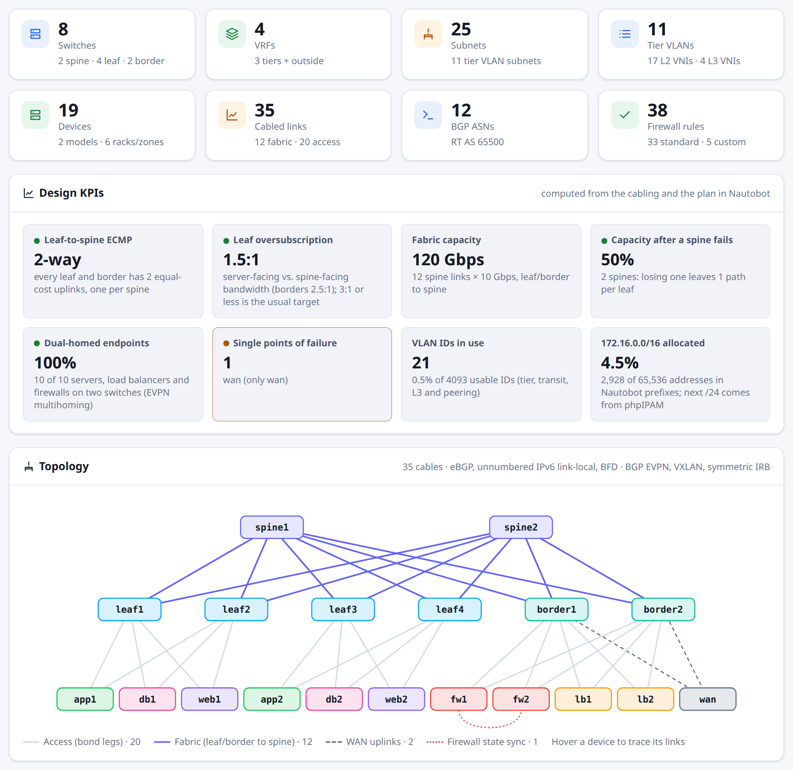


The Fabric Dashboard
The whole fabric at a glance, from Nautobot, with the KPIs its design implies and a live check against it
At a glance, from Nautobot
8 switches by role, 19 devices by model, 4 VRFs, 25 subnets, 11 tier VLANs, a topology drawn from the 35 cables
Design KPIs
2-way ECMP · 1.5:1 oversubscription · 120 Gbps fabric · 50% left after a spine fails · 100% dual-homed · 1 single point of failure (wan)
Live health vs. design
Read-only SSH: 19/19 reachable · 12/12 fabric sessions · BGP 64/64 · BFD 64/64 · the same 14 VNIs on every leaf · one VyOS version
Change KPIs
16 changes completed · 100% success · median 5m 22s from approval to a verified change
Notes:
A Tools card on the New request page; read-only, so no approval. The design half is one GraphQL query to Nautobot: devices with roles, models, racks and cabling; the plan's VRFs, VLANs, transit and peerings. KPIs are computed from it: ECMP width is the uplinks per leaf, oversubscription is server-facing over spine-facing bandwidth, dual-homing counts endpoints cabled to two switches. The live half asks every device over SSH with fixed commands (BGP and BFD summaries, EVPN VNIs, show version) and compares: one spine EVPN session per spine link, every leaf with the same VNIs. Both are cached for 30 seconds; the page reloads its design when a request finishes.

Slide 23
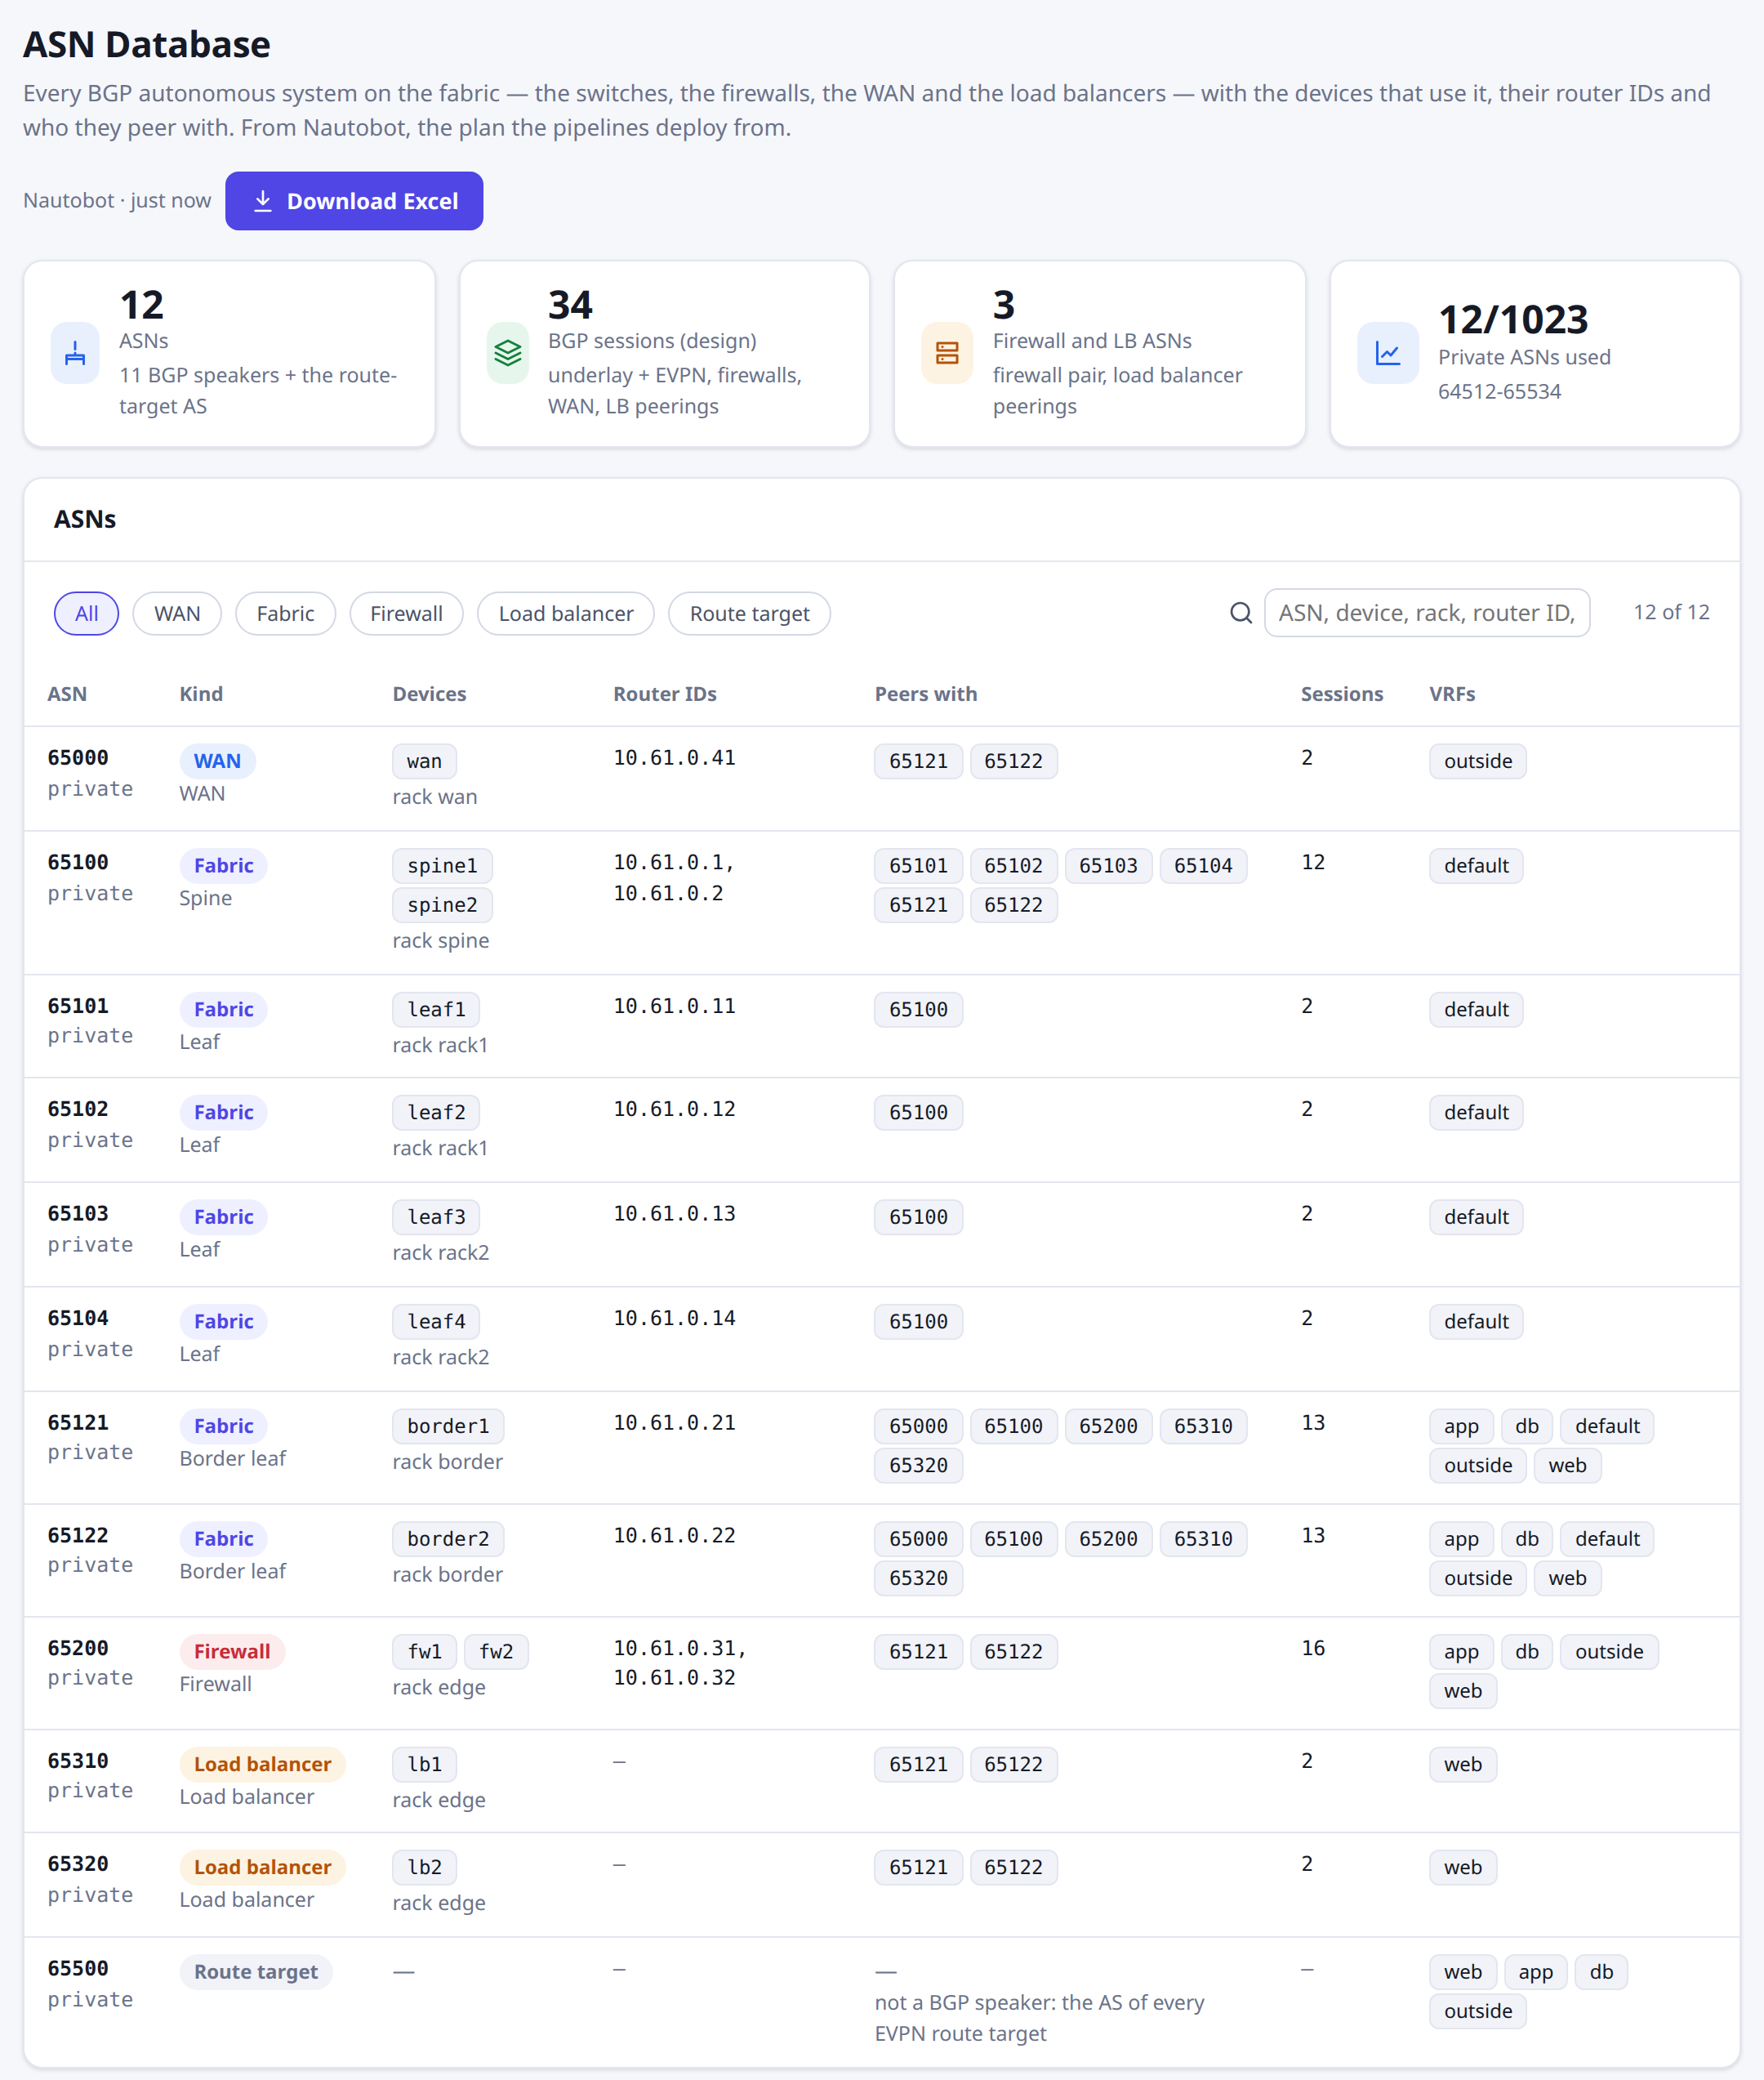
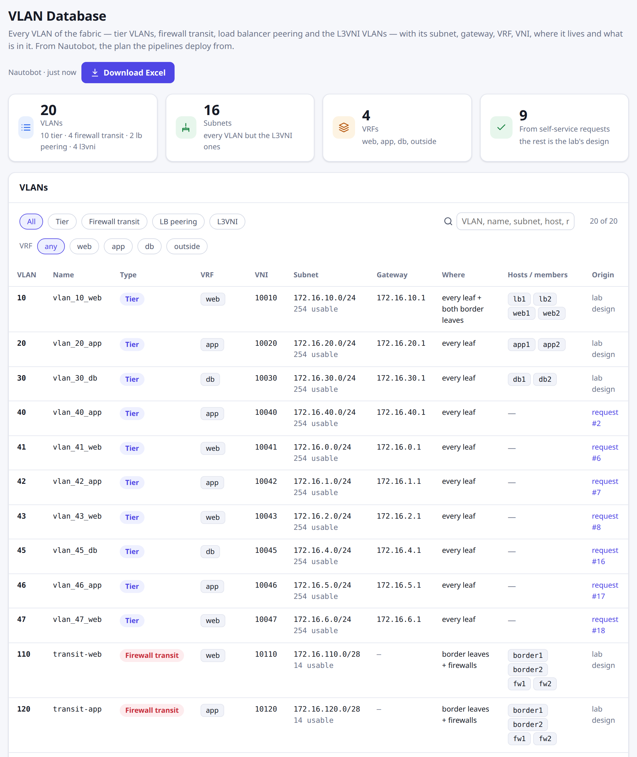


The ASN and VLAN databases
Every AS and every VLAN of the fabric, from Nautobot, searchable, and downloadable as an Excel workbook
ASN Database
12 ASNs — spines, leaves, borders, firewalls, WAN, load balancers, route target — with devices, router IDs, peers, VRFs; all 34 BGP sessions
VLAN Database
20 VLANs: tier, firewall transit, LB peering, L3VNI — subnet, gateway, VRF, VNI, where it lives, hosts, and the request that made it
Excel download
Built on the server: header row frozen, a filter on every column, numbers as numbers, an About sheet with the source and time
ASN Database
VLAN Database
Notes:
Two read-only tools next to the Fabric Dashboard. Both read Nautobot's model, the plan the pipelines deploy from, so they are never out of date. The ASN Database groups devices by AS and derives every BGP session of the design from the cabling and the plan: underlay and EVPN on the spine links, firewall transit per VRF, the WAN and the load balancer peerings. The VLAN Database lists every VLAN in the evpn-3tier group, with the self-service request that created it where there is one. Both download as Excel workbooks built with openpyxl.

Slide 24
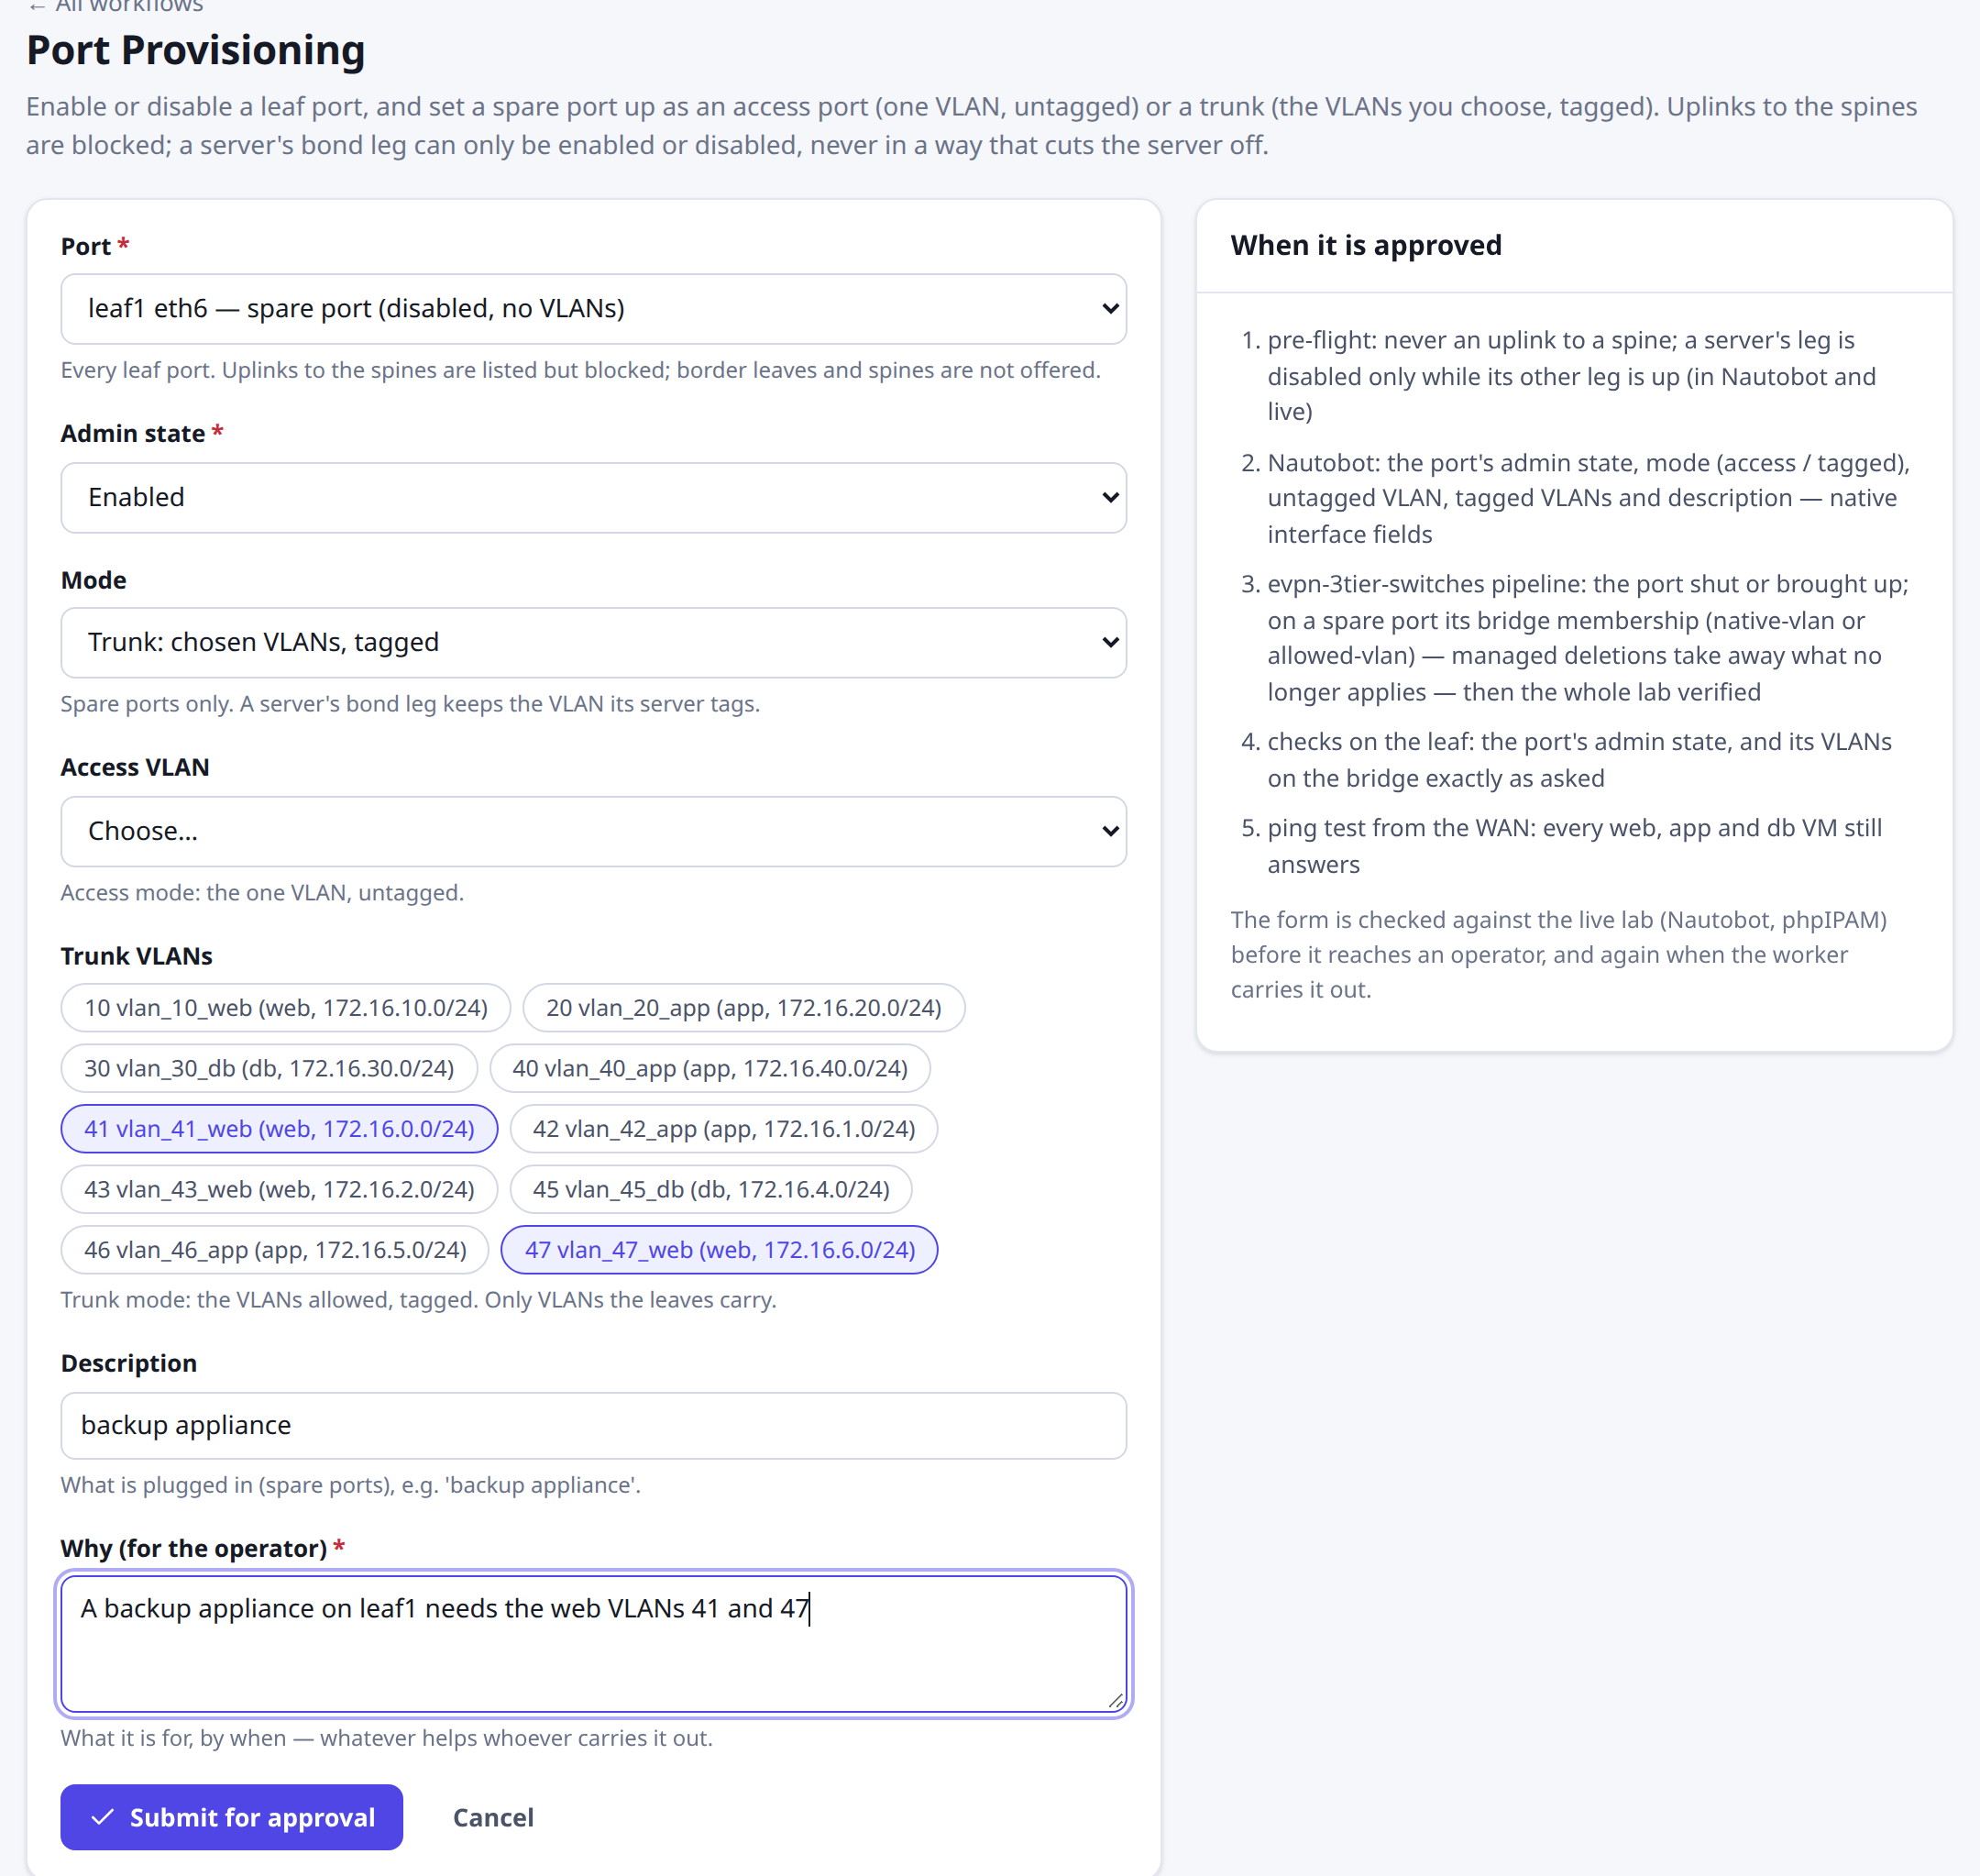


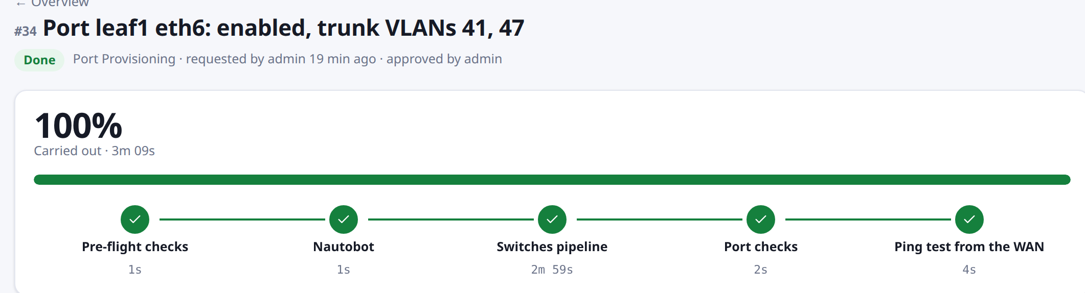
Port Provisioning
Enable or disable a leaf port; set a spare port up as access or trunk. Uplinks to the spines are blocked
Uplinks to the spines
Blocked: listed as such, refused by the form and by the worker
A server's bond leg
Enable or disable — disabled only while its other leg is up (Nautobot and live); its VLAN follows the server
Spare ports eth6, eth7
Access (one VLAN, untagged), trunk (chosen VLANs, tagged) or no VLANs; only VLANs the leaves carry
Intent in Nautobot's interface fields → switches pipeline (verify) → the port's state and bridge VLANs checked → ping from the WAN
The form: a spare port as a trunk
Request #34: leaf1 eth6 a trunk for VLANs 41 and 47, about three minutes
Notes:
Every leaf got two spare ports, eth6 and eth7, for this workflow; they start disabled in Nautobot. The intent lives in Nautobot's native interface fields: enabled, mode, untagged VLAN, tagged VLANs and description. The switches pipeline renders disable, native-vlan for access or allowed-vlan per VLAN for a trunk, and its managed deletions remove whatever no longer applies. Tested live: a trunk, then access, then disabled; web1's leg disabled and re-enabled with web1 serving throughout; an uplink change refused.

Slide 25
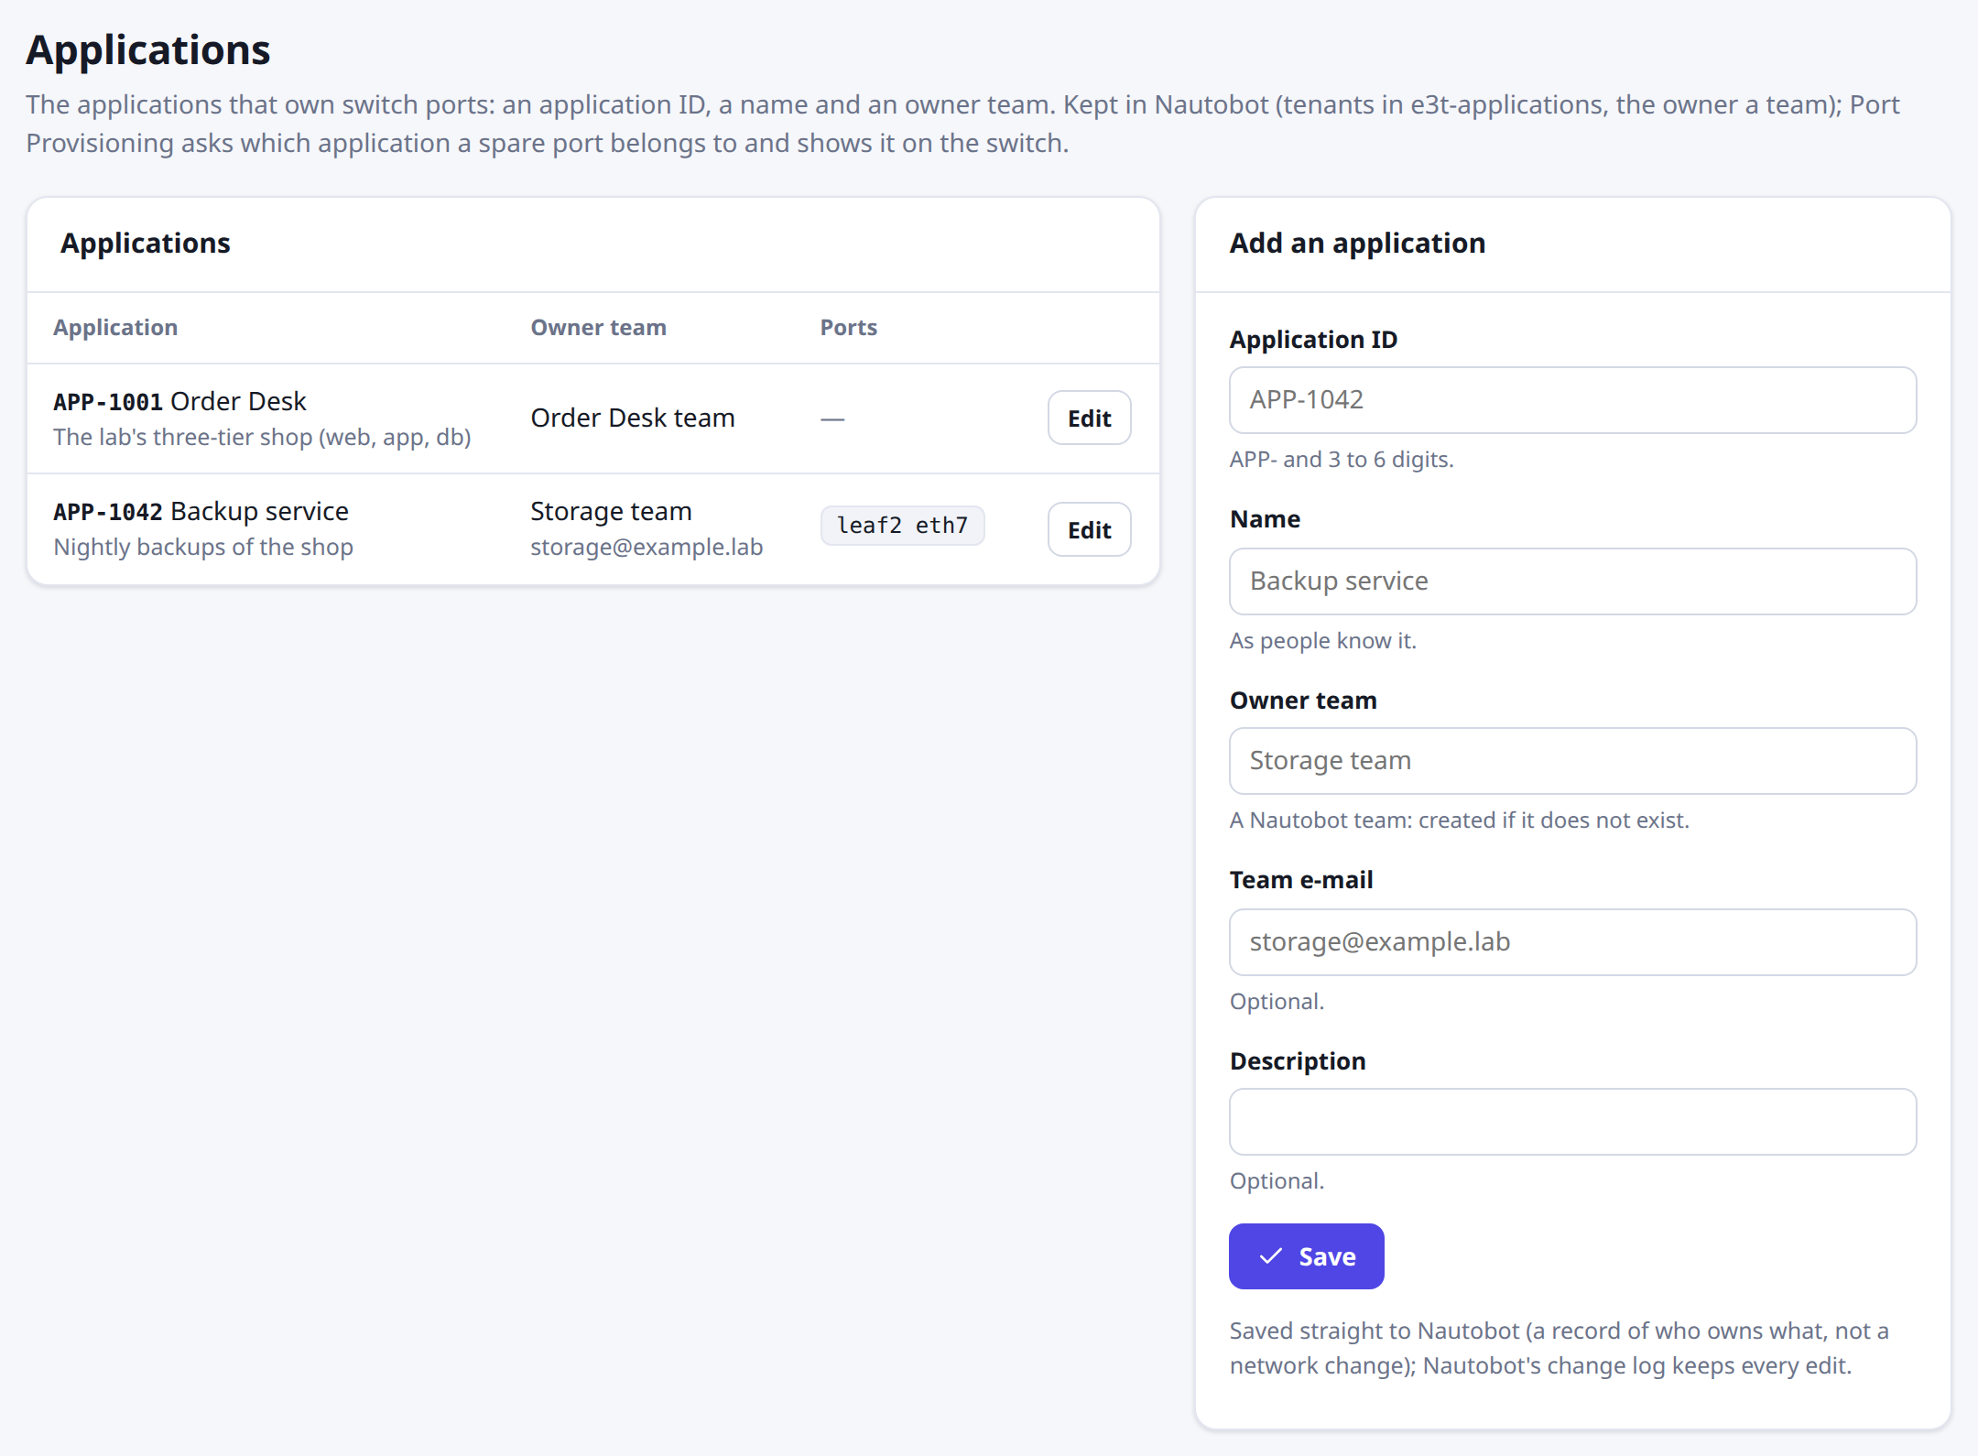


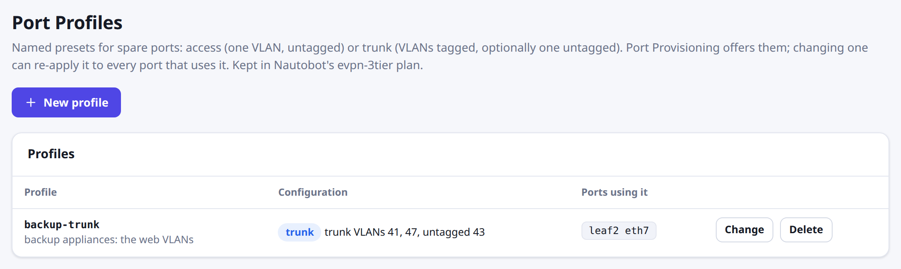

Port profiles, owners and Default
Presets for spare ports, an application and owner team for every provisioned port, one action back to default
Port profiles
Named presets — access, or trunk with an optional native VLAN. A change re-applies to every port using it in one request; one in use cannot be deleted.
Owners
An application (APP-ID, name) and its owner team, in Nautobot. Every enabled spare port needs one; the switch description shows it: 'APP-1042 Backup service — backup appliance'.
Applications and their owner teams
Default
Back to disabled, no VLANs, profile, owner or description — one request.
A profile and the port using it
Notes:
Profiles live in Nautobot's plan (port_profiles); a port records its profile in a custom field. Applications are Nautobot tenants in their own group with an application ID, the owner team linked by a contact association with the role Owner, and each port linked to its application by a Nautobot relationship. Ownership is recorded, not enforced yet. Tested live: a profile created, a port put on it for APP-1042, the profile changed and re-applied, the port defaulted and the profile deleted.

Slide 26
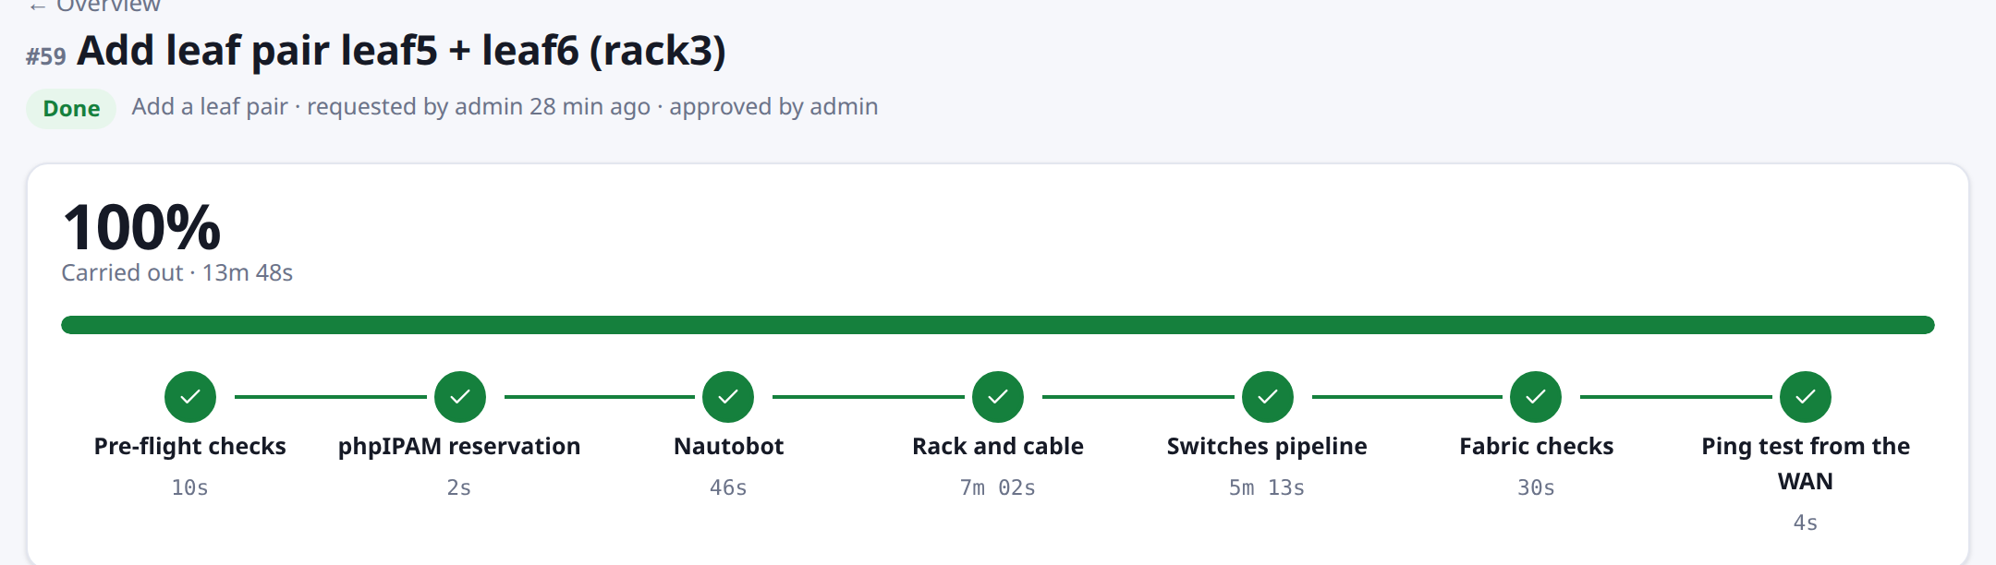

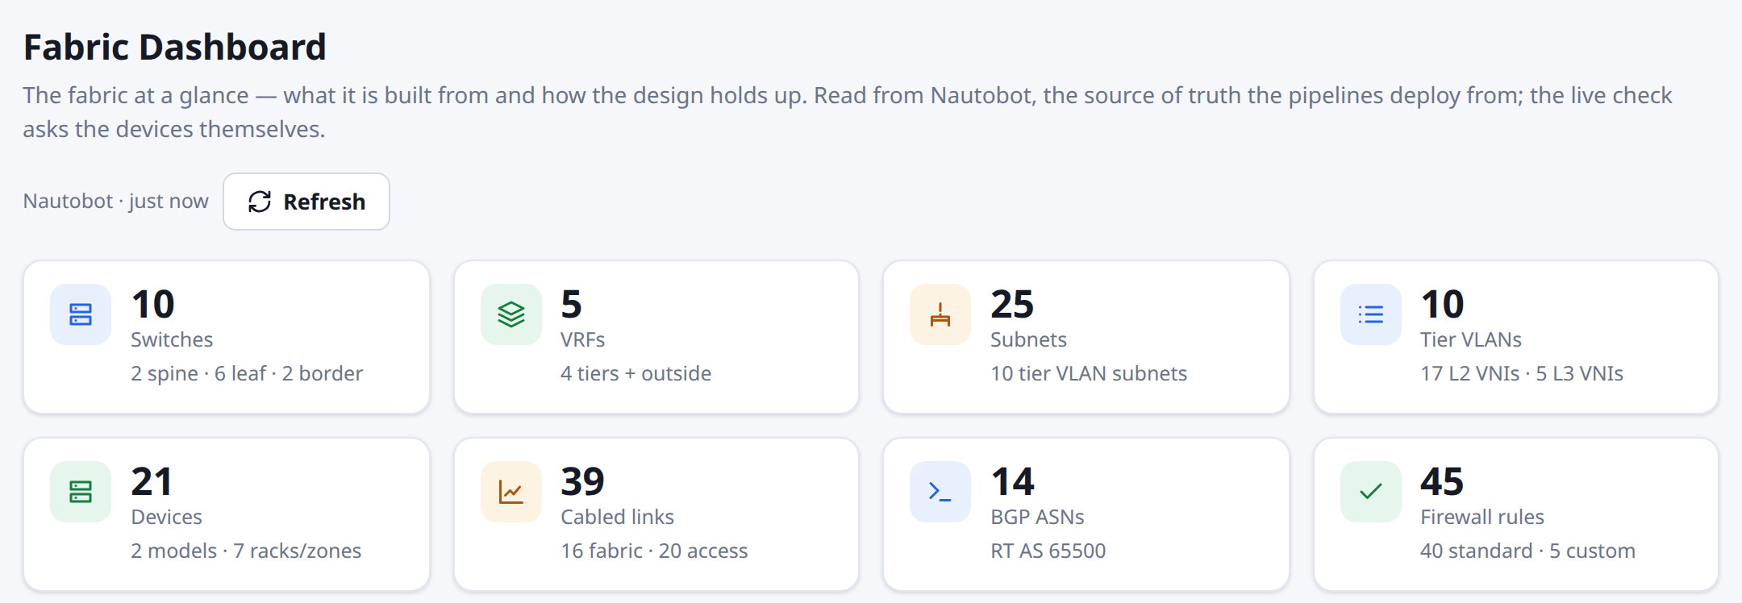

Add a leaf pair
A new rack of two leaves, cabled, configured and verified on the running fabric — one request
Everything allocated
From the leaf number: AS, management and loopback addresses, rack, the spines' next spare ports. The requester only says why.
Request #59: about fourteen minutes
Racked and cabled
phpIPAM, Nautobot (rack, devices, cables), the VMs and day-0 over the serial console, then the switches pipeline and checks: BGP + BFD, VNIs, gateways.
Remove a leaf pair
The last pair added; refused while a server is cabled to it or one of its ports is provisioned.
The dashboard afterwards: six leaves
Notes:
Hardware stays in lab.conf: an added pair is one line in added-leaves.conf, the rest derived from the leaf number. Configuration stays in Nautobot. The spines got four spare ports (eth7-eth10) once, one spine restarted at a time, so two pairs can be added. Tested live: added, a port provisioned, removal refused, the port defaulted, the pair removed.

Slide 27
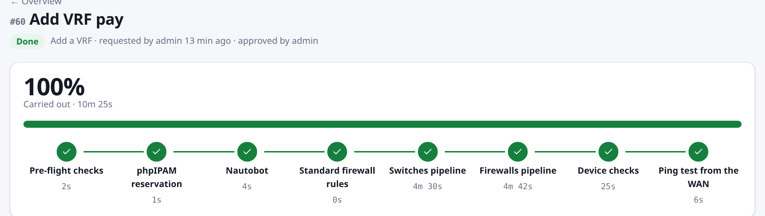
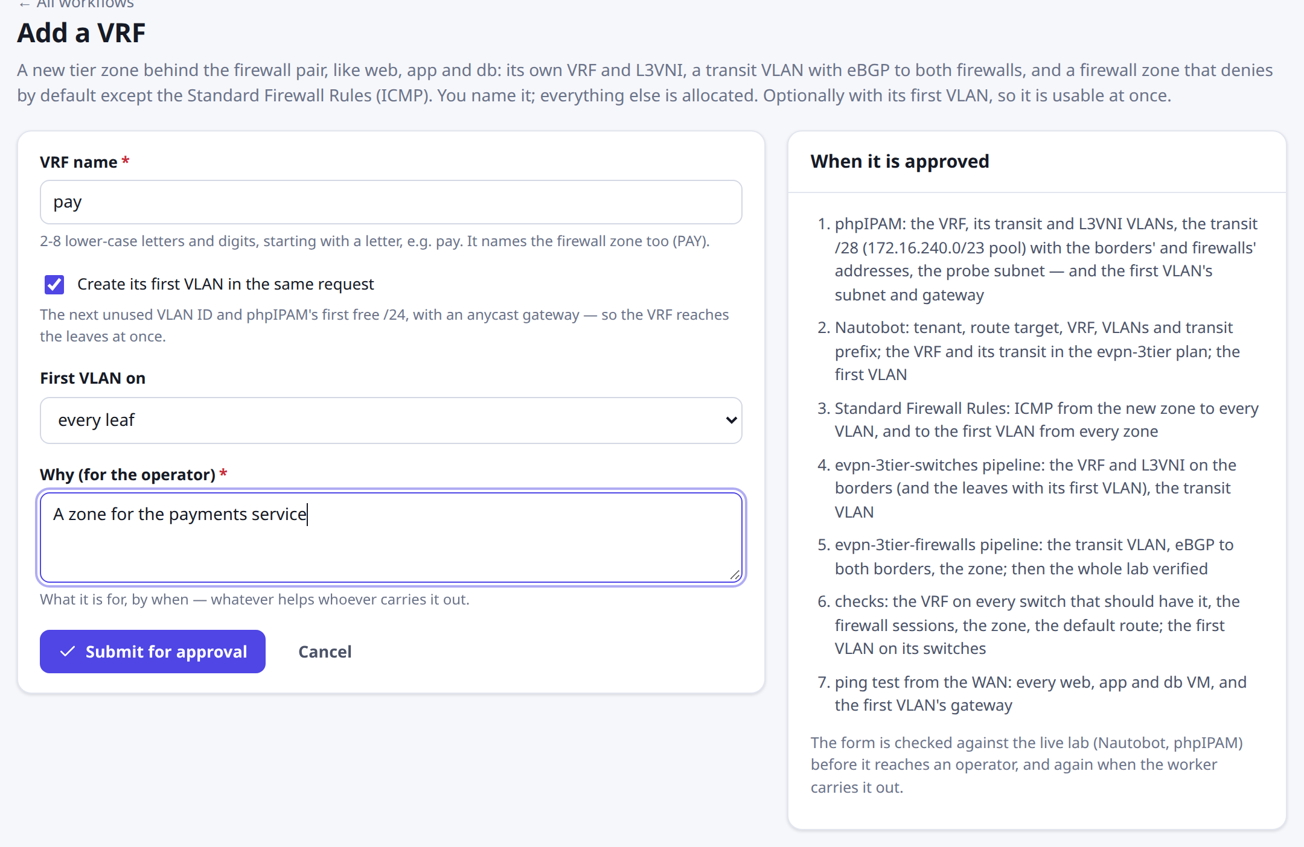
Add a VRF
A new tier zone behind the firewalls: its VRF, a transit to both firewalls and a zone that denies by default
A security zone
Like web, app and db: an L3VNI, a transit VLAN with eBGP to fw1 / fw2, zone PAY — deny by default, plus the standard ICMP rules.
Request #60: VRF pay with its first VLAN
Allocated, up to 20
Table, L3VNI, VLANs, a transit /28 from a phpIPAM pool, probe addresses; the first VLAN as Add a VLAN picks it.
Delete a VRF
Added VRFs only; refused while it holds a VLAN, a server, a peering or a custom rule.
The form: a name and a reason
Notes:
The templates loop over Nautobot's plan, so a VRF is data plus two pipeline runs: switches first without verify, then firewalls with the whole lab verified. Standard Firewall Rules now take their zones from the plan. One extra zone added about 190 lines to each firewall; 20 zones is untested. Tested live: added with VLAN 48, delete refused, VLAN removed, VRF deleted.

Slide 28
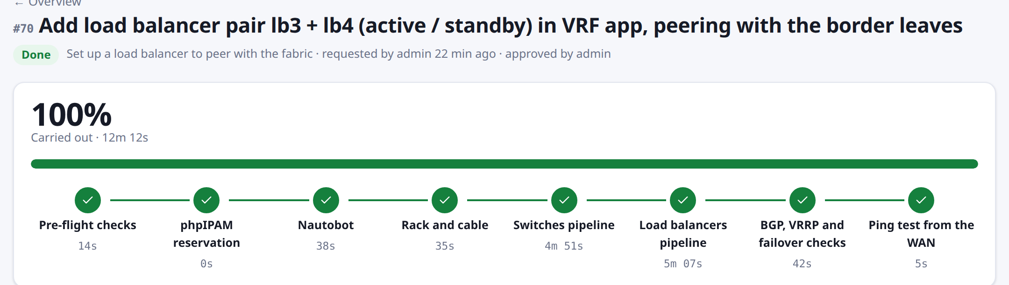
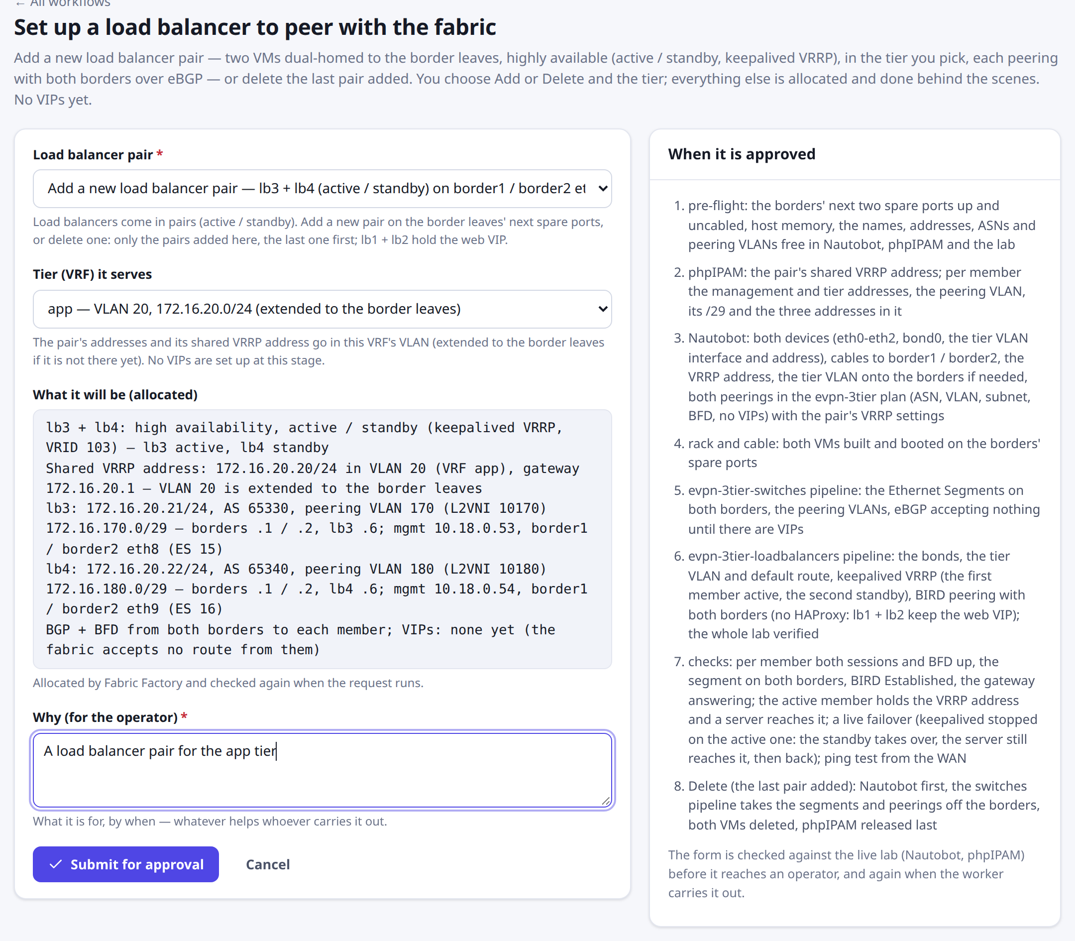
Load balancer pairs
A highly available pair on the border leaves — active / standby with keepalived VRRP — in the tier you pick
High availability
Always a pair: keepalived VRRP holds a shared address, the first member active. Every Add runs a live failover — the standby takes over in under half a second.
Request #70: built, verified, failed over live — about twelve minutes
Everything allocated
The borders' next spare ports, VRID and VRRP address, and per member its address, AS, peering VLAN and /29. BGP + BFD to both borders; no VIPs yet.
Delete a pair
The last pair added only; lb1 + lb2 hold the web VIP and cannot go. Two pairs at most (borders eth8-eth11).
Two choices; the rest allocated
Notes:
Load balancers are added and deleted in pairs. The pair runs keepalived VRRP (unicast, virtual MAC) on a shared address in the tier's VLAN, which the request extends to the border leaves if needed. Each member is its own Ethernet Segment on both borders and peers with both over eBGP with BFD; with no VIPs the borders accept nothing and HAProxy does not run. The borders got four spare ports (eth8-eth11) once, one border restarted at a time. Tested live (#66-#71): added, failed over (0.3-0.4 s), deleted; reconciled 116/116.

Slide 29
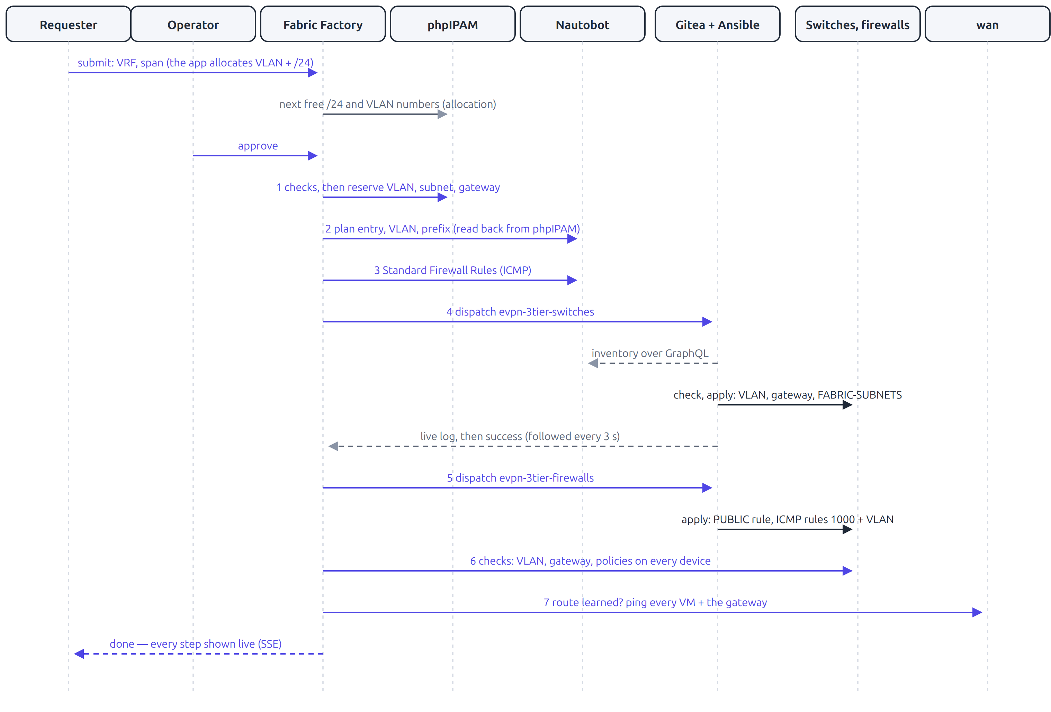
Add a VLAN, end to end
Seven systems, about six minutes, almost all of it in the two pipeline runs
1
Pick a VRF; the app fills in VLAN 45, vlan_45_app and 172.16.4.0/24 itself
2
Operator approves
3
phpIPAM reserves VLAN, subnet, gateway
4
Nautobot: plan entry, VLAN and prefix objects
5
Standard Firewall Rules added
6
Switches pipeline: VNI, gateway, FABRIC-SUBNETS
7
Firewalls pipeline: PUBLIC + ICMP rules
8
Checks on devices and WAN; ping 7/7 from the WAN
Notes:
Remove a VLAN mirrors this with phpIPAM last: pre-flight; Nautobot (plan entry, prefix, VLAN object, its standard rules); both pipelines, whose managed deletions remove every line; checks that no trace remains and the WAN dropped the route; then phpIPAM releases the subnet, gateway and VLAN. Requests 14 and 15 did exactly this for VLAN 45.

Slide 30
Resilience, stack and operations
03
Measured failure behaviour, the full tech stack with versions, design decisions, and what is still missing

Slide 31
Every single failure is survived
Measured under live load: an HTTPS read every 100 ms and an order every second; one component off for 20 s
Off | What takes over
lb1 | keepalived moves the VIP to lb2
web1 | HAProxy health check, redispatch
app1 | nginx uses the other app server
fw1 | BFD + BGP to fw2; conntrack-sync keeps sessions
leaf1 | Each server's other EVPN leg
border1 | border2 for firewalls, LBs, WAN
db1 | db2 promoted after 5 s; the app finds it
0 lost after restore in every case. verify runs 65 checks; 9 Robot Framework suites assert all of this.
Notes:
Lost while down: lb1 0-4 in flight, web1 0-1, border1 4 reads, db1 32 reads and 3 writes; all others zero. The policy matrix tries every TCP flow from every tier and the WAN: 35 flows from the WAN, exactly 2 allowed.

Slide 32
Tech stack: infrastructure and application
Entirely open source; versions as deployed on 9 November 2026
Layer | Component | Version | Runs on | Role
Compute | Ubuntu Server | 26.04.1 LTS, kernel 7.0 | Lab host | 12 cores, 57 GB RAM
Compute | KVM / QEMU, libvirt | 10.2.1, 12.0.0 | Lab host | VMs; UDP tunnels as cables
Network OS | VyOS (rolling) | 2026.09.09 | 11 VMs | Switches, firewalls, WAN
Routing | FRRouting | 10.6.1 | In VyOS | BGP, EVPN, BFD, VRFs
Firewall | VyOS zones, conntrackd | in VyOS | fw1, fw2 | Zone policy, state sync, VRRP
Server OS | Alpine Linux | 3.22.4 | 9 VMs | OpenRC services
Load balancing | HAProxy, keepalived | 3.2.26, 2.3.1 | lb1, lb2 | TLS, health checks, VIP
Load balancing | BIRD | 2.17.2 | lb1, lb2 | eBGP VIP routes, BFD
Web | nginx | 1.28.3 | web1, web2 | Page, reverse proxy
Application | Python, psycopg | 3.12.13, psycopg 3 | app1, app2 | Order Desk API
Database | PostgreSQL | 17.11 | db1, db2 | Primary + hot standby
Monitoring | Prometheus, Grafana | 3.14.0, 13.0.2 | NMS (Docker) | Metrics, alerts, dashboard
Notes:
Twenty VMs: 11 VyOS (2 spines, 4 leaves, 2 borders, 2 firewalls, the WAN) and 9 Alpine Linux (2 load balancers, 2 web, 2 app, 2 db, IPAM).

Slide 33
Tech stack: automation and self-service
The sources of truth, the pipelines, and Fabric Factory
Layer | Component | Version | Runs on | Role
IPAM | phpIPAM, MariaDB | 1.8.3, 11.8.8 | IPAM VM | Addressing; REST API
Source of truth | Nautobot | 3.2.4 | NMS (Docker) | Plan; REST and GraphQL
CI/CD | Gitea, Actions runner | 1.24.7, 3.5.0 | NMS; host | Repos, pipelines, history
Automation | ansible-core | 2.20.11 | Runner venv | Playbooks, Jinja, check mode
Automation | vyos.vyos + netcommon, utils | 6.2.0 | Runner venv | VyOS modules, network_cli
Self-service | Django, Django Ninja | 6.1.3, 1.8.0 | Lab host | Requests, worker, API
Self-service | gunicorn, uvicorn | 26.2.0, 0.54.0 | Lab host | ASGI for the event stream
Self-service | SQLite | with Python | Lab host | Requests, history, progress
Front end | React, TypeScript, Vite | 19.2.0, 5.9.3, 7.2.2 | Browser | The Fabric Factory UI
Build | Node.js | 24.11.1 LTS | Lab host | Front-end build only
SSH tooling | paramiko | 4.0.0 | Lab host | Device tools, checks, ping
Testing | Robot Framework | 7.5.1 | Lab host | Nine test suites
Notes:
ansible-core is pinned to 2.20 because 2.21 removed the paramiko connection plugin the VyOS modules use on this host.

Slide 34
Design decisions, learned the hard way
Most of the design follows from failures found while building the lab; each is now guarded by a check or a test
Decision | Why
No /32s or transit addresses to the firewalls | Forwarded, a /32 sent the firewalls' BFD through the wrong border and the sessions died
Segment bonds raised only after EVPN converges | A rebooting leaf attracted traffic about 6 s before it could forward it
A virtual MAC for the web VIP | With the holder's own MAC, half the flows went to a dead load balancer for minutes
nginx evicts app servers only on connection errors | Counting database-down answers turned a 3 s failover into 13 s of errors
phpIPAM first when adding, last when removing | Addresses are reserved before use and freed only after nothing uses them
Rule numbers keyed to VLAN IDs | Adding or removing a VLAN never renumbers other rules
Inventory committed on every run | Each run's exact input is versioned and diffable
The worker follows Gitea's web job endpoint | Without it, a pipeline run is minutes of silence
Notes:
Other decisions: as-override on the firewalls' outside sessions; ansible-core pinned to 2.20; device tools with a fixed command list and redaction.

Slide 35
Limitations and roadmap
Not reconciled
phpIPAM and Nautobot are written in a fixed order, but nothing repairs a manual difference
lab.conf lags the plan
VLANs and peerings added through Fabric Factory live only in Nautobot (reported as drift)
LB peering order
Load balancer peering still writes phpIPAM last, unlike Add a VLAN
Scale and security
One host, SQLite, one worker, one pipeline at a time; self-signed certificates, plain HTTP
Next: reconcile phpIPAM and Nautobot · layer-4 load-balancing experiments · more self-service workflows
Notes:
Also known: after a firewall fail-back, the standby learns only connections whose state changes, so a long-idle connection can be missing on it.

