Slide 1
SRv6 L3VPN, shown on real boxes
A whiteboard session with proof: seven VyOS routers, two tenants, one packet followed hop by hop
fd00:c
11
13
3
e001
::
block · 32 bits
p1
p3
pe3
uDT4 · tenant-b
one address, five instructions — the whole session in a line
Notes:
Open with the address. Every part of the session explains one slot of it.

Slide 2
Why SRv6: the instructions move into the address
What an SRv6 core does not have
0
1
0
label tables, LDP, RSVP —
no signalling protocol for transport
extra header: IPv6
(and often no SRH at all)
per-tunnel state in the core —
P routers only route IPv6
A SID is an address that means "do this when you own me". End = forward. End.X = out this link. End.DT4 = strip the IPv6 header and look the inner IPv4 packet up in this VRF. A router that does not own the address just routes IPv6 — that is the entire core.
Notes:
5 minutes. The single idea. Everything else follows.

Slide 3
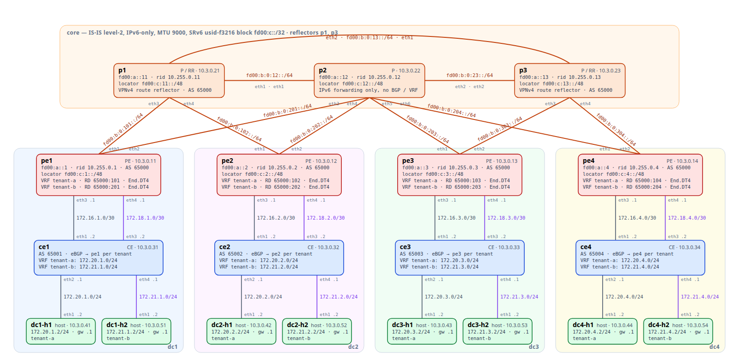
The lab
4 data centres · 3 P routers · 2 tenants · 19 VMs on one host
VyOS rolling (FRR 10.6, Linux 6.18) · IS-IS L2, IPv6-only, MTU 9000 · uSID fd00:c::/32 · reflectors p1 + p3 · BFD everywhere · Alpine hosts
Notes:
Whiteboard 1 starts here: draw the triangle and the four lanes.

Slide 4
A locator is a prefix; a SID is an instruction inside it
Whiteboard 1 — uSID structure f3216: block 32 bits · node 16 · function 16
fd00:c
3
e000
::
block
node: pe3
function: End.DT4, tenant-a
zeros
fd00:c:3::/48 pe3's locator, advertised in IS-IS like any prefix
fd00:c:3:e000:: pe3's End.DT4 for tenant-a (allocated by FRR at run time)
fd00:c:3:e002::/64 an End.X: out pe3's eth1, to p2
What IS-IS carries
What the kernel holds
The /48 (an ordinary prefix) plus SRv6 sub-TLVs: how deep an SRH the node can process (SRH Max SL 3), how many segments it can push. Nothing new on the wire.
seg6local routes on the owner only: End (uN) for the /48, one End.X (uA) per adjacency, one End.DT4 per tenant VRF on a PE. A P router has exactly the first two kinds.
Notes:
Live: show isis neighbor; show ipv6 route isis | grep fd00:c:; ip -6 route show | grep seg6local on p2 and pe1.

Slide 5
Three instructions are enough for an L3VPN
Each is one seg6local route on the node that owns the address
behaviour | example SID | meaning | installed by | where
End (uN) | fd00:c:12::/48 | shift the next uSID into place and forward | isisd | every core node
End.X (uA) | fd00:c:12:e003::/64 | forward out this adjacency, regardless of the IGP | isisd | every core link
End.DT4 (uDT4) | fd00:c:1:e001:: | decapsulate; route the inner IPv4 packet in VRF tenant-a | bgpd (sid vpn export auto) | PEs, one per tenant
The non-textbook part. Linux scopes the SRv6 encapsulation's outer lookup to the ingress VRF for forwarded packets. Without a route to the remote locator inside the tenant table, every encapsulated packet is dropped (Ip6OutNoRoutes). The renderer leaks each locator into each VRF via the attached P routers on the IGP shortest path, plus the whole block as a fallback. You only learn this by building it.
Notes:
Act 1 ends here. Expect 'where is the tunnel?' — there is none.

Slide 6
The overlay is the BGP VPN you already know
Whiteboard 2 — a SID where the label used to be
p1 · RR
p3 · RR
pe1
fd00:a::11
fd00:a::13
pe3
VRF tenant-a · tenant-b
VRF tenant-a · tenant-b
VPNv4 over IPv6 loopback sessions (extended next hop), every PE to both reflectors
RD 65000:103 : 172.20.3.0/24 RT:65000:100 Originator 10.255.0.3, Cluster list 10.255.0.11
Remote SID: fd00:c:3:: sid structure=[32 16 16 0 16 48] Remote labels: 917504
917504 = 0xE000 << 4: the 16 function bits are transposed into the label field; the receiver reassembles fd00:c:3:e000::
Unchanged
Changed
Redundant
RD, RT, reflectors, import/export policy, eBGP to the CE inside the VRF.
The transport attribute: Prefix-SID instead of a label. No LFIB anywhere.
Two copies of every route, one per reflector; losing p1 changes nothing (suite 06).
Notes:
Live: show bgp ipv4 vpn summary; show bgp ipv4 vpn 172.20.3.0/24 on pe1.

Slide 7
What the PE actually installs
No label table — a VRF route that says "wrap in IPv6 to this address"
vyos@pe1:~$ ip route show vrf tenant-a
172.20.3.0/24 nhid 96 encap seg6 mode encap segs 1 [ fd00:c:3:e000:: ] via inet6 fe80::…:603 dev eth2 proto bgp
172.20.2.0/24 nhid 82 proto bgp
nexthop encap seg6 mode encap segs 1 [ fd00:c:2:e001:: ] via … dev eth1 weight 1
nexthop encap seg6 mode encap segs 1 [ fd00:c:2:e001:: ] via … dev eth2 weight 1
One segment
ECMP for free
The CE sees nothing
The destination address is the whole instruction: pe3's End.DT4 for tenant-a. Out eth2 because pe3's locator is shortest via p2.
The dc2 LAN has two next hops: pe2 is equidistant via p1 and p2. Nothing configured — it falls out of the IGP.
Plain eBGP routes from its PE. No SRv6, no IPv6, no idea there is a core.
Notes:
Act 2 ends. Then act 3: the capture.

Slide 8
Packet walk: dc1-h1 → dc3-h1
Captured on p2, the router in the middle
dc1-h1
ce1
pe1
p2
pe3
ce3
dc3-h1
172.20.1.2
IPv4
encap
IPv6 lookup
End.DT4
IPv4
172.20.3.2
IPv6 fd00:a::1 → fd00:c:3:e000:: + SRH (1 entry)
vyos@p2:~$ sudo tcpdump -ni eth5 -vv 'ip6 and dst net fd00:c:3::/48'
IP6 (hlim 62, next-header Routing (43)) fd00:a::1 > fd00:c:3:e000::: RT6 (len=2, type=4, segleft=0, [0]fd00:c:3:e000::)
IP (ttl 63) 172.20.1.2 > 172.20.3.2: ICMP echo request
hlim 62
inner ttl 63
isolation
two routers decremented it: pe1 and p2
only ce1 touched it — the core is invisible to the tenant's traceroute
dc1-h1 → dc1-h2 (tenant-b, same site): 100 % loss. No route, no firewall.
Notes:
Act 3 live. Ping, capture, traceroute, the failed cross-tenant ping.

Slide 9
uSID: the whole path in one address
Whiteboard 3 — shift-and-forward (uN with the NEXT-C-SID flavour)
fd00:c
11
13
3
e001
::
block
p1
p3
pe3
uDT4 · tenant-b
leaves pe1
fd00:c:11:13:3:e001::
the carrier: p1 is first after the block, so p1 owns it
leaves p1
fd00:c:13:3:e001::
p1 deleted its own ID and shifted 16 bits left
leaves p3
fd00:c:3:e001::
down to pe3's uDT4 — exactly what an unsteered packet carries
Captured live on p1's link to p3 and on p3's link to pe3 (act 4). The SRH still shows the original carrier; segments-left stays 0.
Notes:
This is the slide people remember. Then act 4.

Slide 10
Steering: uSID carrier vs. an SRH
The same explicit path pe1 → p1 → p3 → pe3 two ways
uSID carrier (default)
Uncompressed SRH (--uncompressed)
encap seg6 segs 1
[ fd00:c:11:13:3:e001:: ]
encap seg6 segs 3
[ fd00:c:11:: fd00:c:13::
fd00:c:3:e001:: ]
• 1 segment, a one-entry SRH (24 B), none with reduced encapsulation
• P routers only rewrite the destination address
• no per-path state anywhere in the core
• measured ~120 Mbit/s on a 1-vCPU software data plane
• 3 × 128-bit segments: a 56-byte SRH
• every hop processes the SRH (segments-left)
• also works here — within a few percent of the carrier
• what uSID was designed to avoid at scale
Steering is unidirectional: the return path takes the IGP shortest path through p2 unless steered too. tools/steer.py add | del — the portal has the same button.
Notes:
Contrast slide. Point at the byte counts.

Slide 11
Failover: a silent link failure
Act 5 — firewall drops IS-IS and BFD on p2's link to pe3; the interface stays up
300 ms × 3
≈ 1 s
4 / 150
BFD interval and multiplier on every core adjacency
detection + SPF + FIB: pe3 moves every tenant route to p3
packets lost at 0.2 s spacing across cut and repair (suite 08: ≤ 10)
pe3 isisd: %ADJCHANGE: Adjacency to p2 (eth1) for level-2 changed from Up to Down, bfd session went down
Without BFD
Nothing in BGP moves
Seen three ways
30-second IS-IS hold time: half a minute of black hole with the link light on.
The VPN routes still point at the same SIDs; only the IGP path to the locator changed.
Grafana annotation region, the router's syslog line, the log-derived alert.
Notes:
Run act 5 while talking. Say: interfaces stay up, watch the ping count.

Slide 12
Operated like a network, not a demo
Act 6 — everything around the seven routers
1
Source of truth
2
Provisioning
Nautobot models sites, devices, links, VRFs / RTs / RDs, peerings, locators. One renderer produces every config from Nautobot or from lab.conf — a test proves they agree, line for line.
A portal adds a tenant or a site as a pipeline: allocate, model, render, boot, push, test, back up to Gitea — each step's log on the page. Removal is the same pipeline in reverse.
3
Verification
4
Telemetry
64 Robot Framework cases: underlay, SIDs, VPN, isolation, reflector loss, steering, BFD failover, throughput, Nautobot, monitoring. Results with configs and routing tables are committed.
Pulled (node-/frr-exporter) and pushed (VyOS Telegraf) metrics into VictoriaMetrics; syslog into VictoriaLogs with log-derived alerts; sFlow from the core; Grafana with annotated events.
Notes:
Show render --check, the portal state, one Grafana dashboard, the flows.

Slide 13
What you only learn by building it
Four things not in the textbook
Linux scopes the outer lookup
uSID needs a /128 anchor
Encapsulated packets need a route to the remote locator inside the ingress VRF. Leak the locators per VRF, IGP-consistently, or traffic silently dies (Ip6OutNoRoutes).
A connected /48 on the dummy interface outranked the uN route in zebra; the node stopped shifting. A /128 keeps the interface up and lets IS-IS own the /48.
Silence is the hard failure
Routers do not log by default
Admin-disabling a link tells the neighbour. The failure that matters is the one only BFD sees — and this build left a stuck BFD session on a disabled interface.
VyOS renders FRR at 'notifications'; %ADJCHANGE is informational. A failover left no syslog until the level was raised and log-neighbor-changes set per VRF.
Notes:
Good interview material: each of these is a 'tell me about a time you debugged something' story.

Slide 14
Run it yourself
git clone https://github.com/dcantor/srv6-core
./lab.sh up && ./lab.sh bootstrap && ./lab.sh test
docs/srv6-walkthrough.pdf — the long-form version with every capture
docs/session/ — this session: guide, questions, exercises
tools/demo_live.py — the six acts, presenter mode
lab-portal/monitoring — the telemetry stack for every lab
VyOS · FRR · Nautobot · Robot Framework · Prometheus · VictoriaMetrics · VictoriaLogs · Grafana · goflow2
Notes:
Hand out the walkthrough PDF and the question bank.

