Slide 1
The BGP Looking Glass
30 d
A passive route collector in the SRv6 core — every VPN prefix, its attributes, and how they changed
of every change, kept
Alpine + FRR on 512 MiB · iBGP to both route reflectors · a direct read of all twelve routers
SQLite history · Flask API and page · Prometheus metrics · http://192.168.50.231:8092

Slide 2
What it holds
Read from the collector itself while these slides were made — nothing on this page is typed in.
76 / 152
2 / 2
13
25,235
prefixes, paths
reflector sessions
routers read directly
recorded changes
the core's VPNv4 + VPNv6 table, not one router's view
one link to p1, one to p3 — 60 VPNv4 and 16 VPNv6 accepted on each, 0 sent
their own RIB, VPN and per-VRF tables, over their API and over SSH
announces, attribute changes and withdraws, reconciled per path
A looking glass that answers three questions, not one.
What does the core carry, with the attributes the originating PE set? What does each router actually have, after import and after selection? And what did either of those look like at some moment in the past? The first needs a BGP session, the second needs the routers themselves, and the third needs a memory — so it has all three, and says which one every answer came from.

Slide 3
How it is wired
It joins the core as a reflector client on its own two links, and reads every other router besides.
eth1 fd00:b:0:121::2
p1
route reflector · eth5
lg
Alpine + FRR · 512 MiB
AS 65000 · router-id 10.255.0.21
the whole VPNv4 / VPNv6 table, one copy per reflector — and nothing announced back
eth2 fd00:b:0:321::2
p3
route reflector · eth5
SQLite
every announce, attribute change and withdraw, per path — thirty days, pruned hourly
poll
each PE, CE and the firewall, over their own HTTPS API and over SSH, every two minutes
Flask
the page, /api/… for anything that wants the same answers, and /metrics for Prometheus
The reflectors' side of both links is rendered by tools/render.py like every other interface, and the VM is modelled in Nautobot like every other device — nautobot render --check compares its frr.conf and its lgd.json too.

Slide 4
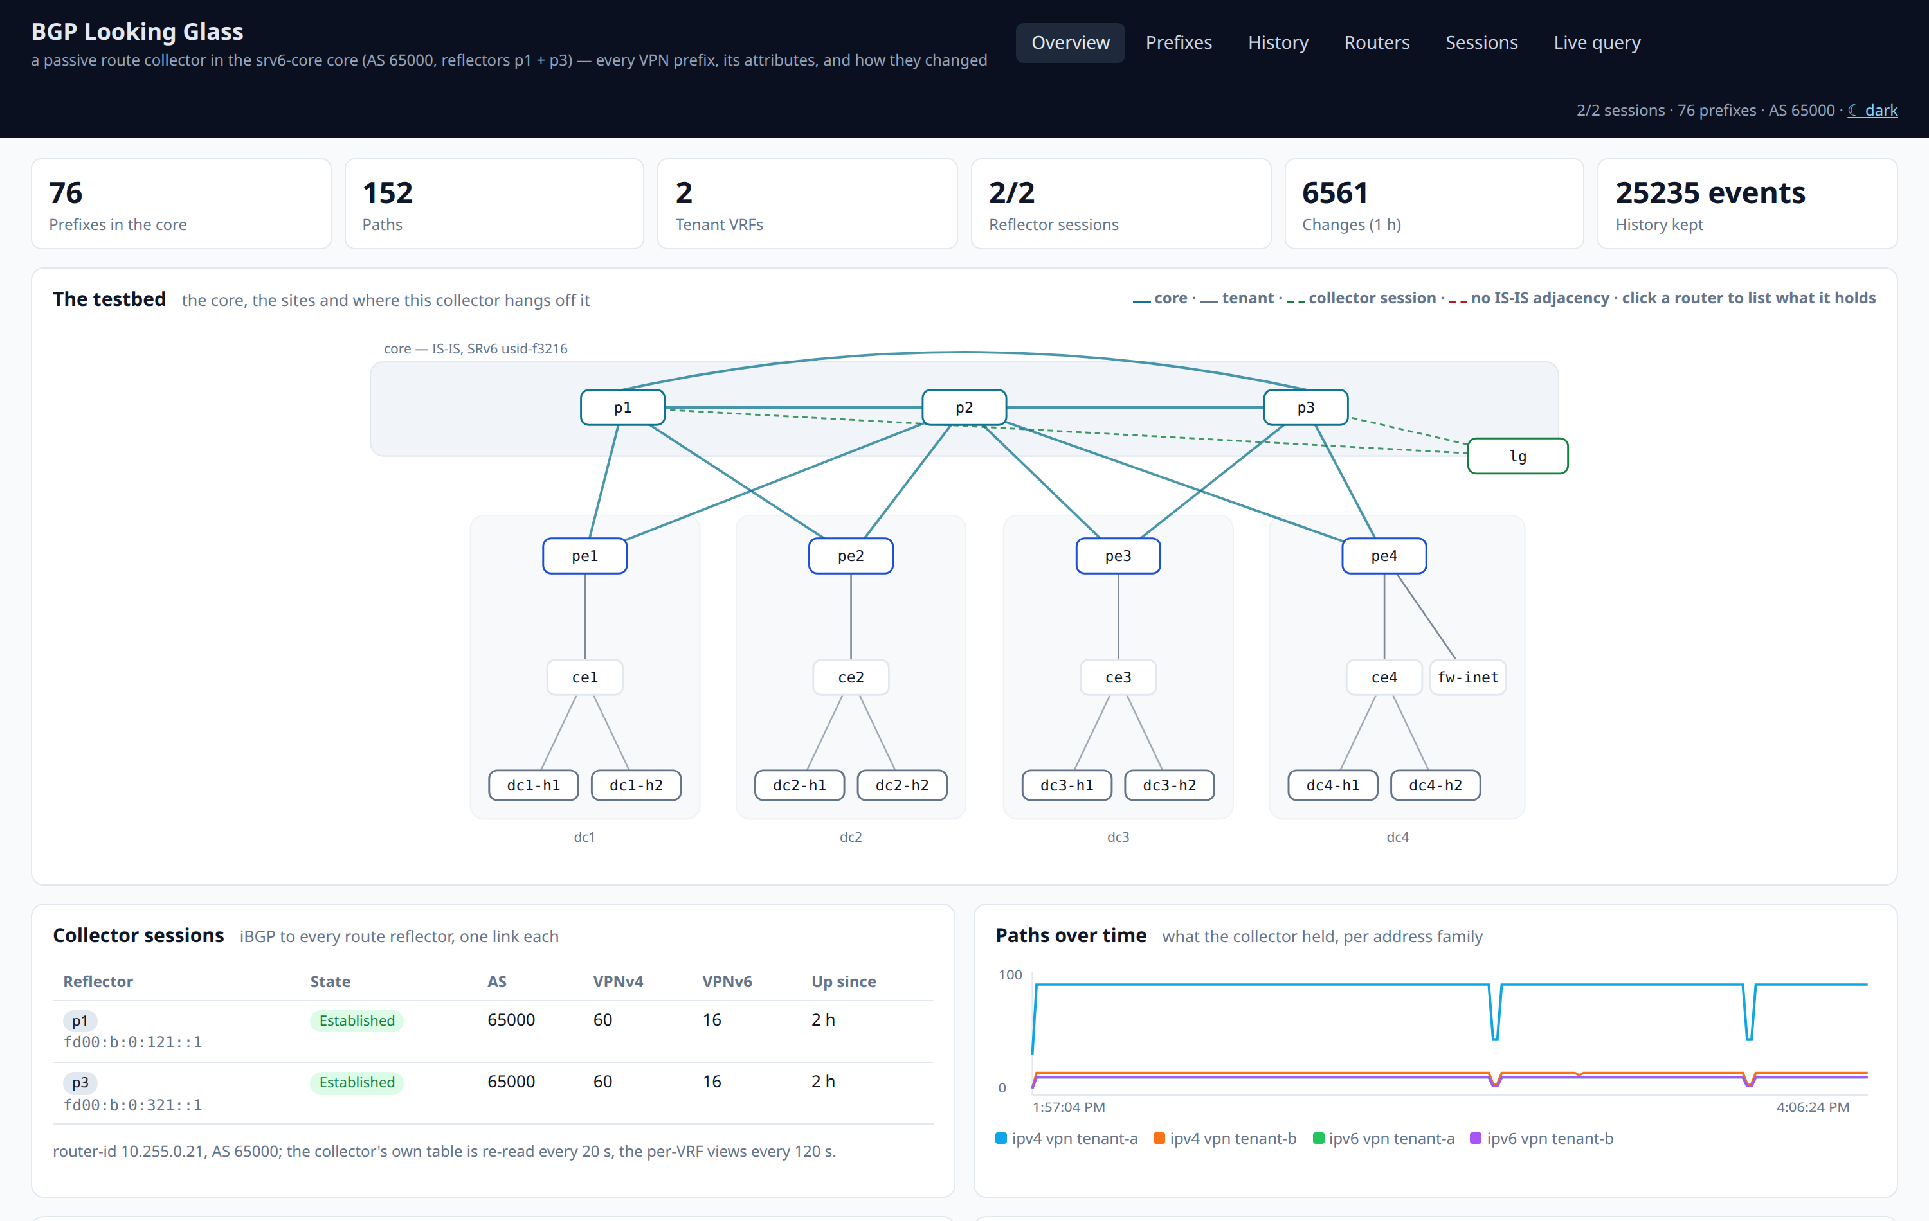
The page you land on
What the collector holds, the sessions it holds it over, the testbed, the per-family count over time, what each view holds, and the newest changes.
Read the top row first
Prefixes and paths are the core's table; tenant VRFs is how many the collector has ever seen.
Reflector sessions is the one number that invalidates everything else if it is not 2/2.
Changes in the last hour is the churn: a quiet core is a flat line, and a noisy one is visible here before anyone reports it.
History kept is the size of the memory behind every question on the following slides.
One page: the answer to “is it healthy and what does it have?” before any question is asked

Slide 5
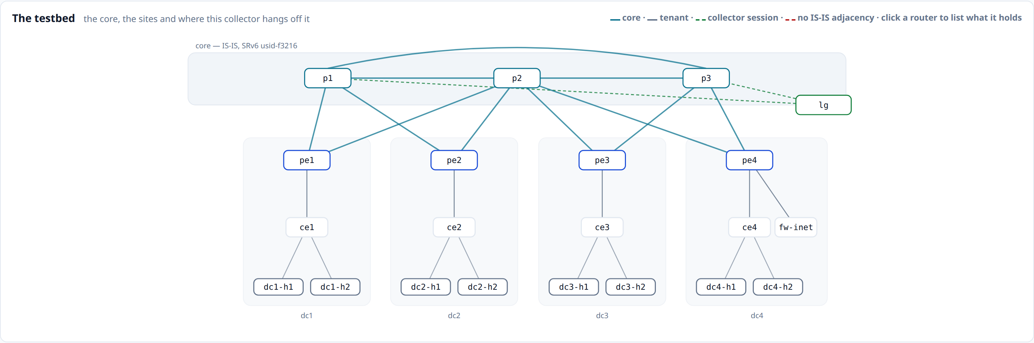
Where it sits in the core
The collector hangs off both route reflectors on its own point-to-point links, and touches nothing else.
Drawn from the model: the core band with the three P routers, a lane per data centre, and the two green sessions on the right
It is a client, not a peer
It announces nothing
A red link is a real fault
p1 and p3 reflect to it as they reflect to a PE — the whole table, with the originating PE's own attributes.
An outbound deny route-map says so, and both sessions report 0 sent: the core cannot be affected by it.
Core links go red where no router reports an IS-IS adjacency — coloured from what the routers say.

Slide 6
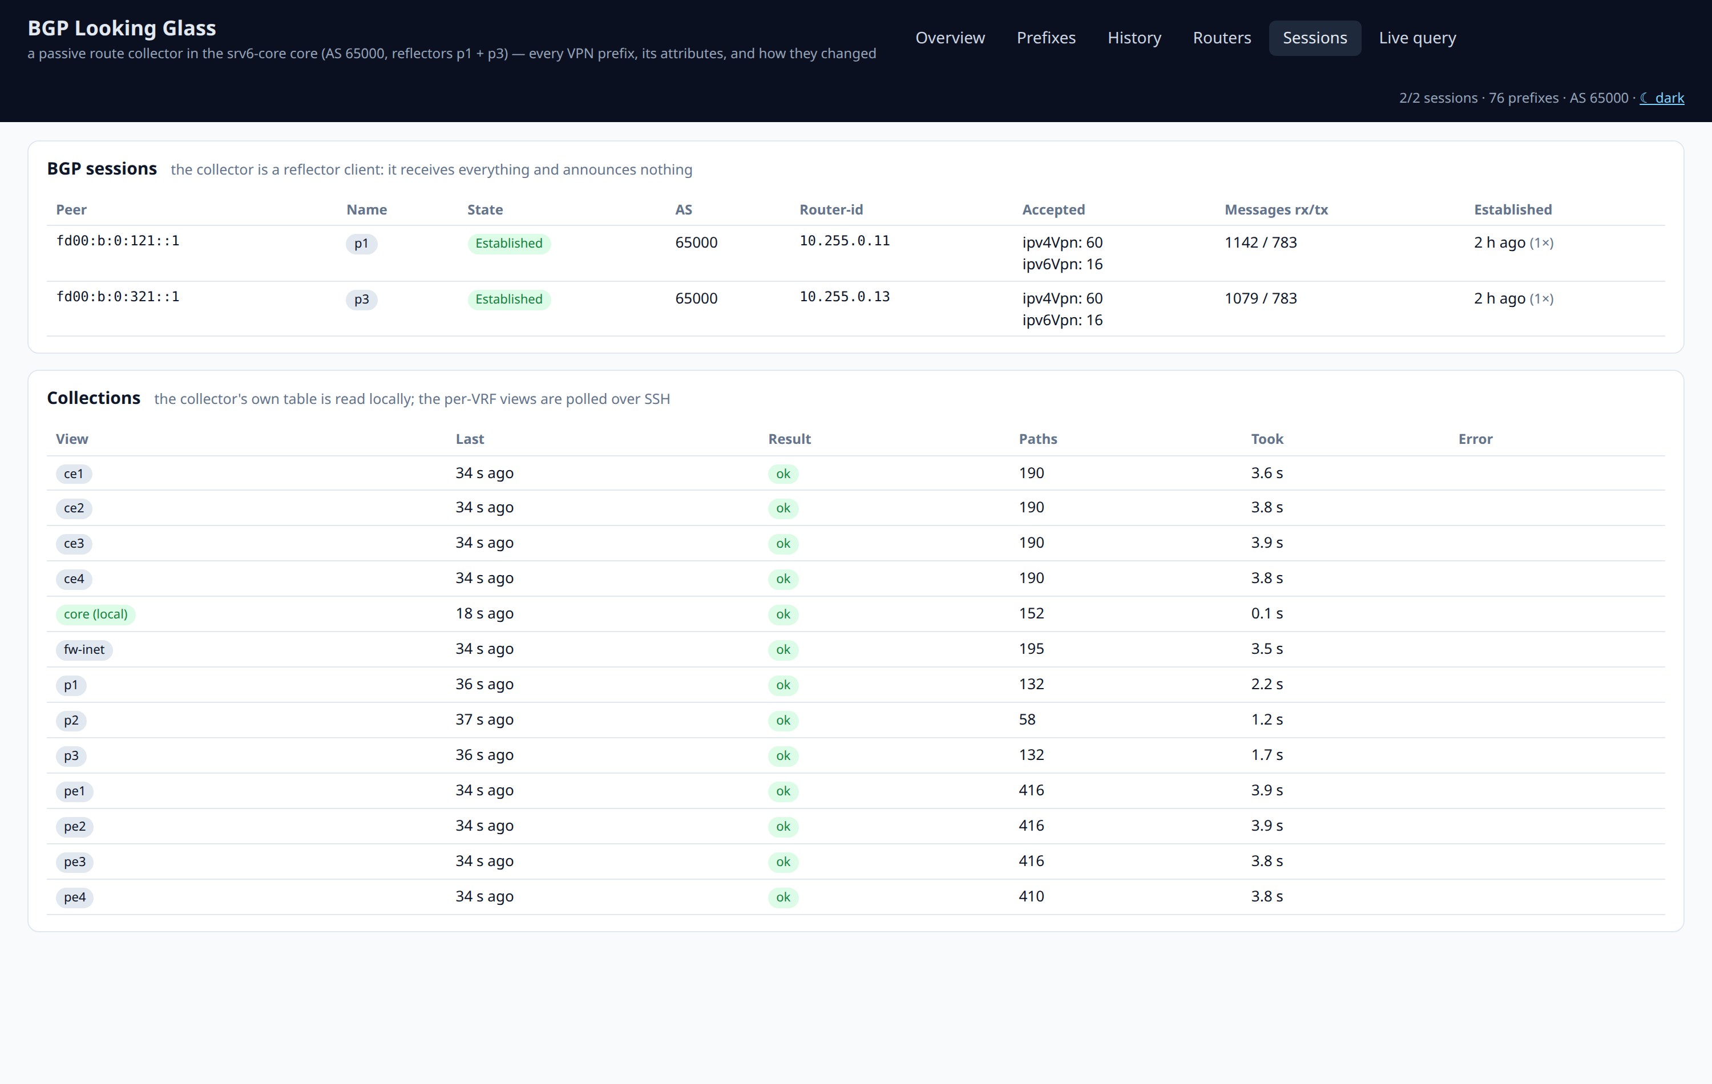
Why a session, and not screen-scraping
The collector receives the same update the reflector sent — route distinguisher, route targets, SRv6 SID and label, originator-id, cluster list, AS path, local preference.
The subtle part
The session negotiates capability extended-nexthop. Without it FRR rewrites the IPv6 next hop of every VPNv4 route to its own address — and every prefix in the core would look as though the reflector had originated it.
With it, the originating PE's loopback is still the next hop, which is what makes the path on a later slide reconstructable at all.
Screen-scraping a `show` command gives you the text a router chose to print. A session gives you what it sent.
The sessions, and the health of every collection beneath them

Slide 7
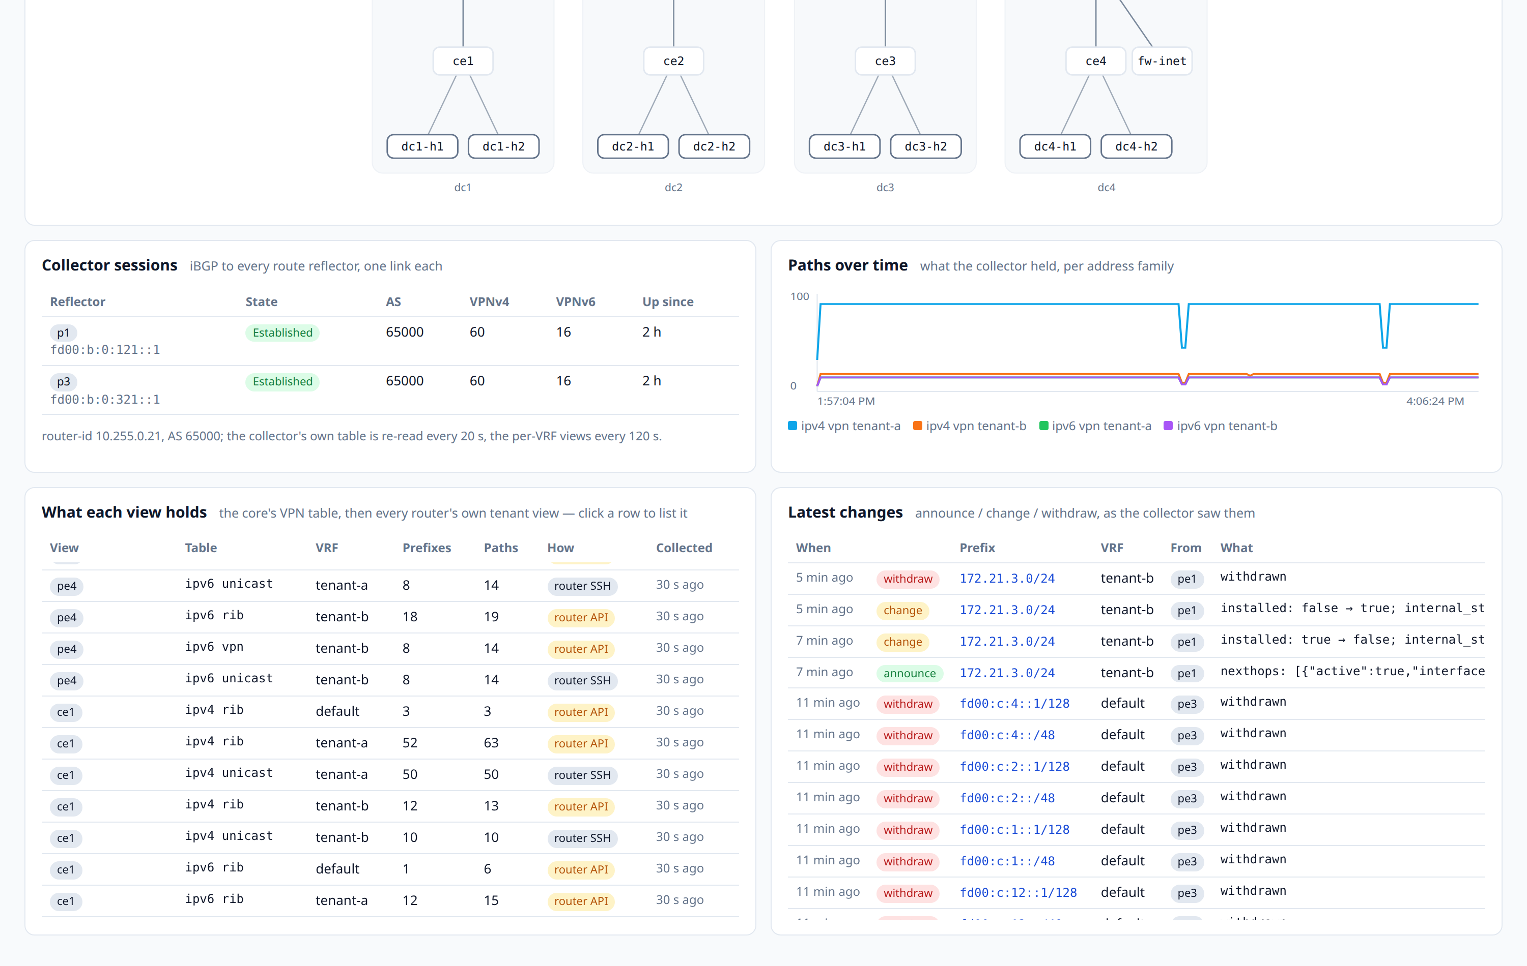
And it reads every router directly, too
The core's table says what travels between PEs. What a tenant actually has is the VRF table after import; what the box will do with a packet is in its RIB.
Three transports, one page
rr-session — the whole VPNv4 / VPNv6 table, as the reflectors handed it over.
router-api — each router's own HTTPS API: its RIB per VRF and family, its own VPN table, its IS-IS adjacencies.
router-ssh — the per-VRF BGP tables, where the API has no JSON form for the question and the text form loses the attributes.
Every row, everywhere in the product, carries which one it came from.
What each view holds, per router, VRF and family — with the transport it came over and when it was collected

Slide 8
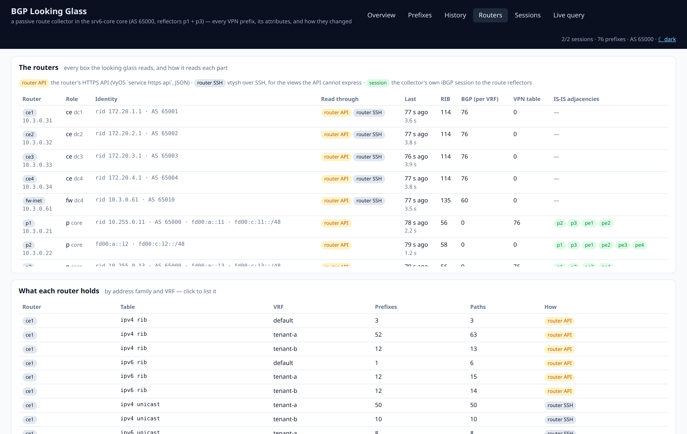
Its account of its own work
The Routers page: identity, the transports each box was read through, when, how much it holds, and the IS-IS adjacencies it reported.
Collection is a first-class thing
A collection that failed is visible here rather than showing up as a prefix that quietly went missing.
Each router's HTTPS API is rendered into its configuration like the rest of it — key srv6core-lab-looking-glass, reachable only from the collector and the lab host.
So the same interface is open to anything else that wants it; the looking glass is one consumer, not a privileged one.
Thirteen routers, each with its own API key, read on a two-minute cycle

Slide 9
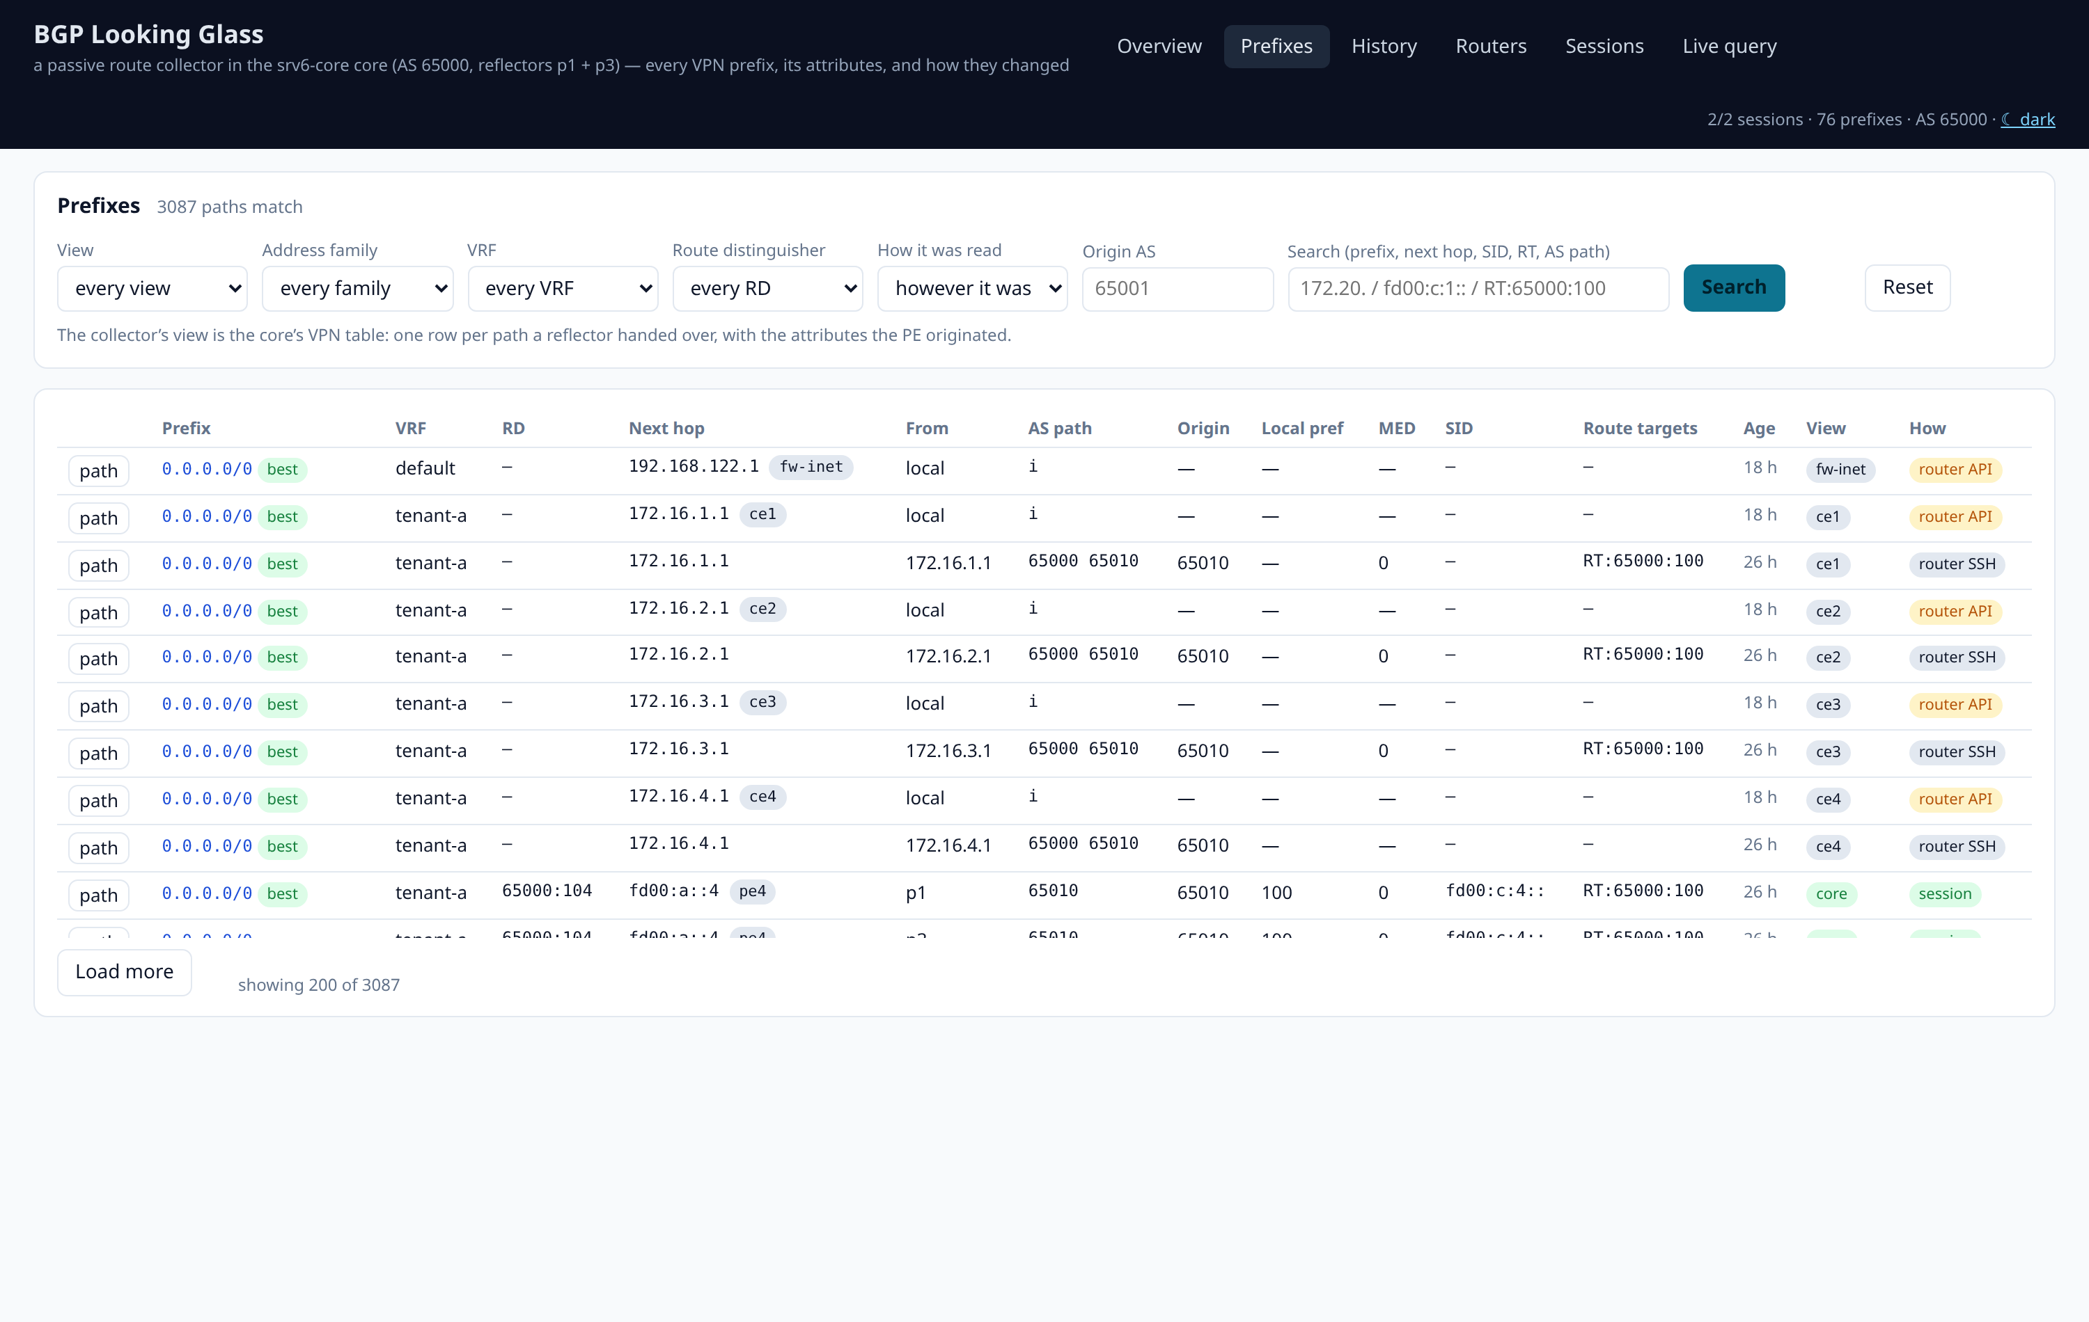
The prefix table
One row per path, with its next hop, AS path, local preference, SRv6 SID and route targets — and, on the right, the view it came from and how it was read.
The classic questions
“Who originates this?” — origin AS and originating node are columns, not something to derive from an AS path.
“Is it in the tenant's VRF, or only in the core?” — the view filter answers it directly.
“What SID does it carry?” — the egress PE's End.DT46 is on the row, and the free-text box searches it.
Every row has a path button, which is the next slide.
Filters for view, family, VRF, route distinguisher, origin AS and transport, plus free text over prefix, next hop, SID, route target and AS path

Slide 10
Two answers to one question
The same tenant, asked of the reflectors' table and then of the routers' own tables — and the difference is the point.
How it was read: session — tenant-a as the reflectors handed it over
How it was read: router API — tenant-a as the routers themselves installed it
The core's table is one path per prefix per originating PE. A router's own tables are what survived import into the VRF and what selection actually installed in its RIB — different counts, legitimately, and the gap between them is where import and selection problems live.
A looking glass that silently merged the two, or showed one and called it the truth, would be one you could not trust. So the transport is a filter here, a column on every row, and a pill beside every view — everywhere in the product.

Slide 11
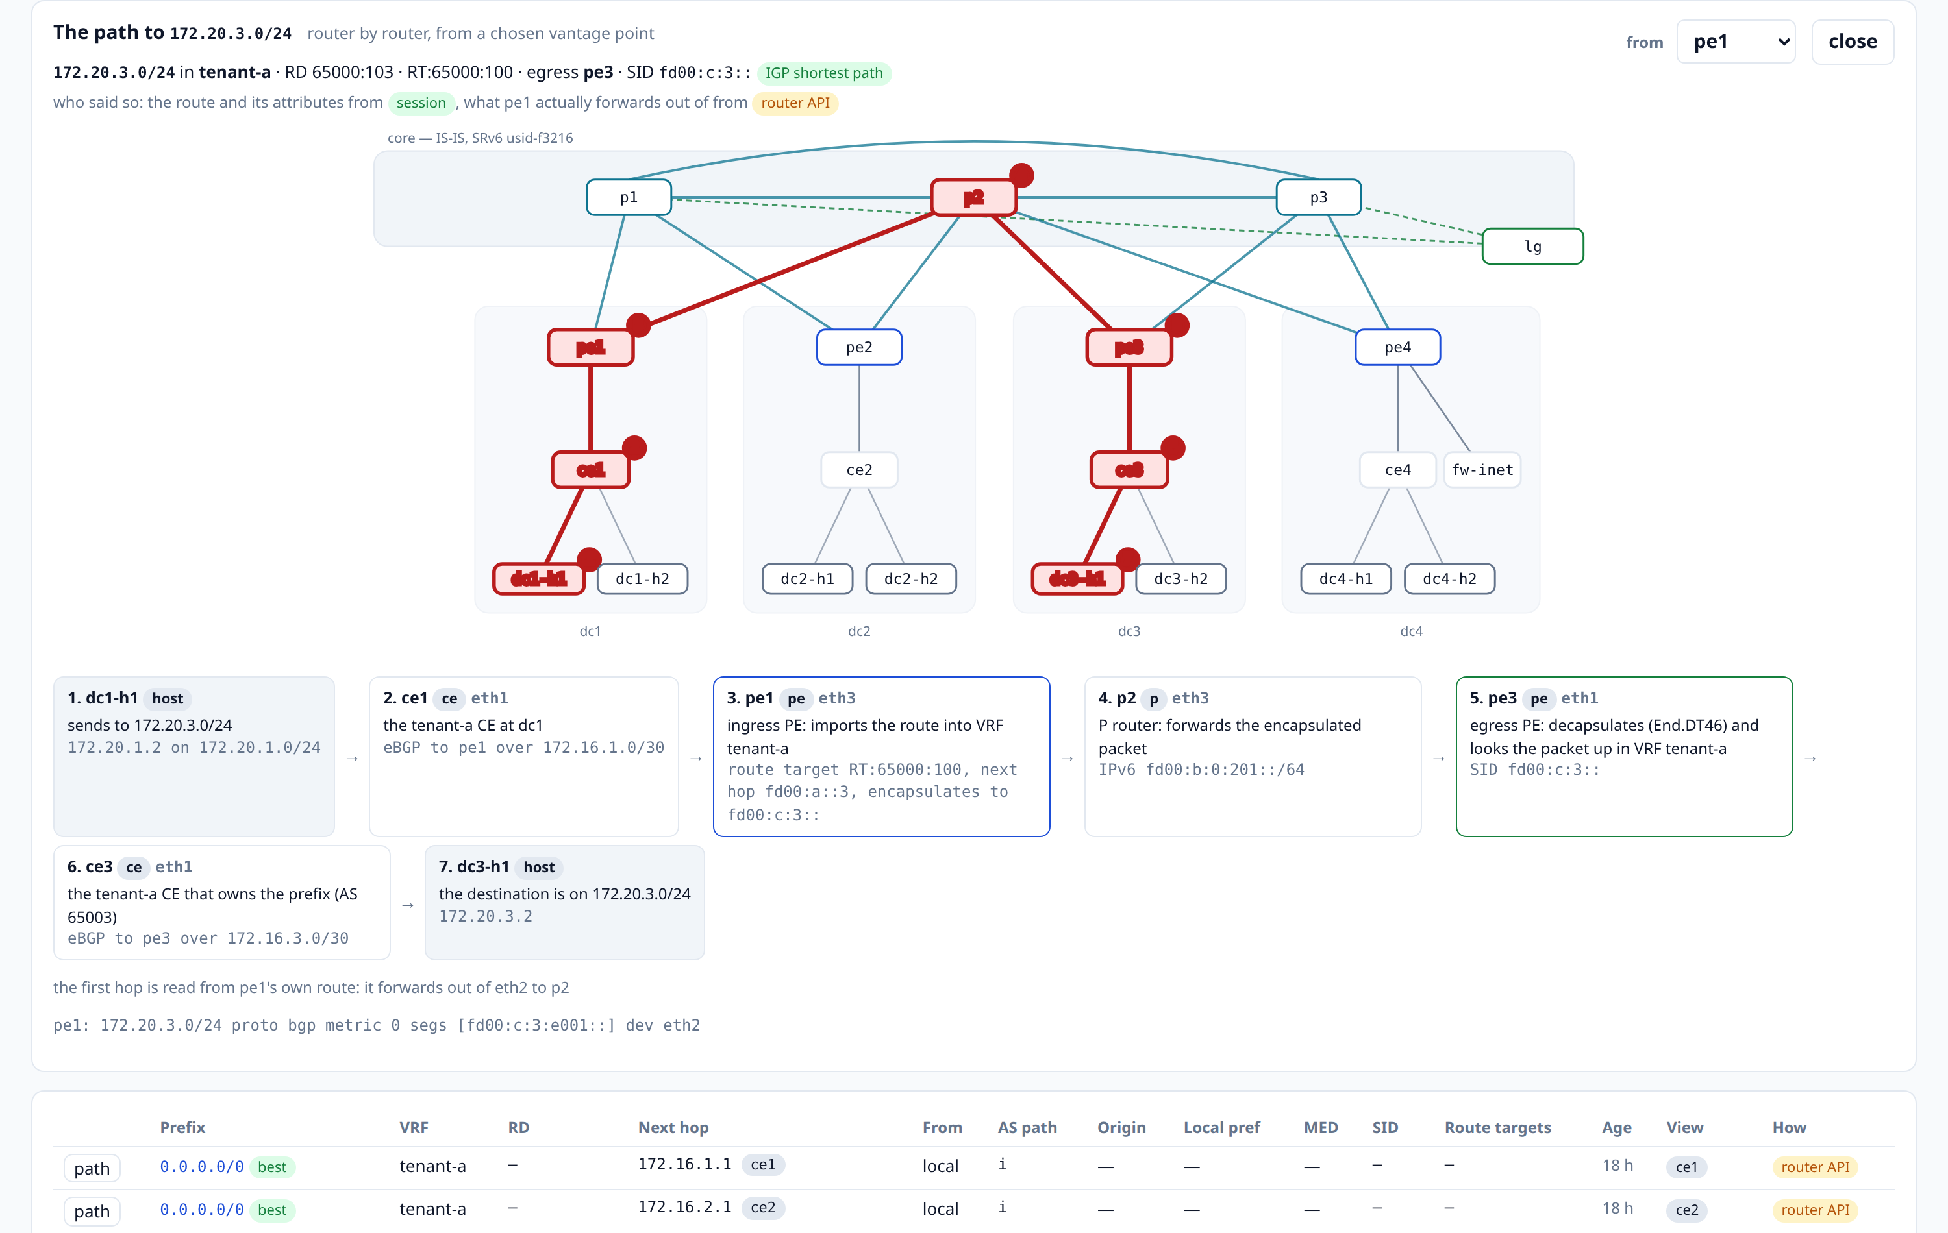
The path, router by router
For one prefix from a chosen vantage point: the map with the path lit up and its hops numbered, then a card per hop.
Two sources, and the card says which
The route and its attributes come from the session; what the router will really do with the packet comes from its own RIB.
Equal-cost paths are named rather than silently collapsed into one line.
A steered prefix is drawn along the segment list its policy installed — the uSID carrier is unpacked back into the routers it names.
Ask the same prefix from a different router and the diagram is rebuilt from that router's view.
dc1-h1 → 172.20.3.0/24: the CE's eBGP hand-off, pe1's import and SRv6 encapsulation, p2, pe3's End.DT46 decapsulation, ce3, the host

Slide 12
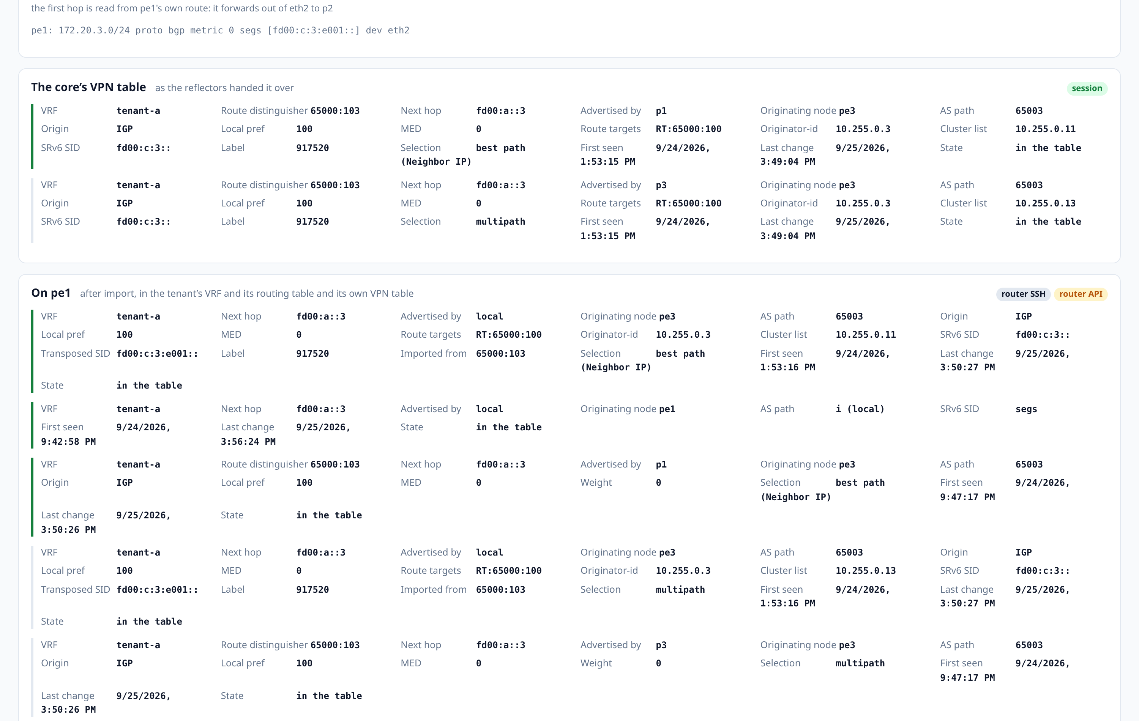
One prefix, every view at once
The core's VPN table, each reflector's and PE's own VPN table, each PE's and CE's VRF table, and every router's RIB — in one page.
Where the answers differ is the diagnosis
In the core but missing from a VRF: an import problem — a route target that does not match.
In the VRF but not in the RIB: a selection problem — something else won.
Attributes are shown whole: route targets, originator-id, cluster list, SID, transposed SID, label, and the selection reason the router gave.
Each with its full attribute set and a pill saying how it was read

Slide 13
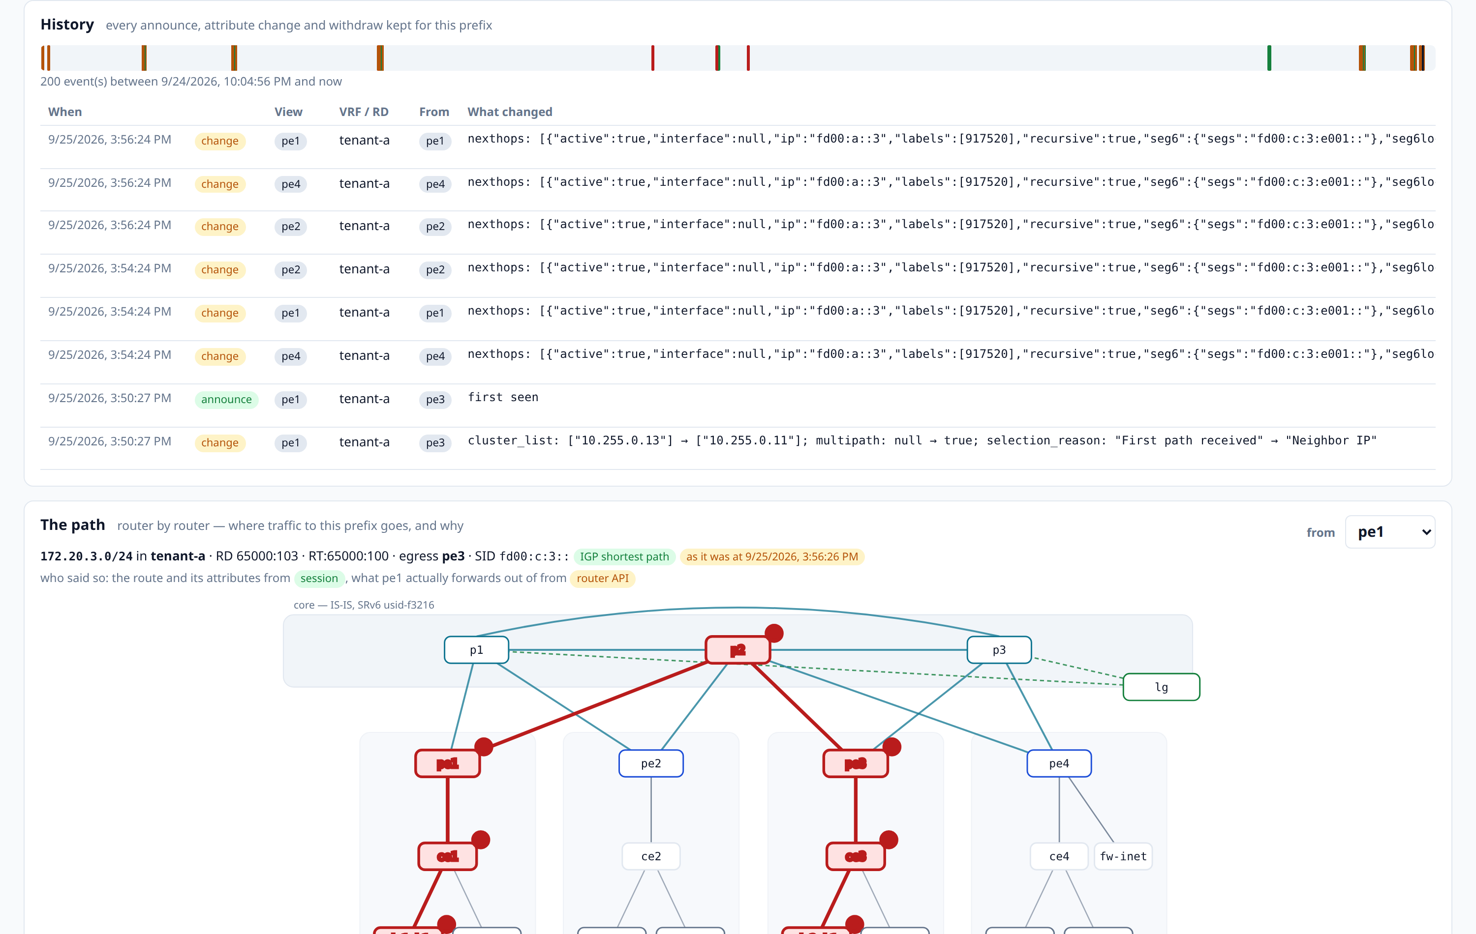
Everything that has happened to it
Each collection is reconciled against what is stored, so the history is a log of events rather than a pile of snapshots.
Reconciled, not sampled
A path that is new raises an announce; one whose attributes differ raises a change carrying the difference — local_pref: 100 → 200; one that has gone raises a withdraw.
So the storage is proportional to what actually changed, not to how often it was polled.
Thirty days are kept and pruned hourly, and the database survives a restart of the collector or of the VM.
168 events for this one prefix, each with the fields that changed

Slide 14
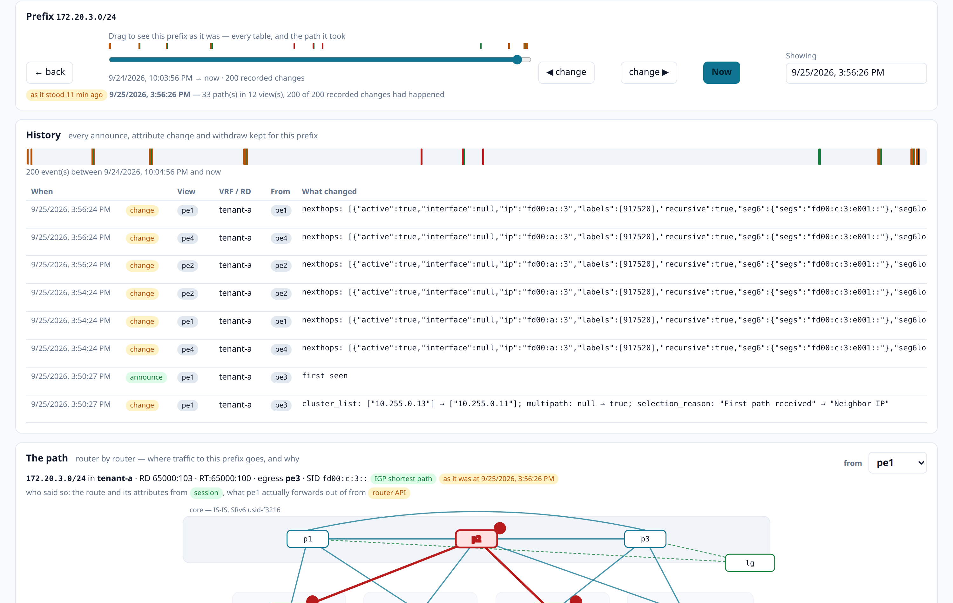
And the slider replays it
Drag it and every table on the page re-renders as it stood at that moment — and so does the path diagram.
Why the path matters here
The forwarding state comes out of the RIB history, not out of today's routers — so a policy that steered this prefix an hour ago is still drawn the way it steered it.
◀ and ▶ snap to the moment just after each recorded change, so nothing is missed between two drags of a slider.
GET /api/state?at=… and GET /api/path?…&at=… are the same replay, for anything that wants it.
“As it stood 31 minutes ago”: 33 paths in 12 views, with 168 of 168 recorded changes having happened

Slide 15
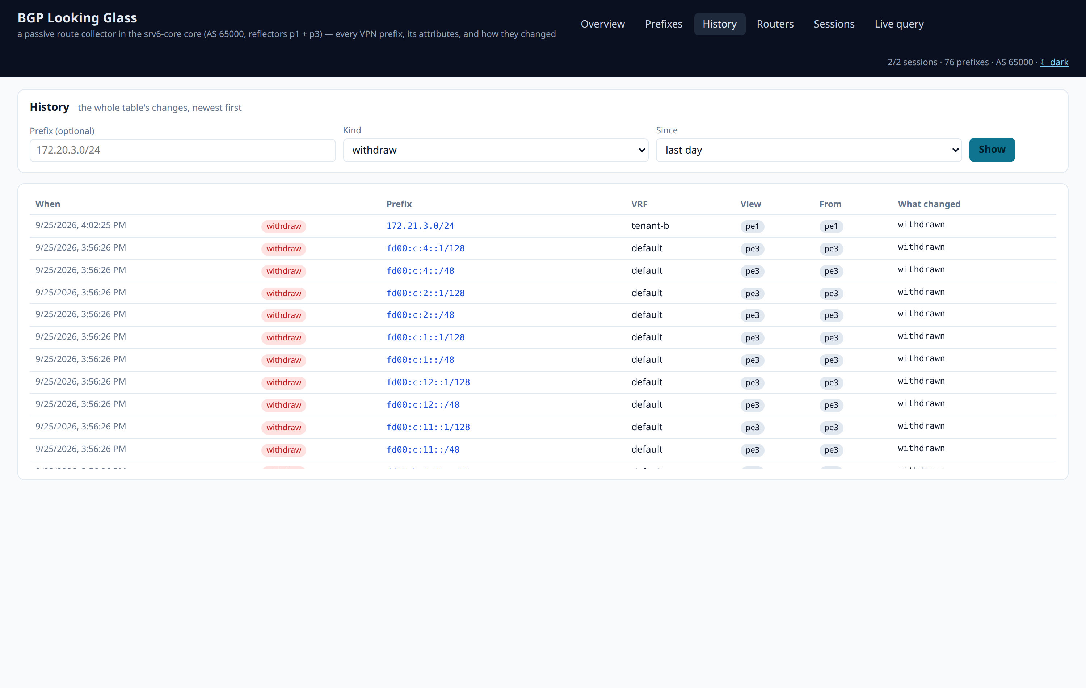
“When did this prefix go away?”
The change log for the whole core, newest first, filterable by prefix, by kind and by age.
The operational value
A prefix that is missing now tells you nothing about when it went, or which PE stopped originating it. This does.
The same log answers “what changed in the last hour?” across the whole core, which is the churn number on the front page.
Every event carries its view and its transport, so a withdraw seen only by one router is distinguishable from one the core agreed on.
Withdraws only — the question a looking glass without a memory cannot answer at all

Slide 16
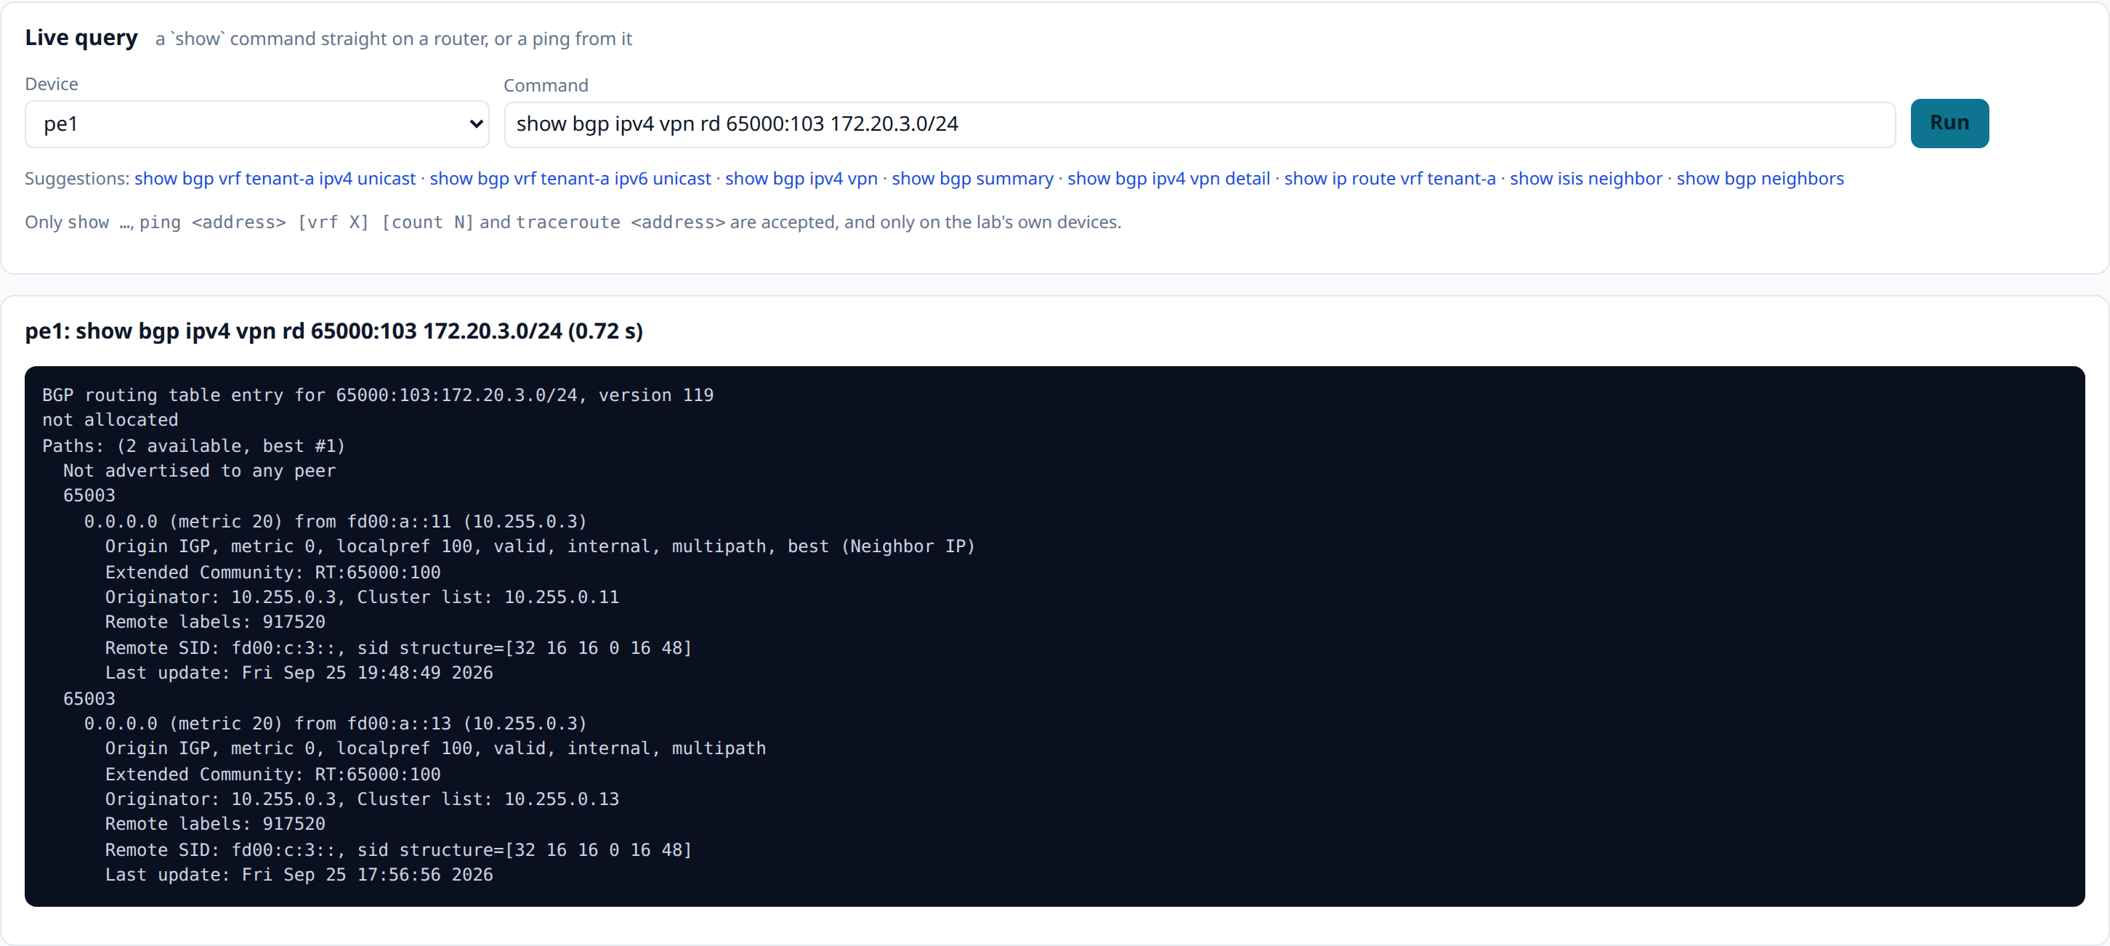
And the classic button: a command on a router
Only show …, ping and traceroute, and only on the lab's own devices — over the same HTTPS API the collector polls with.
Narrow on purpose
No extra access path exists for the button: it is the router API already rendered into every configuration, with the same key and the same allow-client.
Three verbs, validated server-side, against the lab's own device list — a looking glass is a read-only instrument and this keeps it one.
And it is the tie-breaker: when the stored answer and the live box disagree, this says which one is stale.
pe1, asked for the route the collector's session carries — route target, originator, cluster list, remote SID and its structure

Slide 17
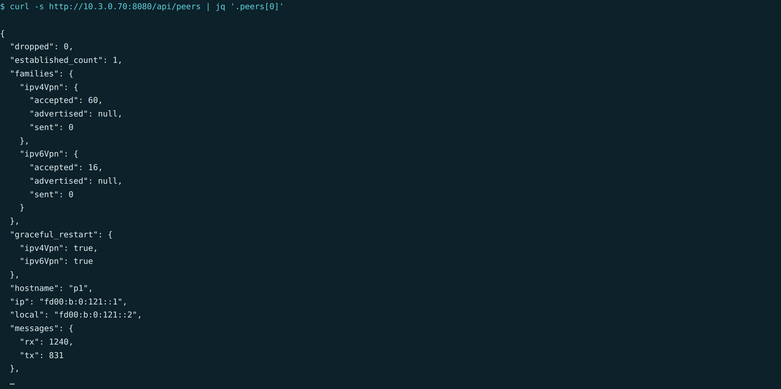
Everything the page does is the API
The page is one consumer of it; Prometheus is another; anything you write is a third.
The read API
/api/prefixes and /api/prefix — the table, and everything known about one prefix in every view.
/api/path — the hop-by-hop reconstruction, from a vantage point you name.
/api/state?at=… and /api/path?…&at=… — the same answers, replayed to any moment in the window.
/api/history, /api/routers, /api/peers and /api/query — and no write verb anywhere in it.
GET /api/peers, as the page itself asks for it

Slide 18
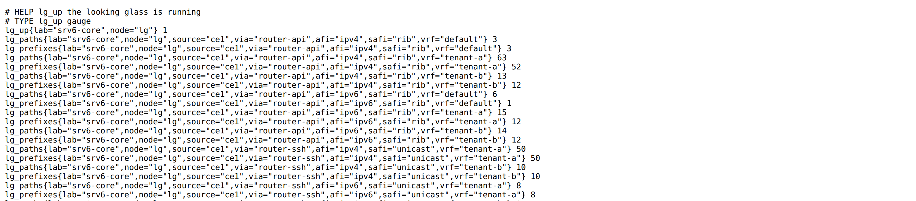
…and the numbers go to Prometheus
Paths and prefixes per node, source, transport, family, VRF and table — plus churn, session state and collection health.
GET /metrics, scraped by the shared lab monitoring on the NMS
One row per view
A dashboard row
And three alerts
The same breakdown the page shows, as a time series — so “when did pe3 stop holding tenant-a?” has a graph as well as a change log.
The shared Grafana has a looking-glass row built from these: paths over time, per transport, and the age of each router's last collection.
A reflector session down, a collection failing, and churn above its threshold — beside every other alert for the host.

Slide 19
What it is for
Three properties, and every one of them is a choice that shows up in the product.
The attributes, unaltered
Every answer, labelled
And yesterday's answer too
A reflector client sees the update the PE originated: route distinguisher, route targets, SRv6 SID, label, originator-id, cluster list, AS path. Nothing is parsed out of a screen, and extended-nexthop keeps the originating PE as the next hop.
The core's table, each router's own tables and each router's RIB, side by side — with the transport each came over, because the same prefix seen two ways is two answers and hiding which is which makes both useless.
Reconciled history rather than samples: thirty days of announces, changes and withdraws, with every table and the path itself re-drawn for any moment in that window.
http://192.168.50.231:8092 · the lab-side address is http://10.3.0.70:8080 · ./lab.sh lg status · the code is lg/ in this repository.
A 3½-minute walkthrough of the same ground is docs/demo/lg-demo.mp4; the portal and the core are in docs/srv6-workflows.pptx.

