Slide 1
The SRv6 Core
21
A tenant provisioning portal, and a looking glass that remembers
VMs, one model
VyOS SRv6 core (uSID f3216) · IS-IS level-2 · BGP L3VPN with End.DT46 · two route reflectors
Nautobot source of truth · Network-as-Code rendering · Robot Framework validation · Prometheus and Grafana

Slide 2
What the core runs
Every number below is read from the routers or from the collector's own history — none of it is typed in.
2 / 8
76
100
~6 min
tenants, sites
prefixes in the core
tests per change
to add a tenant
one VRF per tenant on every PE and CE; tenants never meet
152 paths in the VPNv4 / VPNv6 table, across two address families
twelve Robot Framework suites against the running lab
four sites, four host VMs, the CEs re-wired, Nautobot seeded
Two halves of the same model.
The portal changes the service: a tenant is described on a form, allocated from the live lab, and built by one run that ends in the test suites. The looking glass never changes anything — it sits in the core as a passive BGP listener, reads every router besides, and keeps what it saw, so any prefix can be answered for now and for any moment in the last thirty days.

Slide 3
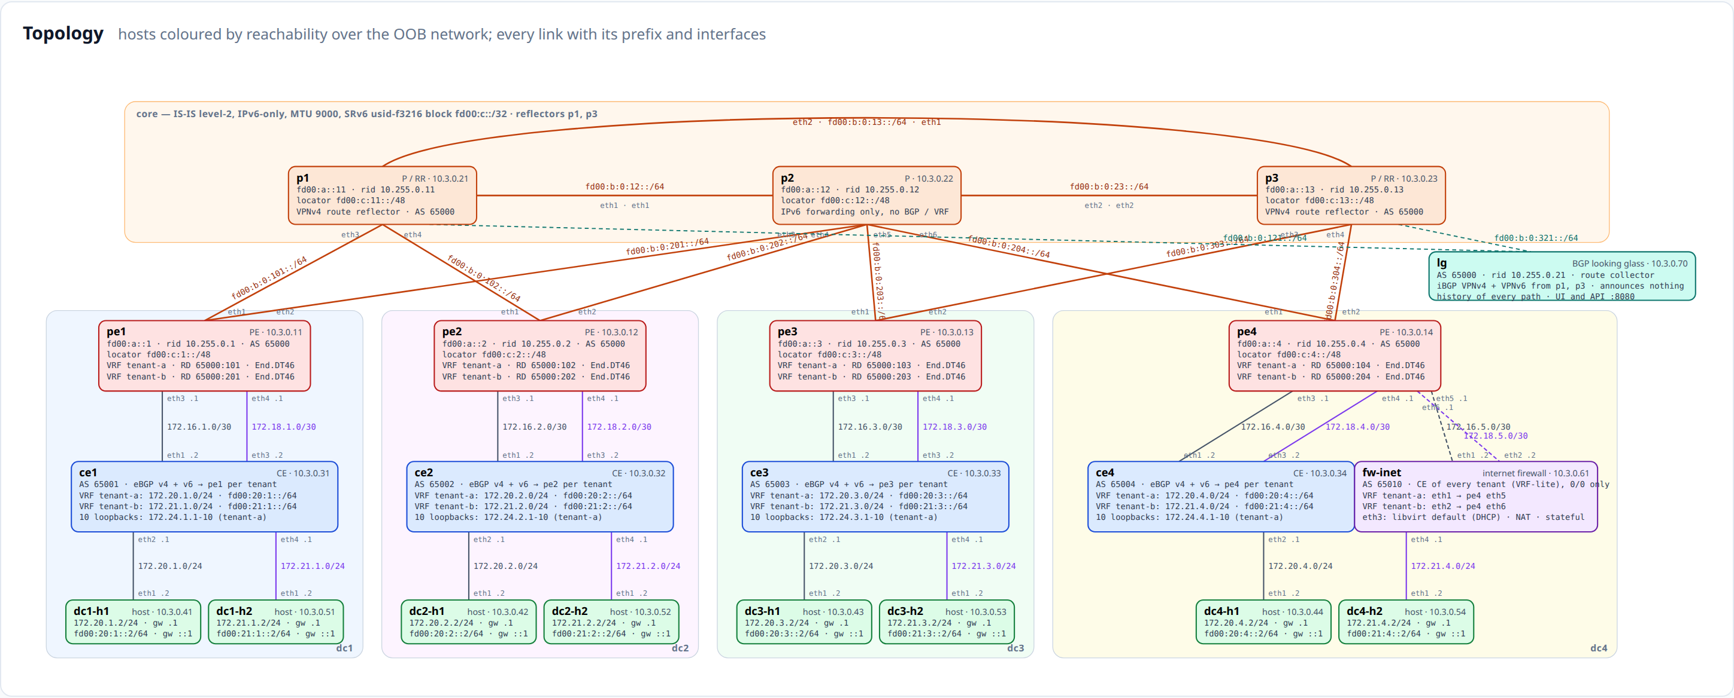
The testbed
An IS-IS level-2, IPv6-only core carrying SRv6 uSID f3216; four data centres behind four PEs; p1 and p3 reflect, and the collector (top right) listens to both.
The portal's own drawing, from the model: every link with its prefix and interfaces, every VRF with its route distinguisher, hosts coloured by live reachability
The picture, the routers' configuration, the Nautobot objects and the test fixtures all come from one file — lab.conf plus the intent. Nothing on this slide is drawn by hand, and Nautobot must render the same thing or the build fails.

Slide 4
Part one
Provisioning a tenant
The portal is the only place the service is changed: a form states the intent, the allocator answers from the
running lab, and a single run builds it — VMs, wiring, configuration, Nautobot and the tests.
http://192.168.50.231:8091

Slide 5
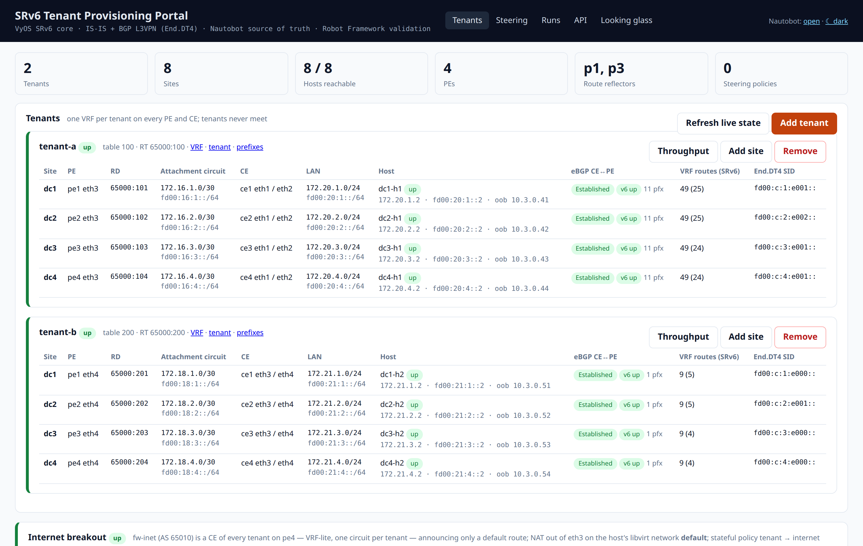
Tenants, with the live state beside them
One card per tenant: its sites, the attachment circuits, the CEs, the hosts — joined with what the PEs actually report.
Model and reality, in one row
The left of each row is the model (PE port, RD, attachment circuit, LAN, host); the right is read live from the PE.
A session that is not Established, or a host that does not answer, shows here first — there is no separate health page to remember.
VRF, tenant and prefixes link straight into Nautobot, so the source of truth is one click from the operational view.
Each row carries the eBGP session to the CE, the prefixes received, the VRF route count and the tenant's End.DT4 SID

Slide 6
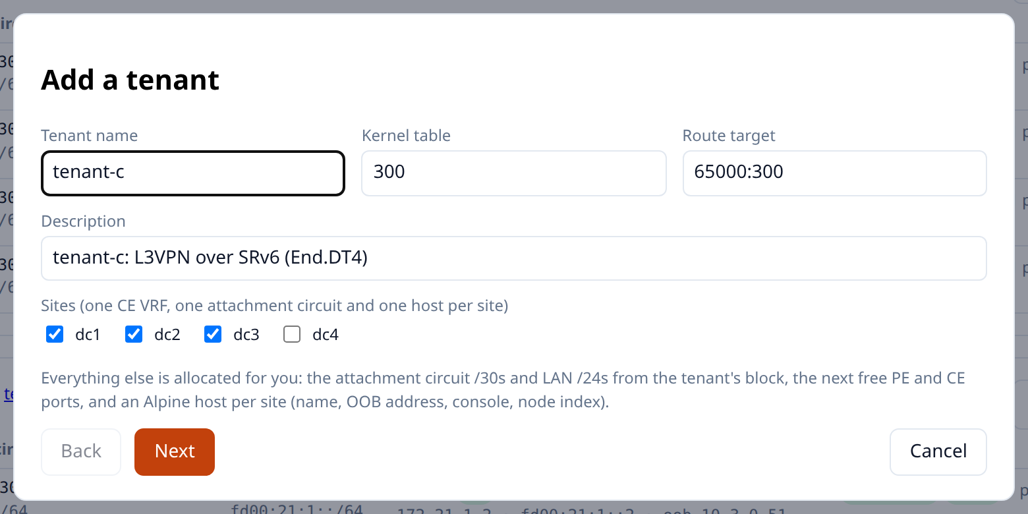
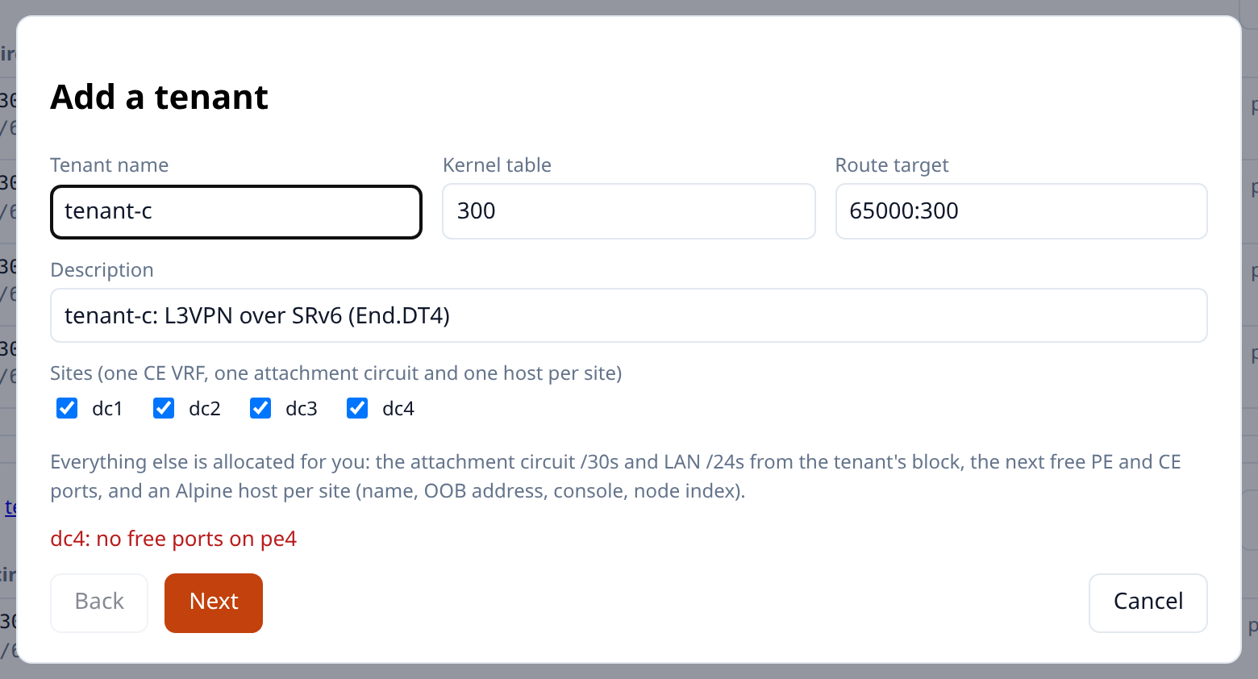
Add a tenant — who it is, and where
The wizard opens with everything it can work out already filled in: the next free name, kernel table and route target.
Step 1 — identity and the sites the tenant will have
The allocator answers from the running lab, so it can say no
Left: tenant-c, kernel table 300, route target 65000:300 — the next free values, and a site in each of the four data centres.
Right: pe4 has no free ports left, so a fourth site is refused before anything is built rather than half-way through the run. Drop that site and the wizard goes on — the allocation is checked against the lab, not against a copy of it.

Slide 7
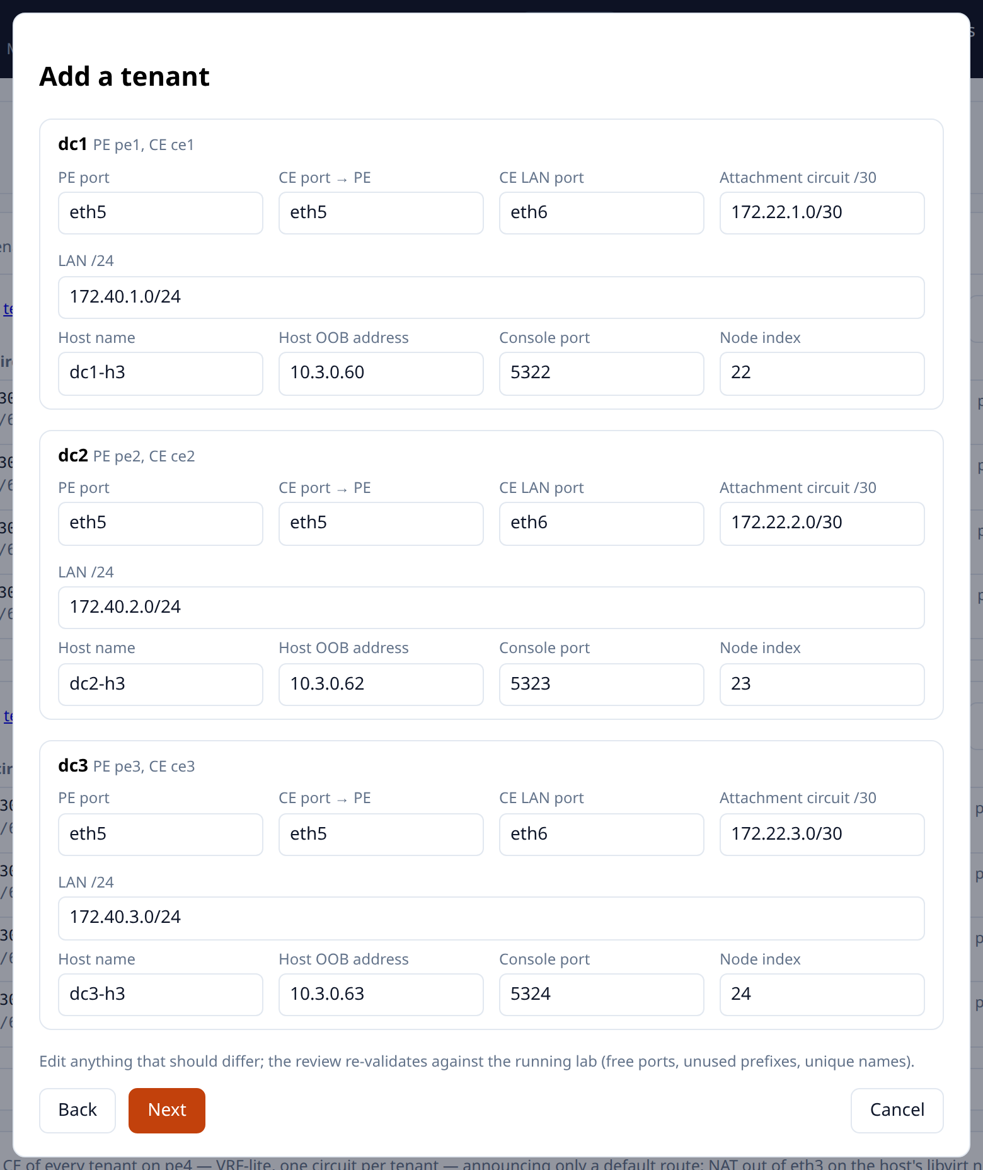
2
Add a tenant — the allocation
Attachment circuit /30s and LAN /24s from the tenant's blocks, the next free PE and CE ports, and a host per site.
Allocation, not arithmetic
Addresses come from the tenant's own blocks — 172.(16+i) for the attachment circuits, 172.(20+i) for the LANs — so a new tenant never collides with an old one.
The host is part of the tenant: name, OOB address, console port and node index are allocated with everything else, and the VM is built by the run.
Edit anything. The next step re-checks free ports, unused prefixes and unique names against the lab as it is now.
Step 2 — every value suggested and editable; the review re-validates whatever you change

Slide 8
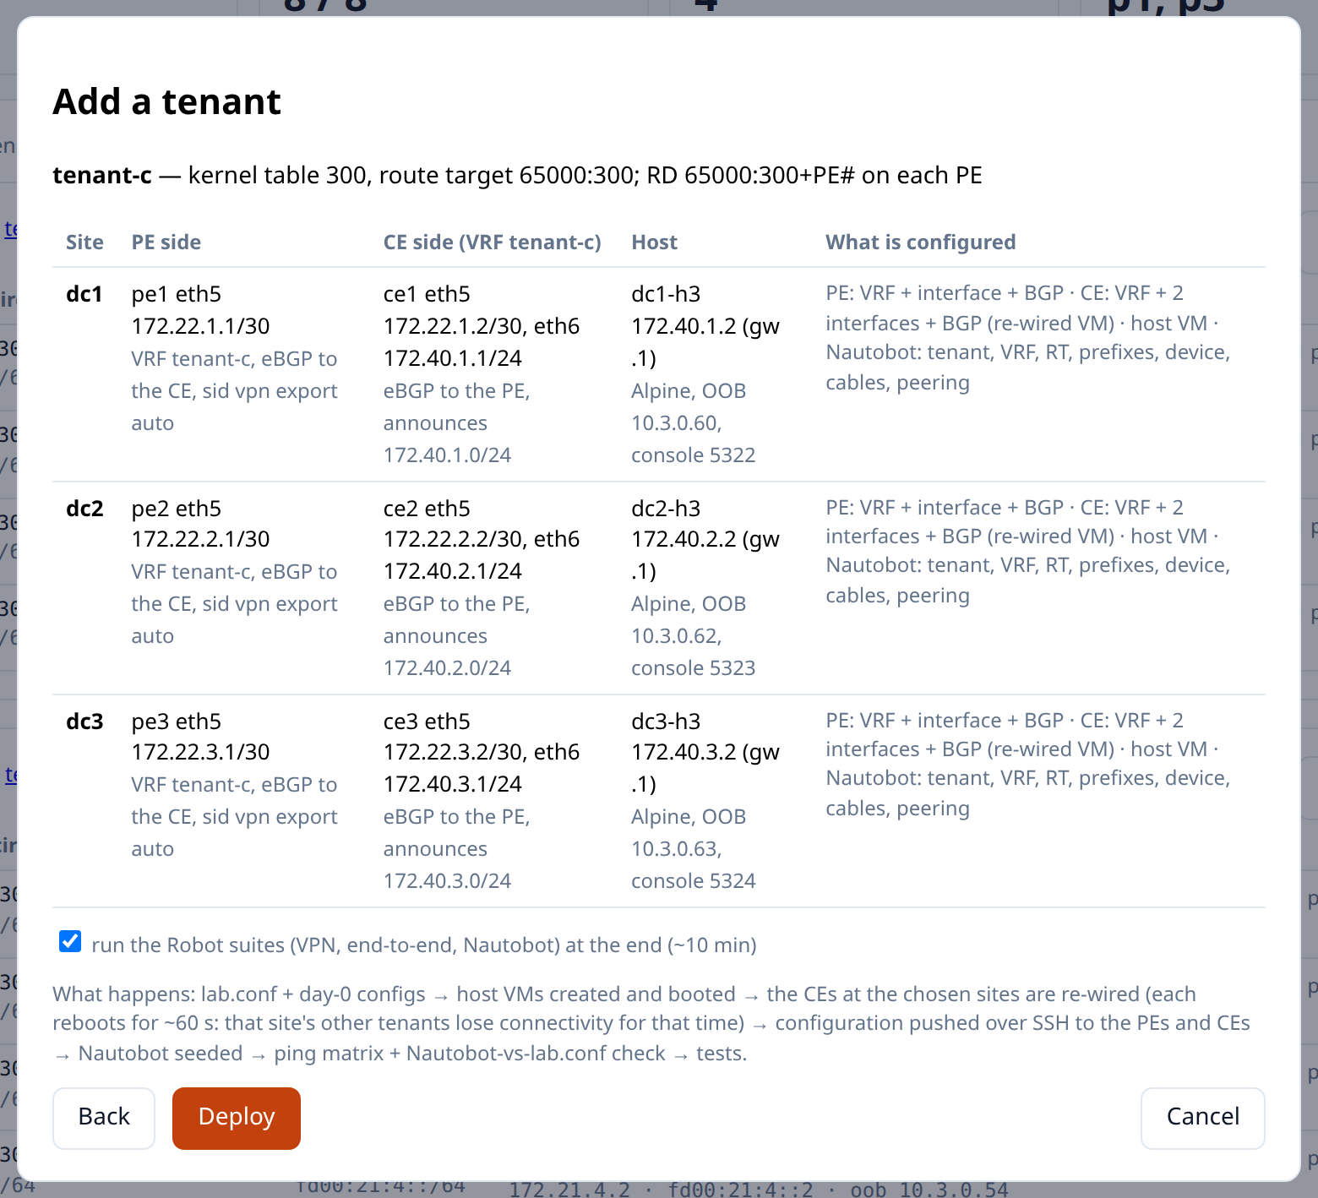
3
Add a tenant — review, then deploy
The last step is the whole change in one table: what each PE gets, what each CE gets, and the host behind it.
One button, one run
lab.conf and the day-0 configs are written, the host VMs are created and booted, and the CEs at the chosen sites are re-wired.
Then the configuration is pushed to the PEs and CEs over SSH, Nautobot is seeded, and the run verifies itself: a ping matrix of the tenant's hosts and a Nautobot-versus-lab.conf render check.
A re-wired CE reboots for about a minute, and the review says so — that site's other tenants lose connectivity for that time.
Step 3 — per-site review, with the option to run the Robot suites at the end

Slide 9
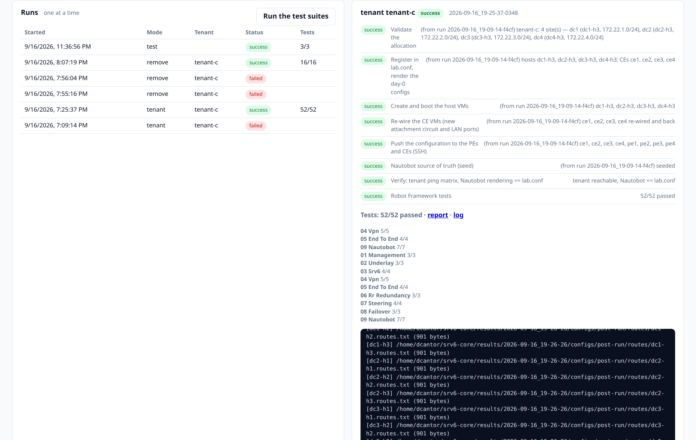
Watch it run — and resume it if it fails
Every run is a list of steps with a streamed log and, at the end, the Robot report.
The record
One run at a time, so two changes can never race on the same router.
A failed or interrupted run resumes from the failed step: the successful steps carry their earlier result forward, which is what the “from run …” notes are.
The suites run inside the job, so the evidence belongs to the change rather than to a separate test cycle.
A real tenant-c run: eight steps, 52/52 tests — and every step marked “from run …-f4cf” was inherited, not repeated

Slide 10
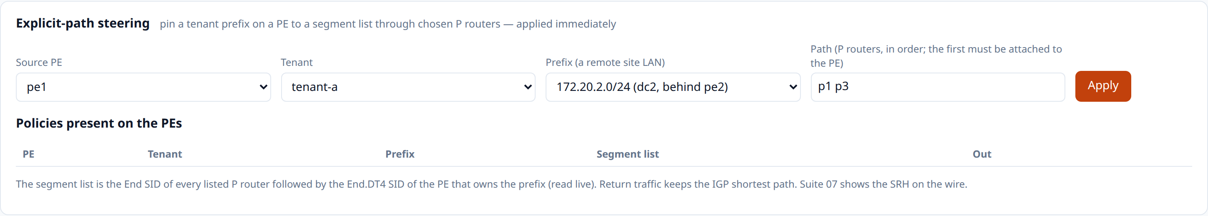
Steering: pin a prefix to a path
Explicit-path traffic engineering as a form — a source PE, a tenant prefix, and the P routers to cross, in order.
The segment list is the End SID of each listed P router, then the End.DT4 SID of the PE that owns the prefix — read live and applied immediately. No policy is in place here.
Cheap, because SRv6
One direction at a time
And it is visible afterwards
No per-hop state and no signalling: the ingress PE writes a segment list into the packet and every router in between only has to forward it.
Return traffic keeps the IGP shortest path, so a policy is one-directional unless you add its mirror. Suite 07 shows the SRH on the wire.
The looking glass draws a steered prefix along the routers its policy named, and keeps drawing it that way for the window in which it was in force.

Slide 11
Part two
The looking glass
A twenty-first VM, Alpine and 512 MiB, sits in the core as a passive route collector: an iBGP session to each
reflector, a direct read of every router besides, and a history of everything it has seen.
http://192.168.50.231:8092

Slide 12
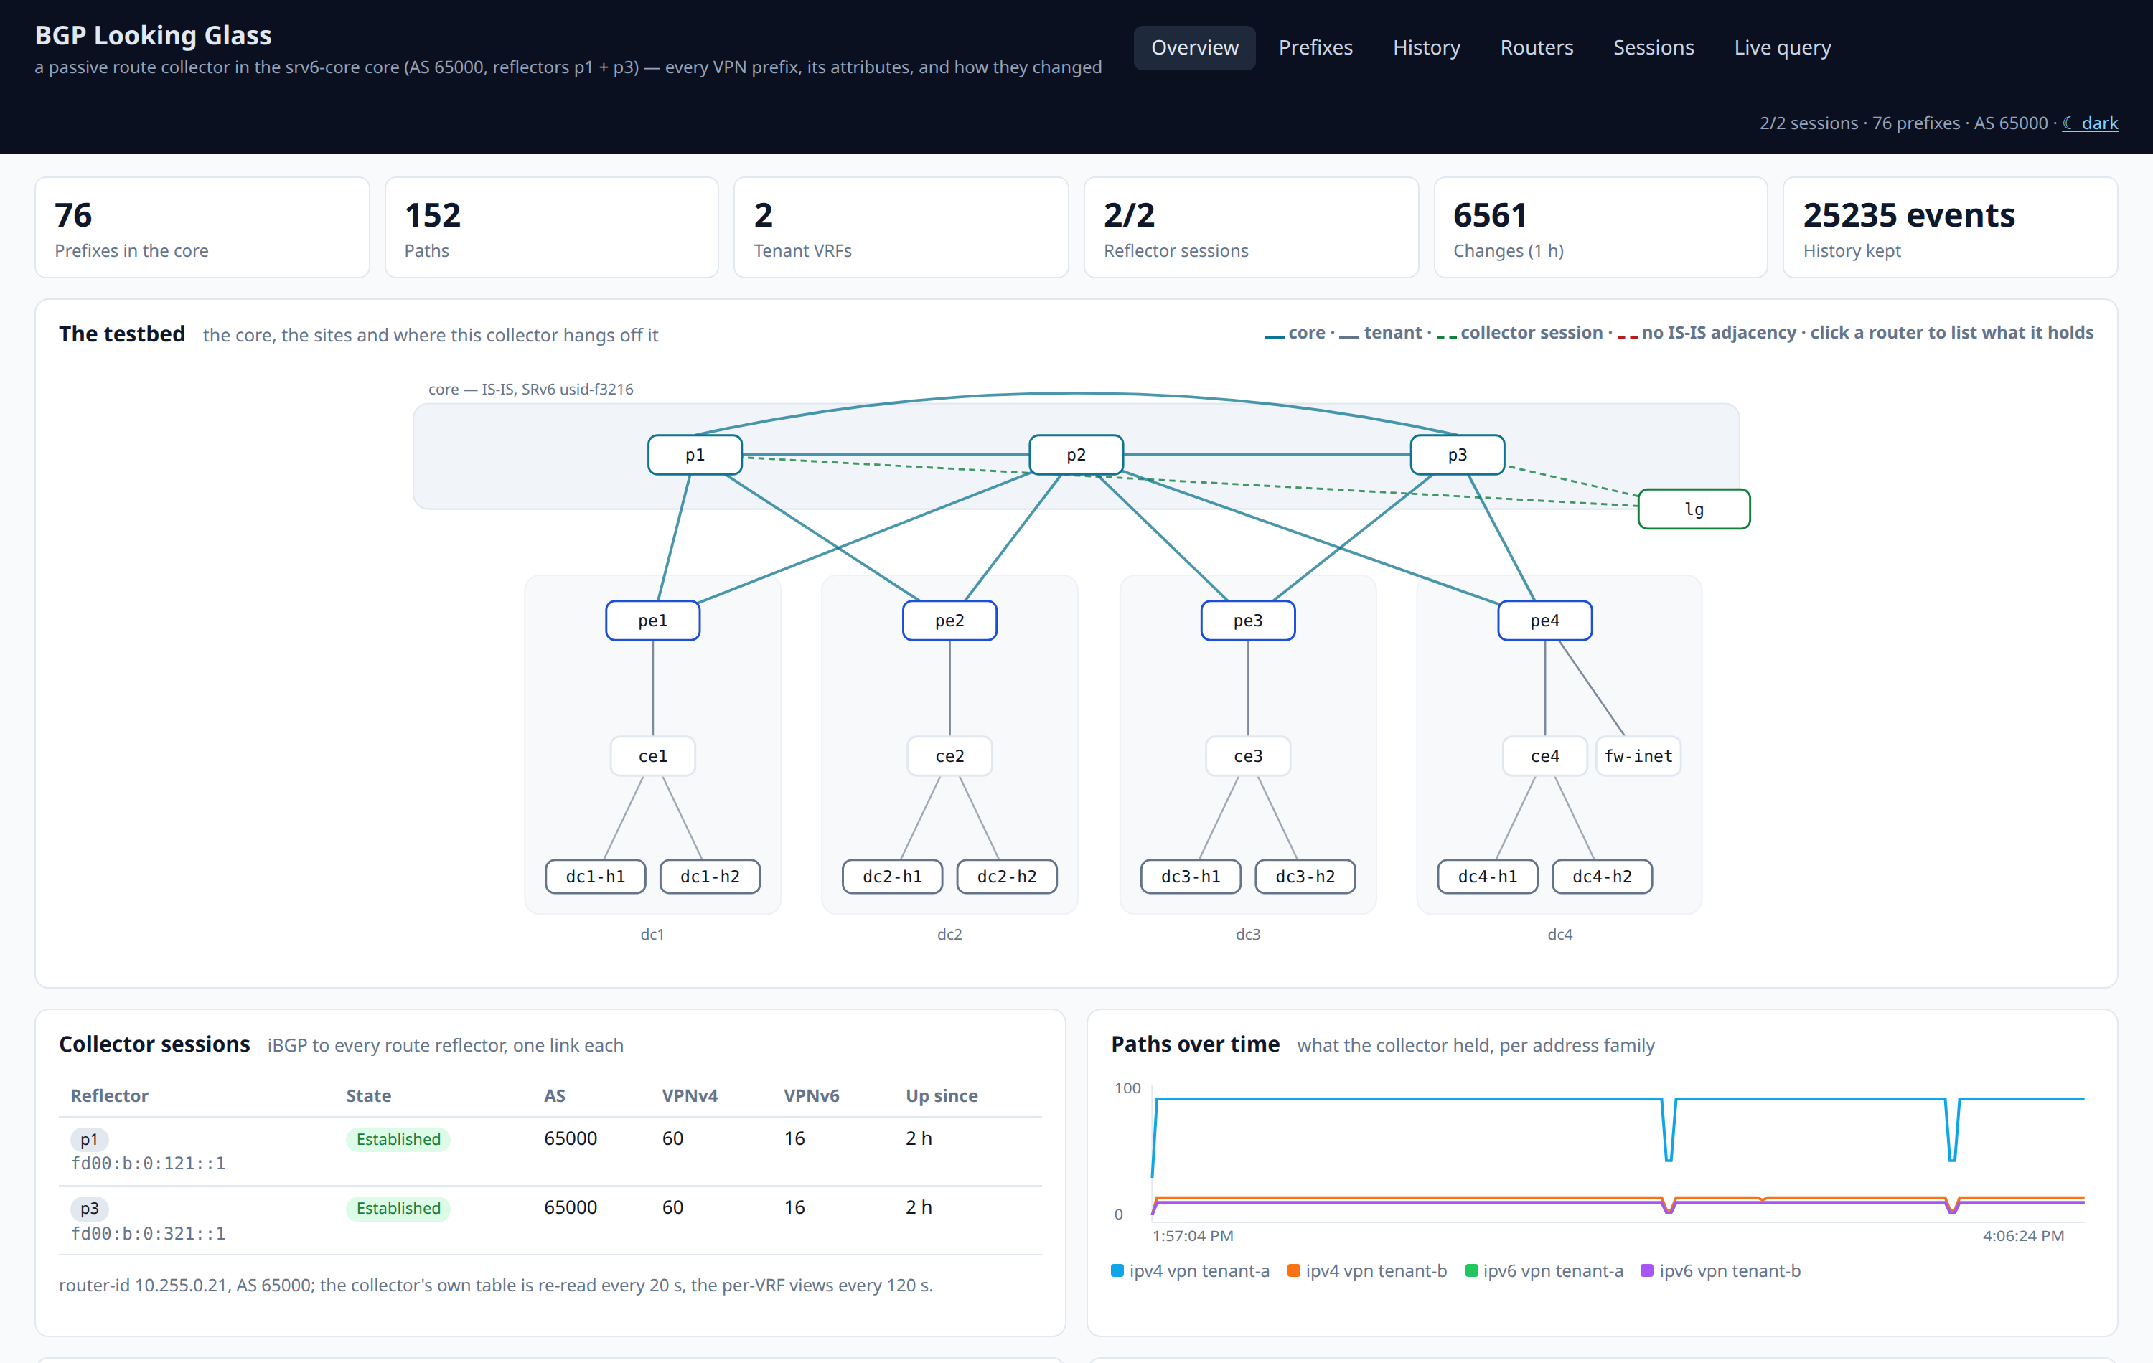
Every VPN prefix in the core, and how it got there
The overview: what the collector holds, the sessions it holds it over, and the testbed drawn from the model.
Why a session, not screen-scraping
The collector receives the same update the reflector sent: route distinguisher, route targets, SRv6 SID and label, originator-id, cluster list, AS path, local preference.
It announces nothing back — an outbound deny route-map says so explicitly, and the sessions show 0 sent.
The session negotiates extended next-hop capability, without which every VPNv4 route would look as though it came from the reflector instead of the PE that originated it.
76 prefixes, 152 paths, two reflector sessions — and 18,674 recorded changes behind them

Slide 13
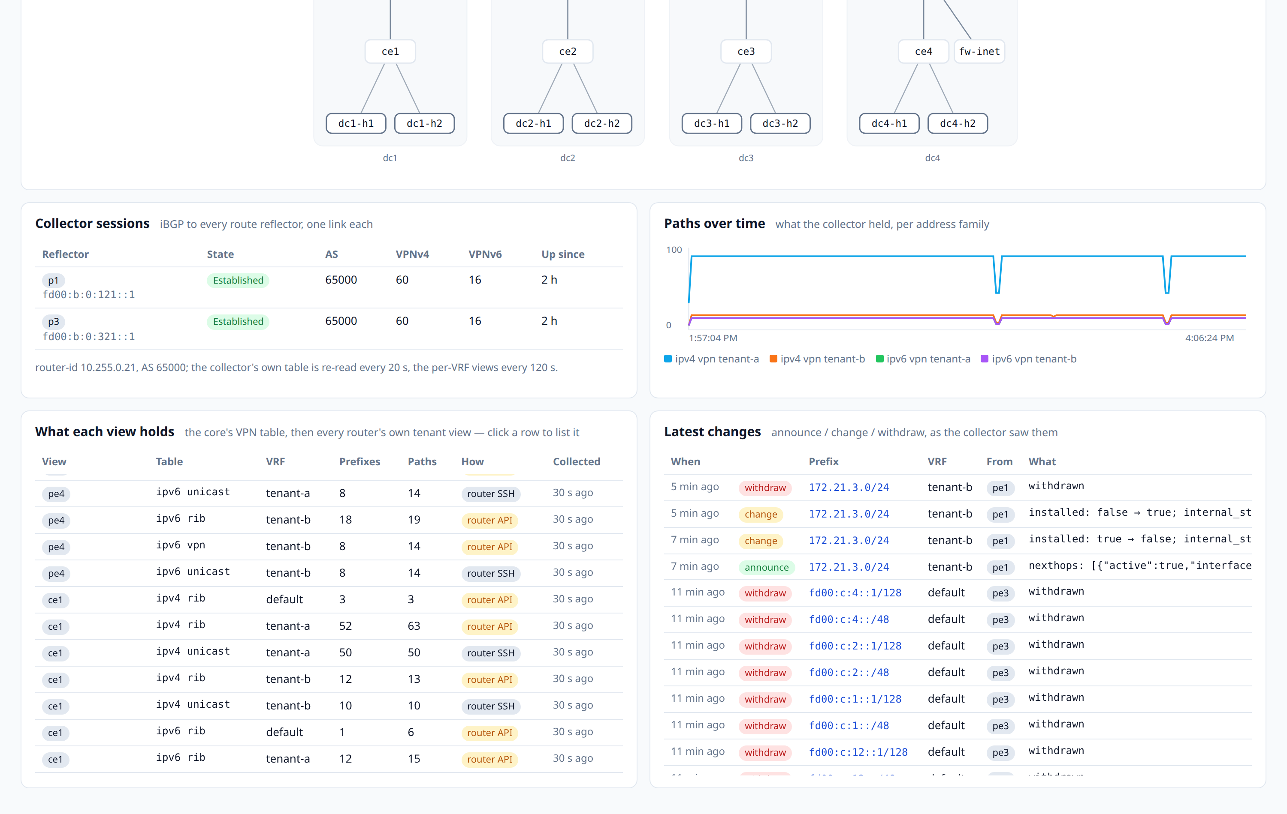
Every row says how it was read
The core's VPN table is one answer. What a tenant actually has, and what a router will really do, are two others.
Three transports, one page
rr-session — the whole VPNv4 / VPNv6 table, as the reflectors handed it over.
router-api — each router's own HTTPS API: its RIB per VRF and family, its own VPN table, its IS-IS adjacencies.
router-ssh — the per-VRF BGP tables, where the API has no JSON form for the question.
The same prefix seen two ways is two answers, so the transport is a column, a filter and a pill — never hidden.
What each view holds, per router, VRF and family — with the transport it came over and when it was collected

Slide 14
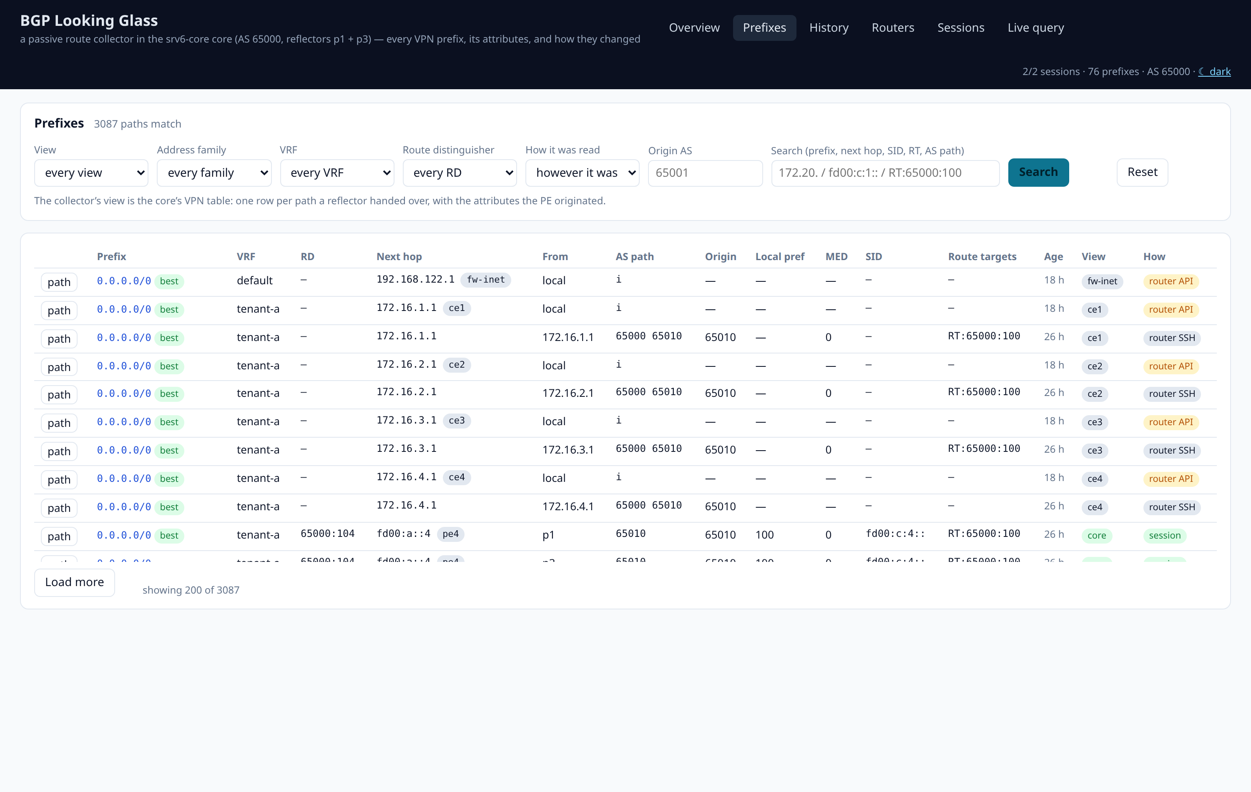
Prefixes, filtered the way an operator asks
View, family, VRF, route distinguisher, origin AS, how it was read — and free text over prefix, next hop, SID, route target and AS path.
The classic questions
“Who originates this?” — origin AS and originating node are columns, not something to derive from an AS path.
“Is it in the tenant's VRF, or only in the core?” — the view filter answers it directly.
“What SID does it carry?” — the End.DT46 SID is on the row, and the free-text box searches it.
Every row carries its attributes and a path button

Slide 15
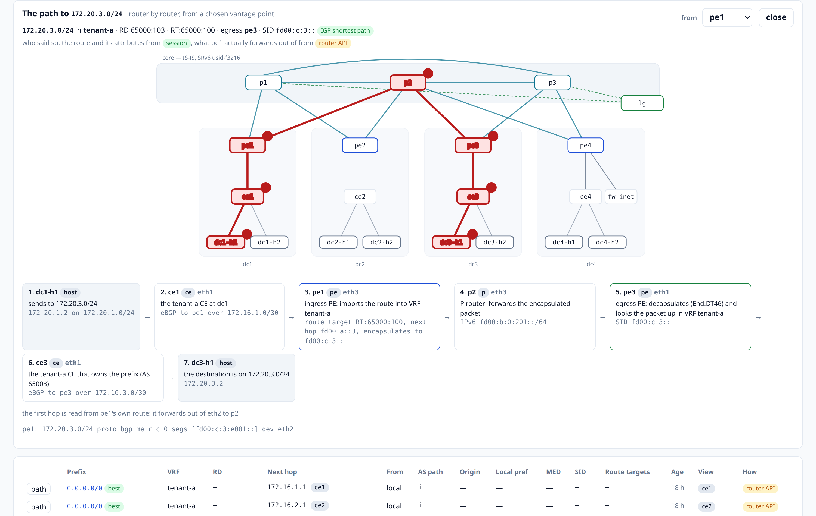
The path, router by router
For one prefix from a chosen vantage point: the map with the path lit up, then a card per hop.
Two sources, one answer
The route and its attributes come from the session; what the router will actually do with the packet comes from its own RIB — and the card says which is which.
Equal-cost paths are named rather than silently collapsed into one line.
A steered prefix is drawn along the segment list the policy installed: the uSID carrier is unpacked back into the routers it names.
dc1-h1 → 172.20.3.0/24: the CE hand-off, pe1's import and SRv6 encapsulation, p2, pe3's End.DT46 decapsulation, ce3, the host

Slide 16
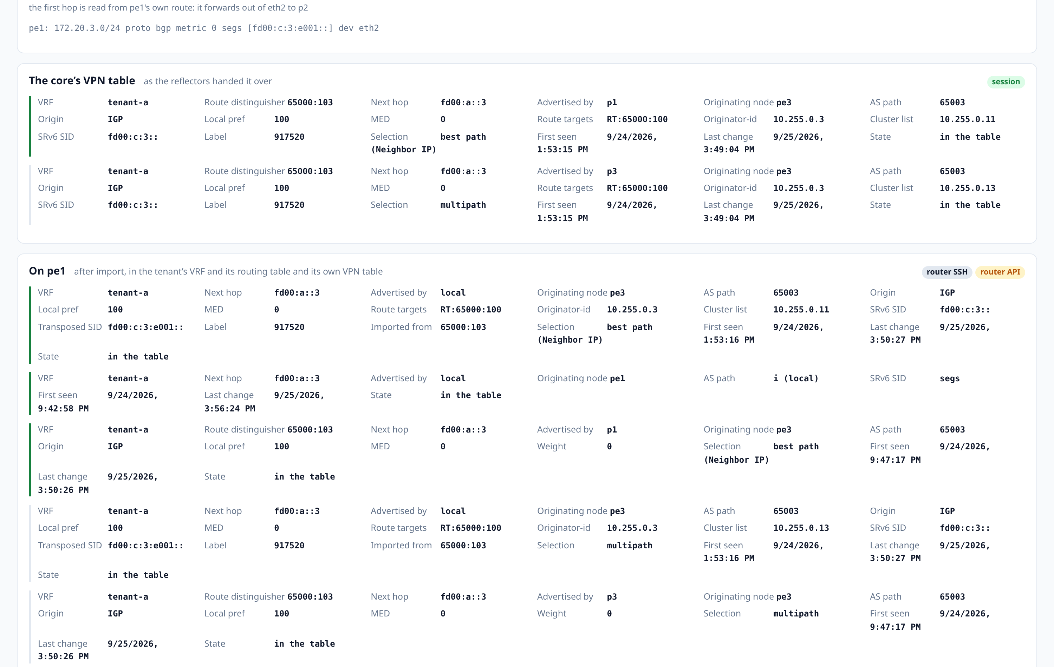
One prefix, every view at once
The core's VPN table, each reflector's and PE's own VPN table, each PE's and CE's VRF table, and every router's RIB.
Where answers differ
A prefix present in the core but missing from a VRF is an import problem; present in the VRF but not in the RIB is a selection problem. The page puts both side by side.
Attributes are shown whole: route targets, originator-id, cluster list, SID, label, selection reason.
Below it, the timeline of everything that has happened to this prefix.
One question, answered by every vantage point that has an opinion — each with its full attribute set and the transport it came over

Slide 17
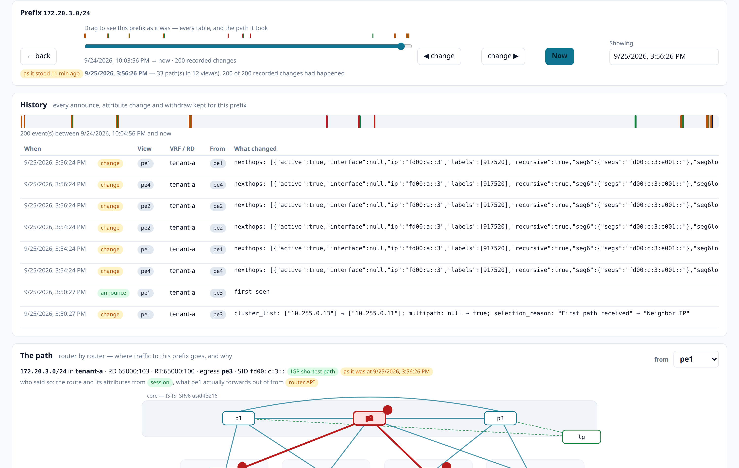
And what it looked like an hour ago
Every collection is reconciled against what is stored, so the history is a log of announces, attribute changes and withdraws.
The point of keeping it
A change carries the fields that changed — local_pref: 100 → 200 — not just a new snapshot.
Drag the slider and every table on the page re-renders, and so does the path: the forwarding state comes out of the RIB history, not out of today's routers.
So a policy that was in place at 22:06 and is gone now still shows as the path it made. Thirty days are kept, pruned hourly.
The slider dragged back: 33 paths in 12 views as they stood at 13:57 — and the path diagram re-drawn for that moment

Slide 18
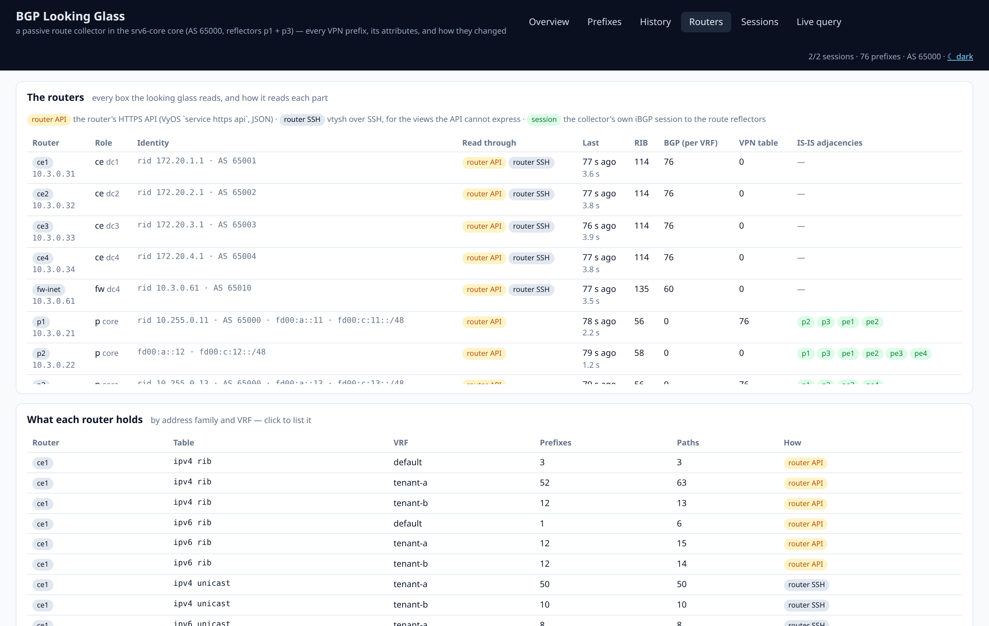
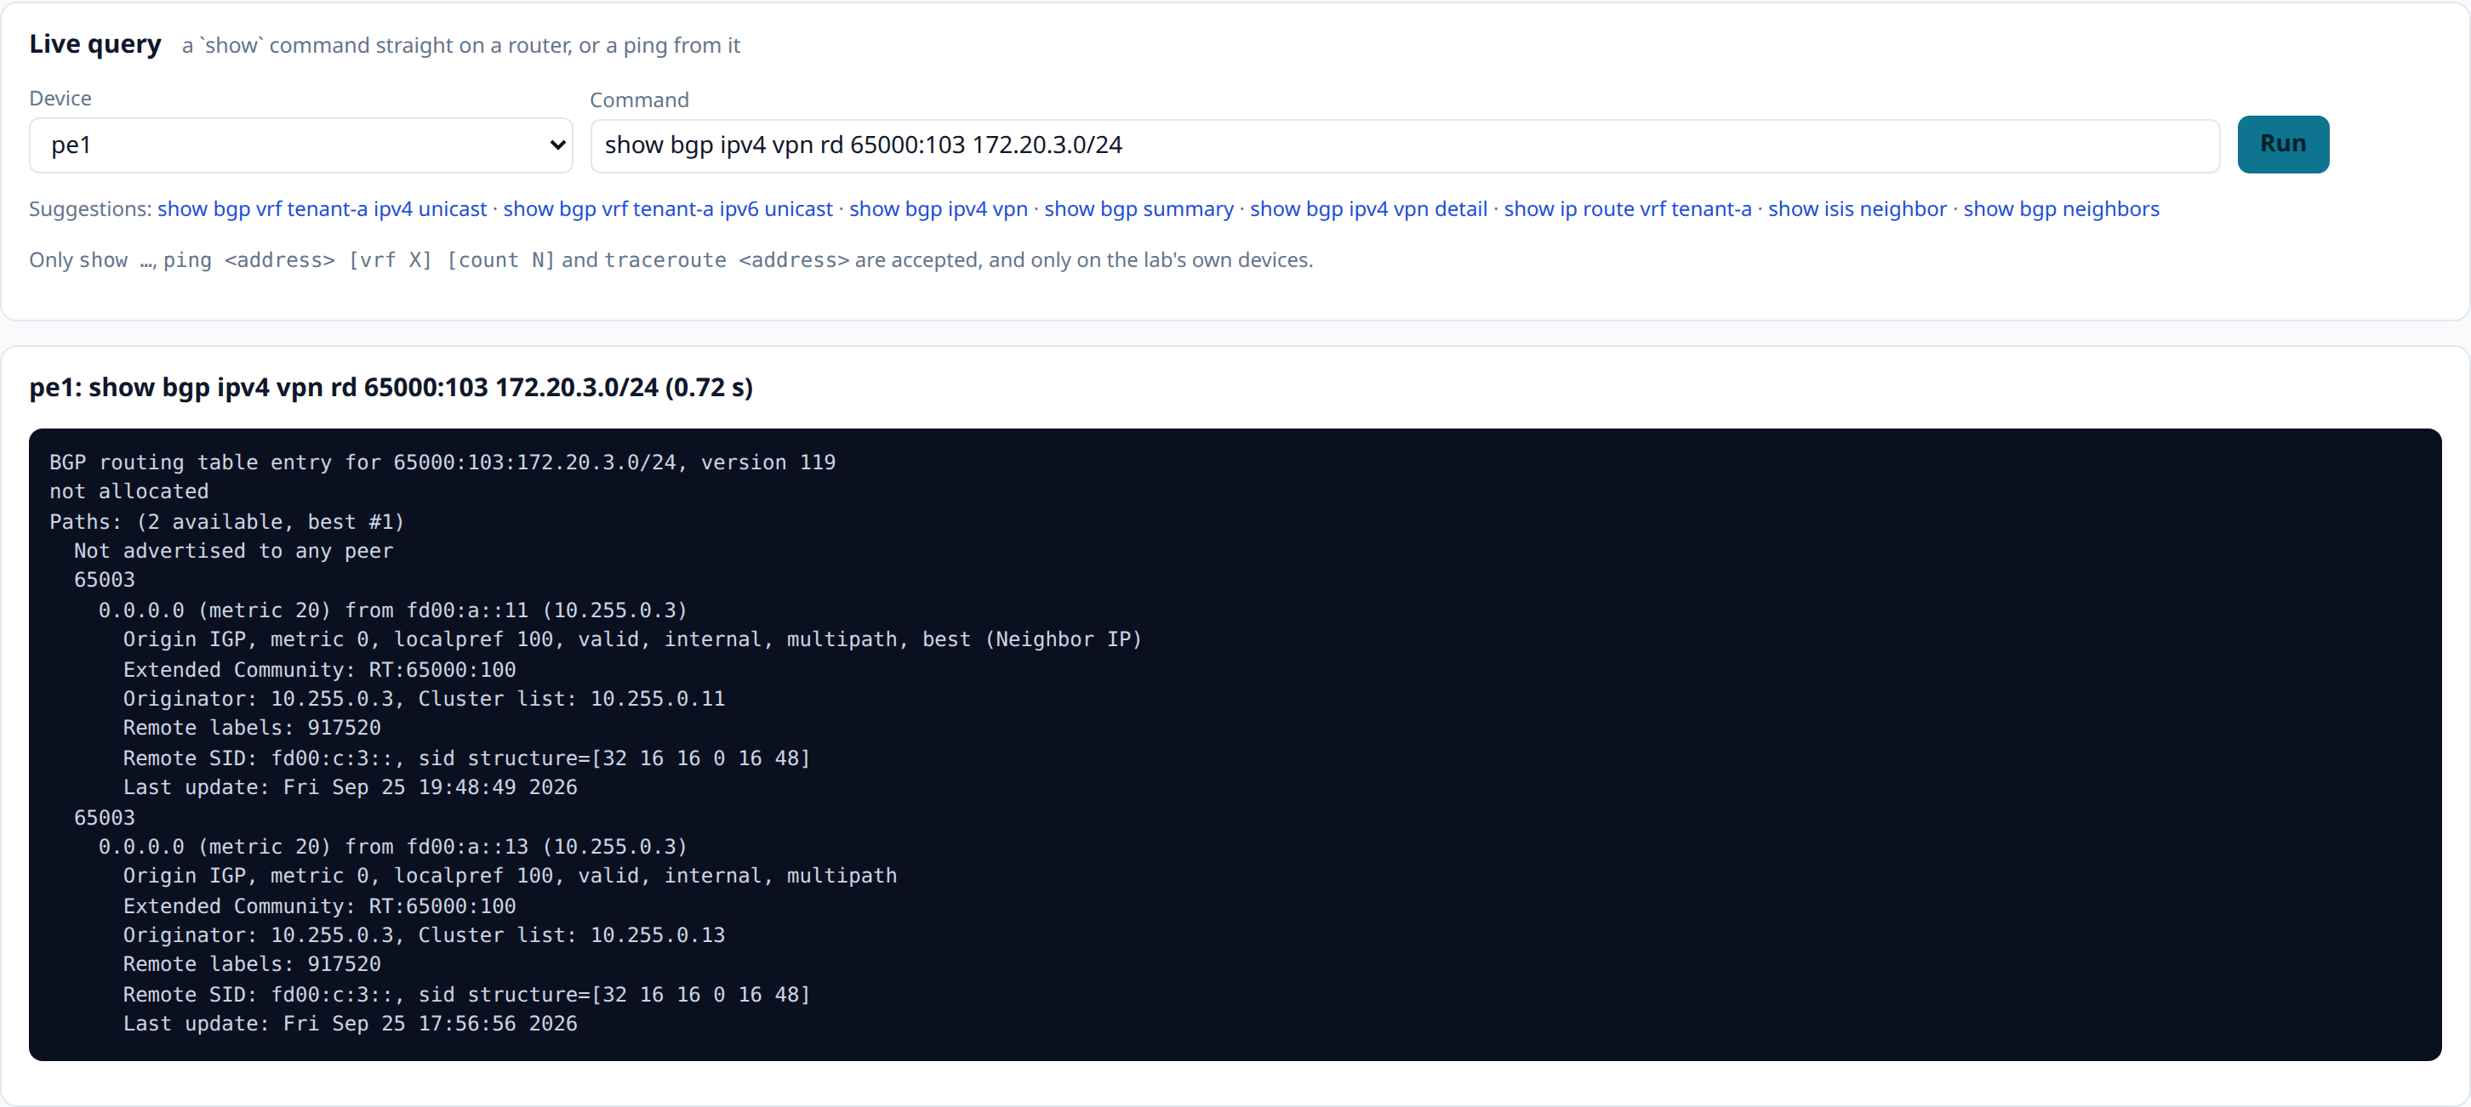
Everything it reads, and one question of your own
The Routers page is the collector's account of its own work; the Live query is the looking-glass button.
Every box it reads: identity, transports, when, and how much it holds
A show command straight on a router — only show, ping and traceroute
Each router's own HTTPS API is rendered into its configuration like everything else (key srv6core-lab-looking-glass, reachable only from the collector and the lab host), so the same interface is open to anything else that wants it.
Numeric series — paths per VRF and family, churn, session state, collection health — go to /metrics, where Prometheus scrapes them for the dashboard's looking-glass row and three alerts.

Slide 19
What the two halves are for
Change it from one place
See it as the network sees it
Ask about yesterday
The portal allocates from the running lab, builds the tenant in one resumable run, and ends in the test suites — so the evidence belongs to the change.
A passive BGP session gets the attributes the PEs originated; the routers' own APIs get what each box installed. Every row says which.
The history is reconciled, not sampled: announces, attribute changes and withdraws, thirty days of them, with the path re-drawn for any moment in that window.
The portal is at http://192.168.50.231:8091 and the looking glass at :8092, both with their REST API at /docs; the lab hub at :8088 lists every lab on the host. The full write-up is README.md and docs/srv6-walkthrough.pdf.

