Slide 1
Stock Price Movement Prediction Based on SVM
Dingxian Cao, Blaire Li

Slide 2
Problem
Financial Market
predict the trend of stock price movement (classification)
stock price forecast(regression)

Slide 3
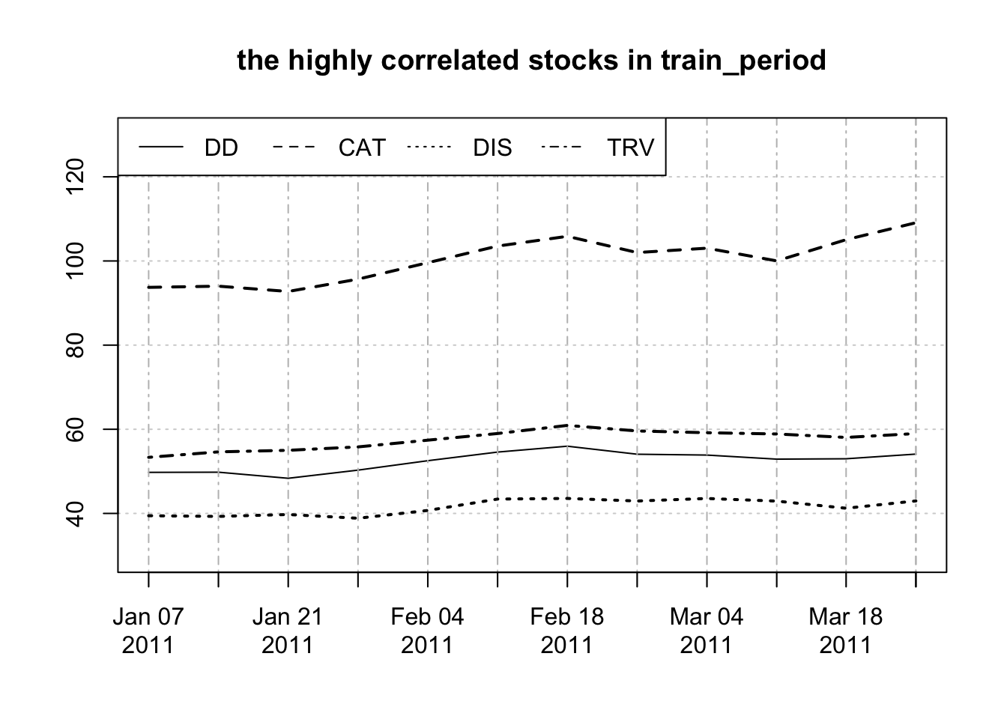
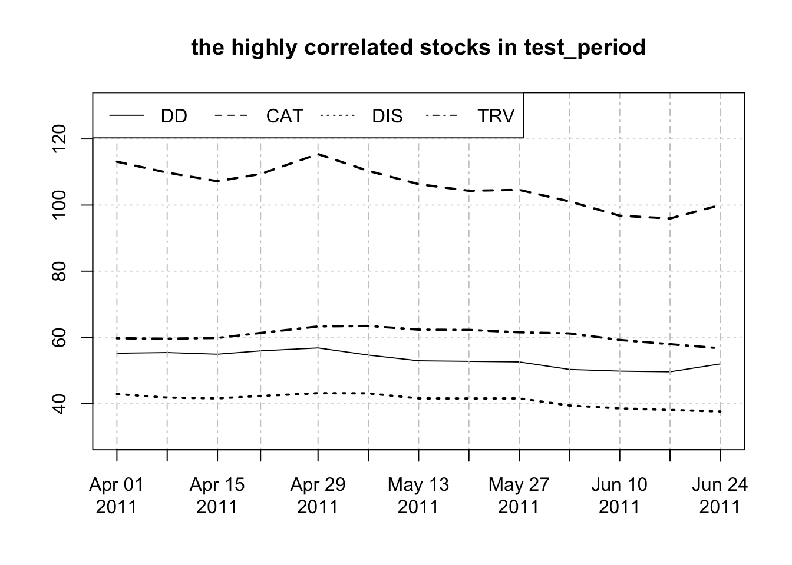
Dow Jones Index set

Slide 4
Methodology
problem | Method | Prediction error/ MSE
Classification | 1.Mixed + Rolling | 0.462
 | 2.Mixed + non-Rolling | 0.615
 | 3.Autoregressive + Rolling | 0.385
 | 4.Autoregressive+non-Rolling | 0.615
Regression | 1.Mixed + Rolling | 4.188
 | 2.Mixed + non-Rolling | 5.744
 | 3.Autoregressive + Rolling | 4.363
 | 4.Autoregressive+non-Rolling | 6.051
KPCA+Regression | KPCA + Mixed + Rolling | 4.248
 | KPCA + Mixed + non-Rolling | 5.714
SVM_1 (inputs: DD lagged items)
SVM_2 (inputs: mixed lagged items)
SVM_2_rolling ( updating the dataset)
KPCA -> New inputs -> SVM
KPCA Trick !!!!!!!!
Notes:
2 problem, same procedure
Mixed : DD ,3 OTHER STOCKS
Rolling: window length=5, update the train data and model before implementing the forecast.
KPCA: produce new inputs

Slide 5
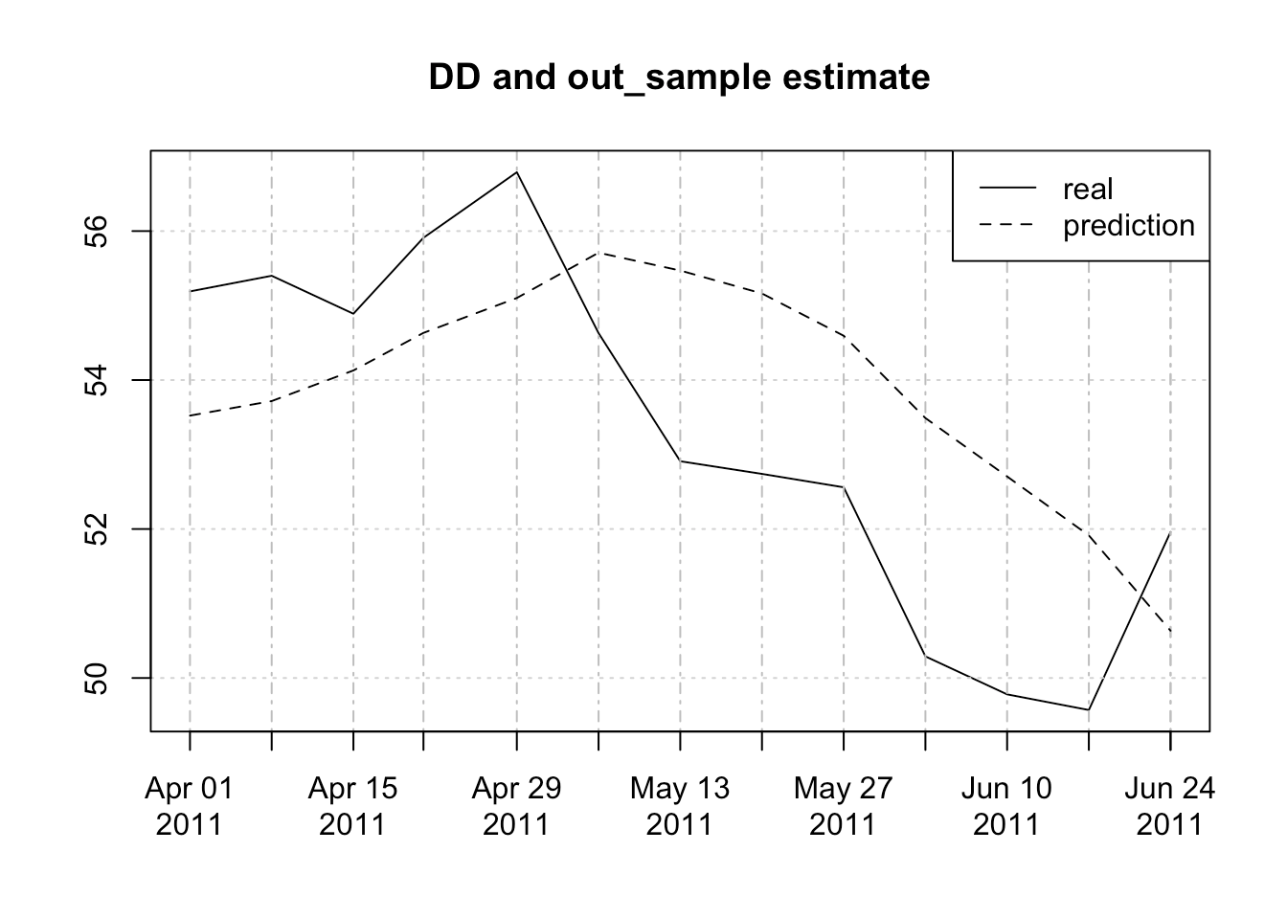
Result Visualization

Slide 6
Conclusion
Rolling better than non-rolling.
Autoregressive methods tend to outperform mixed lag method in classification problems
mixed lag method tend to outperform autoregressive method in regression problem.
Notes:
Capture the changing structure
Mysterious
The more predictors, the better prediction.

Slide 7
Thank you!
Questions?

