Slide 1

STCV Synth
David Cardona
Robert Fischer
DGMD-14 – Final Project
Harvard Extension School – Fall 2021

Slide 2
Description
Main Objective
Provide alternate ways of creative musical expression using Wearables and Computer Vision.
Create a portable audio synthesizer controlled via the SensorTile and Computer Vision.
The synthesizer can be abstracted into two main components: generator and controllers.
The generator is an audio DSP engine.
The controllers are the SensorTile and Computer Vision.
For portability, the generator runs in an embedded system, such as the NVIDIA Jetson Nano.
The embedded system must have BLE capabilities and a camera to receive input data.

Slide 3
Generator
Runs in a computer or an embedded system.
Coded in Pyo, which is an audio DSP Python suite that provides access to oscillators, filters, envelope generators, mixers, and audio effects, as well as other useful audio utilities.
Implements a data-driven design for scale selection.
Applies temperament computations based on A = 440Hz, which allows compatibility with other musical instruments.
Incorporates lossless audio export capabilities.

Slide 4
SensorTile Controller
Use data obtained from the accelerometer, the gyroscope, and the barometer to provide the generator with continuous data.
Perform computations to map data to influential generator parameters, such as filter cutoff frequency and resonance, amplitude multipliers, oscillator frequencies, and others.
Computer Vision Controller
Detect the number of fingers in the camera’s field of view, which will control the number simultaneous voices performed by the generator.
Detect sign language gestures, which will be used to enable/bypass audio effects, to pause the stream of audio, start and stop recordings, switch scales and octave ranges, and other trigger actions.

Slide 5
Equipment
STMicroelectronics SensorTile soldered to the Cradle board
NVIDIA Jetson Nano
Intel 8265 WiFi + Bluetooth Card and compatible antennas
Camera, such as a Logitech C270 HD
Dependencies
Pyo – Audio DSP Library written by Olivier Bélanger
Pygatt – Library for reading and writing GATT descriptors
OpenCV – Computer Vision library
TensorFlow + Keras – Machine Learning Library
Numpy

Slide 6
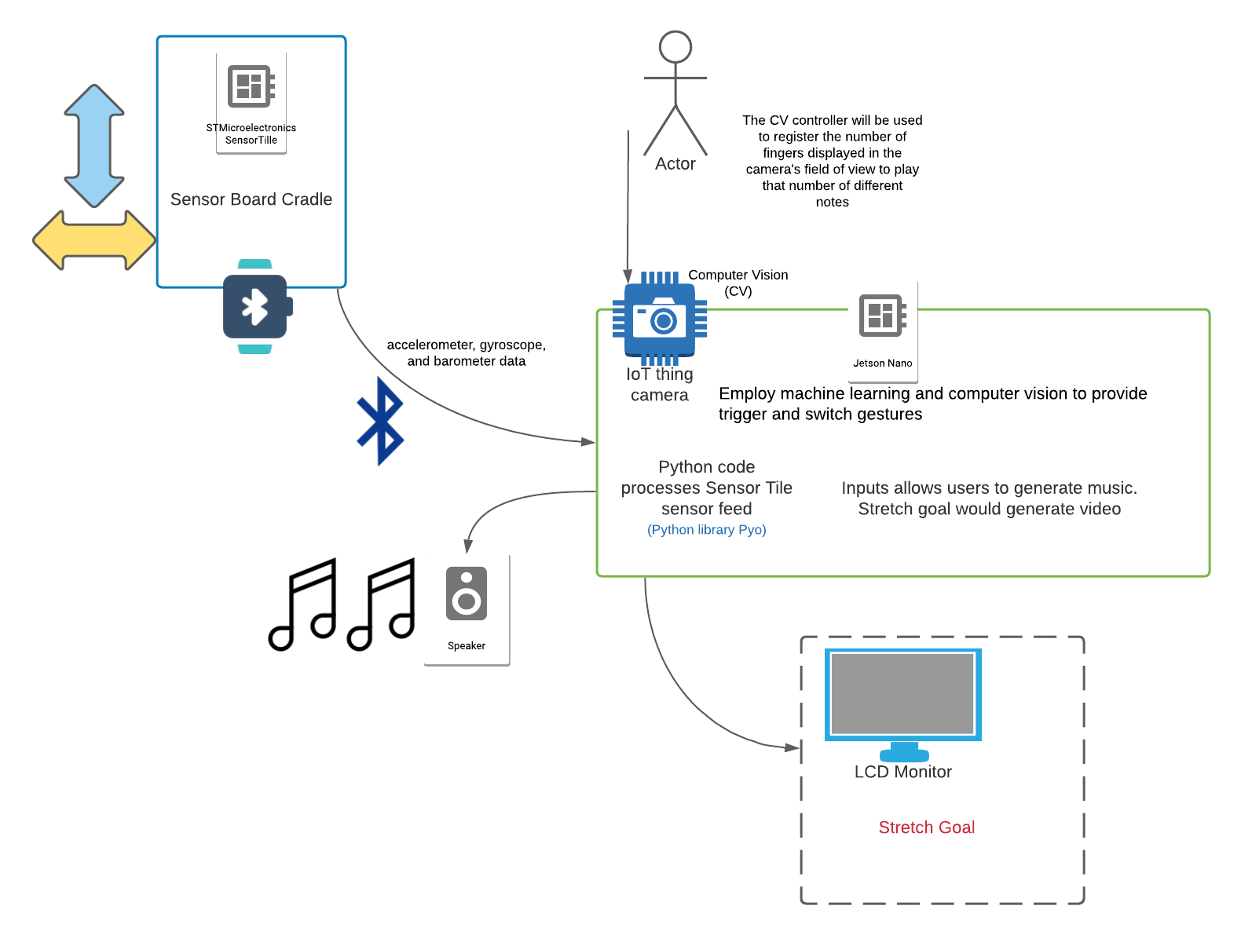
Diagram

Slide 7
Minimum Value Product
Portable and computer synthesizer controlled by the ST via BLE and by CV gestures.
Trained ML model that recognizes the number of fingers in the camera’s field of view, as well as sign language.
Algorithm to map data recorded from the ST into ranges that produce musical output from the generator.
Stretch Goals
Incorporate visualization of incoming data streams.
Capture and map continuous data obtained from the camera, enabling full control of the synthesizer via the CV controller.
Detect tapping gestures from ST to enable full control of the synthesizer via the ST controller.
Output MIDI stream functionality for controlling other generators.

Slide 8
Deliverable
Audio recording example.
Repository containing code and documentation.
Trained Machine Learning Computer model for finger and sign-language detection.
Video demonstration.

Slide 9
Thank you!

