Slide 1

Spring AI Zero to Hero
From AI Fundamentals to Agentic Systems
Neven Cvetkovic
David Caron Andreas Lange Oded Shopen
Additional content by Adib Saikali and Dan Vega
Spring Boot 4.0.5
Spring AI 2.0.0-M4
Java 25
Barcelona • April 13-15, 2026

Slide 2
What We'll Cover
I
The AI Revolution — A Brief History
VI
Embeddings & Vector Stores
II
Java Developers Enter the AI World
VII
RAG & Chat Memory
III
Meet Spring AI
VIII
Advanced Patterns & MCP
IV
Chat, Prompts & Structured Output
IX
Agentic Systems – Basic Intro
V
Tool Calling & Multimodal

Slide 3
PART I
The AI Revolution
From Turing to Transformers

Slide 4
The Long Road to AI
1950
Turing Test — Alan Turing asks "Can machines think?"
1956
Dartmouth Conference — The term "Artificial Intelligence" is coined
1966
ELIZA — First chatbot. Pattern matching, no understanding
1974-93
AI Winters — Overpromise, underdeliver. Funding dries up. Twice.
1997
Deep Blue beats Kasparov — Brute force, not learning

Slide 5
The Deep Learning Revolution
2012
AlexNet — Deep neural nets crush ImageNet. GPU training changes everything.
2013
Word2Vec — Words become vectors. "King - Man + Woman = Queen."
2017
"Attention Is All You Need" — The Transformer architecture.
2018
GPT-1 & BERT — Pre-trained language models arrive.
2020
GPT-3 — 175B parameters. Few-shot learning. "It can write code?!"

Slide 6
The Generative AI Explosion
Nov 2022
ChatGPT launches — 100M users in 2 months
2023
GPT-4, Claude, Gemini, Llama 2 — Multimodal, open-source
2024
Agents & MCP — AI that uses tools, browses the web, writes code
2025
Spring AI 1.0 — The Spring ecosystem embraces AI
2026
Spring AI 2.0 + Spring Boot 4 — That's us, today.

Slide 7



Approaches to AI — What Changed?
Rule-Based (1960s-90s)
Classical ML (2000s-10s)
Generative AI (2020s)
Hand-written rules, expert systems, decision trees. Brittle. Doesn't scale. Every edge case = new rule.
Learn patterns from data. SVM, random forests, gradient boosting. Good for structured data. Requires feature engineering.
Pre-trained on the internet. Understands language. Generates text, code, images. Describe intent in natural language.
The paradigm shift: from programming rules to describing intent. The model figures out the rest.

Slide 8


How LLMs Actually Work
•
A Transformer neural network trained on vast text corpora
•
Core task: predict the next token given all previous tokens
•
Not a database — it generates text probabilistically
•
Stateless: every call is independent. Context must be provided each time.
Tokens
Context Window
LLMs see tokens, not words. ~1 token ≈ 0.75 English words. "Spring Framework" → 2-3 tokens.
Max tokens per request (input + output). GPT-4o: 128K. Claude: 200K. Qwen3: 32K.

Slide 9
LLM Limitations — Know Before You Build
Hallucination
Context Window
Invents facts or API names with total confidence
Long threads get truncated; model "forgets" earlier details
Stale Data
Privacy Leak
Knowledge cutoff — can't answer about recent events
Proprietary/PII text could leave your trusted boundary
Non-Determinism
Cost & Latency
Same prompt, different answer — flaky tests, review churn
High-token chains drain budget and slow UX
These aren't bugs — they're inherent to how LLMs work. The key is building systems that mitigate them.

Slide 10
PART II
Java Enters the AI World
It's Not Just Python Anymore

Slide 11
The Python Assumption
•
AI has been Python-first since the deep learning revolution
•
TensorFlow, PyTorch, scikit-learn, LangChain, HuggingFace — all Python
•
Java developers were told: "Learn Python or get left behind"
But here's the thing: building AI-powered applications is fundamentally different from training AI models.

Slide 12

Training vs. Consuming
Training Models
Building AI Applications
GPU clusters, CUDA, tensor math, loss functions, gradient descent.
This IS Python territory.
You probably won't do this.
REST APIs, dependency injection, transaction management, security, observability.
This is your territory.
This workshop is about this.
vs
LLMs are accessed via HTTP APIs. You need good application architecture — and that's where Java and Spring shine.

Slide 13

Why Java Developers Are Uniquely Positioned
Enterprise Backbone
Production Readiness
Spring Ecosystem
AI features ship inside existing enterprise apps — not as standalone notebooks. Your Spring services are where AI lands.
Type safety, observability, security, transactions, testing. Python notebooks don't deploy themselves.
DI, auto-configuration, portable abstractions, Micrometer, Actuator. All of this now works with AI.

Slide 14
The AI Stack for Java Developers
You DON'T need to know You DO need to know
~~~~~~~~~~~~~~~~~~~~~~ ~~~~~~~~~~~~~~~~~~~~
PyTorch / TensorFlow Spring Boot / Spring AI
CUDA / GPU programming REST APIs / HTTP clients
Model training / fine-tuning Prompt engineering
Python data science stack Embeddings & vector stores
Jupyter notebooks RAG patterns
Gradient descent math Tool calling & agents
Spring AI brings AI to your existing skills. No career pivot required.

Slide 15
PART III
Meet Spring AI
The Spring Way to Build AI Applications

Slide 16

What Is Spring AI?
A Spring ecosystem project for AI-powered applications
Portable abstractions: write once, run against any provider
Auto-configuration: add a starter, set an API key, go
POJO-centric: your business logic stays in plain Java
Think of it as "Spring Data for AI" — a uniform API across providers, just like Spring Data across databases.

Slide 17



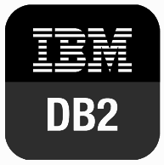
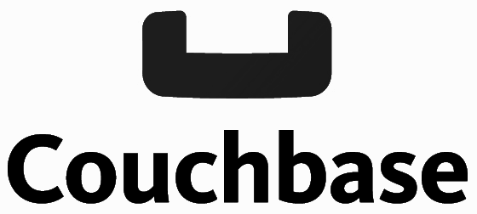
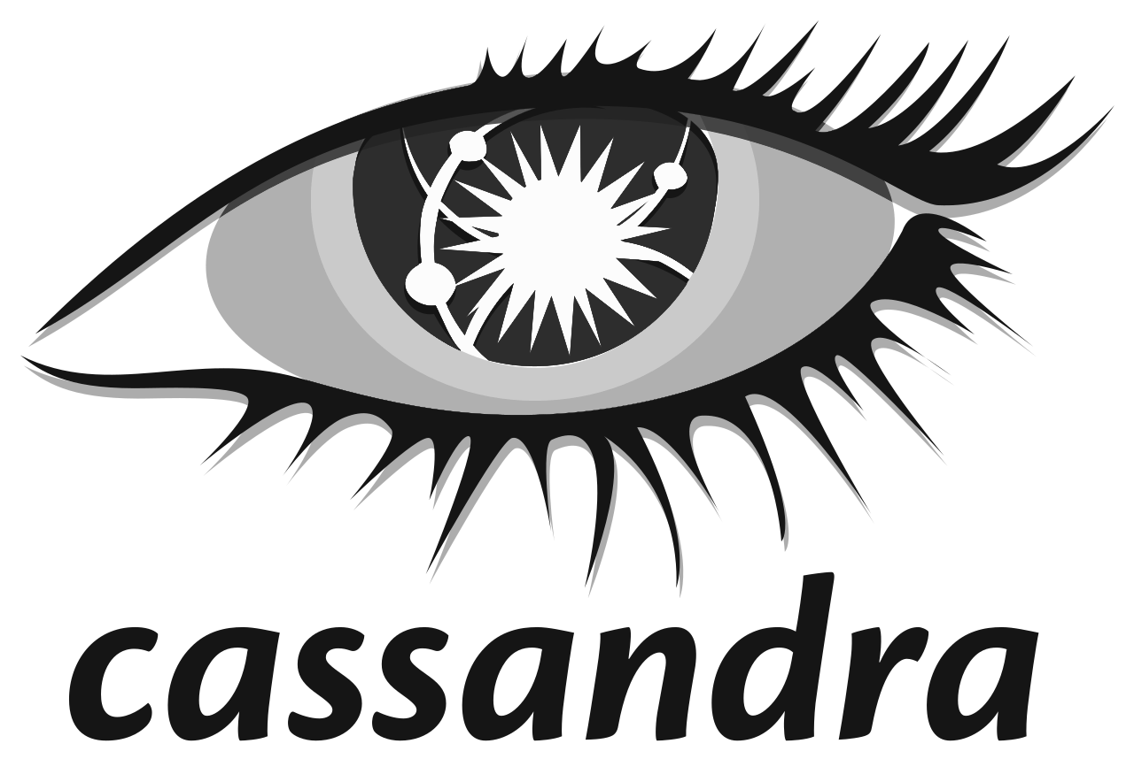
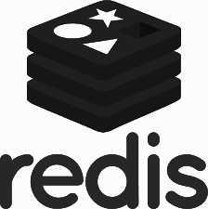






Spring Is Already The World’s Trusted Data Abstraction
Application components, controllers, services …
Spring Data
Relational DBs
Non-relational DBs
Notes:
Each database had a different, but yet similar API
This limited portability so standardization occurred, ODBC/JDBC
This helped but did it was still difficult to create database applications
Many Java database frameworks evolved in the late 90s early 00s
Spring was one of these frameworks,
The impedance mismatch between the JDBC APIs (Result Sets) and Objects we bridged.
Spring also integrated with other frameworks such a Hibernate, that defined object relational mapping, now JPA

Slide 18



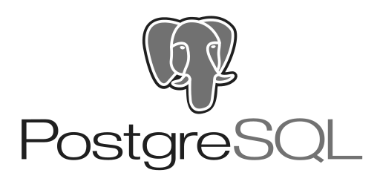
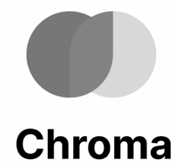


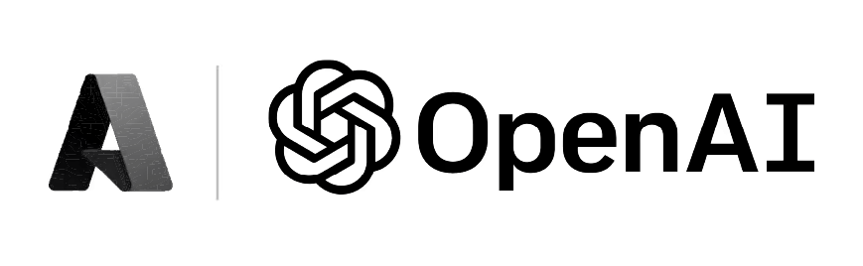



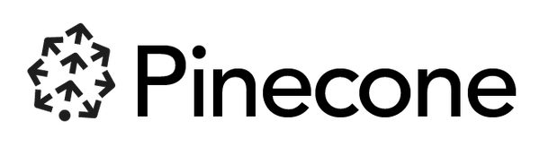


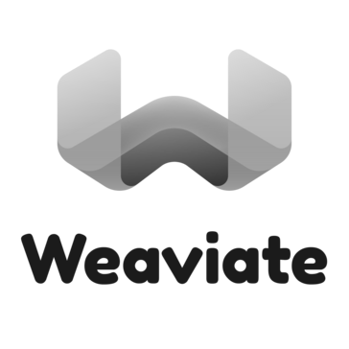


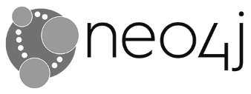
Spring AI abstracts away the complexity of LLMs
Spring AI
APIs
Orchestration
Evaluation
Data ingestion
Model Access
Task execution
ETL pipeline
Embedding
Agent
Prompting
Functions
Supported ecosystem
Chat completion
Image generation
Transcription
Embeddings
Vector databases
Notes:
Spring AI’s AiClient is analogous to the JDBC API
Provides portability, but still low level
Spring AI is building upon that foundation to provide developers a simple means to solve higher level use cases such as
Chat, Q&A, Summarization, Agents and high level AI driven workflows.

Slide 19
Spring AI Architecture
You write code against abstractions — Spring AI maps them to any provider at runtime.
YOUR CODE
@RestController + ChatClient.prompt().user(…).call().content()
▼ calls portable API
SPRING AI
ChatClient
EmbeddingModel
VectorStore
Advisor
▼ auto-configured by starter dependency
AI PROVIDERS
Ollama (local) • OpenAI • Anthropic • Azure • Google Gemini • AWS Bedrock
Switch providers by changing a Maven dependency + one YAML property. Zero code changes.

Slide 20
Key Abstractions
Abstraction
Interface
What It Does
Chat
ChatModel / ChatClient
Text generation & conversation
Embedding
EmbeddingModel
Text → semantic vectors
Vector Store
VectorStore
Store & search embeddings
Advisors
Advisor
Intercept/enrich prompts (RAG, memory)
Tools
@Tool
Let models call your Java methods
MCP
Model Context Protocol
Standardized tool/resource sharing
Streaming
StreamingChatModel
Token-by-token reactive output
Observability
Micrometer + OTel
Metrics, traces, logs for AI calls

Slide 21
Provider Portability
Same code, different provider — swap a Maven dependency and a YAML property.
// This code runs against ANY provider - zero changes
String answer = chatClient.prompt()
.user("Tell me a joke about Spring")
.call()
.content();
Ollama
Local & free — no API key needed
Azure OpenAI
Enterprise compliance & VPC
OpenAI
GPT-4o, o3 — broadest ecosystem
Google Gemini
Multimodal, 1M token context
Anthropic
Claude — strong reasoning
AWS Bedrock
Managed, multi-model gateway

Slide 22
How to Choose a Model
Task Fit
Chat vs. embedding vs. multimodal — pick the right tool
Quality
Accuracy, coherence, instruction-following for your domain
Latency
Interactive chat needs < 500 ms TTFT; batch is fine with seconds
Cost
Token pricing × daily volume — compare cloud vs. local (Ollama = free)
Context Window
4 K → 128 K+ ; RAG doc size & conversation length drive the need
Privacy & Compliance
On-prem (Ollama), VPC (Bedrock), or cloud API — data residency rules
Ecosystem
Spring AI starter available? SDK maturity? Community support?
Licensing
Open-weight (Llama, Qwen) vs. proprietary (GPT, Claude) — know the terms
Spring AI's portable abstractions let you switch models without changing code — experiment freely.

Slide 23
Remember This? LLM Limitations
Hallucination
Context Window
Invents facts or API names with total confidence
Long threads get truncated; model "forgets" earlier details
Stale Data
Privacy Leak
Knowledge cutoff — can't answer about recent events
Proprietary/PII text could leave your trusted boundary
Non-Determinism
Cost & Latency
Same prompt, different answer — flaky tests, review churn
High-token chains drain budget and slow UX
These aren't bugs — they're inherent to how LLMs work. The key is building systems that mitigate them.

Slide 24




How Spring AI Helps Overcome Limitations
Prompt Guarding
System prompts constrain behavior (tone, honesty, refusal policy)
Prompt Stuffing / RAG
Inject fresh, task-specific context so the model quotes facts
Tool Calling
Let the model invoke code or APIs for real-time data and calculations
MCP
Package tools as reusable, versioned endpoints every client can share
Observability
Trace every prompt, token count, and latency to catch cost/quality issues

Slide 25
Workshop Architecture
spring-ai-zero-to-hero/
├── applications/ ← Provider-specific apps (pick one)
│ ├── provider-ollama/ ← LOCAL: no API keys needed
│ ├── provider-openai/ ← CLOUD: full features
│ └── ... ← anthropic, azure, google, aws
├── components/ ← Shared, provider-independent
│ ├── apis/chat/ ← Stage 1: Chat fundamentals
│ ├── apis/embedding/ ← Stage 2: Embeddings
│ ├── apis/vector-store/ ← Stage 3: Vector stores
│ └── patterns/ ← Stages 4-5: RAG, memory, CoT
├── mcp/ ← Stage 6: MCP servers & clients
├── agentic-system/ ← Stage 7: Agentic patterns
└── docker/ ← PostgreSQL, Grafana LGTM
Components depend on spring-ai-client-chat (the abstraction). Provider apps add the starter. No code changes to switch.

Slide 26
STAGE 1
Chat Fundamentals
ChatModel, ChatClient, Prompts

Slide 27
Without Spring AI — Raw HttpClient
HttpClient client = HttpClient.newHttpClient();
String json = """
{ "model": "gpt-4o",
"messages": [{ "role": "user",
"content": "Tell me a joke" }] }
""";
HttpRequest req = HttpRequest.newBuilder()
.uri(URI.create("https://api.openai.com/v1/chat/completions"))
.header("Authorization", "Bearer " + apiKey)
.header("Content-Type", "application/json")
.POST(HttpRequest.BodyPublishers.ofString(json))
.build();
HttpResponse<String> resp =
client.send(req, HttpResponse.BodyHandlers.ofString());
// Now manually parse JSON, handle errors, map to objects…
Manual JSON, manual auth, manual error handling, and locked to one provider. Every AI call looks like this.

Slide 28
The Simplest AI Call
GET /chat/01/joke
private final ChatModel chatModel;
@GetMapping("joke")
public String getJoke() {
return this.chatModel.call("Tell me a joke");
}
ChatModel.call(String) — string in, string out. The absolute minimum API.

Slide 29
ChatClient — The Fluent API
Recommended
// Full response chain
ChatResponse response = chatClient.prompt()
.user("Tell me a joke about " + topic)
.call()
.chatResponse();
Generation generation = response.getResult();
AssistantMessage msg = generation.getOutput();
return msg.getText();
// Shorthand (preferred!)
String joke = chatClient.prompt()
.user("Tell me a short joke")
.call()
.content();
ChatClient is to ChatModel what Spring Data JPA is to JDBC.

Slide 30
LIVE CODING
Demo
ChatClient, Spring AI Petclinic

Slide 31
Prompt Templates
// Inline template with {variable} placeholders
chatClient.prompt()
.user(u -> u.text("Tell me a joke about {topic}")
.param("topic", topic))
.call().content();
// File-based template (classpath resource)
chatClient.prompt()
.user(u -> u.text(new ClassPathResource("prompts/plays.st"))
.param("author", author))
.call().content();
Always use {variable} + .param() instead of string concatenation. Cleaner, testable, supports external files.

Slide 32
Prompt Engineering Best Practices
Zero-Shot
Ask directly — no examples. Works for simple tasks.
"Translate this to French: Hello World"
One/Few-Shot
Include 1-3 examples to steer format and style.
Input: happy → Output: sad. Input: big → Output: small
Chain-of-Thought
"Think step by step" — boosts reasoning accuracy.
"Explain your reasoning before giving the answer."
Task Decomposition
Break complex prompts into smaller sub-tasks.
Step 1: Extract entities. Step 2: Classify sentiment.
System Instructions
Set persona, constraints, and output format up front.
"You are a senior Java developer. Reply in JSON only."

Slide 33
Structured Output
AI → typed Java records
// Define your target type
record Play(String author, String title, Integer publicationYear) {}
// Return typed Java records — the Spring AI magic
Play[] plays = chatClient.prompt()
.user(u -> u.text("List plays by {author}")
.param("author", "Shakespeare"))
.call()
.entity(Play[].class);
.entity(Class) auto-generates JSON schema, appends format instructions, and deserializes. No manual parsing.

Slide 34
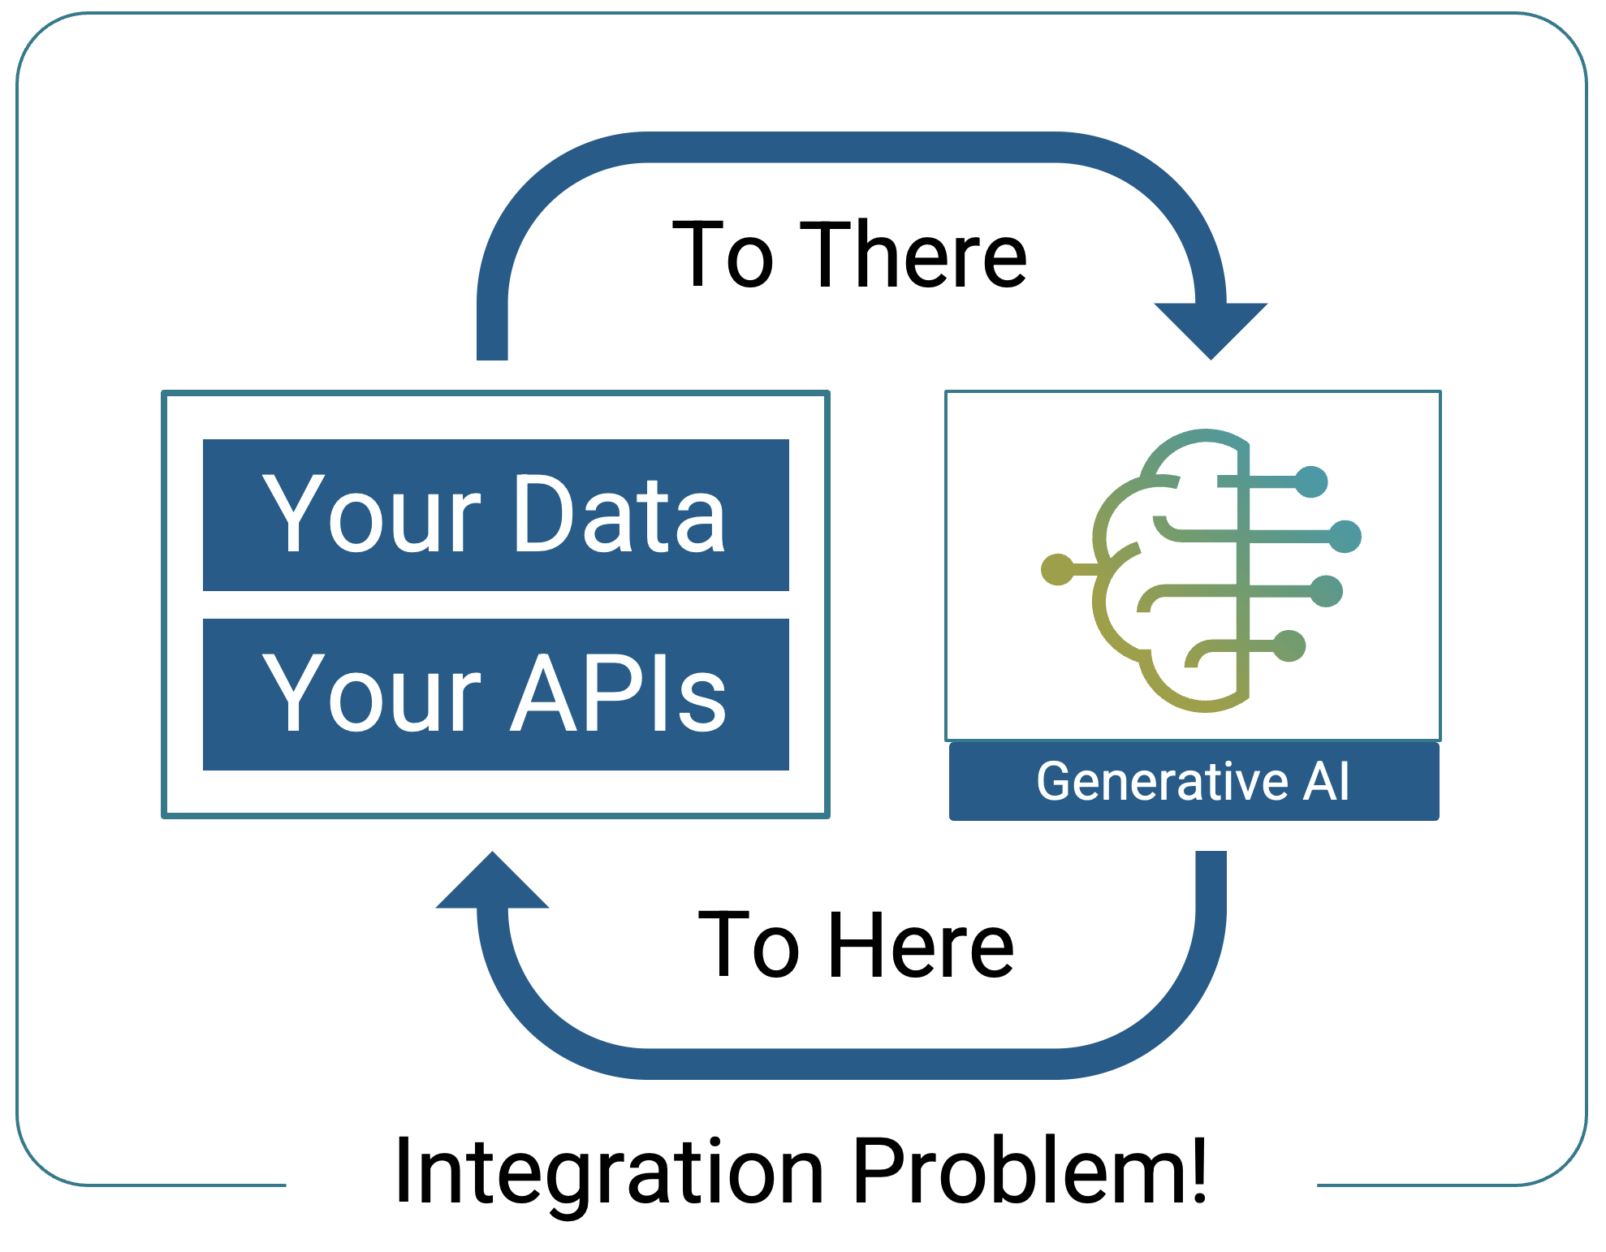
Why Tool Calling is Needed
Integrates LLMs with your own custom APIs for personalized responses.
Enables real-time access to dynamic, external data sources.
Enhances app functionality by making the LLM an active part of your system's ecosystem

Slide 35
Tool Calling with @Tool
// Your Java methods become AI-callable tools
public class TimeTools {
@Tool(description = "Returns the current time in a specific timezone")
public String currentTimeIn(
@ToolParam(description = "IANA timezone") String timeZone) {
ZonedDateTime now = ZonedDateTime.now(ZoneId.of(timeZone));
return "Today is " + now.getDayOfWeek() + " " + now;
}
}
// Register tools with the prompt
chatClient.prompt()
.tools(new TimeTools())
.user(u -> u.text("What is the current time in {city}?")
.param("city", city))
.call().content();
The AI decides when to call the tool. Spring AI handles the multi-turn conversation automatically.

Slide 36
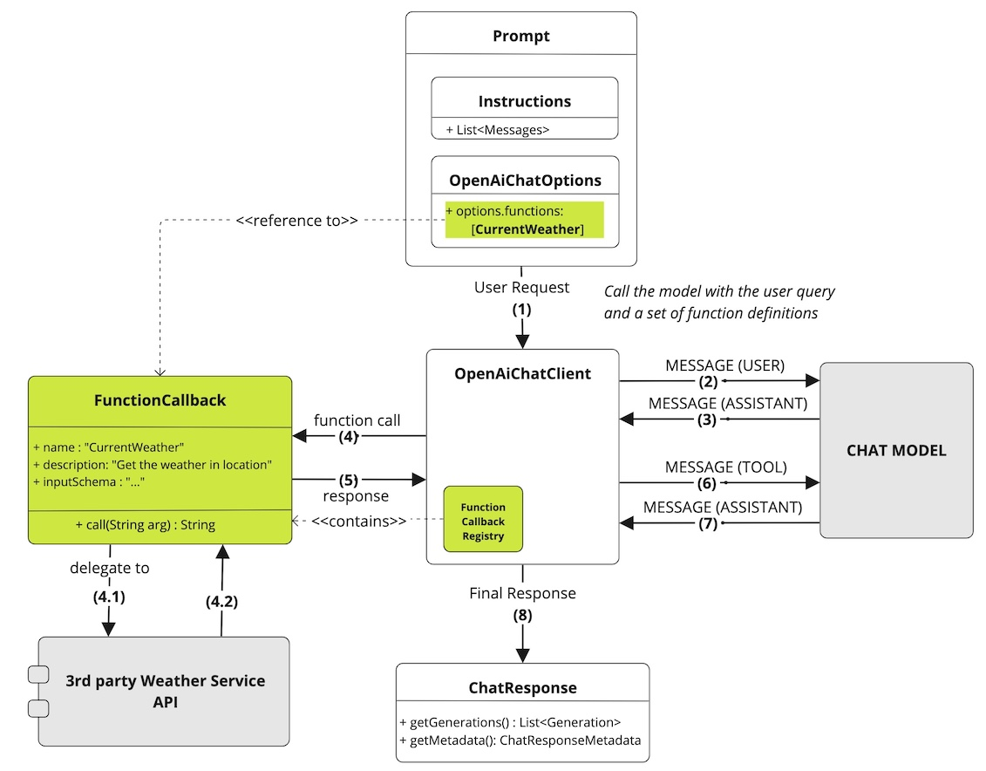
Bring real-time data into your apps using function calling

Slide 37
Bring real-time data into your apps using function calling

Slide 38
Bring realtime data into you apps with function calling

Slide 39
Bring realtime data into you apps with function calling

Slide 40
Bring realtime data into you apps with function calling

Slide 41
Bring real-time data into your apps using function calling

Slide 42
System Roles
public RoleController(ChatClient.Builder builder) {
this.chatClient = builder
.defaultSystem("""
You are a helpful expert on plants, however
you are not allowed to answer any question about
vegetables - you can only answer about fruits.
""")
.build();
}
@GetMapping("/fruit")
public String fruit() {
return chatClient.prompt()
.user("What is the color of a banana?")
.call().content(); // "A banana is yellow when ripe"
}

Slide 43
Multimodal
Send images, audio, and video alongside text prompts.
// Send image + text in a single prompt
chatClient.prompt()
.user(u -> u
.text("Describe this image")
.media(MimeTypeUtils.IMAGE_PNG,
imageResource))
.call().content();
// Audio input
chatClient.prompt()
.user(u -> u
.text("Transcribe this audio")

Slide 44
Streaming Responses
Stream tokens as they arrive for real-time user experiences.
// Token-by-token streaming with Flux
@GetMapping("/stream")
Flux<String> stream(String topic) {
return chatClient.prompt()
.user(topic)
.stream()
.content();
}
// Returns Flux<String> — each token emitted as it arrives
// Perfect for Server-Sent Events (SSE) to the browser

Slide 45
STAGES 2 & 3
Embeddings & Vector Stores
The Foundation of Semantic Search

Slide 46
What Are Embeddings?
Dense float vectors that capture semantic meaning.
"king" → [0.12, -0.45, 0.78, 0.33, ...] ┐
├ close (cosine ~ 0.85)
"queen" → [0.14, -0.42, 0.75, 0.31, ...] ┘
"banana" → [-0.67, 0.22, 0.11, -0.89, ...] far away (~ 0.15)
// Generate an embedding
float[] vector = embeddingModel.embed("mountain bike");
// → 768 floats (nomic-embed-text) or 1536 (OpenAI)

Slide 47
Chunking, Reading & Storing
// Large documents must be split before embedding
TokenTextSplitter splitter = new TokenTextSplitter();
List<Document> chunks = splitter.split(largeDocument);
// Read from various sources
JsonReader jsonReader = new JsonReader(bikesResource,
"name", "price", "shortDescription", "description");
// Load into vector store
vectorStore.add(splitter.split(jsonReader.get()));
// Semantic similarity search
List<Document> results = vectorStore
.similaritySearch("mountain bike");
SimpleVectorStore
PgVectorStore
In-memory, zero setup. Great for dev/testing.
PostgreSQL + pgvector. HNSW index. Production-ready.

Slide 48
STAGE 4
RAG & Chat Memory
Grounding AI in Your Data

Slide 49
Stuff the Prompt
Simplest context pattern: load a document and inject it directly into the prompt. No embeddings, no vector store.
StuffController.java
qa-prompt.st
@Value("classpath:/docs/wikipedia-curling.md")
private Resource docsToStuffResource;
@Value("classpath:/prompts/qa-prompt.st")
private Resource qaPromptResource;
@GetMapping("/query")
public String query(@RequestParam String message) {
PromptTemplate pt = new PromptTemplate(qaPromptResource);
map.put("question", message);
map.put("context", docsToStuffResource); // full doc!
Prompt prompt = pt.create(map);
return chatModel.call(prompt)
.getResult().getOutput().getText();
}
Use the following context to
answer the question at the end.
If you don’t know, say so.
{context}
Question: {question}
Helpful Answer:
Works great for small docs that fit in the token window. When context grows too large, graduate to RAG.

Slide 50
RAG — Retrieval Augmented Generation
The most important AI pattern for enterprise applications.
Embed docs
→
Search
→
Augment prompt
→
Generate
Manual RAG
QuestionAnswerAdvisor
List<Document> docs = vectorStore
.similaritySearch(query);
String context = docs.stream()
.map(Document::getText)
.collect(joining("\n"));
chatClient.prompt()
.system(s -> s.text(qaPrompt)
.param("context", context))
.user(query).call().content();
// All-in-one: search + augment
chatClient.prompt()
.advisors(
new QuestionAnswerAdvisor(
vectorStore))
.user(query)
.call().content();
// Advisor automatically:
// 1. Searches vector store
// 2. Injects into prompt
// 3. Generates answer

Slide 51
Chat Memory
ChatMemory memory = MessageWindowChatMemory.builder()
.chatMemoryRepository(new InMemoryChatMemoryRepository())
.maxMessages(10)
.build();
this.chatClient = builder
.defaultAdvisors(PromptChatMemoryAdvisor.builder(memory).build())
.build();
// Request 1: "Hi, I'm Alice" → stored in memory
// Request 2: "What's my name?" → AI remembers "Alice"
chatClient.prompt()
.user(message)
.advisors(a -> a.param("chat_memory_conversation_id", id))
.call().content();
LLMs are stateless. The memory advisor re-injects conversation history with every request.

Slide 52
STAGES 5 & 6
Advanced Patterns & MCP
Chain of Thought, Self-Reflection, Model Context Protocol

Slide 53
Chain of Thought
public List<String> writeBio(String profile) {
// Step 1: Create outline
String outline = chatClient.prompt()
.user(u -> u.text("Create an outline for a biography:\n\n{profile}")
.param("profile", profile))
.call().content();
// Step 2-3: Draft and condense (similar pattern)
// Step 4: Refine with expert persona
String refined = chatClient.prompt()
.system("You are an expert biography editor")
.user(u -> u.text("Polish this biography:\n\n{draft}")
.param("draft", draft))
.call().content();
return List.of(outline, draft, condensed, refined);
}
Each step focuses on one aspect. The .system() prompt changes the AI's role per step.

Slide 54
Self-Reflection Agent
Writer
→
Critic
→
Writer (revise)
→
Critic
→
Final
for (int i = 0; i < iterations; i++) {
// Writer generates (or revises based on feedback)
String draft = chatClient.prompt()
.system("You are a professional biography writer")
.user(writerPrompt + feedback)
.call().content();
// Critic reviews
String feedback = chatClient.prompt()
.system("You are a harsh but fair biography critic")
.user("Review this biography:\n\n" + draft)
.call().content();
}

Slide 55
Model Context Protocol (MCP)
Open standard for connecting AI apps to external tools & data sources.
MCP Server
MCP Capabilities
@Bean
ToolCallbackProvider weatherTools(
WeatherService svc) {
return MethodToolCallbackProvider
.builder()
.toolObjects(svc)
.build();
}
@Tool
Callable functions
@McpResource
Readable data
@McpPrompt
Prompt templates
@McpComplete
Autocomplete
MCP enables runtime tool discovery. AI apps adapt their capabilities on the fly.

Slide 56
STAGE 7
Agentic Systems
AI That Controls Its Own Execution

Slide 57


From Calls to Agents
Simple Call
Pipeline
Agent
You control the flow. One prompt, one response.
Stages 1-4.
Developer decides what happens.
You orchestrate multi-step chains. CoT, reflection.
Stage 5.
Developer designs the steps.
The model controls execution. Decides tools, steps, when to stop.
Stage 7.
Model decides what happens.

Slide 58
Inner Monologue Agent
The model reveals its reasoning via a structured tool call.
// Force the model to always respond via the tool
OpenAiChatOptions options = OpenAiChatOptions.builder()
.toolChoice("required")
.build();
// The tool captures visible message AND private reasoning
@Tool(description = "Send a message to the user")
public ChatResponse sendMessage(
@ToolParam(description = "The message") String message,
@ToolParam(description = "Private thoughts") String innerThoughts) {
return new ChatResponse(message, innerThoughts);
}

Slide 59
Model-Directed Loop
The model decides whether to continue processing or stop.
List<ChatResponse> trace = new ArrayList<>();
for (int step = 0; step < MAX_STEPS; step++) {
ChatResponse response = chatClient.prompt()
.options(OpenAiChatOptions.builder()
.toolChoice("required").build())
.tools(new SendMessageTool())
.user(step == 0 ? userMessage : "Continue.")
.call().content();
trace.add(response);
if (!response.requestReinvocation()) break; // Model says "done"
}

Slide 60
WORKSHOP
Let's Code!
5-Minute Setup

Slide 61
Getting Started
# 1. Check prerequisites
./workshop.sh check
# 2. Setup infrastructure (Docker, Ollama models)
./workshop.sh setup
# 3. Start with Ollama (local, free, all 44 demos)
./workshop.sh start ollama --profiles pgvector,observation,ui
# 4. Open the dashboard
open http://localhost:8080/dashboard
# 5. Try your first AI call
curl "http://localhost:8080/chat/01/joke?topic=spring"
JDK
Docker
Ollama
Maven
25
Latest
Latest
via mvnw

Slide 62
Spring Profiles
Profile
What It Adds
Infrastructure
(none)
In-memory vector store
None
pgvector
PostgreSQL pgvector
Docker PostgreSQL
observation
Full tracing + metrics
Docker LGTM stack
spy
Network inspection proxy
Gateway app
ui
Interactive dashboard
None
# Combine freely
./workshop.sh start ollama --profiles pgvector,observation,ui
./workshop.sh start openai --profiles spy,pgvector

Slide 63
The Full Journey
1
Chat Fundamentals
ChatClient, @Tool, ChatOptions
2
Embeddings
EmbeddingModel, TokenTextSplitter
3
Vector Stores
VectorStore, similaritySearch()
4
AI Patterns
QuestionAnswerAdvisor, ChatMemory
5
Advanced Patterns
Chain of Thought, Self-Reflection
6
MCP
MCP Server/Client starters
7
Agentic Systems
toolChoice("required"), loops
8
Observability
OTel, Micrometer, Grafana LGTM

Slide 64
Thank You!
Spring AI Zero-to-Hero
Spring Boot 4.0.5
Spring AI 2.0.0-M4
Java 25
Barcelona • April 13-15, 2026

