Slide 1
MIRA OPERATOR AGENT
Fabric Ontology Grounding with a Redis-Governed Schema Cache
Live-tested end to end via Zello radio • AKS • Azure AI Foundry • Azure Managed Redis • Microsoft Fabric
August 2026

Slide 2
THE PROBLEM
Fabric's Data Agent was too slow to ground a live radio conversation
30–58s
45–100s
0
per query through Fabric's Data Agent (NL2SQL)
timeout budget needed just to survive one call
tolerance for that latency on a live push-to-talk radio channel
The fix: stop calling the Data Agent's NL2SQL entirely.
Discover schema from Fabric's own Ontology metadata (entities + relationships).
Read operational data directly from OneLake Delta tables — no SQL generation in the loop.
Mira Operator Agent | Ontology Grounding & Redis Cache
2

Slide 3
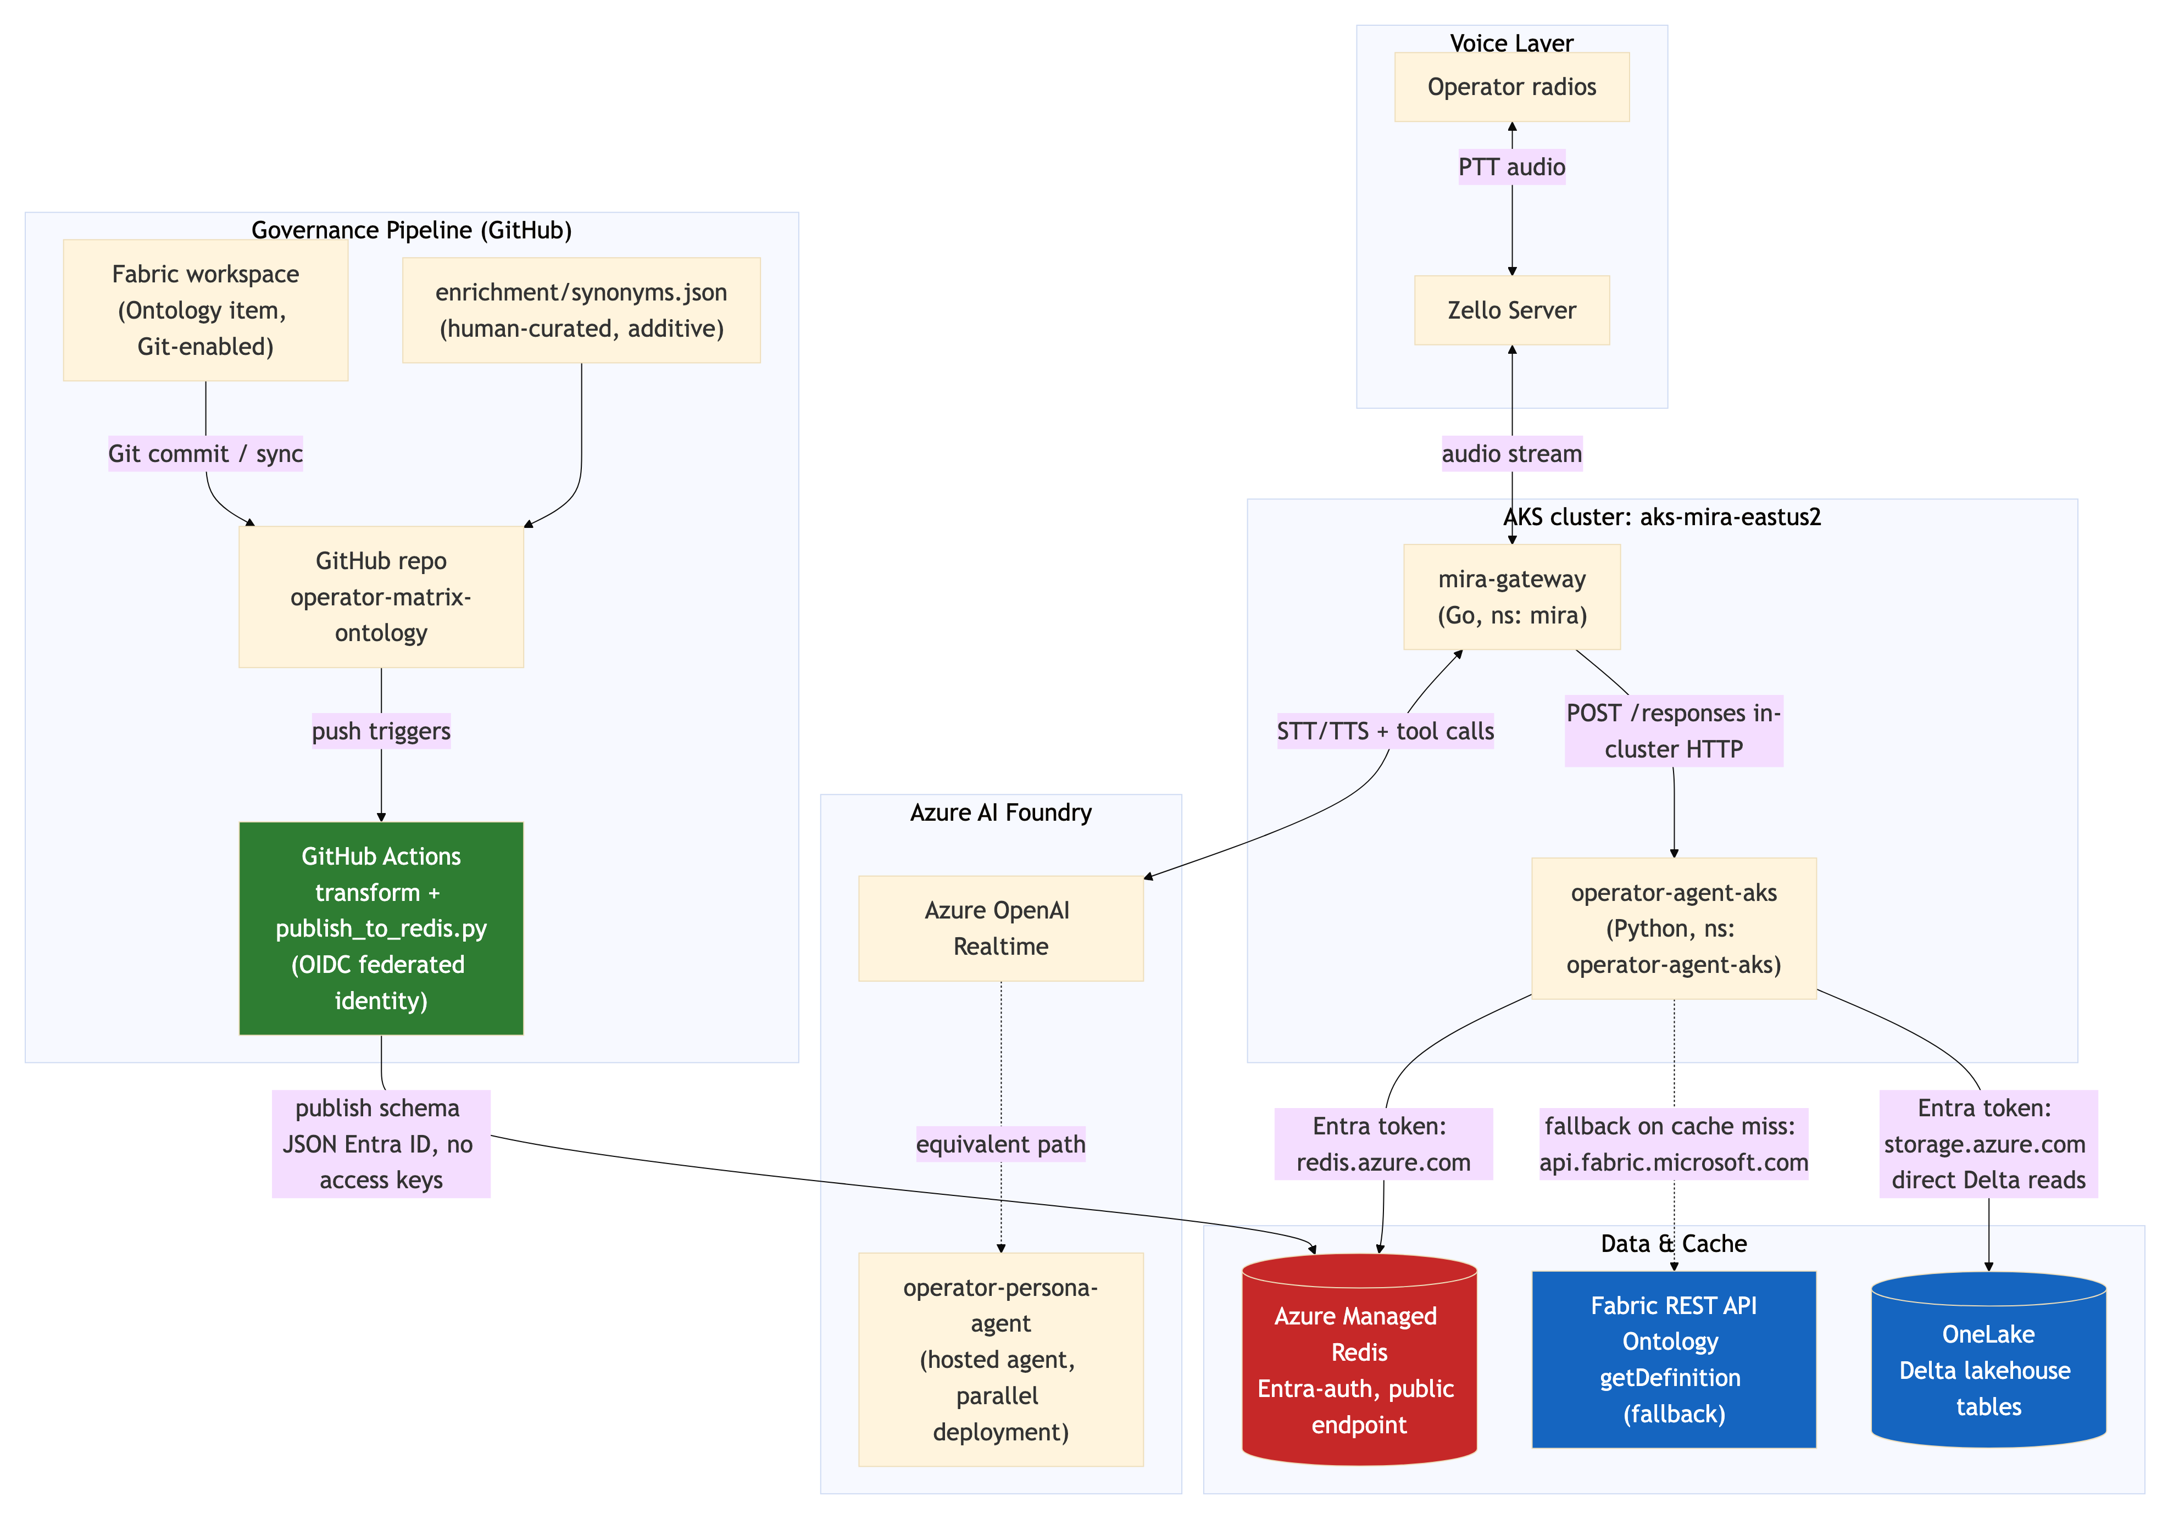
ARCHITECTURE
Components and the governance pipeline
Mira Operator Agent | Ontology Grounding & Redis Cache
3

Slide 4
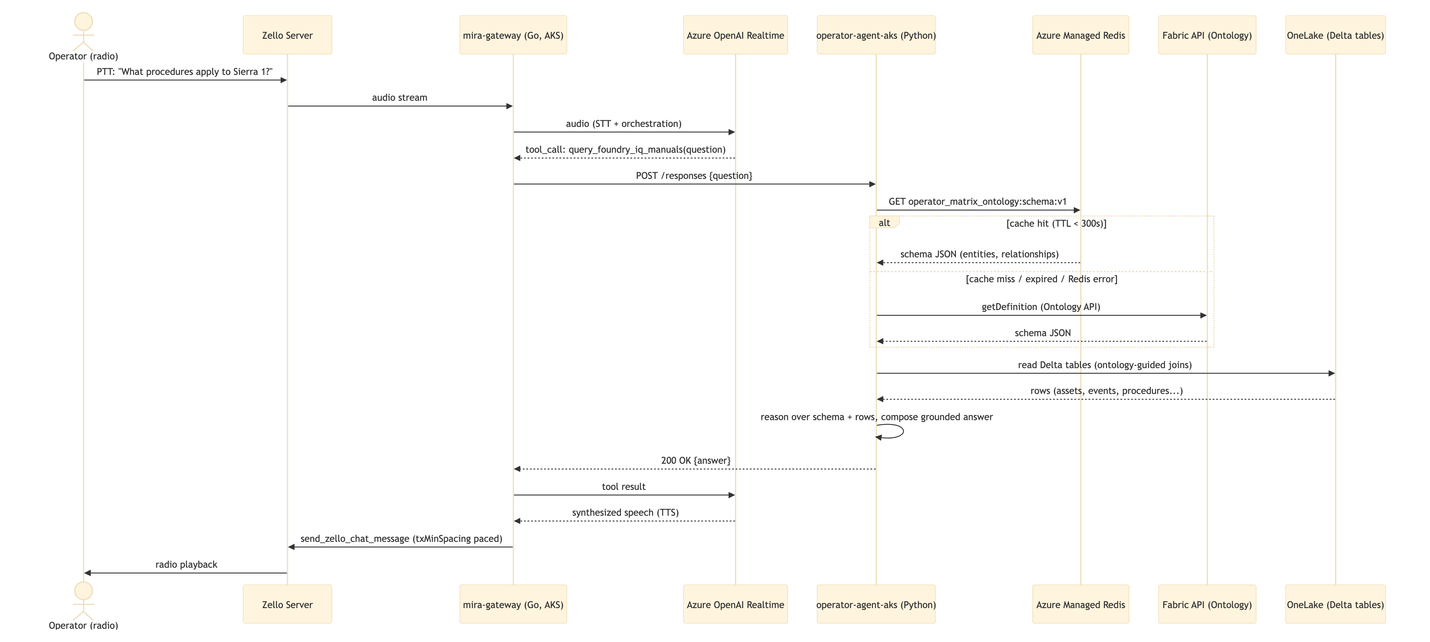
REQUEST FLOW
One query, end to end
Mira Operator Agent | Ontology Grounding & Redis Cache
4

Slide 5
GOVERNANCE
Ontology changes are PR-reviewed, not silent
1
2
3
4
Fabric workspace
GitHub repo
GitHub Actions
Azure Managed Redis
Ontology item is Git-enabled; commits sync it to GitHub as JSON.
Holds the synced schema plus human-curated enrichment/synonyms.json.
Transforms the schema; authenticates via OIDC — no stored secrets.
Publishes via Entra ID. Agent reads this cache first; Fabric is fallback only.
Why this matters beyond speed: the cache is never a hard dependency — on any Redis failure the agent falls back to live Fabric discovery. Governance and enrichment are the real win; the cache is a side benefit.
Mira Operator Agent | Ontology Grounding & Redis Cache
5

Slide 6
LIVE DEMO RESULTS
5 ontology traversal types, tested live — all correct
Relationship exercised | Sample question | Result | Latency
Mission ↔ CallSign | What mission is Echo 2 assigned to? | Correct (MISSION-002) | 20.4s
Mission ↔ Event (join table) | What events happened during Mission 1? | Correct, in order | 19.2s
Procedure ↔ Proword | Prowords in advance-to-Charlie procedure? | Correct (3/3) | 28.1s
Mission ↔ Asset | Assets targeted by Construct Drift Watch? | Correct (2/2, right status) | 24.0s
Asset → Event → CallSign (reverse) | Who last reported on relay hardline? | Correct — most recent of 2 events | 17.7s
Plus a live on-air test over Zello: “What procedures apply to the asset Sierra 1 last reported on?” — correct answer, spoken back on the radio.
Mira Operator Agent | Ontology Grounding & Redis Cache
6

Slide 7
PROOF, NOT ASSERTION
Raw pod logs — Redis served the schema, Fabric fallback never fired
17:01:56 operator_matrix.schema_loaded source=redis entities=6 relationships=8 tables=7
18:12:24 operator_matrix.schema_loaded source=redis entities=6 relationships=8 tables=7
18:17:33 operator_matrix.schema_loaded source=redis entities=6 relationships=8 tables=7
18:34:31 operator_matrix.schema_loaded source=redis entities=6 relationships=8 tables=7
3 reloads across 76 minutes of testing
matches the 300s TTL exactly — not per-request.
Zero Fabric fallback log lines
in the entire window — Redis never missed.
Requests landing on a reload (18:12, 18:17) ran 24–30s.
Requests between reloads ran a flat 17–20s — the reload cost is real but small, and confined to 1-in-5 requests here.
Mira Operator Agent | Ontology Grounding & Redis Cache
7

Slide 8
NEXT STEPS
What's left to close out
!
Connect real Fabric → GitHub Git integration
Repo currently holds a manually-captured schema snapshot for testing; needs the live workspace Git connection.
!
Clean up unused private-endpoint subnet
Leftover from the original private-endpoint plan before switching to public + Entra-only.
✓
Redis-first schema loading with TTL refresh + Fabric fallback
Built, deployed, and verified via live pod logs.
✓
End-to-end live test via Zello radio
Confirmed correct grounded answer, spoken back on air.
Mira Operator Agent | Ontology Grounding & Redis Cache
8

Slide 9
Questions?
github.com/dcasati/mira-operator-agent
github.com/dcasati/operator-matrix-ontology

