Slide 1

Stock Stalker
Own the (Market) Curve

Slide 2

Stock Stalker
Elevator Pitch
As COVID-19 has put the world of pause, stock-markets and companies have taken a massive hit. And so stock market investors are needing timely information, to protect their investments and assets…
At Stock Stalker we assist users “own the market curve” through our mobile app.
Own the (Market) Curve

Slide 3
Stock Stalker
Concept
Description
Stock Stalker aggregates the latest stock prices and financial information from various APIs.
Motivations for Building
We knew we wanted to help people during these uncertain times, so we thought that we could do that by aggregating timely and relevant financial information from various APIs.
User Story
Warren, is a savvy stock market investor, he wants to easily look up companies' prices & other key financial information in order to make an informed purchase or sell decision. He utilizes the Stock Stalker mobile app to supplement his various buying & selling decisions…

Slide 4
Stock Stalker
Process
Technologies Used
The Stock Ticker is by the Intrinio third-party API.
The Stock Pricing is found by the Yahoo server-side API.
The Key financial information is by the Bloomberg server-side API.
Breakdown of tasks and roles
We were able to break down various tasks and roles by utilizing KanBan boards and owning user stories. The daily stand-up meetings allowed us to discuss and remove roadblocks, and then test each module of the code before pushing and deploying it to the master-branch.
Challenges
Originally, we create a job-searching and posting application, utilizing the Indeed API. We were not able to obtain a publisher API, which caused us to pivot. But we were able to use much of the work and processes that we created in order to design & execute Stock Stalker.
Successes
We were able to successfully create the application utilizing the user’s input to call the APIs.

Slide 5
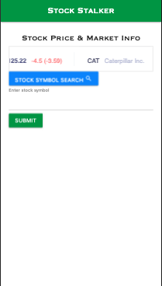
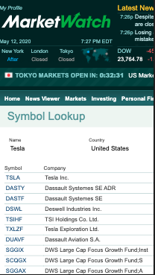
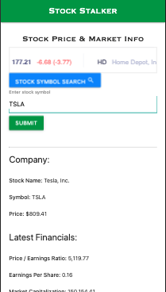
Stock Stalker
Demo

Slide 6
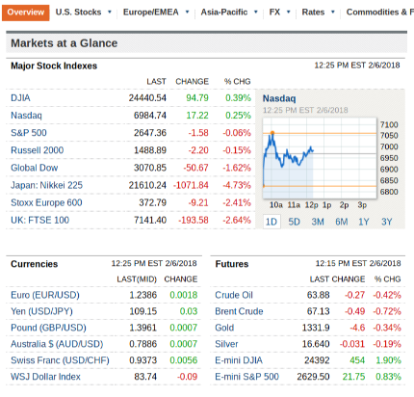
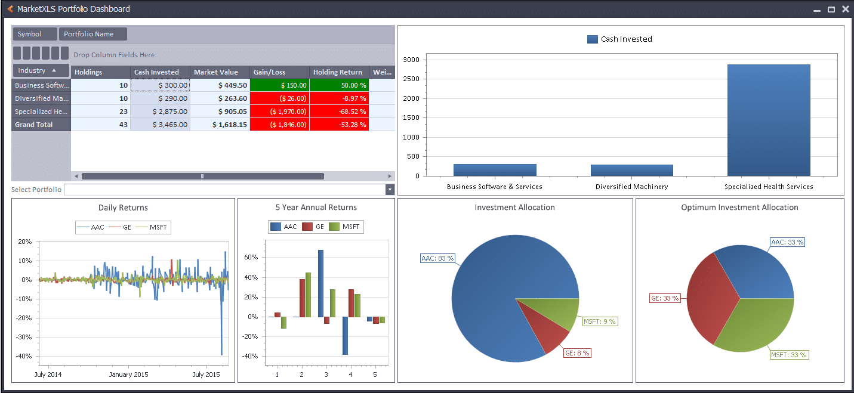
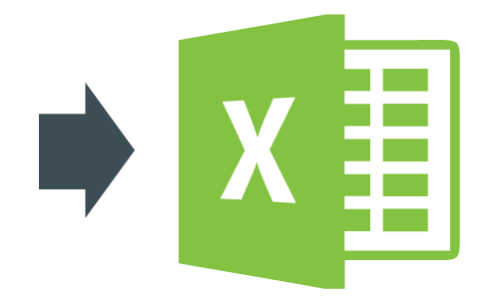
Stock Stalker
Directions for Future Development
Increase chart functionality and add various dashboards and stock watchlist.
We would like to allow users to export their info into excel to create portfolio models.

Slide 7
Stock Stalker
Links
Deployed
https://wrkfullerton.github.io/StockStalker/
Github repo
https://github.com/wrkfullerton/StockStalker

