Slide 1
Crunching Airline Data with Spark
D. Cashon

Slide 2

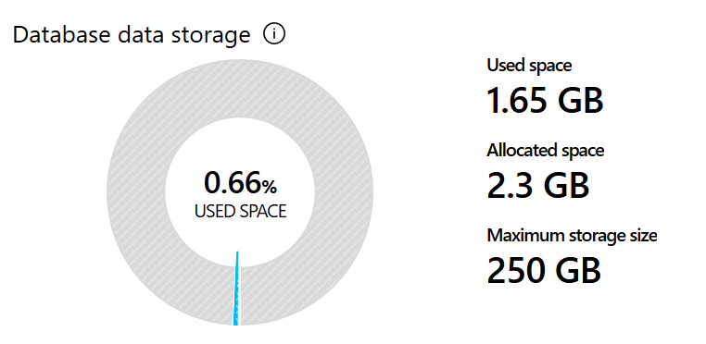
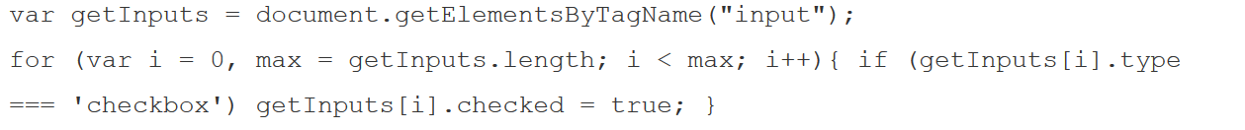
Preprocessing
Source: https://transtats.bts.gov/
Initial idea: Put into Azure SQL DB via JDBC
Lesson: Spark may try to initiate too many connections to the DB
*.csv
*.parquet
dbfs, unionByName
inferSchema
Pro tip: Use JS to check checkboxes

Slide 3
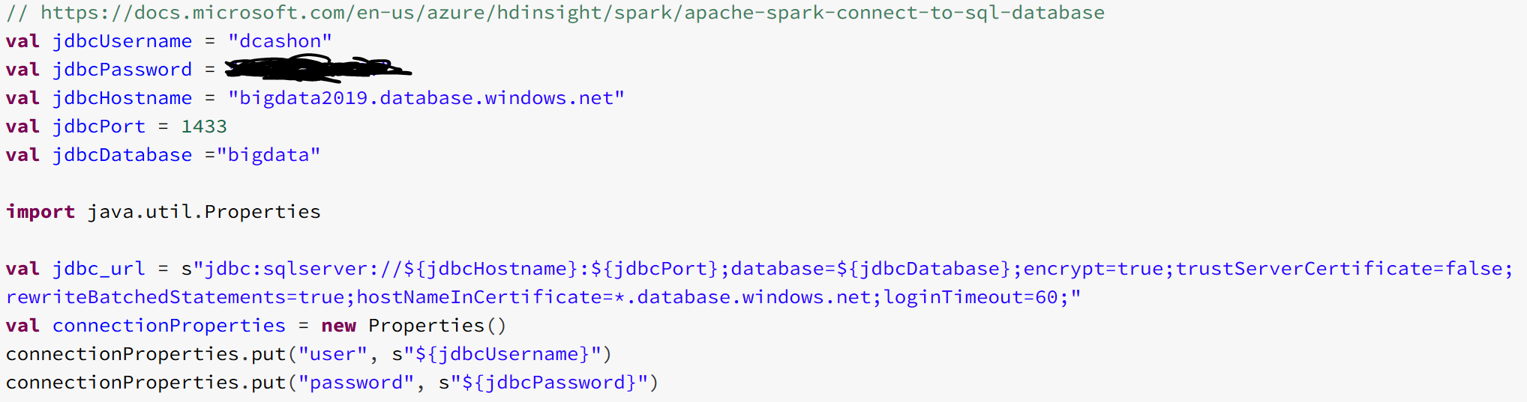
Fun with JDBC

Slide 4
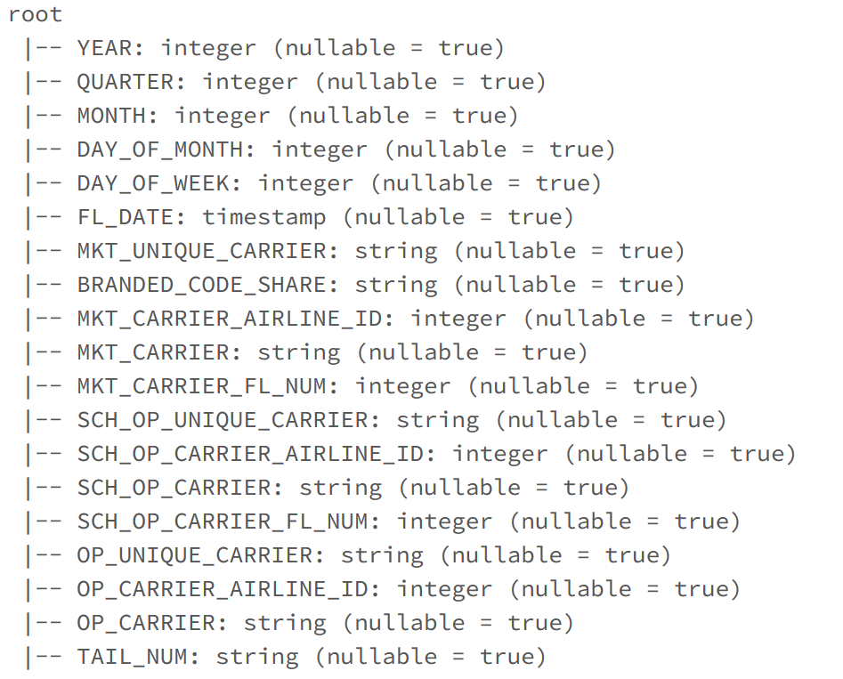
Metadata of the data
120 Fields for 13.7 million flights
Origin/Destination Info (Airports, Times, States)
Carrier Info
Flight Performance Info
28 Carriers
Southwest, Delta, American, Skywest, United, Alaska
375 Airports (Domestic)
Jan 2018 – Sept 2019

Slide 5
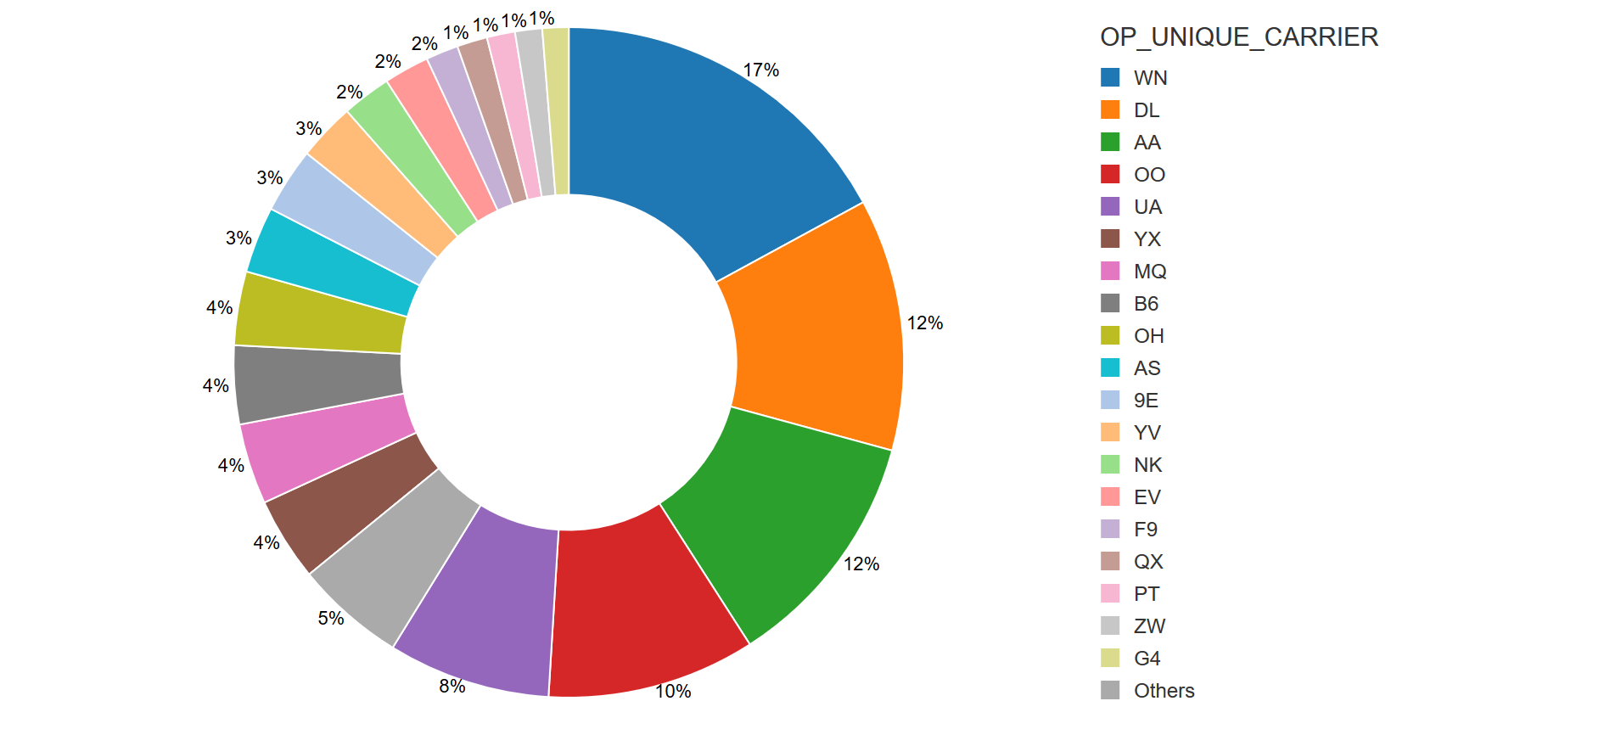
Global Visualizations – Carriers
Southwest
Delta
American
United
Skywest

Slide 6
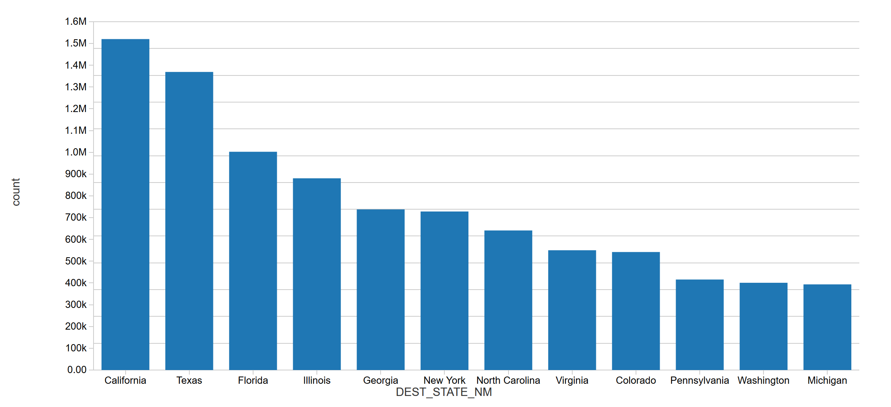
Global Visualizations – Top 12 Destinations

Slide 7
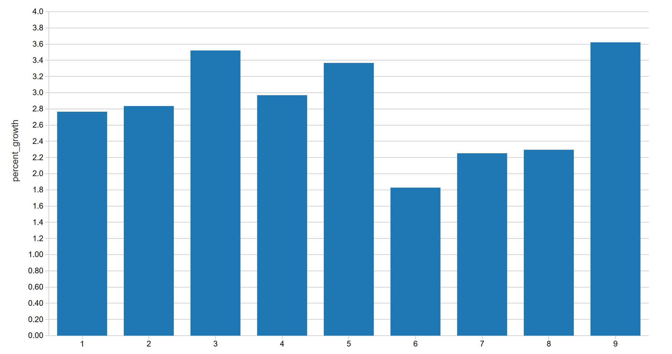
Global Visualizations – Market Trends
March 13
(737 Max Grounded)

Slide 8
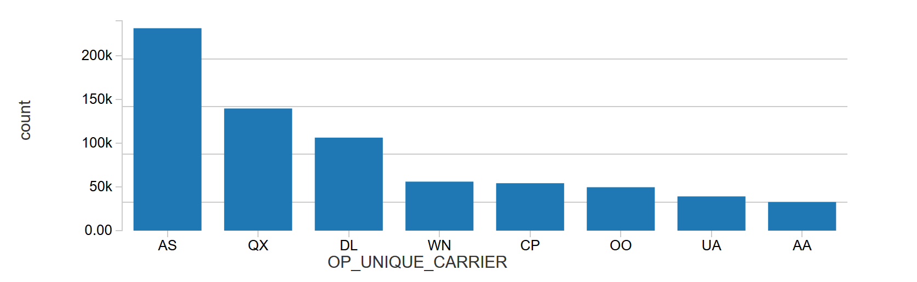
Visualizations – Our State
Horizon
Delta
Southwest
Compass
Skywest
Alaska
United
American
Compass and Skywest – Operating, not marketing carriers!

Slide 9
Closing
Code and notebooks at:
https://github.com/dcashon/bigdata2019_project
Using external databases:
https://docs.microsoft.com/en-us/azure/sql-database/sql-database-spark-connector

