Slide 1

Credit Risk
By David Castillo

Slide 2
Problem Statement
How would you improve the bank's existing state-of-the-art credit scoring of borrowers? How will you predict someone can face financial distress in the next couple of years?
Think about how we gauge financial distress from a banking perspective?
What features most heavily contribute to whether a client will default or not?

Slide 3
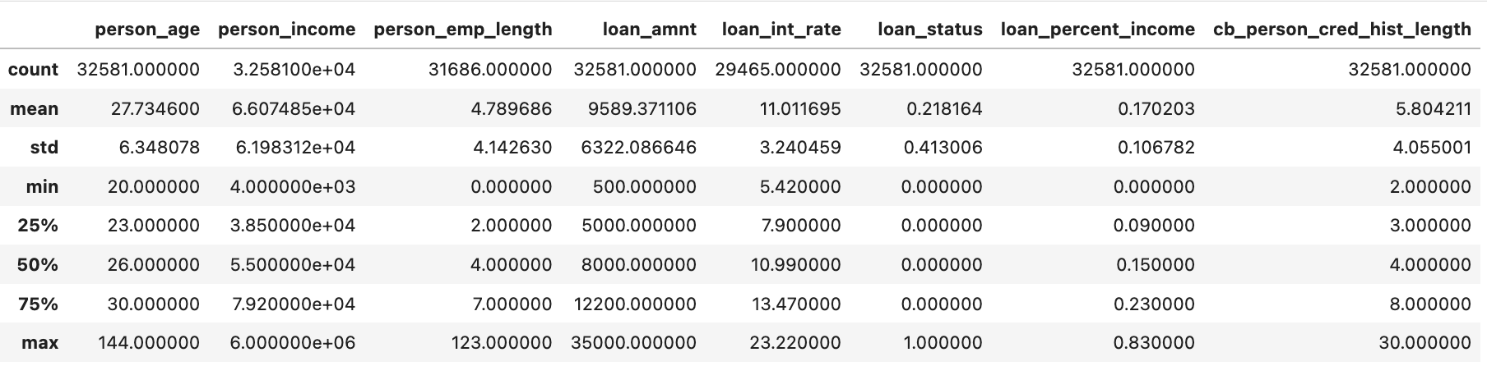
Explore the Data
What does our dataset look like?
Look at aggregations for some of the data.

Slide 4
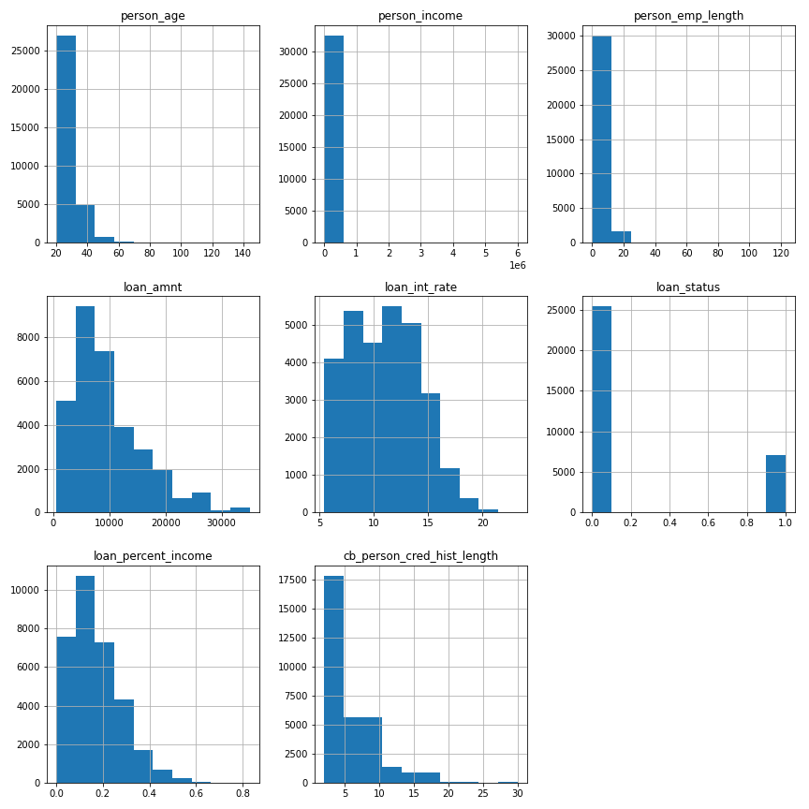
Explore relationships
* Most people in the data set are in between their 20s and 30s
* Most people stay at a job for less than 10 years.
* Most of the population has a loan amount of between 50,000 to 100,000
* The percent of the loan to income seems to stay at less than 30 percent.

Slide 5
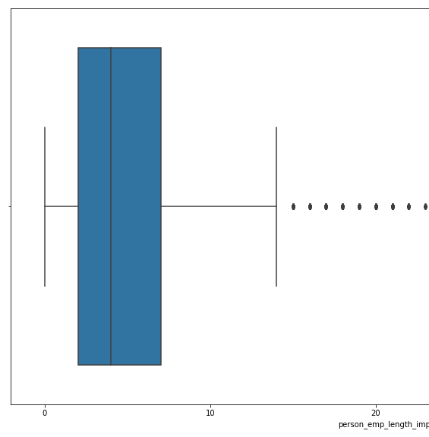
Cleaning the Data
Impute Nulls to fill in null values for person_emp_length(895) and loan_int_rate(3116) using Iterative Imputer.
Deal with outliers using box plots as the visual to what values are within interquartile range.
For example, employment length beyond 14.5 years is an outlier based on statistical methods.

Slide 6

Processing the Data
Ordinal encode ranked categorical data(e.g. think of grades)
Binary string data gets turned into numerical(yes & no become 1 & 0)
Rest of the categorical data gets to be “dummified”, which is a fancy way of making the data numerically encoded.

Slide 7
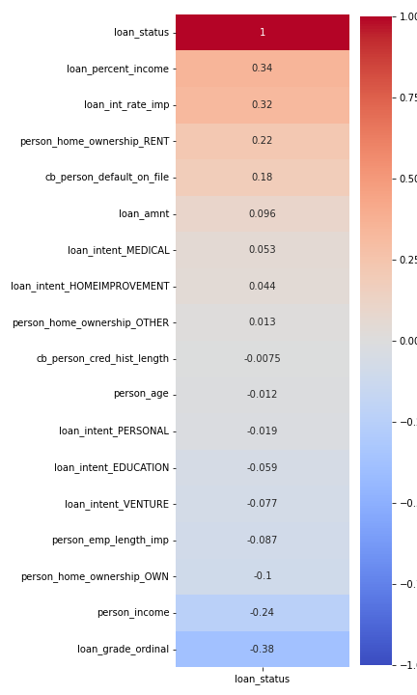
Findings so far…
The top correlated features to whether a loan will default or not are:
loan_percent_income
loan_int_rate
Person_home_ownership_RENT

