Slide 1

Credit Risk Analysis
By David Castillo

Slide 2
Problem Statement
How would you improve the bank's existing state-of-the-art credit scoring of borrowers? How will you predict someone can face financial distress in the next couple of years?
Think about how we gauge financial distress from a banking perspective?
What features most heavily contribute to whether a client will default or not?

Slide 3
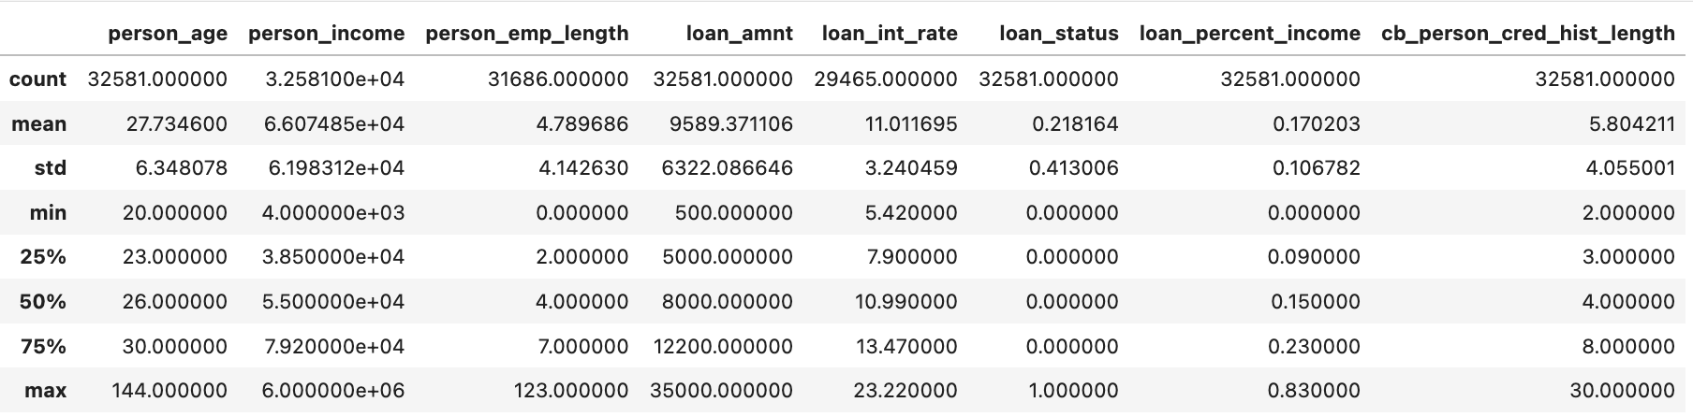
Explore the Data
What does our dataset look like?
Look at aggregations for some of the data.

Slide 4
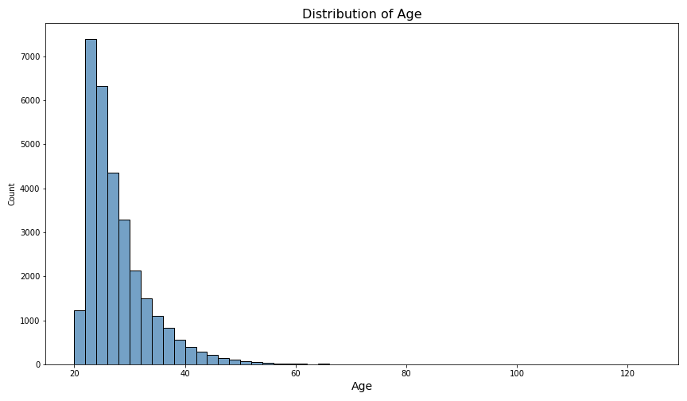
Explore relationships
Most people in the data set are in between their 20s and 30s

Slide 5
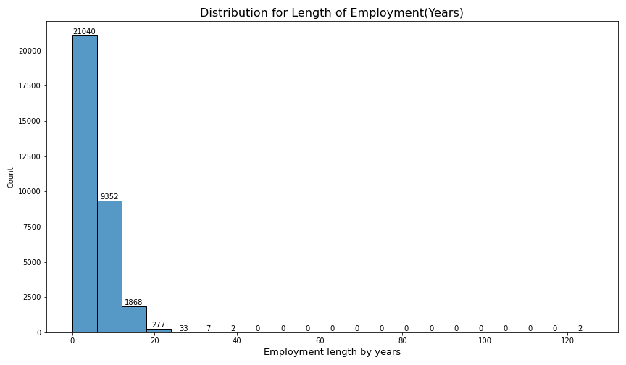
Explore relationships
Most people stay at a job for less than 10 years.

Slide 6
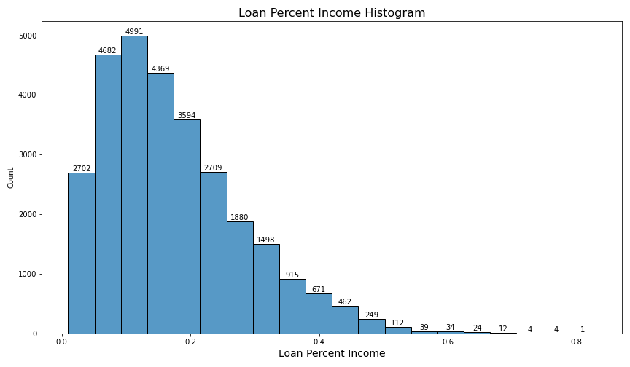
Explore relationships
Most of the people in the distribution have a loan to income percent of less than 25 %.

Slide 7
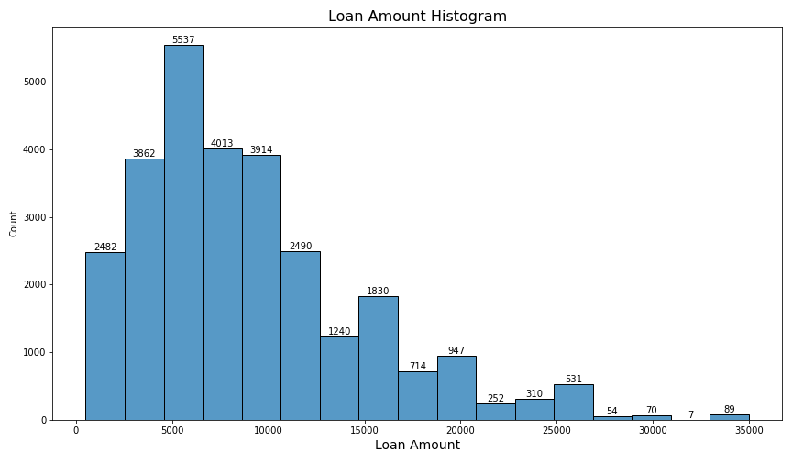
Explore relationships
Most have a loan amount of between 10,000 and 5000

Slide 8
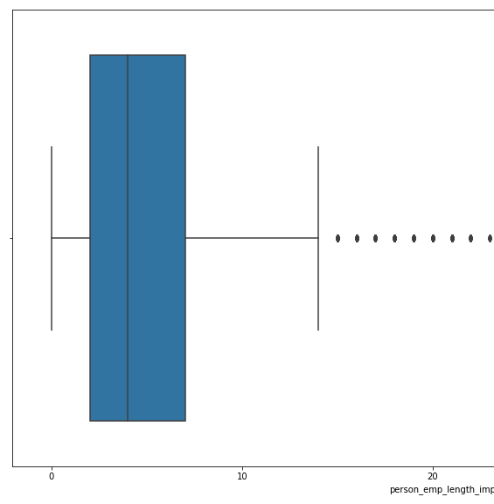
Cleaning the Data
Fill in null values for employment length (895) and loan interest rate(3116) using Iterative Imputer.
Deal with outliers using box plots & applying interquartile range calculations.
For example, employment length beyond 14.5 years is an outlier based on statistical methods.

Slide 9

Processing the Data
Ordinal encode ranked categorical data(e.g. think of grades)
Binary string data gets turned into numerical(yes & no become 1 & 0)
Rest of the categorical data gets to be “dummified”, which is a fancy way of making the data numerically encoded.

Slide 10
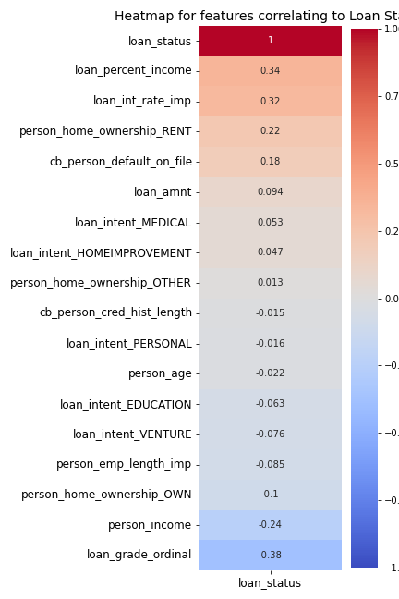
Correlation to Loan Status
The top correlated features to whether a loan status will default or not are:
Loan percent income
Loan interest rate
Home ownership Status (RENT)
Those with the most negative correlation are:
Loan Grade
Personal Income

Slide 11
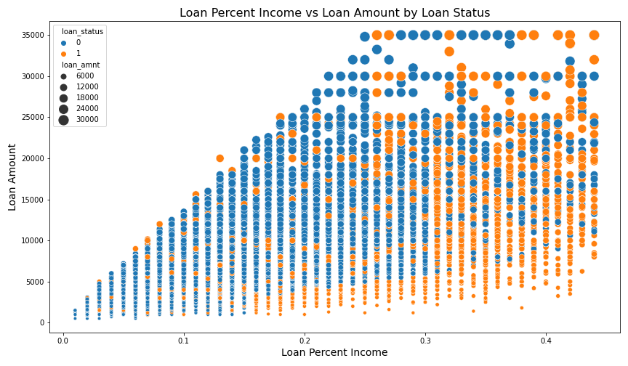
Filtering by Loan Status
* As "Loan amount" and "loan as a percent of income" increase there is more variability in the observed data,
* However, when you filter for whether those people defaulted, you can see the cluster of defaults as soon as the loan percent of income is greater than .15 and loan amount increases.

Slide 12
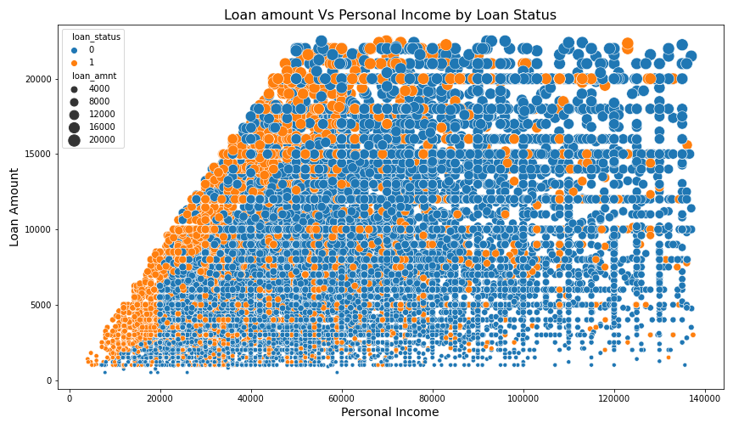
Filtering by Loan Status
Incomes lower than 20k default at a higher rate.
Incomes between 20 k and 70k who have loan amounts between 20k and have loan amounts between about 7k & 17k also show a cluster of loan defaults as well.

Slide 13
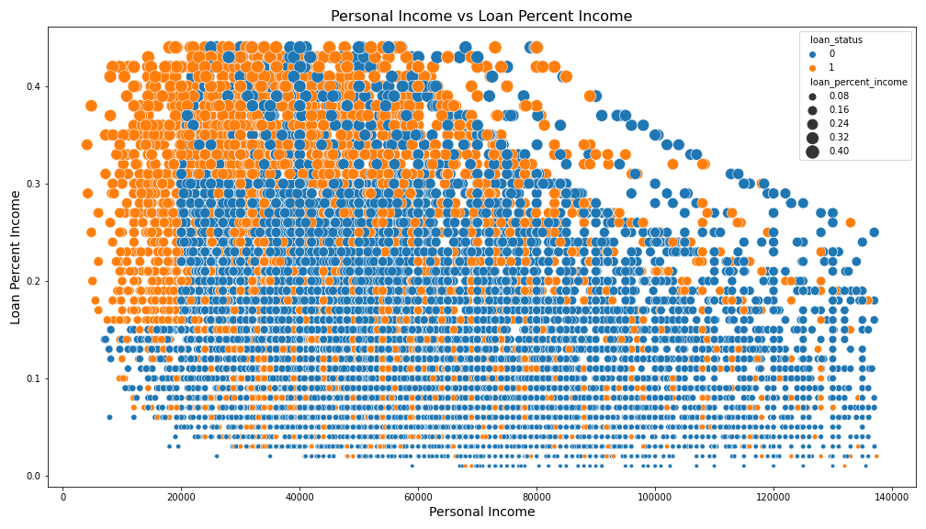
Filtering by Loan Status
Low Income(<20k), interest rate >.15, extremely high defaults.
Income between 20k-80k with loan percent income between .03-.04 also high defaults.

Slide 14
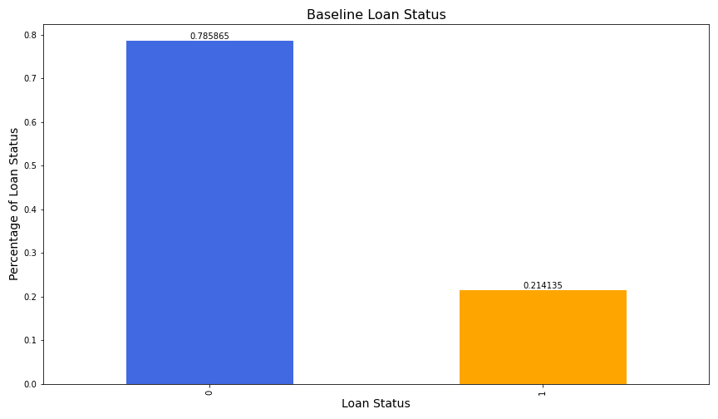
The Modeling Phase
79 % have not defaulted
An imbalanced data set will guide what metrics we use since accuracy will not be as important

Slide 15
Model Selection
Will utilize and compare Logistic Regression, Random Forest, and XGBoost.
Will use scikit-learn’s grid search and pipeline modules in order to automate and tune for best parameters.
Use precision, recall and AUC scores to drive my model selection.

Slide 16
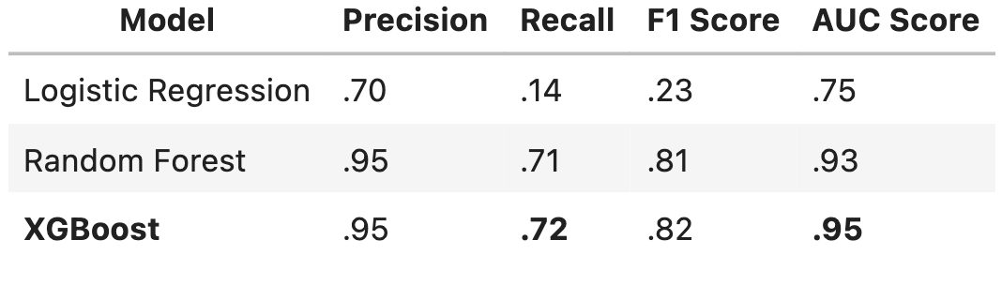
Model Performance

Slide 17

Metrics
Precision indicates your true positives(those predicted positive and true) over the Total predicted positives(true positive + false positive).
Recall measures those true positives over the total actual positives(true positive & false negative).
In this instance a false negative, which in this case would mean being wrong about a person not defaulting, would open yourself to losses. Therefore, it is wise to look to Recall/Sensitivity.
Recall/Sensitivity answers the question "among those who will default, how many did I get correct?" XGBoost is correct 72% of the time.
Precision answers the question "Among those I predicted will default, how many did i get correct?" XGBoost is correct 95% of the time.
XGBoost has the highest Recall, Precision and AUC Score which makes it our strongest model in terms of predicting whether someone can withstand financial hardship/whether they will default on their loan.

Slide 18
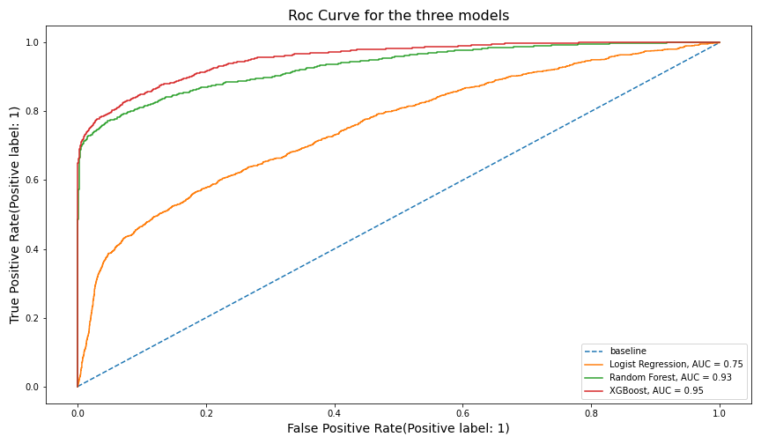

Slide 19
ROC Curve & ROC AUC
ROC Curve is generated by varying threshold from 0 to 1. Which helps visualize the tradeoff between sensitivity and specificity and helps us understand how well-separated our populations are.
When evaluating ROC AUC, the closer to 1 indicates the best model. XGBoost outperforms the RandomForest model by 20%. A score closer to 1 indicates a good separation of our positive and negative populations.
Logistic Regression trails by .20 and is closer to that .5 threshold which would make the model closer to having positive and negative populations overlapping. Which is bad.

Slide 20
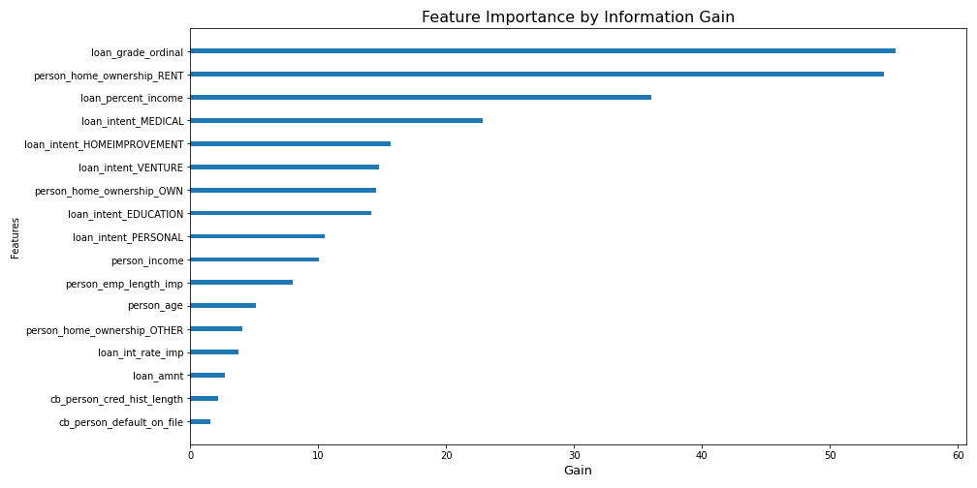
XGBoost Insights(Information Gain)

Slide 21
XGBoost Top Five Predictors
Loan grade
Home Ownership Status as Rent
Loan Percent Income
Loan for medical purposes
Loan for home improvement

Slide 22
Conclusion
Circling back to our problem statement, improving the state-of-the-art credit scoring of borrowers entails really maximizing your current features.
Maximized by cleaning the data in ways such as dealing with null values, and outliers.
Process the data so we can take advantage of our categorical columns, so we encode or dummify them accordingly.
Getting a sense of the data through aggregations & visualizations.
Predict financial distress through our target variable (loan status) and use our features to build predictive classification models.
We were able to use pipelines & gridsearch to build finely tuned logistic regression, RandomForest and XGBoost models.
We determined that because our dataset was imbalanced; precision, recall & AUC scores were the best way to assess our models (instead of accuracy).
XGBoost achieved the highest in those key metrics.
We were able to see the top five features that contributed to this model.

Slide 23

Next Steps
Would love to feature engineer based on some conditionals I may have found through visualizations and see if those improve the models.

