Slide 1
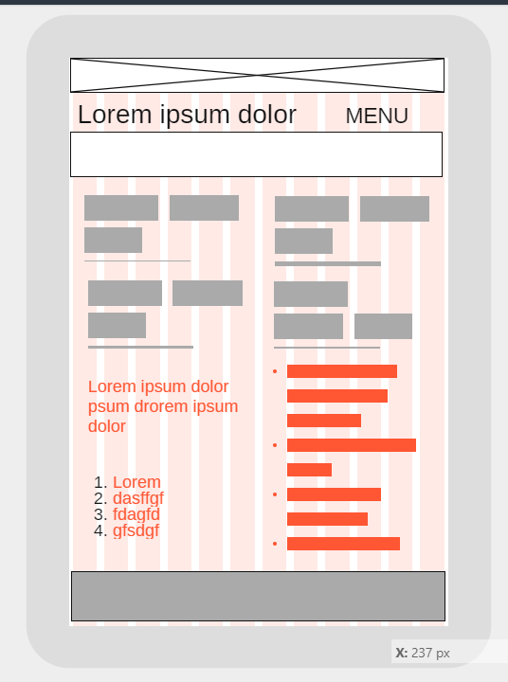
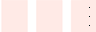
Section
W=320px
H= 740px
Main
Side Bar
Main/Footer

Slide 2
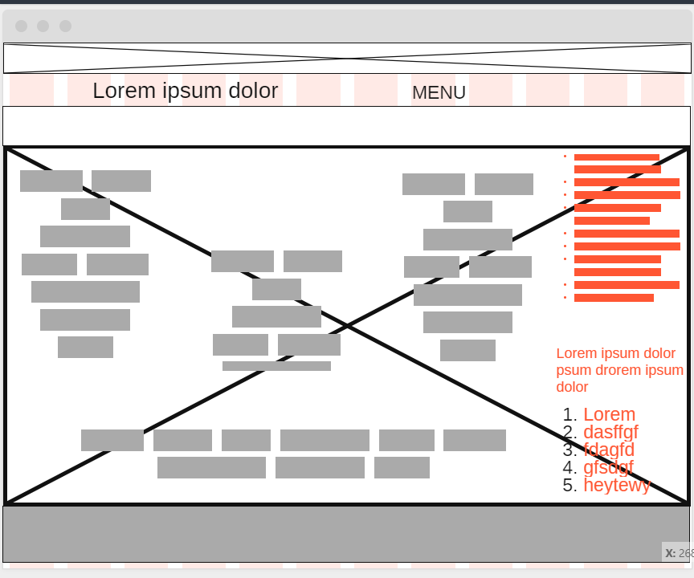
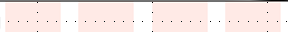
W=1366px
H= 1024px
Section
Side Bar
Main
Main/Footer

