Slide 1
AI OS
PUBLIC DEMO · 2026
AI for daily life
the personal stack I run on
24.05.2026
public template

Slide 2
AI OS
PUBLIC DEMO · 2026
Agenda
1.
Mental model: three concentric layers
2.
Runner: chief-of-staff
3.
Obsidian: second brain · LLM-wiki
4.
Public surface: site + APIs
5.
Personal dashboard: local control center
6.
Co-typist: on-device autocomplete
7.
Codex: agentic coding harness
8.
Runner workflow: request → filed learnings
9.
Demo plan
2 / 21

Slide 3
AI OS
PUBLIC DEMO · 2026
1
Mental model
3 / 21

Slide 4
AI OS
PUBLIC DEMO · 2026
Three concentric layers
Same primitives: personal first, then a scoped subset for the team via Centaur.
Context layer
Obsidian vault · agent memory · public surface: facts about work, projects, finances and notes.
Team
Personal agent layer
Agents
Runner as chief-of-staff. Codex as the coding harness. Co-typist at the keystroke layer.
Context
Team agent layer
A company Slack agent: a curated subset of these abilities with proper permissioning.
4 / 21

Slide 5
AI OS
PUBLIC DEMO · 2026
2
Runner
5 / 21

Slide 6











AI OS
PUBLIC DEMO · 2026
Runner
chief-of-staff agent: Anthropic SDK + MCP, persistent file memory, scheduled automations
Drafts replies, books meetings, runs research.
Connected surfaces
Persistent memory ~/.runner/memory/: user, feedback, project, references.
Mailboxes
Calendars
Skills inbox-triage · morning-briefing · meeting-prep · investor-updates · weekly-review.
Slack
Telegram
Action cards: no silent outbound sends.
WhatsApp
LinkedIn
GitHub
Chrome + Zoom
Supabase
Notion + Granola
runner.now/download/s3sx69
6 / 21

Slide 7
AI OS
PUBLIC DEMO · 2026
3
Obsidian
7 / 21

Slide 8

AI OS
PUBLIC DEMO · 2026
Obsidian
second brain · LLM-wiki: plain markdown so every agent can read & write the same files
Plain markdown: every agent can read + write the same files.
Top-level structure
Git-backed: agents never lose work.
Capture
Wiki layer
raw/
Clippings/
Meeting Transcripts/
daily notes, journals
saved references
calls and notes
wiki/
Knowledge/
People/
canonical entities
evergreen notes
relationship graph
Wikilinks make context navigable across topics.
Karpathy's LLM-wiki pattern (see CLAUDE.md schema).
Work graph
Personal ops
Projects/
Content/
Company/
active work
published surface
team context
Finance/
Investing/
Health/
cashflow, docs
portfolio memory
longitudinal data
8 / 21

Slide 9

AI OS
PUBLIC DEMO · 2026
Public surface + personal dashboard
A public side and a local control center; both consumed and written by agent skills.
Public surface
Personal dashboard
Personal site, writing, projects and lightweight APIs
Local React app over the vault
Structured database tables for repeatable agent writes
Graph view · finance + health + content charts
Object storage for assets, documents and generated files
Static snapshot regenerated by skill
Skills: publish update · tag lead · research pipeline
Next: real DBs + APIs, live data plane
React/Vite · Cloudflare · Supabase · R2 · 1Password
Charts query live data; Runner mutates state via API.
9 / 21

Slide 10
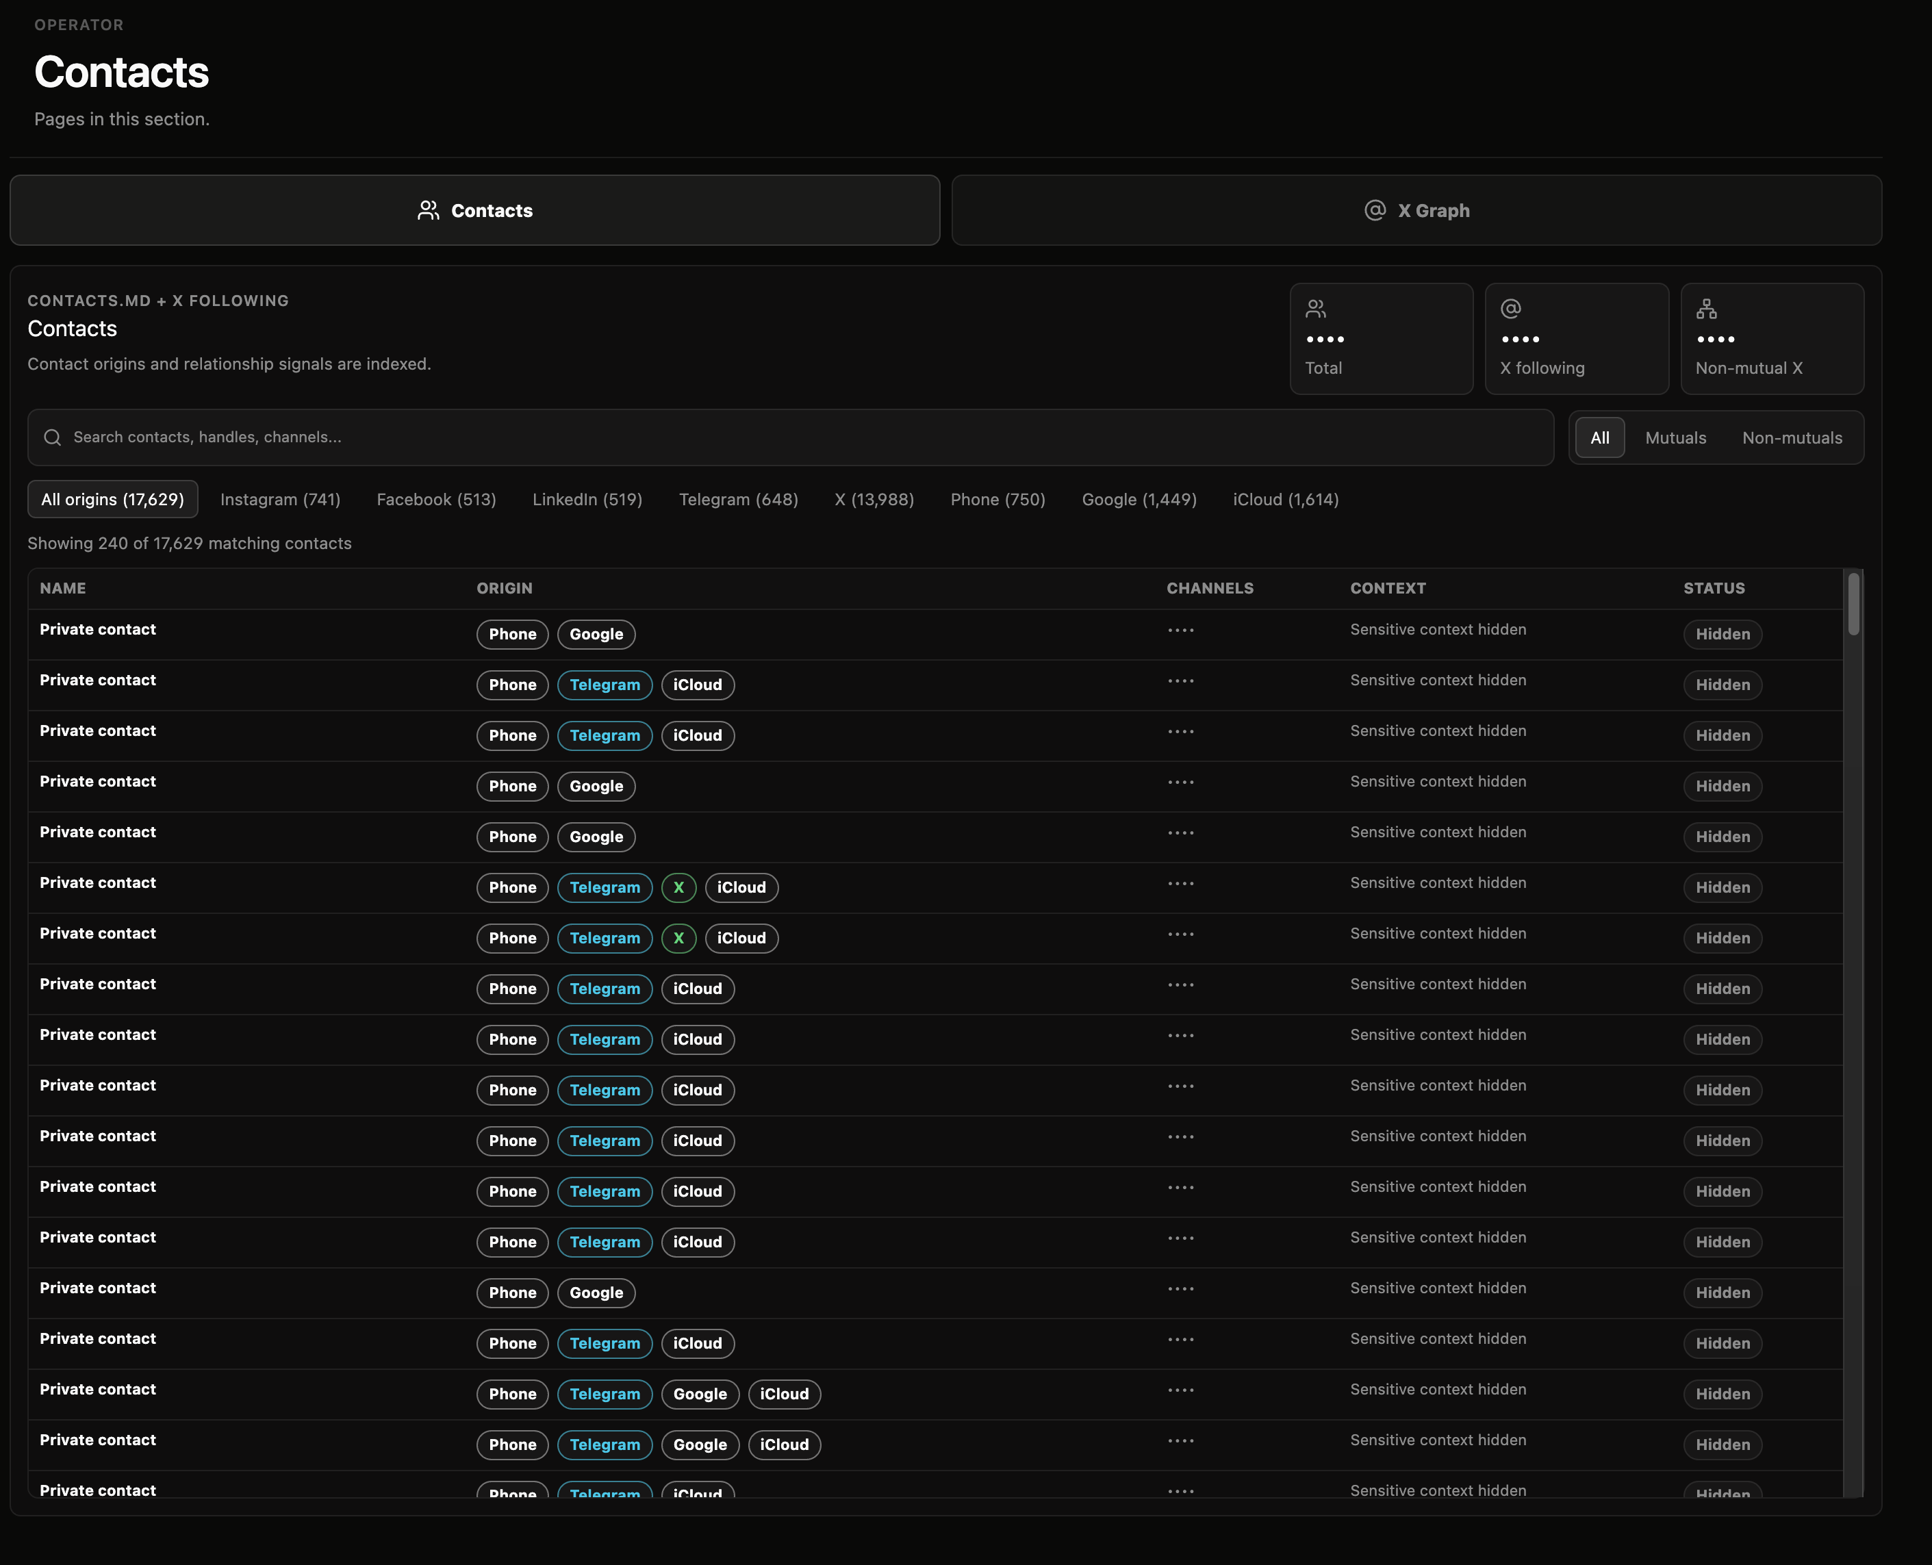
AI OS
PUBLIC DEMO · 2026
Same pattern: private data stays local, but the interface is inspectable and agent-readable.
10 / 21

Slide 11
AI OS
PUBLIC DEMO · 2026
PERSONAL OS
Media queue
Saved knowledge
Videos, books, podcasts and notes become searchable input for agents.
Same pattern: private data stays local, but the interface is inspectable and agent-readable.
11 / 21

Slide 12
AI OS
PUBLIC DEMO · 2026
PERSONAL OS
Network graph
Social graph
Ranked relationships, research targets and outreach paths become legible.
Same pattern: private data stays local, but the interface is inspectable and agent-readable.
12 / 21

Slide 13
AI OS
PUBLIC DEMO · 2026
PERSONAL OS
Folded knowledge graph
Folder-level map
A clean overview of the knowledge base before diving into individual notes.
Same pattern: private data stays local, but the interface is inspectable and agent-readable.
13 / 21

Slide 14
AI OS
PUBLIC DEMO · 2026
PERSONAL OS
Full knowledge graph
Note-level links
Dense clusters expose the real connections inside the personal operating system.
Same pattern: private data stays local, but the interface is inspectable and agent-readable.
14 / 21

Slide 15

AI OS
PUBLIC DEMO · 2026
Co-typist
on-device predictive text for every macOS text field, sitting at the input layer
0
System-wide ghost-text: Mail, Notes, Messages, Slack, Obsidian, editors.
Apple Foundation Models: runs locally; safe to leave on during sensitive typing.
bytes leave the machine
Complements Runner + Codex by speeding up the raw keystroke step everywhere else.
cotypist.app
15 / 21

Slide 16

AI OS
PUBLIC DEMO · 2026
Codex
the agentic coding harness I run for every project, built on OpenAI Codex Pro
Where it shows up
The pattern I prefer
Personal site frontend + APIs
Personal dashboard
Runner skills + local tooling
Work projects: PRs, scripts, infra
Cross-checked vs. Claude Code locally
1. Deterministic Python orchestrator
2. LLMs only at the leaves
3. Short-lived agents
4. Worktree isolation
5. File-based state
16 / 21

Slide 17
AI OS
PUBLIC DEMO · 2026
How it fits together
Personal context feeds personal agents which act on a public + built surface.
Personal context
Obsidian vault · Runner memory · 1Password
Personal agents
Runner Codex Co-typist
Built surface
Public site Personal dashboard APIs
17 / 21

Slide 18
AI OS
PUBLIC DEMO · 2026
A request becomes a graph of work
Pull context, act through tools, write learnings back.
1
2
3
4
5
6
Ask
→
Context pull
→
Tools
→
Voice
→
Action cards
→
File back
Draft follow-ups
memory · contacts
calendar · inbox
style profile
editable drafts
wiki · log
Reads are broad
Writes are bounded
The vault learns
The agent can search vault, calendar, inbox, docs, browser and project systems.
Drafts, files, issues and code can be prepared; irreversible actions stay approval-gated.
Useful outcomes become linked markdown, not transient chat transcript.
18 / 21

Slide 19
AI OS
PUBLIC DEMO · 2026
The operating rails
What keeps the workflow reliable when the tool surface gets large.
BRAIN
MUSCLE
SENSES
Vault contract
Memory with reasons
Deferred connectors
CLAUDE.md defines schema; wiki/raw/explorations make knowledge navigable.
Feedback and project rules include why + how to apply.
~1,500 tools stay out of context until ToolSearch loads the needed schema.
REFLEX
VOICE
SAFETY
Skills as reflexes
Style profiles
Verification guardrails
Morning briefing, meeting prep, inbox triage and research pipelines.
Platform-specific voice profiles shape drafts without steering every time.
Browser proof for visual changes; no destructive writes without explicit approval.
Mental model: Obsidian is the brain; Runner is the hands; connectors are the senses; skills are the reflexes.
19 / 21

Slide 20
AI OS
PUBLIC DEMO · 2026
Demo plan: Part 1 of the sync
~5 minutes: here's what AI can do for you day-to-day.
Inbox triage + a calendar booking
End-to-end workflow with drafts and explicit approvals.
Personal dashboard: finance + health + content
Dashboards over a local vault, regenerated by skills.
Public site updated by an agent
An agent writes structured data, visible in seconds.
One Codex run on the dashboard frontend
Issue → branch → preview, in the time of the demo.
20 / 21

Slide 21
AI OS
PUBLIC DEMO · 2026
Now: the team version.
Same primitives, scoped + permissioned for a team.
AI OS
PUBLIC TEMPLATE
21 / 21

