Slide 1
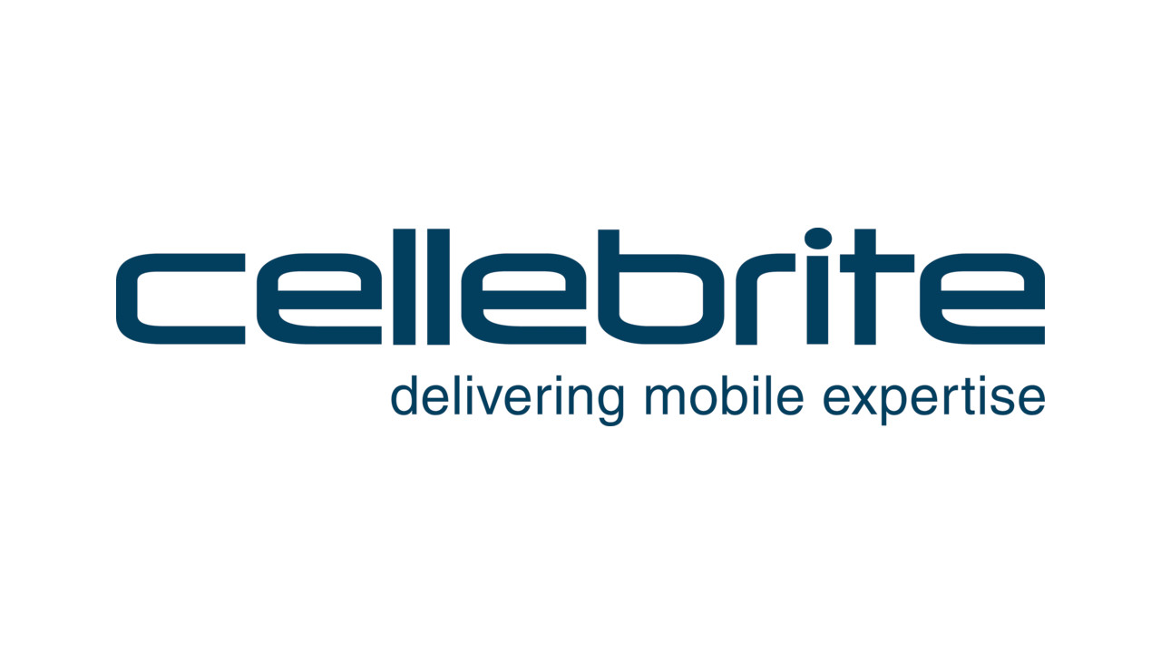
Brooke Guajardo & Patrick Lane

Slide 2
Cellebrite
Founded in Petah Tikva, Israel 1999
Cellebrite Mobile Forensics est. 2007
Two Branches Currently
Cellebrite wireless carriers and retailers
Mobile forensics products
DEDs (Data extraction devices)
UFEDs (Universal forensic extraction device)
Parent Company is Japan’s Sun Corporation

Slide 3
Apple V FBI
Where we started noticing Cellebrite
But where did Apple v FBI begin?

Slide 4
IOS 8
September 2014
Before IOS8, the government could ask for phones to be unlocked.
Apple no longer can access user data, their encryption prevents it.
unable to assist law enforcement
So law enforcement is sad ☹
A possible response to the then, recent activity of Edward Snowden.
Tim Cook, "People have a right to privacy."

Slide 5
Response
2014 FBI Director James Comey, "There will come a day—well it comes every day in this business—when it will matter a great, great deal to the lives of people of all kinds that we be able to, with judicial authorization, gain access to a kidnapper's or a terrorist or a criminal's device.”
Notes:
Government is very sad ☹

Slide 6
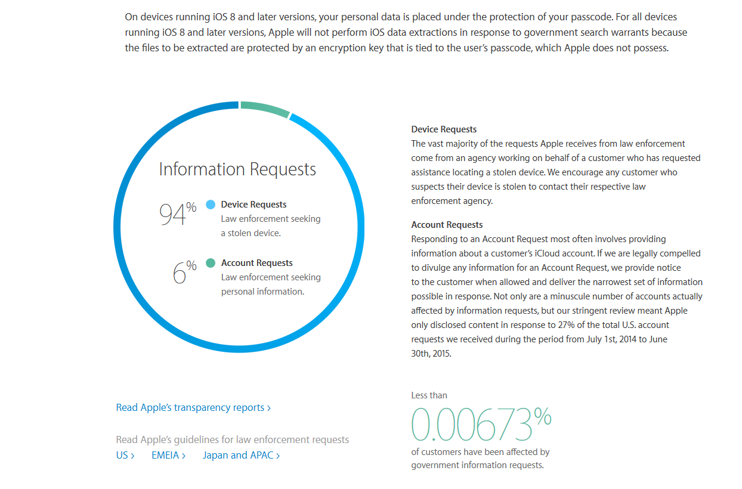
Notes:
A privacy statement from apple to its customers breaking down the requests it receives from the government

Slide 7
San Bernardino Shooting Dec 2015
Shooting, national security concern of Isis/Isil involvement
Data on iPhone needs to be investigated
One of the shooter’s work iPhone
But IOS 8

Slide 8
Apple V FBI Court Case
FBI demands Apples help
Apple of course said no
However what FBI was really asking for was not so simple
Notes:
Apple provided cloud info

Slide 9
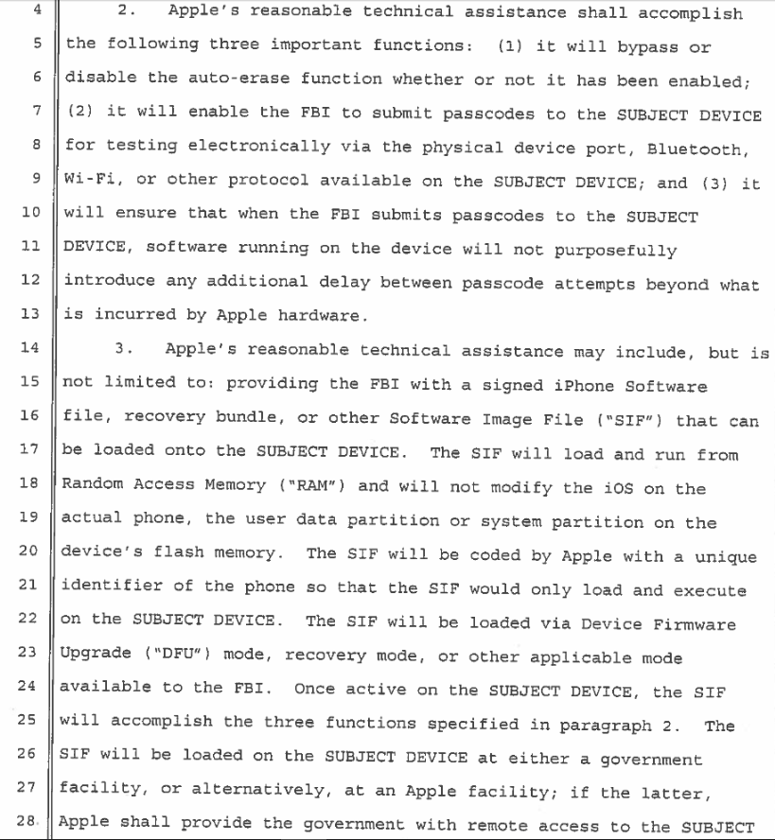
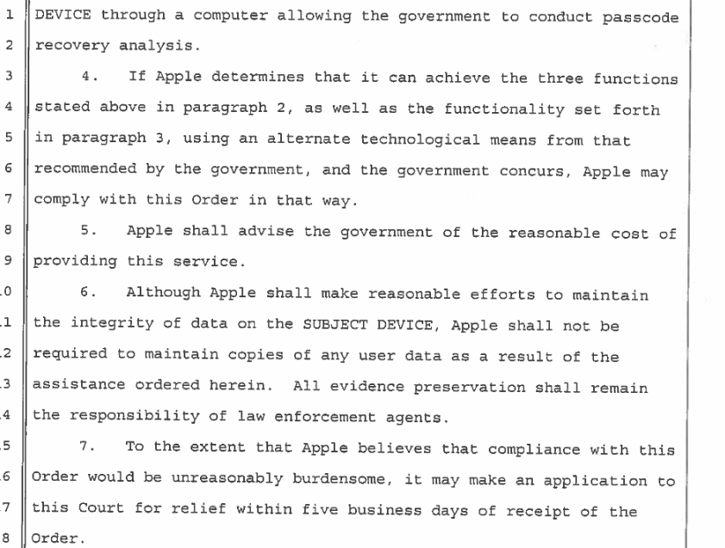

Slide 10
Cellebrite’s Involvement
At first and currently denies involvement
Sun Corp. stock rose (9.8%) March 31, day of FBI announcement. Weird right?

Slide 11
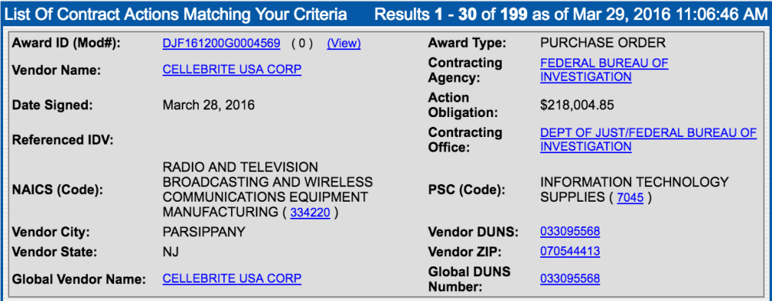
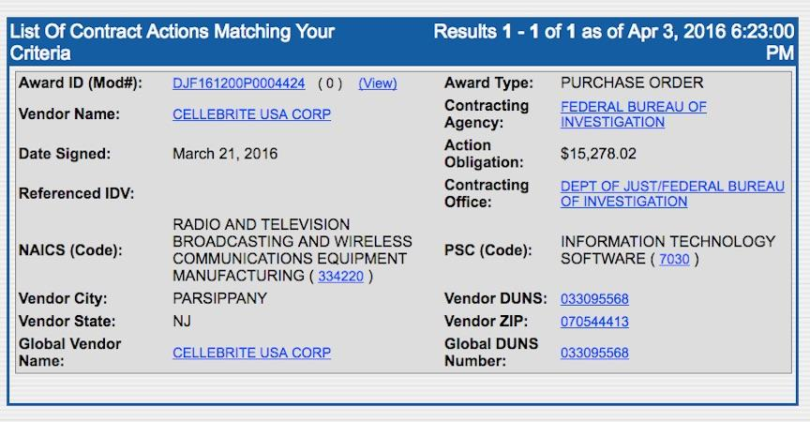
“No comment”
Cellebrite CEO said that they would not comment on their client’s information.

Slide 12
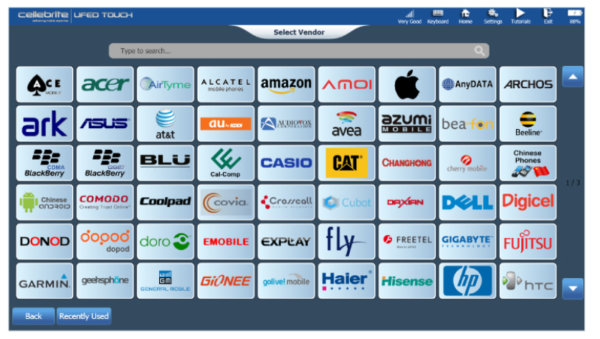
Cellebrite UFED (Touch)

Slide 13
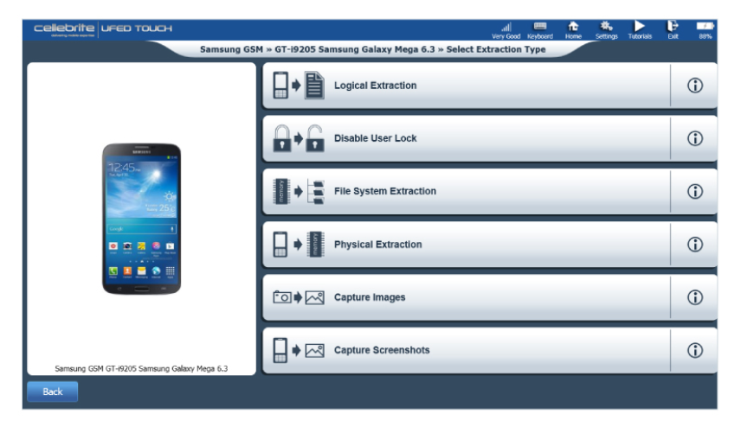
Cellebrite UFED
In 2008 Michigan State Troopers were accused of using DEDs.
Were in fact using Cellebrite UFED devices.
Said it would cost $544,000 to give the public that information.
Punks.
Notes:
http://abcnews.go.com/Technology/michigan-police-cellphone-data-extraction-devices-aclu-objects/story?id=13428178

Slide 14
Ripple Effect (Possibly Legal Implications)
Whatsapp!
Implemented End to End encryption
Justice Department in New York is still pursing Apple in court
Related to a drug case
Even though FBI used Cellebrite
However on Feb 28 2016, a Magistrate Judge declared using All Writs Act (of 1789) was allowing the government to inflate its authority to use the Act to force Apple to extract data from a seized IPhone.
Notes:
On April 5, 2016, WhatsApp and Open Whisper Systems announced that they had finished adding end-to-end encryption to "every form of communication" on WhatsApp, and that users could now verify each others' keys.^{[11][80]} According to a white paper that was released along with the announcement, WhatsApp messages are encrypted with the Signal Protocol,^{[81]} which combines the Double Ratchet Algorithm, prekeys, and a 3-DH handshake.^{[82]} WhatsApp calls are encrypted with SRTP, and all client-server communications are "layered within a separate encrypted channel".^{[81]} The Signal Protocol library used by WhatsApp is open-source and published under the GPLv3 license.^{[81][83]}

