Slide 1
ECE 491 – Multispectral Segmentation
Clay Leach / David Cornett

Slide 2
Slide Index – Kill this eventually
Multispectral definition
Segmentation in general
Our goal – fabric color segmentation (include how this is novel)
Previous work - Summary of references (maybe after our goal)
Camera specs
Sample Images
RGB reconstruction
Dataset overview (include RGB of each) - # images, features, sets (talk about features per point per image)
Feature space 1 (multispectral responses) – Feature Space 2 (multispectral responses + spatial coordinates)
Ground truth manually (side by side with RGB)
K-means overview
Mean shift overview – how we determined a good window size
K-means full feature RGB vs Multi
Mean shift full feature RGB vs Multi
K-means PCA RGB vs Multi
Mean shift PCA RGB vs Multi
Results ??? – visual charts of some type, or at least how we plan on doing this
References

Slide 3
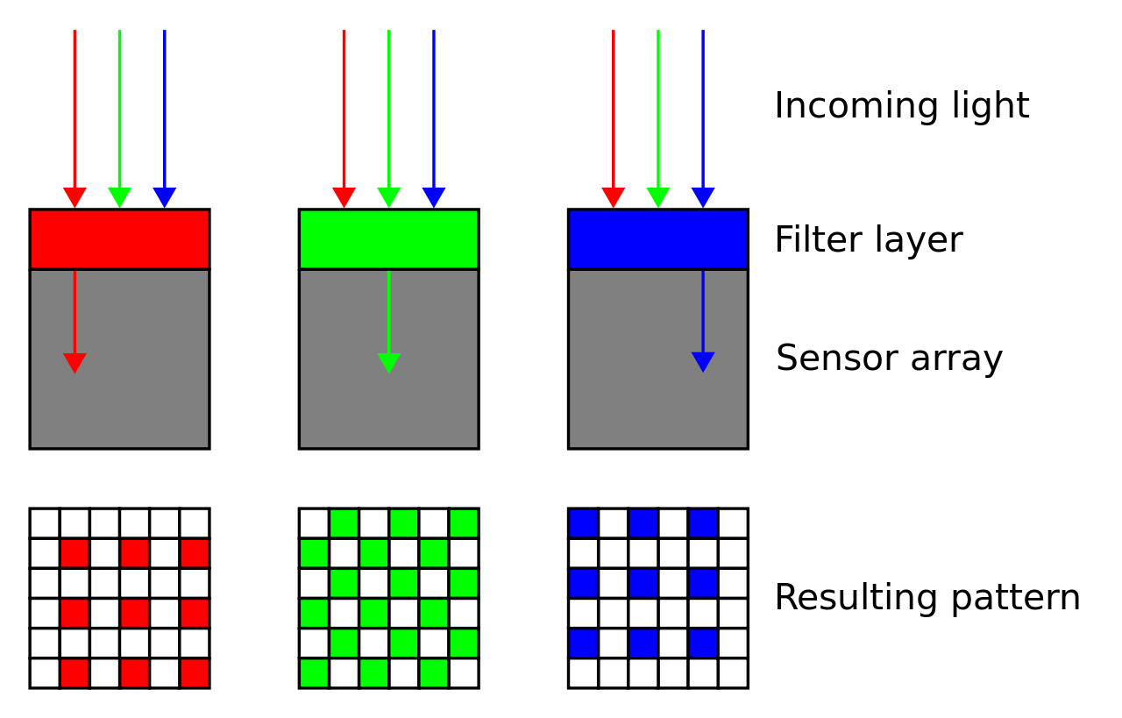
Standard Digital Imaging
Standard digital cameras use a color filter array on-top of the sensor’s pixel array to quantize the color response from a scene
The filters accept common peak wavelengths for R,G and B responses (R=620nm, G=550nm, B=470nm)
This produces images in the RGB feature space we are familiar with
Source: https://en.wikipedia.org/wiki/Bayer_filter

Slide 4
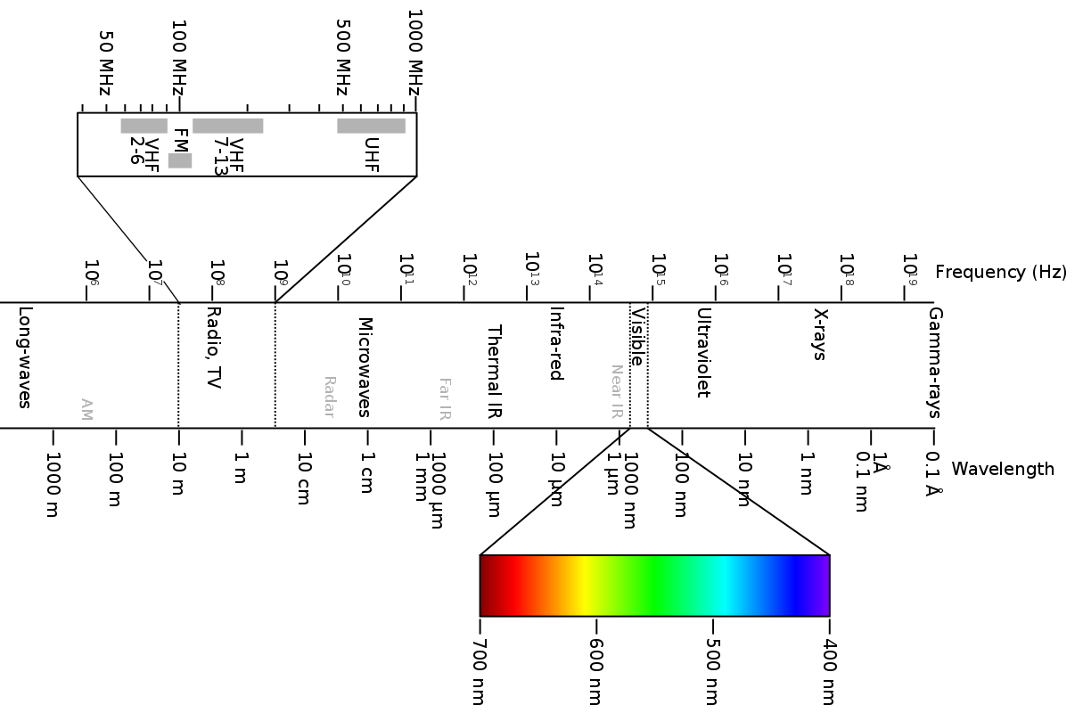
Multispectral Imaging
Source: https://en.wikipedia.org/wiki/Electromagnetic_spectrum

Slide 5
Multispectral Imaging
EM spectrum image
Visible spectrum image
Typical sampling range for RGB sensors
Uses

Slide 6
Processing Pipeline
Multispectral Image Directory
Segment (K-means, Mean Shift, etc.)
Interpret RGB Image from Multispectral
Color Segments Based from Labels
Merge Channels
PCA ?

Slide 7
Multispectral Segmentation
Heavily used in satellite imaging

Slide 8
References
?

