Slide 1
ECE 491 – Multispectral Segmentation
Clay Leach / David Cornett

Slide 2
Slide Index
Multispectral definition
Segmentation in general
Our goal – fabric color segmentation (include how this is novel)
Previous work - Summary of references (maybe after our goal)
Camera specs
Sample Images
RGB reconstruction
Dataset overview (include RGB of each) - # images, features, sets (talk about features per point per image)
Feature space 1 (multispectral responses) – Feature Space 2 (multispectral responses + spatial coordinates)
Ground truth manually (side by side with RGB)
K-means overview
Mean shift overview – how we determined a good window size
K-means full feature RGB vs Multi
Mean shift full feature RGB vs Multi
K-means PCA RGB vs Multi
Mean shift PCA RGB vs Multi
Results ??? – visual charts of some type, or at least how we plan on doing this
References

Slide 3
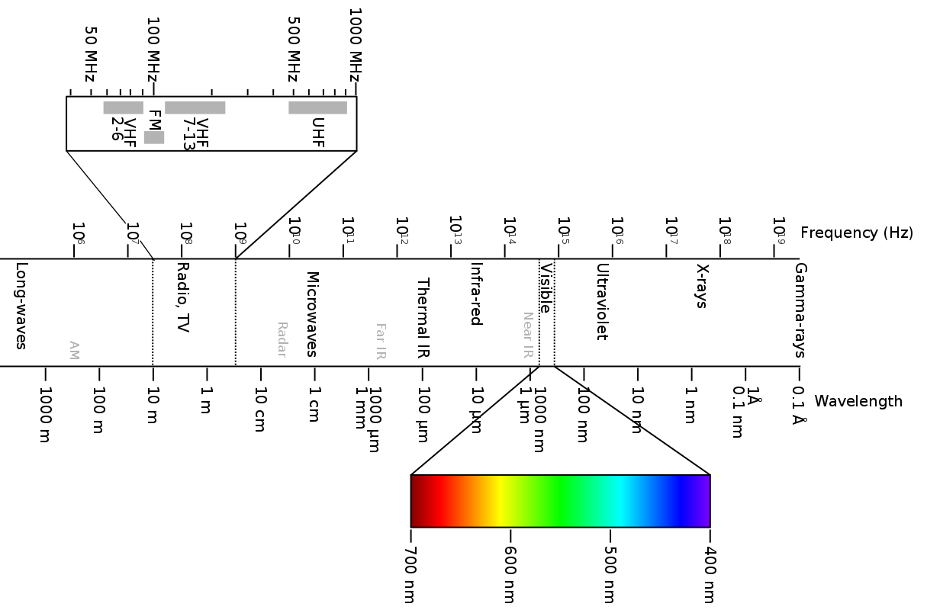
Standard Digital Imaging
Standard RGB
Source: https://en.wikipedia.org/wiki/Electromagnetic_spectrum

Slide 4
Multispectral Imaging
Source: https://en.wikipedia.org/wiki/Electromagnetic_spectrum

Slide 5
Multispectral Imaging
EM spectrum image
Visible spectrum image
Typical sampling range for RGB sensors
Uses

Slide 6
Multispectral Segmentation
Heavily used in satellite imaging

Slide 7
References
?

