Slide 1
ECE 491 – Multispectral Segmentation
Clay Leach / David Cornett

Slide 2
Project Goals
Determine if the multispectral feature space provides greater accuracy than RGB for traditional image segmentation
Create a custom, multispectral image dataset composed of different fabrics and colors

Slide 3
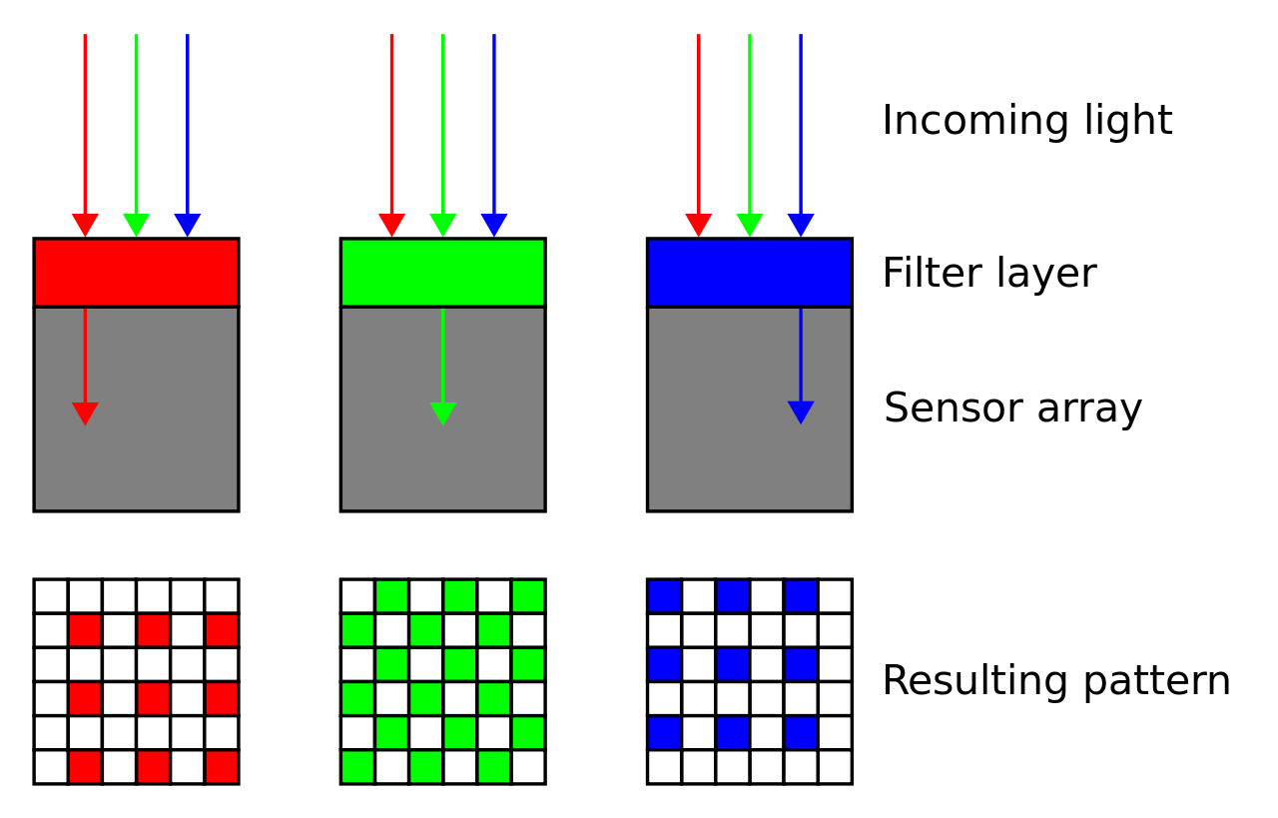
Standard Digital Imaging
Standard digital cameras use a color filter array on-top of the sensor’s pixel array to quantize the color response from a scene
The filters accept common peak wavelengths for R,G and B responses (R=600nm, G=515nm, B=450nm)
This produces images in the RGB feature space we are familiar with
Source: https://en.wikipedia.org/wiki/Bayer_filter

Slide 4
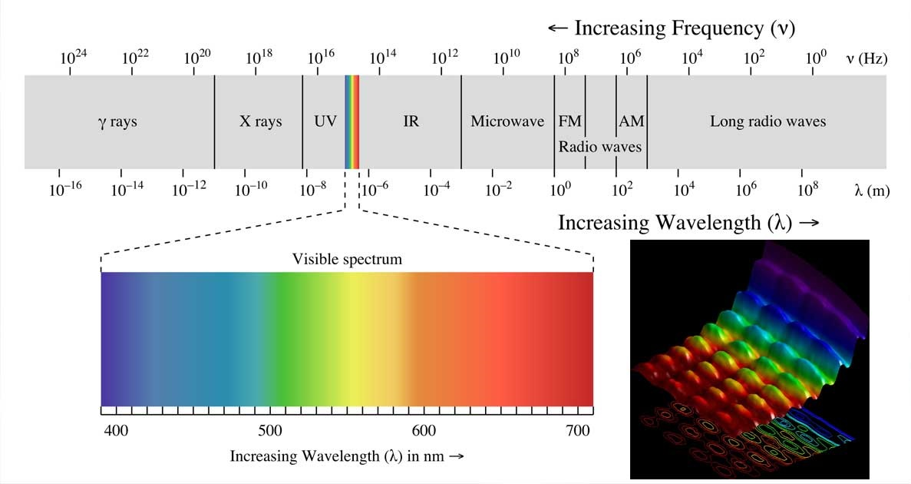
Multispectral Imaging
Source: http://media.factmyth.com/2016/07/
The scene response is captured at several specific wavelengths as opposed to an average response per sensor filter color

Slide 5
Multispectral Uses
Traditionally, multispectral imaging is used for satellite imaging, military applications, astronomical imaging and chemical imaging (due to cost limitations)
Current applications include drones with specific multispectral filters for farming applications and multispectral facial recognition

Slide 6
Multispectral Camera
The camera we used can capture responses 400nm to 720nm at 1nm steps (321 responses)
For our dataset, we used responses with 10nm steps producing images with 32 spectral features

Slide 7
Multispectral Camera
The camera we used can capture responses 400nm to 720nm at 1nm steps (321 responses)
For our dataset, we used responses with 10nm steps producing images with 32 spectral features

Slide 8
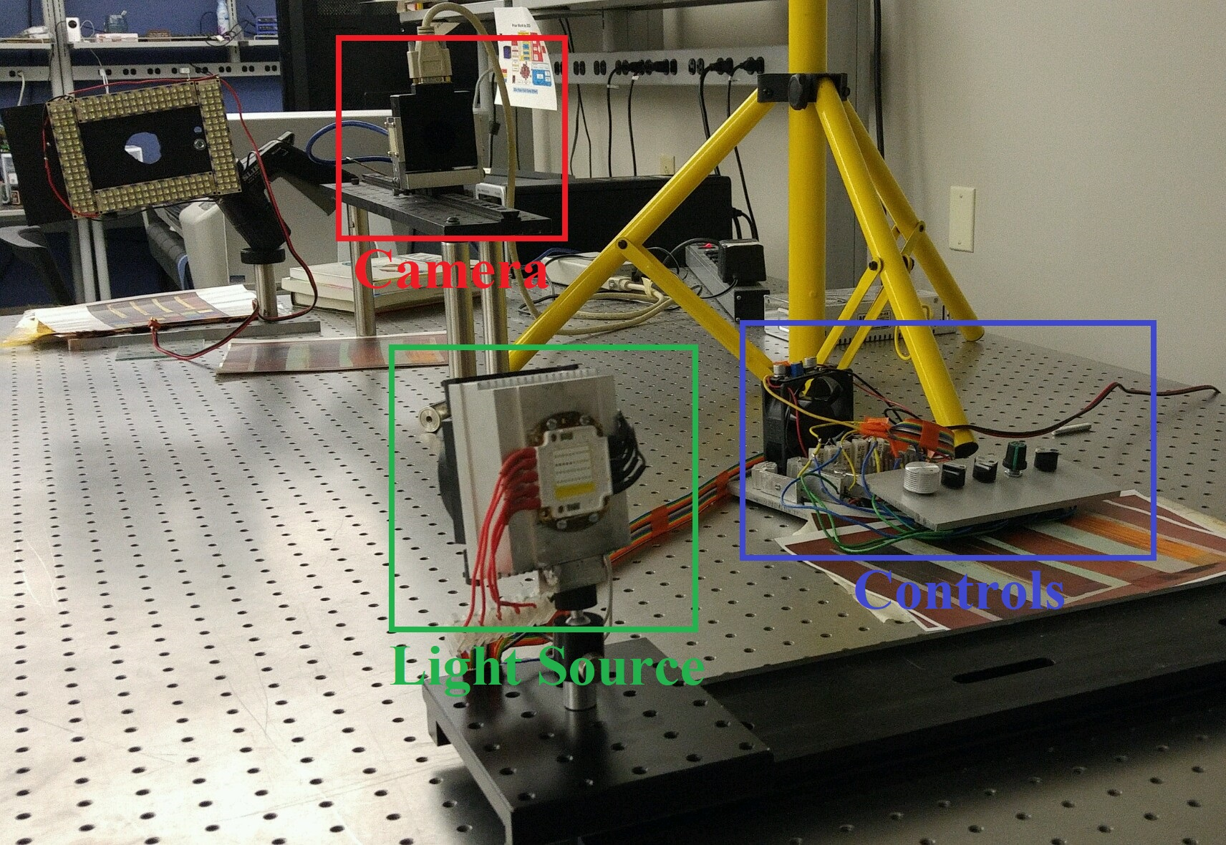
Multispectral Camera

Slide 9
Macbeth Chart Responses
Derp

Slide 10
Dataset
The camera we used can capture responses 400nm to 720nm at 1nm steps (321 responses)
For our dataset, we used responses with 10nm steps producing images with 32 spectral features
We created 10 image example sets (32 images per example). These sets are made up of clothing of various colors and fabric types

Slide 11
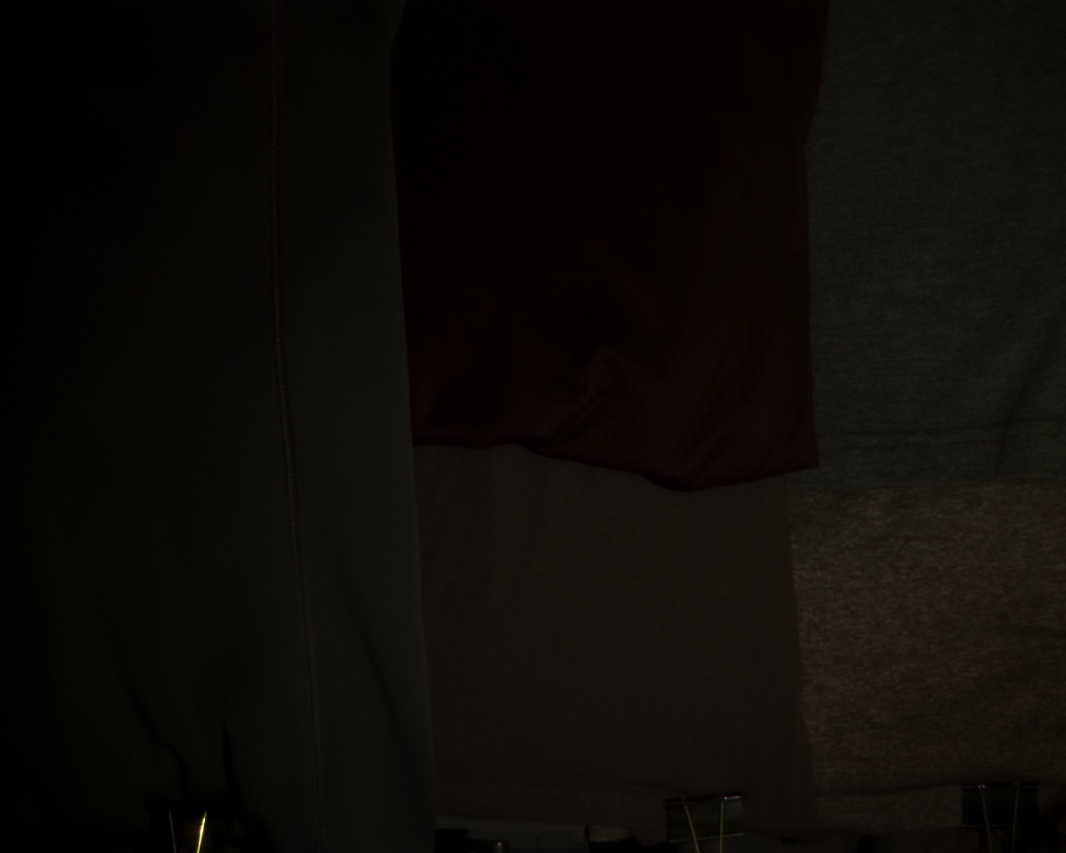
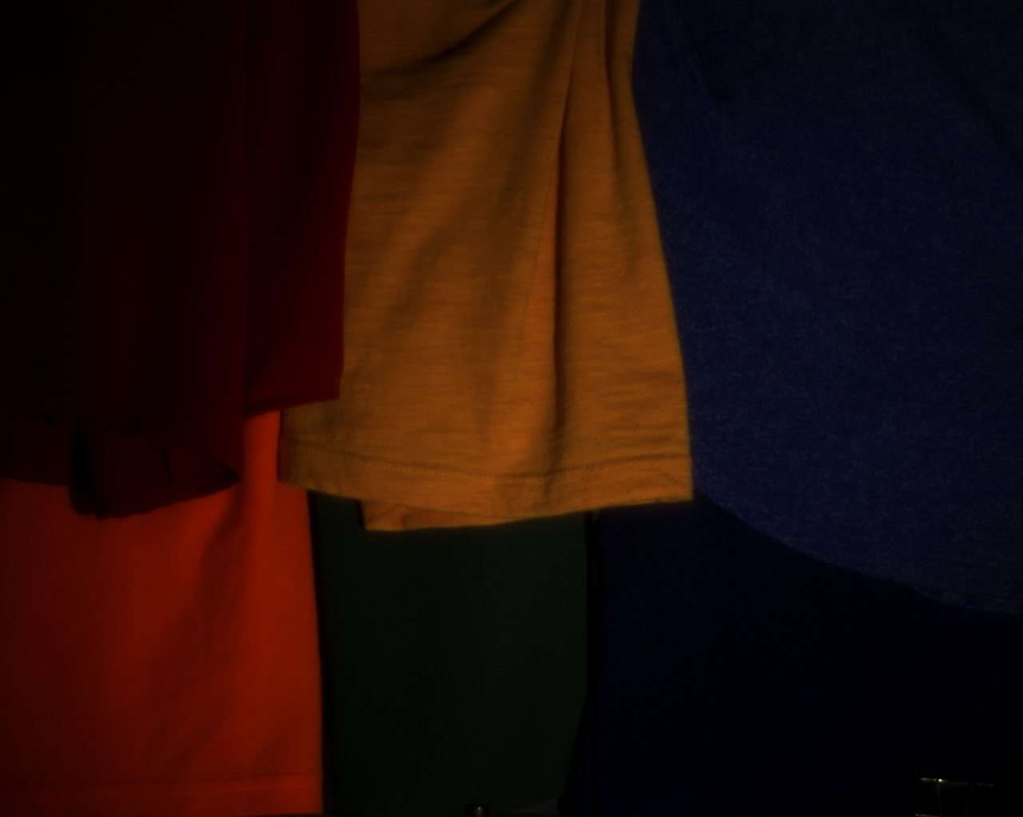
Dataset
Set 1
Grays
Set 2
Six Colors

Slide 12


Dataset
Set 3
Blues
Set 4
Orange/Red

Slide 13
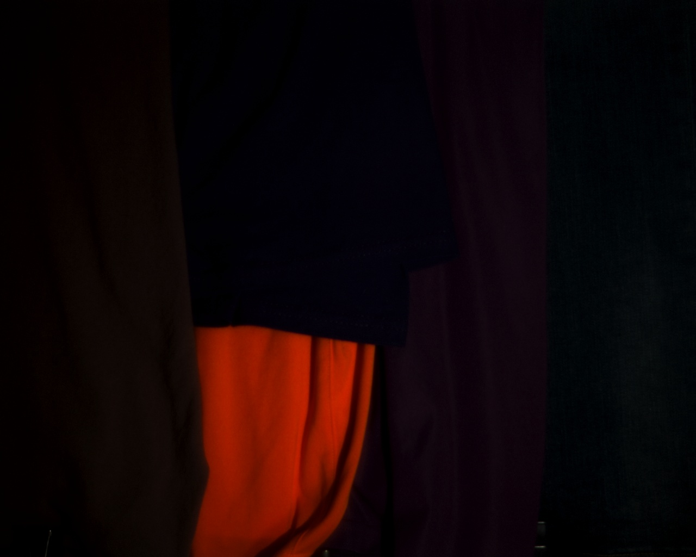
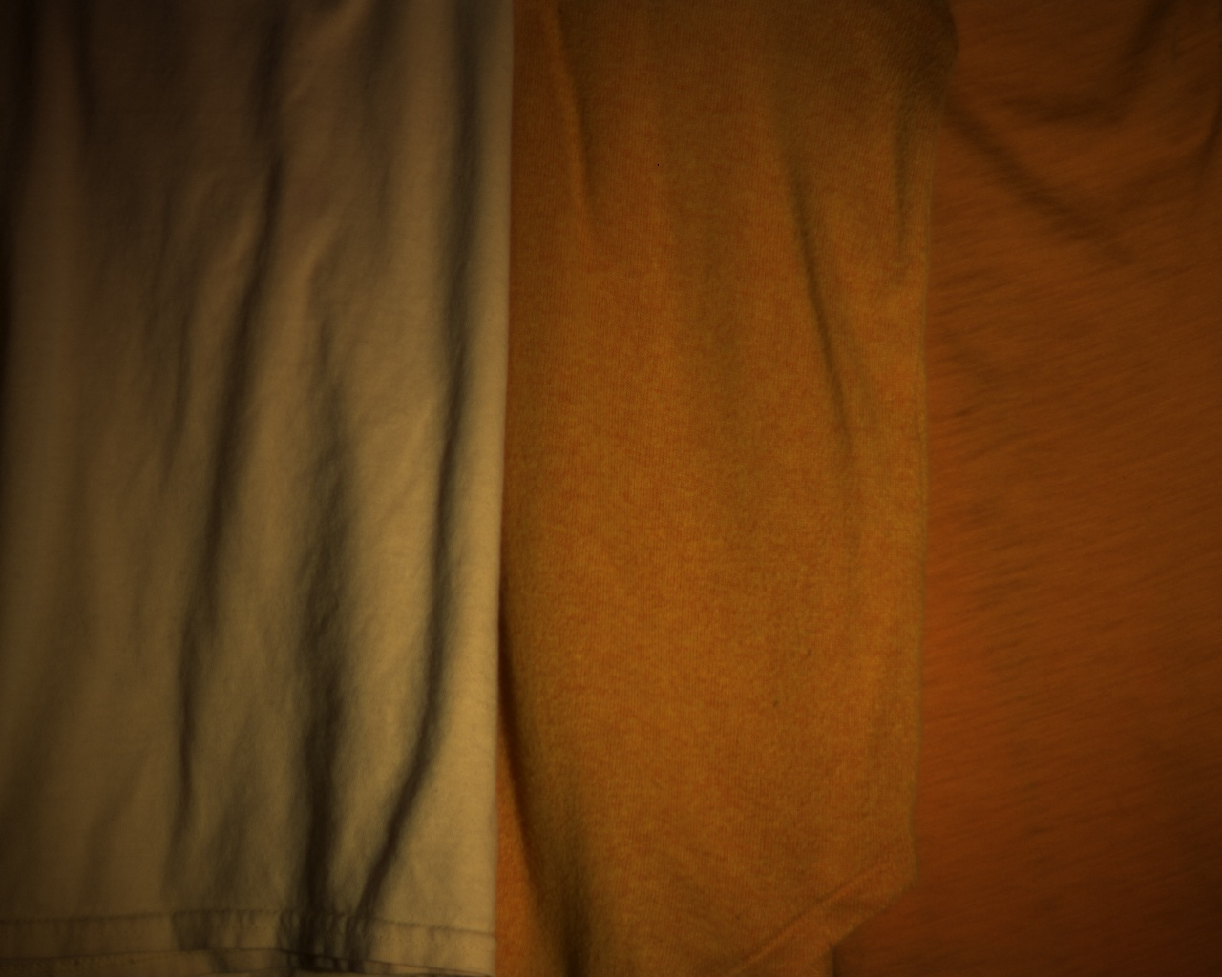
Dataset
Set 5
Jeans, Hoodie, Shirts
Set 6
Oranges

Slide 14


Dataset
Set 7
Complex Segments
Set 8
Greens

Slide 15
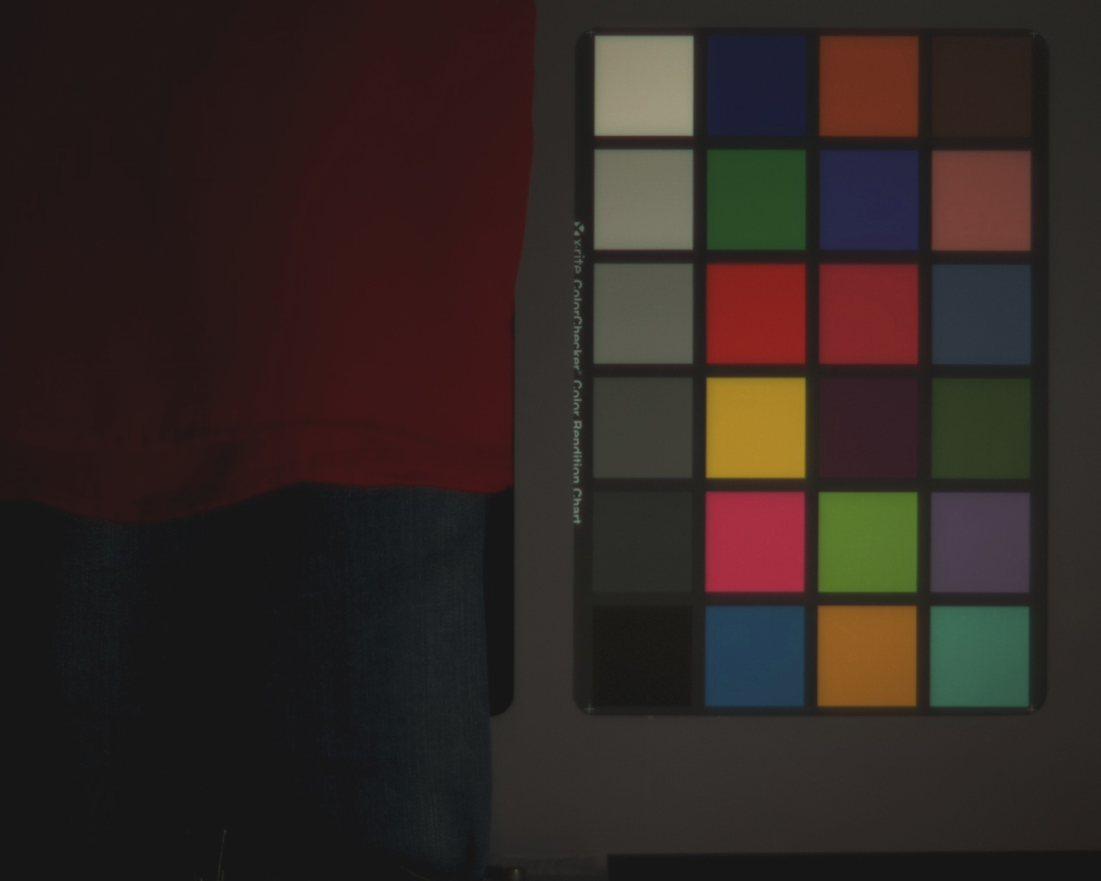
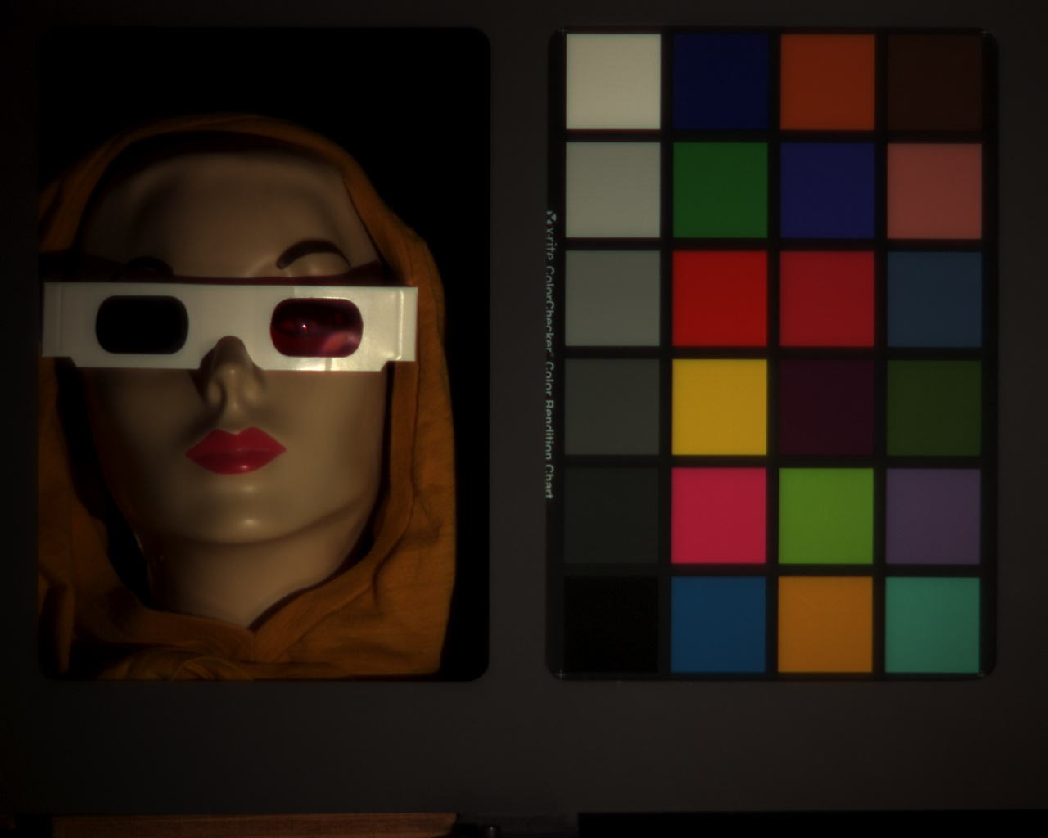
Dataset
Set 9
Jeans/Shirt, Macbeth Chart
Set 10
Lucy, Macbeth Chart

Slide 16
Segmentation Methods
Our base implementation planned on using two traditional segmentation methods:
K-means
Mean Shift
If time allows, we will also implement two others methods:
Watershed
Graph Cuts

Slide 17
Feature Spaces
Each segmentation method is tested with the following feature sets for performance comparison:
RGB
RGB + spatial
Full multispectral
Full multispectral + spatial
PCA reduced multispectral

Slide 18
Processing Pipeline
Multispectral Image Directory
Segment (K-means, Mean Shift, etc.)
Interpret RGB Image from Multispectral
Color Segments Based from Labels
Merge Channels
PCA ?

Slide 19
Engineering Considerations
The full 32 spectrum images are very large (1280 x 1024 = 1,310,720 pixels with 32 features)
Therefore, we wrapped our code in a script so that batch processing code be carried out on higher performance machine

Slide 20
Example Results
Set ? – RGB and K-means RGB

Slide 21
Project Status
Build multispectral dataset
Ground truth dataset
Multispectral to RGB equivalent
K-means code
Mean Shift code
PCA code
Pseudo color on labels to RGB equivalent
RGB segmentation results (K-mean, Mean Shift)
Multispectral results (K-means, Mean Shift)
Multispectral + spatial results (K-means, Mean Shift)
RGB + spatial results (K-means, Mean Shift)
Metrics
Stretch goals: Implement Watershed, Cross-cuts, etc. algorithms

Slide 22
References
?

Slide 23
Slide Index – Kill this eventually
Multispectral definition
Segmentation in general
Our goal – fabric color segmentation (include how this is novel)
Previous work - Summary of references (maybe after our goal)
Camera specs
Sample Images
RGB reconstruction
Dataset overview (include RGB of each) - # images, features, sets (talk about features per point per image)
Feature space 1 (multispectral responses) – Feature Space 2 (multispectral responses + spatial coordinates)
Ground truth manually (side by side with RGB)
K-means overview
Mean shift overview – how we determined a good window size
K-means full feature RGB vs Multi
Mean shift full feature RGB vs Multi
K-means PCA RGB vs Multi
Mean shift PCA RGB vs Multi
Results ??? – visual charts of some type, or at least how we plan on doing this
References

