Slide 1

INDUSTRY 4.0 · LIVE DEMONSTRATION
Smart Factory Assistant
Wokwi demonstration of AI-based predictive maintenance and intelligent job scheduling
Daniel Chidi Chimezie · Roland Bukoola
Programming II · Prof. Martin Sonntag · Hochschule Hamm-Lippstadt

Slide 2

OBJECTIVE
Demonstrating a virtual smart factory
Show how industrial sensors monitor machine health, predict failures, and intelligently schedule manufacturing jobs in a live Industry 4.0 simulation.
01
Monitor Track temperature and vibration in real time
02
Predict Calculate a health score and forecast failures
03
Alert Raise maintenance warnings before breakdowns
Automated Industry 4.0 production line
04
Schedule Assign jobs to the healthiest available machine

Slide 3
SYSTEM ARCHITECTURE
From sensors to smart decisions
SMART FACTORY ASSISTANT · C++ / Object-Oriented
Dashboard
Predictive Maintenance
Intelligent Job Scheduler
Serial / MQTT Communication
ESP32 (Wokwi Simulator)
DS18B20
Temperature
Vibration
Sensor
RGB Status
LED
OLED
Display
Servo
Motor
Buzzer

Slide 4
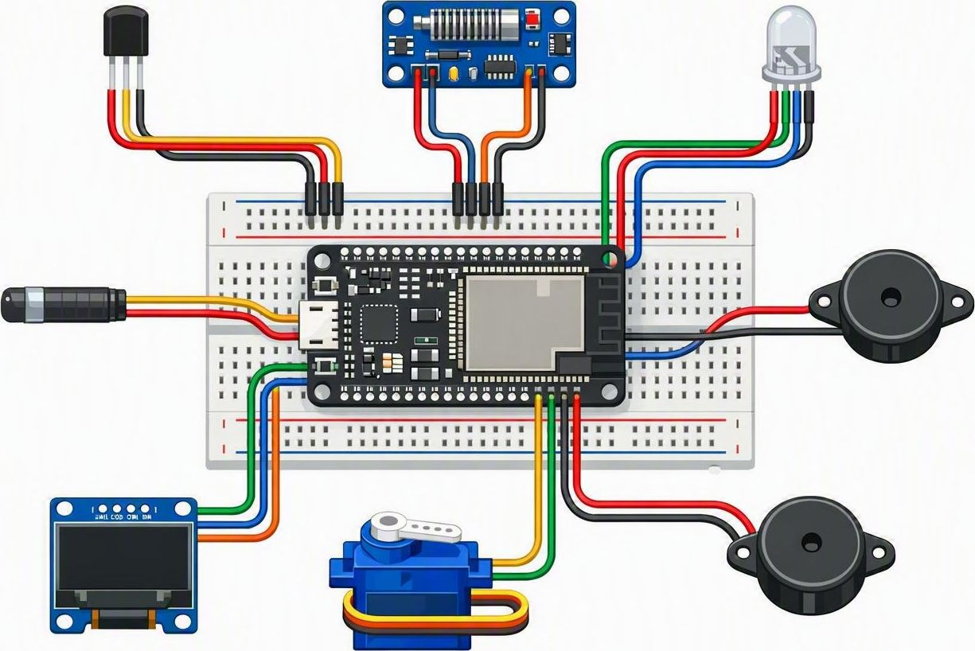
WOKWI WIRING
Components wired to the ESP32 — GPIO callouts
DS18B20 Temp.
GPIO 4 · 1-Wire
RGB Status LED
GPIO 25/26/27
Vibration Sensor
GPIO 34 · analog
Buzzer
GPIO 14 · digital
OLED Display
GPIO 21/22 · I²C
Servo Motor
GPIO 13 · PWM

Slide 5
WOKWI COMPONENTS
Hardware that powers the simulation
Component | Purpose
ESP32 | Main controller for data acquisition
DS18B20 | Measures machine temperature
Vibration Sensor | Detects abnormal machine vibration
RGB LED | Indicates machine health — green, yellow, red
OLED Display | Shows machine status and health score
Buzzer | Sounds an alarm during critical failures
Servo Motor | Simulates machine operation
7
simulated components
Status colours
● Green — healthy
● Yellow — warning
● Red — critical

Slide 6
PREDICTIVE MAINTENANCE
How the health score drives decisions
HEALTH SCORE
Health Score = 100 − ( 0.4 × Temperature Risk + 0.6 × Vibration Risk )
A lower score signals a higher likelihood of failure — alerts fire when thresholds are exceeded.
Healthy
Warning
Critical
Score 70–100
Score 40–69
Below 40
Green LED · servo running · jobs assigned freely
Yellow LED · maintenance alert raised · monitor closely
Red LED · buzzer alarm · machine excluded from scheduling

Slide 7
CLASS DESIGN
How the six C++ classes relate
Sensor
MaintenanceManager
+ readValue() : double
+ sendData() : void
- type, currentValue
+ predictFailure() : bool
+ generateAlert() : void
owns 1..*
monitors
Machine
+ calculateHealthScore()
- temperature, vibration
- healthScore, status
displays
assigns
Dashboard
runs on
Scheduler
+ render() : void
+ showAlerts() : void
Job
+ recommendMachine()
+ assignJob() : void
manages
- jobID, priority
+ getDuration() : int

Slide 8
C++ IMPLEMENTATION · 1 OF 3
Machine & Sensor classes
Each machine encapsulates its sensor readings and computes its own health score from the weighted risk formula.
class Sensor {
public:
int sensorID;
string type; // "temperature" | "vibration"
double currentValue;
double readValue(); // poll the hardware pin
void sendData(); // push over Serial / MQTT
};
class Machine {
public:
int machineID; string status; // Healthy|Warning|Critical
double temperature, vibration, healthScore;
double calculateHealthScore() {
double tRisk = clamp((temperature - 40.0) / 40.0);
double vRisk = clamp(vibration / 5.0);
healthScore = 100.0 - (0.4*tRisk + 0.6*vRisk) * 100.0;
return healthScore;
}
};

Slide 9
C++ IMPLEMENTATION · 2 OF 3
Predictive maintenance & scheduling
The maintenance manager flags failing machines, and the scheduler routes each job to the healthiest one available.
class MaintenanceManager {
public:
bool predictFailure(const Machine& m) {
return m.healthScore < 40.0; // critical threshold
}
void generateAlert(const Machine& m) {
if (m.healthScore < 70.0)
cout << "[ALERT] machine " << m.machineID;
}
};
class Scheduler {
public:
// assign the job to the healthiest eligible machine
Machine* recommendMachine(vector<Machine>& pool) {
Machine* best = nullptr;
for (auto& m : pool)
if (m.healthScore >= 70.0 &&
(!best || m.healthScore > best->healthScore))
best = &m;
return best;
}
};

Slide 10
C++ IMPLEMENTATION · 3 OF 3
ESP32 firmware in Wokwi
On the device, the ESP32 reads the sensors, drives the status outputs, and streams JSON telemetry to the assistant.
// ESP32 firmware (Wokwi) - read sensors, drive outputs
#include <OneWire.h>
#include <DallasTemperature.h>
OneWire oneWire(4);
DallasTemperature ds18b20(&oneWire);
void loop() {
ds18b20.requestTemperatures();
float tempC = ds18b20.getTempCByIndex(0);
int vib = analogRead(34); // vibration
float health = computeHealth(tempC, vib);
setStatusLed(health); // green / yellow / red
if (health < 40) tone(BUZZER, 2000); // alarm
Serial.printf("{\"temp\":%.1f,\"health\":%.0f}\n",
tempC, health); // -> Assistant
}

Slide 11
OOP PRINCIPLES
Object-oriented design in action
1
Encapsulation
2
Abstraction
Each Machine hides its raw sensor data and exposes only calculateHealthScore() — internal state stays private.
The Sensor interface defines readValue() and sendData(); callers never touch the underlying hardware details.
3
Inheritance
4
Polymorphism
TemperatureSensor and VibrationSensor extend a shared Sensor base class, reusing its common contract.
A single readValue() call resolves to the correct sensor implementation at runtime through a base pointer.

Slide 12
DEMONSTRATION WORKFLOW
From machine start to dashboard update
1
Machine starts
2
Read temperature & vibration
3
Calculate health score
4
Predict failure
7
Update dashboard
6
Assign manufacturing job
5
Generate maintenance alert
Notes:
Presenter walkthrough: 1. Start the Wokwi simulation. 2. Increase the temperature to simulate overheating. 3. Show the RGB LED changing from Green to Yellow to Red. 4. Demonstrate the buzzer activating when the machine becomes critical. 5. Explain how the C++ Smart Factory Assistant receives the sensor data. 6. Show the health score decreasing as conditions worsen. 7. Trigger a manufacturing job and explain why the scheduler selects the healthiest machine. 8. Conclude by highlighting how predictive maintenance reduces downtime and improves production efficiency.

Slide 13
LIVE DEMO SCENARIO
Watch a machine overheat — then recover
STEP 1
STEP 2
STEP 3
STEP 4
Normal
Heating up
Critical
Recovery
HEALTH
HEALTH
HEALTH
HEALTH
92
64
28
↑
Temp 38 °C
Temp 58 °C
Temp 78 °C
Temp —
Green LED
Yellow LED
Red LED
Reschedule
Servo running · jobs assigned freely.
Maintenance alert raised · monitor closely.
Buzzer alarm · machine paused immediately.
Scheduler routes the job to a healthier machine.

Slide 14
RESULTS & STACK
Expected output and technologies
Expected output
Technologies
Live sensor monitoring
✓
C++
OOP
ESP32
Machine health calculation
Wokwi Simulator
IoT Sensors
✓
Predictive Maintenance
Predictive maintenance alerts
✓
Intelligent Scheduling
Automatic job scheduling
✓
Object-oriented C++ classes — Machine, Sensor, MaintenanceManager, Job, Scheduler and Dashboard — drive the simulation logic.
Industry 4.0 smart factory simulation
✓

Slide 15

WHY IT MATTERS
Less downtime, smarter production
Predictive maintenance catches failures early, while intelligent scheduling keeps jobs flowing to the healthiest machines — a practical Industry 4.0 application built on object-oriented C++.
Daniel Chidi Chimezie · Roland Bukoola
Programming II · Hochschule Hamm-Lippstadt

