Slide 1
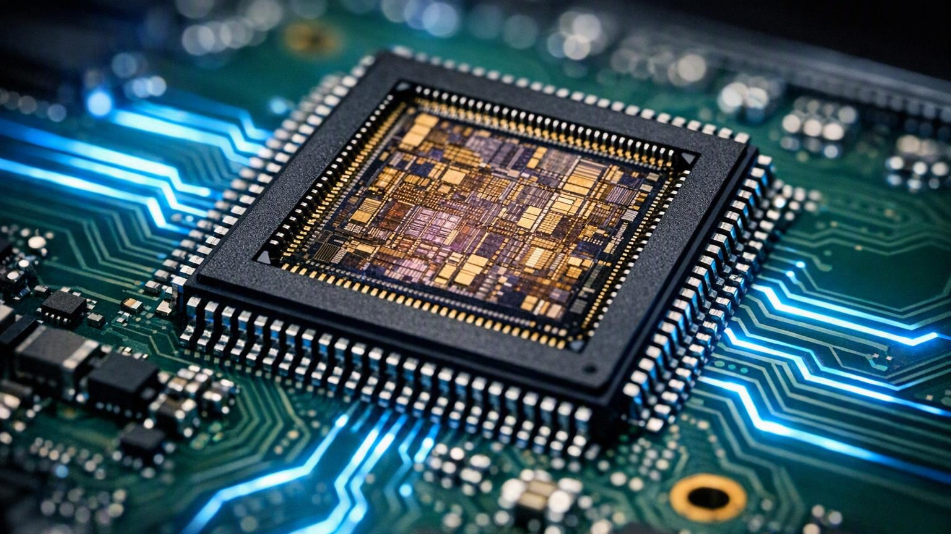
HOCHSCHULE HAMM-LIPPSTADT • EMBEDDED ELECTRONIC ENGINEERING A
Sharing and Binding within
High-Level Synthesis
Modern FPGA and ASIC Design Optimization
Student
Daniel Chidi Chimezie
Matriculation Number: 1230515
Supervisors
Prof. Dr. Achim Rettberg
Prof. Dr. Stefan Henkler
Seminar Presentation June 29, 2026
Fig. 1. FPGA package and silicon die (illustrative rendering) [I1].

Slide 2

INTRODUCTION
Introduction to High-Level Synthesis
High-Level Synthesis (HLS) automatically converts a behavioral software description into register-transfer-level hardware. [1]
Benefits
✔
Faster hardware development
C / C++ / SystemC
▼
✔
Reduced design time
Behavioral Model
▼
RTL (Verilog / VHDL)
✔
Improved productivity
✔
Easier verification
EXAMPLE
y = a*b + c*d;
↓
RTL hardware implementation
✔
Rapid design exploration
Fig. 2. C-to-RTL conversion concept (illustrative) [I2].
Sharing and Binding within High-Level Synthesis
HSHL • Seminar Presentation
2

Slide 3
DESIGN FLOW
High-Level Synthesis Design Flow
Main HLS Stages
Stage Responsibilities
Behavioral Specification
Stage | Purpose
Scheduling | Assign an execution time (control step) to each operation
Allocation | Select the type and number of hardware resources
Binding | Map operations and variables onto physical hardware
RTL Generation | Produce synthesizable Verilog / VHDL
▼
Scheduling
▼
Allocation
▼
Binding
▼
RTL Generation
▼
FPGA / ASIC
Scheduling, allocation and binding together determine the final area, latency and power of the generated hardware. [2]
Sharing and Binding within High-Level Synthesis
HSHL • Seminar Presentation
3

Slide 4

CORE CONCEPT
Resource Sharing Concept
Resource sharing lets multiple operations reuse the same physical hardware resource. [3]
WITHOUT SHARING
WITH SHARING
Area Reduction
Fewer hardware units on the die
a · b
►
Mult 1
a · b
►
Shared
Multiplier
Power Reduction
c · d
►
Mult 2
c · d
Less switching activity
Cost Reduction
Smaller FPGA / ASIC implementation
Fig. 3. Shared functional blocks (ALU / RAM) in an integrated circuit, illustrative [I3].
Sharing and Binding within High-Level Synthesis
HSHL • Seminar Presentation
4

Slide 5
TAXONOMY
Types of Resource Sharing
1
2
3
4
Functional Unit Sharing
Register Sharing
Memory Sharing
Bus Sharing
One multiplier or ALU used by multiple operations
Multiple variables stored in the same register
Common RAM / BRAM block for several arrays [4]
Shared communication / interconnect channel
Hardware Saved by Each Sharing Type
Sharing Type | Hardware Resource Saved
Functional Units | Multipliers, ALUs
Registers | Flip-flops
Memory | Block RAM (BRAM)
Buses | Interconnects / wiring
Sharing and Binding within High-Level Synthesis
HSHL • Seminar Presentation
5

Slide 6
BINDING
Binding in High-Level Synthesis
Definition. Binding maps scheduled operations and variables onto specific physical hardware resources.
SCHEDULING ANSWERS
BINDING ANSWERS
WHEN?
WHERE?
Example — Mapping Operations to a Resource
O1 = a · b
►
Both operations are bound to the same multiplier M1, executed at different clock cycles. [7]
Multiplier M1
O2 = c · d
►
Fig. 4. Datapath resources on a chip, illustrative [I3].
Sharing and Binding within High-Level Synthesis
HSHL • Seminar Presentation
6

Slide 7
ALGORITHMS
Binding Algorithms
1
2
Left-Edge Algorithm
Compatibility Graph
Commonly used for register binding; packs intervals like a colouring problem.
Operations whose lifetimes never overlap may share the same hardware.
3
4
Clique Partitioning
Heuristic Algorithms
Groups mutually compatible operations into cliques to minimise resources.
Fast approximate methods used by modern industrial HLS tools. [5], [6]
OPTIMIZATION GOAL
Minimise the number of hardware resources
Subject to no timing conflicts
Sharing and Binding within High-Level Synthesis
HSHL • Seminar Presentation
7

Slide 8
COMPARISON
Scheduling vs Binding
Feature | Scheduling | Binding
Main Goal | Assign execution time | Assign hardware resource
Input | Data-flow graph (DFG) | Scheduled DFG
Output | Control steps | Resource mapping
Constraints | Data dependencies | Resource conflicts
Optimizes | Latency | Area
Key Difference
SCHEDULING
WHEN?
BINDING
WHERE?
Scheduling fixes timing while binding fixes hardware assignment — the two stages cooperate to trade latency against area.
Sharing and Binding within High-Level Synthesis
HSHL • Seminar Presentation
8

Slide 9
WORKED EXAMPLE
Practical Example
Original C Code
y = a*b + c*d;
WITHOUT SHARING
WITH SHARING
Hardware
Hardware
Mult M1
Mult M2
Adder A1
Shared Mult
MUX
Adder
Resources used
Resources used
2 Multipliers 1 Adder
1 Multiplier 1 MUX 1 Adder
Larger silicon footprint and higher power — every multiply needs its own DSP block.
One multiplier is time-multiplexed by a MUX — saving a full DSP block at the cost of a little control logic.
Sharing and Binding within High-Level Synthesis
HSHL • Seminar Presentation
9

Slide 10
RESULTS
Resource Utilization Comparison
Resource | No Sharing | Sharing
Multipliers | 2 | 1
Adders | 1 | 1
MUX | 0 | 1
DSP Blocks | 2 | 1
Area | High | Low
Power | High | Lower
Hardware Units: No Sharing vs Sharing
✔
Result. Resource sharing roughly halves multiplier and DSP-block usage, significantly reducing FPGA utilization, area and power.
Sharing and Binding within High-Level Synthesis
HSHL • Seminar Presentation
10

Slide 11
ARCHITECTURE
RTL Architecture after Binding
Shared Datapath
Controller FSM
a, b
►
MUX
State 1
1
Compute a · b
c, d
►
▼
▼
2
State 2
Shared Multiplier
Compute c · d
▼
▼
Adder
3
State 3
Perform addition → y
▼
y
The FSM sequences the shared datapath so one multiplier serves both products across clock cycles.
Sharing and Binding within High-Level Synthesis
HSHL • Seminar Presentation
11

Slide 12

WRAP-UP
Conclusion and Discussion
Key Takeaways
Future Research
IEEE References
✔
HLS transforms high-level code into RTL
[1] D. Gajski et al., High-Level Synthesis: Introduction to Chip and System Design.
[2] P. Coussy and A. Morawiec, High-Level Synthesis.
[3] C. Bobda, Introduction to Reconfigurable Computing.
[4] J. Cong et al., “High-Level Synthesis for FPGAs.”
[5] AMD Xilinx Vivado HLS User Guide.
[6] Intel HLS Compiler User Guide.
[7] S. Gupta et al., “SPARK: A High-Level Synthesis Framework.”
✔
Sharing reduces area and power
✔
Binding determines hardware assignment
•
AI-assisted HLS
•
ML-based binding
✔
Scheduling and binding work together
•
Power-aware scheduling
•
FPGA accelerator optimization
✔
Essential for FPGA / ASIC optimization
Discussion Questions
Challenges
1
Why is sharing important in FPGA design?
✖
Additional multiplexers
2
Can excessive sharing reduce performance?
✖
More control logic
3
How does binding affect latency?
Image figures are illustrative renderings: [I1]–[I3] generated for this presentation.
✖
Increased latency
4
What trade-off exists between area and speed?
Sharing and Binding within High-Level Synthesis
HSHL • Seminar Presentation
12

Slide 13
Declaration of AI Usage and Originality
I hereby declare that this coursework and presentation are my own academic work and were prepared under my personal responsibility.
During the preparation of this work, I used ChatGPT Pro as an assistive tool for tasks such as structuring ideas, summarizing concepts, and reviewing drafts. The AI tool was not used as a substitute for my own academic judgment, analysis, or understanding of the subject matter.
All technical content, interpretations, conclusions, design decisions, calculations, and final submissions were reviewed, verified, and approved by me. Where applicable, information generated with AI assistance was checked against course materials, scientific literature, official documentation, or other reliable sources before inclusion in the final work.
I accept full responsibility for the accuracy, originality, integrity, and academic quality of the submitted work. This declaration is provided in accordance with the transparency requirements regarding the use of Artificial Intelligence tools in higher education and the applicable guidelines of Hochschule Hamm-Lippstadt and the State of North Rhine-Westphalia (NRW).
Student: Daniel Chidi Chimezie Matriculation Number: 1230515 University: Hochschule Hamm-Lippstadt
Course: Embedded Electronic Engineering A
Date: June 23, 2026

