Slide 1

IEEE 802.3cg · 10BASE-T1L
Advanced Physical Layer Ethernet
Ethernet-APL
Bringing Ethernet into Hazardous Process Industries
Daniel Chidi Chimezie (1230515)
Bertrand Mungu Cho (2220052)
Stephen Uzochi Obuh (2210044)
Riwaj Ghimire (1232171)
Hamm-Lippstadt University of Applied Sciences
Notes:
Title slide. Introduce the topic: Ethernet-APL — Advanced Physical Layer Ethernet — and the goal of bringing standard Ethernet directly into hazardous process industries such as chemical and oil & gas plants. Introduce the four authors and Hamm-Lippstadt University of Applied Sciences. One-line hook: for the first time, a single twisted pair can deliver Ethernet speed AND intrinsic safety into explosive zones.

Slide 2
Why Do We Need Ethernet-APL?
02
THE PROBLEM — legacy field communication
INDUSTRY 4.0 REQUIRES
Technology | Limitation
4–20 mA | One value only
HART | Very slow
PROFIBUS PA | Limited bandwidth
✓ Diagnostics
✓ Cloud connectivity
✓ Predictive maintenance
✓ Digital twins
4–20 mA
→
HART
→
PROFIBUS PA
→
Ethernet-APL
evolution toward Ethernet in the field
Notes:
Traditional process plants still rely on legacy field communication. 4–20 mA carries only a single value per wire. HART adds digital data but is very slow. PROFIBUS PA is digital but bandwidth-limited. Meanwhile Industry 4.0 demands rich diagnostics, cloud connectivity, predictive maintenance and digital twins — none of which legacy buses can deliver. The bottom strip frames the whole talk: an evolution from analog current loops toward true Ethernet in the field with Ethernet-APL.

Slide 3
Evolution of Industrial Communication
03
1960
1989
1990s
2022
4–20 mA
HART
PROFIBUS PA
Ethernet-APL
Analog current loop — one value per wire.
Digital data over the analog loop; slow.
Digital fieldbus; limited bandwidth.
Ethernet speed + intrinsic safety.
Key message: Ethernet-APL is the first technology that combines Ethernet speed with intrinsic safety.
Notes:
Walk the audience along six decades of field communication. 1960: the 4–20 mA analog current loop — robust but one value per wire. 1989: HART overlays digital data on that loop, but slowly. 1990s: PROFIBUS PA brings a true digital fieldbus, yet with limited bandwidth. 2022: Ethernet-APL arrives. The key message to land: Ethernet-APL is the first technology that combines full Ethernet speed with intrinsic safety for explosive areas.

Slide 4
Ethernet-APL Architecture
04
CLOUD
TRUNK
ERP
Backbone segment
1000 m · 10 Mbps
SCADA
POWER SWITCH
TRUNK
SPUR
Branch to field devices
200 m · Zone 0 capable
FIELD SWITCH
Sensor
Valve
Transmitter
Hierarchy from enterprise cloud down to intrinsically-safe field devices.
Notes:
This is the anchor slide. Read the architecture top to bottom: business systems in the Cloud, then ERP, then SCADA supervision, down to the Power Switch that feeds the network. The Trunk is the high-power backbone — up to 1000 m at 10 Mbps. From the Field Switch, short Spurs (up to 200 m) reach the actual sensors, valves and transmitters, and these spurs are Zone 0 capable, meaning they can run inside the most hazardous explosive atmospheres. One infrastructure carries both data and power all the way to the field.

Slide 5
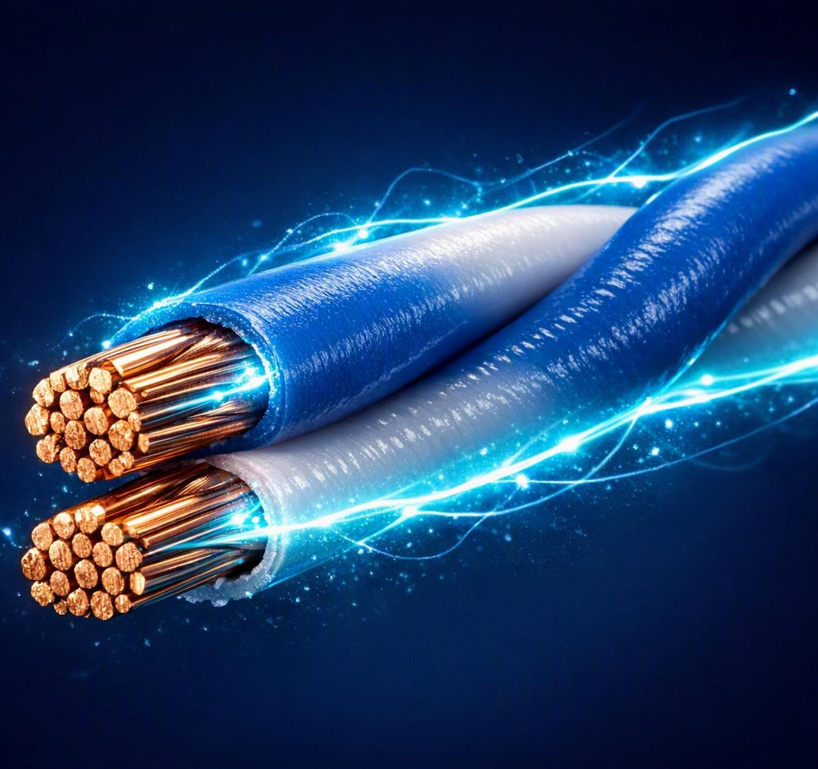
How Ethernet-APL Works
05
IEEE 802.3cg
10BASE-T1L physical layer
✓
Single Pair Ethernet (one twisted pair)
✓
10 Mbps data rate
✓
Full-duplex communication
✓
Up to 1000 m reach
Single Pair Ethernet — power + data on one twisted pair
Power + data on the same cable
✓
Notes:
Ethernet-APL is defined by the IEEE 802.3cg standard and uses the 10BASE-T1L physical layer. The key ideas: it is Single Pair Ethernet — just one twisted pair instead of four — running at 10 Mbps full-duplex, reaching up to 1000 m, and carrying both power and data on that same pair. So a single cable energises the field device and exchanges Ethernet frames with it. The cross-section image shows that single twisted pair carrying both energy and signal.

Slide 6
Why Hazardous Areas Are Difficult
06
ZONE CLASSIFICATION
✕ Standard Ethernet can't operate safely
Zone | Meaning
Zone 0 | Always explosive
Zone 1 | Sometimes explosive
Zone 2 | Rarely explosive
• Too much energy
• Not intrinsically safe
• RJ45 connector unsuitable
✓ Ethernet-APL solves this
Hazardous zones are ranked by how often an explosive atmosphere is present.
Energy-limited single pair, intrinsically safe by design, purpose-built for Zone 0–2.
Notes:
Process plants are classified into hazardous zones by how often an explosive atmosphere exists: Zone 0 is always explosive, Zone 1 sometimes, Zone 2 rarely. Standard office Ethernet simply cannot run there — it carries too much energy, it is not intrinsically safe, and the RJ45 connector is unsuitable for the environment. A single spark could ignite the atmosphere. Ethernet-APL was engineered specifically to solve this: it limits energy on a single pair and is intrinsically safe by design, so it can reach into Zone 0.

Slide 7
Intrinsic Safety — 2-WISE
07
2-Wire Intrinsically Safe Ethernet
HOW IT WORKS
High Energy
Explosion
✕
1
Based on IEC TS 60079-47 the 2-WISE technical specification
2
Limits voltage and current energy kept below ignition threshold
▼
Low Energy
Safe Operation
✓
3
Prevents ignition no spark can release enough energy
ATEX
IECEx
Zone 0 certified
Notes:
Intrinsic safety is the heart of Ethernet-APL, implemented through 2-WISE — 2-Wire Intrinsically Safe Ethernet — based on the IEC TS 60079-47 specification. The principle is simple but powerful: strictly limit the voltage and current on the wire so the available energy always stays below what is needed to ignite the atmosphere. High energy could create a spark and an explosion; by keeping energy low, operation stays safe even in Zone 0. This is what earns ATEX, IECEx and Zone 0 certification. This concept is exactly what examiners like to probe.

Slide 8
Comparison at a Glance
08
Feature | HART | PROFIBUS PA | Ethernet-APL
Speed | 1.2 kbps | 31.25 kbps | 10 Mbps
Ethernet | No | No | Yes
Cloud Ready | No | Limited | Yes
Industry 4.0 | Poor | Medium | Excellent
Ethernet-APL outperforms legacy fieldbuses on every dimension that matters for Industry 4.0.
Notes:
This single table communicates roughly half of the paper. Across every dimension Ethernet-APL leads: 10 Mbps versus 1.2 kbps for HART and 31.25 kbps for PROFIBUS PA — that is roughly a thousand-fold jump. It is real Ethernet, where the others are not; it is fully cloud-ready where HART is not and PROFIBUS only partly; and its Industry 4.0 fit is excellent where the legacy buses are poor or medium. If the audience remembers one slide, it should be this one.

Slide 9







Industry 4.0 Impact
09
Ethernet-APL unlocks the connected, data-rich field that Industry 4.0 depends on.
Digital Twin
OPC-UA
Asset Management
Predictive Maintenance
Cloud Analytics
AI at Field Devices
Notes:
Because Ethernet-APL puts genuine Ethernet at the field device, it directly enables the Industry 4.0 toolbox: high-fidelity Digital Twins fed by live field data; OPC-UA as the common information model from sensor to cloud; richer Asset Management; Predictive Maintenance from continuous diagnostics; Cloud Analytics on plant-wide data; and even AI running at the field device itself. This corresponds to Section VIII of the paper — the move from isolated measurements to a fully connected, intelligent plant.

Slide 10
Future Technologies
10
01
02
100BASE-T1L
OPC-UA TSN
10× faster single-pair Ethernet
Deterministic real-time Ethernet
03
04
5G + Ethernet-APL
Edge AI
Hybrid wired & wireless networks
Local intelligence at the device
Notes:
Ethernet-APL is a foundation, not an endpoint. Four directions to watch: 100BASE-T1L, the next single-pair step at roughly ten times the speed; OPC-UA over TSN, adding deterministic, real-time scheduling on standard Ethernet; the pairing of 5G with Ethernet-APL into hybrid wired-and-wireless plant networks; and Edge AI, pushing intelligence right down to the field device. Together these extend the same single-pair philosophy toward faster, smarter, more autonomous plants.

Slide 11
Conclusion
11
Ethernet-APL brings Ethernet directly into hazardous areas.
1
Delivers 10 Mbps over 1000 m using one cable pair.
2
A foundation technology for Industry 4.0 and IIoT.
3
Notes:
Three takeaways to close on. First, Ethernet-APL brings standard Ethernet directly into hazardous areas that were previously off-limits to it. Second, it delivers 10 Mbps over up to 1000 m using just one twisted cable pair carrying both power and data. Third, it is a foundation technology for Industry 4.0 and the Industrial IoT — the physical layer that finally connects the field to the cloud safely. Invite questions after this slide.

Slide 12

Thank You
Questions?
Anticipated examiner questions
Q1
Why not simply use Wi-Fi or 5G?
Q2
Why is intrinsic safety necessary?
Q3
How does it differ from standard Ethernet?
Q4
Why is 10 Mbps sufficient?
Q5
What role does OPC-UA play?
Q6
Can it fully replace PROFIBUS PA?
Notes:
Closing slide and Q&A. Likely examiner questions and crisp answers: Q1 Why not Wi-Fi or 5G? Wireless cannot guarantee intrinsic safety, deterministic timing or wired power to field devices, and radio is hard to certify for Zone 0. Q2 Why intrinsic safety? In explosive atmospheres the wiring energy itself must be incapable of igniting gas; 2-WISE caps voltage and current below the ignition threshold. Q3 Difference from standard Ethernet? Single twisted pair at 10 Mbps with power, 1000 m reach, energy-limited and intrinsically safe — not 4-pair RJ45 office Ethernet. Q4 Why is 10 Mbps enough? Process measurements are low-bandwidth; 10 Mbps is orders of magnitude beyond fieldbuses and ample for diagnostics, plus distance and safety matter more than raw speed. Q5 Role of OPC-UA? It is the standard information model and semantic layer carried over Ethernet-APL, giving interoperable field-to-cloud data. Q6 Replace PROFIBUS PA? Technically it is the successor, but migration is gradual; PROFIBUS PA installations will coexist for years before full replacement.

