Slide 1
Hnefatafl
BetterByte
Carson Tunnell
Dan McClure
John Pokorski
Hayden Cannalte
Devin Dennis

Slide 2


Slide 3


Slide 4
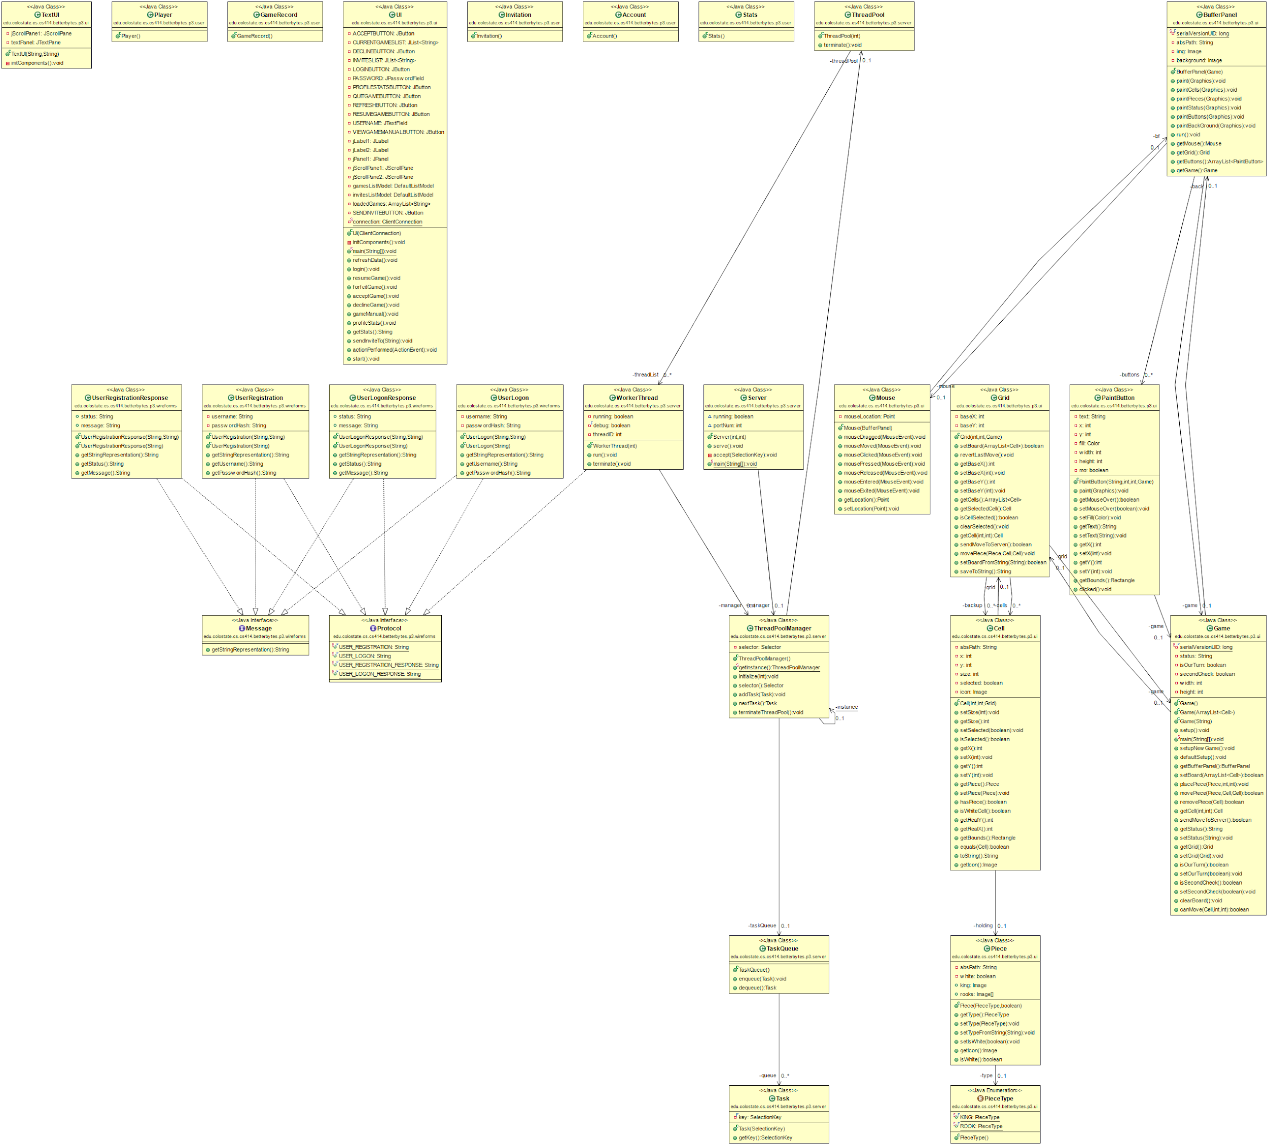

Slide 5
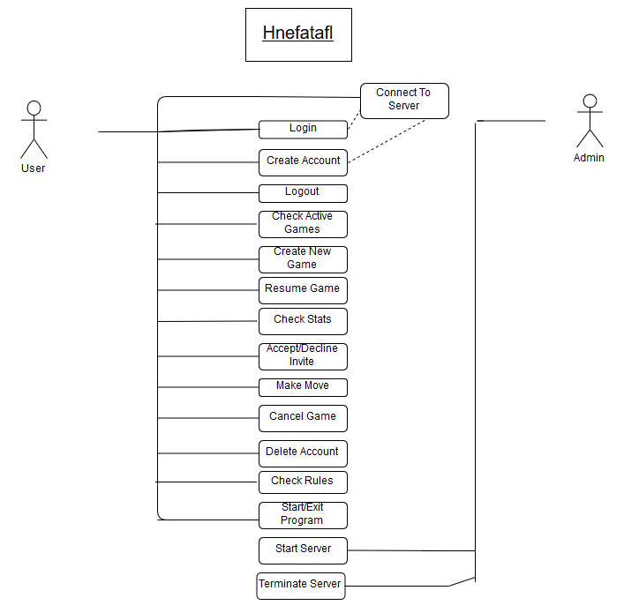

Slide 6
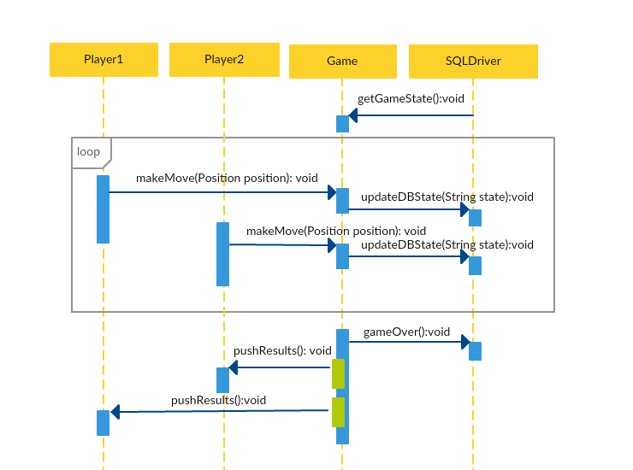

Slide 7
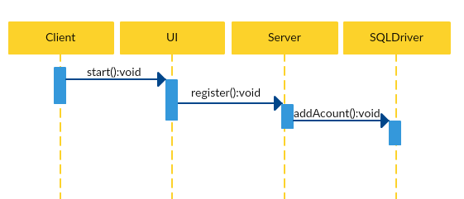

Slide 8
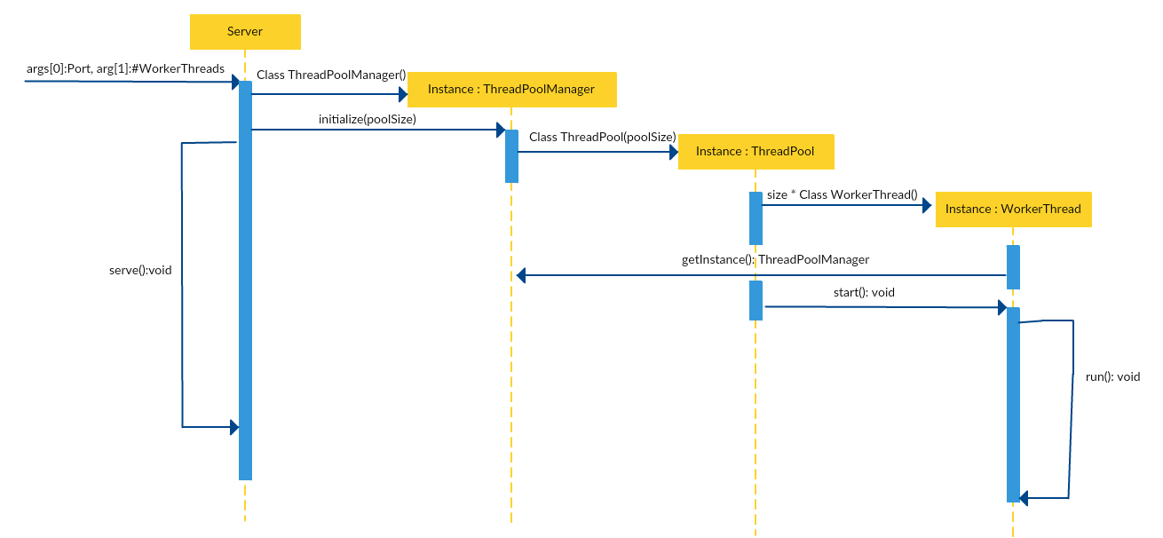

Slide 9
Database and Storage
MySQL
Allows storage to be saved when server is offline
Standard access through SQL statements
Simple to use and easy to manage
Can be synced on a CS machine to keep all data the same
Custom Storage
Must be saved when server is shutdown
Will be a proprietary format for our project
Hard to navigate and manage
Lots of extra overhead to code and maintain

Slide 10
GUI Demo

