Slide 1
Gitorial
Introduction to Github

Slide 2
Overview
Talk about what git and Github are
Go over a basic git workflow
Mess around with branching
Hopefully have time for some group collaboration

Slide 3
What is git?
Version Control System
Stores snapshots of your work over time
Local to your computer

Slide 4
What is Github?
Website where you can host Git repositories
Github is remote (not on your computer)
Github or some alternative like SVN is good/essential for code collaboration

Slide 5
Why use Github?
If you make a mistake, you can go back
If your computer fails, your code is on Github
If you want to work with others, you can

Slide 6
Setting up a remote repository

Slide 7
Step Zero: Get an account
If you didn’t do this, that’s ok, but you may want to now.
Unless you just want to hear me talk. That’s okay too.

Slide 8
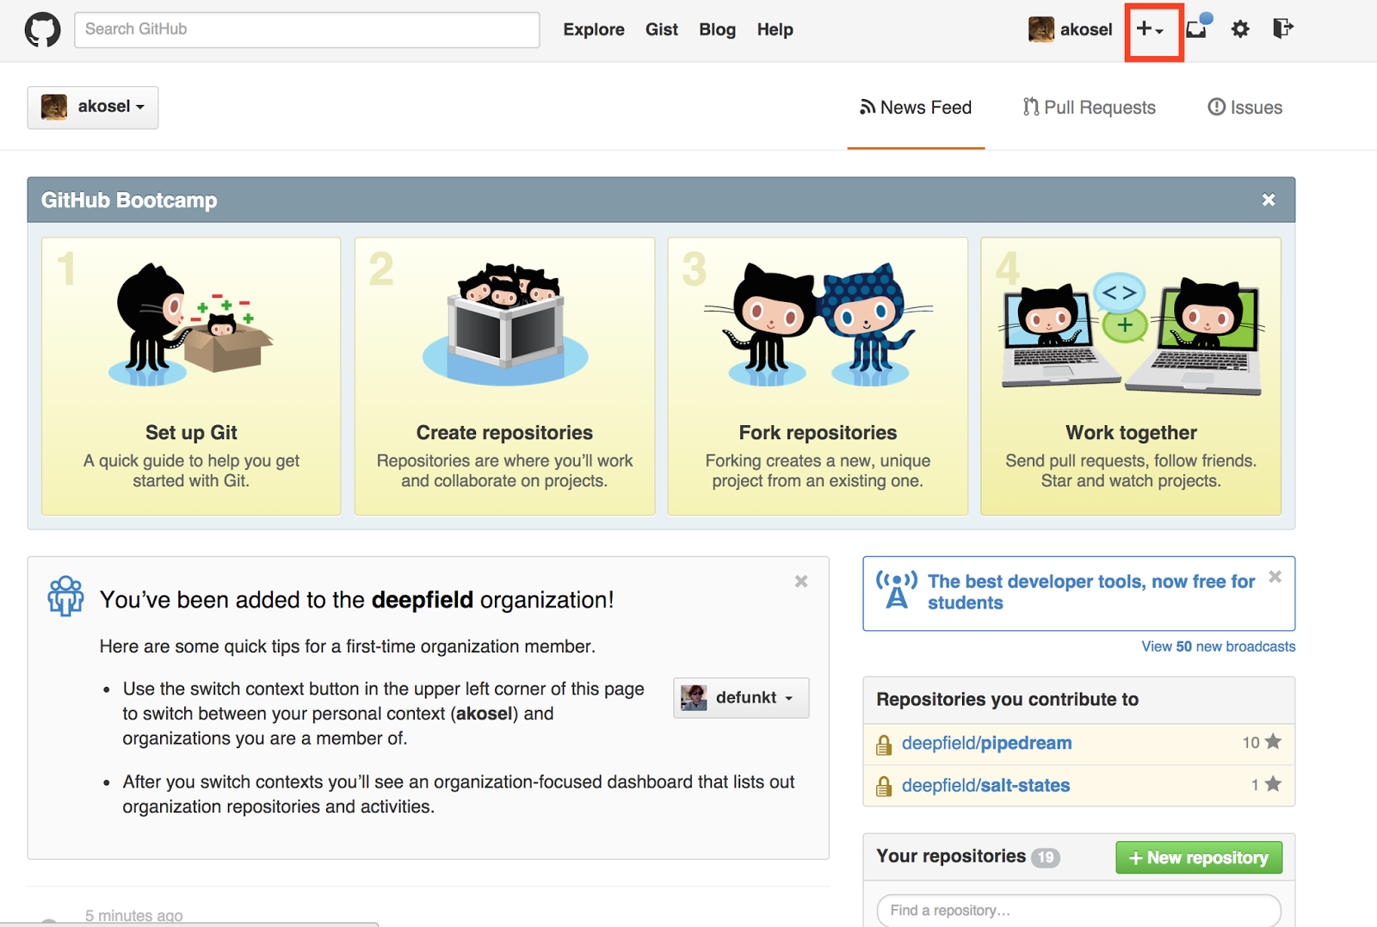
Step One: Add a repository

Slide 9
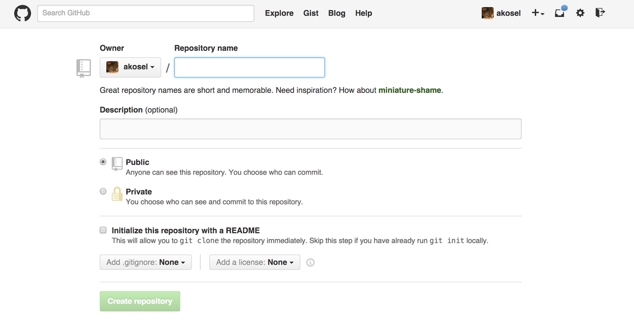
Step Two: Give it a name

Slide 10
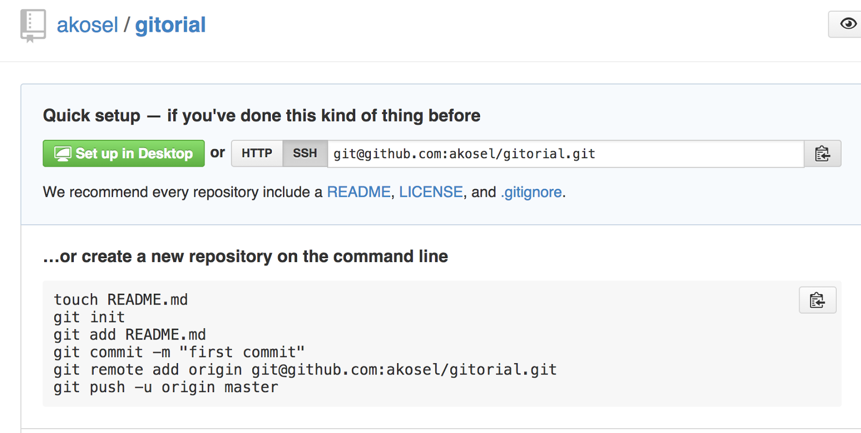
Step Three: You are all set on Github

Slide 11
Set up a local repository

Slide 12
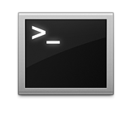
Head to the command line
MAC: Cmd-spacebar “Terminal”
(or go to Applications > Utilities > Terminal)
Windows: In search box, type “powershell”
Linux: Ctrl + Alt + T

Slide 13
git config
git config --global user.name “Aaron Kosel”
git config --global user.email “a_kosel@yahoo.com”

Slide 14
git init
mkdir ~/gitorial
cd ~/gitorial
git init
creates a local repository

Slide 15
git status
git status
get the status of your repo, useful for seeing what files have changed since your last commit

Slide 16
Github has no knowledge that the local repository even exists
Your local repository doesn’t know that the remote repo even exists
Remote Repo (also called gitorial)
Local Repository
(called gitorial)

Slide 17
Connect the two together

Slide 18
Make your first commit
touch README.md (PS: echo $null > README.md)
(git status, if you are curious)
git add README.md
Tells git to track README, putting it into a staging area
(git status, if you are curious)
git commit -m ‘Initial commit’
Records the snapshot, with the associated message ‘Initial commit’
(git status, if you are curious)

Slide 19
Local Repository
(called gitorial)
Remote Repo (also called gitorial)
Locally, you are are still here, but git knows something is different
Remote repo still doesn’t know anything!
Initial commit

Slide 20
Connect to the remote gitorial
git remote add origin git@github.com:akosel/gitorial.git
tells our local repository that it should connect with the remote repository
(git remote -v, if curious)
git push -u origin master -- two things happen here!
git push origin master says that the local changes should be added to the location we set as the origin and specifically to the branch called master
-u flag sets the upstream as origin, which means you can now simply type ‘git push’ to push

Slide 21
Remote Repo (also called gitorial)
Local Repository
(called gitorial)
Remote repo now knows about the initial commit
Locally, you are are here
Initial commit

Slide 22
Update the README
open README.md (PS: type README.md, hit enter)
Write anything you want. For example, ‘I love learning!’
Save and close the file
(git status, if you are curious)
git add README.md
git commit -m ‘Updated readme’

Slide 23
Remote Repo (also called gitorial)
Local Repository
(called gitorial)
Remote repo only knows about the initial commit, not the update to the README
Locally, you are now here
Initial commit
Updated README

Slide 24
Push to remote
(git status, if you are curious)
git push (origin master)

Slide 25
Local Repository
(called gitorial)
Remote Repo (also called gitorial)
Remote repo is now in sync with your local repository
Locally, you are still in the same place
Initial commit
Updated README

Slide 26
Intro to Branching

Slide 27
What is branching?
Allows you to work on different features without affecting the main codebase
Useful when you want to keep what you are working on separate from what other people are working on
Remember! Master is also a branch. Everything is a branch in git. Master is just a special branch by convention, but there is nothing magical about it.

Slide 28
Make a branch
git branch foo
tells git to create a new branch (based off of master)
(git status, if you are curious)
git checkout foo
moves the HEAD pointer from the master branch to the foo branch. now any changes we make will be tracked on the foo branch rather than the master branch
(git status, if you are curious)

Slide 29
Both branches are pointing to the same commit, but the current branch is now foo
Any changes you make will be made off of foo
All of this is local, so I am excluding the laptop and server icons
master (was current branch)
Initial commit
Updated README
foo (current branch)

Slide 30
Add a new file
Add a file. Any file. It can be empty, but do what you will
git add .
the dot is a nice little shortcut that adds all of the files that have changed.
git commit -m ‘Added a file’

Slide 31
Current Commit Graph
master (still here)
Initial commit
Updated README
Added a file
foo (current branch)

Slide 32
git checkout master
master (now current branch)
Initial commit
Updated README
Added a file
foo (not current branch)

Slide 33
Create a file, add it, commit it. (If you need a refresher, review slide 28)
master (current branch and now it is here)
Initial commit
Updated README
Added a different file
Added a file
foo (still here)

Slide 34
git merge foo
merge will incorporate changes from the target branch
master (still current branch and now here)
Initial commit
Updated README
Added a different file
Merge branch ‘foo’ into master
git push
publish your commits
Added a file
git log
this shows you the history of commits. you should see everything featured on this picture
foo (still here)

Slide 35
GROUP TIME!

Slide 36
Things to do
add collaborators to your repository via the Github site. see if they can push to your repository and you can pull down the change
mess around with branching and merging, see if you can create a merge conflict!
check out .gitignore. try to figure out what it does and why it might be useful.

Slide 37
There is a lot we didn’t cover
This week, we will have a time set aside to work on things we didn’t cover, or give you a chance to ask questions, or just a place to work on things together related to Github, or anything.
5pm-7pm @ lab on liberty (if there is space, otherwise ERC on State St)

Slide 38
Resources
Become a Git Branch Master
http://pcottle.github.io/learnGitBranching/
Github Cheatsheet
https://training.github.com/kit/downloads/github-git-cheat-sheet.pdf
Github Project Management Tool
Waffle.io · Work Better on GitHub Issues

