Slide 1
Masking Input
學 | 0.1
灣 | 0.7
台 | 0.1
大 | 0.1
…… | ……
https://arxiv.org/abs/1810.04805
softmax
=
(special token)
Linear
MASK
(all characters)
or
=
Random
一、天、大、小 …
Transformer
Encoder
BERT
Randomly masking some tokens
台
灣
大
學

Slide 2
Masking Input
Ground truth
https://arxiv.org/abs/1810.04805
minimize cross entropy
softmax
灣
=
(special token)
Linear
MASK
or
=
Random
一、天、大、小 …
Transformer
Encoder
BERT
Randomly masking some tokens
台
灣
大
學

Slide 3
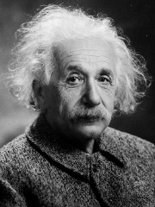
Next Sentence Prediction
This approach is not helpful.
Linear
Robustly optimized BERT approach (RoBERTa)
Yes/No
(句子是否相接)
https://arxiv.org/abs/1907.11692
SOP: Sentence order prediction
Used in ALBERT
https://arxiv.org/abs/1909.11942
BERT
[CLS]
w₁
w₂
[SEP]
w₃
w₄
w₅
Sentence 1
Sentence 2
Notes:
[CLS] stands for classification.

Slide 4

BERT
Self-supervised Learning
Masked token prediction
Next sentence prediction
Pre-train
Fine-tune
Model for Task 1
Model for Task 2
Model for Task 3
Downstream Tasks
The tasks we care
We have a little bit labeled data.
Notes:
Downstream Tasks : the task you really want to solve
Better than directly using labeld data

Slide 5
GLUE
General Language Understanding Evaluation (GLUE)
https://gluebenchmark.com/
Corpus of Linguistic Acceptability (CoLA)
Stanford Sentiment Treebank (SST-2)
Microsoft Research Paraphrase Corpus (MRPC)
Quora Question Pairs (QQP)
Semantic Textual Similarity Benchmark (STS-B)
Multi-Genre Natural Language Inference (MNLI)
Question-answering NLI (QNLI)
Recognizing Textual Entailment (RTE)
Winograd NLI (WNLI)
GLUE also has Chinese version (https://www.cluebenchmarks.com/)
Notes:
COLA: Each example is a sequence of words annotated with whether it is a grammatical English sentence
MRPC: with human annotations for whether the sentences in the pair are semantically equivalent
QQP:o determine whether a pair of questions are semantically equivalent.
STS: Each pair is human-annotated with a similarity score from 1 to 5; the task is to predict these scores

Slide 6
How to use BERT – Case 1
class
Input: sequence
output: class
Linear
Random initialization
Example:
Sentiment analysis
Better than random
this is good
Init by pre-train
BERT
positive
This is the model to be learned.
[CLS]
w₁
w₂
w₃
sentence
Notes:
Do I have to mention adaptor???
(https://arxiv.org/abs/1805.12471)

Slide 7
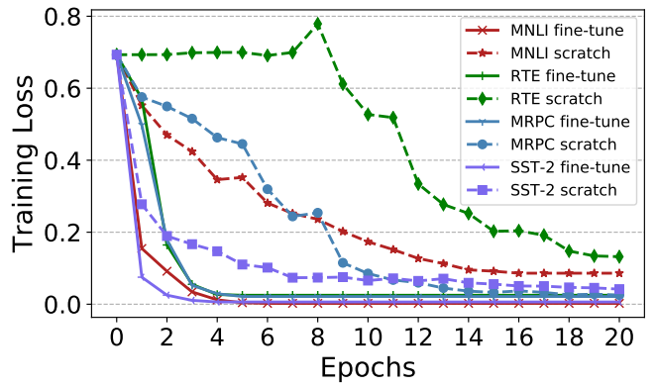
Pre-train v.s. Random Initialization
(fine-tune)
(scratch)
Source of image: https://arxiv.org/abs/1908.05620

Slide 8
How to use BERT – Case 2
class
class
class
Input: sequence
output: same as input
Linear
Linear
Linear
Example:
POS tagging
I saw a saw
BERT
N
V
DET
N
[CLS]
w₁
w₂
w₃
sentence
Notes:
(https://arxiv.org/abs/1805.12471)

Slide 9
How to use BERT – Case 3
Input: two sequences
Output: a class
Example:
Natural Language Inferencee (NLI)
contradiction
entailment
neutral
premise: A person on a horse jumps over a broken down airplane
Model
hypothesis: A person is at a diner.
contradiction
Notes:
premise前提

Slide 10
How to use BERT – Case 3
Class
Input: two sequences
Output: a class
Linear
BERT
[CLS]
w₁
w₂
[SEP]
w₃
w₄
w₅
Sentence 1
Sentence 2
Notes:
determining whether a “hypothesis” is true (entailment), false (contradiction), or undetermined (neutral) given a “premise”.

Slide 11
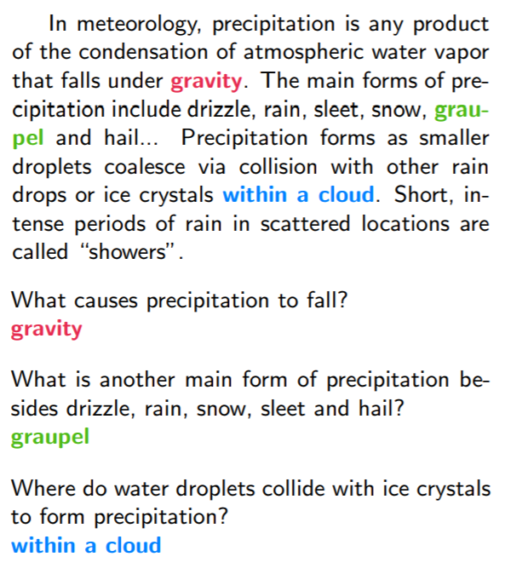




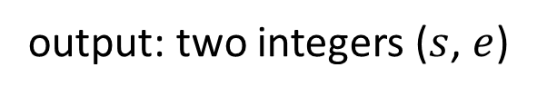





How to use BERT – Case 4
Extraction-based(答案一定出现在文章中) Question Answering (QA)
17
Document:
$$D=\left\{d_{1},d_{2},⋯,d_{N}\right\}$$
Query:
$$Q=\left\{q_{1},q_{2},⋯,q_{M}\right\}$$
77
79
$$D$$
QA
Model
$$s$$
$$e$$
$$s=17,e=17$$
$$Q$$
output: two integers ($s$, $e$)
Answer:
$$A=\left\{d_{s}, ⋯,d_{e}\right\}$$
$$s=77,e=79$$
Notes:
(E.g. SQuAD)

Slide 12
How to use BERT – Case 4
Random Initialized
0.3
0.5
0.2
s = 2
Softmax
inner product
BERT
[CLS]
q₁
q₂
[SEP]
d₁
d₂
d₃
question
document
Notes:
determining whether a “hypothesis” is true (entailment), false (contradiction), or undetermined (neutral) given a “premise”.

Slide 13
How to use BERT – Case 4
Random Initialized
0.1
0.2
0.7
s = 2
e = 3
Softmax
The answer is “d₂ d₃”.
inner product
BERT
[CLS]
q₁
q₂
[SEP]
d₁
d₂
d₃
question
document
Notes:
determining whether a “hypothesis” is true (entailment), false (contradiction), or undetermined (neutral) given a “premise”.

Slide 14
Pre-training a seq2seq model
Reconstruct the input
w₁
w₂
w₃
w₄
w₅
w₆
w₇
w₈
Cross Attention
Encoder
Decoder
w₁
w₂
w₃
w₄
Corrupted
Notes:
[Song, et al., ICML’19]
[Lewis, et al., arXiv’19]

Slide 15
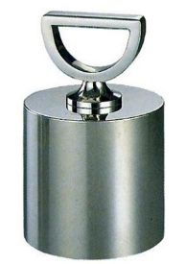

MASS / BART
MASS
A B [SEP] C D E
A B [SEP] C E
BART
(Delete “D”)
A B [SEP] C D E
C D E [SEP] A B
(permutation)
D E A B [SEP] C
(rotation)
https://arxiv.org/abs/1905.02450
https://arxiv.org/abs/1910.13461
A B [SEP] E
Text Infilling
Notes:
Permutation / Rotation do not perform well.
Text Infilling is consistently good.

Slide 16

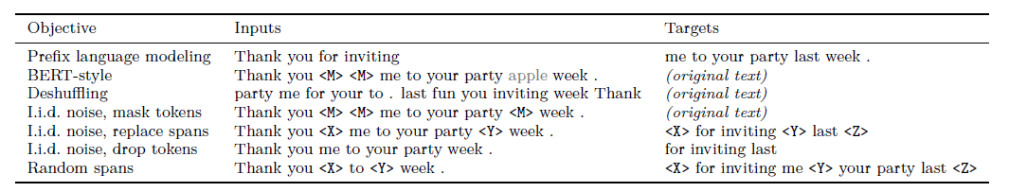
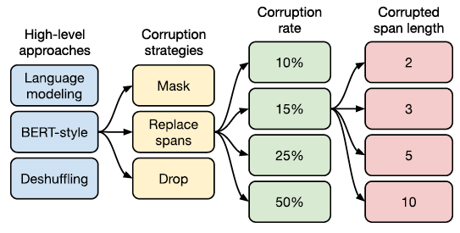
T5 – Comparison
Transfer Text-to-Text Transformer (T5)
Colossal Clean Crawled Corpus (C4)
Notes:
The C4 dataset we created for unsupervised pre-training is available in TensorFlow Datasets, but it requires a significant amount of bandwidth for downloading the raw Common Crawl scrapes (~7 TB) and compute for its preparation (~335 CPU-days). We suggest you take advantage of the Apache Beam support in TFDS, which enables distributed preprocessing of the dataset and can be run on Google Cloud Dataflow. With 500 workers, the job should complete in ~16 hours.
Colossal龐大柯羅索巨獸
吐槽谷歌T5 Level（高級軟件工程師）。
Interesting demo: https://ai.googleblog.com/2020/02/exploring-transfer-learning-with-t5.html
67

Slide 17
Why does BERT work?
Represent the meaning of “大”
The tokens with similar meaning have similar embedding.
embedding
草
吃蘋
果
鳥
BERT
魚
電
蘋果手機
台
灣
大
學
Context is considered.

Slide 18
Why does BERT work?
compute cosine similarity
BERT
BERT
喝
蘋
果
汁
蘋
果
電
腦

Slide 19
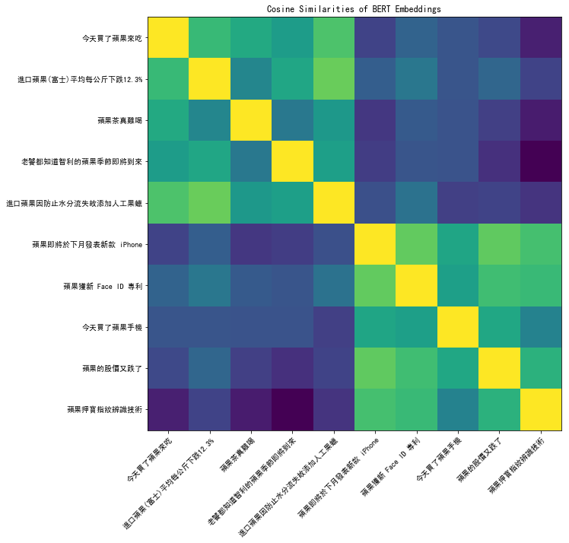
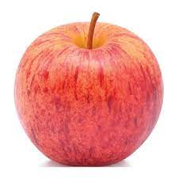

Notes:
https://colab.research.google.com/drive/1mWOWFdmI_f18Vo2HpxaVrauzlnAAWw2C

Slide 20
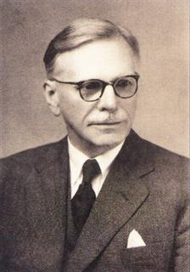
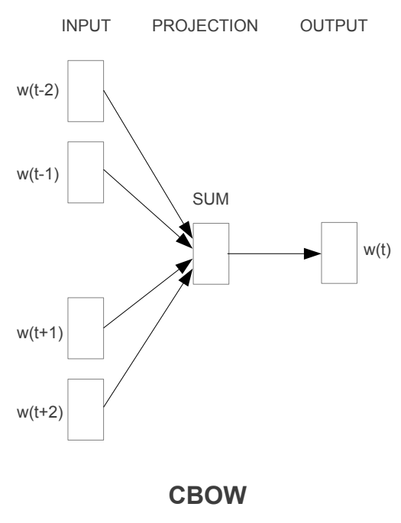
Why does BERT work?
You shall know a word by the company it keeps
Contextualized word embedding
w₂
John Rupert Firth
BERT
word embedding
w₁
w₂
w₃
w₄

Slide 21
Multi-lingual BERT
Multi-BERT
Multi-BERT
high
est
Mask
Mask
moun
tain
深
度
學
習
Training a BERT model by many different languages.
Notes:
You have an universal token set for all languages.

Slide 22
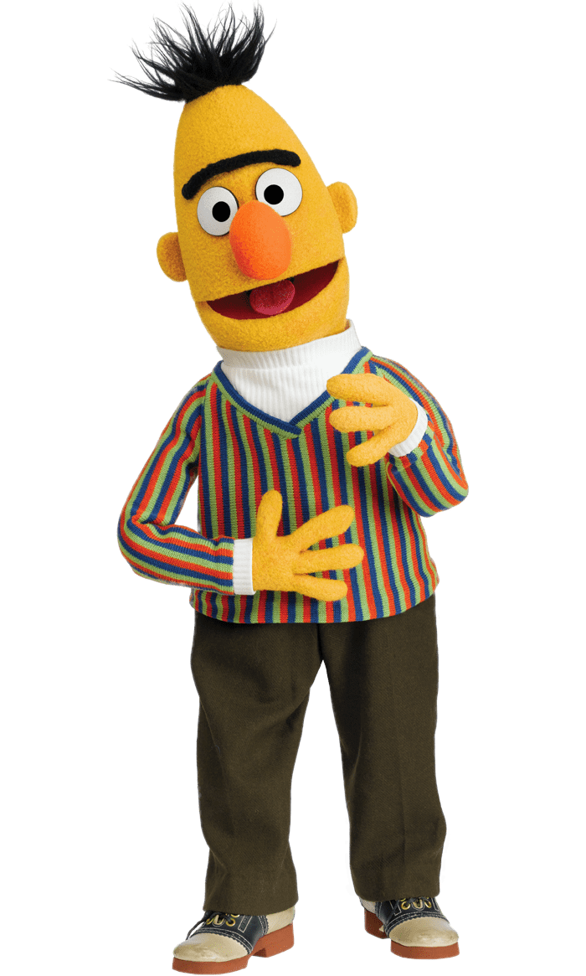
Zero-shot Reading Comprehension
Training on the sentences of 104 languages
Doc1
Query1
Ans1
Doc2
Query2
Ans2
Doc1
Query1
?
Doc3
Query3
Ans3
Doc3
Query3
?
Doc4
Query4
Ans4
Doc5
Query5
Ans5
Doc2
Query2
?
Train on English QA training examples
Test on Chinese
QA test
Multi-BERT
Notes:
Beto, Bentz, Becas: The Surprising Cross-Lingual Effectiveness of BERT
https://arxiv.org/abs/1904.09077

Slide 23
Zero-shot Reading Comprehension
English: SQuAD, Chinese: DRCD
Model | Pre-train | Fine-tune | Test | EM | F1
QANet | none | Chinese | Chinese | 66.1 | 78.1
BERT | Chinese | Chinese |  | 82.0 | 89.1
 | 104 languages | Chinese |  | 81.2 | 88.7
 |  | English |  | 63.3 | 78.8
 |  | Chinese + English |  | 82.6 | 90.1
F1 score of Human performance is 93.30%
This work is done by 劉記良、許宗嫄
https://arxiv.org/abs/1909.09587

