Slide 1

Gate check
22 Nov 2016
Dominic Celiano

Slide 2
Demo

Slide 3
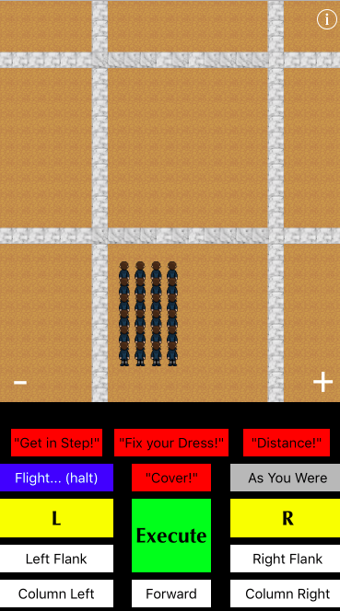
Project Description
March a flight/squadron
Practice marching
Relive the glory days
Complete tasks
Explore the Terrazzo
Unlock different zones
Must give corrections

Slide 4
Model View Controller Scene Discussion

Slide 5
Functional Requirements
March a flight/squadron
Change size of flight/squadron
Have flight/squadron make random mistakes
Allow the user to rank up
Allow the player to give commands to both control and correct his flight/squadron
Save progress of the player and his flight/squadron
Implement marching tasks/missions for the player to complete
Implement a “settings menu” where the player can view both his progress and the progress of his flight

Slide 6
Frameworks
Foundation
Social Framework
Post to Facebook
Distance reached
Tasks completed
SpriteKit
Lessons Learned

Slide 7
Implementation Plan
Test Plan
T35 (Gate Check) – save game
T36 – player can track progress
T37 – different marching scenarios implemented
T38 – final tests conducted/
T35 (Gate Check) – start a game from scratch, progress through some levels, and then quit the game completely and see if you pick up from where you left off
T36 – check to see if in the “settings” menu you can view how good your flight is and how much they are progressing. Make sure the better they are, the less mistakes they make.
T37 – Choose between a flight and squadron in the splash screen and make sure the game implements the choice which you selected.
T38 – Give the game to some of my friends to have them play it and “try to break it”

Slide 8
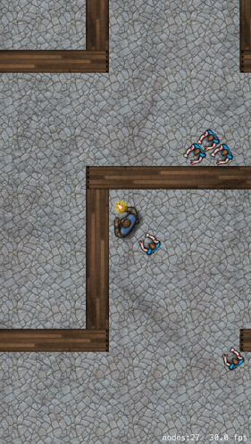
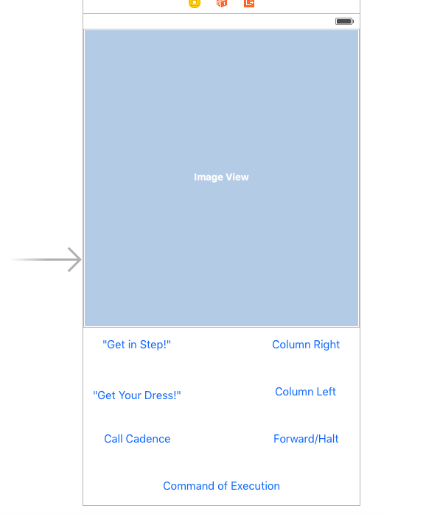
Critical Path Experiment
Terrazzo created, single player moving around
Used SpriteKit SceneKit Tutorial (see pic)
Many similarities to my game
Moving a squadron or flight
Drew out controls for marching the
flight/squadron

Slide 9
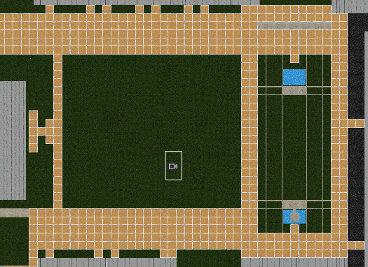
Lessons Learned
SpriteKit Scene Editor
Swift Syntax
Extensions are hard/impossible if adding variables
Use subclasses
Animation, Art
Column Left
MVC turns into MVSC
This can be fun

Slide 10
Questions

