Slide 1
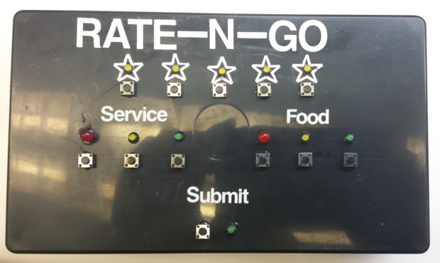
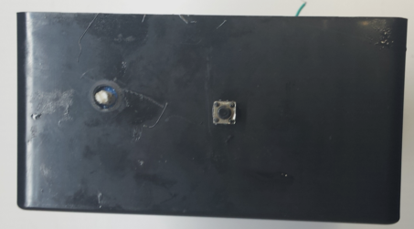

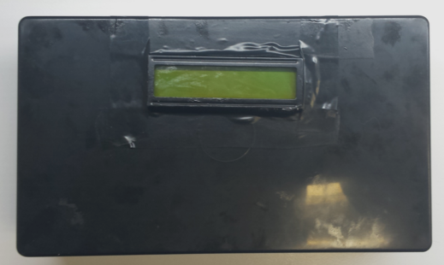

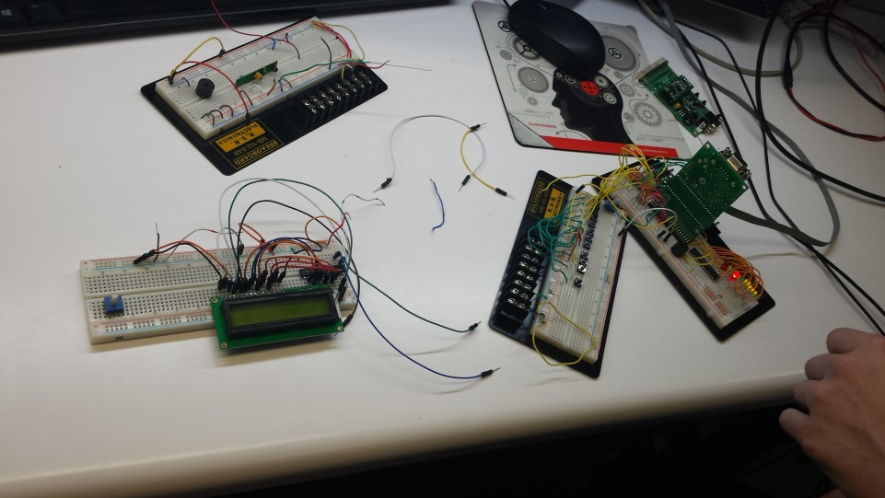
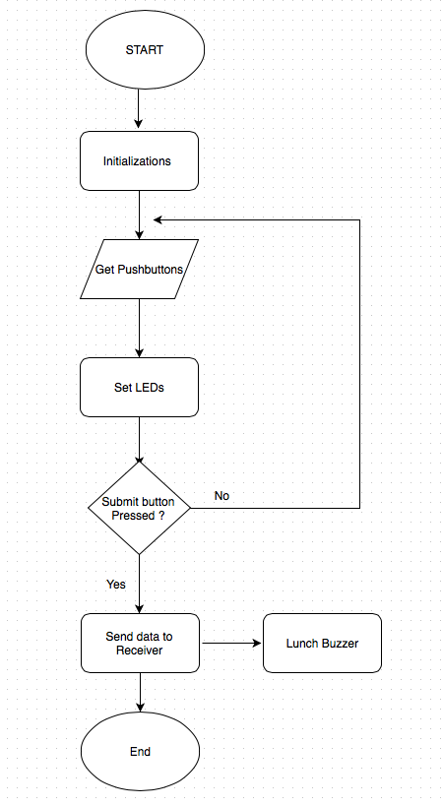
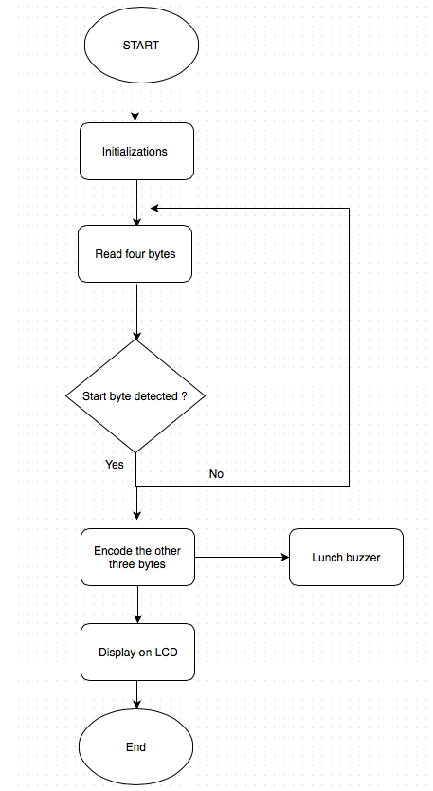
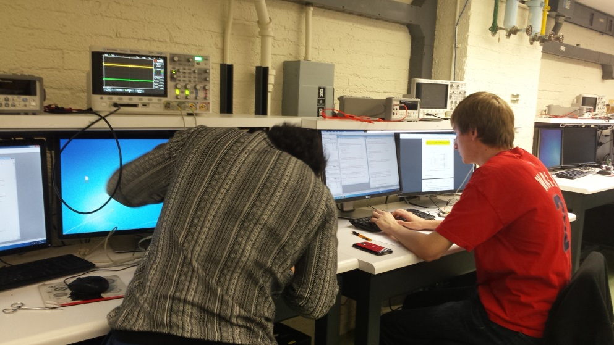
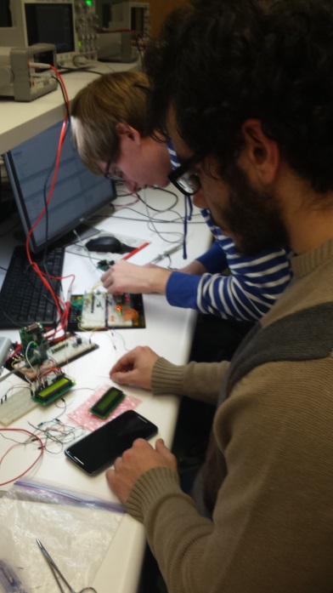
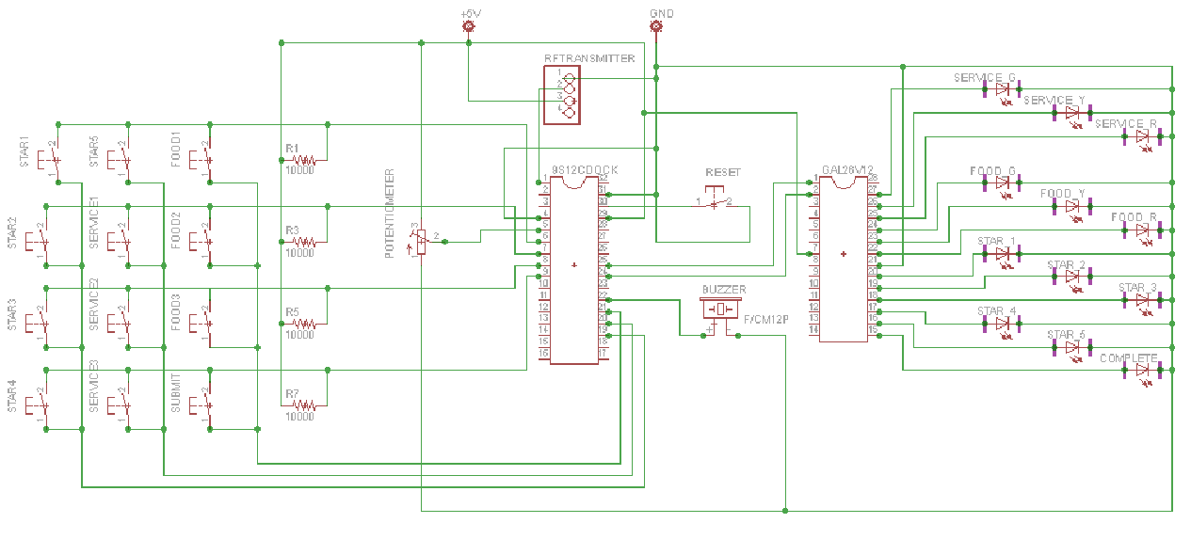
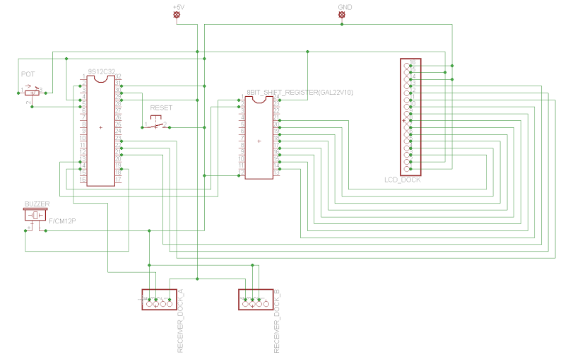
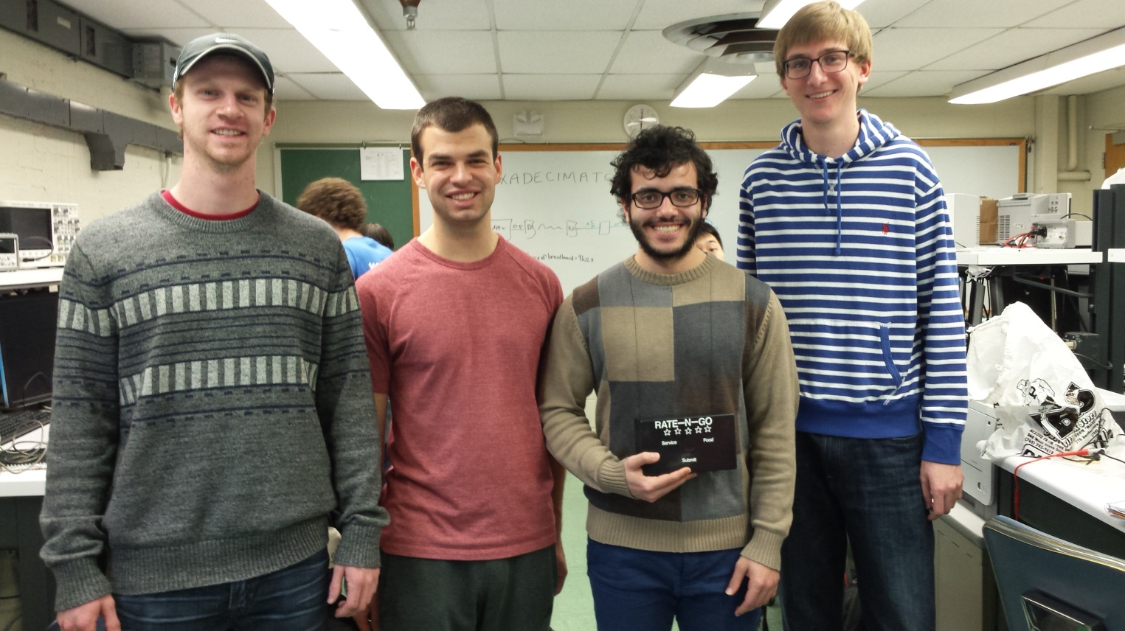
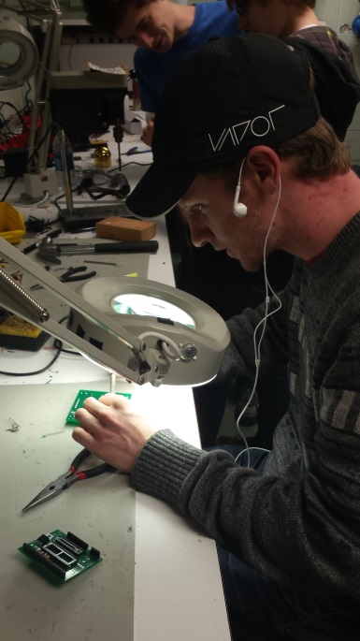
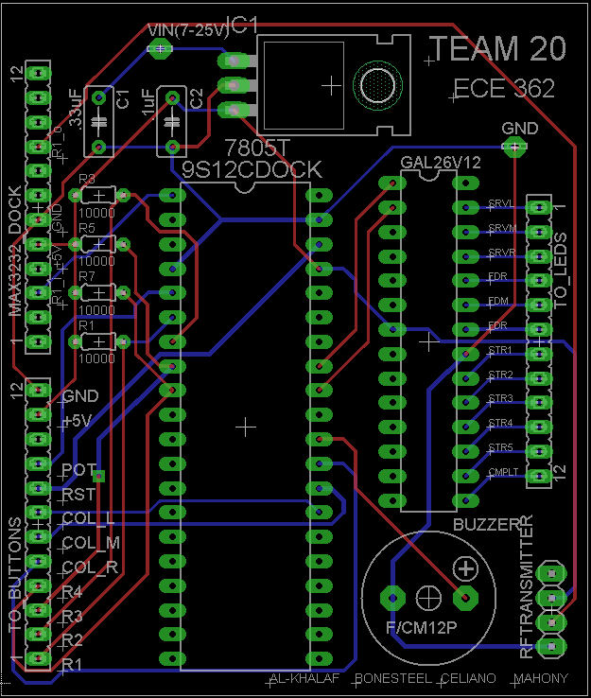
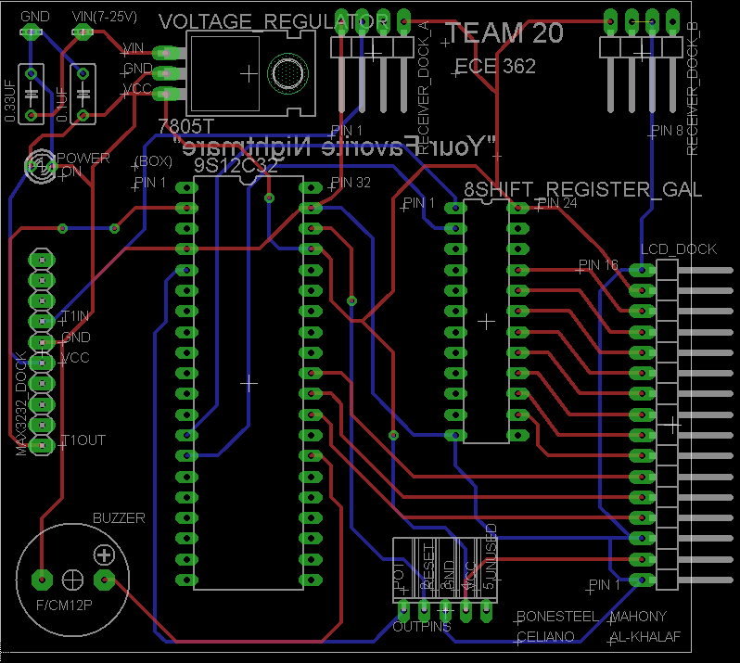


ECE 362 Embedded Microcontroller Mini-Project − Fall 2015
Team 20 – <Rate ‘n Go>
What is it?
What it does
Social Impact
Future Development
Two sides
Receiver → Submit Ratings
Transmitter → View Ratings (via LCD)
Better service at restaurants
Possibility to affect online restaurant ratings (Google, Zagat, etc.)
Multiple Transmitters
Better Packaging
Website Ratings
‘First Time?’ Button
Hardware
Software
Transmitter
Receiver
The Details
9S12 Microcontrollers
Shift Registers
LCD Screen
Pushbuttons/LED’s
RF Communication
John and Iaman coding furiously
Circuit Schematics
Building and Debugging
The Team
Design and Fabrication
Transmitter
Receiver
Left: John and Iaman debugging
Below: Trevor soldering one of the PCB’s
PCB Layout
Transmitter
Receiver
Left to Right: Trevor Bonesteel, Dom Celiano, Iaman Alkhalaf, John Mahony
Digijock(ette)-Strength Digital System DesignTM

