Slide 1



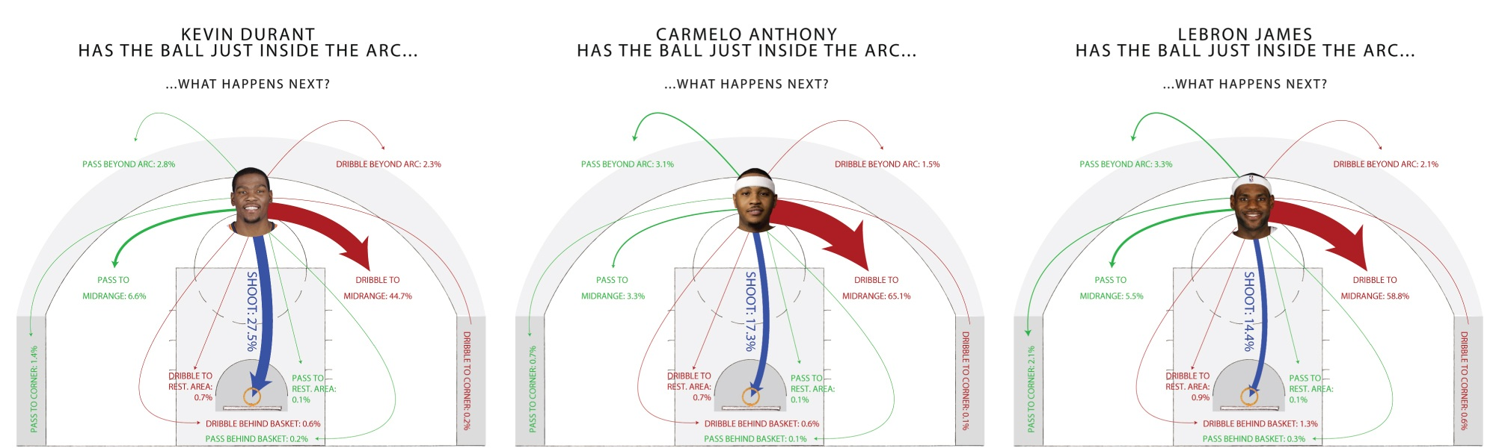
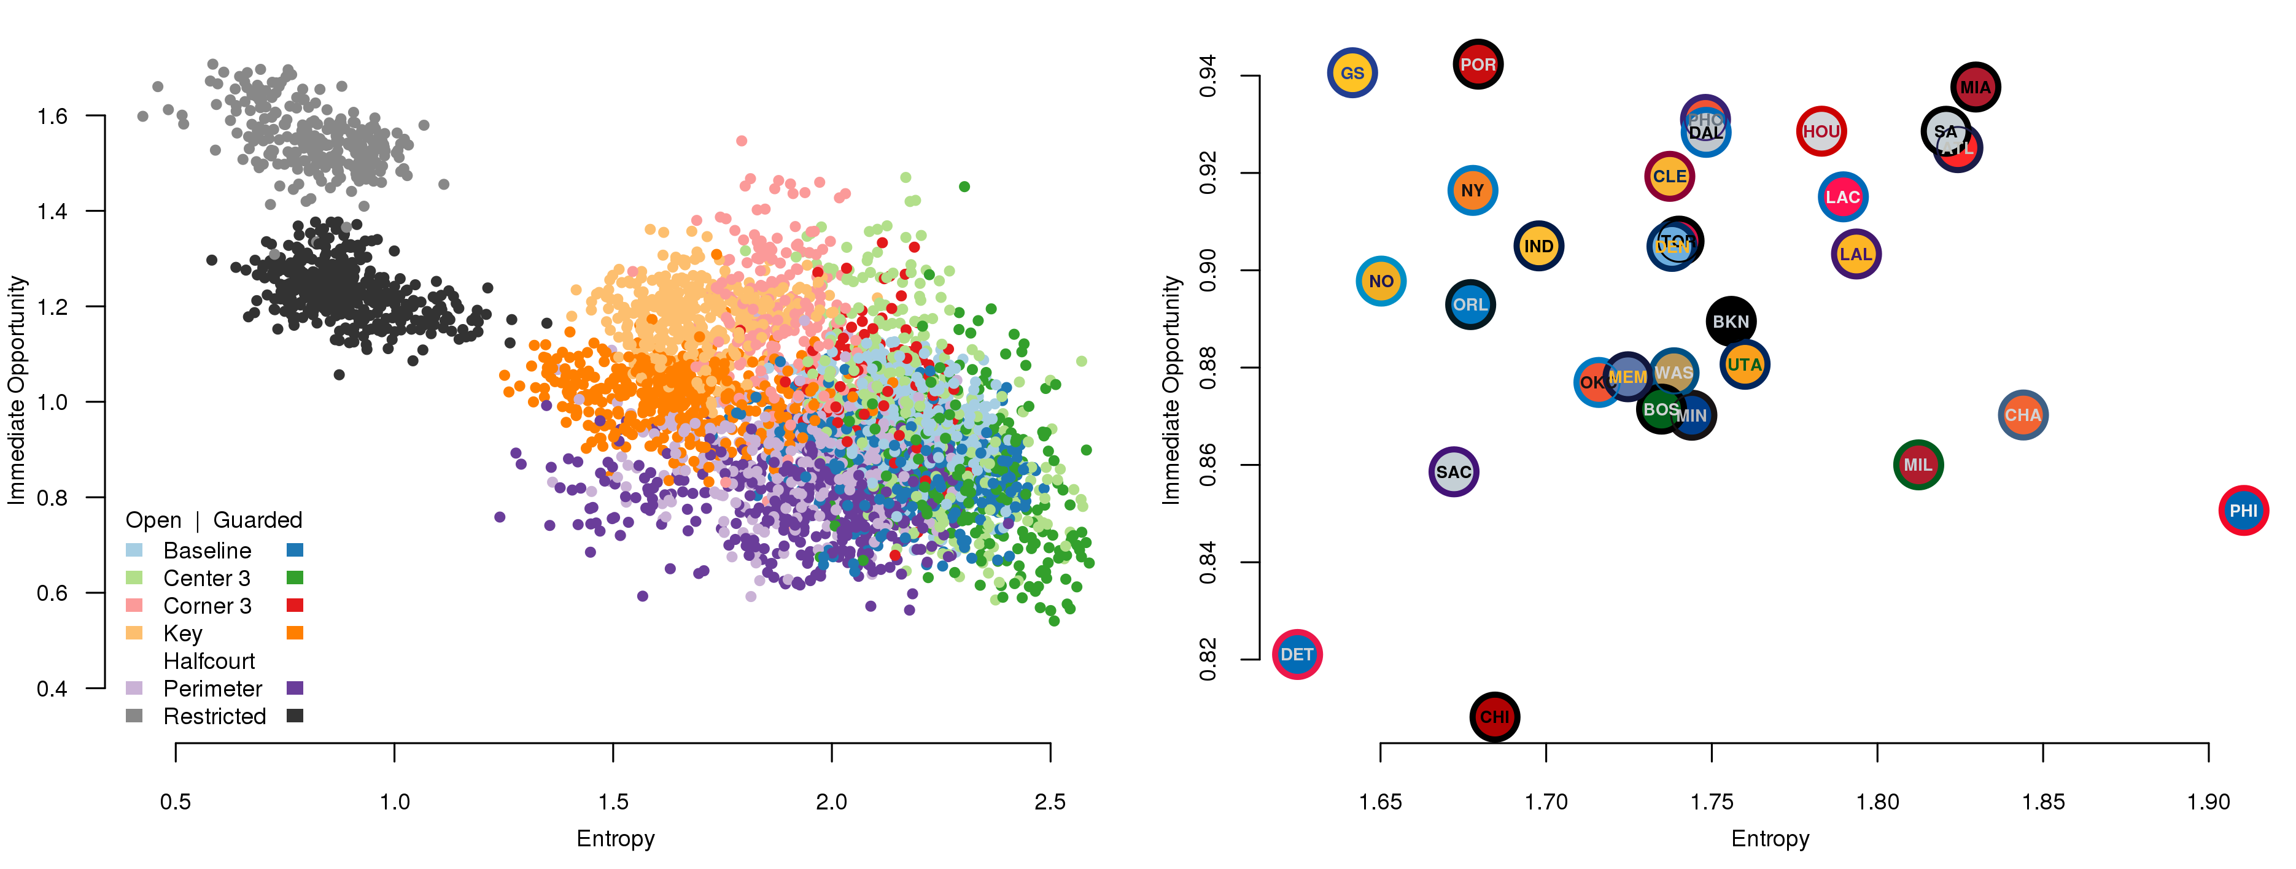
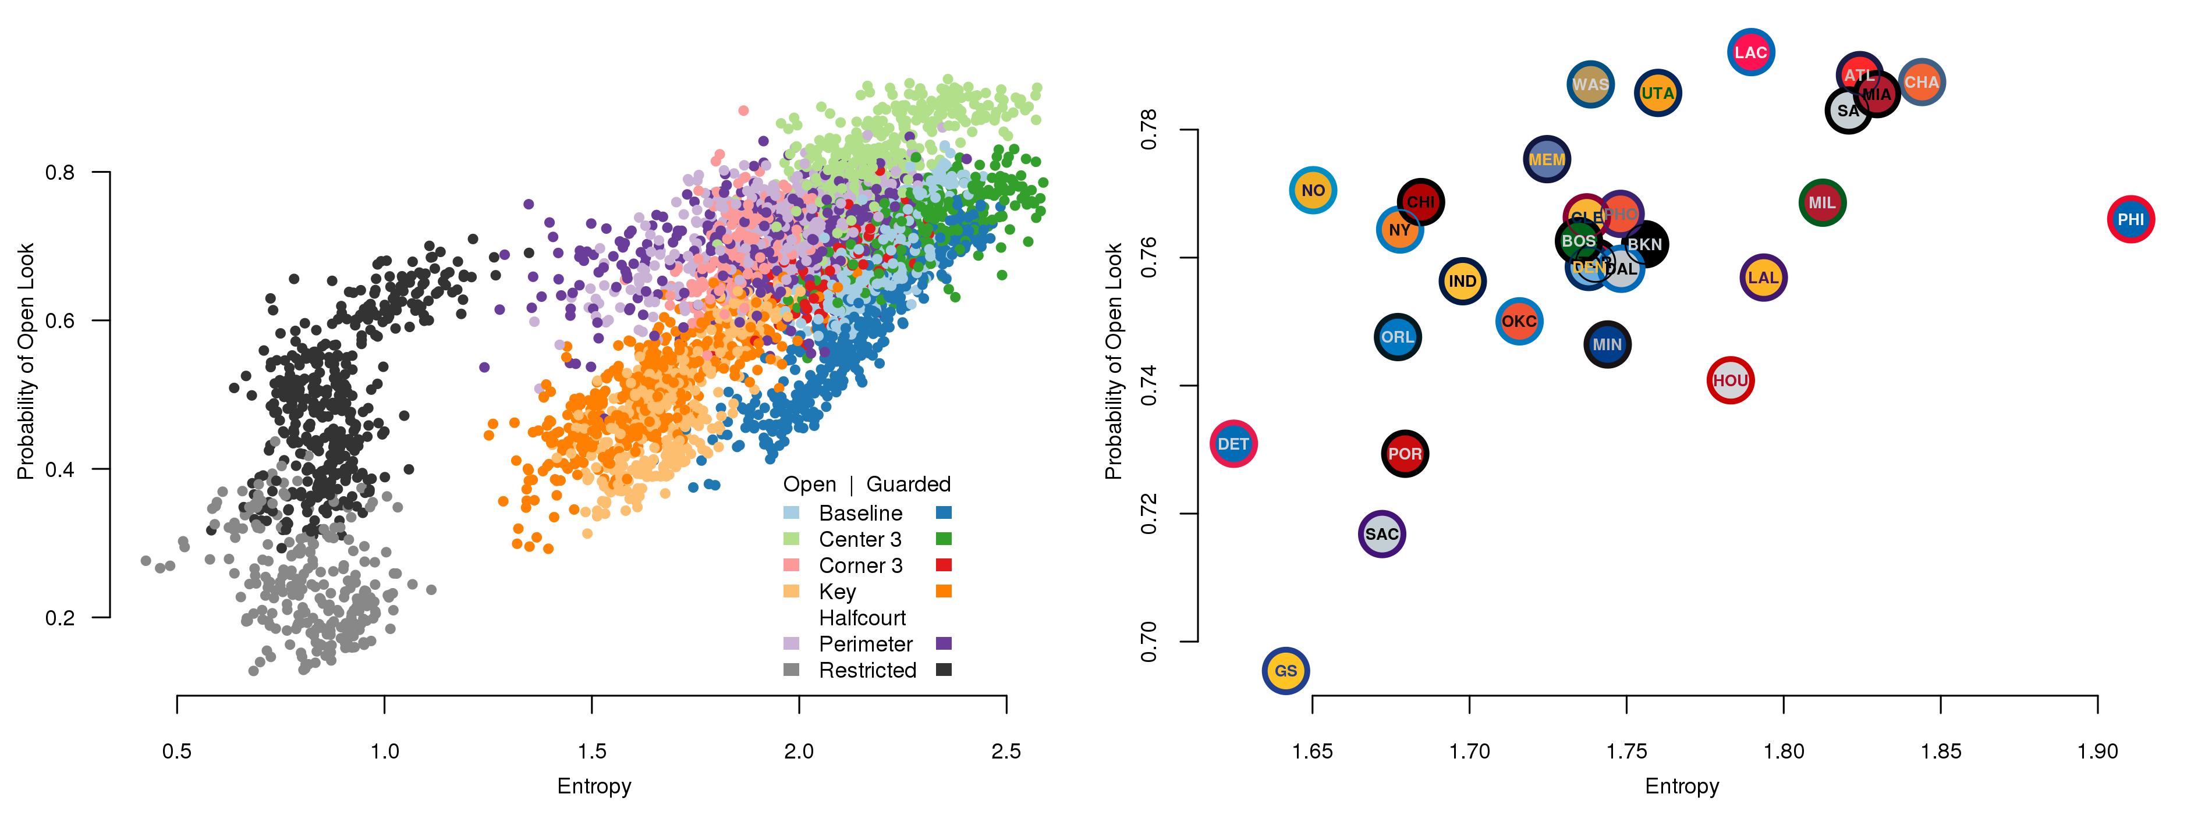


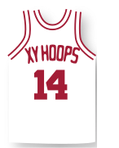
Move or Die: How Ball Movement Creates Open Shots in the NBA
Alex D'Amour, Dan Cervone, Luke Bornn, and Kirk Goldsberry / Harvard University / damour@fas.harvard.edu
Entropy and Opportunity
Conventional metrics fail to link ball movement with offensive success. League-wide, there are no significant correlations between speed, distance, passes, and touches and measures of scoring efficiency, either on a per-possession or per-game basis. Entropy is a new metric describing ball movement, and key to understanding how ball movement leads to points.
Entropy measures the unpredictability of the offense. High entropy game states evolve quickly and diversely. Low entropy states evolve slowly and predictably. Unlike speed or passing frequency, entropy is not directly observed in the data, and we estimate it using a Markov model for ball movement (see Figure 1).
Opportunity quantifies the scoring potential of the an offensive state. At any given time in a possession, we have both:
Immediate opportunity, if a good shot is available now.
Long-run opportunity, if a good shot (open corner 3, layup, etc.) is likely down the road.
Figure 1: Entropy is calculated using the probability distribution of future ball movements given the current state of the possession, represented by the ballcarrier and his position on the court.
Teams trade off entropy and immediate opportunity…
We see a negative correlation between entropy and immediate opportunity (both within and between offensive states). That’s because high opportunity states are represent good shots, which are predictable. Despite this, the best offenses on average have high entropy and high opportunity (Figure 2). These offenses are unpredictable, and constantly a threat to score throughout the possession.
Immediate Opportunity vs. Entropy, by offensive state
Immediate Opportunity vs. Entropy, averaged by team
Figure 2: opportunity vs. entropy plots for player/state combinations (left) and teams (right).
Future Opportunity vs. Entropy, by offensive state
…but entropy leads to open shots later in the possession
Entropy correlates strongly with future opportunities such as the probability of an uncontested look at the basket from a viable scoring region (pictured in Figure 3). High entropy states stretch the defense, increasing the possibility that a player eventually receives the ball with an uncontested shot attempt. We observe this pattern both within and between states, and averaged by team.
Future Opportunity vs. Entropy, averaged by team
Figure 3: future opportunity (probability of an open look from a viable scoring region) vs. entropy, both for player/state combinations (left) and teams (right).
“Either you move it or you die.”
San Antonio Spurs Coach Gregg Popovich, following a game 2 loss to the Miami Heat during the NBA Finals on June 8, 2014.
Notes:
<number>

