Slide 1
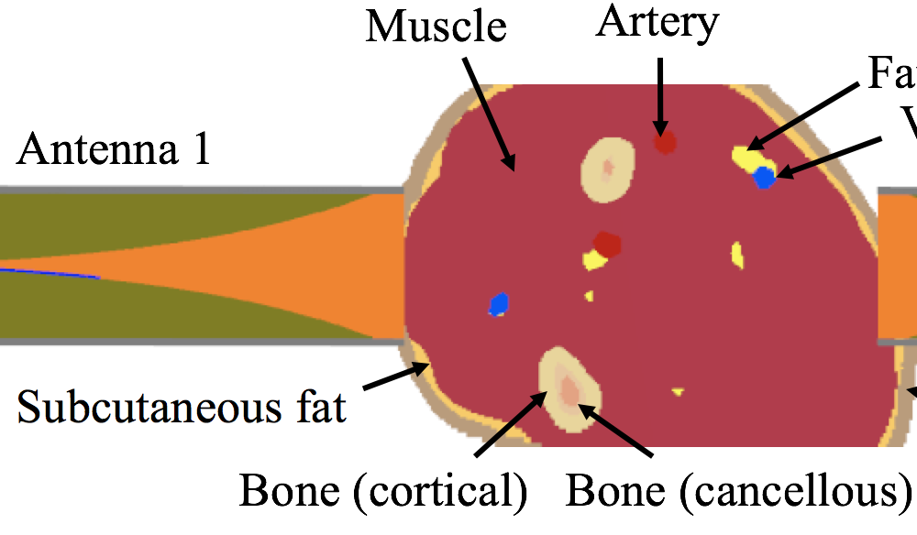
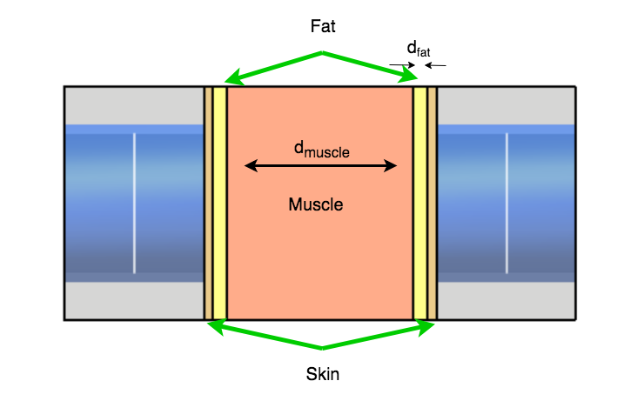

Slide 2
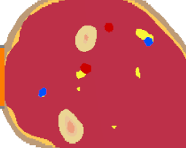
Muscle
Bone
Fat
Waveguide 1
Waveguide 2
Skin
Subcut. fat
Vein

