Slide 1

From Microservices to Monoliths
BSDCan 2017
Dave Cottlehuber

Slide 2

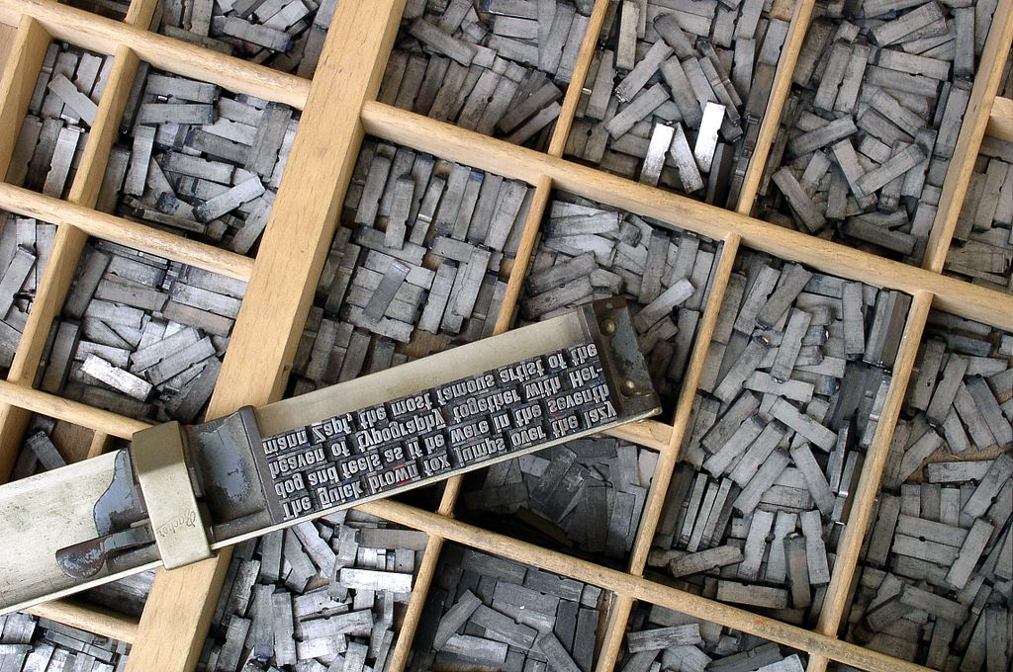
Hand-Crafted Artisanal Domain Resellers
Domains for Real People
Ethical business
Simple interface
NZ + global distributed team
Perl Catalyst front end
Erlang backend: RabbitMQ, Apache CouchDB, Search App
Kyoto Tycoon Session Store
20 Debian Unstable VMs

Slide 3
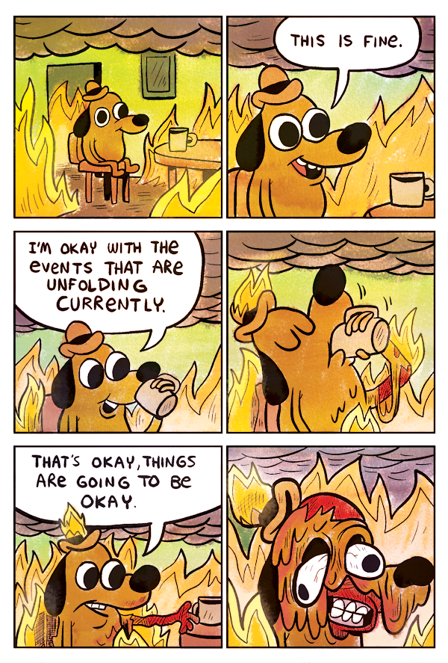
Why Migrate?
- Microservices-induced Latency
- VM-induced network instability
- Upgrade Hell – no turning back
- Debian-induced base package variability – OpenSSL, Net::HTTP

Slide 4

Choose Wisely
- slight bias to FreeBSD

Slide 5
The Holy Grail
- Boot Environments = robust and easy rollbacks for DBs
- custom git ports tree + poudriere = reliable packages
- pkg-create = custom packages for repeatable deployment
- Jails = stable API for containers – no fuss, no latency
- CARP + haproxy = robust transparent failover for app & backend
- spiped instead of ssh tunnels = faster & more resilient to abuse
- 3 physical machines (A + B cluster nodes, C sysadmin/backup)
- a few virtual machines for eventual consolidation
- ansible for lower non-sysadmin learning curve

Slide 6
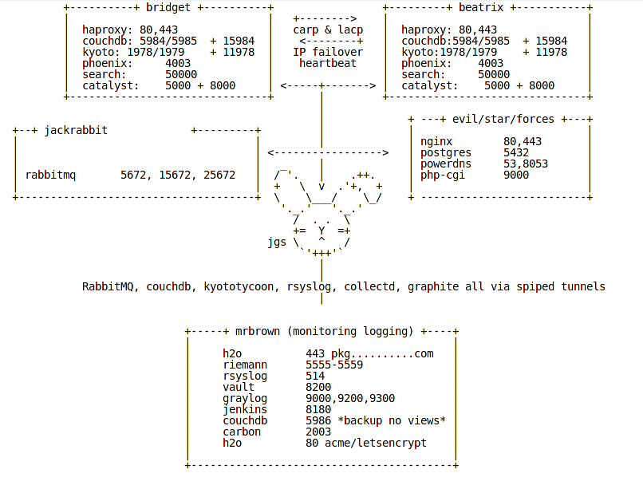
Architecture

Slide 7
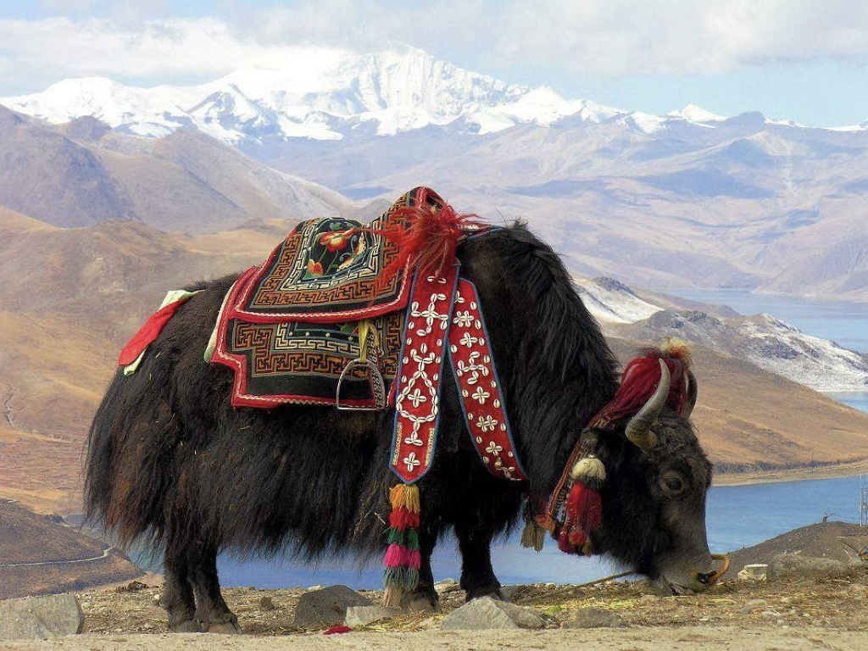
Behold, The Sacred Beast of
SysAdmins: The Hardy Yak
“They Who Must Be Shaved”
S

Slide 8

Back End
All distributed, reliable, boring tech:
- Session: Kyoto Tycoon
- Store: Apache CouchDB – Erlang/OTP JSON doc DB
- Queue: RabbitMQ – Erlang/OTP
Multiple nodes all behind Haproxy

Slide 9
SysAdmin Batbelt
- vault – secrets management
- ansible – config management
- rsyslog – centralised log shipping
- graylog – log aggregation & search
- collectd – host-based metrics agent
- riemann – centralised event correlation & realtime dashboard
- graphite – pretty pictures and trends
- poudriere & jenkins – custom ports and applications

Slide 10
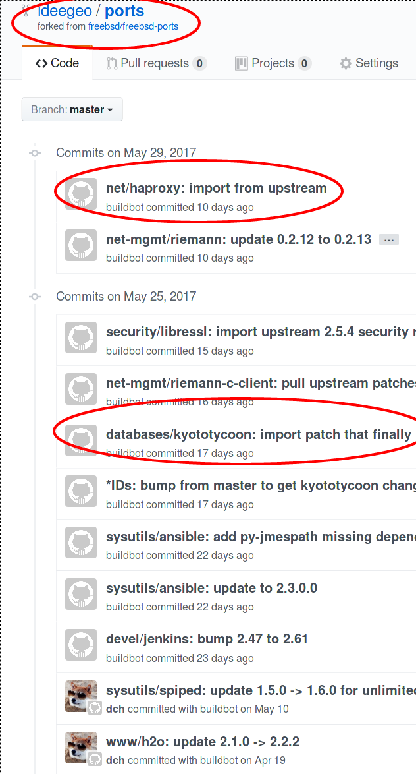
Poudriere – Floating Ports
- custom git fork of github:freebsd-ports
- custom ports + private packages
- best of both worlds
- bump every 2-3 months when it suits
- pull in security fixes only when needed
- no rush for upstream committers ;-)
- guaranteed consistency across dev/prod

Slide 12
Thanks!
Questions?

