Slide 1

Models of behaviour and classification
Aphrodite Galata
Derek Magee
Vincent Devin
Tony Cohn
David Hogg
University of Leeds
2nd Year CogVis meeting, 3 June 2003

Slide 2
Dynamic classifier scheduling
Knowledge So Far (K_{t})
Classifier Scheduling
(Bayesian) Classifier Output Combination
Class Probabilities

Slide 3
Dynamic classifier scheduling: using cross entropy
On each iteration, select the classifier maximising:
P(true positive | K_{t})
But K_{t} is high dimensional and may have discrete and continuous components
So separate into separate distributions for each element of K_{t} and use weighted voting to determine the classifier to use
Weights come from the cross-entropy between P(true positive) and P(true positive | K_{t,n}) for element n (measures the difference between the distributions)
Evaluated on COGVIS db. Improvement on Adaboost.MH

Slide 4

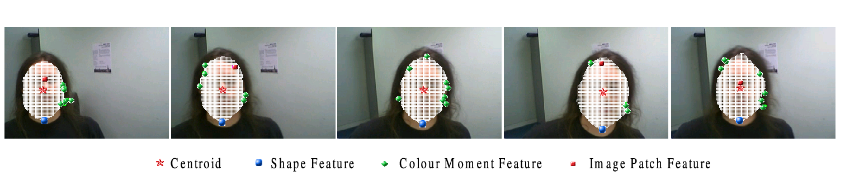
Tracking via a level set steered by local features
Given a set of detectors for localised features of the target – for example, the correlation Kernel method (ETH)
Incorporate into diffusion equation to steer level set
towards desired position

Slide 5
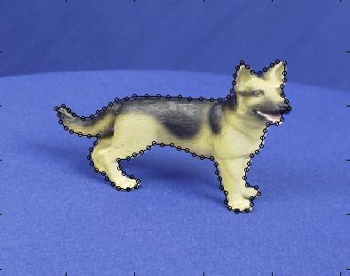
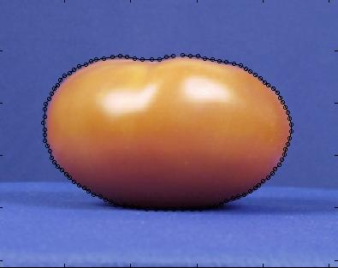
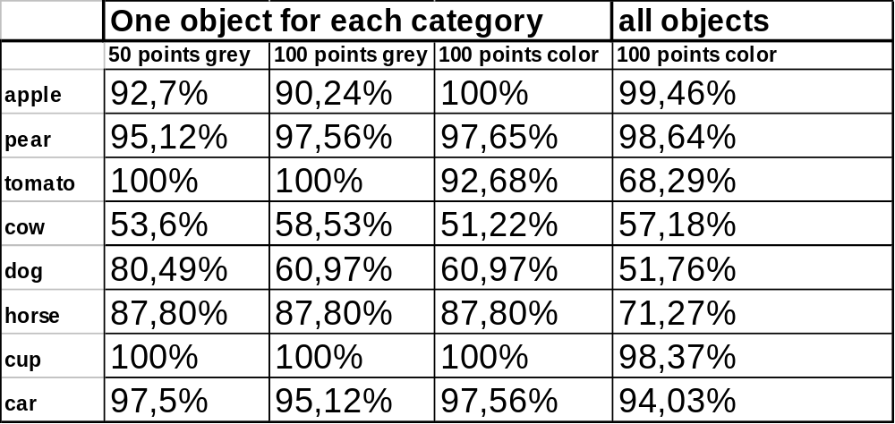
Classification using appearance models
Collaboration Leeds/ETH, using COGVIS db
Results (single view models)

Slide 6
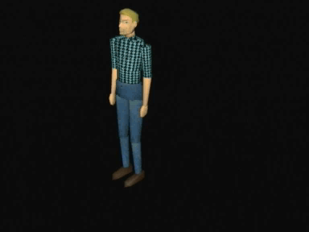
Earlier work:
Variable length Markov model over motion templates
VLMM
behaviours
Motion 1
Motion 2
Motion 3
motion primitives
time
Captures motion at different temporal scales.
But ad-hoc segmentation of motion primitives during learning,
no variability within motion primitives

Slide 7
VLMM over VLHMMs
VLMM
Motion primitives represented by
variable length hidden Markov models
(VLHMMs)
VLHMM1
VLHMM2
VLHMM3
time
Training by segmentation of sequences into VLMM sources – Seldin et al., 2001
- followed by standard training of higher-level VLMM
Sampling using ML formulation and augmentation of configuration with
first derivative – Brand, 1999

