Slide 1


Analysing Interactions Using Logical Reasoning with Adaptive Classification and Multiple Features
School of Computing, University of Leeds
Derek Magee, Brandon Bennett
Aphrodite Galata, Vincent Devin
David Hogg, Tony Cohn
(Paolo Santos [Imperial College Cognitive Robotics] , from June 1, 2003)

Slide 2
Aims
Combine high(er) level logical/symbolic reasoning with low(er) level processing
  Exploit qualitative spatio-temporal representations to abstract away from:
    unnecessary details
    error and uncertainty
  Exploit commonsense knowledge of the world as constraints on interpretations
Complementary, “symbiotic” use of low/high level mechanisms
Demonstrate ideas in prototype system

Slide 3
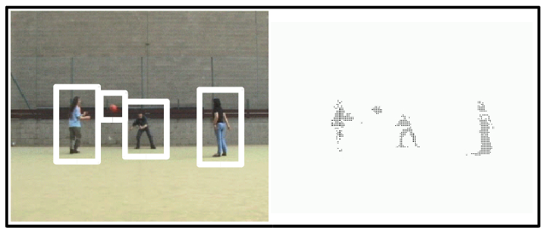
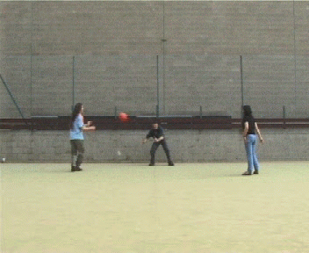
System Overview
Object Tracking / FG Segmentation
Image & Vision Computing (2003)
Reasoning Engine
(Submitted)
Multiple Classifiers
Input Video
Classifier Scheduling & (Bayesian) Combination
Int. Workshop on MCS (2003)

Slide 4
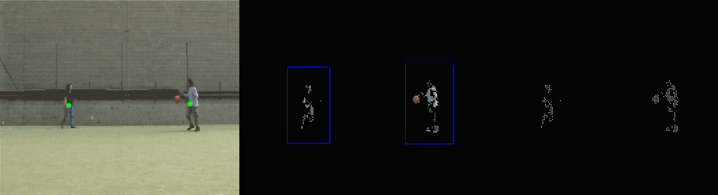
Increasing Vagueness
to Increase Robustness
Blobs merge when they significantly overlap.
Blobs split if they contain >1 separable object.
Reason over time to disambiguate which objects in which blobs

Slide 5
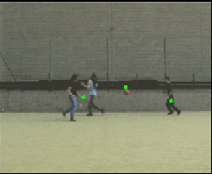
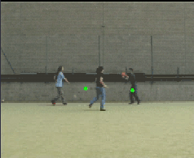
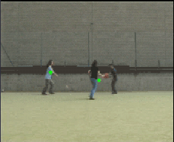
Reasoning with Uncertain Information
Afro 0.7
Derek 0.3
Vinnie 0.5
Ball 0.01
Afro 0.5
Derek 0.9
Vinnie 0.1
Ball 0.01
Afro 0.3
Derek 0.05
Vinnie 0.5
Ball 0.01
Afro 0.5
Derek 0.4
Vinnie 0.1
Ball 0.01
Afro 0.4
Derek 0.2
Vinnie 0.8
Ball 0.5
Afro 0.5
Derek 0.4
Vinnie 0.1
Ball 0.01
Afro 0.01
Derek 0.01
Vinnie 0.01
Ball 0.99
Afro 0.3
Derek 0.8
Vinnie 0.1
Ball 0.01
Information could be processed at each frame, however to maintain
logical consistency an alternative approach is proposed.

Slide 6
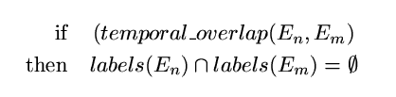
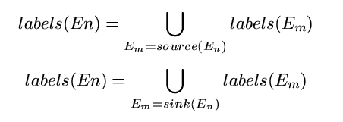
Ensuring Logical Consistency
of Scene Explanation
“An object cannot be in more than one place at the same time”
“An object is continuous in space-time”
(i.e. it cannot jump and appearances/disappearances must have an explanation)

Slide 7
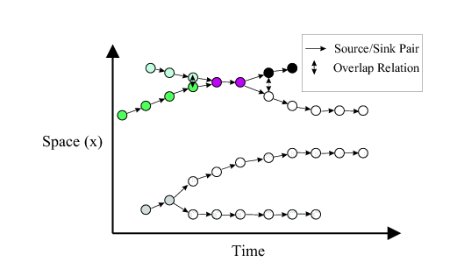
Implementation of Logical Constraints
Tracker Output
Issue: potentially very many blobs and objects and little change over extended periods of time.
Need to abstract to create efficient knowledge structures for logical constraint reasoning
- create spatio-temporal envelopes

Slide 8
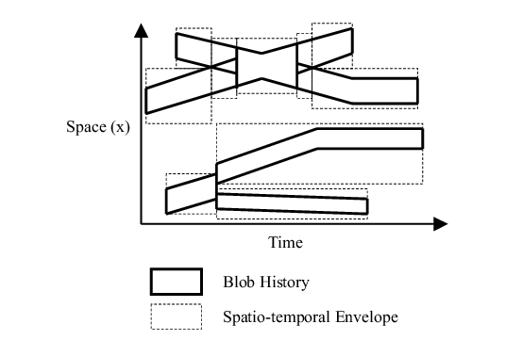
Implementation of Logical Constraints
To allow combination of classifier output information over time and efficient application of constraints, sequences are translated into graphs of “spatio-temporal envelopes”.
Tracker Output
Forming Spatio-temporal Envelopes
Can now abstract spatio-temporal envelope structure
as a temporally sequenced graph

Slide 9
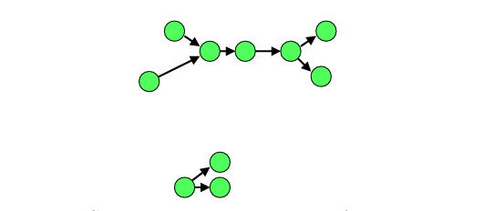
Implementation of Logical Constraints
To allow combination of classifier output information over time and efficient application of constraints, sequences are translated into graphs of “spatio-temporal envelopes”.
A constraint satisfaction procedure is applied to this graph, maximising explanation probability while satisfying logical constraints.
Tracker Output
Forming Spatio-temporal Envelopes
Envelopes represented
as a directed graph

Slide 10
Combination of Classifier information
Information must be combined:
Within a single spatio-temporal envelope
Across the whole sequence (or a sub-sequence, e.g. all frames up to the current)
There are several possibilities for this:
Weighted Voting
Bayesian approach
A Combination of (1) & (2)
The various options are currently being discussed & evaluated.

Slide 11
Prototype system
Implements “not in same place at same time constraint”, and partly implements the continuity constraint.
Currently works on a complete graph abstracted from a frame sequence
  Processes this in much faster than “real time”
Display shows:
  Classifier hypotheses
  Ground truth
  Computed best classification

Slide 12
Summary and Plans for the Future
A qualitative spatio-temporal framework for combining the output of an Object tracker and a classification system with logical consistency constraints.
  Enables better classification of objects
  Not dependent on particular lower level classifier
Exploit further constraints
  E.g. type dependent constraints:
    humans remain near ground level
    maximum speeds of different kinds of objects, …
Move to a higher, more cognitive level
  Event recognition
  abduction
Learning is key
New Scenario

Slide 14
New Scenario
Table top scenario
  E.g. simple game (snap, dominos, dice, “21”)
Learn “the rules of the game”
  Possible interaction during learning
  (asking questions to aid learning)
Computer is then able to play them game
  Talking head
  Predict next situation/event

