Slide 1
Finding the Next NBA City

Slide 2
Introduction
Background
  Professional sports is a multi-billion dollar industry
    Major leagues include NFL, NBA, NHL and MLB
  Continually looking to expand to new markets
  The NBA is next likely candidate for expansion
    Has seen revenue and ratings increase in recent years
    Only 30 NBA teams vs 32 for NFL and NHL
Problem Statement
  Help the NBA find a new city for expansion

Slide 3
Collecting City Data
City data collected via web scraping and the FourSquare city data API
Data | Source
US City population Data | https://en.m.wikipedia.org/wiki/List_of_United_States_cities_by_population
US TV Market Data | https://en.wikipedia.org/wiki/List_of_United_States_television_markets
US Per-Capita Income Data | https://en.wikipedia.org/wiki/List_of_United_States_metropolitan_areas_by_per_capita_income
List of current NBA cities | https://www.basketball-reference.com/teams/
City Venue/Interests Data | FourSquare API

Slide 4
Clean City Data
Wikipedia city data cleaned and merged
  Converted numerical strings and objects to floats
  Extracted city TV Market and per-capita income from regional data
  Merged tables
  Interpolated for missing values based on population
Added NBA column to distinguish if city has team
  1 = YES, 0 = NO
Carried forward relevant features
  City, State, Population, TV Market Size, Per-Capita-Income, NBA City

Slide 5
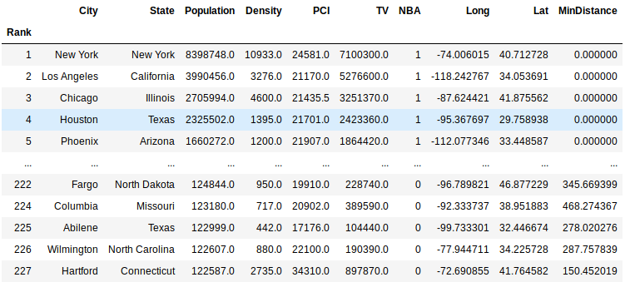
Add/Calculate Location Information
Python GeoPy module used to...
  Get latitude and longitude for each city
  Calculate distance from each city to nearest NBA city
Filter down data set by...
  Removing non-NBA cities within 150km of current NBA cities
  Taking 120 most populous cities from remaining set
    27 NBA cities
    93 non-NBA cities

Slide 6
Adding FourSquare Data
“Explore” function used from FourSquare API
Function called 9 times for each city
  Once at city’s Long/Lat
  8 times at permutations of Long/Lat +/-0.2
  Gave more venue data (limited to 100 venues per call)
One-hot encoded venue categories
Venue categories averaged based on city
Venue information appended to city data set

Slide 7
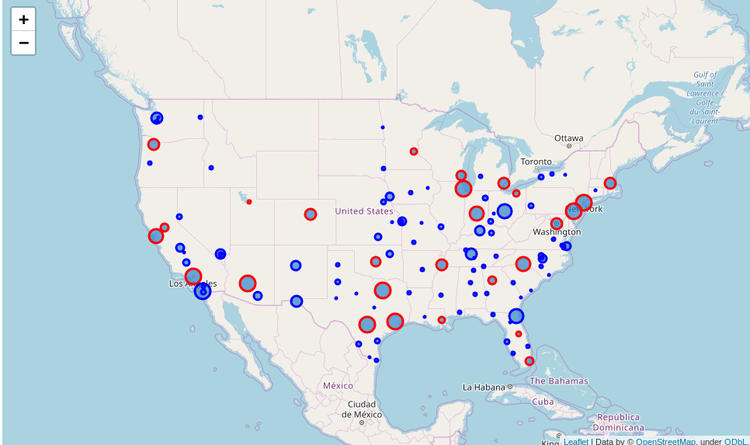
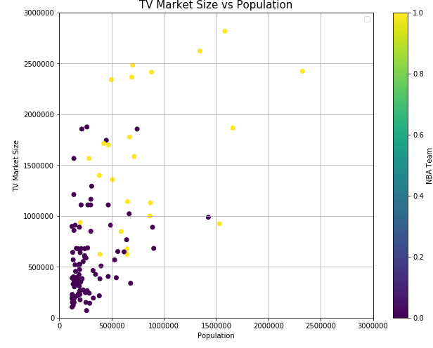
City Data Exploratory Analysis
NBA cities (RED)
NBA candidates (BLUE)
Size of marker proportional to size of city
Some candidate cities fall in similar population and TV market range as NBA cities
Population alone isn’t predictor of NBA city success

Slide 8
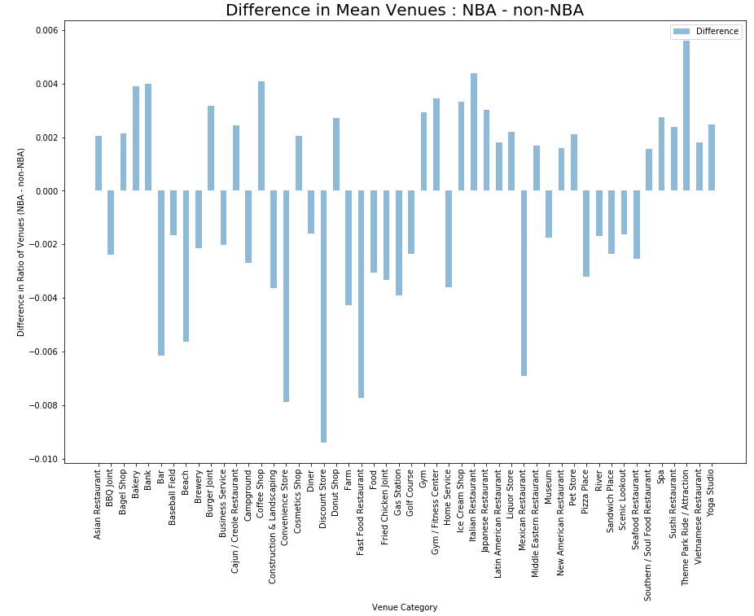
FourSquare Exploratory Analysis
Difference in proportion of total venues a category consists of between Average NBA Cities and Average Non-NBA Cities give insight into NBA city characteristics

Slide 9
Modeling – KMeans Cluster
Cluster Number | Number of Cities | NBA City?
0 | 14 | Avg. Small
1 | 20 | --
2 | 1 | Avg. Large
3 | 6 | Avg. Medium
4 | 5 | --
5 | 9 | --
6 | 41 | --
Data prepared for modeling
  Dropped NBA cities
  Created 3 average NBA “cities”
    Large = 10 largest cities
    Medium = 10 middle cities
    Small = 7 smallest cities
KMeans Clustering used to group data
  # of Clusters = 7
  Initializer = k-means++
Non-NBA cities clustered against 3 categories of an “Average” NBA city

Slide 10
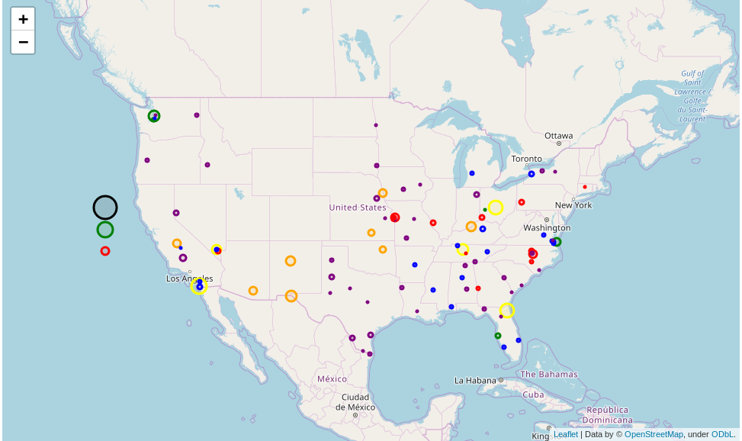
Results
Cluster 0 = Avg Small NBA City = RED in map
Cluster 3 = Avg Medium NBA City = GREEN in map
Cluster 2 = Avg Large NBA City = BLACK in map
Cluster 3 with 5 non-NBA cities best candidate for future NBA city based on data in study

Slide 11
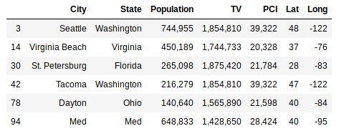
Discussion
Closer inspection of 5 cities in cluster 3 reveals Seattle, WA recommended selection
  Population and TV market largest among candidates
  Tacoma, WA also on this list, potentially supports a Seattle franchise
Cluster 3 – Detailed Results
Study recommends Seattle, WA as next NBA city location

Slide 12
Closing
Study looked at candidate NBA cities based on city and locale data
Recommendation of study is Seattle, WA as next location
Additional information would need to be explored before final decision, such as…
  Is the city willing to fund or build a stadium?
  Is there an area within the city to build a new stadium or otherwise house the team?
  Is there ample public transit and/or parking nearby to get people to the stadium?

